Slide 1
CS 61C: Great Ideas in Computer Architecture (Machine Structures) Caches II
Instructors: Randy H. Katz David A. Patterson
http://inst.eecs.Berkeley.edu/~cs61c/sp11

Slide 3
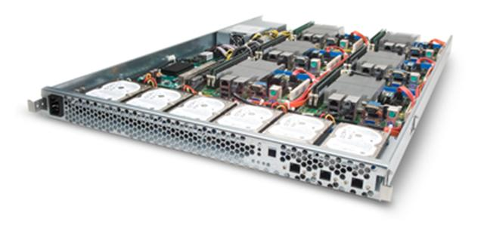
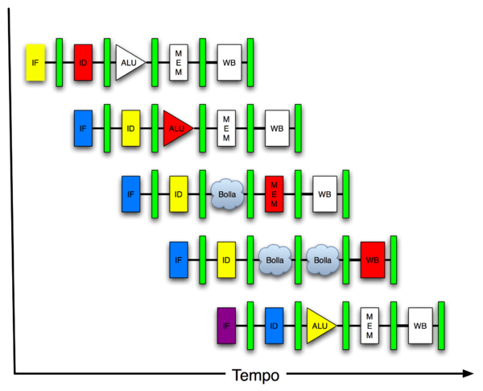
New-School Machine Structures (It’s a bit more complicated!)
Software Hardware
Parallel Requests
Assigned to computer
e.g., Search “Katz”
Parallel Threads
Assigned to core
e.g., Lookup, Ads
Parallel Instructions
>1 instruction @ one time
e.g., 5 pipelined instructions
Parallel Data
>1 data item @ one time
e.g., Add of 4 pairs of words
Hardware descriptions
All gates @ one time
Warehouse Scale Computer
Smart Phone
Harness Parallelism &
Achieve High Performance
Computer
Today’s
Lecture
Core
…
Core
Memory (Cache)
Input/Output
Core
Instruction Unit(s)
Functional
Unit(s)
A₀+B₀
A₁+B₁
A₂+B₂
A₃+B₃
Main Memory
Logic Gates

Slide 4
Review
Principle of Locality for Libraries /Computer Memory
Hierarchy of Memories (speed/size/cost per bit) to Exploit Locality
Cache – copy of data lower level in memory hierarchy
Direct Mapped to find block in cache using Tag field and Valid bit for Hit
Larger caches reduce Miss rate via Temporal and Spatial Locality, but can increase Hit time
Larger blocks to reduces Miss rate via Spatial Locality, but increase Miss penalty
AMAT (Average Memory Access Time) helps balance Hit time, Miss rate, Miss penalty

Slide 5
Agenda
Cache Hits and Misses, Consistency
Administrivia
Cache Performance and Size
Technology Break
Designing Memory Systems for Caches
(If time permits – cache blocking with video!)

Slide 6
Handling Cache Misses (Single Word Blocks)
Read misses (I$ and D$)
Stall execution, fetch the block from the next level in the memory hierarchy, install it in the cache, send requested word to processor, and then let execution resume
Write misses (D$ only)
Write allocate: Stall execution, fetch the block from next level in the memory hierarchy, install it in cache, write the word from processor to cache, also update memory, then let execution resume
or
No-write allocate: skip the cache write and just write the word to memory (but must invalidate cache block since it will now hold stale data)
Notes:
Let’s look at our 1KB direct mapped cache again.
Assume we do a 16-bit write to memory location 0x000000 and causes a cache miss in our 1KB direct mapped cache that has 32-byte block select.
After we write the cache tag into the cache and write the 16-bit data into Byte 0 and Byte 1, do we have to read the rest of the block (Byte 2, 3, ... Byte 31) from memory?
If we do read the rest of the block in, it is called write allocate. But the type of access we are going to do is likely to be another write.
So if even if we do read in the data, we may end up overwriting them anyway so it is a common practice to NOT read in the rest of the block on a write miss.
If you don’t bring in the rest of the block, or use the more technical term, Write Not Allocate, you better have some way to tell the processor the rest of the block is no longer valid.

Slide 7
Cache-Memory Consistency? (1/2)
Need to make sure cache and memory have same value: 2 policies
1) Write-Through Policy: write cache and write through the cache to memory
Every write eventually gets to memory
Too slow, so include Write Buffer to allow processor to continue once data in Buffer, Buffer updates memory in parallel to processor

Slide 8
Cache-Memory Consistency? (2/2)
Need to make sure cache and memory have same value: 2 policies
2) Write-Back Policy: write only to cache and then write cache block back to memory when evict block from cache
Writes collected in cache, only single write to memory per block
Include bit to see if wrote to block or not, and then only write back if bit is set
Called “Dirty” bit (writing makes it “dirty”)

Slide 9
Sources of Cache Misses (3 C’s)
Compulsory (cold start, first reference):
1st access to a block, “cold” fact of life, not a lot you can do about it.
If running billions of instruction, compulsory misses are insignificant
Solution: increase block size (increases miss penalty; very large blocks could increase miss rate)
Capacity:
Cache cannot contain all blocks accessed by the program
Solution: increase cache size (may increase access time)
Conflict (collision):
Multiple memory locations mapped to the same cache location
Solution 1: increase cache size (may increase hit time)
Solution 2: (later in semester) increase associativity (may increase hit time)
Notes:
(Capacity miss) That is the cache misses are due to the fact that the cache is simply not large enough to contain all the blocks that are accessed by the program.
The solution to reduce the Capacity miss rate is simple: increase the cache size.
Here is a summary of other types of cache miss we talked about.
First is the Compulsory misses. These are the misses that we cannot avoid. They are caused when we first start the program.
Then we talked about the conflict misses. They are the misses that caused by multiple memory locations being mapped to the same cache location.
There are two solutions to reduce conflict misses. The first one is, once again, increase the cache size. The second one is to increase the associativity.
For example, say using a 2-way set associative cache instead of directed mapped cache.
But keep in mind that cache miss rate is only one part of the equation. You also have to worry about cache access time and miss penalty. Do NOT optimize miss rate alone.
Finally, there is another source of cache miss we will not cover today. Those are referred to as invalidation misses caused by another process, such as IO , update the main memory so you have to flush the cache to avoid inconsistency between memory and cache.
+2 = 43 min. (Y:23)

Slide 10
Average Memory Access Time (AMAT)
Average Memory Access Time (AMAT) is the average to access memory considering both hits and misses
AMAT = Time for a hit + Miss rate x Miss penalty
How reduce Miss Penalty?
Notes:
AMAT = 1 + 0.02x50 = 2

Slide 11
Reducing Cache Miss Rates
Use multiple $ levels
With advancing technology, have more room on die for bigger L1 caches and for second level cache – normally a unified L2 cache (i.e., it holds both instructions and data,) and in some cases even a unified L3 cache
E.g., CPI_{ideal} of 2, 100 cycle miss penalty (to main memory), 25 cycle miss penalty (to L2$), 36% load/stores, a 2% (4%) L1 I$ (D$) miss rate, add a 0.5% L2$ miss rate
CPI_{stalls} = 2 + .02×25 + .36×.04×25 + .005×100 + .36×.005×100
= 3.54 (vs. 5.44 with no L2$)
Notes:
Also reduces cache miss penalty

Slide 12
Local vs. Global Miss Rates
Local miss rate – the fraction of references to one level of a cache that miss
Local Miss rate L2$ = $L2 Misses / L1$ Misses
Global miss rate – the fraction of references that miss in all levels of a multilevel cache
L2$ local miss rate >> than the global miss rate
Global Miss rate = L2$ Misses / Total Accesses
= L2$ Misses / L1$ Misses x L1$ Misses / Total Accesses
= Local Miss rate L2$ x Local Miss rate L1$
AMAT = Time for a hit + Miss rate x Miss penalty
AMAT = Time for a L1$ hit + (local) Miss rateL1$ x (Time for a L2$ hit + (local) Miss rate L2$ x L2$ Miss penalty)

Slide 13
Multilevel Cache Design Considerations
Different design considerations for L1$ and L2$
L1$ focuses on minimizing hit time for shorter clock cycle: Smaller $ with smaller block sizes
L2$(s) focus on reducing miss rate to reduce penalty of long main memory access times: Larger $ with larger block sizes
Miss penalty of L1$ is significantly reduced by presence of L2$, so can be smaller/faster but with higher miss rate
For the L2$, hit time is less important than miss rate
L2$ hit time determines L1$’s miss penalty
Notes:
Global miss rate – the fraction of references that miss in all levels of a multilevel cache. The global miss rate dictates how often we must access the main memory.
Local miss rate – the fraction of references to one level of a cache that miss

Slide 14
Agenda
Cache Hits and Misses, Consistency
Administrivia
Cache Performance and Size
Technology Break
Memory Performance for Caches

Slide 15
Administrivia
Lab #6 posted
Project #2 Due Sunday @ 11:59:59
No Homework this week!
Midterm in less than 2 weeks:
Exam: Tu, Mar 8, 6-9 PM, 145/155 Dwinelle
Split: A-Lew in 145, Li-Z in 155
Covers everything through lecture March 3
Closed book, can bring one sheet notes, both sides
Copy of Green card will be supplied
No phones, calculators, …; just bring pencils & eraser
TA Review: Su, Mar 6, 2-5 PM, 2050 VLSB

Slide 16
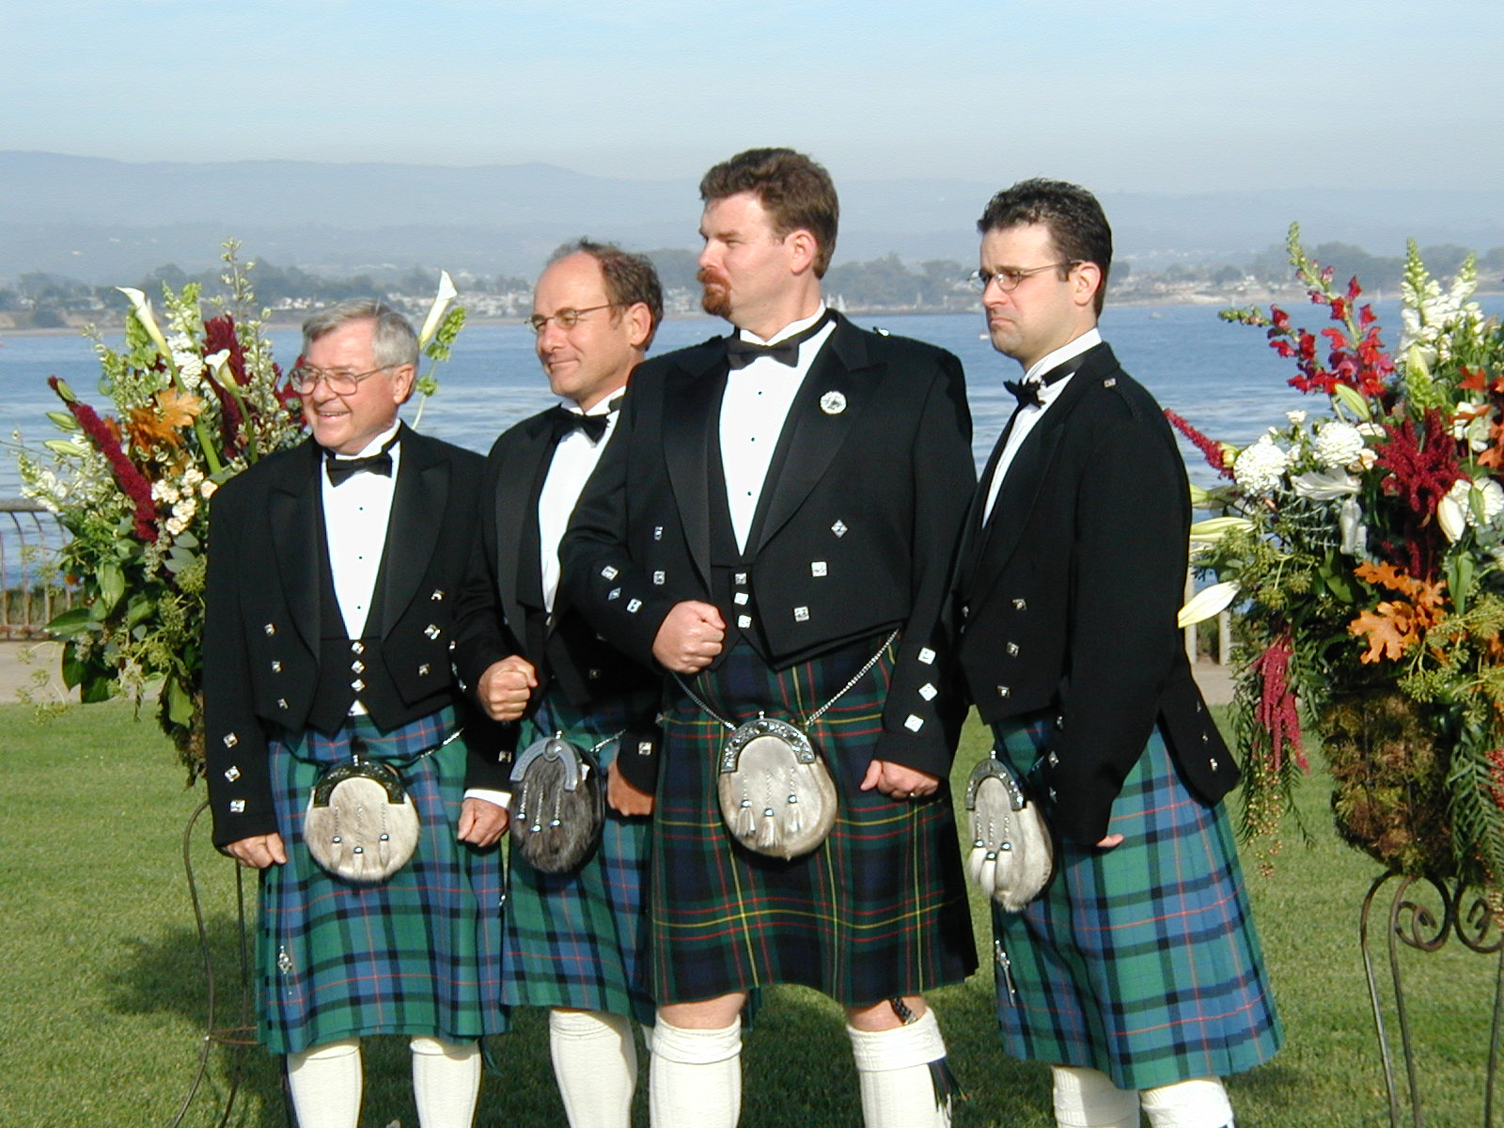
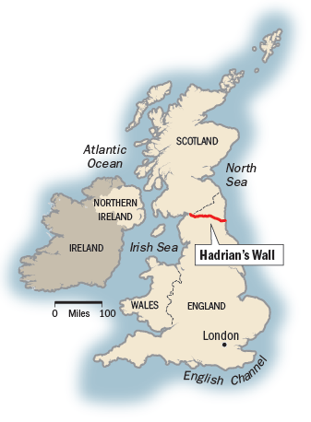
Getting to Know Profs: Family
Dad’s family Scotch-Irish, Mom’s family Swedish
Grew up in Torrance, CA
(Still) married to high school sweetheart
1st to graduate from college
Liked it so much didn’t stop to PhD
Spend 1 week/summer hosting Patterson Family Reunion
27 people: 2 parents, 3 siblings, 2 sons, 7 nieces and nephews, 7 spouses, 3 grandchildren, 1 grandnephew, 1 grandniece, 6 dogs …

Slide 17
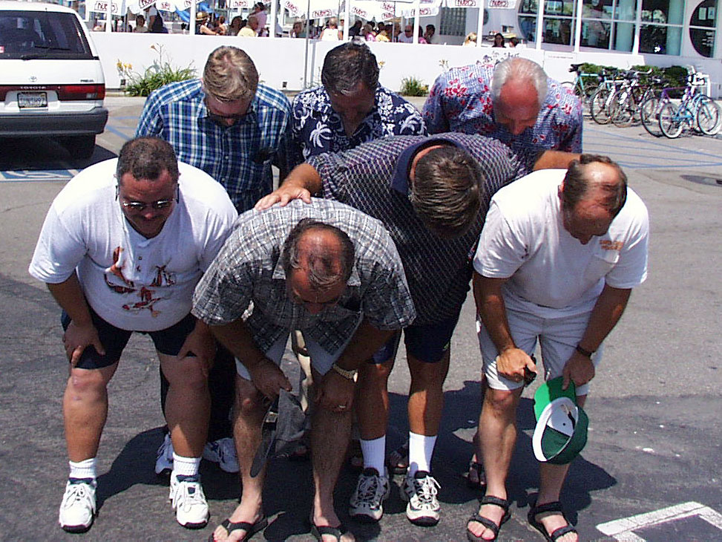
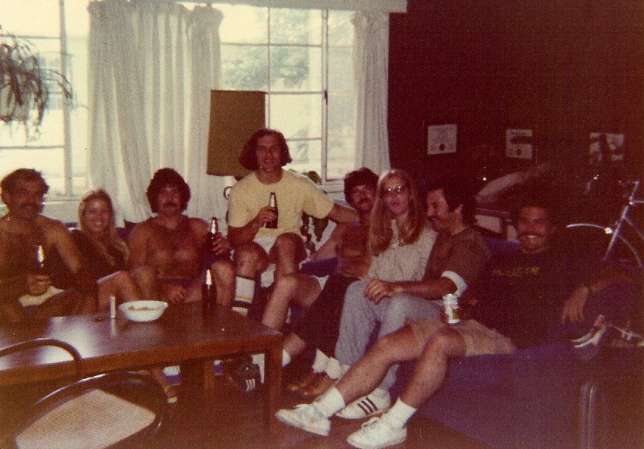
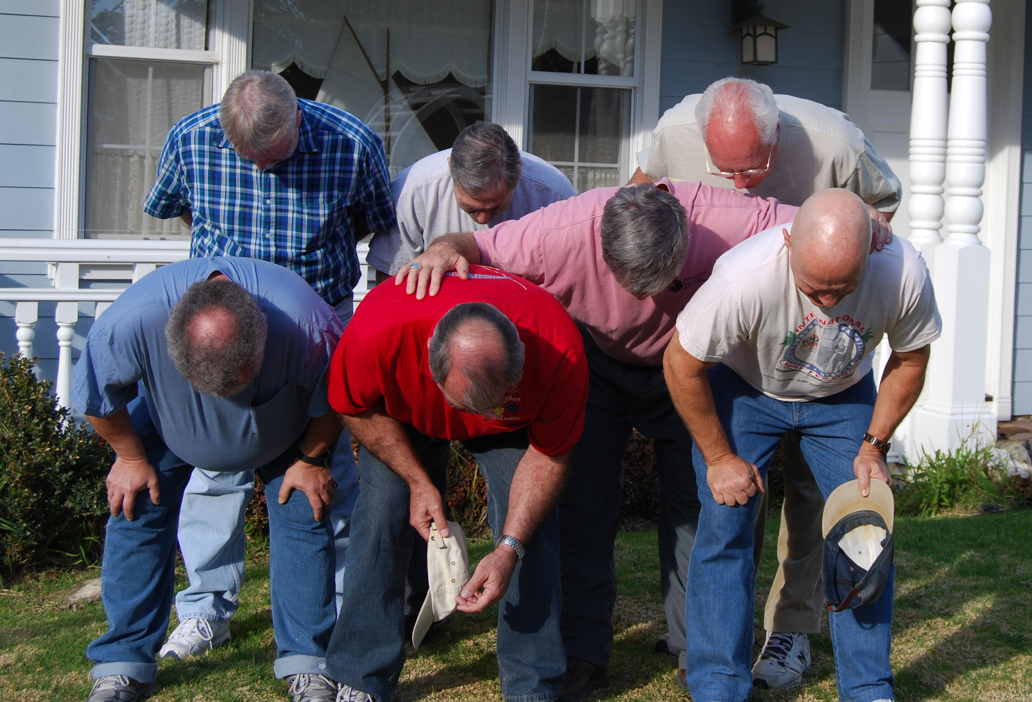
Getting to Know Profs: (old) Friends
1999
2 to 3 times/year spend weekend with old friends I went to high school (South Torrance) with to play poker, watch Superbowl, go bodysurfing, talk about life
2009
1974
Old friends even more valuable as you age

Slide 18
Improving Cache Performance (1 of 3)
1. Reduce the time to hit in the cache
Smaller cache
1 word blocks (no multiplexor/selector to pick word)
2. Reduce the miss rate
Bigger cache
Larger blocks (16 to 64 bytes typical)
(Later in semester: More flexible placement by increasing associativity)

Slide 19
Improving Cache Performance (2 of 3)
3. Reduce the miss penalty
Smaller blocks
Use multiple cache levels
L2 cache not tied to processor clock rate
Use a write buffer to hold dirty blocks being replaced so don’t have to wait for the write to complete before reading
Check write buffer on read miss – may get lucky
Faster backing store/improved memory bandwidth
(Later in lecture)

Slide 20
The Cache Design Space (3 of 3)
Several interacting dimensions
Cache size
Block size
Write-through vs. write-back
Write allocation
(Later Associativity)
(Later Replacement policy)
Optimal choice is a compromise
Depends on access characteristics
Workload
Use (I-cache, D-cache)
Depends on technology / cost
Simplicity often wins
Cache Size
(Associativity)
Block Size
Bad
Good
Factor A
Factor B
Less
More
Notes:
No fancy replacement policy is needed for the direct mapped cache.
As a matter of fact, that is what cause direct mapped trouble to begin with: only one place to go in the cache--causes conflict misses.
No fancy replacement policy is needed for the direct mapped cache.
As a matter of fact, that is what cause direct mapped trouble to begin with: only one place to go in the cache--causes conflict misses.
Besides working at Sun, I also teach people how to fly whenever I have time.
Statistic have shown that if a pilot crashed after an engine failure, he or she is more likely to get killed in a multi-engine light airplane than a single engine airplane.
The joke among us flight instructors is that: sure, when the engine quit in a single engine stops, you have one option: sooner or later, you land. Probably sooner.
But in a multi-engine airplane with one engine stops, you have a lot of options. It is the need to make a decision that kills those people.

Slide 21
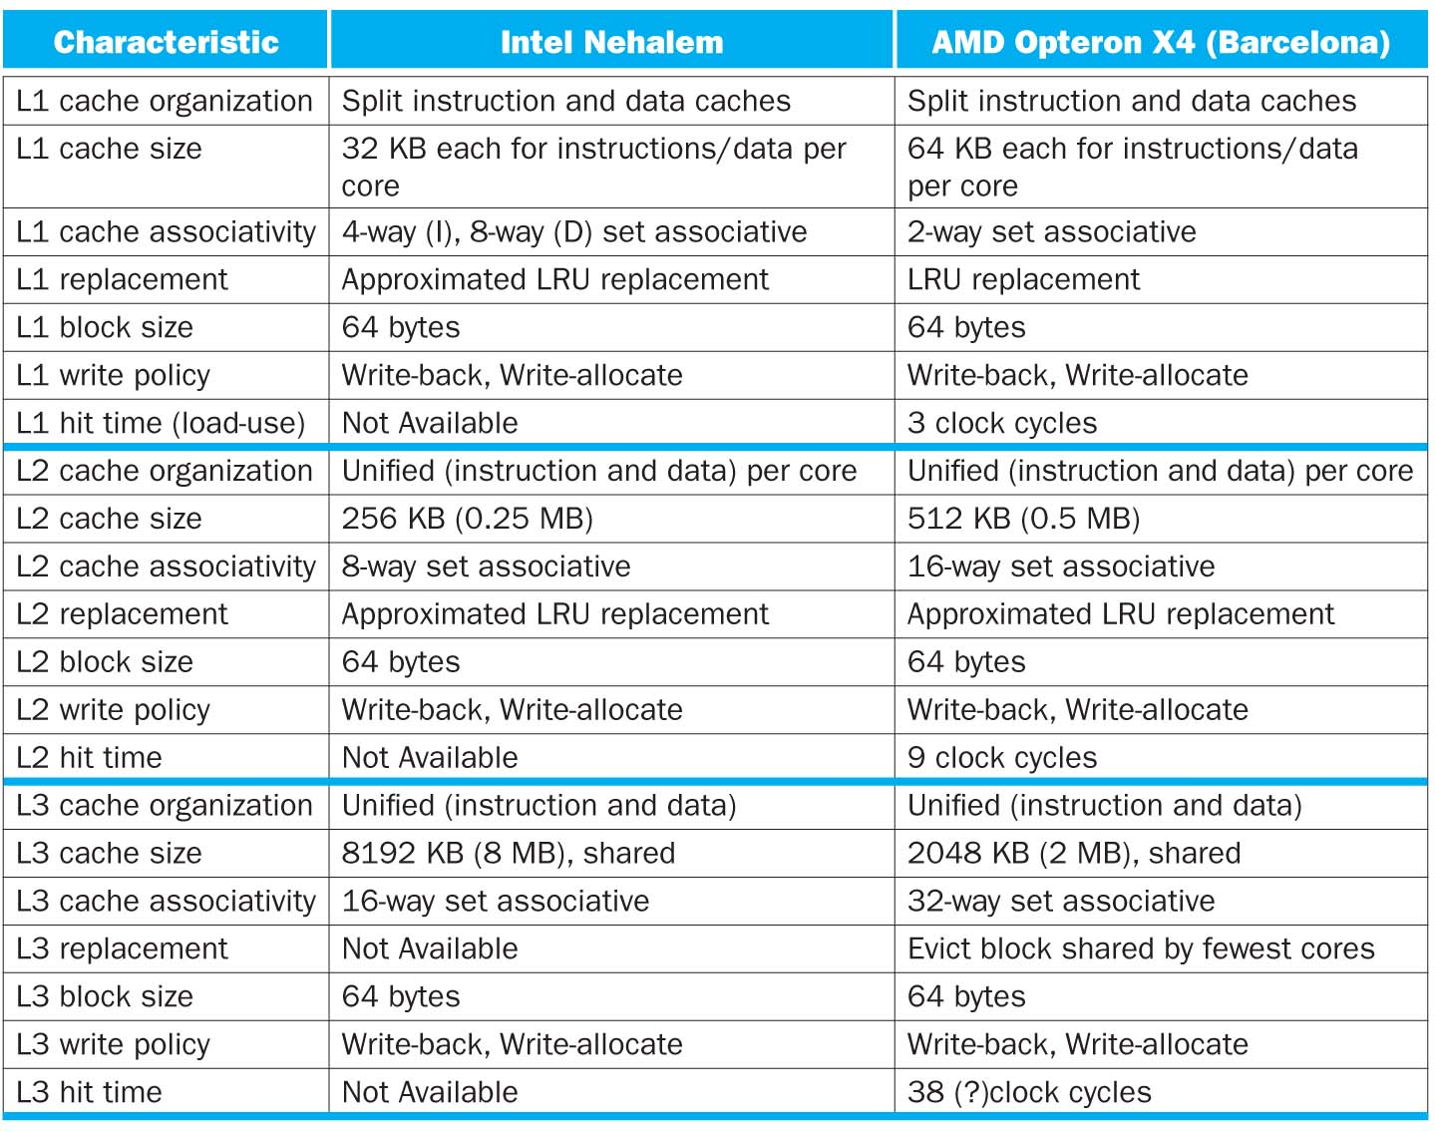

Slide 22
Fields within an Address
Tag<32-n-(m+2)>
Index<n bits>
Block offset<m+2 bits>
For a direct mapped cache with 2^{n} blocks, n bits are used for the index
For a block size of 2^{m} words (2^{m+2} bytes), m bits are used to address the word within the block and 2 bits are used to address the byte within the word: block offset
Size of the tag field is Address size – index size – block offset size
32-bit byte address => 32 – n – (m+2)
Notes:
The tag field is 32 – (n+m+2)
16KB is 4K (2^12 words). With a block size of 4 words, there are 1024 (2^10) blocks. Each block has 4x32 or 128 bits of data plus a tag which is 32 – 10 -2 – 2 bits, plus a valid bit. So the total cache size is
2^10 x (4x32 +18 + 1) = 2^10 x 147 = 147Kbits (or about 1.15 times as many as needed just for storage of the data).

Slide 23
Cache Sizes
Valid<1>
Dirty<1>
Tag<30-n-m>
Data in block
…
…
…
…
2^{n}
Valid<1>
Dirty<1>
Tag<30-n-m>
Data in block
Number of bits in a direct-mapped cache includes both the storage for data and for the tags + valid bit + dirty bit (if needed)
Total number of bits in a cache is then
2^{n} x (block size + tag field size + valid field size + dirty field size if needed)
Why don’t need to store Block Offset in Cache? Why not Index in Cache?
Student Roulette
Notes:
The tag field is 32 – (n+m+2)
16KB is 4K (2^12 words). With a block size of 4 words, there are 1024 (2^10) blocks. Each block has 4x32 or 128 bits of data plus a tag which is 32 – 10 -2 – 2 bits, plus a valid bit. So the total cache size is
2^10 x (4x32 +18 + 1) = 2^10 x 147 = 147Kbits (or about 1.15 times as many as needed just for storage of the data).

Slide 24
Peer Instruction
Assuming a direct-mapped, write-through cache with 16 KB of data and 4-word blocks, how divide a 32-bit byte address to access a cache?
A red) Tag <14 bits> | Index <14 bits> | Block Offset <4 bits>
B orange) Tag <16 bits> | Index <14 bits> | Block Offset <2 bits>
C green) Tag <18 bits> | Index <10 bits> | Block Offset <4 bits>
D yellow) Tag <20 bits> | Index <10 bits> | Block Offset <2 bits>
E pink) Valid <1> | Tag <14 bits> | Index <14 bits> | Block Offset <4 bits>
F blue) Valid <1> | Dirty <1> |Tag <14 bits> | Index <14 bits> | Block Offset <4 bits>
G purple) Valid <1> | Tag <18 bits> | Index <10 bits> | Block Offset <4 bits>
H teal) Valid <1> | Dirty <1> |Tag <18 bits> | Index <10 bits> | Block Offset <4 bits>

Slide 25
Peer Instruction
Assuming a direct-mapped, write-through cache with 16 KB of data and 4-word blocks, how divide a 32-bit byte address to access a cache?
A red) Tag <14 bits> | Index <14 bits> | Block Offset <4 bits>
B orange) Tag <16 bits> | Index <14 bits> | Block Offset <2 bits>
C green) Tag <18 bits> | Index <10 bits> | Block Offset <4 bits>
D yellow) Tag <20 bits> | Index <10 bits> | Block Offset <2 bits>
E pink) Valid <1> | Tag <14 bits> | Index <14 bits> | Block Offset <4 bits>
F blue) Valid <1> | Dirty <1> |Tag <14 bits> | Index <14 bits> | Block Offset <4 bits>
G purple) Valid <1> | Tag <18 bits> | Index <10 bits> | Block Offset <4 bits>
H teal) Valid <1> | Dirty <1> |Tag <18 bits> | Index <10 bits> | Block Offset <4 bits>

Slide 26
Peer Instruction
How many total bits are required for that cache? (Round to nearest Kbits)
Direct-mapped, write-through, 16 KBytes of data, 4-word (16 Byte) blocks, 32-bit address
Tag <18 bits> | Index <10 bits> | Block Offset <4 bits>
A red) 16 Kbits | E pink) 139 Kbits
B orange) 18 Kbits | F blue) 146 Kbits
C green) 128 Kbits | G purple) 147 Kbits
D yellow) 138 Kbits | H teal) 148 Kbits

Slide 27
Peer Instruction
How many total bits are required for that cache? (Round to nearest Kbits)
Direct-mapped, write-through, 16 KBytes of data, 4-word (16 Byte) blocks, 32-bit address
Tag <18 bits> | Index <10 bits> | Block Offset <4 bits>
A red) 16 Kbits | E pink) 139 Kbits
B orange) 18 Kbits | F blue) 146 Kbits
C green) 128 Kbits | G purple) 147 Kbits
D yellow) 138 Kbits | H teal) 148 Kbits

Slide 28
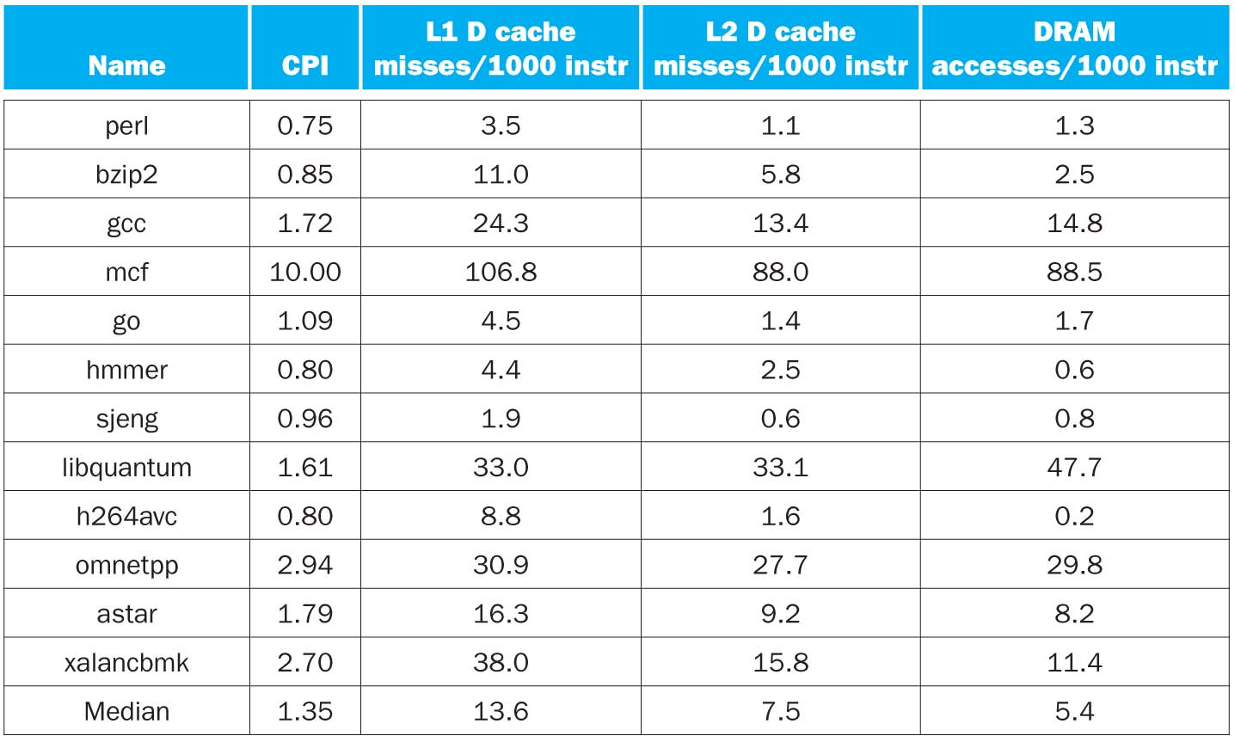
CPI/Miss Rates/DRAM Access SpecInt2006
Data Only
Data Only
Instructions and Data

Slide 29
Reading Miss Penalty: Memory Systems that Support Caches
The off-chip interconnect and memory architecture affects overall system performance in dramatic ways
on-chip
CPU
One word wide organization (one word wide bus and one word wide memory)
Assume
1 memory bus clock cycle to send address
15 memory bus clock cycles to get the 1st word in the block from DRAM (row cycle time), 5 memory bus clock cycles for 2nd, 3rd, 4th words (subsequent column access time)—note effect of latency!
1 memory bus clock cycle to return a word of data
Memory-Bus to Cache bandwidth
Number of bytes accessed from memory and transferred to cache/CPU per memory bus clock cycle
Cache
32-bit data
&
32-bit addr
per cycle
bus
DRAM
Memory
Notes:
We can reduce the miss penalty if we can increase the bandwidth from the memory to the cache. Allows larger block sizes to be used while still maintaining a low miss penalty.
The clock rate of this bus is usually much slower than the processor which negatively affects the miss penalty

Slide 30
(DDR) SDRAM Operation
Column
Address
+1
After a row is read into the SRAM register
Input CAS as the starting “burst” address along with a burst length
Transfers a burst of data (ideally a cache block) from a series of sequential addresses within that row
Memory bus clock controls transfer of successive words in the burst
N cols
DRAM
Row
Address
N rows
N x M SRAM
M bit planes
Cycle Time
M-bit Output
1st M-bit Access
2nd M-bit
3rd M-bit
4th M-bit
RAS
CAS
Row Address
Col Address
Row Add
Notes:
Double data rate synchronous dynamic random access memory (DDR SDRAM) is a class of memory integrated circuits used in computers.
Compared to single data rate (SDR) SDRAM, the DDR SDRAM interface makes higher transfer rates possible by more strict control of the timing of the electrical data and clock signals. Implementations often have to use schemes such as phase-locked loops and self-calibration to reach the required timing accuracy.[1][2]The interface uses double pumping (transferring data on both the rising and falling edges of the clock signal) to lower the clock frequency. One advantage of keeping the clock frequency down is that it reduces the signal integrity requirements on the circuit board connecting the memory to the controller. The name "double data rate" refers to the fact that a DDR SDRAM with a certain clock frequency achieves nearly twice the bandwidth of a single data rate (SDR) SDRAM running at the same clock frequency, due to this double pumping.
With data being transferred 64 bits at a time, DDR SDRAM gives a transfer rate of (memory bus clock rate) × 2 (for dual rate) × 64 (number of bits transferred) / 8 (number of bits/byte). Thus, with a bus frequency of 100 MHz, DDR SDRAM gives a maximum transfer rate of 1600 MB/s.
"Beginning in 1996 and concluding in June 2000, JEDEC developed the DDR (Double Data Rate) SDRAM specification (JESD79)."[3] JEDEC has set standards for data rates of DDR SDRAM, divided into two parts. The first specification is for memory chips, and the second is for memory modules. DDR SDRAM (sometimes referred to as DDR1 SDRAM) has been superseded by DDR2 SDRAM and DDR3 SDRAM.

Slide 31
One Word Wide Bus, One Word Blocks
If block size is one word, then for a memory access due to a cache miss, the pipeline will have to stall for the number of cycles required to return one data word from memory
memory bus clock cycle to send address
memory bus clock cycles to read DRAM
memory bus clock cycle to return data
total clock cycles miss penalty
Number of bytes transferred per clock cycle (bandwidth) for a single miss is
bytes per memory bus clock cycle
on-chip
CPU
Cache
bus
DRAM
Memory
Notes:
For lecture

Slide 32
One Word Wide Bus, One Word Blocks
If block size is one word, then for a memory access due to a cache miss, the pipeline will have to stall for the number of cycles required to return one data word from memory
memory bus clock cycle to send address
memory bus clock cycles to read DRAM
memory bus clock cycle to return data
total clock cycles miss penalty
Number of bytes transferred per clock cycle (bandwidth) for a single miss is
bytes per memory bus clock cycle
on-chip
CPU
Cache
1
15
1
17
bus
DRAM
Memory
4/17 = 0.235
Notes:
For lecture

Slide 33
One Word Wide Bus, Four Word Blocks
on-chip
What if the block size is four words and each word is in a different DRAM row?
cycle to send 1st address
cycles to read DRAM
cycles to return last data word
total clock cycles miss penalty
Number of bytes transferred per clock cycle (bandwidth) for a single miss is
bytes per clock
CPU
Cache
bus
DRAM
Memory
Notes:
For class handout

Slide 34
One Word Wide Bus, Four Word Blocks
on-chip
What if block size is four words and each word is in a different DRAM row?
cycle to send 1st address
cycles to read DRAM
cycles to return last data word
total clock cycles miss penalty
Number of bytes transferred per clock cycle (bandwidth) for a single miss is
bytes per clock
CPU
1
4 x 15 = 60
1
62
Cache
bus
15 cycles
DRAM
Memory
15 cycles
15 cycles
15 cycles
(4 x 4)/62 = 0.258
Notes:
For lecture

Slide 35
One Word Wide Bus, Four Word Blocks
on-chip
What if block size is four words and all words are in the same DRAM row?
cycle to send 1st address
cycles to read DRAM
cycles to return last data word
total clock cycles miss penalty
Number of bytes transferred per clock cycle (bandwidth) for a single miss is
bytes per clock
CPU
Cache
bus
DRAM
Memory
Notes:
For class handout

Slide 36
One Word Wide Bus, Four Word Blocks
on-chip
What if the block size is four words and all words are in the same DRAM row?
cycle to send 1st address
cycles to read DRAM
cycles to return last data word
total clock cycles miss penalty
Number of bytes transferred per clock cycle (bandwidth) for a single miss is
bytes per clock
CPU
1
15 + 3*5 = 30
1
32
Cache
bus
15 cycles
DRAM
Memory
5 cycles
5 cycles
5 cycles
(4 x 4)/32 = 0.5
Notes:
For lecture

Slide 37
Interleaved Memory, One Word Wide Bus
For a block size of four words
cycle to send 1st address
cycles to read DRAM banks
cycles to return last data word
total clock cycles miss penalty
on-chip
CPU
Cache
bus
DRAM
Memory
bank 0
DRAM
Memory
bank 1
DRAM
Memory
bank 2
DRAM
Memory
bank 3
Number of bytes transferred per clock cycle (bandwidth) for a single miss is
bytes per clock
Notes:
For class handout

Slide 38
Interleaved Memory, One Word Wide Bus
For a block size of four words
cycle to send 1st address
cycles to read DRAM banks
cycles to return last data word
total clock cycles miss penalty
on-chip
1
15
4*1 = 4
20
CPU
Cache
15 cycles
bus
15 cycles
DRAM
Memory
bank 0
DRAM
Memory
bank 1
DRAM
Memory
bank 2
DRAM
Memory
bank 3
15 cycles
15 cycles
Number of bytes transferred per clock cycle (bandwidth) for a single miss is
bytes per clock
(4 x 4)/20 = 0.8
Notes:
For lecture
The width of the bus and the cache need not be changed, but sending an address to several banks permits them all to read simultaneously. Interleaving retains the advantage of incurring the full memory latency only once.
Low order interleaving (low order bits select bank, high order bits used to access DRAM banks in parallel).
Low order memory interleaving, i.e.,
Bank 0 holds addresses xx…xx00
Bank 1 holds addresses xx…xx01
Bank 2 holds addresses xx…xx10
Bank 3 holds addresses xx…xx11
May want to add another example where you also have a wide bus (e.g., a 2 word bus between the interleaved memory and the processor).

Slide 39
DRAM Memory System Observations
Its important to match the cache characteristics
Caches access one block at a time (usually more than one word)
1) With the DRAM characteristics
Use DRAMs that support fast multiple word accesses, preferably ones that match the block size of the cache
2) With the memory-bus characteristics
Make sure the memory-bus can support the DRAM access rates and patterns
With the goal of increasing the Memory-Bus to Cache bandwidth

Slide 40
Performance Programming: Adjust software accesses to improve miss rate
Now that understand how caches work, can revise program to improve cache utilization
Cache size
Block size
Multiple levels

Slide 41
Performance of Loops and Arrays
Array performance often limited by memory speed
OK if access memory different order as long as get correct result
Goal: Increase performance by minimizing traffic from cache to memory
That is, reduce Miss rate by getting better reuse of data already in cache
One approach called Cache Blocking: “shrink” problem by performing multiple iterations within smaller cache blocks
Use Matrix Multiply as example: Next Lab and Project 3
Notes:
PICTURE HEAT FLOW
Cache-blocking algorithms “shrink” problem by PERFORMING MULTIPLE ITERATIONS WITHIN SMALLER CACHE BLOCKS

Slide 42
Matrix Multiplication
c
a
b
=
*

Slide 43
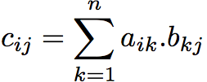
Matrix Multiplication
c
a
b
c_{ij}
=
*
a_{i*}
b_{*j}
Simple Matrix Multiply - www.youtube.com/watch?v=yl0LTcDIhxc
100 x 100 Matrix, Cache 1000 blocks, 1 word/block

Slide 44
The simplest algorithm
Assumption: the matrices are stored as 2-D NxN arrays
for (i=0;i<N;i++)
for (j=0;j<N;j++)
for (k=0;k<N;k++) c[i][j] += a[i][k] * b[k][j];
Advantage: code simplicity
Disadvantage: Marches through memory and caches

Slide 45
Note on Matrix in Memory
A matrix is a 2-D array of elements, but memory addresses are “1-D”
Conventions for matrix layout
by column, or “column major” (Fortran default); A(i,j) at A+i+j*n
by row, or “row major” (C default) A(i,j) at A+i*n+j
Column major matrix in memory
Column major
Row major
0
5
10
15
0
1
2
3
1
6
11
16
4
5
6
7
2
7
12
17
8
9
10
11
3
8
13
18
12
13
14
15
4
9
14
19
16
17
18
19
Blue row of matrix is stored in red cache blocks
Cache blocks

Slide 46
Improving reuse via Blocking: 1st “Naïve” Matrix Multiply
{implements C = C + A*B}
for i = 1 to n
{read row i of A into cache}
for j = 1 to n
{read c(i,j) into cache}
{read column j of B into cache}
for k = 1 to n
c(i,j) = c(i,j) + a(i,k) * b(k,j)
{write c(i,j) back to main memory}
C(i,j)
C(i,j)
A(i,:)
=
+
*
B(:,j)

Slide 47
Linear Algebra to the Rescue!
Instead of Multiplying two, say, 6 x 6 matrices
Thus, can get same result as multiplication of a set of submatricies

Slide 48
Blocked Matrix Multiply
Consider A,B,C to be N-by-N matrices of b-by-b subblocks where b=n / N is called the block size
for i = 1 to N
for j = 1 to N
{read block C(i,j) into cache}
for k = 1 to N
{read block A(i,k) into cache}
{read block B(k,j) into cache}
C(i,j) = C(i,j) + A(i,k) * B(k,j) {do a matrix multiply on blocks}
{write block C(i,j) back to main memory}
C(i,j)
C(i,j)
A(i,k)
=
+
*
B(k,j)
Blocked Matrix Multiply - www.youtube.com/watch?v=IFWgwGMMrh0
100 x 100 Matrix, 1000 cache blocks, 1 word/block, block 30x30

Slide 49
Another View of “Blocked” Matrix Multiplication
C₁₁
C₁₂
C₁₃
C₁₄
A₁₁
A₁₂
A₁₃
A₁₄
B₁₁
B₁₂
B₁₃
B₁₄
C₂₁
C₂₂
C₂₃
C₂₄
A₂₁
A₂₂
A₂₃
A₂₄
B₂₁
B₂₂
B₂₃
B₂₄
C₃₁
C₃₂
C₄₃
C₃₄
A₃₁
A₃₂
A₃₃
A₃₄
B₃₂
B₃₂
B₃₃
B₃₄
C₄₁
C₄₂
C₄₃
C₄₄
A₄₁
A₄₂
A₄₃
A₁₄₄
B₄₁
B₄₂
B₄₃
B₄₄
N = 4 *r
C₂₂ = A₂₁B₁₂ + A₂₂B₂₂ + A₂₃B₃₂ + A₂₄B₄₂ =
∑_{k} A_{2k}*B_{k2}
Main Point: each multiplication operates on small “block” matrices, whose size may be chosen so that they fit in the cache.

Slide 50
Blocked Algorithm
The blocked version of the i-j-k algorithm is written simply as (A,B,C are submatricies of a, b, c)
for (i=0;i<N/r;i++)
for (j=0;j<N/r;j++)
for (k=0;k<N/r;k++)
C[i][j] += A[i][k]*B[k][j]
r = block (sub-matrix) size (Assume r divides N)
X[i][j] = a sub-matrix of X, defined by block row i and block column j
r x r matrix addition
r x r matrix multiplication

Slide 51
Maximum Block Size
The blocking optimization works only if the blocks fit in cache.
That is, 3 blocks of size r x r must fit in memory (for A, B, and C)
M = size of cache (in elements/words)
We must have: 3r² ≈ M, or r ≈ √(M/3)
Ratio of cache misses blocked vs. unblocked up to ≈ √M
Simple Matrix Multiply Whole Thing - www.youtube.com/watch?v=f3-z6t_xIyw
1x1 blocks: 1,020,000 misses: read A once, read B 100 times, read C once
Blocked Matrix Multiply Whole Thing - www.youtube.com/watch?v=tgpmXX3xOrk
30x30 blocks: 90,000 misses = read A and B four times, read C once
“Only” 11X vs 30X Matrix small enough that row of A in simple version fits completely in cache; other things

Slide 52
Review
To access cache, Memory Address divided into 3 fields: Tag, Index, Block Offset
Cache size is Data + Management (tags, valid, dirty bits)
Write misses trickier to implement than reads
Write back vs. Write through
Write allocate vs. No write allocate
Cache Performance Equations:
CPU time = IC × CPI_{stall} × CC = IC × (CPI_{ideal} + Memory-stall cycles) × CC
AMAT = Time for a hit + Miss rate x Miss penalty
If understand caches, can adapt software to improve cache performance and thus program performance

