Slide 1
CS 61C: Great Ideas in Computer Architecture (Machine Structures)
Instructors: Randy H. Katz David A. Patterson
http://inst.eecs.Berkeley.edu/~cs61c/fa10

Slide 3
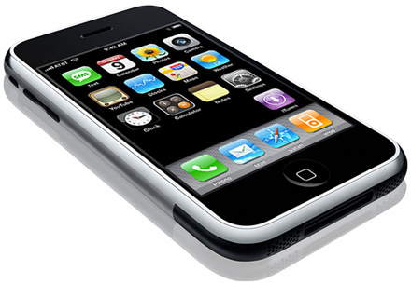
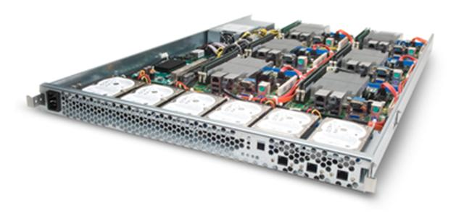
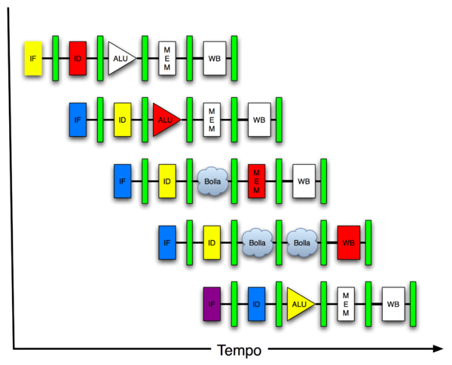
New-School Machine Structures (It’s a bit more complicated!)
Software Hardware
Parallel Requests
Assigned to computer
e.g., Search “Katz”
Parallel Threads
Assigned to core
e.g., Lookup, Ads
Parallel Instructions
>1 instruction @ one time
e.g., 5 pipelined instructions
Parallel Data
>1 data item @ one time
e.g., Add of 4 pairs of words
Hardware descriptions
All gates @ one time
Warehouse Scale Computer
Smart Phone
Harness Parallelism &
Achieve High Performance
Computer
Today’s Lecture
Core
…
Core
Memory (Cache)
Input/Output
Core
Instruction Unit(s)
Functional
Unit(s)
A₀+B₀
A₁+B₁
A₂+B₂
A₃+B₃
Main Memory
Logic Gates

Slide 4
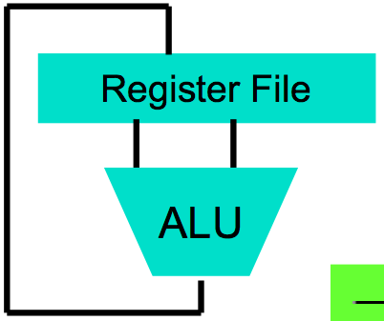
Levels of Representation/Interpretation
Today’s Lecture
High Level Language Program (e.g., C)
temp = v[k];
v[k] = v[k+1];
v[k+1] = temp;
Compiler
Anything can be represented as a number, i.e., data or instructions
lw $t0, 0($2)
lw $t1, 4($2)
sw $t1, 0($2)
sw $t0, 4($2)
Assembly Language Program (e.g., MIPS)
Assembler
0000 1001 1100 0110 1010 1111 0101 1000
1010 1111 0101 1000 0000 1001 1100 0110
1100 0110 1010 1111 0101 1000 0000 1001
0101 1000 0000 1001 1100 0110 1010 1111
Machine Language Program (MIPS)
Machine Interpretation
Hardware Architecture Description (e.g., block diagrams)
Architecture Implementation
Logic Circuit Description (Circuit Schematic Diagrams)

Slide 5
Review
Everything is a (binary) number in a computer
Instructions and data; stored program concept
Assemblers can enhance machine instruction set to help assembly-language programmer
Translate from text that easy for programmers to understand into code that machine executes efficiently: Compilers, Assemblers
Linkers allow separate translation of modules

Slide 6
Agenda
Compilers, Optimization, Interpreters, Just-In-Time Compiler
Administrivia
Dynamic Linking
Technology Trends Revisited
Technology Break
Components of a Computer

Slide 7
What’s a Compiler?
Compiler: a program that accepts as input a program text in a certain language and produces as output a program text in another language, while preserving the meaning of that text.
The text must comply with the syntax rules of whichever programming language it is written in.
A compiler's complexity depends on the syntax of the language and how much abstraction that programming language provides.
A C compiler is much simpler than C++ Compiler
Compiler executes before compiled program runs

Slide 8
Compiled Languages: Edit-Compile-Link-Run
Editor
Source
code
Compiler
Object
code
Linker
Executable
program
Editor
Source
code
Compiler
Object
code
☺
Editor
Source
code
Compiler
Object
code
Notes:
If you read your code carefully and reason about it before compiling, the number of cycles through Edit-Compile-Link-Run will be reduced, perhaps even to one!

Slide 9
Compiler Optimization
gcc compiler options
-O1: the compiler tries to reduce code size and execution time, without performing any optimizations that take a great deal of compilation time
-O2: Optimize even more. GCC performs nearly all supported optimizations that do not involve a space-speed tradeoff. As compared to -O, this option increases both compilation time and the performance of the generated code
-O3: Optimize yet more. All -O2 optimizations and also turns on the -finline-functions, …

Slide 10
What is Typical Benefit of Compiler Optimization?
What is a typical program?
For now, try a toy program:
BubbleSort.c
#define ARRAY_SIZE 20000
int main() {
int iarray[ARRAY_SIZE], x, y, holder;
for(x = 0; x < ARRAY_SIZE; x++)
for(y = 0; y < ARRAY_SIZE-1; y++)
if(iarray[y] > iarray[y+1]) {
holder = iarray[y+1];
iarray[y+1] = iarray[y];
iarray[y] = holder;
}
}
Notes:
Login into lab computer and try gcc-mips
I tried to build gcc on a mac machine today, but failed even after applying Scott's patches. I think it will take more time to port the toolchain to snow leopard, but I can get it working before next week's lab. In the meantime you can login to nova.cs.berkeley.edu and use mips-gcc.
61C password
$ ssh cs61c@nova.cs.berkeley.edu
$ mips-gcc -S test.c (assuming you have test.c)
$ cat test.c

Slide 11
Unoptimized MIPS Code
$L3:
lw $2,80016($sp)
slt $3,$2,20000
bne $3,$0,$L6
j $L4
$L6:
.set noreorder
nop
.set reorder
sw $0,80020($sp)
$L7:
lw $2,80020($sp)
slt $3,$2,19999
bne $3,$0,$L10
j $L5
$L10:
lw $2,80020($sp)
move $3,$2
sll $2,$3,2
addu $3,$sp,16
addu $2,$3,$2
lw $4,80020($sp)
addu $3,$4,1
move $4,$3
sll $3,$4,2
addu $4,$sp,16
addu $3,$4,$3
lw $2,0($2)
lw $3,0($3)
slt $2,$3,$2
beq $2,$0,$L9
lw $3,80020($sp)
addu $2,$3,1
move $3,$2
sll $2,$3,2
addu $3,$sp,16
addu $2,$3,$2
lw $3,0($2)
sw $3,80024($sp
$L11:
$L9:
lw $2,80020($sp)
addu $3,$2,1
sw $3,80020($sp)
j $L7
$L8:
$L5:
lw $2,80016($sp)
addu $3,$2,1
sw $3,80016($sp)
j $L3
$L4:
$L2:
li $12,65536
ori $12,$12,0x38b0
addu $13,$12,$sp
addu $sp,$sp,$12
j $31
lw $3,80020($sp)
addu $2,$3,1
move $3,$2
sll $2,$3,2
addu $3,$sp,16
addu $2,$3,$2
lw $3,80020($sp)
move $4,$3
sll $3,$4,2
addu $4,$sp,16
addu $3,$4,$3
lw $4,0($3)
sw $4,0($2)
lw $2,80020($sp)
move $3,$2
sll $2,$3,2
addu $3,$sp,16
addu $2,$3,$2
lw $3,80024($sp)
sw $3,0($2)

Slide 12
-O2 optimized MIPS Code
li $13,65536
ori $13,$13,0x3890
addu $13,$13,$sp
sw $28,0($13)
move $4,$0
addu $8,$sp,16
$L6:
move $3,$0
addu $9,$4,1
.p2align 3
$L10:
sll $2,$3,2
addu $6,$8,$2
addu $7,$3,1
sll $2,$7,2
addu $5,$8,$2
lw $3,0($6)
lw $4,0($5)
slt $2,$4,$3
beq $2,$0,$L9
sw $3,0($5)
sw $4,0($6)
$L9:
move $3,$7
slt $2,$3,19999
bne $2,$0,$L10
move $4,$9
slt $2,$4,20000
bne $2,$0,$L6
li $12,65536
ori $12,$12,0x38a0
addu $13,$12,$sp
addu $sp,$sp,$12
j $31
.

Slide 13
What’s an Interpreter?
It reads and executes source statements executed one at a time
No linking
No machine code generation, so more portable
Start executing quicker, but run much more slowly than compiled code
Performing the actions straight from the text allows better error checking and reporting to be done
The interpreter stays around during execution
Unlike compiler, some work is done after program starts
Writing an interpreter is much less work than writing a compiler

Slide 14
Interpreted Languages: Edit-Run
Editor
Source
code
Interpreter
☺
Notes:
When you use an interpreted language, the program that is being executed is the interpreter; the text of your program serves as data for the interpreter.

Slide 15
Compiler vs. Interpreter Advantages
Compilation:
Faster Execution
Single file to execute
Compiler can do better diagnosis of syntax and semantic errors, since it has more info than an interpreter (Interpreter only sees one line at a time)
Can find syntax errors before run program
Compiler can optimize code
Interpreter:
Easier to debug program
Faster development time

Slide 16
Compiler vs. Interpreter Disadvantages
Compilation:
Harder to debug program
Takes longer to change source code, recompile, and relink
Interpreter:
Slower execution times
No optimization
Need all of source code available
Source code larger than executable for large systems
Interpreter must remain installed while the program is interpreted

Slide 17
Java’s Hybrid Approach: Compiler + Interpreter
A Java compiler converts Java source code into instructions for the Java Virtual Machine (JVM)
These instructions, called bytecodes, are same for any computer / OS
A CPU-specific Java interpreter interprets bytecodes on a particular computer
Notes:
Java Virtual Machine is an imaginary computer with a CPU instruction set that is “the least common denominator” for typical real CPUs.

Slide 18
Java’s Compiler + Interpreter
Editor
Compiler
:
:
7


K
Hello.java
Hello.class

Interpreter
Interpreter


Hello,
World!
Notes:
There is also JIT (Just-In-Time) compiler technology where the program is interpreted and compiled at the same time. On subsequent runs the compiled code is used; there is no need to reinterpret it.

Slide 19
Why Bytecodes?
Platform-independent
Load from the Internet faster than source code
Interpreter is faster and smaller than it would be for Java source
Source code is not revealed to end users
Interpreter performs additional security checks, screens out malicious code
Notes:
Java’s culture is pretty open, and many applets are available on the Internet with their source code. Still, software vendors may want to protect their source code.
For obvious reasons, the interpreter wouldn’t allow an applet to read or write files on your computer.
Hackers have peculiar ethics (or rather, a gap in ethics): they won’t go around checking locks on the doors of houses or cars or spread real disease germs (even if non-lethal ones), but they will break into your computer system (which may be much more harmful and expensive) and spread computer viruses.

Slide 20
JVM uses Stack vs. Registers
a = b + c;
=>
iload b ; push b onto Top Of Stack (TOS)
iload c ; push c onto Top Of Stack (TOS)
iadd ; Next to top Of Stack (NOS) =
; Top Of Stack (TOS) + NOS
istore a ; store TOS into a and pop stack

Slide 21
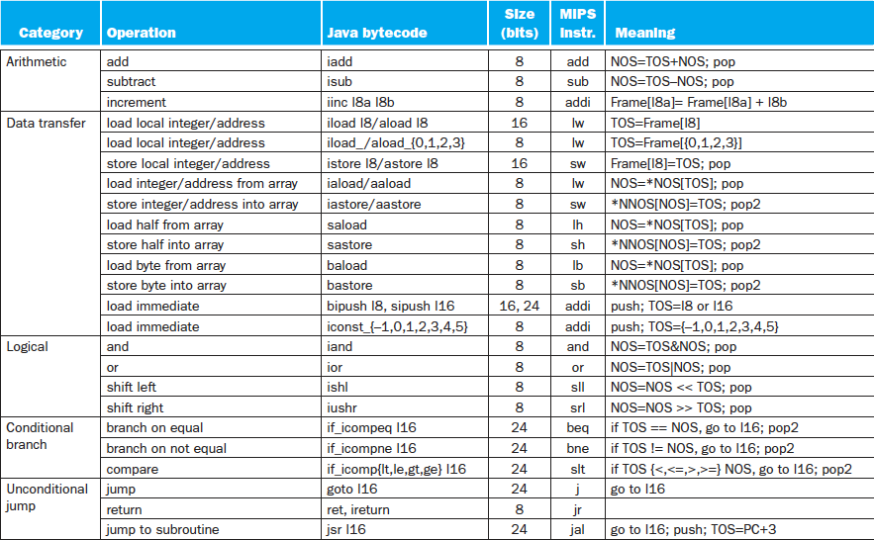
Java Bytecodes (Stack) vs. MIPS (Reg.)

Slide 22
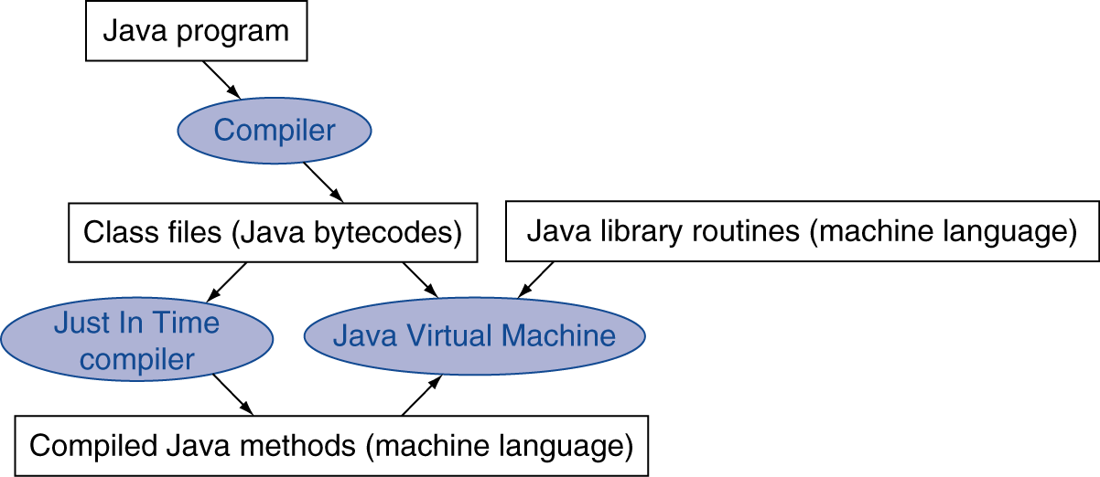
Starting Java Applications
Simple portable instruction set for the JVM
Compiles bytecodes of “hot” methods into native code for host machine
Interprets bytecodes
Just In Time (JIT) compiler translates bytecode into machine language just before execution

Slide 23
Agenda
Compilers, Optimization, Interpreters, Just-In-Time Compiler
Administrivia
Dynamic Linking
Technology Trends Revisited
Technology Break
Components of a Computer

Slide 24
Administrivia
Labs 5and 6 posted, Project 2 posted
Homework, Proj 2- Part 1 Due Sunday @ 11:59:59
Want in from the Wait List?
Sign up for Lab 019 (Friday, 7-9 PM – there is space available! 13 on wait list, 8 slots for Friday)
Midterm is now on the horizon:
Exam: Tu, Mar 8, 6-9 PM, 145/155 Dwinelle
No discussion during exam week, no lecture March 8
TA Review: Su, Mar 6, 2-5 PM, 2050 VLSB
Small number of special consideration cases, due to class conflicts, etc.—contact Dave or Randy

Slide 25
Projects
Project 1: MapReduce on EC2
No credit if programs didn’t compile
6 that used combiners worked after regrade
Can’t share even a little code with your friend; mostly your own is not your own
Project 2: MIPS ISA simulator in C
Add ~ 200 (repetitive) lines of C code to framework
Lots of Cut & Past
Appendix B describes all MIPS instructions in detail
Make your own unit test!

Slide 26
EC2 instances over 2 weeks

Slide 27
EC2 usage: $/student Avg $40, 25th $30, 75th $55

Slide 28
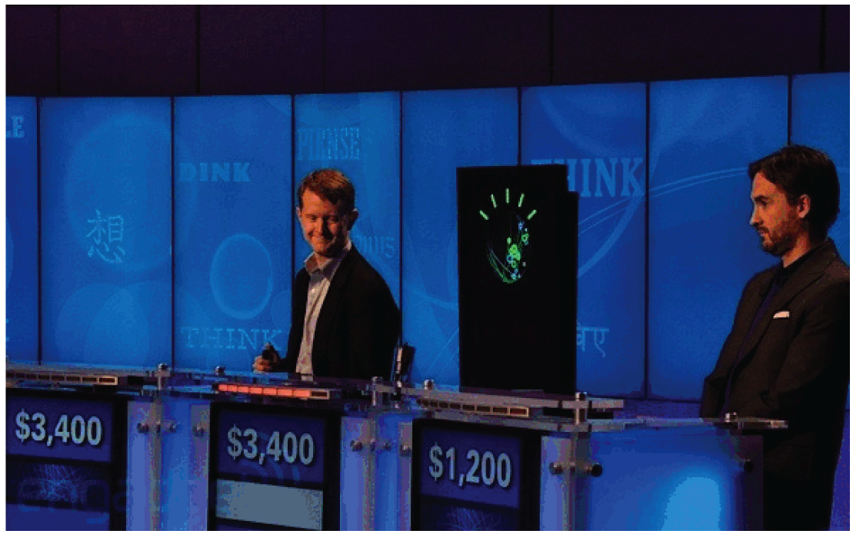
Computers In The News
IBM Watson plays Jeopardy! with champions
A significant milestone in computing, on par with IBM Deep Blue vs. Kasparov in chess in 1997?
Tonight & Wed 2/16 7-7:30PM KGO Channel 7
http://www-03.ibm.com/innovation/us/watson

Slide 29
Dynamic Linking
Only link/load library procedure when it is called
Automatically picks up new library versions
Requires procedure code to be relocatable
Avoids image bloat caused by static linking of all (transitively) referenced libraries
Dynamic linking is default on UNIX and Windows Systems

Slide 30
Dynamic Linking Idea
1st time pay extra overhead of DLL (Dynamically Linked Library), subsequent times almost no cost
Compiler sets up code and data structures to find desired library first time
Linker fixes up address at runtime so fast call subsequent times
Note that return from library is fast every time

Slide 31
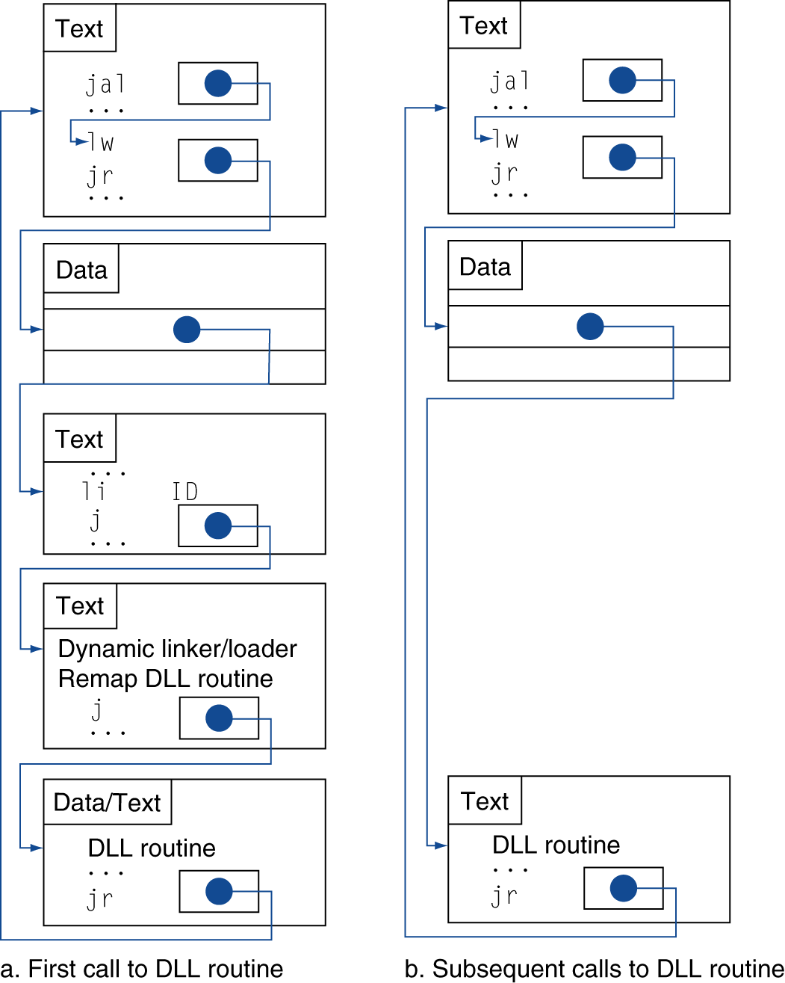
Dynamic Linkage
Call to DLL Library
Indirection table that initially
points to stub code
Stub: Loads routine ID so can find desired library, Jump to linker/loader
Indirection table now points to DLL
Linker/loader code finds desired library and edits jump address in indirection table, jumps to desired routine
Dynamically mapped code executes and returns
Notes:
Book has more detailed figure
At compile time these data structures to point into the linker
At run time the linker edits the file

Slide 32
Dynamic Linkage
Call to DLL Library
Indirection table that initially
points to stub code
Stub: Loads routine ID so can find desired library, Jump to linker/loader
Indirection table now points to DLL
Linker/loader code finds desired library and edits jump address in indirection table, jumps to desired routine
Dynamically mapped code executes and returns
Notes:
Book has more detailed figure
At compile time these data structures to point into the linker
At run time the linker edits the file

Slide 33
Technology Cost over Time: What does Improving Technology Look Like?
Student Roulette?
Cost
$
A
D
B
C
Time

Slide 34
Technology Cost over Time
Cost
$
C
Time

Slide 35
Technology Cost over Time Successive Generations
Cost
$
How Can Tech Gen 2 Replace Tech Gen 1?
Technology Generation 1
Technology Generation 2
Technology Generation 2
Technology Generation 3
Time

Slide 36
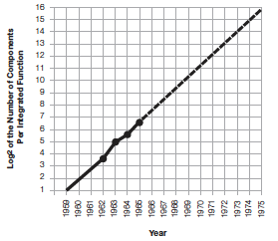
Moore’s Law
“The complexity for minimum component costs has increased at a rate of roughly a factor of two per year. …That means by 1975, the number of components per integrated circuit for minimum cost will be 65,000.” (from 50 in 1965)
Gordon Moore, “Cramming more components onto integrated circuits,” Electronics, Volume 38, Number 8, April 19, 1965
“Integrated circuits will lead to such wonders as home computers--or at least terminals connected to a central computer--automatic controls for automobiles, and personal portable communications equipment. The electronic wristwatch needs only a display to be feasible today.”

Slide 37
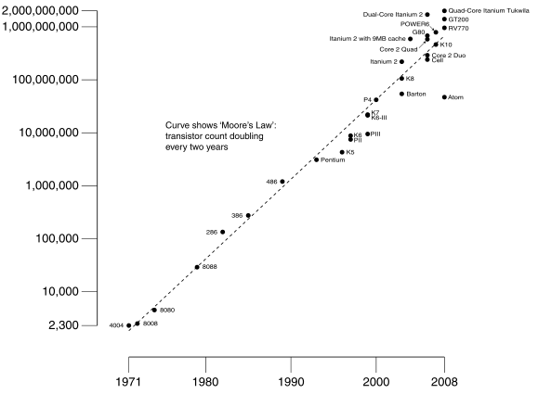
Moore’s Law
Predicts: 2X Transistors / chip every 2 years
# of transistors on an integrated circuit (IC)
Gordon Moore Intel Cofounder B.S. Cal 1950!
Year

Slide 38
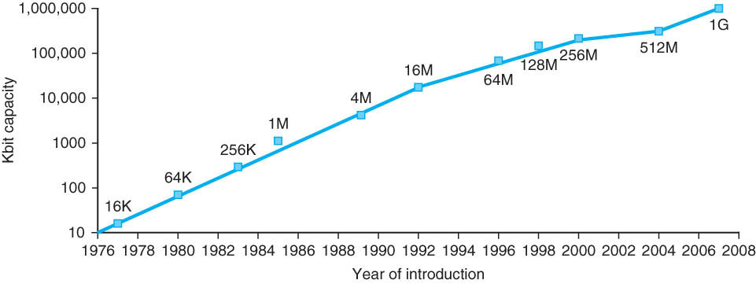
Memory Chip Size
4x in 3 years
2x in 3 years
Growth in memory capacity slowing

Slide 39
End of Moore’s Law?
It’s also a law of investment in equipment as well as increasing volume of integrated circuits that need more transistors per chip
Exponential growth cannot last forever
More transistors/chip will end during your careers
2020? 2025?
(When) will something replace it?

Slide 40
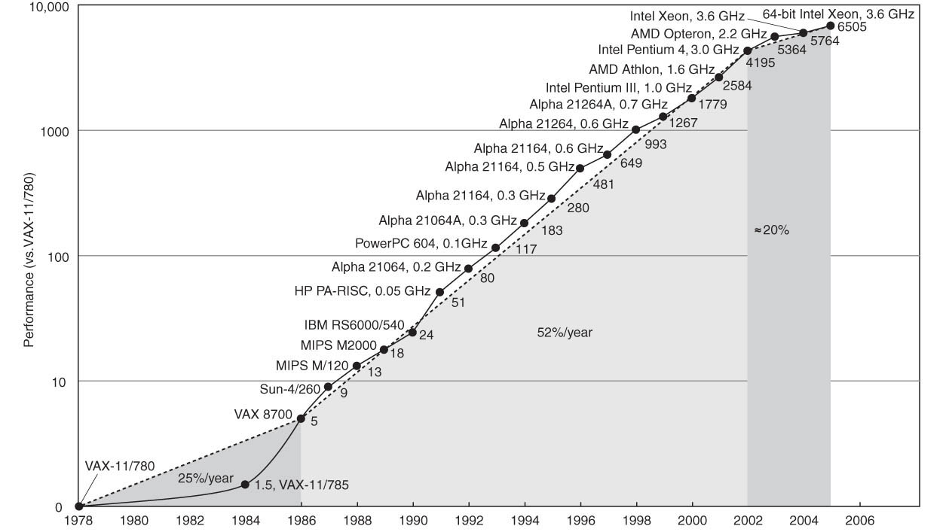
Technology Trends: Uniprocessor Performance (SPECint)
Improvements in processor performance have slowed
Why?

Slide 41
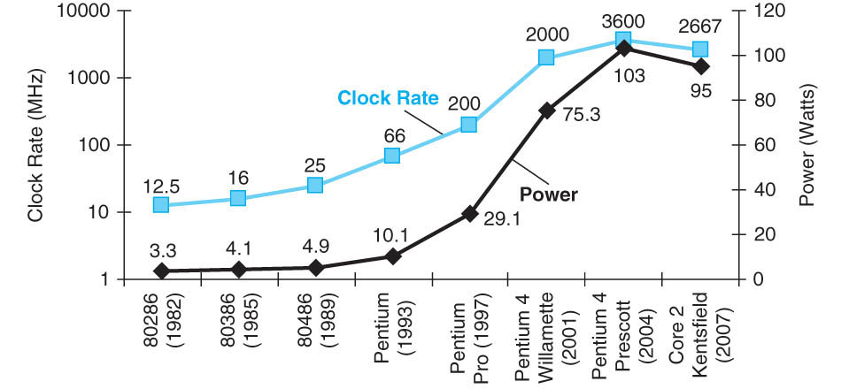
Limits to Performance: Faster Means More Power
P = CV²f

Slide 42
P = C V² f
Power is proportional to Capacitance * Voltage² * Frequency of switching
What is the effect on power consumption of:
“Simpler” implementation (fewer transistors)?
Smaller implementation (shrunk down design)?
Reduced voltage?
Increased clock frequency?

Slide 43
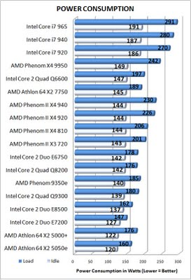
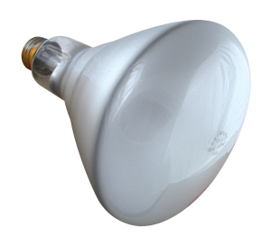
Doing Nothing Well—NOT!
Traditional processors consume about two thirds as much power at idle (doing nothing) as they do at peak
Higher performance (server class) processors approaching 300 W at peak
Implications for battery life?

Slide 44
Computer Technology: Growing, But More Slowly
Processor
Speed 2x / 1.5 years (since ’85-”05) [slowing!]
Now +2 cores / 2 years
When you graduate: 3-4 GHz, 10-14 Cores
Memory (DRAM)
Capacity: 2x / 2 years (since ’96) [slowing!]
Now 2X/3-4 years
When you graduate: 8-16 GigaBytes
Disk
Capacity: 2x / 1 year (since ’97)
250X size last decade
When you graduate: 6-12 TeraBytes
Network
Core: 2x every 2 years
Access: 100-1000 mbps from home, 1-10 mbps cellular

Slide 45
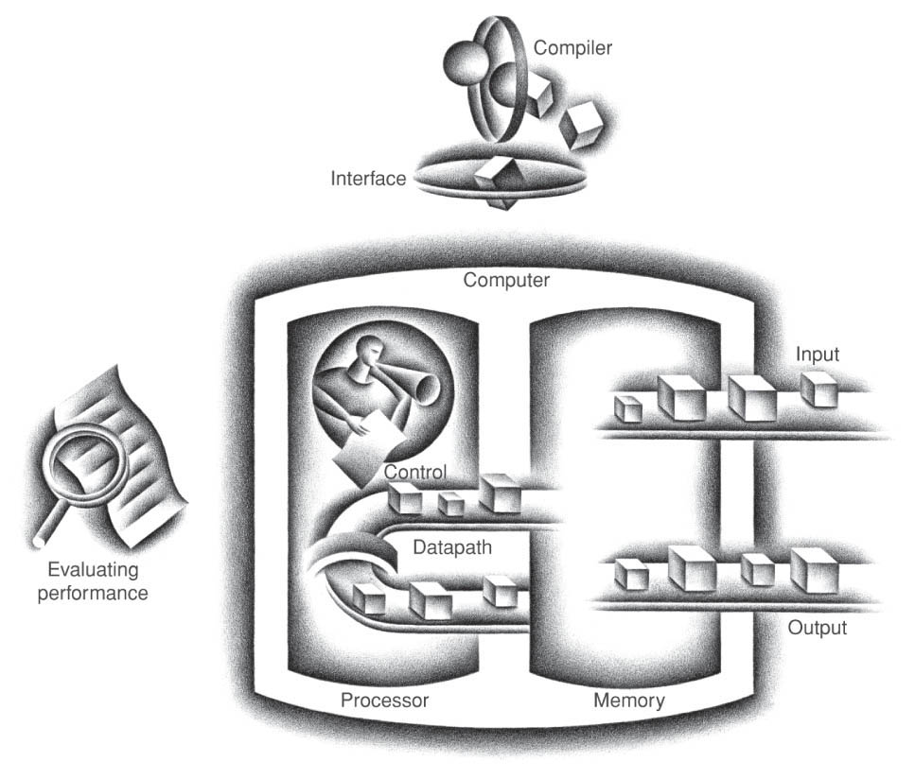
Five Components of a Computer
Control
Datapath
Memory
Input
Output
Notes:
That is, any computer, no matter how primitive or advance, can be divided into five parts:
1. The input devices bring the data from the outside world into the computer.
2. These data are kept in the computer’s memory until ...
3. The datapath request and process them.
4. The operation of the datapath is controlled by the computer’s controller.
All the work done by the computer will NOT do us any good unless we can get the data back to the outside world.
5. Getting the data back to the outside world is the job of the output devices.
The most COMMON way to connect these 5 components together is to use a network of busses.

Slide 46
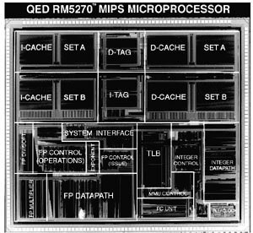
Reality Check: Typical MIPS Chip Die Photograph
Protection- oriented
Virtual
Memory
Support
Performance
Enhancing
On-Chip
Memory
(iCache +
dCache)
Floating Pt
Control and
Datapath
Integer
Control and
Datapath

Slide 47
The Processor
Processor (CPU): the active part of the computer, which does all the work (data manipulation and decision-making)
Datapath: portion of the processor which contains hardware necessary to perform operations required by the processor (the brawn)
Control: portion of the processor (also in hardware) which tells the datapath what needs to be done (the brain)

Slide 48
Stages of the Datapath : Overview
Problem: a single, atomic block which “executes an instruction” (performs all necessary operations beginning with fetching the instruction) would be too bulky and inefficient
Solution: break up the process of “executing an instruction” into stages or phases, and then connect the phases to create the whole datapath
Smaller phases are easier to design
Easy to optimize (change) one phase without touching the others

Slide 49
Instruction Level Parallelism
P 1
P 2
P 3
P 4
P 5
P 6
P 7
P 8
P 9
P 10
P 11
P 12
Instr 1
IF
ID
ALU
MEM
WR
IF
ID
ALU
MEM
WR
Instr 2
IF
ID
ALU
MEM
WR
Instr 2
Instr 3
IF
ID
ALU
MEM
WR
Instr 4
IF
ID
ALU
MEM
WR
Instr 5
IF
ID
ALU
MEM
WR
Instr 6
IF
ID
ALU
MEM
WR
Instr 7
IF
ID
ALU
MEM
WR
Instr 8
IF
ID
ALU
MEM
WR

Slide 50
Project 2 Warning
You are going to write a simulator in C for MIPS, implementing these 5 phases of execution

Slide 51
Phases of the Datapath (1/5)
There is a wide variety of MIPS instructions: so what general steps do they have in common?
Phase 1: Instruction Fetch
No matter what the instruction, the 32-bit instruction word must first be fetched from memory (the cache-memory hierarchy)
Also, this is where we Increment PC (that is, PC = PC + 4, to point to the next instruction: byte addressing so + 4)
Simulator: Instruction = Memory[PC]; PC+=4;

Slide 52
Phases of the Datapath (2/5)
Phase 2: Instruction Decode
Upon fetching the instruction, we next gather data from the fields (decode all necessary instruction data)
First, read the opcode to determine instruction type and field lengths
Second, read in data from all necessary registers
For add, read two registers
For addi, read one register
For jal, no reads necessary

Slide 53
Simulator for Decode Phase
Register1 = Register[rsfield];
Register2 = Register[rtfield];
if (opcode == 0) …
else if (opcode >5 && opcode <10) …
else if (opcode …) …
else if (opcode …) …
Better C statement for chained if statements?
Student Roulette?

Slide 54
Phases of the Datapath (3/5)
Phase 3: ALU (Arithmetic-Logic Unit)
Real work of most instructions is done here: arithmetic (+, -, *, /), shifting, logic (&, |), comparisons (slt)
What about loads and stores?
lw $t0, 40($t1)
Address we are accessing in memory = the value in $t1 PLUS the value 40
So we do this addition in this stage
Simulator: Result = Register1 op Register2; Address = Register1 + Addressfield

Slide 55
Phases of the Datapath (4/5)
Phase 4: Memory Access
Actually only the load and store instructions do anything during this phase; the others remain idle during this phase or skip it all together
Since these instructions have a unique step, we need this extra phase to account for them
As a result of the cache system, this phase is expected to be fast
Simulator: Register[rtfield] = Memory[Address] or Memory[Address] = Register[rtfield]

Slide 56
Phases of the Datapath (5/5)
Phase 5: Register Write
Most instructions write the result of some computation into a register
E.g.,: arithmetic, logical, shifts, loads, slt
What about stores, branches, jumps?
Don’t write anything into a register at the end
These remain idle during this fifth phase or skip it all together
Simulator: Register[rdfield] = Result

Slide 57
Summary
Key Technology Trends and Limitations
Transistor doubling BUT power constraints and latency considerations limit performance improvement
(Single Processor) computers are about as fast as they are likely to get, exploit parallelism to go faster
Five Components of a Computer
Processor/Control + Datapath
Memory
Input/Output: Human interface/KB + Mouse, Display, Storage … evolving to speech, audio, video
Architectural Family: One Instruction Set, Many Implementations

Slide 58
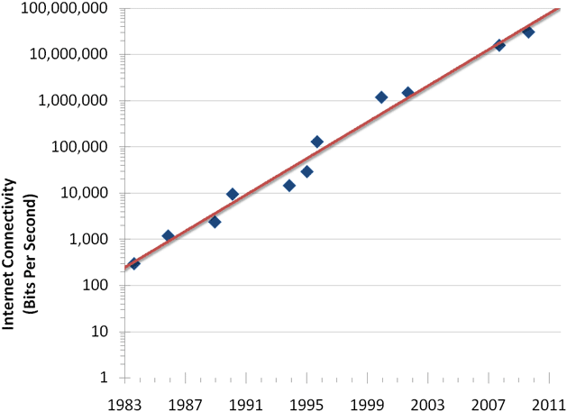
Internet Connection Bandwidth Over Time
50% annualized growth rate per year

Slide 59
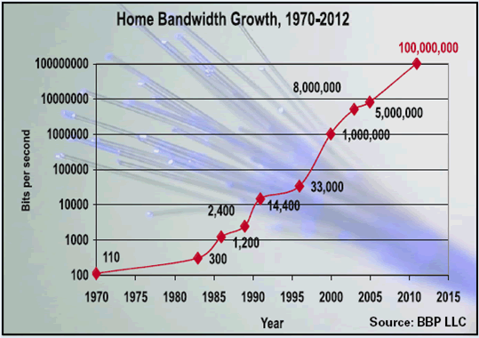
Internet Connection Bandwidth Over Time

Slide 60
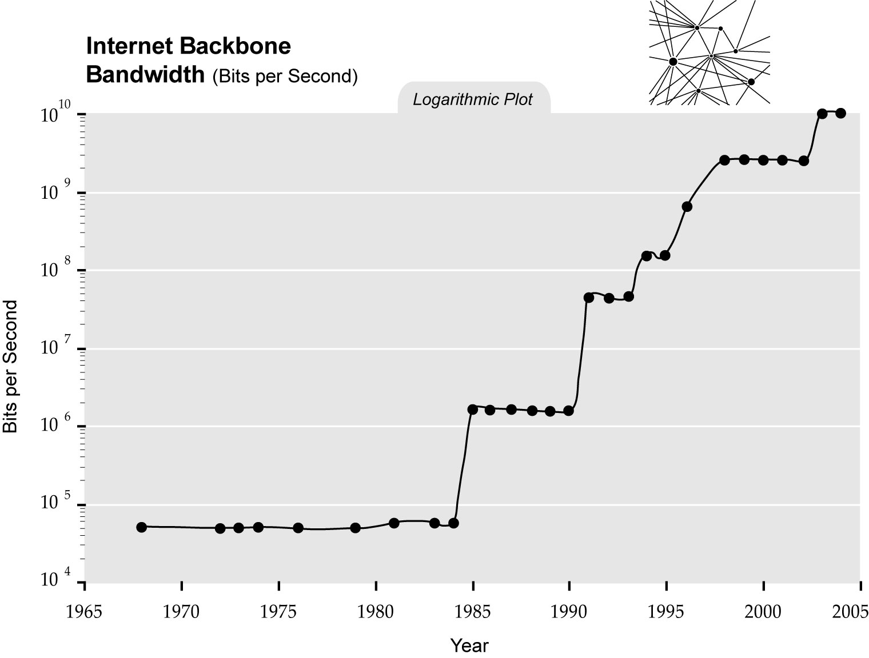
Internet Connection Bandwidth Over Time

Slide 61
Wireless Bandwidth

