Slide 1
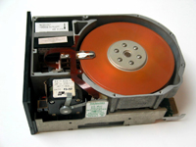
Seagate ships billionth drive!
inst.eecs.berkeley.edu/~cs61c UCB CS61C : Machine Structures Lecture 37 – Disks 2008-04-28
Lecturer SOE Dan Garcia
How much storage do YOU have?
The ST506 was their first drive in 1979 (shown here), weighed 5 lbs, cost $1,500 and held 5 MeB. Today’s drives hold 1 TB, and are available for less than $200.
1b.seagatestorage.com

Slide 2
Magnetic Disk – common I/O device
Computer
Keyboard, Mouse
Processor
(active)
Devices
Memory
(passive)
(where
programs,
data live
when
running)
Input
Control
(“brain”)
Disk,
Network
Output
Datapath
(“brawn”)
Display, Printer

Slide 3
Magnetic Disk – common I/O device
A kind of computer memory
Information stored by magnetizing ferrite material on surface of rotating disk
similar to tape recorder except digital rather than analog data
Nonvolatile storage
retains its value without applying power to disk.
Two Types
Floppy disks – slower, less dense, removable.
Hard Disk Drives (HDD) – faster, more dense, non-removable.
Purpose in computer systems (Hard Drive):
Long-term, inexpensive storage for files
“Backup” for main-memory. Large, inexpensive, slow level in the memory hierarchy (virtual memory)

Slide 4
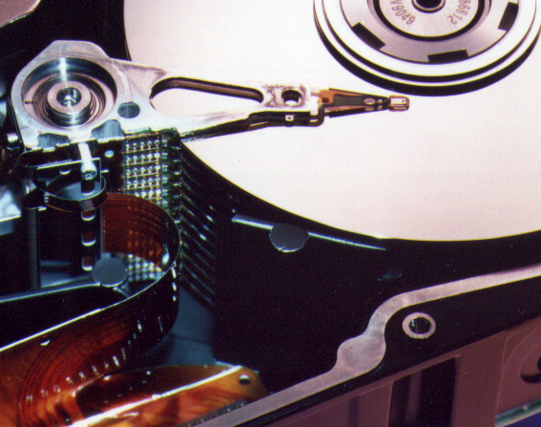
Photo of Disk Head, Arm, Actuator
Spindle
Arm
Head
Actuator
{
Platters (1-12)

Slide 5
Disk Device Terminology
Several platters, with information recorded magnetically on both surfaces (usually)
Bits recorded in tracks, which in turn divided into sectors (e.g., 512 Bytes)
Actuator moves head (end of arm) over track (“seek”), wait for sector rotate under head, then read or write
Inner
Track
Arm
Head
Sector
Outer
Track
Platter
Actuator

Slide 6
Disk Device Performance (1/2)
Disk Latency = Seek Time + Rotation Time + Transfer Time + Controller Overhead
Seek Time? depends on no. tracks to move arm, speed of actuator
Rotation Time? depends on speed disk rotates, how far sector is from head
Transfer Time? depends on data rate (bandwidth) of disk (f(bit density,rpm)), size of request
Outer
Track
Inner
Track
Sector
Head
Arm
Controller
Spindle
Platter
Actuator
Notes:
Use analogy to records

Slide 7
Disk Device Performance (2/2)
Average distance of sector from head?
1/2 time of a rotation
7200 Revolutions Per Minute ⇒ 120 Rev/sec
1 revolution = 1/120 sec ⇒ 8.33 milliseconds
1/2 rotation (revolution) ⇒ 4.17 ms
Average no. tracks to move arm?
Disk industry standard benchmark:
Sum all time for all possible seek distances from all possible tracks / # possible
Assumes average seek distance is random
Size of Disk cache can strongly affect perf!
Cache built into disk system, OS knows nothing

Slide 8
Data Rate: Inner vs. Outer Tracks
To keep things simple, originally same number of sectors per track
Since outer track longer, lower bits per inch
Competition  decided to keep bits per inch (BPI) high for all tracks (“constant bit density”)
⇒ More capacity per disk
⇒ More sectors per track towards edge
⇒ Since disk spins at constant speed, outer tracks have faster data rate
Bandwidth outer track 1.7x inner track!

Slide 9
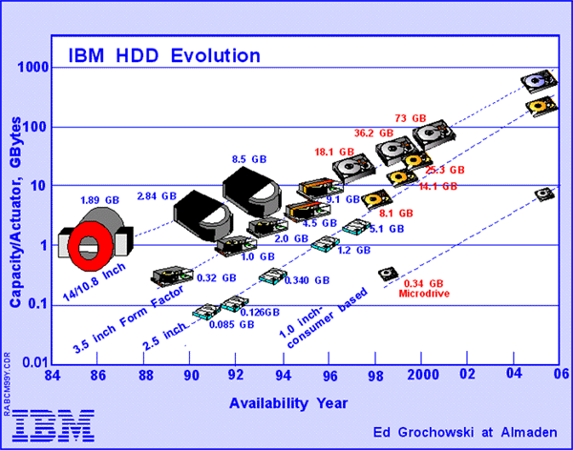
Disk Performance Model /Trends
Capacity : + 100% / year (2X / 1.0 yrs)
Over time, grown so fast that # of platters has reduced (some even use only 1 now!)
Transfer rate (BW) : + 40%/yr (2X / 2 yrs)
Rotation+Seek time : – 8%/yr (1/2 in 10 yrs)
Areal Density
Bits recorded along a track: Bits/Inch (BPI)
# of tracks per surface: Tracks/Inch (TPI)
We care about bit density per unit area Bits/Inch²
Called Areal Density = BPI x TPI
“~120 Gb/In² is longitudinal limit”
“230 Gb/In² now with perpendicular”
GB/$: > 100%/year (2X / 1.0 yrs)
Fewer chips + areal density

Slide 10
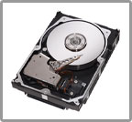
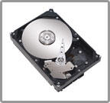
State of the Art: Two camps (2008)
Performance
Enterprise apps, servers
E.g., Seagate Cheetah 15K.6
3 Gb/s, Serial Attached SCSI, Fibre Channel
450 GB, 3.5-inch disk
4 disks, 8 heads
15,000 RPM
12-17 watts (idle-normal)
3.4 ms avg. seek
164 MB/s transfer rate
1.6 Million Hrs MTBF
5 year warrantee
$1000 = $3.30 / GB
Capacity
Mainstream, home uses
E.g., Seagate Barracuda 7200.11
SATA 3Gb/s NCQ, SATA 1.5Gb/s NCQ
1 TB, 3.5-inch disk
4 disks, 8 heads
7,200 RPM
8-12 watts (idle-normal)
?? ms avg. seek (last one 8.5)
115 MB/s transfer rate
0.75 Million Hrs MTBF
5 year warrantee
$200 = $0.20 / GB
These use Perpendicular Magnetic Recording (PMR)!!
source: www.seagate.com

Slide 11
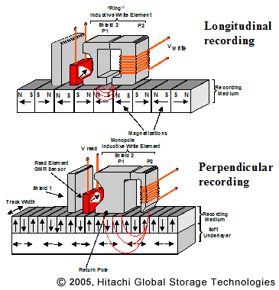
1 inch disk drive!
Hitachi 2007 release
Development driven by iPods & digital cameras
8GB, 5-10MB/s (higher?)
42.8 x 36.4 x 5 mm
Perpendicular Magnetic Recording (PMR)
FUNDAMENTAL new technique
Evolution from Longitudinal
Starting to hit physical limit due to superparamagnetism
They say 10x improvement
www.hitachi.com/New/cnews/050405.html
www.hitachigst.com/hdd/research/recording_head/pr/

Slide 12
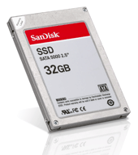
Where does Flash memory come in?
Microdrives and Flash memory (e.g., CompactFlash) are going head-to-head
Both non-volatile (no power, data ok)
Flash benefits: durable & lower power (no moving parts, need to spin µdrives up/down)
Flash limitations: finite number of write cycles (wear on the insulating oxide layer around the charge storage mechanism)
How does Flash memory work?
NMOS transistor with an additional conductor between gate and source/drain which “traps” electrons. The presence/absence is a 1 or 0.
en.wikipedia.org/wiki/Flash_memory

Slide 13
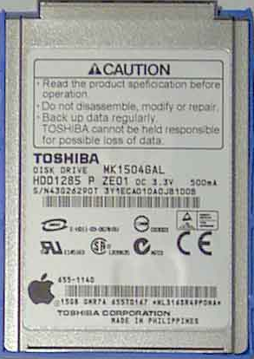
What does Apple put in its iPods?
en.wikipedia.org/wiki/Ipod www.apple.com/ipod
Toshiba flash 1, 2GB
Samsung flash 4, 8GB
Toshiba flash 8, 16, 32GB
Toshiba 1.8-inch HDD 80, 160GB
shuffle, nano, classic, touch

Slide 14
Upcoming Calendar
Week # | Mon | Wed | Thu Lab | Fri
#15 This week | I/O Disks | Performance | I/O Polling P4 due | Writing really fast code (Casey)
#16 Next week | Parallelism in Processor Design | IntRA-machine Parallelism (Matt) | Parallel | IntER-machine Parallelism Perf comp due
#17 Last week o’ classes | LAST CLASS Summary, Review, & HKN Evals
#18 FINAL REVIEW Sun @ 2-5pm 10 Evans | FINAL EXAM Mon 5-8pm 1 Pimintel

Slide 15
Use Arrays of Small Disks…
Katz and Patterson asked in 1987:
Can smaller disks be used to close gap in performance between disks and CPUs?
Conventional: 4 disk designs
3.5”
5.25”
10”
14”
Low End
High End
Disk Array: 1 disk design
3.5”

Slide 16
Replace Small # of Large Disks with Large # of Small!
(1988 Disks)
IBM 3390K
20 GBytes
97 cu. ft.
3 KW
15 MB/s
600 I/Os/s
250 KHrs
$250K
IBM 3.5" 0061
320 MBytes
0.1 cu. ft.
11 W
1.5 MB/s
55 I/Os/s
50 KHrs
$2K
x70
23 GBytes
11 cu. ft.
1 KW
120 MB/s
3900 I/Os/s
??? Hrs
$150K
Capacity
Volume
Power
Data Rate
I/O Rate
MTTF
Cost
9X
3X
8X
6X
Disk Arrays potentially high performance, high MB per cu. ft., high MB per KW, but what about reliability?

Slide 17
Array Reliability
Reliability - whether or not a component has failed
measured as Mean Time To Failure (MTTF)
Reliability of N disks = Reliability of 1 Disk ÷ N (assuming failures independent)
50,000 Hours ÷ 70 disks = 700 hour
Disk system MTTF: Drops from 6 years to 1 month!
Disk arrays too unreliable to be useful!

Slide 18
Redundant Arrays of (Inexpensive) Disks
Files are “striped” across multiple disks
Redundancy yields high data availability
Availability: service still provided to user, even if some components failed
Disks will still fail
Contents reconstructed from data redundantly stored in the array
⇒ Capacity penalty to store redundant info
⇒ Bandwidth penalty to update redundant info

Slide 19
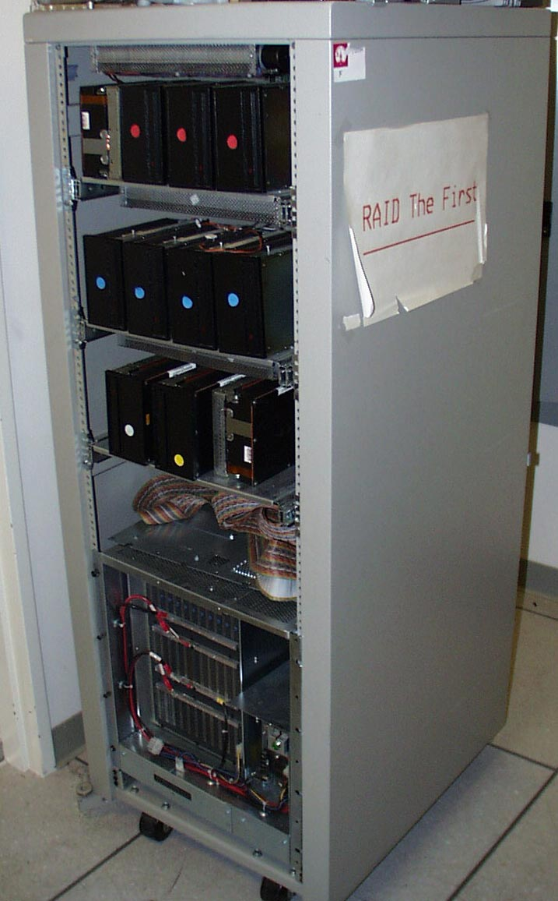
Berkeley History, RAID-I
RAID-I (1989)
Consisted of a Sun 4/280 workstation with 128 MB of DRAM, four dual-string SCSI controllers, 28 5.25-inch SCSI disks and specialized disk striping software
Today RAID is > tens billion dollar industry, 80% nonPC disks sold in RAIDs

Slide 20
“RAID 0”: No redundancy = “AID”
Assume have 4 disks of data for this example, organized in blocks
Large accesses faster since transfer from several disks at once
This and next 5 slides from RAID.edu, http://www.acnc.com/04_01_00.html http://www.raid.com/04_00.html also has a great tutorial

Slide 21
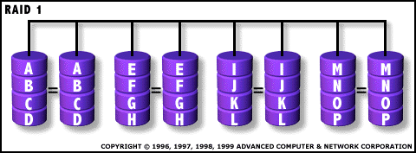
RAID 1: Mirror data
Each disk is fully duplicated onto its “mirror”
Very high availability can be achieved
Bandwidth reduced on write:
1 Logical write = 2 physical writes
Most expensive solution: 100% capacity overhead

Slide 22
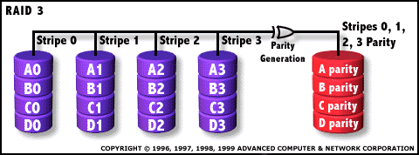
RAID 3: Parity
Parity computed across group to protect against hard disk failures, stored in P disk
Logically, a single high capacity, high transfer rate disk
25% capacity cost for parity in this example vs. 100% for RAID 1 (5 disks vs. 8 disks)

Slide 23
Inspiration for RAID 5 (RAID 4 block-striping)
Small writes (write to one disk):
Option 1: read other data disks, create new sum and write to Parity Disk (access all disks)
Option 2: since P has old sum, compare old data to new data, add the difference to P: 1 logical write = 2 physical reads + 2 physical writes to 2 disks
Parity Disk is bottleneck for Small writes: Write to A0, B1 ➔ both write to P disk
A0
B0
C0
D0
P
A1
B1
C1
D1
P

Slide 24
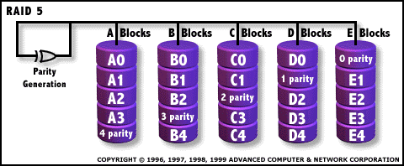
RAID 5: Rotated Parity, faster small writes
Independent writes possible because of interleaved parity
Example: write to A0, B1 uses disks 0, 1, 4, 5, so can proceed in parallel
Still 1 small write = 4 physical disk accesses
en.wikipedia.org/wiki/Redundant_array_of_independent_disks

Slide 25
Peer Instruction
ABC
0: FFF
1: FFT
2: FTF
3: FTT
4: TFF
5: TFT
6: TTF
7: TTT
RAID 1 (mirror) and 5 (rotated parity) help with performance and availability
RAID 1 has higher cost than RAID 5
Small writes on RAID 5 are slower than on RAID 1

Slide 26
Peer Instruction Answer
All RAID (0-5) helps with performance, only RAID0 doesn’t help availability. TRUE
Surely! Must buy 2x disks rather than 1.25x (from diagram, in practice even less) TRUE
RAID5 (2R,2W) vs. RAID1 (2W). Latency worse, throughput (|| writes) better. TRUE
ABC
0: FFF
1: FFT
2: FTF
3: FTT
4: TFF
5: TFT
6: TTF
7: TTT
RAID 1 (mirror) and 5 (rotated parity) help with performance and availability
RAID 1 has higher cost than RAID 5
Small writes on RAID 5 are slower than on RAID 1

Slide 27
“And In conclusion…”
Magnetic Disks continue rapid advance: 60%/yr capacity, 40%/yr bandwidth, slow seek, rotation improvements, MB/$ improving 100%/yr?
Designs to fit high volume form factor
PMR a fundamental new technology
breaks through barrier
RAID
Higher performance with more disk arms per $
Adds option for small # of extra disks
Can nest RAID levels
Today RAID is > tens-billion dollar industry, 80% nonPC disks sold in RAIDs, started at Cal

Slide 28
Bonus slides
These are extra slides that used to be included in lecture notes, but have been moved to this, the “bonus” area to serve as a supplement.
The slides will appear in the order they would have in the normal presentation
Bonus

Slide 29
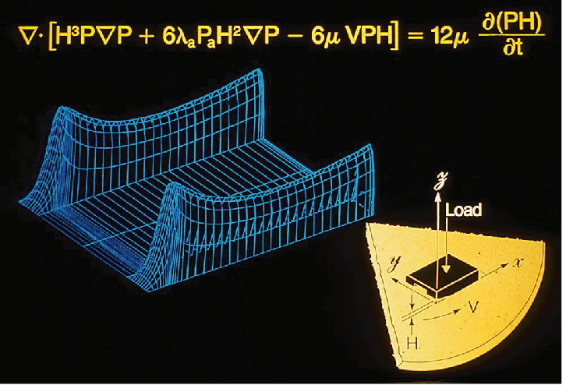
BONUS : Hard Drives are Sealed. Why?
The closer the head to the disk, the smaller the “spot size” and thus the denser the recording.
Measured in Gbit/in2. ~60 is state of the art.
Disks are sealed to keep the dust out.
Heads are designed to “fly” at around 5-20nm above the surface of the disk.
99.999% of the head/arm weight is supported by the air bearing force (air cushion) developed between the disk and the head.

Slide 30
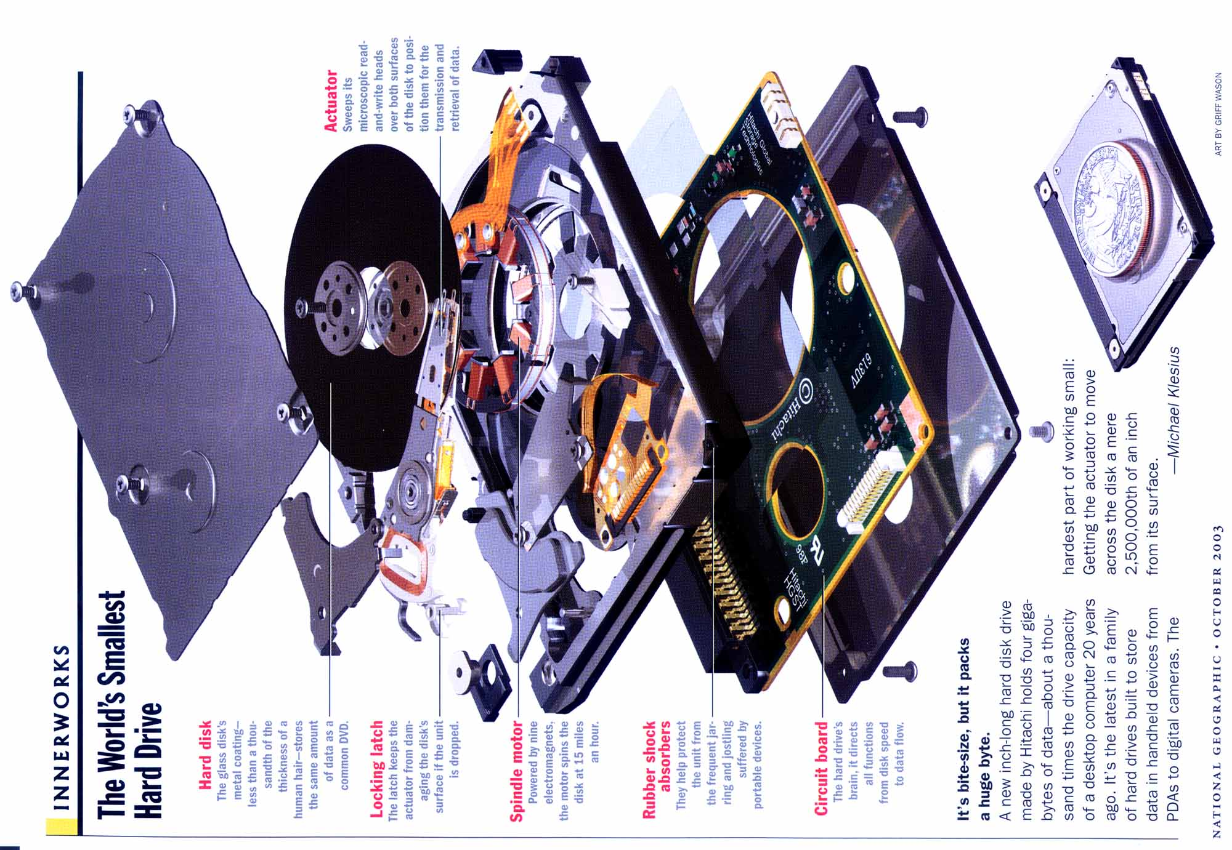

Slide 31
Historical Perspective
Form factor and capacity are more important in the marketplace than is performance
Form factor evolution:
1970s: Mainframes  14 inch diameter disks
1980s: Minicomputers, Servers  8”, 5.25” diameter disks
Late 1980s/Early 1990s:
PCs  3.5 inch diameter disks
Laptops, notebooks  2.5 inch disks
Palmtops didn’t use disks, so 1.8 inch diameter disks didn’t make it
Early 2000s:
MP3 players   1 inch disks

Slide 32
Early Disk History (IBM)
Data
density
Mbit/sq. in.
Capacity of
unit shown
Megabytes
1973:
1. 7 Mbit/sq. in
140 MBytes
1979:
7. 7 Mbit/sq. in
2,300 MBytes
source: New York Times, 2/23/98, page C3, “Makers of disk drives crowd even more data into even smaller spaces”

Slide 33
Early Disk History
1989:
63 Mbit/sq. in
60,000 MBytes
1997:
1450 Mbit/sq. in
1600 MBytes
1997:
3090 Mbit/sq. in
8100 MBytes
source: New York Times, 2/23/98, page C3, “Makers of disk drives crowd even more data into even smaller spaces”

Slide 34
Disk Performance Example
Calculate time to read 1 sector (512B) for Deskstar using advertised performance; sector is on outer track
Disk latency = average seek time + average rotational delay + transfer time + controller overhead
= 8.5 ms + 0.5 * 1/(7200 RPM) + 0.5 KB / (100 MB/s) + 0.1 ms
= 8.5 ms + 0.5 /(7200 RPM/(60000ms/M)) + 0.5 KB / (100 KB/ms) + 0.1 ms
= 8.5 + 4.17 + 0.005 + 0.1 ms = 12.77 ms
How many CPU clock cycles is this?

