Slide 1
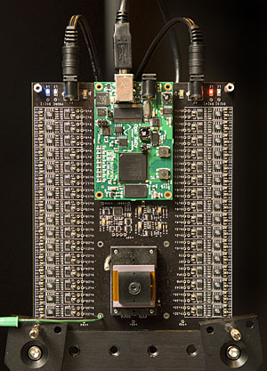
3d camera with 12,616 lenses
inst.eecs.berkeley.edu/~cs61c UCB CS61C : Machine Structures Lecture 24 Introduction to CPU design 2008-03-21
Hi to Vitaly Babiy from Albany, NY!
Lecturer SOE Dan Garcia
Stanford researchers developing 3D camera with 12,616 lenses! This enables the reconstruction of the normal picture and a depth-map. It would also be possible to defocus the image after the fact, in software. Lots of uses for this: security (facial recognition), 3D scanning for VR worlds, 3D modeling of objects, etc. Very cool!
news-service.stanford.edu/news/2008/march19/camera%20-031908.html

Slide 2
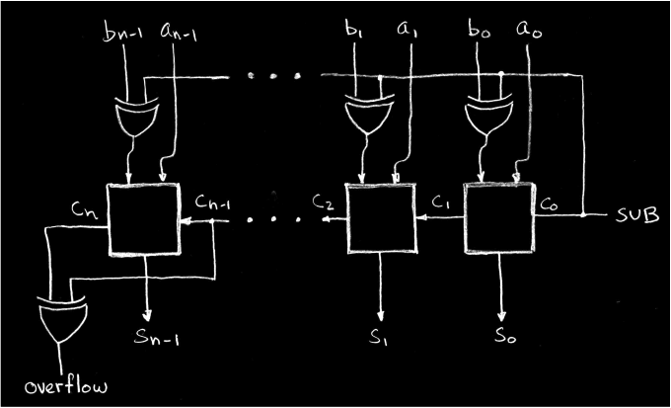
Clever Signed Adder/Subtractor
A - B = A + (-B); how do we make “-B”?
x | y | xor
0 | 0 | 0
0 | 1 | 1
1 | 0 | 1
1 | 1 | 0
An xor is a “Conditional Inverter!”

Slide 3
Five Components of a Computer
Computer
Keyboard, Mouse
Devices
Processor
Memory
(passive)
(where
programs,
data live
when
running)
Disk (where
programs,
data live when not running)
Input
Control
Output
Datapath
Display, Printer

Slide 4
The CPU
Processor (CPU): the active part of the computer, which does all the work (data manipulation and decision-making)
Datapath: portion of the processor which contains hardware necessary to perform operations required by the processor (the brawn)
Control: portion of the processor (also in hardware) which tells the datapath what needs to be done (the brain)

Slide 5
Stages of the Datapath : Overview
Problem: a single, atomic block which “executes an instruction” (performs all necessary operations beginning with fetching the instruction) would be too bulky and inefficient
Solution: break up the process of “executing an instruction” into stages, and then connect the stages to create the whole datapath
smaller stages are easier to design
easy to optimize (change) one stage without touching the others

Slide 6
Stages of the Datapath (1/5)
There is a wide variety of MIPS instructions: so what general steps do they have in common?
Stage 1: Instruction Fetch
no matter what the instruction, the 32-bit instruction word must first be fetched from memory (the cache-memory hierarchy)
also, this is where we Increment PC (that is, PC = PC + 4, to point to the next instruction: byte addressing so + 4)

Slide 7
Stages of the Datapath (2/5)
Stage 2: Instruction Decode
upon fetching the instruction, we next gather data from the fields (decode all necessary instruction data)
first, read the opcode to determine instruction type and field lengths
second, read in data from all necessary registers
for add, read two registers
for addi, read one register
for jal, no reads necessary

Slide 8
Stages of the Datapath (3/5)
Stage 3: ALU (Arithmetic-Logic Unit)
the real work of most instructions is done here: arithmetic (+, -, *, /), shifting, logic (&, |), comparisons (slt)
what about loads and stores?
lw $t0, 40($t1)
the address we are accessing in memory = the value in $t1 PLUS the value 40
so we do this addition in this stage

Slide 9
Stages of the Datapath (4/5)
Stage 4: Memory Access
actually only the load and store instructions do anything during this stage; the others remain idle during this stage or skip it all together
since these instructions have a unique step, we need this extra stage to account for them
as a result of the cache system, this stage is expected to be fast

Slide 10
Stages of the Datapath (5/5)
Stage 5: Register Write
most instructions write the result of some computation into a register
examples: arithmetic, logical, shifts, loads, slt
what about stores, branches, jumps?
don’t write anything into a register at the end
these remain idle during this fifth stage or skip it all together

Slide 11
Generic Steps of Datapath
rd
PC
instruction
memory
registers
rs
Data
memory
rt
ALU
+4
imm
2. Decode/
Register
Read
1. Instruction
Fetch
5. Reg.
Write
3. Execute
4. Memory

Slide 12
Administrivia
Homework 5 due tonight
Have a GREAT and RELAXING spring break!

Slide 13
Datapath Walkthroughs (1/3)
add $r3,$r1,$r2 # r3 = r1+r2
Stage 1: fetch this instruction, inc. PC
Stage 2: decode to find it’s an add, then read registers $r1 and $r2
Stage 3: add the two values retrieved in Stage 2
Stage 4: idle (nothing to write to memory)
Stage 5: write result of Stage 3 into register $r3

Slide 14
Example: add Instruction
reg[1]
3
instruction
memory
reg[1]+reg[2]
PC
1
registers
Data
memory
reg[2]
ALU
2
+4
imm
add r3, r1, r2

Slide 15
Datapath Walkthroughs (2/3)
slti $r3,$r1,17
Stage 1: fetch this instruction, inc. PC
Stage 2: decode to find it’s an slti, then read register $r1
Stage 3: compare value retrieved in Stage 2 with the integer 17
Stage 4: idle
Stage 5: write the result of Stage 3 in register $r3

Slide 16
Example: slti Instruction
reg[1]
x
instruction
memory
reg[1]<17?
PC
1
registers
Data
memory
ALU
3
+4
imm
17
slti r3, r1, 17

Slide 17
Datapath Walkthroughs (3/3)
sw $r3, 17($r1)
Stage 1: fetch this instruction, inc. PC
Stage 2: decode to find it’s a sw, then read registers $r1 and $r3
Stage 3: add 17 to value in register $r1 (retrieved in Stage 2)
Stage 4: write value in register $r3 (retrieved in Stage 2) into memory address computed in Stage 3
Stage 5: idle (nothing to write into a register)

Slide 18
Example: sw Instruction
reg[1]
x
instruction
memory
reg[1]+17
PC
1
registers
Data
memory
reg[3]
ALU
3
+4
imm
17
MEM[r1+17]<=r3
SW r3, 17(r1)

Slide 19
Why Five Stages? (1/2)
Could we have a different number of stages?
Yes, and other architectures do
So why does MIPS have five if instructions tend to idle for at least one stage?
The five stages are the union of all the operations needed by all the instructions.
There is one instruction that uses all five stages: the load

Slide 20
Why Five Stages? (2/2)
lw $r3, 17($r1)
Stage 1: fetch this instruction, inc. PC
Stage 2: decode to find it’s a lw, then read register $r1
Stage 3: add 17 to value in register $r1 (retrieved in Stage 2)
Stage 4: read value from memory address compute in Stage 3
Stage 5: write value found in Stage 4 into register $r3

Slide 21
Example: lw Instruction
reg[1]
x
instruction
memory
reg[1]+17
PC
1
registers
Data
memory
ALU
3
MEM[r1+17]
+4
imm
17
LW r3, 17(r1)

Slide 22
Datapath Summary
The datapath based on data transfers required to perform instructions
A controller causes the right transfers to happen
rd
PC
instruction
memory
registers
rs
Data
memory
rt
ALU
+4
imm
opcode, funct
Controller

Slide 23
What Hardware Is Needed? (1/2)
PC: a register which keeps track of memory addr of the next instruction
General Purpose Registers
used in Stages 2 (Read) and 5 (Write)
MIPS has 32 of these
Memory
used in Stages 1 (Fetch) and 4 (R/W)
cache system makes these two stages as fast as the others, on average

Slide 24
What Hardware Is Needed? (2/2)
ALU
used in Stage 3
something that performs all necessary functions: arithmetic, logicals, etc.
we’ll design details later
Miscellaneous Registers
In implementations with only one stage per clock cycle, registers are inserted between stages to hold intermediate data and control signals as they travels from stage to stage.
Note: Register is a general purpose term meaning something that stores bits. Not all registers are in the “register file”.

Slide 25
CPU clocking (1/2)
For each instruction, how do we control the flow of information though the datapath?
Single Cycle CPU: All stages of an instruction are completed within one long clock cycle.
The clock cycle is made sufficient long to allow each instruction to complete all stages without interruption and within one cycle.
2. Decode/
Register
Read
1. Instruction
Fetch
5. Reg.
Write
3. Execute
4. Memory

Slide 26
CPU clocking (2/2)
For each instruction, how do we control the flow of information though the datapath?
Multiple-cycle CPU: Only one stage of instruction per clock cycle.
The clock is made as long as the slowest stage.
Several significant advantages over single cycle execution: Unused stages in a particular instruction can be skipped OR instructions can be pipelined (overlapped).
2. Decode/
Register
Read
1. Instruction
Fetch
5. Reg.
Write
3. Execute
4. Memory

Slide 27
Peer Instruction
If the destination reg is the same as the source reg, we could compute the incorrect value!
We’re going to be able to read 2 registers and write a 3rd in 1 cycle
Datapath is hard, Control is easy
ABC
0: FFF
1: FFT
2: FTF
3: FTT
4: TFF
5: TFT
6: TTF
7: TTT
Notes:
Answer: [correct=3, FTF]
A: F (waste of resources -- won’t work for pipelining)
B: T (yep!)
C: F (nope, that’s not our mantra silly)

Slide 28
Peer Instruction
Truth table for mux with 4-bits of signals has 2⁴ rows
We could cascade N 1-bit shifters to make 1 N-bit shifter for sll, srl
If 1-bit adder delay is T, the N-bit adder delay would also be T
ABC
1: FFF
2: FFT
3: FTF
4: FTT
5: TFF
6: TFT
7: TTF
8: TTT

Slide 29
Peer Instruction Answer
Truth table for mux with 4-bits of signals controls 16 inputs, for a total of 20 inputs, so truth table is 2²⁰ rows…FALSE
We could cascade N 1-bit shifters to make 1 N-bit shifter for sll, srl … TRUE
What about the cascading carry? FALSE
Truth table for mux with 4-bits of signals is 2⁴ rows long
We could cascade N 1-bit shifters to make 1 N-bit shifter for sll, srl
If 1-bit adder delay is T, the N-bit adder delay would also be T
ABC
1: FFF
2: FFT
3: FTF
4: FTT
5: TFF
6: TFT
7: TTF
8: TTT
Notes:
Answer: [correct=5, TFF] Individual (6, 3, 6, 3, 34, 37, 7, 4)% & Team (9, 4, 4, 4, 39, 34, 0, 7)%
A: T [18/82 & 25/75] (The game breaks up very quickly into separate, independent games -- big win to solve separated & put together)
B: F [80/20 & 86/14] (The game tree grows exponentially! A better static evaluator can make all the difference!)
C: F [53/57 & 52/48] (If you're just looking for the best move, just keep theBestMove around [ala memoizing max])

Slide 30
“And In conclusion…”
N-bit adder-subtractor done using N 1-bit adders with XOR gates on input
XOR serves as conditional inverter
CPU design involves Datapath,Control
Datapath in MIPS involves 5 CPU stages
Instruction Fetch
Instruction Decode & Register Read
ALU (Execute)
Memory
Register Write

