Slide 1
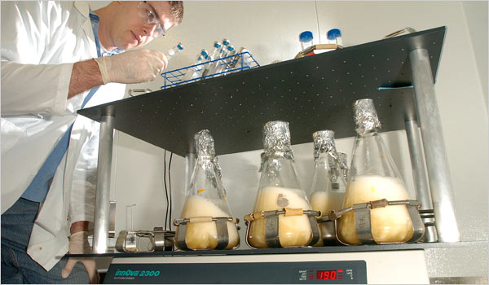
inst.eecs.berkeley.edu/~cs61c UC Berkeley CS61C : Machine Structures Lecture 22 – Representations of Combinatorial Logic Circuits 2008-03-17
Lecturer SOE Dan Garcia
www.cs.berkeley.edu/~ddgarcia
100 MPG Car contest! ⇒ The X Prize Foundation has put up two prizes; one for city cars (which can have 3 wheelers) and one for four-wheel, four-seat cars. Deadline? 2010.
www.nytimes.com/2008/03/16/technology/16ping.html
Notes:
Greet class

Slide 2
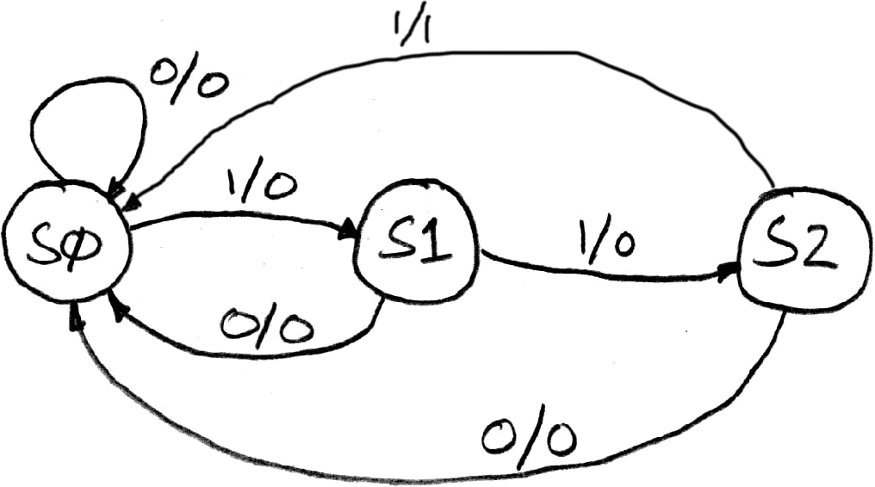
Finite State Machine Example: 3 ones…
FSM to detect the occurrence of 3 consecutive 1’s in the input.
Draw the FSM…
Assume state transitions are controlled by the clock:
on each clock cycle the machine checks the inputs and moves to a new state and produces a new output…

Slide 3
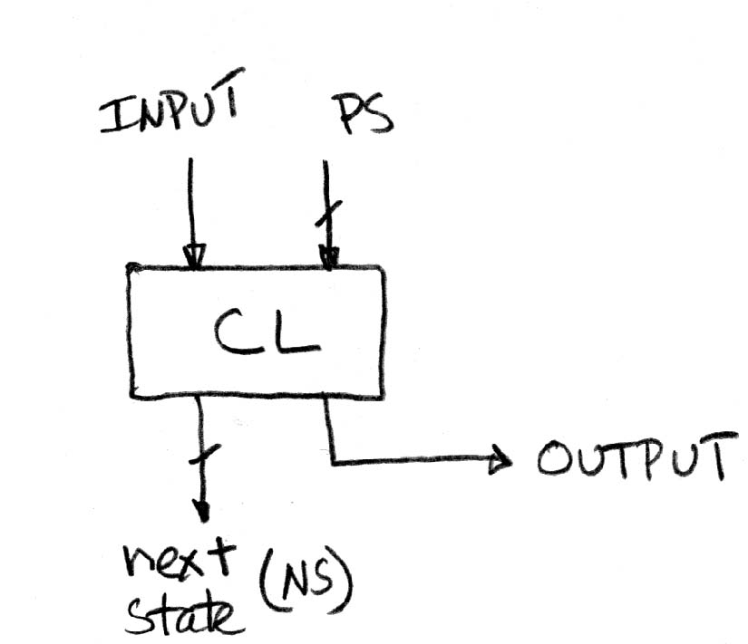
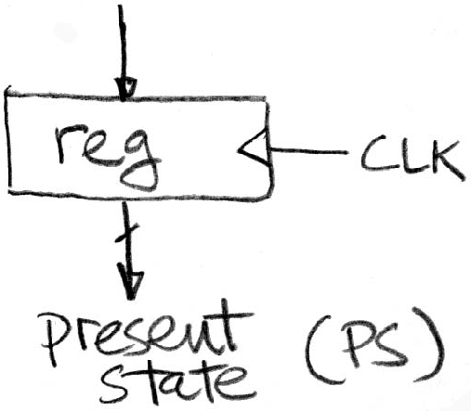
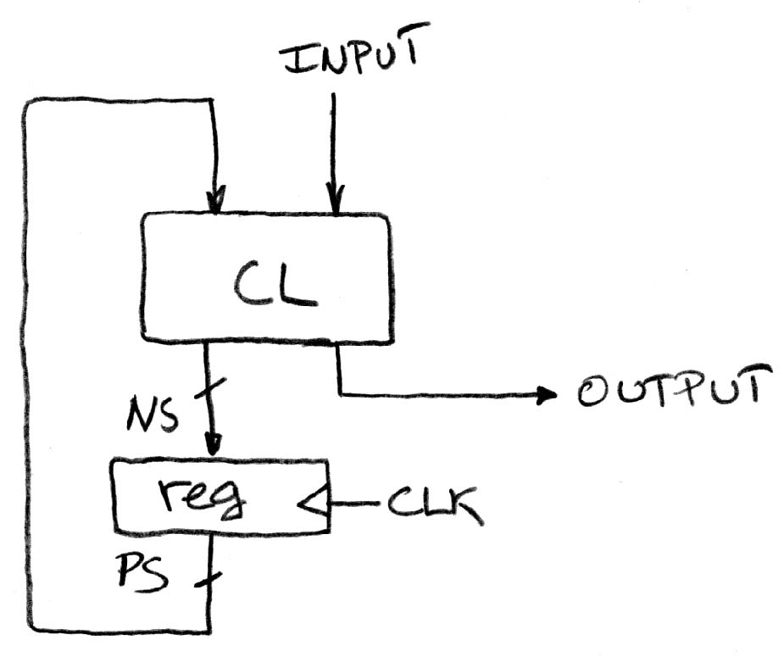
Hardware Implementation of FSM
… Therefore a register is needed to hold the a representation of which state the machine is in. Use a unique bit pattern for each state.
+
?
=
Combinational logic circuit is used to implement a function maps from present state and input to next state and output.

Slide 4
Hardware for FSM: Combinational Logic
This lecture we will discuss the detailed implementation, but for now can look at its functional specification, truth table form.
Truth table…
PS
Input
NS
Output
00
0
00
0
00
1
01
0
01
0
00
0
01
1
10
0
10
0
00
0
10
1
00
1

Slide 5
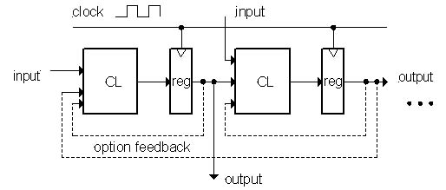
General Model for Synchronous Systems
Collection of CL blocks separated by registers.
Registers may be back-to-back and CL blocks may be back-to-back.
Feedback is optional.
Clock signal(s) connects only to clock input of registers.

Slide 6
Review
State elements are used to:
Build memories
Control the flow of information between other state elements and combinational logic
D-flip-flops used to build registers
Clocks tell us when D-flip-flops change
Setup and Hold times important
We pipeline long-delay CL for faster clock
Finite State Machines extremely useful
Represent states and transitions

Slide 7
Combinational Logic
FSMs had states and transitions
How to we get from one state to the next?
Answer: Combinational Logic

Slide 8
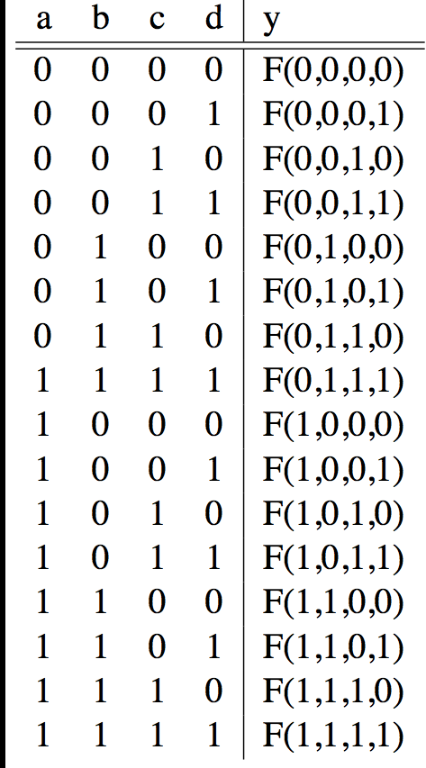
Truth Tables
0

Slide 9
TT Example #1: 1 iff one (not both) a,b=1
a | b | y
0 | 0 | 0
0 | 1 | 1
1 | 0 | 1
1 | 1 | 0

Slide 10
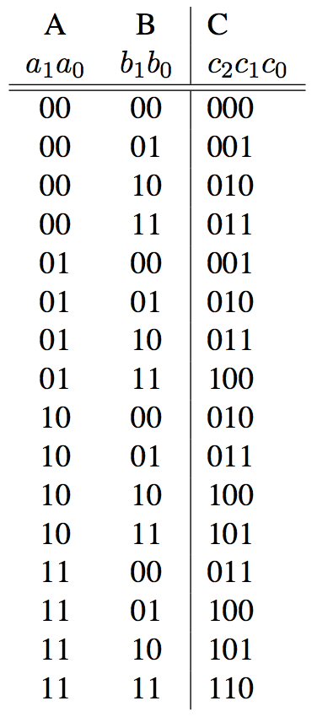
TT Example #2: 2-bit adder
How Many Rows?

Slide 11
TT Example #3: 32-bit unsigned adder
How Many Rows?

Slide 12
TT Example #3: 3-input majority circuit

Slide 13
Logic Gates (1/2)

Slide 14
And vs. Or review – Dan’s mnemonic
AND Gate
Symbol
Definition
^{AN}D
A
C
B

Slide 15
Logic Gates (2/2)

Slide 16
2-input gates extend to n-inputs
N-input XOR is the only one which isn’t so obvious
It’s simple: XOR is a 1 iff the # of 1s at its input is odd ⇒

Slide 17
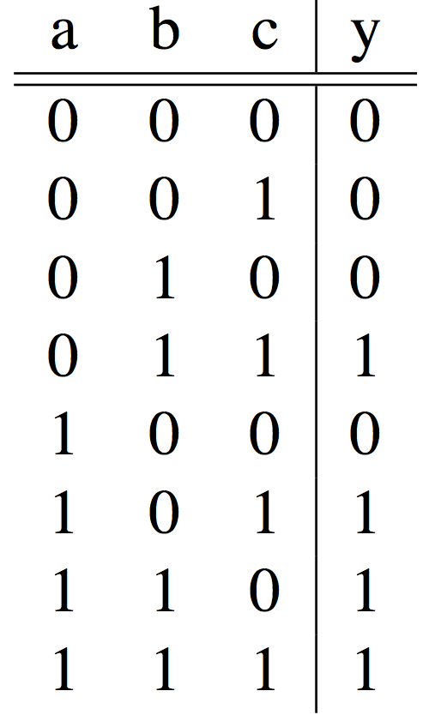
Truth Table ⇒ Gates (e.g., majority circ.)

Slide 18
Truth Table ⇒ Gates (e.g., FSM circ.)
PS | Input | NS | Output
00 | 0 | 00 | 0
00 | 1 | 01 | 0
01 | 0 | 00 | 0
01 | 1 | 10 | 0
10 | 0 | 00 | 0
10 | 1 | 00 | 1
or equivalently…

Slide 19
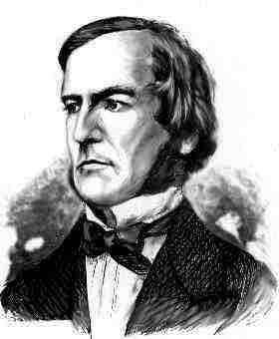
Boolean Algebra
George Boole, 19th Century mathematician
Developed a mathematical system (algebra) involving logic
later known as “Boolean Algebra”
Primitive functions: AND, OR and NOT
The power of BA is there’s a one-to-one correspondence between circuits made up of AND, OR and NOT gates and equations in BA
+ means OR,• means AND, x means NOT

Slide 20
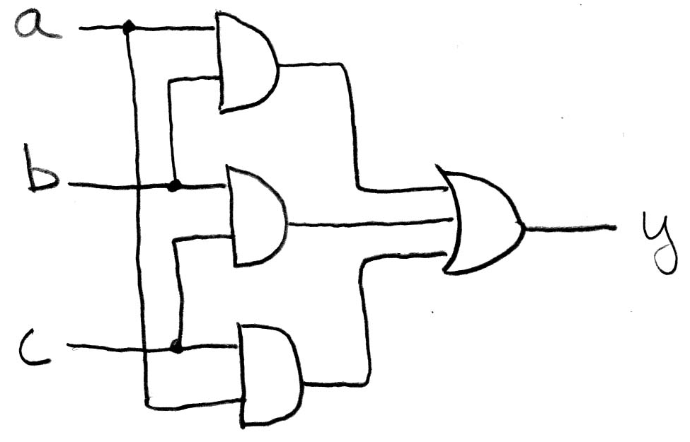
Boolean Algebra (e.g., for majority fun.)
y = a • b + a • c + b • c
y = ab + ac + bc

Slide 21
Boolean Algebra (e.g., for FSM)
PS | Input | NS | Output
00 | 0 | 00 | 0
00 | 1 | 01 | 0
01 | 0 | 00 | 0
01 | 1 | 10 | 0
10 | 0 | 00 | 0
10 | 1 | 00 | 1
or equivalently…
y = PS₁ • PS₀ • INPUT

Slide 22
BA: Circuit & Algebraic Simplification
BA also great for circuit verification Circ X = Circ Y? use BA to prove!

Slide 23
Laws of Boolean Algebra

Slide 24
Boolean Algebraic Simplification Example

Slide 25
Canonical forms (1/2)
Sum-of-products
(ORs of ANDs)

Slide 26
Canonical forms (2/2)

Slide 27
Peer Instruction
(a+b)• (a+b) = b
N-input gates can be thought of cascaded 2-input gates. I.e., (a ∆ bc ∆ d ∆ e) = a ∆ (bc ∆ (d ∆ e)) where ∆ is one of AND, OR, XOR, NAND
You can use NOR(s) with clever wiring to simulate AND, OR, & NOT
ABC
1: FFF
2: FFT
3: FTF
4: FTT
5: TFF
6: TFT
7: TTF
8: TTT
Notes:
Answer: [correct=5, TFF] Individual (6, 3, 6, 3, 34, 37, 7, 4)% & Team (9, 4, 4, 4, 39, 34, 0, 7)%
A: T [18/82 & 25/75] (The game breaks up very quickly into separate, independent games -- big win to solve separated & put together)
B: F [80/20 & 86/14] (The game tree grows exponentially! A better static evaluator can make all the difference!)
C: F [53/57 & 52/48] (If you're just looking for the best move, just keep theBestMove around [ala memoizing max])

Slide 28
Peer Instruction Answer
(a+b)•(a+b) = aa+ab+ba+bb = 0+b(a+a)+b = b+b = b TRUE
(next slide)
You can use NOR(s) with clever wiring to simulate AND, OR, & NOT.
NOR(a,a)= a+a = aa = a
Using this NOT, can we make a NOR an OR? An And?
TRUE
(a+b)• (a+b) = b
N-input gates can be thought of cascaded 2-input gates. I.e., (a ∆ bc ∆ d ∆ e) = a ∆ (bc ∆ (d ∆ e)) where ∆ is one of AND, OR, XOR, NAND
You can use NOR(s) with clever wiring to simulate AND, OR, & NOT
ABC
1: FFF
2: FFT
3: FTF
4: FTT
5: TFF
6: TFT
7: TTF
8: TTT

Slide 29
Peer Instruction Answer (B)
N-input gates can be thought of cascaded 2-input gates. I.e., (a ∆ bc ∆ d ∆ e) = a ∆ (bc ∆ (d ∆ e)) where ∆ is one of AND, OR, XOR, NAND…FALSE
Let’s confirm!
CORRECT 3-input
XYZ|AND|OR|XOR|NAND
000| 0 |0 | 0 | 1
001| 0 |1 | 1 | 1
010| 0 |1 | 1 | 1
011| 0 |1 | 0 | 1
100| 0 |1 | 1 | 1
101| 0 |1 | 0 | 1
110| 0 |1 | 0 | 1
111| 1 |1 | 1 | 0
CORRECT 2-input
YZ|AND|OR|XOR|NAND
00| 0 |0 | 0 | 1
01| 0 |1 | 1 | 1
10| 0 |1 | 1 | 1
11| 1 |1 | 0 | 0
0 0 0 1
0 1 1 1
0 1 1 1
0 1 0 1
0 1 1 0
0 1 0 0
0 1 0 0
1 1 1 1
Notes:
Answer: [correct=5, TFF] Individual (6, 3, 6, 3, 34, 37, 7, 4)% & Team (9, 4, 4, 4, 39, 34, 0, 7)%
A: T [18/82 & 25/75] (The game breaks up very quickly into separate, independent games -- big win to solve separated & put together)
B: F [80/20 & 86/14] (The game tree grows exponentially! A better static evaluator can make all the difference!)
C: F [53/57 & 52/48] (If you're just looking for the best move, just keep theBestMove around [ala memoizing max])

Slide 30
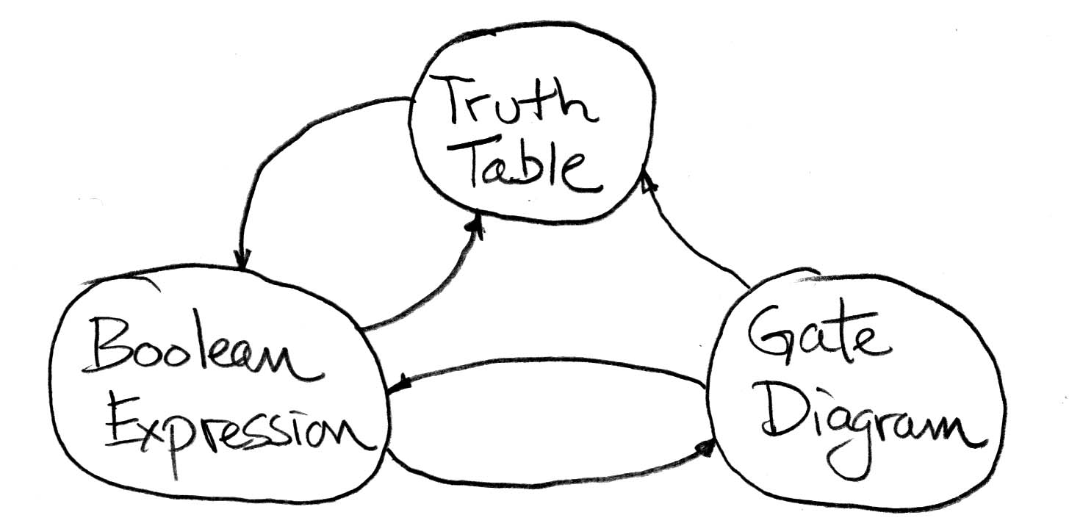
“And In conclusion…”
Pipeline big-delay CL for faster clock
Finite State Machines extremely useful
You’ll see them again in 150, 152 & 164
Use this table and techniques we learned to transform from 1 to another

