Slide 1
CS 61C: Great Ideas in Computer Architecture Lecture 19: Thread-Level Parallel Processing
Krste Asanović & Randy H. Katz
http://inst.eecs.berkeley.edu/~cs61c/fa17
11/2/17
Fall 2017 - Lecture #19

Slide 2
Agenda
MIMD - multiple programs simultaneously
Threads
Parallel programming: OpenMP
Synchronization primitives
Synchronization in OpenMP
And, in Conclusion …
11/2/17
Fall 2017 - Lecture #19

Slide 3
Improving Performance
Increase clock rate f_{s}
Reached practical maximum for today’s technology
< 5GHz for general purpose computers
Lower CPI (cycles per instruction)
SIMD, “instruction level parallelism”
Perform multiple tasks simultaneously
Multiple CPUs, each executing different program
Tasks may be related
E.g. each CPU performs part of a big matrix multiplication
or unrelated
E.g. distribute different web http requests over different computers
E.g. run pptx (view lecture slides) and browser (youtube) simultaneously
Do all of the above:
High f_{s}, SIMD, multiple parallel tasks
Today’s
lecture
11/2/17
Fall 2017 - Lecture #19

Slide 4
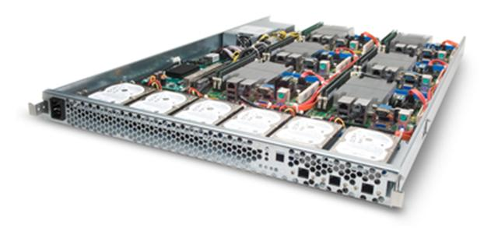
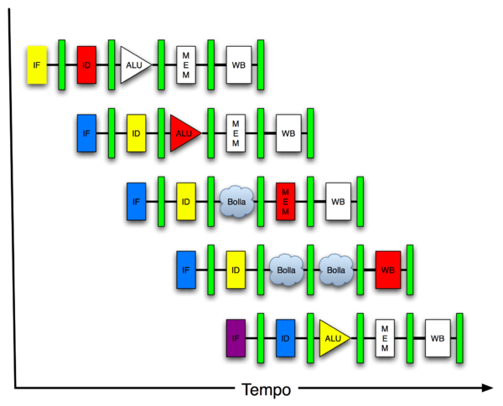
New-School Machine Structures (It’s a bit more complicated!)
Software Hardware
Parallel Requests
Assigned to computer
e.g., Search “Katz”
Parallel Threads
Assigned to core
e.g., Lookup, Ads
Parallel Instructions
>1 instruction @ one time
e.g., 5 pipelined instructions
Parallel Data
>1 data item @ one time
e.g., Add of 4 pairs of words
Hardware descriptions
All gates @ one time
Programming Languages
Warehouse Scale Computer
Smart Phone
Harness Parallelism &
Achieve High Performance
Computer
Core
…
Core
Memory (Cache)
Input/Output
Core
Projects 3 and 5!
Instruction Unit(s)
Functional
Unit(s)
A₀+B₀
A₁+B₁
A₂+B₂
A₃+B₃
Cache Memory
Logic Gates
11/2/17
Fall 2017 - Lecture #19

Slide 5
Parallel Computer Architectures
Massive array of computers,
fast communication between processors
Several separate computers,
some means for communication
(e.g., Ethernet)
GPU “graphics processing unit”
Multi-core CPU:
1 datapath in single chip
share L3 cache, memory, peripherals
Example: Hive machines
11/2/17
Fall 2017 - Lecture #19

Slide 6
Example: CPU with Two Cores
Processor “Core” 1
Control
Memory
Processor 0 Memory Accesses
Input
Datapath
PC
Registers
(ALU)
Bytes
Processor “Core” 2
Control
Processor 1 Memory Accesses
Datapath
Output
PC
Registers
(ALU)
I/O-Memory Interfaces
11/2/17
Fall 2017 - Lecture #19

Slide 7
Multiprocessor Execution Model
Each processor (core) executes its own instructions
Separate resources (not shared)
Datapath (PC, registers, ALU)
Highest level caches (e.g., 1st and 2nd)
Shared resources
Memory (DRAM)
Often 3rd level cache
Often on same silicon chip
But not a requirement
Nomenclature
“Multiprocessor Microprocessor”
Multicore processor
E.g., four core CPU (central processing unit)
Executes four different instruction streams simultaneously
11/2/17
Fall 2017 - Lecture #19

Slide 8
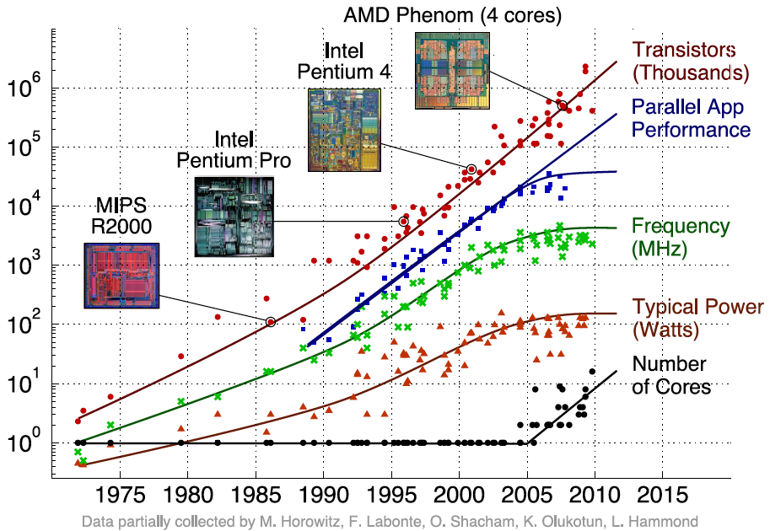
Transition to Multicore
+50% per year, ~ 100x per decade
Sequential App Performance
11/2/17
Fall 2017 - Lecture #19

Slide 9
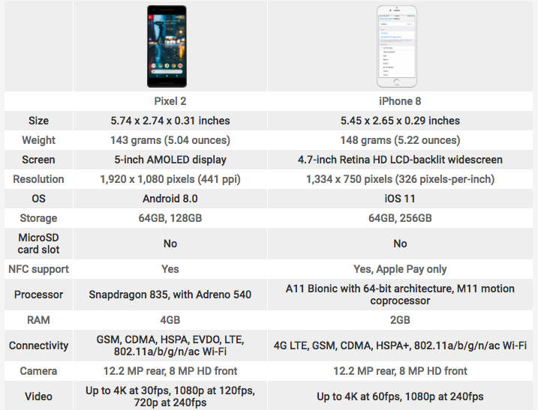
Pixel 2 vs. iPhone 8
11/2/17
Fall 2017 - Lecture #19

Slide 10
Pixel 2 vs. iPhone 8
2.35Ghz + 1.9Ghz, 64Bit Octa-Core
ALUs
nm
MHz
GFlops
11/2/17
Fall 2017 - Lecture #19
Notes:
Dhrystone MIPS (Million Instructions per Second), or DMIPS, is a measure of computer performance relative to the performance of the DEC VAX 11/780 minicomputer of the 1970s.
Adreno GPU: 256 ALUs, 10 nm, 710 Mhz, 567 GFlops

Slide 11
Pixel 2 vs. iPhone 8
11/2/17
Fall 2017 - Lecture #19

Slide 12
Pixel 2 vs. iPhone 8
11/2/17
Fall 2017 - Lecture #19

Slide 13
Multiprocessor Execution Model
Shared memory
Each “core” has access to the entire memory in the processor
Special hardware keeps caches consistent (next lecture!)
Advantages:
Simplifies communication in program via shared variables
Drawbacks:
Does not scale well:
“Slow” memory shared by many “customers” (cores)
May become bottleneck (Amdahl’s Law)
Two ways to use a multiprocessor:
Job-level parallelism
Processors work on unrelated problems
No communication between programs
Partition work of single task between several cores
E.g., each performs part of large matrix multiplication
11/2/17
Fall 2017 - Lecture #19

Slide 14
Parallel Processing
It’s difficult!
It’s inevitable
Only path to increase performance
Only path to lower energy consumption (improve battery life)
In mobile systems (e.g., smart phones, tablets)
Multiple cores
Dedicated processors, e.g.,
Motion processor, image processor, neural processor in iPhone 8 + X
GPU (graphics processing unit)
Warehouse-scale computers (next week!)
Multiple “nodes”
“Boxes” with several CPUs, disks per box
MIMD (multi-core) and SIMD (e.g. AVX) in each node
11/2/17
Fall 2017 - Lecture #19

Slide 15
Potential Parallel Performance (assuming software can use it)
Year | Cores | SIMD bits /Core | Core * SIMD bits | Total, e.g. FLOPs/Cycle
2003 | 2 | 128 | 256 | 4
2005 | 4 | 128 | 512 | 8
2007 | 6 | 128 | 768 | 12
2009 | 8 | 128 | 1024 | 16
2011 | 10 | 256 | 2560 | 40
2013 | 12 | 256 | 3072 | 48
2015 | 14 | 512 | 7168 | 112
2017 | 16 | 512 | 8192 | 128
2019 | 18 | 1024 | 18432 | 288
2021 | 20 | 1024 | 20480 | 320
MIMD
SIMD
MIMD & SIMD
+2/
2yrs
2X/
4yrs
12
years
2.5X
8X
20X
20 x in 12 years
20^{1/12} = 1.28 x → 28% per year or 2x every 3 years!
IF (!) we can use it
11/2/17
Fall 2017 - Lecture #19

Slide 16
Agenda
MIMD - multiple programs simultaneously
Threads
Parallel programming: OpenMP
Synchronization primitives
Synchronization in OpenMP
And, in Conclusion …
11/2/17
Fall 2017 - Lecture #19

Slide 17
Programs Running on my Computer
PID TTY TIME CMD
220 ?? 0:04.34 /usr/libexec/UserEventAgent (Aqua)
222 ?? 0:10.60 /usr/sbin/distnoted agent
224 ?? 0:09.11 /usr/sbin/cfprefsd agent
229 ?? 0:04.71 /usr/sbin/usernoted
230 ?? 0:02.35 /usr/libexec/nsurlsessiond
232 ?? 0:28.68 /System/Library/PrivateFrameworks/CalendarAgent.framework/Executables/CalendarAgent
234 ?? 0:04.36 /System/Library/PrivateFrameworks/GameCenterFoundation.framework/Versions/A/gamed
235 ?? 0:01.90 /System/Library/CoreServices/cloudphotosd.app/Contents/MacOS/cloudphotosd
236 ?? 0:49.72 /usr/libexec/secinitd
239 ?? 0:01.66 /System/Library/PrivateFrameworks/TCC.framework/Resources/tccd
240 ?? 0:12.68 /System/Library/Frameworks/Accounts.framework/Versions/A/Support/accountsd
241 ?? 0:09.56 /usr/libexec/SafariCloudHistoryPushAgent
242 ?? 0:00.27 /System/Library/PrivateFrameworks/CallHistory.framework/Support/CallHistorySyncHelper
243 ?? 0:00.74 /System/Library/CoreServices/mapspushd
244 ?? 0:00.79 /usr/libexec/fmfd
246 ?? 0:00.09 /System/Library/PrivateFrameworks/AskPermission.framework/Versions/A/Resources/askpermissiond
248 ?? 0:01.03 /System/Library/PrivateFrameworks/CloudDocsDaemon.framework/Versions/A/Support/bird
249 ?? 0:02.50 /System/Library/PrivateFrameworks/IDS.framework/identityservicesd.app/Contents/MacOS/identityservicesd
250 ?? 0:04.81 /usr/libexec/secd
254 ?? 0:24.01 /System/Library/PrivateFrameworks/CloudKitDaemon.framework/Support/cloudd
258 ?? 0:04.73 /System/Library/PrivateFrameworks/TelephonyUtilities.framework/callservicesd
267 ?? 0:02.15 /System/Library/CoreServices/AirPlayUIAgent.app/Contents/MacOS/AirPlayUIAgent --launchd
271 ?? 0:03.91 /usr/libexec/nsurlstoraged
274 ?? 0:00.90 /System/Library/PrivateFrameworks/CommerceKit.framework/Versions/A/Resources/storeaccountd
282 ?? 0:00.09 /usr/sbin/pboard
283 ?? 0:00.90 /System/Library/PrivateFrameworks/InternetAccounts.framework/Versions/A/XPCServices/com.apple.internetaccounts.xpc/Contents/MacOS/com.apple.internetaccounts
285 ?? 0:04.72 /System/Library/Frameworks/ApplicationServices.framework/Frameworks/ATS.framework/Support/fontd
291 ?? 0:00.25 /System/Library/Frameworks/Security.framework/Versions/A/Resources/CloudKeychainProxy.bundle/Contents/MacOS/CloudKeychainProxy
292 ?? 0:09.54 /System/Library/CoreServices/CoreServicesUIAgent.app/Contents/MacOS/CoreServicesUIAgent
293 ?? 0:00.29 /System/Library/PrivateFrameworks/CloudPhotoServices.framework/Versions/A/Frameworks/CloudPhotoServicesConfiguration.framework/Versions/A/XPCServices/com.apple.CloudPhotosConfiguration.xpc/Contents/MacOS/com.apple.CloudPhotosConfiguration
297 ?? 0:00.84 /System/Library/PrivateFrameworks/CloudServices.framework/Resources/com.apple.sbd
302 ?? 0:26.11 /System/Library/CoreServices/Dock.app/Contents/MacOS/Dock
303 ?? 0:09.55 /System/Library/CoreServices/SystemUIServer.app/Contents/MacOS/SystemUIServer
… 156 total at this moment
How does my laptop do this?
Imagine doing 156 assignments all at the same time!
ps -x
11/2/17
Fall 2017 - Lecture #19

Slide 18
Threads
Sequential flow of instructions that performs some task
Up to now we just called this a “program”
Each thread has:
Dedicated PC (program counter)
Separate registers
Accesses the shared memory
Each physical core provides one (or more)
Hardware threads that actively execute instructions
Each executes one “hardware thread”
Operating system multiplexes multiple
Software threads onto the available hardware threads
All threads except those mapped to hardware threads are waiting
11/2/17
Fall 2017 - Lecture #19

Slide 19
Operating System Threads
Give illusion of many “simultaneously” active threads
Multiplex software threads onto hardware threads:
Switch out blocked threads (e.g., cache miss, user input, network access)
Timer (e.g., switch active thread every 1 ms)
Remove a software thread from a hardware thread by
Interrupting its execution
Saving its registers and PC to memory
Start executing a different software thread by
Loading its previously saved registers into a hardware thread’s registers
Jumping to its saved PC
11/2/17
Fall 2017 - Lecture #19

Slide 20
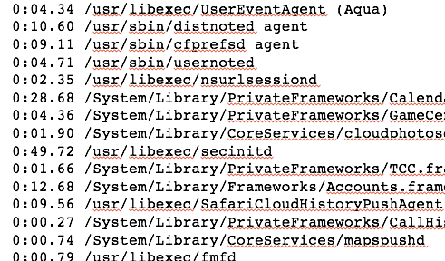
Example: Four Cores
Thread pool:
List of threads competing for processor
OS maps threads to cores and schedules
logical (software) threads
Core 1
Core 2
Core 3
Core 4
Each “Core” actively runs one instruction stream at a time
11/2/17
Fall 2017 - Lecture #19

Slide 21
Multithreading
Typical scenario:
Active thread encounters cache miss
Active thread waits ～ 1000 cycles for data from DRAM
→ switch out and run different thread until data available
Problem
Must save current thread state and load new thread state
PC, all registers (could be many, e.g. AVX)
→ must perform switch in ≪1000 cycles
Can hardware help?
Moore’s Law: transistors are plenty
11/2/17
Fall 2017 - Lecture #19

Slide 22
Hardware Assisted Software Multithreading
Processor (1 Core, 2 Threads)
Memory
Control
Input
Datapath
PC 0
PC 1
Registers 0
Registers 1
(ALU)
Bytes
Two copies of PC and Registers inside processor hardware
Looks identical to two processors to software (hardware thread 0, hardware thread 1)
Hyperthreading:
Both threads can be active simultaneously
Output
I/O-Memory Interfaces

Slide 23
Multithreading
Logical threads
≈ 1% more hardware, ≈ 10% (?) better performance
Separate registers
Share datapath, ALU(s), caches
Multicore
=> Duplicate Processors
≈50% more hardware, ≈2X better performance?
Modern machines do both
Multiple cores with multiple threads per core
11/2/17
Fall 2017 - Lecture #19

Slide 24
Randy’s Laptop
$ sysctl -a | grep hw
hw.physicalcpu: 2
hw.logicalcpu: 4
hw.l1icachesize: 32,768
hw.l1dcachesize: 32,768
hw.l2cachesize: 262,144
hw.l3cachesize: 4,194,304
2 Cores
4 Threads total
11/2/17
Fall 2017 - Lecture #19

Slide 25
Example: 6 Cores, 24 Logical Threads
Thread pool:
List of threads competing for processor
OS maps threads to cores and schedules
logical (software) threads
Core 1
Core 2
Core 3
Core 4
Core 5
Core 6
Thread 1
Thread 1
Thread 1
Thread 1
Thread 1
Thread 1
Thread 2
Thread 2
Thread 2
Thread 2
Thread 2
Thread 2
Thread 3
Thread 3
Thread 3
Thread 3
Thread 3
Thread 3
Thread 4
Thread 4
Thread 4
Thread 4
Thread 4
Thread 4
4 Logical threads per core (hardware) thread
11/2/17
Fall 2017 - Lecture #19

Slide 26
Break!
11/2/17
Fall 2017 - Lecture #19

Slide 27
Agenda
MIMD - multiple programs simultaneously
Threads
Parallel programming: OpenMP
Synchronization primitives
Synchronization in OpenMP
And, in Conclusion …
11/2/17
Fall 2017 - Lecture #19

Slide 28
Languages Supporting Parallel Programming
ActorScript | Concurrent Pascal | JoCaml | Orc
Ada | Concurrent ML | Join | Oz
Afnix | Concurrent Haskell | Java | Pict
Alef | Curry | Joule | Reia
Alice | CUDA | Joyce | SALSA
APL | E | LabVIEW | Scala
Axum | Eiffel | Limbo | SISAL
Chapel | Erlang | Linda | SR
Cilk | Fortan 90 | MultiLisp | Stackless Python
Clean | Go | Modula-3 | SuperPascal
Clojure | Io | Occam | VHDL
Concurrent C | Janus | occam-π | XC
Which one to pick?
11/2/17
Fall 2017 - Lecture #19

Slide 29
Why So Many Parallel Programming Languages?
Why “intrinsics”?
TO Intel: fix your #()&$! Compiler!
It’s happening ... but
SIMD features are continually added to compilers (Intel, gcc)
Intense area of research
Research progress:
20+ years to translate C into good (fast!) assembly
How long to translate C into good (fast!) parallel code?
General problem is very hard to solve
Present state: specialized solutions for specific cases
Your opportunity to become famous!
11/2/17
Fall 2017 - Lecture #19

Slide 30
Parallel Programming Languages
Number of choices is indication of
No universal solution
Needs are very problem specific
E.g.,
Scientific computing/machine learning (matrix multiply)
Webserver: handle many unrelated requests simultaneously
Input / output: it’s all happening simultaneously!
Specialized languages for different tasks
Some are easier to use (for some problems)
None is particularly ”easy” to use
61C
Parallel language examples for high-performance computing
OpenMP
11/2/17
Fall 2017 - Lecture #19

Slide 31
Parallel Loops
Serial execution:
for (int i=0; i<100; i++) {
…
}
Parallel Execution:
for (int i=0; i<25; i++) { … } | for (int i=25; i<50; i++) { … } | for (int i=50; i<75; i++) { … } | for (int i=75; i<100; i++) { … }
11/2/17
Fall 2017 - Lecture #19

Slide 32
Parallel for in OpenMP
#include <omp.h>
#pragma omp parallel for
for (int i=0; i<100; i++) {
…
}
11/2/17
Fall 2017 - Lecture #19

Slide 33
OpenMP Example
$ gcc-5 -fopenmp for.c;./a.out
thread 0, i = 0
thread 1, i = 3
thread 2, i = 6
thread 3, i = 8
thread 0, i = 1
thread 1, i = 4
thread 2, i = 7
thread 3, i = 9
thread 0, i = 2
thread 1, i = 5
01 02 03 14 15 16 27 28 39 40
11/2/17
Fall 2017 - Lecture #19

Slide 34
OpenMP
C extension: no new language to learn
Multi-threaded, shared-memory parallelism
Compiler Directives, #pragma
Runtime Library Routines, #include <omp.h>
#pragma
Ignored by compilers unaware of OpenMP
Same source for multiple architectures
E.g., same program for 1 & 16 cores
Only works with shared memory
11/2/17
Fall 2017 - Lecture #19

Slide 35
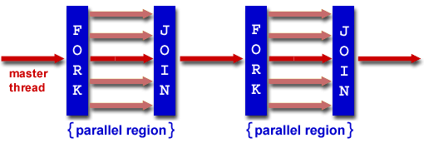
OpenMP Programming Model
Fork - Join Model:
OpenMP programs begin as single process (master thread)
Sequential execution
When parallel region is encountered
Master thread “forks” into team of parallel threads
Executed simultaneously
At end of parallel region, parallel threads ”join”, leaving only master thread
Process repeats for each parallel region
Amdahl’s Law?
11/2/17
Fall 2017 - Lecture #19

Slide 36
What Kind of Threads?
OpenMP threads are operating system (software) threads
OS will multiplex requested OpenMP threads onto available hardware threads
Hopefully each gets a real hardware thread to run on, so no OS-level time-multiplexing
But other tasks on machine compete for hardware threads!
Be “careful” (?) when timing results for Project 3!
5AM?
Job queue?
11/2/17
Fall 2017 - Lecture #19

Slide 37
Example 2: Computing π
http://openmp.org/mp-documents/omp-hands-on-SC08.pdf
11/2/17
Fall 2017 - Lecture #19

Slide 38
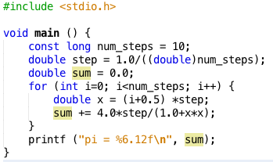
Sequential π
pi = 3.142425985001
Resembles π, but not very accurate
Let’s increase num_steps and parallelize
11/2/17
Fall 2017 - Lecture #19

Slide 39
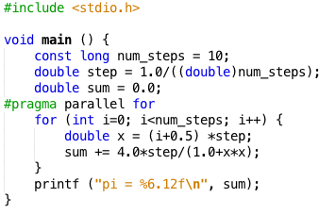
Parallelize (1) …
Problem: each threads needs access to the shared variable sum
Code runs sequentially …
11/2/17
Fall 2017 - Lecture #19

Slide 40
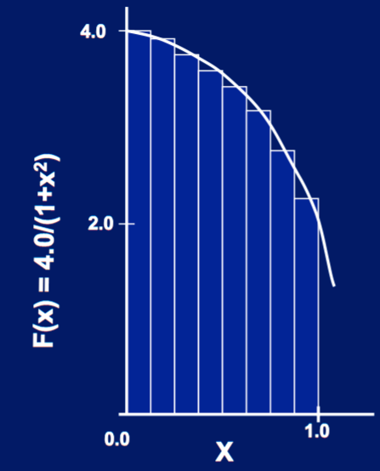
Parallelize (2) …
Compute
sum[0]and sum[1]
in parallel
Compute
sum = sum[0] + sum[1]
sequentially
sum[0]
sum[1]
11/2/17
Fall 2017 - Lecture #19

Slide 41
Parallel π
11/2/17
Fall 2017 - Lecture #19

Slide 42
Trial Run
i = 1, id = 1
i = 0, id = 0
i = 2, id = 2
i = 3, id = 3
i = 5, id = 1
i = 4, id = 0
i = 6, id = 2
i = 7, id = 3
i = 9, id = 1
i = 8, id = 0
pi = 3.142425985001
11/2/17
Fall 2017 - Lecture #19

Slide 43
Scale up: num_steps = 10⁶
pi = 3.141592653590
You verify how many digits are correct …
11/2/17
Fall 2017 - Lecture #19

Slide 44
Can We Parallelize Computing sum?
Always looking for ways to beat Amdahl’s Law …
Summation inside parallel section
Insignificant speedup in this example, but …
pi = 3.138450662641
Wrong! And value changes between runs?!
What’s going on?
11/2/17
Fall 2017 - Lecture #19

Slide 45
Peer Instruction
What are the possible values of *(x1) after executing this code by two concurrent threads?
# *(x1) = 100
lw x2,0(x1)
addi x2,x2,1
sw x2,0(x1)
Answer | *(x1)
RED | 100 or 101
GREEN | 101
ORANGE | 101 or 102
YELLOW | 100 or 101 or 102
11/2/17
Fall 2017 - Lecture #19

Slide 46
What’s Going On?
Operation is really
pi = pi + sum[id]
What if >1 threads reads current (same) value of pi, computes the sum, stores the result back to pi?
Each processor reads same intermediate value of pi!
Result depends on who gets there when
A “race” → result is not deterministic
11/2/17
Fall 2017 - Lecture #19

Slide 47
Administrivia
Homework 4 (Caches, Floating Point) due tomorrow at 11:59pm
Project 2-2 due Monday
Project Office hours that Monday will be well staffed!
Test your CPU thoroughly!
Write programs with Venus and load them into your circuit
Project 3 will be released Monday night
A two-week performance project
Can earn extra credit from the performance contest (Project 5)
Midterm scores will be released before Tuesday on Gradescope
11/2/17
Fall 2017 - Lecture #19

Slide 48
Break!
11/2/17
Fall 2017 - Lecture #19

Slide 49
Agenda
MIMD - multiple programs simultaneously
Threads
Parallel programming: OpenMP
Synchronization primitives
Synchronization in OpenMP
And, in Conclusion …
11/2/17
Fall 2017 - Lecture #19

Slide 50
Synchronization
Problem:
Limit access to shared resource to 1 actor at a time
E.g. only 1 person permitted to edit a file at a time
otherwise changes by several people get all mixed up
Solution:
Take turns:
Only one person get’s the microphone & talks at a time
Also good practice for classrooms, btw …
11/2/17
Fall 2017 - Lecture #19

Slide 51
Locks
Computers use locks to control access to shared resources
Serves purpose of microphone in example
Also referred to as “semaphore”
Usually implemented with a variable
int lock;
0 for unlocked
1 for locked
11/2/17
Fall 2017 - Lecture #19

Slide 52
Synchronization with Locks
// wait for lock released
while (lock != 0) ;
// lock == 0 now (unlocked)
// set lock
lock = 1;
// access shared resource ...
// e.g. pi
// sequential execution! (Amdahl ...)
// release lock
lock = 0;
11/2/17
Fall 2017 - Lecture #19

Slide 53
Lock Synchronization
Thread 1
Thread 2
while (lock != 0) ;
lock = 1;
// critical section
lock = 0;
while (lock != 0) ;
lock = 1;
// critical section
lock = 0;
Thread 2 finds lock not set, before thread 1 sets it
Both threads believe they got and set the lock!
Try as you like, this problem has no solution, not even at the assembly level.
Unless we introduce new instructions, that is!
11/2/17
Fall 2017 - Lecture #19

Slide 54
Hardware Synchronization
Solution:
Atomic read/write
Read & write in single instruction
No other access permitted between read and write
Note:
Must use shared memory (multiprocessing)
Common implementations:
Atomic swap of register ↔ memory
Pair of instructions for “linked” read and write
write fails if memory location has been “tampered” with after linked read
RISCV has variations of both, but for simplicity we will focus on the former
11/2/17
Fall 2017 - Lecture #19
Notes:
Interloper thread can be from same core or another core.

Slide 55
RISCV Atomic Memory Operations (AMOs)
AMOs atomically perform an operation on an operand in memory and set the destination register to the original memory value
R-Type Instruction Format: Add, And, Or, Swap, Xor, Max, Max Unsigned, Min, Min Unsigned
Load from address in rs1 to “t”
rd = ”t”, i.e., the value in memory
Store at address in rs1 the calculation “t” <operation> rs2
aq and rl insure in order execution
amoadd.w rd,rs2,(rs1):
t = M[x[rs1]];
x[rd] = t; M[x[rs1]] = t + x[rs2]
11/2/17
Fall 2017 - Lecture #19

Slide 56
RISCV Critical Section
Assume that the lock is in memory location stored in register a0
The lock is “set” if it is 1; it is “free” if it is 0 (it’s initial value)
li t0, 1 # Get 1 to set lock
Try: amoswap.w.aq t1, t0, (a0) # t1 gets old lock value
# while we set it to 1
bnez t1, Try # if it was already 1, another
# thread has the lock,
# so we need to try again
… critical section goes here …
amoswap.w.rl x0, x0, (a0) # store 0 in lock to release
11/2/17
Fall 2017 - Lecture #19

Slide 57
Lock Synchronization
Broken Synchronization
Fix (lock is at location (a0))
while (lock != 0) ;
lock = 1;
// critical section
lock = 0;
li t0, 1
Try amoswap.w.aq t1, t0, (a0)
bnez t1, Try
Locked:
# critical section
Unlock:
amoswap.w.rl x0, x0, (a0)
11/2/17
Fall 2017 - Lecture #19

Slide 58
Agenda
MIMD - multiple programs simultaneously
Threads
Parallel programming: OpenMP
Synchronization primitives
Synchronization in OpenMP
And, in Conclusion …
11/2/17
Fall 2017 - Lecture #19

Slide 59
OpenMP Locks
11/2/17
Fall 2017 - Lecture #19

Slide 60
Synchronization in OpenMP
Typically are used in libraries of higher level parallel programming constructs
E.g. OpenMP offers $pragmas for common cases:
critical
atomic
barrier
ordered
OpenMP offers many more features
See online documentation
Or tutorial at
http://openmp.org/mp-documents/omp-hands-on-SC08.pdf
11/2/17
Fall 2017 - Lecture #19

Slide 61
OpenMP Critical Section
11/2/17
Fall 2017 - Lecture #19

Slide 62
The Trouble with Locks …
… is dead-locks
Consider 2 cooks sharing a kitchen
Each cooks a meal that requires salt and pepper (locks)
Cook 1 grabs salt
Cook 2 grabs pepper
Cook 1 notices s/he needs pepper
it’s not there, so s/he waits
Cook 2 realizes s/he needs salt
it’s not there, so s/he waits
A not so common cause of cook starvation
But deadlocks are possible in parallel programs
Very difficult to debug
malloc/free is easy …
11/2/17
Fall 2017 - Lecture #19

Slide 63
Agenda
MIMD - multiple programs simultaneously
Threads
Parallel programming: OpenMP
Synchronization primitives
Synchronization in OpenMP
And, in Conclusion …
11/2/17
Fall 2017 - Lecture #19

Slide 64
And, in Conclusion, …
Sequential software execution speed is limited
Parallel processing is the only path to higher performance
SIMD: instruction level parallelism
Implemented in all high performance CPUs today (x86, ARM, …)
Partially supported by compilers
MIMD: thread level parallelism
Multicore processors
Supported by Operating Systems (OS)
Requires programmer intervention to exploit at single program level
E.g. OpenMP
SIMD & MIMD for maximum performance
Synchronization
Requires hardware support: specialized assembly instructions
Typically use higher-level support
Beware of deadlocks
11/2/17
Fall 2017 - Lecture #19

