Slide 1
CS 61C: Great Ideas in Computer Architecture Virtual Machines/Programming Contest
Instructor:
Randy H. Katz
http://inst.eecs.Berkeley.edu/~cs61c/fa13

Slide 2
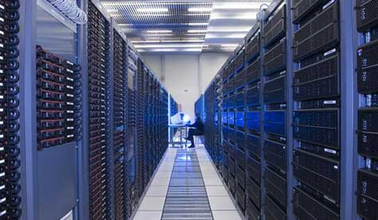
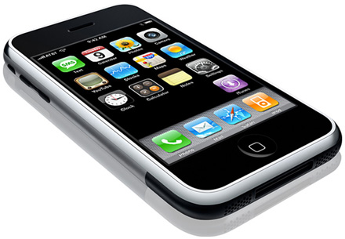
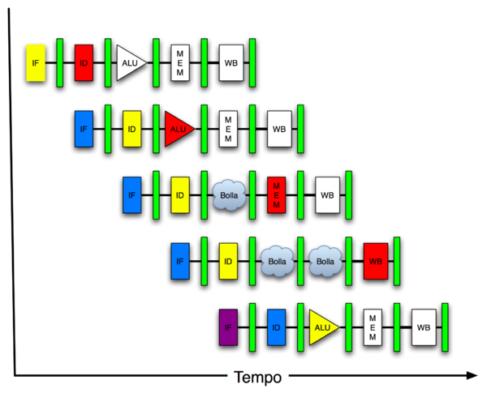
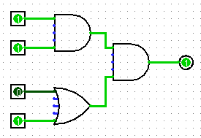
Part II: You Are Here!
Software Hardware
Parallel Requests
Assigned to computer
e.g., Search “Katz”
Parallel Threads
Assigned to core
e.g., Lookup, Ads
Parallel Instructions
>1 instruction @ one time
e.g., 5 pipelined instructions
Parallel Data
>1 data item @ one time
e.g., Add of 4 pairs of words
Hardware descriptions
All gates @ one time
Programming Languages
Warehouse Scale Computer
Smart Phone
Harness Parallelism &
Achieve High Performance
Computer
Core
…
Core
Memory (Cache)
Input/Output
Core
Today’s
Lecture
Instruction Unit(s)
Functional
Unit(s)
A₀+B₀
A₁+B₁
A₂+B₂
A₃+B₃
Main Memory
Logic Gates

Slide 3
Agenda
Virtual Memory Review
Virtual Machines
Administrivia
Programming Contest
And, in Conclusion …

Slide 4
Agenda
Virtual Memory Review
Virtual Machines
Administrivia
Programming Contest
And, in Conclusion …

Slide 5
Modern Virtual Memory Systems Illusion of a large, private, uniform store
Protection & Privacy
several users, each with their private address space and one or more shared address spaces
page table ≡ name space
Demand Paging
Provides the ability to run programs larger than the primary memory
Hides differences in machine configurations
The price is address translation on
each memory reference
OS
user_{i}
Swapping
Store
Primary
Memory
VA
mapping
PA
TLB
Notes:
Portability on machines with different memory configurations.

Slide 6
Paged Memory Systems
Processor-generated address can be split into:
page number offset
A page table contains the physical address of the base of each page
1
0
0
0
1
1
Physical Memory
2
2
3
3
3
Address Space
of User-1
Page Table
of User-1
2
Page tables make it possible to store the pages of a program non-contiguously.
Notes:
Relaxes the contiguous allocation requirement.

Slide 7
Hierarchical Page Table
Virtual Address
31
22
21
12
11
0
p1 p2 offset
10-bit
L1 index
10-bit
L2 index
offset
Root of the Current
Page Table
p2
p1
Physical Memory
(Processor
Register)
Level 1
Page Table
Level 2
Page Tables
page in primary memory
page in secondary memory
PTE of a nonexistent page
Data Pages

Slide 8
Address Translation & Protection
Virtual Address
Virtual Page No. (VPN)
offset
Kernel/User Mode
Read/Write
Protection
Check
Address
Translation
Exception?
Physical Address
Physical Page No. (PPN)
offset
Every instruction and data access needs address
translation and protection checks
A good VM design needs to be fast (~ one cycle) and space efficient

Slide 9
Translation Lookaside Buffers (TLB)
Address translation is very expensive!
In a two-level page table, each reference becomes several memory accesses
Solution: Cache translations in TLB
TLB hit ⇒ Single-Cycle Translation
TLB miss ⇒ Page-Table Walk to refill
virtual address
VPN offset
V R W D tag PPN
(VPN = virtual page number)
(PPN = physical page number)
hit?
physical address
PPN offset
Notes:
3 memory references
2 page faults (disk accesses) + ..
Actually used in IBM before paged memory.

Slide 10
Page-Based Virtual-Memory Machine (Hardware Page-Table Walk)
Page Fault?
Protection violation?
Page Fault?
Protection violation?
Virtual Address
Virtual Address
Physical Address
Physical Address
PC
Inst. TLB
D
Decode
E
M
Data TLB
W
Inst. Cache
Data Cache
+
Miss?
Miss?
Page-Table Base Register
Hardware Page Table Walker
Physical Address
Memory Controller
Physical Address
Physical Address
Main Memory (DRAM)
Assumes page tables held in untranslated physical memory

Slide 11
Address Translation: Putting it All Together
Virtual Address
hardware
hardware or software
software
TLB
Lookup
miss
hit
Page Table
Walk
Protection
Check
the page is
∉ memory ∈ memory
denied
permitted
Page Fault
(OS loads page)
Update TLB
Protection
Fault
Physical
Address
(to cache)
Where?
SEGFAULT
Notes:
Need to restart instruction.
Soft and hard page faults.

Slide 12
Agenda
Virtual Memory Review
Virtual Machines
Administrivia
Programming Contest
And, in Conclusion …

Slide 13
Safely Sharing a Machine
Amazon Web Services allows independent tasks run on same computer
Can sell each “instance”
Can a “small” operating system (~10,000 LOC) simulate the hardware of some machine, so that
Another operating system can run in that simulated hardware?
More than one instance of that operating system run on the same hardware at the same time?
More than one different operating system can share the same hardware at the same time?
And none can access each others’ data?
Answer: Yes

Slide 14
Solution – Virtual Machine
A virtual machine provides interface identical to underlying bare hardware
I.e., all devices, interrupts, memory, etc.
Examples
IBM VM/370 (1970s technology!)
VMWare (founded by Mendel & Diane Rosenblum)
Xen (used by AWS)
Microsoft Virtual PC
Called “System Virtual Machines” vs. language interpreters (e.g., Java Virtual Machine)
Virtualization has some performance impact
Feasible with modern high-performance computers

Slide 15
Virtual Machines
Host Operating System:
OS actually running on the hardware
Together with virtualization layer, it simulates environment for …
Guest Operating System:
OS running in the simulated environment
Runs identical as if on native hardware (except performance)
Cannot change access of real system resources
Guest OS code runs in native machine ISA
The resources of the physical computer are shared to create the virtual machines
Processor scheduling by OS can create the appearance that each user has own processor

Slide 16
Virtual Machine Monitor (a.k.a. Hypervisor)
Maps virtual resources to physical resources
Memory, I/O devices, processors
VMM handles real I/O devices
Emulates generic virtual I/O devices for guest OS
Host OS must intercept attempts by Guest OS to access real I/O devices, allocate resources

Slide 17
Why Virtual Machines Popular (Again)?
Increased importance of isolation and security
Failures in security and reliability of modern OS’s
Sharing of single computer between many unrelated users
E.g., Cloud computing
Dramatic increase in performance of processors makes VM overhead acceptable

Slide 18
5 Reasons Amazon Web Services uses Virtual Machines
(Uses x86 ISA, Linux Host OS, and Xen VMM)
Allow AWS protect users from each other
Simplified SW distribution within WSC
Customers install image, AWS distributes to all instances
Can reliably “kill” a VM => control resource usage
VMs hide identity of HW => can keep selling old HW AND can introduce new more efficient HW
VM Performance not need be integer multiple of real HW
VM limiting rate of processing, network, and disk space => AWS offers many price points

Slide 19
Peer Instruction: True or False
Which statements is True about Virtual Machines?
Multiple Virtual Machines can run on one computer
Multiple Virtual Machine Monitors can run on one computer
III. The Guest OS must be the same as the Host OS
A) I only
B) II only
C) III only
D) I and II
Notes:
I is true

Slide 20
Peer Instruction: True or False
Which statements is True about Virtual Machines?
Multiple Virtual Machines can run on one computer
Multiple Virtual Machine Monitors can run on one computer
III. The Guest OS must be the same as the Host OS
A) I only
B) II only
C) III only
D) I and II
Notes:
D) 1c, 2a, 3b

Slide 21
Virtual Machine/Memory Instruction Set Support
2 modes in hardware: User and System modes
Some instruction only run in System mode
Page Table Base Register (PTBR): Page Table addr
Privileged instructions only available in system mode
Trap to system (and VMM) if executed in user mode
All physical resources only accessible using privileged instructions
Including interrupt controls, I/O registers
Renaissance of virtualization support in ISAs
Current ISAs (e.g., x86) adapting, following IBM’s path

Slide 22
Example: Timer Virtualization
In native machine (no VMM), on timer interrupt
OS suspends current process, handles interrupt, selects and resumes next process
With Virtual Machine Monitor
VMM suspends current VM, handles interrupt, selects and resumes next VM
If a VM requires timer interrupts
VMM emulates a virtual timer
Emulates interrupt for VM when physical timer interrupt occurs

Slide 23
Virtual Machine Monitor (a.k.a. Hypervisor)
Maps virtual resources to physical resources
Memory, I/O devices, processors
Guest OS code runs on native machine ISA in user mode
Traps to VMM on privileged instructions and access to protected resources
Guest OS may be different from host OS
VMM handles real I/O devices
Emulates generic virtual I/O devices for guest

Slide 24
Performance Impact of Virtual Machines?
No impact on computation bound program, since they spend ≈0 time in OS
E.g., matrix multiply
Big impact on I/O-intensive programs, since spend lots of time in OS and execute many systems calls and many privileged instructions
Although if I/O-bound => spend most time waiting for I/O device, then can hide VM overhead

Slide 25
Virtual Machines and Cores
Host OS can also limit amount of time a virtual machine uses a processor (core)
Hence, at cost of swapping registers, it can run multiple virtual machines on a single core
AWS cheapest VM was originally 2 VMs per core
Now, with faster processors, can install more VMs per core and deliver same performance or have multiple speeds of cores

Slide 26
Agenda
Virtual Memory Review
Virtual Machines
Administrivia
Programming Contest
And, in Conclusion …

Slide 27
Administrivia
Verify all HW, Lab, Midterm, and Project Grades by Friday, 12/6!
Final Exam
Friday, December 20, 8:00-11:00 RSF Fieldhouse!
Short answer, fill in the blank, multiple choice, mix and match: 100 points/minutes
Comprehensive, but concentrated on material since midterm examination
Closed book/note, open crib sheet as before, MIPS Green Card provided
Review Session, Monday, 12/9, 1-4 PM, Room 155 Dwinelle
Special consideration students, please contact

Slide 28
Administrivia
Topics for Final Exam
Cache Aware Programming/Cache Blocking
Data Level Parallelism: Intel SIMD SSE instructions and programming
Thread Parallelism: Cache Coherency + Synchronization concepts
OpenMP Programming
Hardware: Transistors to Gates
Hardware: Truth Tables to Boolean Algebra
Hardware: Synchronous System Timing and Timing Diagrams
Finite State Machines: State Diagrams and Implementation
CPU Design: Data Path Design (ALUs, Shifters, Register Files, Muxes)
CPU Design: Controller Design (FSMs for processor implementation)
Instruction Level Parallelism/Instruction Pipelining
Set Associative Caches
Dependability: ECC + RAID
Virtual Memory
X-semester issues: Great Ideas in Computer Architecture

Slide 29
Agenda
Virtual Memory Review
Virtual Machines
Administrivia
Programming Contest
And, in Conclusion …

Slide 30
Programming Contest

Slide 31
Agenda
Virtual Memory
Virtual Machines
Administrivia
Programming Contest
And, in Conclusion …

Slide 32
Agenda
Virtual Memory
Administrivia
Virtual Machines
And, in Conclusion …

Slide 33
And in Conclusion, …
Virtual Memory, Paging for Isolation and Protection, help Virtual Machines share memory
Can think of as another level of memory hierarchy, but not really used like caches are today
Not really routinely paging to disk today
Virtual Machines as even greater level of protection to allow greater level of sharing
Enables fine control, allocation, software distribution, multiple price points for Cloud Computing

