Slide 1
CS 61C: Great Ideas in Computer Architecture Exceptions/Traps/Interrupts
Instructors:
Krste Asanovic, Randy H. Katz
http://inst.eecs.Berkeley.edu/~cs61c/fa12

Slide 2
Review
Great Idea: Redundancy to Get Dependability
Spatial (extra hardware) and Temporal (retry if error)
Reliability: MTTF & Annualized Failure Rate (AFR)
Availability: % uptime (MTTF-MTTR/MTTF)
Memory
Hamming distance 2: Parity for Single Error Detect
Hamming distance 3: Single Error Correction Code + encode bit position of error
Hamming distance 4: SEC/Double Error Detection
CRC for many bit detection, Reed Solomon per disk sector for many bit error detection/correction

Slide 3
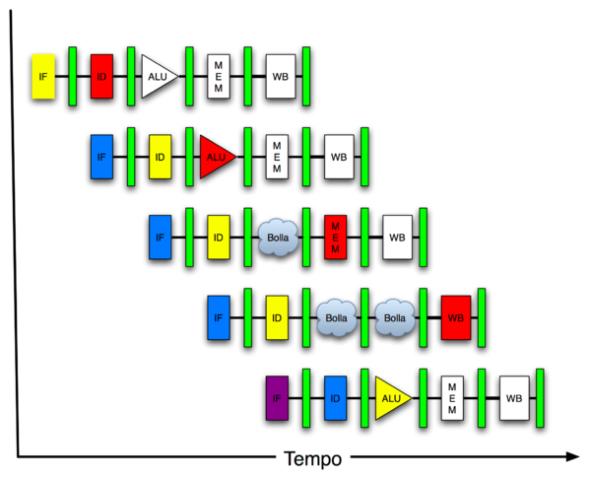
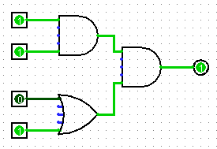
You Are Here!
Software Hardware
Parallel Requests
Assigned to computer
e.g., Search “Katz”
Parallel Threads
Assigned to core
e.g., Lookup, Ads
Parallel Instructions
>1 instruction @ one time
e.g., 5 pipelined instructions
Parallel Data
>1 data item @ one time
e.g., Add of 4 pairs of words
Hardware descriptions
All gates @ one time
Programming Languages
Warehouse Scale Computer
Smart Phone
Harness Parallelism &
Achieve High Performance
Today’s
Lecture
Computer
Core
…
Core
Memory (Cache)
Input/Output
Core
Instruction Unit(s)
Functional
Unit(s)
A₀+B₀
A₁+B₁
A₂+B₂
A₃+B₃
Main Memory
Logic Gates

Slide 4
I/O Hardware
Memory
Processor
Input/Output Interface
Enable?
Read/Write
Control
Device
Registers
Datapath
Address
Bytes
PC
Registers
Write Data
External Devices
Arithmetic & Logic Unit
(ALU)
ReadData
Processor-Memory Interface
I/O-Memory Interfaces

Slide 5
Interfacing to I/O Devices
Programmed I/O
Software on CPU reads and writes to I/O device registers to explicitly transfer I/O data
Usually “memory-mapped” where device I/O registers are given memory addresses allowing regular load and store instructions to change register contents
Also possible to have special I/O instructions (x86, IBM mainframes)
Cheap but slow, burdens CPU
DMA (Direct Memory Access)
Extra hardware on device to autonomously transfer blocks of data into and out of memory
Expensive but fast, offloads CPU

Slide 6
When to get I/O data?
Most I/O devices are much slower than CPU
Polling
Software occasionally checks I/O devices to see if data ready
How often to poll?
Too often, waste CPU time
Too little, slow I/O
What if software forgets?
Interrupts
I/O device requests attention when something to do!

Slide 7
I/O Hardware
Interrupt Request Signal
Memory
Processor
Input/Output Interface
Enable?
Read/Write
Control
Device
Registers
Datapath
Address
Bytes
PC
Registers
Write Data
External Devices
Arithmetic & Logic Unit
(ALU)
ReadData
Processor-Memory Interface
I/O-Memory Interfaces

Slide 8
Invoking the interrupt handler
An I/O device requests attention by asserting one of the prioritized interrupt request signals
Signals driven from external hardware
When the processor decides to process the interrupt
Stops the current program at instruction I_{i}, completing all the instructions up to I_{i-1}
Saves the PC of instruction I_{i} in a special register
In MIPS, called EPC (Exception Program Counter)
Disables interrupts and transfers control to a designated interrupt handler, switching CPU to kernel mode
Most CPUs have a privileged execution mode to support operating systems, allowing software to do more than in regular user mode
After handling interrupt
Interrupt handler restores user program state and jumps back to current program in regular user mode using a special instruction
In MIPS, instruction is called RFE (Return From Exception)

Slide 9
Interrupts: altering the normal flow of control
I_{i-1}
HI₁
interrupt
handler
program
I_{i}
HI₂
I_{i+1}
HI_{n}
An external or internal event that needs to be processed by another (system) program. The event is usually unexpected or rare from program’s point of view.

Slide 10
Types of Interrupts
Interrupt: an event that requests the attention of the processor
Asynchronous: an external event
input/output device service-request
timer expiration
power disruptions, hardware failure
Synchronous: an internal event (a.k.a. traps or exceptions)
undefined opcode, privileged instruction
arithmetic overflow, FPU exception
misaligned memory access
virtual memory exceptions: page faults, TLB misses, protection violations
system calls, e.g., calling functions in operating system kernel

Slide 11
History of Exception Handling
First system with exceptions was Univac-I, 1951
Arithmetic overflow would either
1. trigger the execution a two-instruction fix-up routine at address 0, or
2. at the programmer's option, cause the computer to stop
Later Univac 1103, 1955, modified to add external interrupts
Used to gather real-time wind tunnel data
First system with I/O interrupts was DYSEAC, 1954
Had two program counters, and I/O signal caused switch between two PCs
Also, first system with DMA (direct memory access by I/O device)
[Courtesy Mark Smotherman]

Slide 12
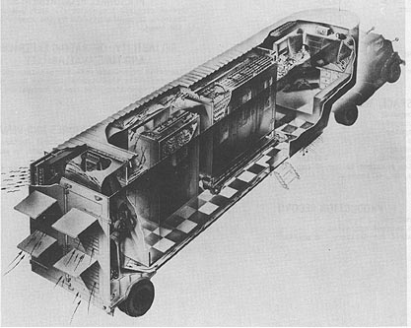
DYSEAC, first mobile computer!
Carried in two tractor trailers, 12 tons + 8 tons
Built for US Army Signal Corps
[Courtesy Mark Smotherman]

Slide 13
Interrupt Handler (software inside operating system)
Saves EPC before enabling interrupts to allow nested interrupts
need an instruction to move EPC into GPRs
need a way to mask further interrupts at least until EPC can be saved
Needs to read a status register that indicates the cause of the interrupt
Uses a special indirect jump instruction RFE (return-from-exception) which
enables interrupts
restores the processor to the user mode
restores hardware status and control state

Slide 14
Administrivia
Project 3 regrade requests – DON’T EMAIL INSTRUCTORS
Email proj3.1regrade@gmail.com or proj3.2regrade@gmail.com
See Piazza posting for more details

Slide 15
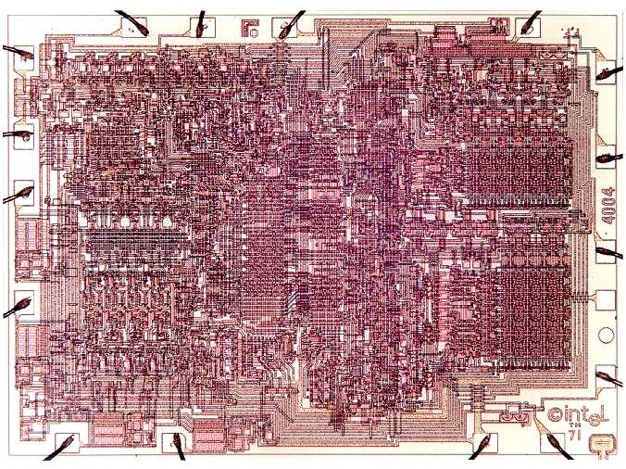
CS61C in the News: Intel 4004, 41 years old yesterday
First microprocessor
4-bit accumulator architecture
8μm pMOS
2,300 transistors
3 x 4 mm²
750kHz clock
8-16 cycles/inst.

Slide 16
CS61C In the News: “Texas Instruments Cuts 1,700 Jobs and Winds Down Tablet Chips”, NY Times 11/14/2012
“Texas Instruments is eliminating 1,700 jobs, as it winds down its mobile processor business to focus on chips for more profitable markets like cars and home appliances. Texas Instruments said in September it would halt costly investments in the increasingly competitive smartphone and tablet chip business, leading Wall Street to speculate that part of the company's processor unit, called OMAP, could be sold. The layoffs are equivalent to nearly 5 percent of the Austin, Texas-based company's global workforce.
TI has been under pressure in mobile processors, where it has lost ground to rival Qualcomm Inc. Leading smartphone makers Apple Inc and Samsung Electronics Co Ltd have been developing their own chips instead of buying them from suppliers like TI. Instead of competing in phones and tablets, TI wants to sell its OMAP processors in markets that require less investment, like industrial clients like carmakers. TI is expected to continue selling existing tablet and phone processors for products like Amazon.Com Inc's Kindle tablets for as long as demand remains, but stop developing new chips.”
[Rumors of Amazon being interested in buying this OMAP unit from TI ]

Slide 17
Precise Interrupts
Interrupt handler’s view of machine state is that every instruction prior to the interrupted one has completed, and no instruction after the interrupt has executed.
Instruction taking interrupt might have written some special state but can be restarted.
Implies that handler can return from interrupt by restoring user registers and jumping to EPC
Software doesn’t need to understand the pipeline of the machine!
Providing precise interrupts is tricky in a pipelined superscalar out-of-order processor!
But handling imprecise interrupts in software is even worse.

Slide 18
Synchronous Trap
A synchronous trap is caused by a particular instruction
E.g., system call, virtual memory page fault, unimplemented instruction, misaligned memory address
In general, the instruction cannot be completed and needs to be restarted after the trap has been handled
requires undoing the effect of one or more partially executed instructions
In the case of a system call trap, the instruction is considered to have been completed
a special jump instruction involving a change to privileged kernel mode

Slide 19
Exception Handling 5-Stage Pipeline
PC
Inst. Mem
D
Decode
E
M
Data Mem
W
+
PC address Exception
Illegal Opcode
Data address Exceptions
Overflow
Asynchronous Interrupts
How to handle multiple simultaneous exceptions in different pipeline stages?
How and where to handle external asynchronous interrupts?

Slide 20
Exception Handling 5-Stage Pipeline
Commit Point
PC
Inst. Mem
D
Decode
E
M
Data Mem
W
+
Illegal Opcode
Overflow
Data address Exceptions
PC address Exception
Exc
D
Exc
E
Exc
M
Cause
PC
D
PC
E
PC
M
EPC
Select Handler PC
Asynchronous
Interrupts
Kill F Stage
Kill D Stage
Kill E Stage
Kill Writeback

Slide 21
Exception Handling 5-Stage Pipeline
Hold exception flags in pipeline until commit point (M stage)
Exceptions in earlier pipe stages override later exceptions for a given instruction
Inject external interrupts at commit point (override others)
If exception at commit: update Cause and EPC registers, kill all stages, inject handler PC into fetch stage

Slide 22
Speculating on Exceptions to avoid Control Hazard
Prediction mechanism
Exceptions are rare, so simply predicting no exceptions is very accurate!
Check prediction mechanism
Exceptions detected at end of instruction execution pipeline, special hardware for various exception types
Recovery mechanism
Only write architectural state at commit point, so can throw away partially executed instructions after exception
Launch exception handler after flushing pipeline
Bypassing allows use of uncommitted instruction results by following instructions

Slide 23
Exception Pipeline Diagram
time
t0 t1 t2 t3 t4 t5 t6 t7 . . . .
(I₁) 096: ADD IF₁ ID₁ EX₁ MA₁ - overflow!
(I₂) 100: XOR IF₂ ID₂ EX₂ - -
(I₃) 104: SUB IF₃ ID₃ - - -
(I₄) 108: ADD IF₄ - - - -
(I₅) Exc. Handler code IF₅ ID₅ EX₅ MA₅ WB₅
time
t0 t1 t2 t3 t4 t5 t6 t7 . . . .
IF I₁ I₂ I₃ I₄ I₅
ID I₁ I₂ I₃ - I₅
EX I₁ I₂ - - I₅
MA I₁ - - - I₅
WB - - - - I₅
Resource
Usage

Slide 24
Summary
Asynchronous interrupts versus synchronous traps
Precise interrupts simplify software view of interrupted state
Handling exceptions is one of the most difficult parts of processor design, even though they occur infrequently
Separate “commit” from execute in design

Slide 25
Acknowledgements
These slides contain material developed and copyright by:
Arvind (MIT)
Krste Asanovic (MIT/UCB)
James Hoe (CMU)
MIT material derived from course 6.823
UCB material derived from course CS252

