Slide 1
CS 61C: Great Ideas in Computer Architecture More Cache: Set Associativity
Instructors:
Krste Asanovic, Randy H. Katz
http://inst.eecs.Berkeley.edu/~cs61c/fa12

Slide 2
Review
Big Ideas of Instruction-Level Parallelism
Pipelining, Hazards, and Stalls
Forwarding, Speculation to overcome Hazards
Multiple issue to increase performance
IPC instead of CPI
Dynamic Execution: Superscalar in-order issue, branch prediction, register renaming, out-of-order execution, in-order commit
“unroll loops in HW”, hide cache misses

Slide 3
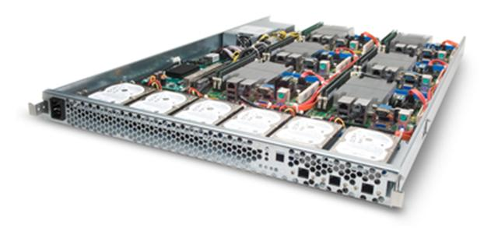
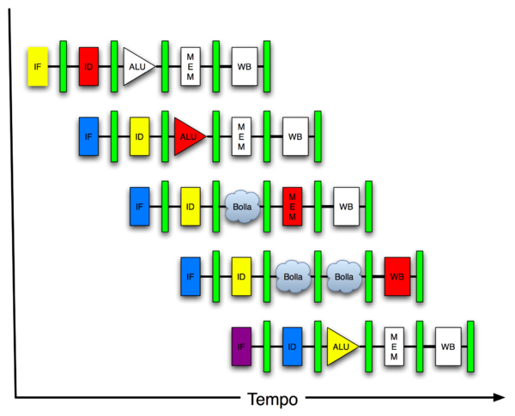
You Are Here!
Software Hardware
Parallel Requests
Assigned to computer
e.g., Search “Katz”
Parallel Threads
Assigned to core
e.g., Lookup, Ads
Parallel Instructions
>1 instruction @ one time
e.g., 5 pipelined instructions
Parallel Data
>1 data item @ one time
e.g., Add of 4 pairs of words
Hardware descriptions
All gates @ one time
Programming Languages
Warehouse Scale Computer
Smart Phone
Harness Parallelism &
Achieve High Performance
Computer
Today’s
Lecture
Core
…
Core
Memory (Cache)
Input/Output
Core
Instruction Unit(s)
Functional
Unit(s)
A₀+B₀
A₁+B₁
A₂+B₂
A₃+B₃
Main Memory
Logic Gates

Slide 4
Agenda
Cache Memory Recap
Administrivia
Set-Associative Caches
AMAT and Multilevel Cache Review
Nehalem Memory Hierarchy

Slide 5
Recap: Components of a Computer
Processor
Devices
Control
Memory
Input
Datapath
Output
Cache
Main Memory
Secondary Memory
(Disk)

Slide 6
Recap: Typical Memory Hierarchy
Take advantage of the principle of locality to present the user with as much memory as is available in the cheapest technology at the speed offered by the fastest technology
On-Chip Components
Control
Instr
Cache
Second
Level
Cache
(SRAM)
Secondary
Memory
(Disk)
Main
Memory
(DRAM)
Datapath
Data
Cache
RegFile
Speed (cycles): ½’s 1’s 10’s 100’s 10,000’s
Size (bytes): 100’s 10K’s M’s G’s T’s
Cost: highest lowest
Notes:
Instead, the memory system of a modern computer consists of a series of black boxes ranging from the fastest to the slowest.
Besides variation in speed, these boxes also varies in size (smallest to biggest) and cost.
What makes this kind of arrangement work is one of the most important principle in computer design. The principle of locality. The principle of locality states that programs access a relatively small portion of the address space at any instant of time.
The design goal is to present the user with as much memory as is available in the cheapest technology (points to the disk).
While by taking advantage of the principle of locality, we like to provide the user an average access speed that is very close to the speed that is offered by the fastest technology.
(We will go over this slide in detail in the next lectures on caches).

Slide 7
Recap: Cache Performance and Average Memory Access Time (AMAT)
CPU time = IC × CPI × CC = IC × (CPI_{ideal} + Memory-stall cycles) × CC Memory-stall cycles = Read-stall cycles + Write-stall cycles
AMAT is the average time to access memory considering both hits and misses
AMAT = Time for a hit + Miss rate x Miss penalty
CPI_{stall}
Read-stall cycles = reads/program × read miss rate × read miss penalty
Write-stall cycles = (writes/program × write miss rate × write miss penalty)
+ write buffer stalls
Notes:
Reasonable write buffer depth (e.g., four or more words) and a memory capable of accepting writes at a rate that significantly exceeds the average write frequency means write buffer stalls are small

Slide 8
Improving Cache Performance
Reduce the time to hit in the cache
E.g., Smaller cache, direct-mapped cache, special tricks for handling writes
Reduce the miss rate
E.g., Bigger cache, larger blocks
More flexible placement (increase associativity)
Reduce the miss penalty
E.g., Smaller blocks or critical word first in large blocks, special tricks for handling writes, faster/higher bandwidth memories
Use multiple cache levels

Slide 9
Sources of Cache Misses: The 3Cs
Compulsory (cold start or process migration, 1st reference):
First access to block impossible to avoid; small effect for long running programs
Solution: increase block size (increases miss penalty; very large blocks could increase miss rate)
Capacity:
Cache cannot contain all blocks accessed by the program
Solution: increase cache size (may increase access time)
Conflict (collision):
Multiple memory locations mapped to the same cache location
Solution 1: increase cache size
Solution 2: increase associativity (may increase access time)
Notes:
(Capacity miss) That is the cache misses are due to the fact that the cache is simply not large enough to contain all the blocks that are accessed by the program.
The solution to reduce the Capacity miss rate is simple: increase the cache size.
Here is a summary of other types of cache miss we talked about.
First is the Compulsory misses. These are the misses that we cannot avoid. They are caused when we first start the program.
Then we talked about the conflict misses. They are the misses that caused by multiple memory locations being mapped to the same cache location.
There are two solutions to reduce conflict misses. The first one is, once again, increase the cache size. The second one is to increase the associativity.
For example, say using a 2-way set associative cache instead of directed mapped cache.
But keep in mind that cache miss rate is only one part of the equation. You also have to worry about cache access time and miss penalty. Do NOT optimize miss rate alone.
Finally, there is another source of cache miss we will not cover today. Those are referred to as invalidation misses caused by another process, such as IO , update the main memory so you have to flush the cache to avoid inconsistency between memory and cache.
+2 = 43 min. (Y:23)

Slide 10
Reducing Cache Misses
Allow more flexible block placement
Direct mapped $: memory block maps to exactly one cache block
Fully associative $: allow a memory block to be mapped to any cache block
Compromise: divide $ into sets, each of which consists of n “ways” (n-way set associative) to place memory block
Memory block maps to unique set determined by index field and is placed in any of the n-ways of that set
Calculation: (block address) modulo (# sets in the cache)
Notes:
All of the tags of all of the elements of the set must be searched for a match.

Slide 11
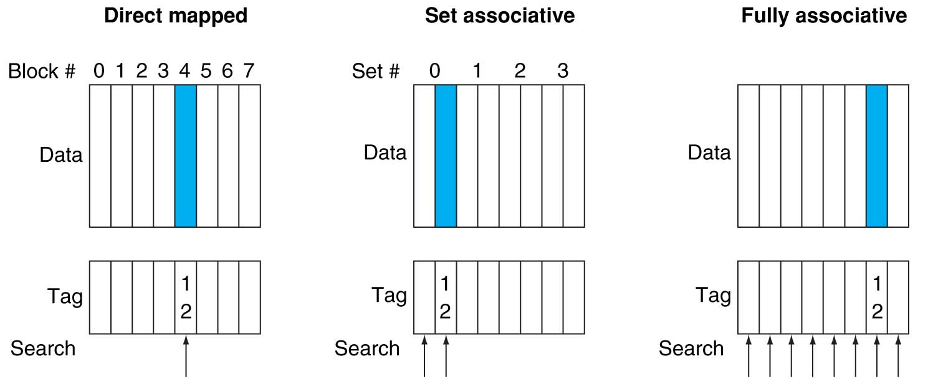
Alternative Block Placement Schemes
DM placement: mem block 12 in 8 block cache: only one cache block where mem block 12 can be found—(12 modulo 8) = 4
SA placement: four sets x 2-ways (8 cache blocks), memory block 12 in set (12 mod 4) = 0; either element of the set
FA placement: mem block 12 can appear in any cache blocks

Slide 12
Example: 4-Word Direct-Mapped $ Worst-Case Reference String
Consider the main memory word reference string
0 4 0 4 0 4 0 4
Start with an empty cache - all blocks initially marked as not valid
0
4
0
4
0
4
0
4
Notes:
For class handout

Slide 13
Example: 4-Word Direct-Mapped $ Worst-Case Reference String
Consider the main memory word reference string
0 4 0 4 0 4 0 4
Start with an empty cache - all blocks initially marked as not valid
0
miss
01
4
miss
00
0
miss
01
4
miss
4
4
0
00 Mem(0)
00 Mem(0)
01 Mem(4)
00 Mem(0)
00
0
miss
0
01
4
miss
4
00
0
miss
0
01
4
miss
4
01 Mem(4)
00 Mem(0)
01 Mem(4)
00 Mem(0)
8 requests, 8 misses
Ping pong effect due to conflict misses - two memory locations that map into the same cache block
Notes:
For class handout

Slide 14
Example: 2-Way Set Associative $ (4 words = 2 sets x 2 ways per set)
Main Memory
0000xx
0001xx
0010xx
0011xx
0100xx
0101xx
0110xx
0111xx
1000xx
1001xx
1010xx
1011xx
1100xx
1101xx
1110xx
1111xx
One word blocks
Two low order bits define the byte in the word (32b words)
Cache
Way
Set
V
Tag
Data
0
0
1
0
1
1
Q: How do we find it?
Use next 1 low order memory address bit to determine which cache set (i.e., modulo the number of sets in the cache)
Q: Is it there?
Compare all the cache tags in the set to the high order 3 memory address bits to tell if the memory block is in the cache
Notes:
For lecture
This picture is as opposed to
Way 0
both red Set 0
Way 1
------------------------------------
Way 0
both green Set 1
Way 1

Slide 15
Example: 4 Word 2-Way SA $ Same Reference String
Consider the main memory word reference string
0 4 0 4 0 4 0 4
Start with an empty cache - all blocks initially marked as not valid
0
4
0
4
Notes:
For class handout

Slide 16
Example: 4-Word 2-Way SA $ Same Reference String
Consider the main memory word reference string
0 4 0 4 0 4 0 4
Start with an empty cache - all blocks initially marked as not valid
0
miss
4
miss
0
hit
4
hit
000 Mem(0)
000 Mem(0)
000 Mem(0)
000 Mem(0)
010 Mem(4)
010 Mem(4)
010 Mem(4)
8 requests, 2 misses
Solves the ping pong effect in a direct mapped cache due to conflict misses since now two memory locations that map into the same cache set can co-exist!
Notes:
For lecture
Another sample string to try 0 1 2 3 0 8 11 0 3

Slide 17
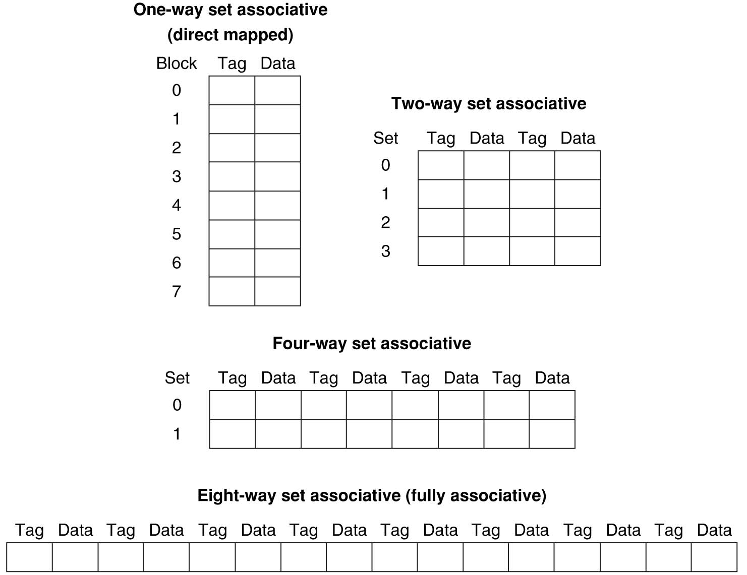
Example: Eight-Block Cache with Different Organizations
Total size of $ in blocks is equal to number of sets x associativity. For fixed $ size, increasing associativity decreases number of sets while increasing number of elements per set. With eight blocks, an 8-way set-associative $ is same as a fully associative $.

Slide 18
Four-Way Set-Associative Cache
2⁸ = 256 sets each with four ways (each with one block)
31 30 . . . 13 12 11 . . . 2 1 0
Byte offset
Tag
22
8
Index
Index
V
Tag
Data
V
Tag
Data
V
Tag
Data
V
Tag
Data
0
1
2
.
.
.
253
254
255
0
1
2
.
.
.
253
254
255
0
1
2
.
.
.
253
254
255
0
1
2
.
.
.
253
254
255
Way 0
Way 1
Way 2
Way 3
32
4x1 select
Hit
Data
Notes:
This is called a 4-way set associative cache because there are four cache entries for each cache index. Essentially, you have four direct mapped cache working in parallel.
This is how it works: the cache index selects a set from the cache. The four tags in the set are compared in parallel with the upper bits of the memory address.
If no tags match the incoming address tag, we have a cache miss.
Otherwise, we have a cache hit and we will select the data from the way where the tag matches occur.
This is simple enough. What is its disadvantages?
+1 = 36 min. (Y:16)

Slide 19
Flashcard Quiz: For fixed capacity and fixed block size, how does increasing associativity effect AMAT?
Increases hit time, decreases miss rate
Decreases hit time, decreases miss rate
Increases hit time, increases miss rate
Decreases hit time, decreases miss rate

Slide 20
Range of Set-Associative Caches
For a fixed-size cache, each increase by a factor of two in associativity doubles the number of blocks per set (i.e., the number or ways) and halves the number of sets – decreases the size of the index by 1 bit and increases the size of the tag by 1 bit
Tag
Index
Block offset
Byte offset
Notes:
For class handout

Slide 21
Range of Set-Associative Caches
For a fixed-size cache, each increase by a factor of two in associativity doubles the number of blocks per set (i.e., the number or ways) and halves the number of sets – decreases the size of the index by 1 bit and increases the size of the tag by 1 bit
Used for tag compare
Selects the set
Selects the word in the block
Tag
Index
Block offset
Byte offset
Increasing associativity
Decreasing associativity
Fully associative
(only one set)
Tag is all the bits except
block and byte offset
Direct mapped
(only one way)
Smaller tags, only a single comparator
Notes:
For lecture
In 2008, the greater size and power consumption of CAMs generally leads to 2-way and 4-way set associativity being built from standard SRAMs with comparators with 8-way and above being built using CAMs

Slide 22
Costs of Set-Associative Caches
When miss occurs, which way’s block selected for replacement?
Least Recently Used (LRU): one that has been unused the longest
Must track when each way’s block was used relative to other blocks in the set
For 2-way SA $, one bit per set → set to 1 when a block is referenced; reset the other way’s bit (i.e., “last used”)
N-way set-associative cache costs
N comparators (delay and area)
MUX delay (set selection) before data is available
Data available after set selection (and Hit/Miss decision). DM $: block is available before the Hit/Miss decision
In Set-Associative, not possible to just assume a hit and continue and recover later if it was a miss
Notes:
First of all, a N-way set associative cache will need N comparators instead of just one comparator (use the right side of the diagram for direct mapped cache).
A N-way set associative cache will also be slower than a direct mapped cache because of this extra multiplexer delay.
Finally, for a N-way set associative cache, the data will be available AFTER the hit/miss signal becomes valid because the hit/mis is needed to control the data MUX.
For a direct mapped cache, that is everything before the MUX on the right or left side, the cache block will be available BEFORE the hit/miss signal (AND gate output) because the data does not have to go through the comparator.
This can be an important consideration because the processor can now go ahead and use the data without knowing if it is a Hit or Miss. Just assume it is a hit.
Since cache hit rate is in the upper 90% range, you will be ahead of the game 90% of the time and for those 10% of the time that you are wrong, just make sure you can recover.
You cannot play this speculation game with a N-way set-associative cache because as I said earlier, the data will not be available to you until the hit/miss signal is valid.
+2 = 38 min. (Y:18)

Slide 23
Cache Block Replacement Policies
Random Replacement
Hardware randomly selects a cache item and throw it out
Least Recently Used
Hardware keeps track of access history
Replace the entry that has not been used for the longest time
For 2-way set-associative cache, need one bit for LRU replacement
Example of a Simple “Pseudo” LRU Implementation
Assume 64 Fully Associative entries
Hardware replacement pointer points to one cache entry
Whenever access is made to the entry the pointer points to:
Move the pointer to the next entry
Otherwise: do not move the pointer
Entry 0
Entry 1
Replacement
:
Pointer
Entry 63

Slide 24
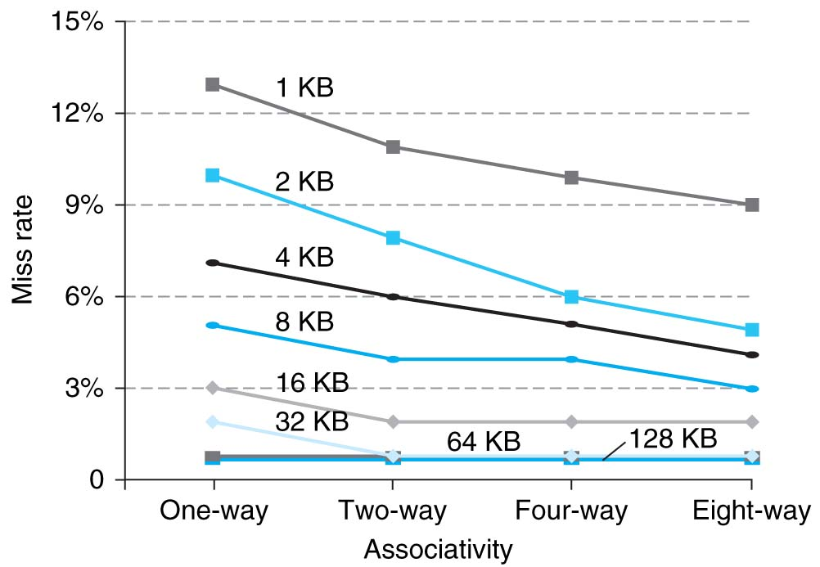
Benefits of Set-Associative Caches
Choice of DM $ or SA $ depends on the cost of a miss versus the cost of implementation
Largest gains are in going from direct mapped to 2-way (20%+ reduction in miss rate)
Notes:
As cache sizes grow, the relative improvement from associativity increases only slightly; since the overall miss rate of a larger cache is lower, the opportunity for improving the miss rate decreases and the absolute improvement in miss rate from associativity shrinks significantly.

Slide 25
Administrivia
Final Exam Monday Dec 10: 11:30-2:30
220/230/242 Hearst Gym

Slide 26
CS61c in the News: End of MIPS?
ARM, Imagination divvy up MIPS
Junko Yoshida, EE Times
11/6/2012 9:41 AM EST
NEW YORK -- MIPS Technologies, which had been on the block for almost a year, finally found buyers in a complicated deal involving Imagination Technologies and ARM.
Imagination said Tuesday (Nov. 6) it has agreed to buy MIPS' operating business for $60 million. Under terms of the deal, the U.K. graphics IP vendor will gain 160 engineers and 82 MIPS patents.
The move is viewed as a way for Imagination to beef up its CPU core expertise while defending its graphics lead. It would also position Imagination to competing against ARM, which has been pursuing its integrated CPU-GPU solution strategy.
Separately, ARM said it will lead a consortium buying the rights to the MIPS portfolio of 498 patents. The consortium, called Bridge Crossing LLC, will pay $350 million in cash to purchase the rights to the portfolio, of which ARM will contribute $167.5 million.

Slide 27
How to Calculate 3C’s using Cache Simulator
Compulsory: set cache size to infinity and fully associative, and count number of misses
Capacity: Change cache size from infinity, usually in powers of 2, and count misses for each reduction in size
16 MB, 8 MB, 4 MB, … 128 KB, 64 KB, 16 KB
Conflict: Change from fully associative to n-way set associative while counting misses
Fully associative, 16-way, 8-way, 4-way, 2-way, 1-way

Slide 28
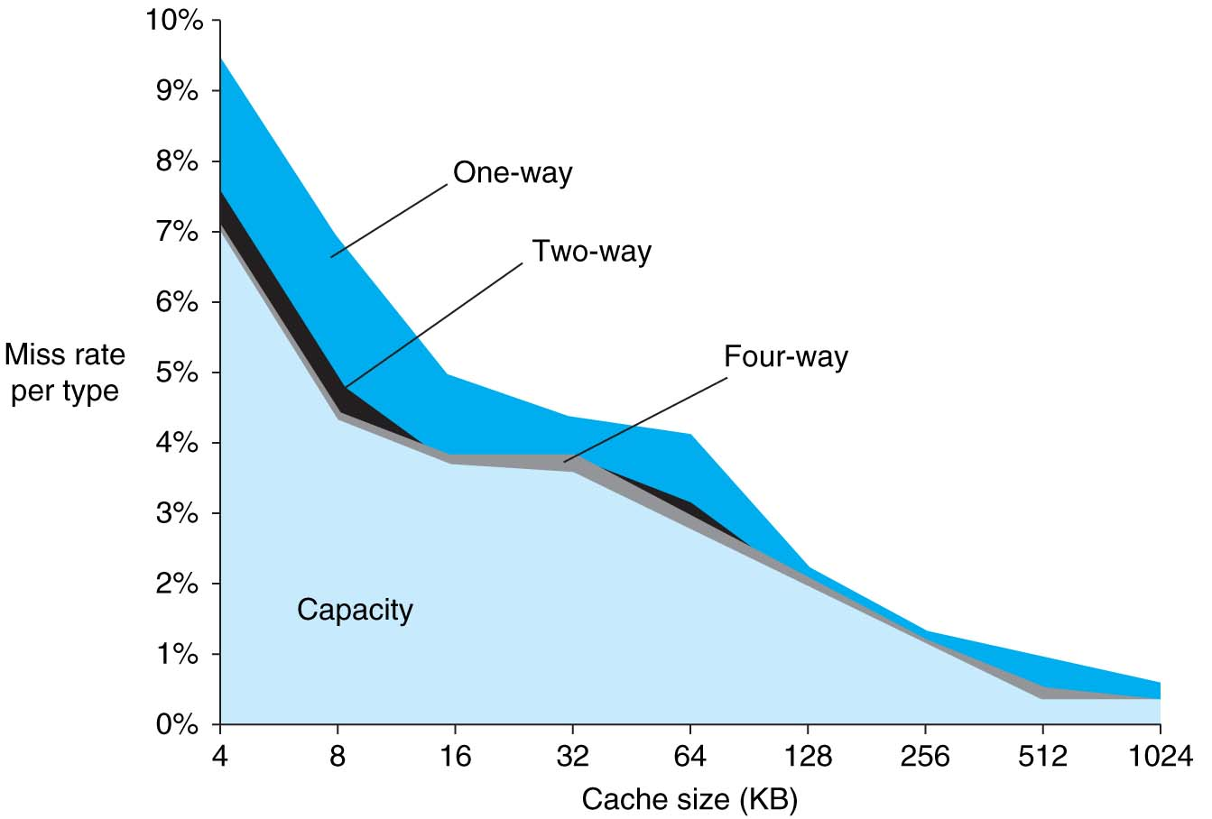
3Cs Revisted
Three sources of misses (SPEC2000 integer and floating-point benchmarks)
Compulsory misses 0.006%; not visible
Capacity misses, function of cache size
Conflict portion depends on associativity and cache size

Slide 29
Improving Cache Performance
Reduce the time to hit in the cache
E.g., Smaller cache, direct-mapped cache, special tricks for handling writes
Reduce the miss rate
E.g., Bigger cache, larger blocks
More flexible placement (increase associativity)
Reduce the miss penalty
E.g., Smaller blocks or critical word first in large blocks, special tricks for handling for writes, faster/higher bandwidth memories
Use multiple cache levels

Slide 30
Reduce AMAT
Use multiple levels of cache
As technology advances, more room on IC die for larger L1$ or for additional levels of cache (e.g., L2$ and L3$)
Normally the higher cache levels are unified, holding both instructions and data
Notes:
Also reduces cache miss penalty

Slide 31
Design Considerations
Different design considerations for L1$ and L2$
L1$ focuses on fast access: minimize hit time to achieve shorter clock cycle, e.g., smaller $
L2$, L3$ focus on low miss rate: reduce penalty of long main memory access times: e.g., Larger $ with larger block sizes/higher levels of associativity
Miss penalty of L1$ is significantly reduced by presence of L2$, so can be smaller/faster even with higher miss rate
For the L2$, fast hit time is less important than low miss rate
L2$ hit time determines L1$’s miss penalty
L2$ local miss rate >> than the global miss rate
Notes:
Global miss rate – the fraction of references that miss in all levels of a multilevel cache. The global miss rate dictates how often we must access the main memory.
Local miss rate – the fraction of references to one level of a cache that miss

Slide 32
Flashcard Quiz: In a machine with two levels of cache, what effect does increasing L1 capacity have on L2*?
Decreases L2 capacity misses
Increases L2 local miss rate
Decreases L2 compulsory misses
Decreases L2 global miss rate

Slide 33
Two Machines’ Cache Parameters
 | Intel Nehalem | AMD Barcelona
L1 cache organization & size | Split I$ and D$; 32KB for each per core; 64B blocks | Split I$ and D$; 64KB for each per core; 64B blocks
L1 associativity | 4-way (I), 8-way (D) set assoc.; ~LRU replacement | 2-way set assoc.; LRU replacement
L1 write policy | write-back, write-allocate | write-back, write-allocate
L2 cache organization & size | Unified; 256KB (0.25MB) per core; 64B blocks | Unified; 512KB (0.5MB) per core; 64B blocks
L2 associativity | 8-way set assoc.; ~LRU | 16-way set assoc.; ~LRU
L2 write policy | write-back | write-back
L2 write policy | write-back, write-allocate | write-back, write-allocate
L3 cache organization & size | Unified; 8192KB (8MB) shared by cores; 64B blocks | Unified; 2048KB (2MB) shared by cores; 64B blocks
L3 associativity | 16-way set assoc. | 32-way set assoc.; evict block shared by fewest cores
L3 write policy | write-back, write-allocate | write-back; write-allocate

Slide 34
Nehalem Memory Hierarchy Overview
32KB L1 I$
32KB L1 I$
CPU Core
4-8 Cores
CPU Core
Private L1/L2 per core
32KB L1 D$
32KB L1 D$
L3 fully inclusive of higher levels (but L2 not inclusive of L1)
256KB L2$
256KB L2$
Local memory access latency ~60ns
8MB Shared L3$
3 DDR3 DRAM Memory Controllers
QuickPath System Interconnect
Other sockets’ caches kept coherent using QuickPath messages
Each DRAM Channel is 64/72b wide at up to 1.33Gb/s
Each direction is 20b@6.4Gb/s
Notes:
Integrated Memory Controller
3 DDR3 channels per socket
Massive memory bandwidth
Memory Bandwidth scales with # of processors
Very low memory latency
Intel® QuickPath Interconnect (Intel® QPI)
New point-to-point interconnect
Socket to socket connections
Socket to chipset connections
Build scalable solutions
Up to 6.4 GT/sec (12.8 GB/sec)
Bidirectional (=> 25.6 GB/sec)

Slide 35
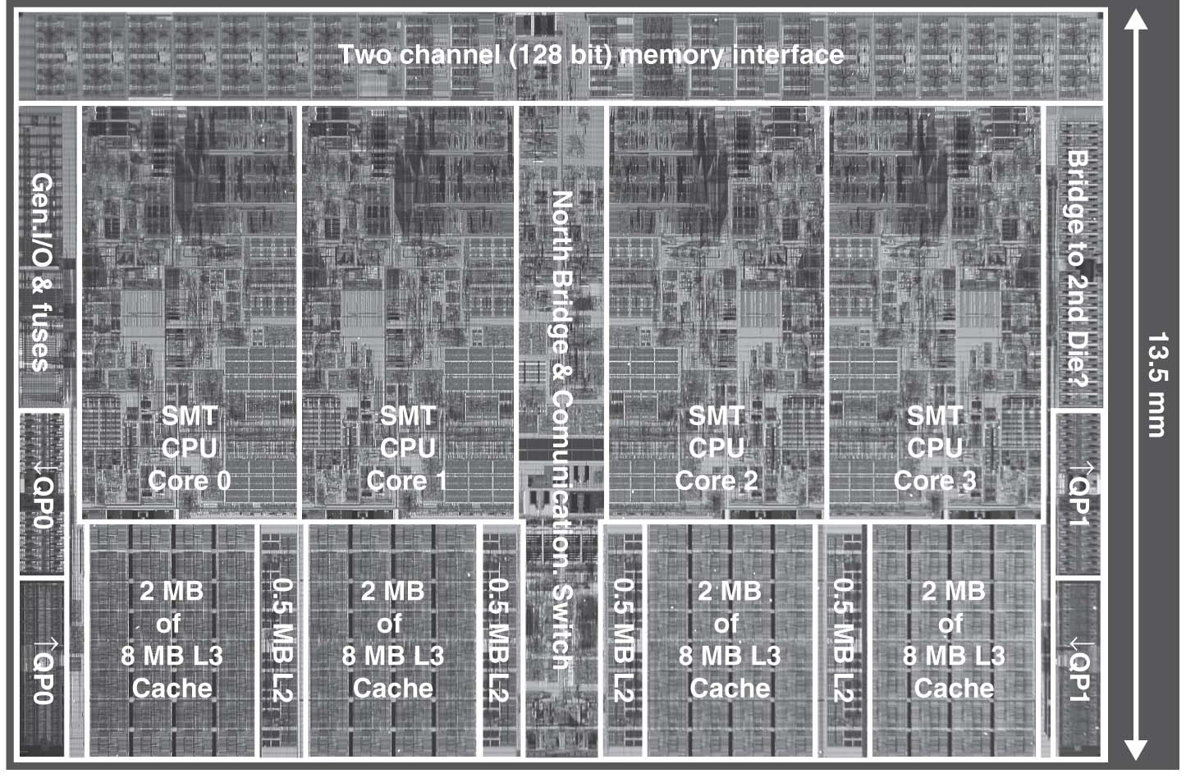
Intel Nehalem Die Photo
4 cores, 32KB I$/32-KB D$, 512KB L2$
Share one 8-MB L3$

Slide 36
Cache Hierarchy Latencies
L1 I & D 32KB 8-way, latency 4 cycles, 64B blocks
L2 256 KB 8-way, latency <12 cycles
L3 8 MB, 16-way, latency 30-40 cycles
DRAM, latency ~180-200 cycles

Slide 37
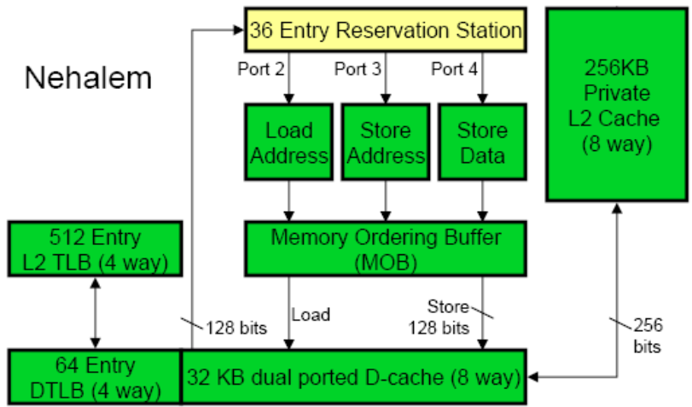
Core’s Private Memory System
Load queue 48 entries
Store queue 32 entries
Divided statically between 2 threads
Up to 16 outstanding misses in flight per core

Slide 38
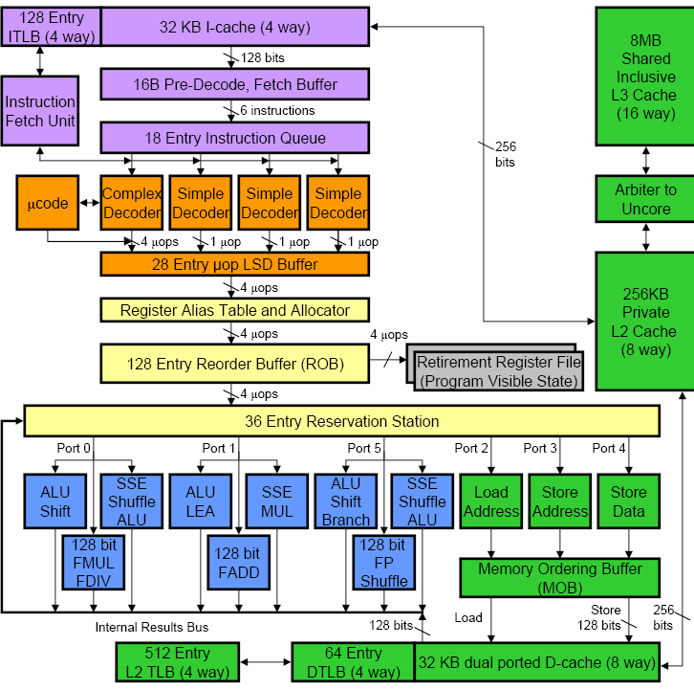

Slide 42
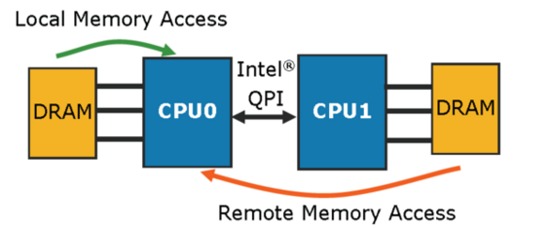
All Sockets can Access all Data
How ensure that get data allocated to local DRAM?
Lunix doesn’t allocate pages to physical memory after malloc until first access to page. Be sure to touch what each CPU wants nearby
~60ns
Such systems called “NUMA” for Non Uniform Memory Access: some addresses are slower than others
~100ns

Slide 43
Cache Design Space
Several interacting dimensions
Cache size
Block size
Associativity
Replacement policy
Write-through vs. write-back
Write allocation
Optimal choice is a compromise
Depends on access characteristics
Workload
Use (I-cache, D-cache)
Depends on technology / cost
Simplicity often wins
Cache Size
Associativity
Block Size
Bad
Good
Factor A
Factor B
Less
More
Notes:
No fancy replacement policy is needed for the direct mapped cache.
As a matter of fact, that is what cause direct mapped trouble to begin with: only one place to go in the cache--causes conflict misses.
No fancy replacement policy is needed for the direct mapped cache.
As a matter of fact, that is what cause direct mapped trouble to begin with: only one place to go in the cache--causes conflict misses.
Besides working at Sun, I also teach people how to fly whenever I have time.
Statistic have shown that if a pilot crashed after an engine failure, he or she is more likely to get killed in a multi-engine light airplane than a single engine airplane.
The joke among us flight instructors is that: sure, when the engine quit in a single engine stops, you have one option: sooner or later, you land. Probably sooner.
But in a multi-engine airplane with one engine stops, you have a lot of options. It is the need to make a decision that kills those people.

Slide 44
Summary
Name of the Game: Reduce Cache Misses
2 memory blocks mapping to same block knock each other out as program bounces from 1 memory location to next
One way to do it: set-associativity
Memory block maps into more than 1 cache block
N-way: n possible places in cache to hold a memory block
N-way Cache of 2^{N+M} blocks: 2^{N} ways x 2^{M} sets
Multi-level caches
Optimize first level to be fast!
Optimize 2nd and 3rd levels to minimize the memory access penalty

