Slide 1
CS 61C: Great Ideas in Computer Architecture Instruction Level Parallelism: Multiple Instruction Issue
Instructors:
Krste Asanovic, Randy H. Katz
http://inst.eecs.Berkeley.edu/~cs61c/fa12

Slide 2
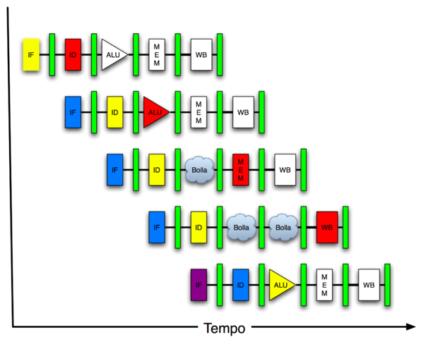
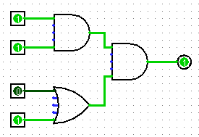
You Are Here!
Software Hardware
Parallel Requests
Assigned to computer
e.g., Search “Katz”
Parallel Threads
Assigned to core
e.g., Lookup, Ads
Parallel Instructions
>1 instruction @ one time
e.g., 5 pipelined instructions
Parallel Data
>1 data item @ one time
e.g., Add of 4 pairs of words
Hardware descriptions
All gates @ one time
Programming Languages
Warehouse Scale Computer
Smart Phone
Harness Parallelism &
Achieve High Performance
Computer
Core
…
Core
Memory (Cache)
Input/Output
Core
Today’s Lecture
Instruction Unit(s)
Functional
Unit(s)
A₀+B₀
A₁+B₁
A₂+B₂
A₃+B₃
Main Memory
Logic Gates

Slide 3
Review
The BIG Picture
Pipelining improves performance by increasing instruction throughput: exploits ILP
Executes multiple instructions in parallel
Each instruction has the same latency
Subject to hazards
Structure, data, control
Stalls reduce performance
But are required to get correct results
Compiler can arrange code to avoid hazards and stalls
Requires knowledge of the pipeline structure

Slide 4
Agenda
More ILP
Instruction Scheduling
Administrivia
Out of Order Execution
Parallelism Big Picture
And, in Conclusion, …

Slide 5
Agenda
More ILP
Instruction Scheduling
Administrivia
Out of Order Execution
Parallelism Big Picture
And, in Conclusion, …

Slide 6
Greater Instruction-Level Parallelism (ILP)
Deeper pipeline (5 => 10 => 15 stages)
Less work per stage ⇒ shorter clock cycle
Multiple issue “superscalar”
Replicate pipeline stages ⇒ multiple pipelines
Start multiple instructions per clock cycle
CPI < 1, so use Instructions Per Cycle (IPC)
E.g., 4GHz 4-way multiple-issue
16 BIPS, peak CPI = 0.25, peak IPC = 4
But dependencies reduce this in practice

Slide 7
Multiple Issue
Static multiple issue
Compiler groups instructions to be issued together
Packages them into “issue slots”
Compiler detects and avoids hazards
Dynamic multiple issue
CPU examines instruction stream and chooses instructions to issue each cycle
Compiler can help by reordering instructions
CPU resolves hazards using advanced techniques at runtime

Slide 8
Superscalar Laundry: Parallel per stage
6 PM
7
8
9
10
11
12
1
2 AM
More resources, HW to match mix of parallel tasks?
30
30
30
30
30
Time
T
a
s
k
O
r
d
e
r
A
(light clothing)
(dark clothing)
B
(very dirty clothing)
C
D
(light clothing)
(dark clothing)
E
(very dirty clothing)
F

Slide 9
Pipeline Depth and Issue Width
Intel Processors over Time
Microprocessor | Year | Clock Rate | Pipeline Stages | Issue width | Cores | Power
i486 | 1989 | 25 MHz | 5 | 1 | 1 | 5W
Pentium | 1993 | 66 MHz | 5 | 2 | 1 | 10W
Pentium Pro | 1997 | 200 MHz | 10 | 3 | 1 | 29W
P4 Willamette | 2001 | 2000 MHz | 22 | 3 | 1 | 75W
P4 Prescott | 2004 | 3600 MHz | 31 | 3 | 1 | 103W
Core 2 Conroe | 2006 | 2930 MHz | 14 | 4 | 2 | 75W
Core 2 Yorkfield | 2008 | 2930 MHz | 16 | 4 | 4 | 95W
Core i7 Gulftown | 2012 | 3460 MHz | 16 | 4 | 6 | 130W

Slide 10
Pipeline Depth and Issue Width

Slide 11
Static Multiple Issue
Compiler groups instructions into “issue packets”
Group of instructions that can be issued on a single cycle
Determined by pipeline resources required
Think of an issue packet as a very long instruction
Specifies multiple concurrent operations

Slide 12
Scheduling Static Multiple Issue
Compiler must remove some/all hazards
Reorder instructions into issue packets
No dependencies with a packet
Possibly some dependencies between packets
Varies between ISAs; compiler must know!
Pad with nop if necessary

Slide 13
MIPS with Static Dual Issue
Two-issue packets
One ALU/branch instruction
One load/store instruction
64-bit aligned
ALU/branch, then load/store
Pad an unused instruction with nop
Address | Instruction type | Pipeline Stages
n | ALU/branch | IF | ID | EX | MEM | WB
n + 4 | Load/store | IF | ID | EX | MEM | WB
n + 8 | ALU/branch |  | IF | ID | EX | MEM | WB
n + 12 | Load/store |  | IF | ID | EX | MEM | WB
n + 16 | ALU/branch |  |  | IF | ID | EX | MEM | WB
n + 20 | Load/store |  |  | IF | ID | EX | MEM | WB

Slide 14
Hazards in the Dual-Issue MIPS
More instructions executing in parallel
EX data hazard
Forwarding avoided stalls with single-issue
Now can’t use ALU result in load/store in same packet
add $t0, $s0, $s1 load $s2, 0($t0)
Split into two packets, effectively a stall
Load-use hazard
Still one cycle use latency, but now two instructions
More aggressive scheduling required

Slide 15
Scheduling Example
Schedule this for dual-issue MIPS
Loop: lw $t0, 0($s1) # $t0=array element addu $t0, $t0, $s2 # add scalar in $s2 sw $t0, 0($s1) # store result addi $s1, $s1,–4 # decrement pointer bne $s1, $zero, Loop # branch $s1!=0
 | ALU/branch | Load/store | cycle
Loop: | nop | lw $t0, 0($s1) | 1
 | addi $s1, $s1,–4 | nop | 2
 | addu $t0, $t0, $s2 | nop | 3
 | bne $s1, $zero, Loop | sw $t0, 4($s1) | 4
IPC = 5/4 = 1.25 (c.f. peak IPC = 2)

Slide 16
Loop Unrolling
Replicate loop body to expose more parallelism
Reduces loop-control overhead
Use different registers per replication
Called “register renaming”
Avoid loop-carried “anti-dependencies”
Store followed by a load of the same register
Aka “name dependence”
Reuse of a register name

Slide 17
Loop Unrolling Example
 | ALU/branch | Load/store | cycle
Loop: | addi $s1, $s1,–16 | lw $t0, 0($s1) | 1
 | nop | lw $t1, 12($s1) | 2
 | addu $t0, $t0, $s2 | lw $t2, 8($s1) | 3
 | addu $t1, $t1, $s2 | lw $t3, 4($s1) | 4
 | addu $t2, $t2, $s2 | sw $t0, 16($s1) | 5
 | addu $t3, $t4, $s2 | sw $t1, 12($s1) | 6
 | nop | sw $t2, 8($s1) | 7
 | bne $s1, $zero, Loop | sw $t3, 4($s1) | 8
IPC = 14/8 = 1.75
Closer to 2, but at cost of registers and code size

Slide 18
Dynamic Multiple Issue
“Superscalar” processors
CPU decides whether to issue 0, 1, 2, … each cycle
Avoiding structural and data hazards
Avoids the need for compiler scheduling
Though it may still help
Code semantics ensured by the CPU

Slide 19
Dynamic Pipeline Scheduling
Allow the CPU to execute instructions out of order to avoid stalls
But commit result to registers in order
Example
lw $t0, 20($s2) addu $t1, $t0, $t2 subu $s4, $s4, $t3 slti $t5, $s4, 20
Can start subu while addu is waiting for lw

Slide 20
Why Do Dynamic Scheduling?
Why not just let the compiler schedule code?
Not all stalls are predicable
e.g., cache misses
Can’t always schedule around branches
Branch outcome is dynamically determined
Different implementations of an ISA have different latencies and hazards

Slide 21
Agenda
More ILP
Instruction Scheduling
Administrivia
Out of Order Execution
Parallelism Big Picture
And, in Conclusion, …

Slide 22
Administrivia
As of today, made 1 pass over all Big Ideas in Computer Architecture
Following lectures go into more depth on topics you’ve already seen while you work on projects
1 lecture in more depth on Caches
1 on C storage management
1 on Dependability/Reliability/Redundancy
1 on Protection, Virtual Memory, Virtual Machines
1 on Exceptions, Traps, Interrupts
2 on Modern Phone and Computer Architectures
1 on Programming Contest (Extra Credit Project 5)
1 on Course Wrap-up and Review

Slide 23
Agenda
More ILP
Instruction Scheduling
Administrivia
Out of Order Execution
Parallelism Big Picture
And, in Conclusion, …

Slide 24
Speculation
“Guess” what to do with an instruction
Start operation as soon as possible
Check whether guess was right
If so, complete the operation
If not, roll-back and do the right thing
Common to static and dynamic multiple issue
Examples
Speculate on branch outcome (Branch Prediction)
Roll back if path taken is different
Speculate on load
Roll back if location is updated

Slide 25
Pipeline Hazard: Matching socks in later load
6 PM
7
8
9
10
11
12
1
2 AM
A depends on D; stall since folder tied up;
30
30
30
30
30
Time
T
a
s
k
O
r
d
e
r
30
30
A
bubble
B
C
D
E
F

Slide 26
Out-of-Order Laundry: Don’t Wait
6 PM
7
8
9
10
11
12
1
2 AM
A depends on D; rest continue; need more resources to allow out-of-order
30
30
30
30
30
Time
T
a
s
k
O
r
d
e
r
30
30
A
bubble
B
C
D
E
F

Slide 27
Out-of-Order Execution (1/2)
Basically, unroll loops in hardware
Fetch instructions in program order (≤4/clock)
Predict branches as taken/untaken
To avoid hazards on registers, rename registers using a set of internal registers (~80 registers)
Collection of renamed instructions might execute in a window (~60 instructions)
Execute instructions with ready operands in 1 of multiple functional units (ALUs, FPUs, Ld/St)

Slide 28
Out-of-Order Execution (2/2)
Basically, unroll loops in hardware
Buffer results of executed instructions until predicted branches are resolved in reorder buffer
If predicted branch correctly, commit results in program order
If predicted branch incorrectly, discard all dependent results and start with correct PC

Slide 29
Out Of Order Intel
All use OOO since 2001
Microprocessor | Year | Clock Rate | Pipeline Stages | Issue width | Out-of-order/ Speculation | Cores | Power
i486 | 1989 | 25MHz | 5 | 1 | No | 1 | 5W
Pentium | 1993 | 66MHz | 5 | 2 | No | 1 | 10W
Pentium Pro | 1997 | 200MHz | 10 | 3 | Yes | 1 | 29W
P4 Willamette | 2001 | 2000MHz | 22 | 3 | Yes | 1 | 75W
P4 Prescott | 2004 | 3600MHz | 31 | 3 | Yes | 1 | 103W
Core | 2006 | 2930MHz | 14 | 4 | Yes | 2 | 75W
Core 2 Yorkfield | 2008 | 2930 MHz | 16 | 4 | Yes | 4 | 95W
Core i7 Gulftown | 2012 | 3460 MHz | 16 | 4 | Yes | 6 | 130W

Slide 30
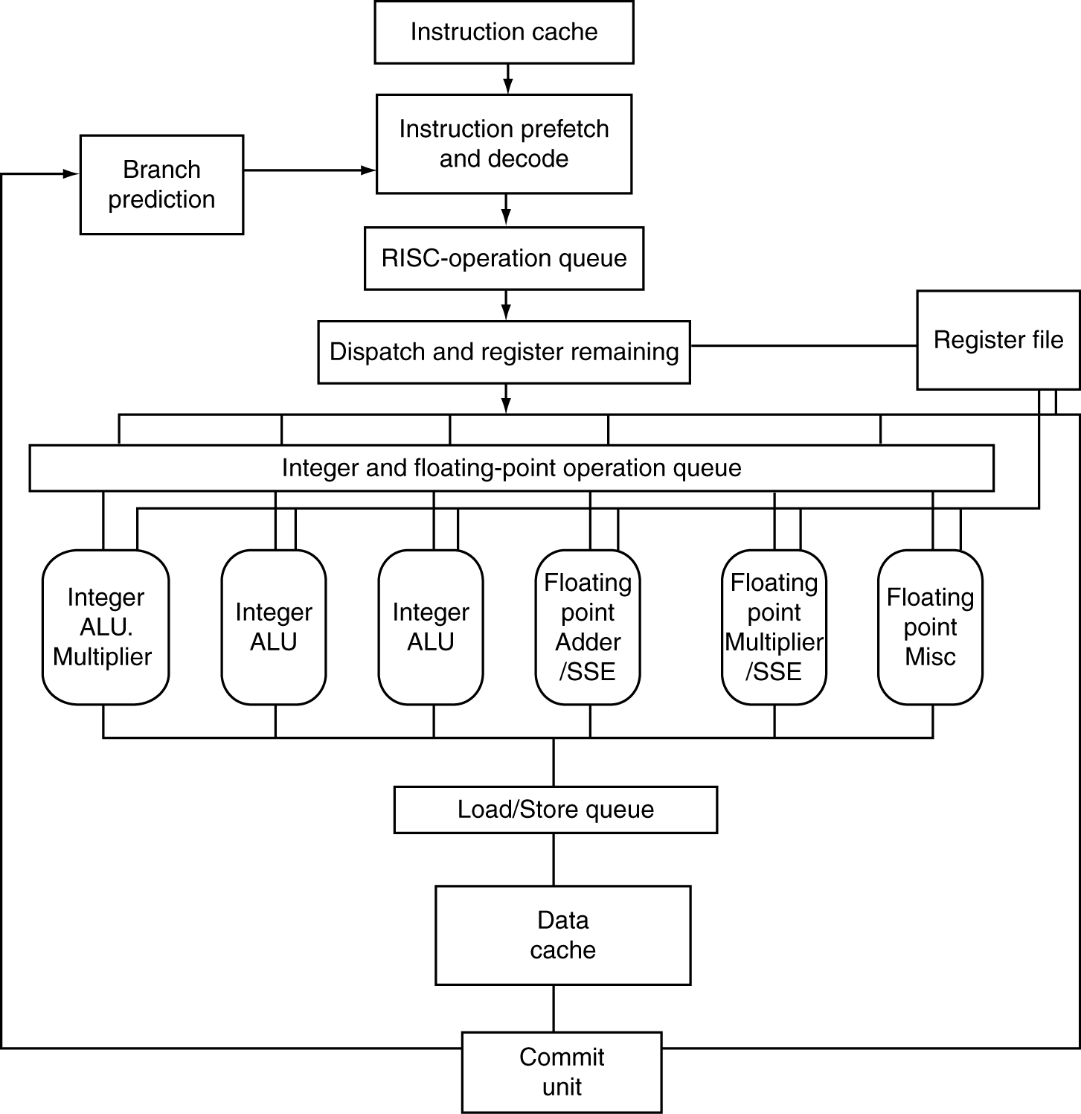
AMD Opteron X4 Microarchitecture
72 physical registers

Slide 31
AMD Opteron X4 Pipeline Flow
For integer operations
12 stages (Floating Point is 17 stages)
Up to 106 RISC-ops in progress
Intel Nehalem is 16 stages for integer operations, details not revealed, but likely similar to above+
Intel calls RISC operations “Micro operations” or “μops”

Slide 32
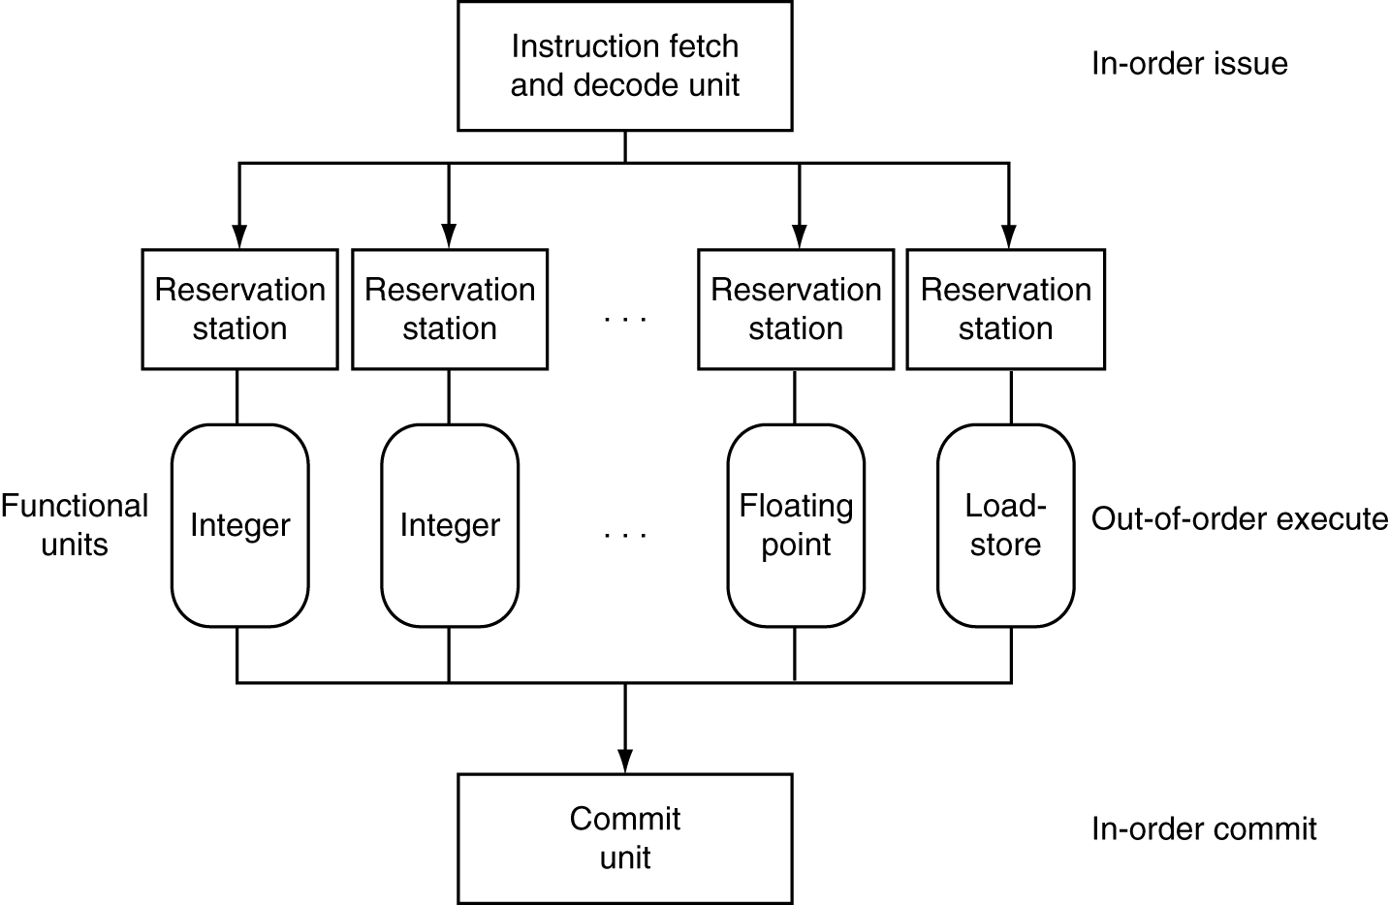
Dynamically Scheduled CPU
Preserves dependencies
Hold pending operands
Results also sent to any waiting reservation stations
Reorders buffer for register writes
Can supply operands for issued instructions

Slide 33
Does Multiple Issue Work?
The BIG Picture
Yes, but not as much as we’d like
Programs have real dependencies that limit ILP
Some dependencies are hard to eliminate
e.g., pointer aliasing
Some parallelism is hard to expose
Limited window size during instruction issue
Memory delays and limited bandwidth
Hard to keep pipelines full
Speculation can help if done well

Slide 34
Big Picture on Parallelism
Two types of parallelism in applications
Data-Level Parallelism (DLP): arises because there are many data items that can be operated on at the same time
Task-Level Parallelism (TLP): arises because tasks of work are created that can operate largely in parallel

Slide 35
Big Picture on Parallelism
Hardware can exploit app Data LP and Task LP in 4 ways:
Instruction-Level Parallelism: Hardware exploits application DLP using ideas like pipelining and speculative execution
SIMD architectures: exploit app DLP by applying a single instruction to a collection of data in parallel
Thread-Level Parallelism: exploits either app DLP or TLP in a tightly-coupled hardware model that allows for interaction among parallel threads
Request-Level Parallelism: exploits parallelism among largely decoupled tasks and is specified by the programmer of the operating system

Slide 36
“And in Conclusion..”
Pipeline challenge is hazards
Forwarding helps w/many data hazards
Delayed branch helps with control hazard in 5 stage pipeline
Load delay slot / interlock necessary
More aggressive performance:
Longer pipelines
Superscalar
Out-of-order execution
Speculation

Slide 37
Peer Question
State if following techniques are associated primarily with a software- or hardware-based approach to exploiting ILP (in some cases, the answer may be both): Superscalar, Out-of-Order execution, Speculation, Register Renaming
 | Super-scalar | Out of Order | Specu-lation | Register Renaming
Orange | HW | HW | HW | HW
Green | HW | HW | Both | Both
Pink | HW | HW | HW | Both
Yellow | HW | HW | HW | SW

Slide 38
Peer Question
State if following techniques are associated primarily with a software- or hardware-based approach to exploiting ILP (in some cases, the answer may be both): Superscalar, Out-of-Order execution, Speculation, Register Renaming
 | Super-scalar | Out of Order | Specu-lation | Register Renaming
Orange | HW | HW | HW | HW
Green | HW | HW | Both | Both
Pink | HW | HW | HW | Both
Yellow | HW | HW | HW | SW

Slide 39
Peer Instruction
Instr LP, SIMD, Thread LP, Request LP are examples of
Parallelism above (∧) the Instruction Set Architecture
Parallelism explicitly at (=) the level of the ISA
Parallelism below (∨) the level of the ISA
 | Inst. LP | SIMD | Thr. LP | Req. LP
Orange | ∨ | = | = | ∧
Green | = | = | ∧ | ∧
Pink | ∨ | = | ∧ | ∧
Yellow | = | ∧ | ∧ | ∧
Notes:
Pink

Slide 40
Peer Instruction
Instr LP, SIMD, Thread LP, Request LP are examples of
Parallelism above (∧) the Instruction Set Architecture
Parallelism explicitly at (=) the level of the ISA
Parallelism below (∨) the level of the ISA
 | Inst. LP | SIMD | Thr. LP | Req. LP
Orange | ∨ | = | = | ∧
Green | = | = | ∧ | ∧
Pink | ∨ | = | ∧ | ∧
Yellow | = | ∧ | ∧ | ∧
Notes:
Pink

Slide 41
Peer Instruction
Thanks to pipelining, I have reduced the time it took me to wash my one shirt.
Longer pipelines are always a win (since less work per stage & a faster clock).
A)(orange) I is True and II is True
B)(green) I is False and II is True
C)(pink) I is True and II is False
D)(yellow) I is False and II is False

Slide 42
Peer Answer
Thanks to pipelining, I have reduced the time it took me to wash my one shirt.
Longer pipelines are always a win (since less work per stage & a faster clock).
Red I is True and II is True
Orange I is False and II is True
Green I is True and II is False
Yellow I is False and II is False

Slide 43
Peer Question
Not all instructions are active in every stage of the 5-stage pipeline. Ignoring the effects of hazards, which of the following is true?
1. Allowing jumps, branches, and ALU instructions to take fewer stages than the 5 required by the load instruction will increase pipeline performance for most programs.
2. You cannot make ALU instructions take fewer cycles because of the write back of the result, but branches and jumps can take fewer cycles, so there is some opportunity for improvement.
3. Instead of trying to make instructions take fewer cycles, we should explore making the pipeline longer, so that instructions take more cycles, but the cycles are shorter. This could improve performance.
4. The number of pipe stages per instruction affects throughput, not latency.
Orange: 1
Green: 2
Pink: 3
Yellow: 4
Notes:
Pink: Statements 3 are correct; the rest are incorrect

Slide 44
Peer Answer
Not all instructions are active in every stage of the 5-stage pipeline. Ignoring the effects of hazards, which of the following is true?
1. Allowing jumps, branches, and ALU instructions to take fewer stages than the 5 required by the load instruction will increase pipeline performance for most programs.
2. You cannot make ALU instructions take fewer cycles because of the write back of the result, but branches and jumps can take fewer cycles, so there is some opportunity for improvement.
3. Instead of trying to make instructions take fewer cycles, we should explore making the pipeline longer, so that instructions take more cycles, but the cycles are shorter. This could improve performance.
4. The number of pipe stages per instruction affects throughput, not latency.
Orange: 1
Green: 2
Pink: 3
Yellow: 4
Notes:
Pink: Statements 3 are correct; the rest are incorrect

Slide 45
“And in Conclusion, …”
Big Ideas of Instruction Level Parallelism
Pipelining, Hazards, and Stalls
Forwarding, Speculation to overcome Hazards
Multiple issue to increase performance
IPC instead of CPI
Dynamic Execution: Superscalar in-order issue, branch prediction, register renaming, out-of-order execution, in-order commit
“unroll loops in HW”, hide cache misses

