Slide 1
CS 61C: Great Ideas in Computer Architecture Cache Performance
Instructors:
Krste Asanovic, Randy H. Katz
http://inst.eecs.Berkeley.edu/~cs61c/fa12

Slide 2
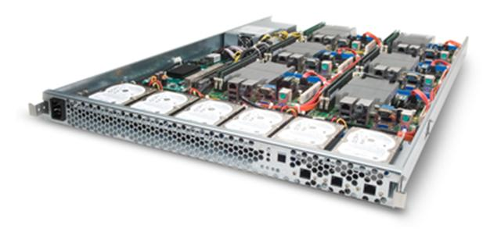
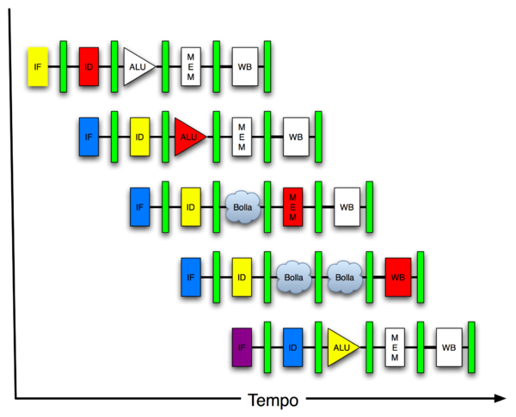
New-School Machine Structures (It’s a bit more complicated!)
Software Hardware
Parallel Requests
Assigned to computer
e.g., Search “Katz”
Parallel Threads
Assigned to core
e.g., Lookup, Ads
Parallel Instructions
>1 instruction @ one time
e.g., 5 pipelined instructions
Parallel Data
>1 data item @ one time
e.g., Add of 4 pairs of words
Hardware descriptions
All gates @ one time
Programming Languages
Warehouse Scale Computer
Smart Phone
Harness Parallelism &
Achieve High Performance
Computer
Today’s
Lecture
Core
…
Core
Memory (Cache)
Input/Output
Core
Instruction Unit(s)
Functional
Unit(s)
A₀+B₀
A₁+B₁
A₂+B₂
A₃+B₃
Cache Memory
Logic Gates

Slide 3
Review
Memory hierarchy exploits temporal and spatial locality in instruction and data memory references from applications
Almost as fast as small, expensive memory, while having capacity of large, cheap memory.
Cache is hardware-managed, programmer-invisible structure to hold copies of recently-used memory locations
Cache hits serviced quickly
Cache misses need to go to memory, SLOW!

Slide 4
Review: Direct-Mapped Cache
One word blocks, cache size = 1K words (or 4KB)
Block offset
Address from CPU
31 30 . . . 13 12 11 . . . 2 1 0
Hit
Tag
20
10
Data
Valid bit ensures something useful in cache for this index
Index
Read data from cache instead of memory if a Hit
Index
Valid
Tag
Data
0
1
2
.
.
.
1021
1022
1023
Compare Tag with upper part of Address to see if a Hit
20
32
Comparator
Student Roulette
What if we used high bits of address as set index?
Notes:
Let’s use a specific example with realistic numbers: assume we have a 1 K word (4Kbyte) direct mapped cache with block size equals to 4 bytes (1 word).
In other words, each block associated with the cache tag will have 4 bytes in it (Row 1).
With Block Size equals to 4 bytes, the 2 least significant bits of the address will be used as byte select within the cache block.
Since the cache size is 1K word, the upper 32 minus 10+2 bits, or 20 bits of the address will be stored as cache tag.
The rest of the (10) address bits in the middle, that is bit 2 through 11, will be used as Cache Index to select the proper cache entry
Temporal!

Slide 5
Handling Stores with Write-Through
Store instructions write to memory, changing values
Need to make sure cache and memory have same values on writes: 2 policies
1) Write-Through Policy: write cache and write through the cache to memory
Every write eventually gets to memory
Too slow, so include Write Buffer to allow processor to continue once data in Buffer
Buffer updates memory in parallel to processor

Slide 6
Write-Through Cache
Processor
Write both values in cache and in memory
Write buffer stops CPU from stalling if memory cannot keep up
Write buffer may have multiple entries to absorb bursts of writes
What if store misses in cache?
32-bit
Address
32-bit
Data
Cache
252
12
1022
99
Write Buffer
7
131
2041
20
Addr
Data
32-bit
Address
32-bit
Data
Memory

Slide 7
Handling Stores with Write-Back
2) Write-Back Policy: write only to cache and then write cache block back to memory when evict block from cache
Writes collected in cache, only single write to memory per block
Include bit to see if wrote to block or not, and then only write back if bit is set
Called “Dirty” bit (writing makes it “dirty”)

Slide 8
Write-Back Cache
Processor
Store/cache hit, write data in cache only & set dirty bit
Memory has stale value
Store/cache miss, read data from memory, then update and set dirty bit
“Write-allocate” policy
Load/cache hit, use value from cache
On any miss, write back evicted block, only if dirty. Update cache with new block and clear dirty bit.
32-bit
Address
32-bit
Data
Cache
252
D
12
1022
Dirty Bits
D
99
131
D
7
2041
D
20
32-bit
Address
32-bit
Data
Memory

Slide 9
Write-Through vs. Write-Back
Write-Through:
Simpler control logic
More predictable timing simplifies processor control logic
Easier to make reliable, since memory always has copy of data
Write-Back
More complex control logic
More variable timing (0,1,2 memory accesses per cache access)
Usually reduces write traffic
Harder to make reliable, sometimes cache has only copy of data

Slide 10
Average Memory Access Time (AMAT)
Average Memory Access Time (AMAT) is the average to access memory considering both hits and misses in the cache
AMAT = Time for a hit + Miss rate x Miss penalty
Notes:
AMAT = 1 + 0.02x50 = 2

Slide 11
Average Memory Access Time (AMAT) is the average to access memory considering both hits and misses
AMAT = Time for a hit + Miss rate x Miss penalty
Given a 200 psec clock, a miss penalty of 50 clock cycles, a miss rate of 0.02 misses per instruction and a cache hit time of 1 clock cycle, what is AMAT?
☐
≤200 psec
☐
400 psec
☐
600 psec
☐
≥ 800 psec
Notes:
VertLeftWhiteCheck1
B: Print It saves PC+4 …because ints in this system are 4-bytes long and the actual address increments by 4 even though it appears to only incrememt 1.

Slide 12
Average Memory Access Time (AMAT)
Average Memory Access Time (AMAT) is the average to access memory considering both hits and misses
AMAT = Time for a hit + Miss rate x Miss penalty
What is the AMAT for a processor with a 200 psec clock, a miss penalty of 50 clock cycles, a miss rate of 0.02 misses per instruction and a cache access time of 1 clock cycle?
1 + 0.02 x 50 = 2 clock cycles
Or 2 x 200 = 400 psecs
Notes:
AMAT = 1 + 0.02x50 = 2

Slide 13
Average Memory Access Time (AMAT)
Average Memory Access Time (AMAT) is the average to access memory considering both hits and misses
AMAT = Time for a hit + Miss rate x Miss penalty
How calculate if separate instruction and data caches?
Notes:
AMAT = 1 + 0.02x50 = 2

Slide 14
Impact of Cache on CPI
Assume cache hit time included in normal CPU execution time, then
CPU time = Instruction Count (IC) × Cycles Per Instruction (CPI) × Cycle Time (CT)
= IC × (CPI_{ideal} + CPI_{miss}) × CT
CPI_{stalls}
A simple model for cache miss impact on CPI
CPI_{miss}= accesses/instruction × miss rate × miss penalty
Notes:
Reasonable write buffer depth (e.g., four or more words) and a memory capable of accepting writes at a rate that significantly exceeds the average write frequency means write buffer stalls are small

Slide 15
Impacts of Cache Performance
Relative $ penalty increases as processor performance improves (faster clock rate and/or lower CPI)
When calculating CPI_{stalls}, cache miss penalty is measured in processor clock cycles needed to handle a miss
Lower the CPI_{ideal}, more pronounced impact of stalls
Processor with a CPI_{ideal} of 2, a 100-cycle miss penalty, 36% load/store instr’s, and 2% I$ and 4% D$ miss rates
CPI_{miss}= 2% × 100 + 36% × 4% × 100 = 3.44
So CPI_{stalls} = 2 + 3.44 = 5.44
More than twice the CPI_{ideal} !
What if the CPI_{ideal} is reduced to 1?
What if the D$ miss rate went up by 1%?
Student Roulette
Notes:
For ideal CPI = 1, then CPIstall = 4.44 and the amount of execution time spent on memory stalls would have risen from 3.44/5.44 = 63% to 3.44/4.44 = 77%
For miss penalty of 200, memory stall cycles = 2% 200 + 36% x 4% x 200 = 6.88 so that CPIstall = 8.88
This assumes that hit time (so hit time is 1 cycle) is not a factor in determining cache performance. A larger cache would have a longer access time (if a lower miss rate), meaning either a slower clock cycle or more stages in the pipeline for memory access.

Slide 16
Impact of larger cache on AMAT?
Notes:
AMAT = 1 + 0.02x50 = 2

Slide 17
Impact of larger cache on AMAT?
1) Lower Miss rate
2) Longer Access time (Hit time): smaller is faster
Increase in hit time will likely add another stage to the pipeline
At some point, increase in hit time for a larger cache may overcome the improvement in hit rate, yielding a decrease in performance
Computer architects expend considerable effort optimizing organization of cache hierarchy – big impact on performance and power!
Notes:
AMAT = 1 + 0.02x50 = 2

Slide 18
Administrivia
Lab #5: MIPS Assembly
HW #4 (of six), due Sunday
Project 2a: MIPS Emulator, due Sunday
Midterm, a week from Tuesday

Slide 19
How to Reduce Miss Penalty?
Could there be locality on misses from a cache?
Use multiple cache levels!
With Moore’s Law, more room on die for bigger L1 caches and for second-level (L2)cache
And in some cases even an L3 cache!
IBM mainframes have ~1GB L4 cache off-chip.

Slide 20
Multiple Cache Levels
E.g., CPI_{ideal} of 2, 100 cycle miss penalty (to main memory), 25 cycle miss penalty (to L2$), 36% load/stores, a 2% (4%) L1 I$ (D$) miss rate, add a 0.5% L2$ miss rate
CPI_{stalls} = 2 + 0.02×25 + 0.36×0.04×25 + 0.005×100 + 0.36×0.005×100
= 3.54 (vs. 5.44 with no L2$)
Notes:
Also reduces cache miss penalty

Slide 21
Typical Memory Hierarchy
On-Chip Components
Control
Instr
Cache
Second
Level
Cache
(SRAM)
Secondary
Memory
(Disk
Or Flash)
Main
Memory
(DRAM)
Datapath
RegFile
Data
Cache
Speed (cycles): ½’s 1’s 10’s 100’s 1,000,000’s
Size (bytes): 100’s 10K’s M’s G’s T’s
Cost/bit: highest lowest
Principle of locality + memory hierarchy presents programmer with ≈ as much memory as is available in the cheapest technology at the ≈ speed offered by the fastest technology
Notes:
Instead, the memory system of a modern computer consists of a series of black boxes ranging from the fastest to the slowest.
Besides variation in speed, these boxes also varies in size (smallest to biggest) and cost.
What makes this kind of arrangement work is one of the most important principle in computer design. The principle of locality. The principle of locality states that programs access a relatively small portion of the address space at any instant of time.
The design goal is to present the user with as much memory as is available in the cheapest technology (points to the disk).
While by taking advantage of the principle of locality, we like to provide the user an average access speed that is very close to the speed that is offered by the fastest technology.
(We will go over this slide in detail in the next lectures on caches).

Slide 22
Local vs. Global Miss Rates
Local miss rate – the fraction of references to one level of a cache that miss
Local Miss rate L2$ = $L2 Misses / L1$ Misses
Global miss rate – the fraction of references that miss in all levels of a multilevel cache
L2$ local miss rate >> than the global miss rate
Often as high as 50% local miss rate – still useful?

Slide 23
For L1 cache
AMAT = Time for a hit + Miss rate x Miss penalty
What is AMAT for system with L1 and L2 cache (L2 miss rate is local miss rate)?
☐
Time for L2 hit + L2 Miss rate x L2 Miss penalty
☐
Time for L1 hit + L1 Miss rate x L2 Miss rate x Miss penalty
☐
Time for L1 hit + L1 Miss rate x (Time for L2 hit + L2 Miss rate x Miss Penalty)
☐
Time for L1 hit + L1 Miss rate x Miss penalty + Time for L2 hit + L2 Miss rate x Miss penalty
Notes:
VertLeftWhiteCheck1
B: Print It saves PC+4 …because ints in this system are 4-bytes long and the actual address increments by 4 even though it appears to only incrememt 1.

Slide 24
Local vs. Global Miss Rates
Local miss rate – the fraction of references to one level of a cache that miss
Local Miss rate L2$ = $L2 Misses / L1$ Misses
Global miss rate – the fraction of references that miss in all levels of a multilevel cache
L2$ local miss rate >> than the global miss rate
Global Miss rate = L2$ Misses / Total Accesses
= L2$ Misses / L1$ Misses x L1$ Misses / Total Accesses
= Local Miss rate L2$ x Local Miss rate L1$
AMAT = Time for a hit + Miss rate x Miss penalty
AMAT = Time for a L1$ hit + (local) Miss rateL1$ x (Time for a L2$ hit + (local) Miss rate L2$ x L2$ Miss penalty)

Slide 25
Improving Cache Performance (1 of 3)
AMAT = Hit Time + Miss rate x Miss penalty
1. Reduce the time to hit in the cache
Smaller cache
2. Reduce the miss rate
Bigger cache
Larger blocks (16 to 64 bytes typical)
(Later in semester: More flexible placement by increasing associativity)

Slide 26
Improving Cache Performance (2 of 3)
3. Reduce the miss penalty
Smaller blocks
Use multiple cache levels
L2 cache size not tied to processor clock rate
Higher DRAM memory bandwidth (faster DRAMs)
Use a write buffer to hold dirty blocks being replaced so don’t have to wait for the write to complete before reading

Slide 27
The Cache Design Space (3 of 3)
Several interacting dimensions
Cache size
Block size
Write-through vs. write-back
Write allocation
(Later Associativity)
(Later Replacement policy)
Optimal choice is a compromise
Depends on access characteristics
Workload
Use (I-cache, D-cache)
Depends on technology / cost
Simplicity often wins
Cache Size
(Associativity)
Block Size
Bad
Good
Factor A
Factor B
Less
More
Notes:
No fancy replacement policy is needed for the direct mapped cache.
As a matter of fact, that is what cause direct mapped trouble to begin with: only one place to go in the cache--causes conflict misses.
No fancy replacement policy is needed for the direct mapped cache.
As a matter of fact, that is what cause direct mapped trouble to begin with: only one place to go in the cache--causes conflict misses.
Besides working at Sun, I also teach people how to fly whenever I have time.
Statistic have shown that if a pilot crashed after an engine failure, he or she is more likely to get killed in a multi-engine light airplane than a single engine airplane.
The joke among us flight instructors is that: sure, when the engine quit in a single engine stops, you have one option: sooner or later, you land. Probably sooner.
But in a multi-engine airplane with one engine stops, you have a lot of options. It is the need to make a decision that kills those people.

Slide 28
Multilevel Cache Design Considerations
Different design considerations for L1$ and L2$
L1$ focuses on minimizing hit time for shorter clock cycle: Smaller $ with smaller block sizes
L2$(s) focus on reducing miss rate to reduce penalty of long main memory access times: Larger $ with larger block sizes
Miss penalty of L1$ is significantly reduced by presence of L2$, so can be smaller/faster but with higher miss rate
For the L2$, hit time is less important than miss rate
L2$ hit time determines L1$’s miss penalty
Notes:
Global miss rate – the fraction of references that miss in all levels of a multilevel cache. The global miss rate dictates how often we must access the main memory.
Local miss rate – the fraction of references to one level of a cache that miss

Slide 29
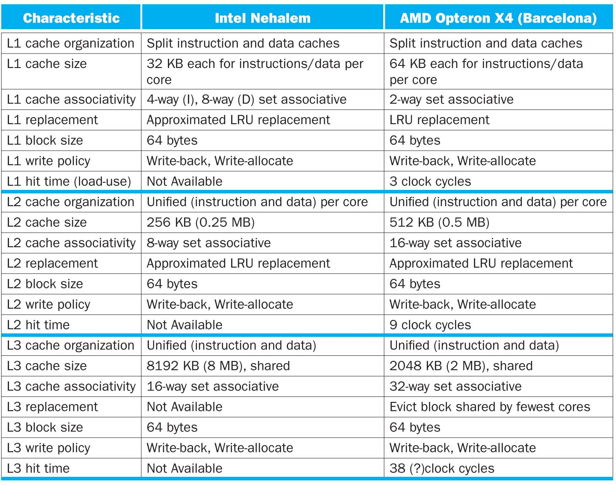

Slide 30
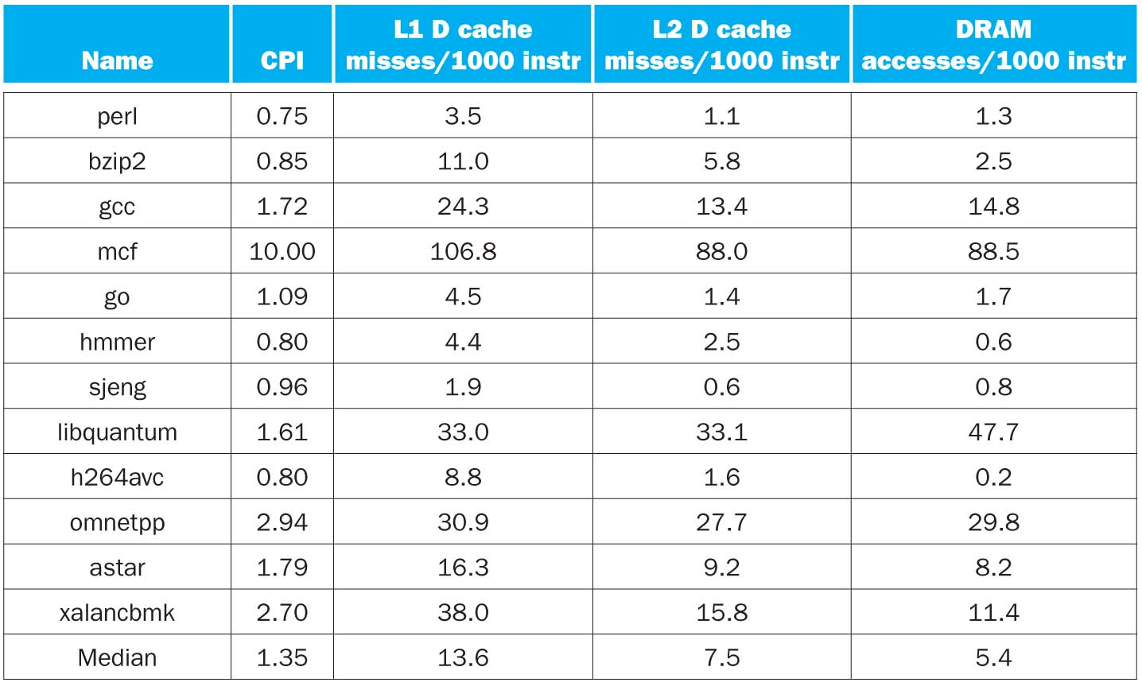
CPI/Miss Rates/DRAM Access SpecInt2006
Data Only
Data Only
Instructions and Data

Slide 31
….and in Conclusion
Write-through versus write-back caches
Larger caches reduce Miss rate via Temporal and Spatial Locality, but can increase Hit time
AMAT helps balance Hit time, Miss rate, Miss penalty
Multilevel caches help Miss penalty

