Slide 1
CS 61C: Great Ideas in Computer Architecture (Machine Structures) Map Reduce
Instructors
Krste Asanovic, Randy H. Katz
http://inst.eecs.Berkeley.edu/~cs61c/fa12

Slide 2
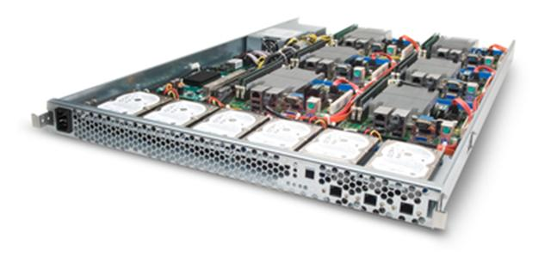
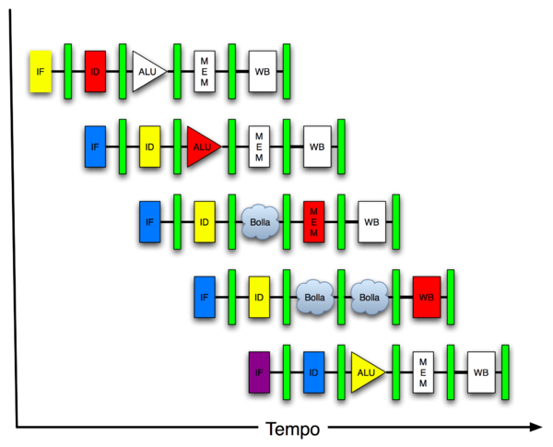
New-School Machine Structures (It’s a bit more complicated!)
Today’s Lecture
Software Hardware
Parallel Requests
Assigned to computer
e.g., Search “Katz”
Parallel Threads
Assigned to core
e.g., Lookup, Ads
Parallel Instructions
>1 instruction @ one time
e.g., 5 pipelined instructions
Parallel Data
>1 data item @ one time
e.g., Add of 4 pairs of words
Hardware descriptions
All gates @ one time
Programming Languages
Warehouse Scale Computer
Smart Phone
Harness Parallelism &
Achieve High Performance
Computer
Core
…
Core
Memory (Cache)
Input/Output
Core
Instruction Unit(s)
Functional
Unit(s)
A₀+B₀
A₁+B₁
A₂+B₂
A₃+B₃
Cache Memory
Logic Gates

Slide 3
Power Usage Effectiveness
Overall WSC Energy Efficiency: amount of computational work performed divided by the total energy used in the process
Power Usage Effectiveness (PUE): Total building power / IT equipment power
A commonly used power efficiency measure for WSC
Considers the relative overhead of datacenter infrastructure, such as cooling and power distribution
But does NOT consider the absolute efficiency of servers, networking gear
1.0 = perfection (i.e., no building infrastructure overhead)

Slide 4
Agenda
MapReduce Examples
Administrivia + 61C in the News + The secret to getting good grades at Berkeley
MapReduce Execution
Costs in Warehouse Scale Computer

Slide 5
Agenda
MapReduce Examples
Administrivia + 61C in the News + The secret to getting good grades at Berkeley
MapReduce Execution
Costs in Warehouse Scale Computer

Slide 6
Request-Level Parallelism (RLP)
Hundreds or thousands of requests per second
Not your laptop or cell-phone, but popular Internet services like Google search
Such requests are largely independent
Mostly involve read-only databases
Little read-write (aka “producer-consumer”) sharing
Rarely involve read–write data sharing or synchronization across requests
Computation easily partitioned within a request and across different requests

Slide 7
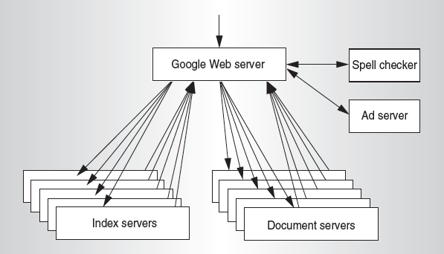
Google Query-Serving Architecture

Slide 8
MapReduce Processing Example: Count Word Occurrences
Pseudo Code: for each word in input, generate <key=word, value=1>
Reduce sums all counts emitted for a particular word across all mappers
map(String input_key, String input_value):
// input_key: document name
// input_value: document contents
for each word w in input_value:
EmitIntermediate(w, "1"); // Produce count of words
reduce(String output_key, Iterator intermediate_values):
// output_key: a word
// intermediate_values: a list of counts
int result = 0;
for each v in intermediate_values:
result += ParseInt(v); // get integer from key-value
Emit(AsString(result));

Slide 9
Another Example: Word Index (How Often Does a Word Appear?)
Distribute
that that is is that that is not is not is that it it is
Map 1
Map 2
Map 3
Map 4
that 1, that 1, is 1
Is 1, that 1, that 1
Local Sort
Is 1, that 1, that 1
is 1, not 1, is 1, not 1
is 1, that 1, it 1, it 1, is 1
is 1, that 1, that 1
is 1, is 1, not 1,not 1
is 1, is 1, it 1, it 1, that 1
Shuffle
is 1,1
is 1
that 1,1
is 1,1,1,1,1,1
it 1,1
that 1,1,1,1
that 1,1,1,1,1
not 1,1
Reduce 1
Reduce 2
is 6; it 2
not 2; that 5
Collect
is 6; it 2; not 2; that 5

Slide 10
Another Example: Word Index (How Often Does a Word Appear?)
Distribute
that that is is that that is not is not is that it it is
Map 1
Map 2
Map 3
Map 4
Local Sort
Is 1, that 1, that 1
is 1, is 1, not 1,not 1
Combine
is 1, that 1, that 1
is 1, that 2
is 2, not 2
is 1, is 1, it 1, it 1, that 1
is 1, that 2
is 2, it 2, that 1
Shuffle
is 1,1
is 1
that 2
is 1,1,2,2
It 2
that 2,2
that 2,2,1
not 2
Reduce 1
Reduce 2
is 6; it 2
not 2; that 5
Collect
is 6; it 2; not 2; that 5

Slide 11
Types
map (k1,v1) ➔ list(k2,v2)
reduce (k2,list(v2)) ➔ list(v2)
Input keys and values from different domain than output keys and values
Intermediate keys and values from same domain as output keys and values

Slide 12
Execution Setup
Map invocations distributed by partitioning input data into M splits
Typically 16 MB to 64 MB per piece
Input processed in parallel on different servers
Reduce invocations distributed by partitioning intermediate key space into R pieces
E.g., hash(key) mod R
User picks M >> # servers, R > # servers
Big M helps with load balancing, recovery from failure
One output file per R invocation, so not too many

Slide 13
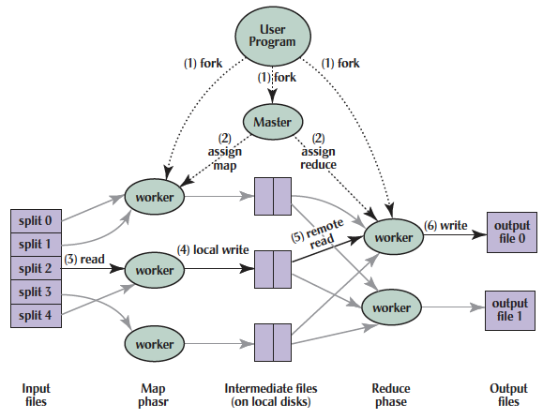
MapReduce Processing
Shuffle phase

Slide 14
MapReduce Processing
1. MR 1st splits the input files into M “splits” then starts many copies of
program on servers
Shuffle phase

Slide 15
MapReduce Processing
2. One copy—the master— is special. The rest
are workers. The master picks idle workers and
assigns each 1 of M map tasks or 1 of R reduce tasks.
Shuffle phase
Notes:
We subdivide the map phase into M pieces and the reduce phase into R pieces as described previously. Ideally, M and R should be much larger than the number of worker machines. Having each worker perform many different tasks improves dynamic load balancing and also speeds up recovery when a worker fails: the many map tasks it has completed can be spread out across all the other worker machines. There are practical bounds on how large M and R can be in our implementation since the master must make O(M+R) scheduling decisions and keep O(M*R) state in memory as described. (The constant factors for memory usage are small, however. The O(M*R) piece of the state consists of approximately one byte of data per map task/reduce task pair.) Furthermore, R is often constrained by users because the output of each reduce task ends up in a separate output file. In practice, we tend to choose M so that each individual task is roughly 16MB to 64MB of input data (so that the locality optimization described previously is most effective), and we make R a small multiple of the number of worker machines we expect to use. We often perform MapReduce computations with M=200,000 and R=5,000, using 2,000 worker machines.

Slide 16
MapReduce Processing
3. A map worker reads the input split. It parses key/value pairs of the input data and passes each pair to the user-defined map function.
(The intermediate
key/value pairs produced by the map function are buffered in memory.)
Shuffle phase

Slide 17
MapReduce Processing
4. Periodically, the buffered pairs are written to local disk, partitioned
into R regions by the partitioning function.
Shuffle phase
Notes:
The locations of these buffered pairs on the local disk are passed back to the master who is responsible for forwarding these locations to the reduce workers.

Slide 18
MapReduce Processing
5. When a reduce worker has read all intermediate data for its partition, it bucket sorts using inter-mediate keys so that occur-rences of same keys are grouped together
(The sorting is needed because typically many different keys map to
the same reduce task )
Shuffle phase

Slide 19
MapReduce Processing
6. Reduce worker iterates over sorted intermediate data and for each unique intermediate key, it passes key and corresponding set of values to the user’s reduce function.
The output of the reduce function is appended to a final output file for this reduce partition.
Shuffle phase

Slide 20
MapReduce Processing
7. When all map tasks and reduce tasks have been completed, the master
wakes up the user program. The MapReduce call
in user program returns back to user code.
Output of MR is in R output files (1 per reduce task, with file names specified by user); often passed into another MR job so don’t concatenate
Shuffle phase

Slide 21
Master Data Structures
For each map task and reduce task
State: idle, in-progress, or completed
Identify of worker server (if not idle)
For each completed map task
Stores location and size of R intermediate files
Updates files and size as corresponding map tasks complete
Location and size are pushed incrementally to workers that have in-progress reduce tasks

Slide 22
Agenda
MapReduce Examples
Administrivia + 61C in the News + The secret to getting good grades at Berkeley
MapReduce Execution
Costs in Warehouse Scale Computer

Slide 23
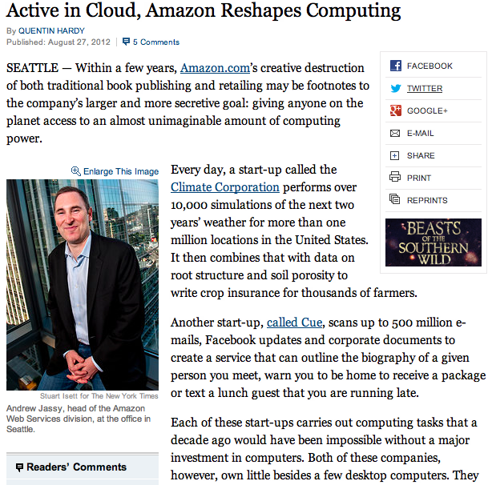
61C in the News
http://www.nytimes.com/2012/08/28/technology/active-in-cloud-amazon-reshapes-computing.html

Slide 24
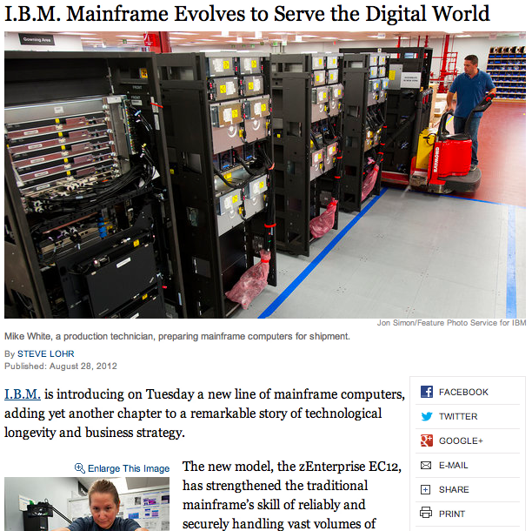
61C in the News
http://www.nytimes.com/2012/08/28/technology/ibm-mainframe-evolves-to-serve-the-digital-world.html

Slide 25
Do I Need to Know Java?
Java used in Labs 2, 3; Project #1 (MapReduce)
Prerequisites:
Official course catalog: “61A, along with either 61B or 61BL, or programming experience equivalent to that gained in 9C, 9F, or 9G”
Course web page: “The only prerequisite is that you have taken Computer Science 61B, or at least have solid experience with a C-based programming language”
61a + Python alone is not sufficient

Slide 26
The Secret to Getting Good Grades
It’s easy!
Do assigned reading the night before the lecture, to get more value from lecture
(Two copies of the correct textbook now on reserve at Engineering Library)

Slide 27
Agenda
MapReduce Examples
Administrivia + 61C in the News + The secret to getting good grades at Berkeley
MapReduce Execution
Costs in Warehouse Scale Computer

Slide 28
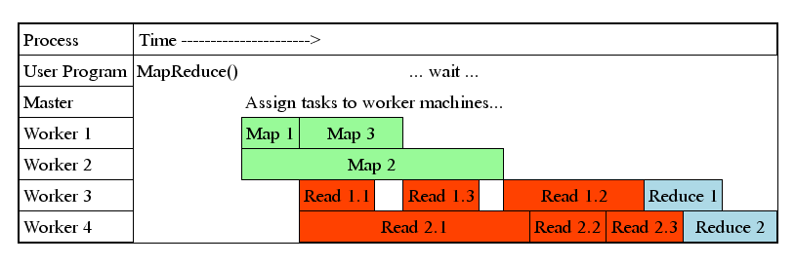
MapReduce Processing Time Line
Master assigns map + reduce tasks to “worker” servers
As soon as a map task finishes, worker server can be assigned a new map or reduce task
Data shuffle begins as soon as a given Map finishes
Reduce task begins as soon as all data shuffles finish
To tolerate faults, reassign task if a worker server “dies”

Slide 29
Show MapReduce Job Running
~41 minutes total
~29 minutes for Map tasks & Shuffle tasks
~12 minutes for Reduce tasks
1707 worker servers used
Map (Green) tasks read 0.8 TB, write 0.5 TB
Shuffle (Red) tasks read 0.5 TB, write 0.5 TB
Reduce (Blue) tasks read 0.5 TB, write 0.5 TB

Slide 30
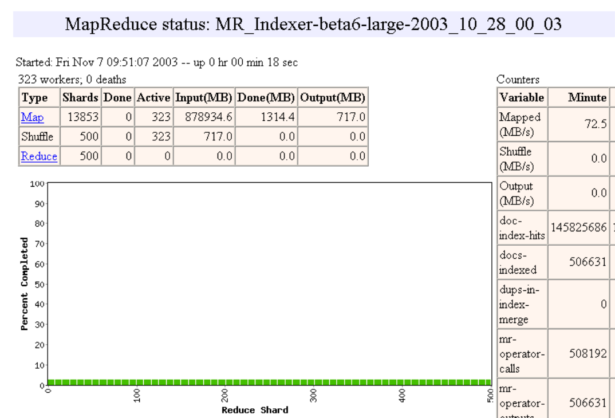

Slide 31
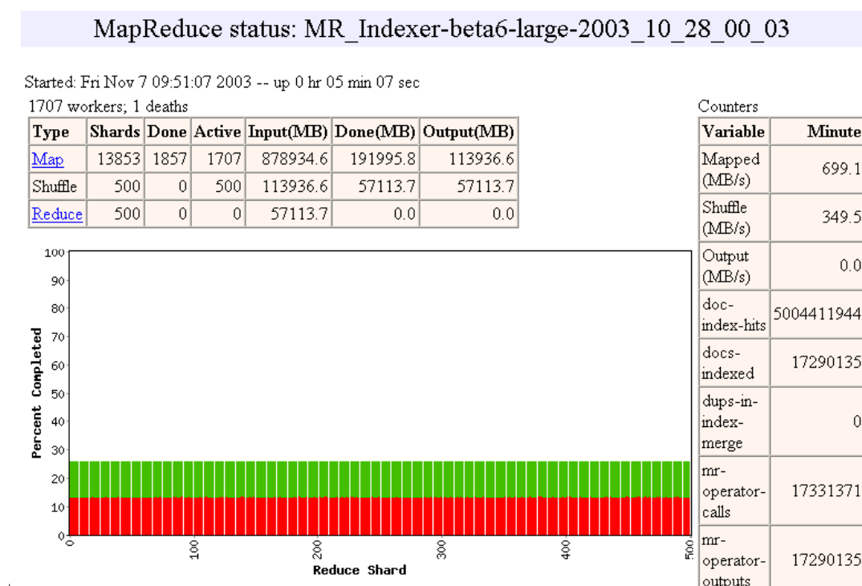

Slide 32
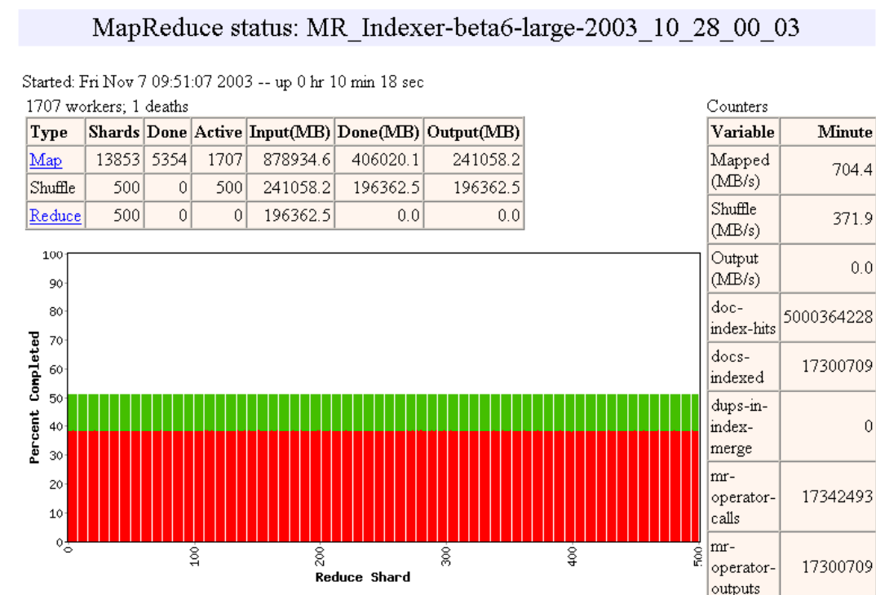

Slide 33
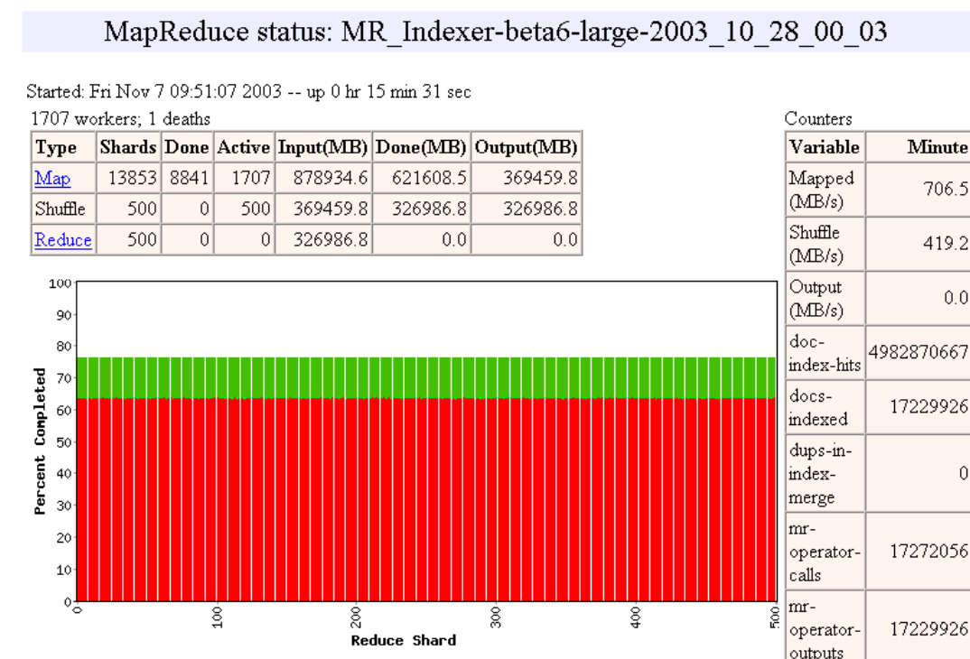

Slide 34
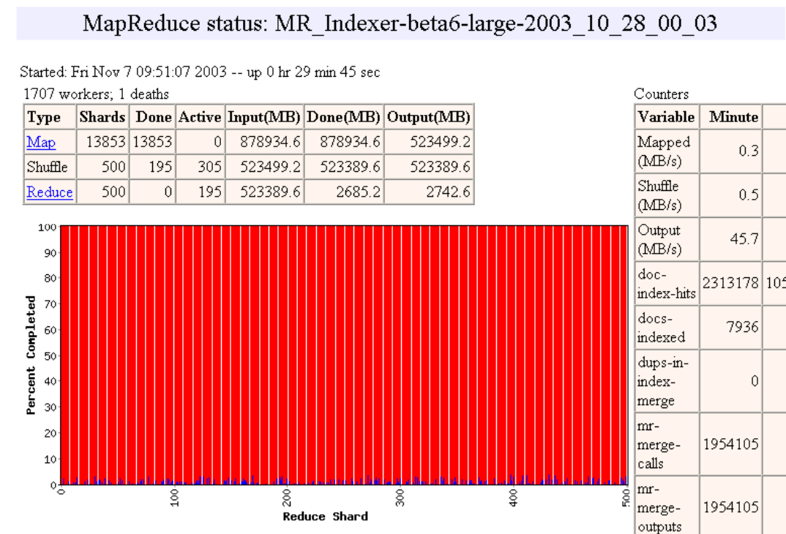

Slide 35
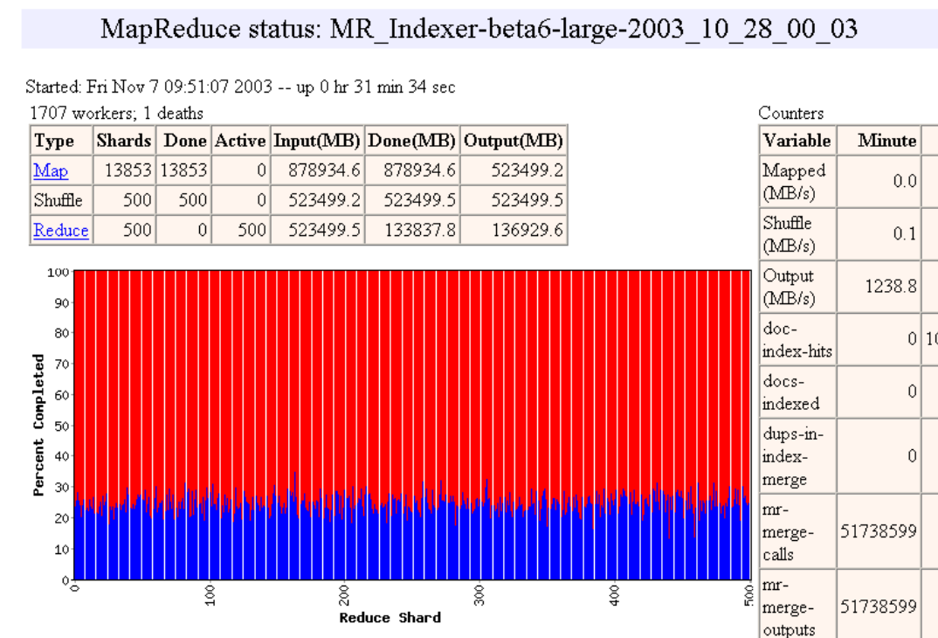

Slide 36
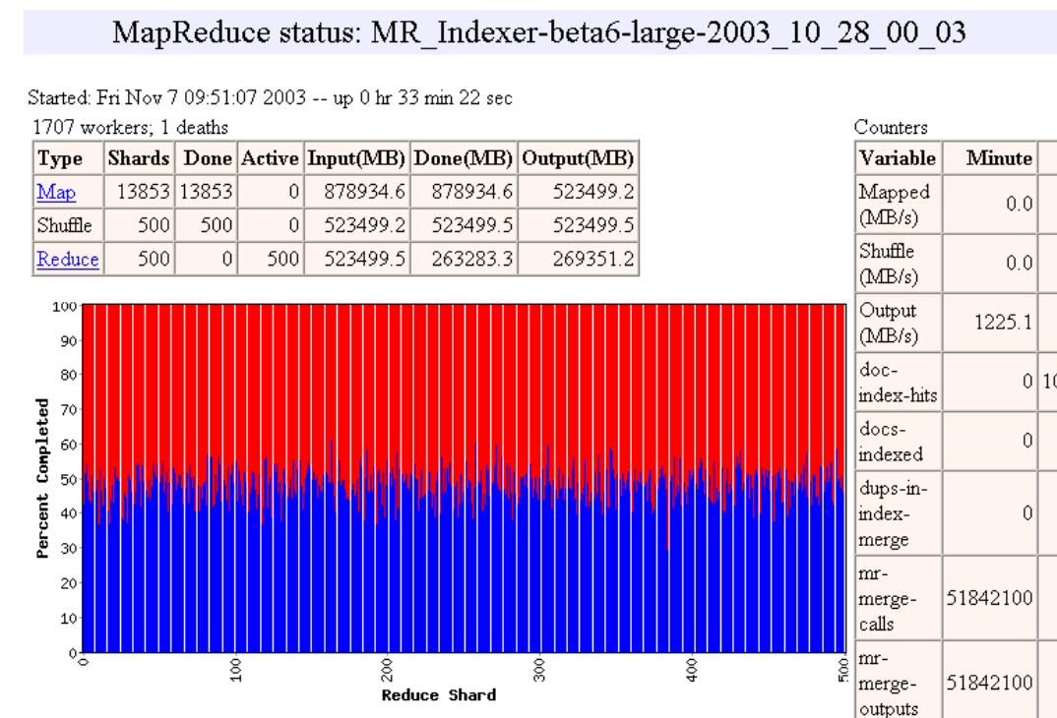

Slide 37
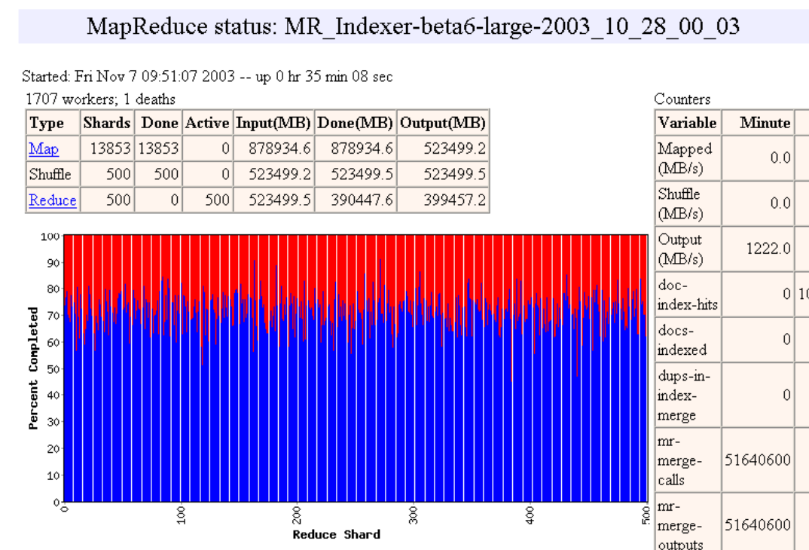

Slide 38
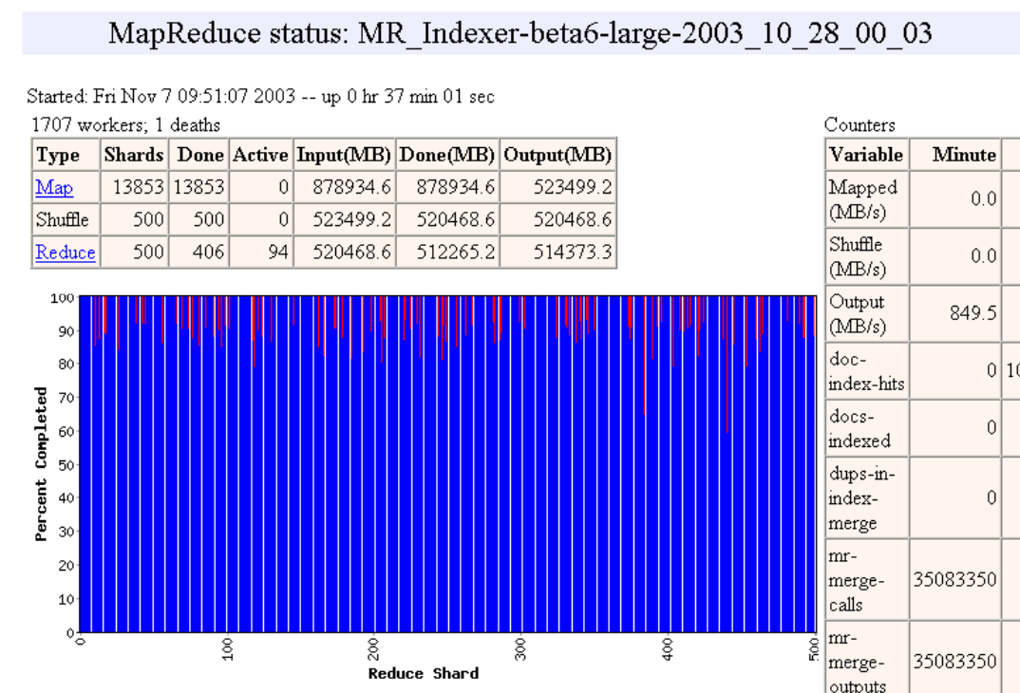

Slide 41
MapReduce Failure Handling
On worker failure:
Detect failure via periodic heartbeats
Re-execute completed and in-progress map tasks
Re-execute in progress reduce tasks
Task completion committed through master
Master failure:
Could handle, but don't yet (master failure unlikely)
Robust: lost 1600 of 1800 machines once, but finished fine

Slide 42
MapReduce Redundant Execution
Slow workers significantly lengthen completion time
Other jobs consuming resources on machine
Bad disks with soft errors transfer data very slowly
Weird things: processor caches disabled (!!)
Solution: Near end of phase, spawn backup copies of tasks
Whichever one finishes first "wins"
Effect: Dramatically shortens job completion time
3% more resources, large tasks 30% faster

Slide 43
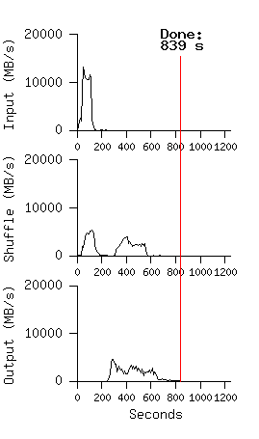
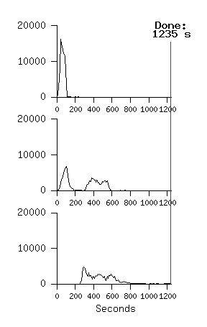
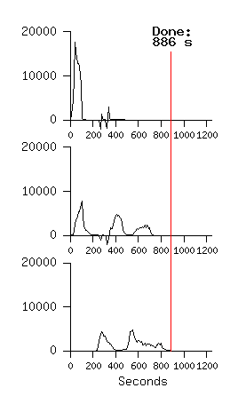
Impact on Execution of Restart, Failure for 10B record Sort using 1800 servers
No Backup Tasks
(44% Longer)
Kill 200 workers
(5% Longer)
Notes:
Figure 3 (a) shows the progress of a normal execution of the sort program.
The top-left graph shows the rate at which input is read. The rate peaks at about 13 GB/s and dies off fairly quickly since all map tasks finish before 200 seconds have elapsed.
The middle-left graph shows the rate at which data is sent over the network from the map tasks to the reduce tasks. This shuffling starts as soon as the first map task completes. The first hump in the graph is for the first batch of approximately 1700 reduce tasks (the entire MapReduce was assigned about 1700 machines, and each machine executes at most one reduce task at a time). Roughly 300 seconds into the computation, some of these first batch of reduce tasks finish and we start shuffling data for the remaining reduce tasks. All of the shuffling is done about 600 seconds into the computation.
The bottom-left graph shows the rate at which sorted data is written to the final output files by the reduce tasks. There is a delay between the end of the first shuffling period and the start of the writing period because the machines are busy sorting the intermediate data. The writes continue at a rate of about 2-4 GB/s for a while. All of the writes finish about 850 seconds into the computation.
Including startup overhead, the entire computation takes 891 seconds.
A few things to note: the input rate is higher than the shuffle rate and the output rate because of our locality optimization – most data is read from a local disk and bypasses our relatively bandwidth constrained network.
The shuffle rate is higher than the output rate because the output phase writes two copies of the sorted data (we make two replicas of the output for reliability and avail- ability reasons). We write two replicas because that is the mechanism for reliability and availability provided by our underlying file system.
In Figure 3 (b)[middle], we show an execution of the sort pro- gram with backup tasks disabled. The execution flow is similar to that shown in Figure 3 (a), except that there is a very long tail where hardly any write activity occurs. After 960 seconds, all except 5 of the reduce tasks are completed. However these last few stragglers don’t fin- ish until 300 seconds later. The entire computation takes 1283 seconds, an increase of 44% in elapsed time.
In Figure 3 (c)[right], we show an execution of the sort program where we intentionally killed 200 out of 1746 worker processes several minutes into the computation. The underlying cluster scheduler immediately restarted new worker processes on these machines (since only the pro- cesses were killed, the machines were still functioning properly).The worker deaths show up as a negative input rate since some previously completed map work disappears (since the corresponding map workers were killed) and needs to be redone. The re-execution of this map work happens relatively quickly. The entire computation fin- ishes in 933 seconds including startup overhead (just an increase of 5% over the normal execution time).

Slide 44
MapReduce Locality Optimization during Scheduling
Master scheduling policy:
Asks GFS (Google File System) for locations of replicas of input file blocks
Map tasks typically split into 64MB (== GFS block size)
Map tasks scheduled so GFS input block replica are on same machine or same rack
Effect: Thousands of machines read input at local disk speed
Without this, rack switches limit read rate

Slide 45
Question: Which statements are NOT TRUE about about MapReduce?
☐
MapReduce divides computers into 1 master and N-1 workers; masters assigns MR tasks
☐
Towards the end, the master assigns uncompleted tasks again; 1st to finish wins
☐
Reducers can start reducing as soon as they start to receive Map data
☐
Reduce worker sorts by intermediate keys to group all occurrences of same key
Notes:
VertLeftWhiteCheck1

Slide 46
Question: Which statements are NOT TRUE about about MapReduce?
☐
MapReduce divides computers into 1 master and N-1 workers; masters assigns MR tasks
☐
Towards the end, the master assigns uncompleted tasks again; 1st to finish wins
☐
Reducers can start reducing as soon as they start to receive Map data
☐
Reduce worker sorts by intermediate keys to group all occurrences of same key
Notes:
VertLeftWhiteCheck1

Slide 47
Agenda
MapReduce Examples
Administrivia + 61C in the News + The secret to getting good grades at Berkeley
MapReduce Execution
Costs in Warehouse Scale Computer

Slide 48
Design Goals of a WSC
Unique to Warehouse-scale
Ample parallelism:
Batch apps: large number independent data sets with independent processing. Also known as Data-Level Parallelism
Scale and its Opportunities/Problems
Relatively small number of these make design cost expensive and difficult to amortize
But price breaks are possible from purchases of very large numbers of commodity servers
Must also prepare for high component failures
Operational Costs Count:
Cost of equipment purchases << cost of ownership

Slide 49
WSC Case Study Server Provisioning
WSC Power Capacity |  | 8.00 | MW
Power Usage Effectiveness (PUE) | 1.45
IT Equipment Power Share | 0.67 | 5.36 | MW
Power/Cooling Infrastructure | 0.33 | 2.64 | MW
IT Equipment Measured Peak (W) | 145.00
Assume Average Pwr @ 0.8 Peak | 116.00
# of Servers |  | 46207
# of Servers |  | 46000
# of Servers per Rack | 40.00
# of Racks |  | 1150
Top of Rack Switches |  | 1150
# of TOR Switch per L2 Switch | 16.00
# of L2 Switches |  | 72
# of L2 Switches per L3 Switch | 24.00
# of L3 Switches |  | 3
Internet
L3 Switch
L2 Switch
…
TOR Switch
Server
Rack …

Slide 50
Cost of WSC
US account practice separates purchase price and operational costs
Capital Expenditure (CAPEX) is cost to buy equipment (e.g.. buy servers)
Operational Expenditure (OPEX) is cost to run equipment (e.g., pay for electricity used)

Slide 51
WSC Case Study Capital Expenditure (Capex)
Facility cost and total IT cost look about the same
Facility Cost | $88,000,000
Total Server Cost | $66,700,000
Total Network Cost | $12,810,000
Total Cost | $167,510,000
However, replace servers every 3 years, networking gear every 4 years, and facility every 10 years

Slide 52
Cost of WSC
US account practice allow converting Capital Expenditure (CAPEX) into Operational Expenditure (OPEX) by amortizing costs over time period
Servers 3 years
Networking gear 4 years
Facility 10 years

Slide 53
WSC Case Study Operational Expense (Opex)
Years
Amortization
Monthly Cost
Amortized
Capital
Expense
Server | 3 | $66,700,000 | $2,000,000 | 55%
Network | 4 | $12,530,000 | $295,000 | 8%
Facility |  | $88,000,000
Pwr&Cooling | 10 | $72,160,000 | $625,000 | 17%
Other | 10 | $15,840,000 | $140,000 | 4%
Amortized Cost |  |  | $3,060,000
Power (8MW) |  | $0.07 | $475,000 | 13%
People (3) |  |  | $85,000 | 2%
Total Monthly |  |  | $3,620,000 | 100%
Operational
Expense
$/kWh
Monthly Power costs
$475k for electricity
$625k + $140k to amortize facility power distribution and cooling
60% is amortized power distribution and cooling

Slide 54
How much does a watt cost in a WSC?
8 MW facility
Amortized facility, including power distribution and cooling is $625k + $140k = $765k
Monthly Power Usage = $475k
Watt-Year = ($765k+$475k)*12/8M = $1.86 or about $2 per year
To save a watt, if spend more than $2 a year, lose money

Slide 55
Which statement is TRUE about Warehouse Scale Computer economics?
☐
The dominant operational monthly cost is server replacement.
☐
The dominant operational monthly cost is the electric bill.
☐
The dominant operational monthly cost is facility replacement.
☐
The dominant operational monthly cost is operator salaries.
Notes:
VertLeftWhiteCheck1
No

Slide 56
Which statement is TRUE about Warehouse Scale Computer economics?
☐
The dominant operational monthly cost is server replacement.
☐
The dominant operational monthly cost is the electric bill.
☐
The dominant operational monthly cost is facility replacement.
☐
The dominant operational monthly cost is operator salaries.
Notes:
VertLeftWhiteCheck1
No

Slide 57
WSC Case Study Operational Expense (Opex)
Years
Amortization
Monthly Cost
Amortized
Capital
Expense
Server | 3 | $66,700,000 | $2,000,000 | 55%
Network | 4 | $12,530,000 | $295,000 | 8%
Facility |  | $88,000,000
Pwr&Cooling | 10 | $72,160,000 | $625,000 | 17%
Other | 10 | $15,840,000 | $140,000 | 4%
Amortized Cost |  |  | $3,060,000
Power (8MW) |  | $0.07 | $475,000 | 13%
People (3) |  |  | $85,000 | 2%
Total Monthly |  |  | $3,620,000 | 100%
Operational
Expense
$/kWh
$3.8M/46000 servers = ~$80 per month per server in revenue to break even
~$80/720 hours per month = $0.11 per hour
So how does Amazon EC2 make money???

Slide 58
January 2012 AWS Instances & Prices
Instance | Per Hour | Ratio to Small | Compute Units | Virtual Cores | Compute Unit/ Core | Memory (GB) | Disk (GB) | Address
Standard Small | $0.085 | 1.0 | 1.0 | 1 | 1.00 | 1.7 | 160 | 32 bit
Standard Large | $0.340 | 4.0 | 4.0 | 2 | 2.00 | 7.5 | 850 | 64 bit
Standard Extra Large | $0.680 | 8.0 | 8.0 | 4 | 2.00 | 15.0 | 1690 | 64 bit
High-Memory Extra Large | $0.500 | 5.9 | 6.5 | 2 | 3.25 | 17.1 | 420 | 64 bit
High-Memory Double Extra Large | $1.200 | 14.1 | 13.0 | 4 | 3.25 | 34.2 | 850 | 64 bit
High-Memory Quadruple Extra Large | $2.400 | 28.2 | 26.0 | 8 | 3.25 | 68.4 | 1690 | 64 bit
High-CPU Medium | $0.170 | 2.0 | 5.0 | 2 | 2.50 | 1.7 | 350 | 32 bit
High-CPU Extra Large | $0.680 | 8.0 | 20.0 | 8 | 2.50 | 7.0 | 1690 | 64 bit
Cluster Quadruple Extra Large | $1.300 | 15.3 | 33.5 | 16 | 2.09 | 23.0 | 1690 | 64 bit
Closest computer in WSC example is Standard Extra Large
@$0.11/hr, Amazon EC2 can make money!
even if used only 50% of time

Slide 59
And in Conclusion, …
Request-Level Parallelism
High request volume, each largely independent of other
Use replication for better request throughput, availability
MapReduce Data Parallelism
Map: Divide large data set into pieces for independent parallel processing
Reduce: Combine and process intermediate results to obtain final result
WSC CapEx vs. OpEx
Economies of scale mean WSC can sell computing as a utility
Servers dominate cost
Spend more on power distribution and cooling infrastructure than on monthly electricity costs

