Slide 1
CS 61C: Great Ideas in Computer Architecture (Machine Structures) Course Introduction
Instructors:
Krste Asanovic Randy H. Katz
http://inst.eecs.Berkeley.edu/~cs61c/F12

Slide 2
Agenda
Great Ideas in Computer Architecture
Administrivia
PostPC Era: From Phones to Datacenters

Slide 3
Agenda
Great Ideas in Computer Architecture
Administrivia
PostPC Era: From Phones to Datacenters

Slide 4
CS61c is NOT really about C Programming
It is about the hardware-software interface
What does the programmer need to know to achieve the highest possible performance
Languages like C are closer to the underlying hardware, unlike languages like Scheme!
Allows us to talk about key hardware features in higher level terms
Allows programmer to explicitly harness underlying hardware parallelism for high performance

Slide 5
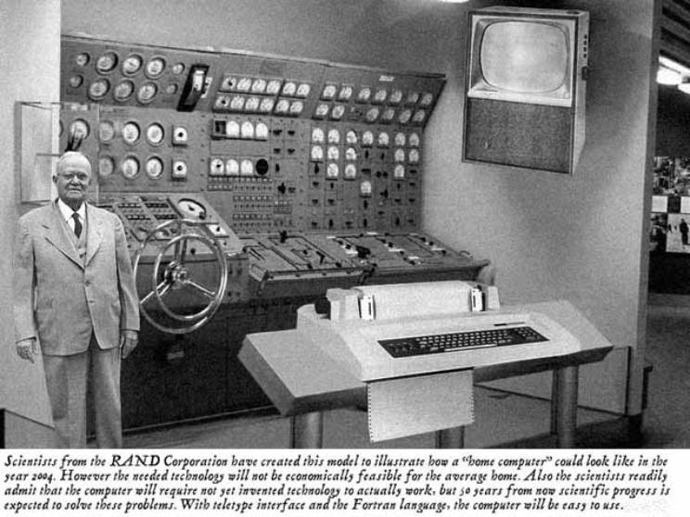
Old School CS61c

Slide 6
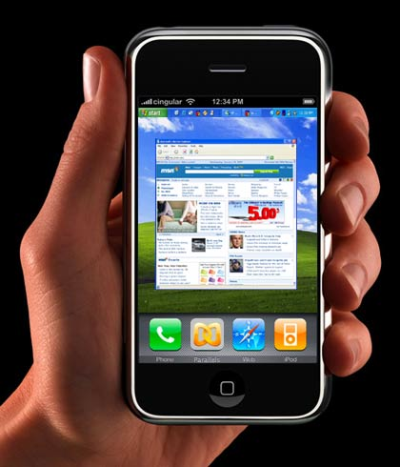
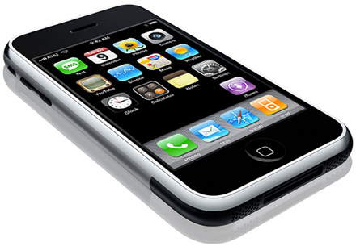
New School CS61c
Personal Mobile Devices

Slide 7
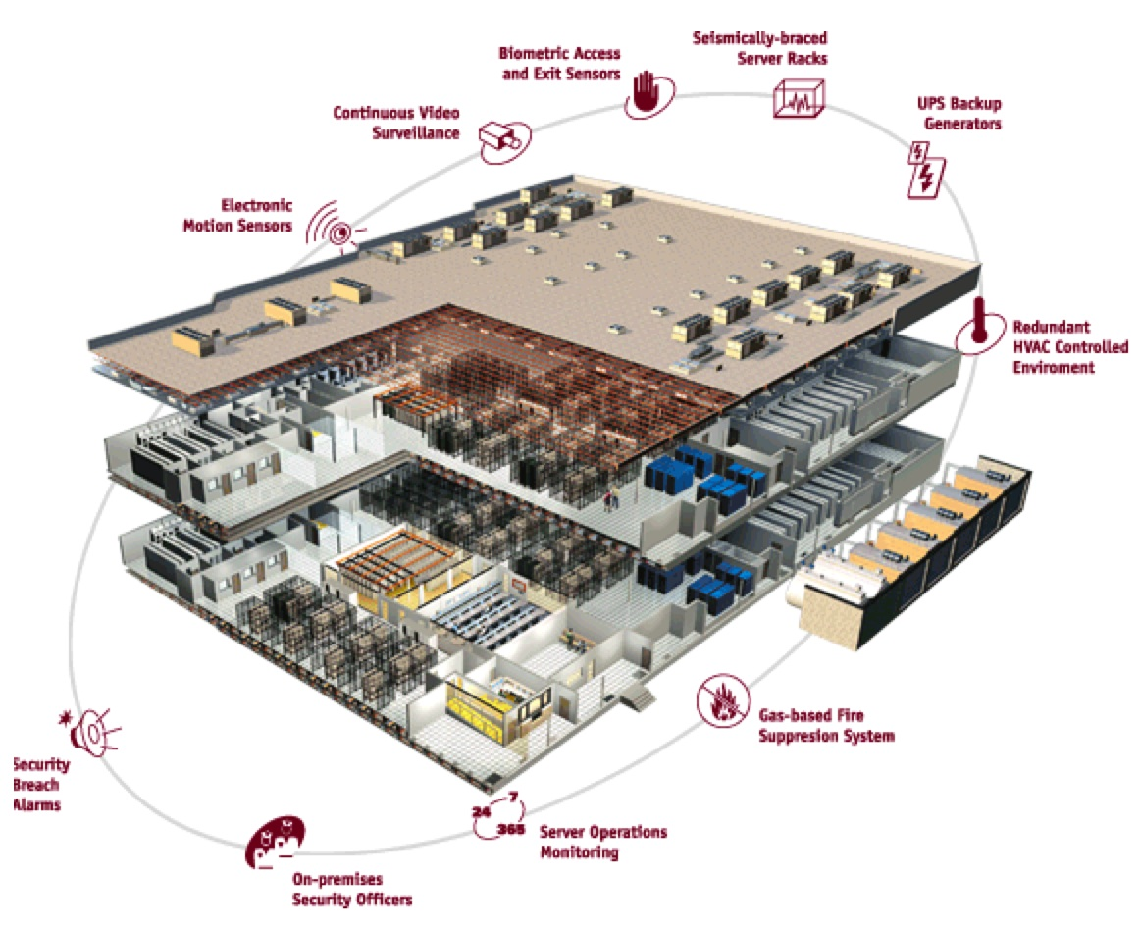
Warehouse
Scale
Computer

Slide 8
Old-School Machine Structures
Application (ex: browser)
CS61c
Operating
Compiler
System
(Mac OSX)
Software
Assembler
Instruction Set
Architecture
Hardware
Processor
Memory
I/O system
Datapath & Control
Digital Design
Circuit Design
transistors

Slide 9
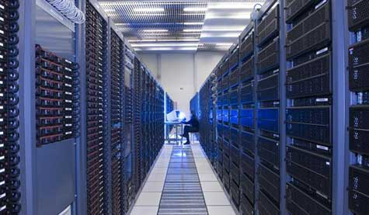
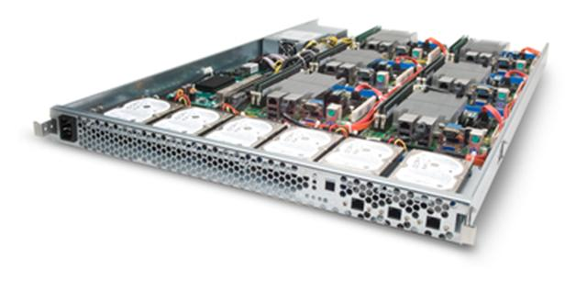
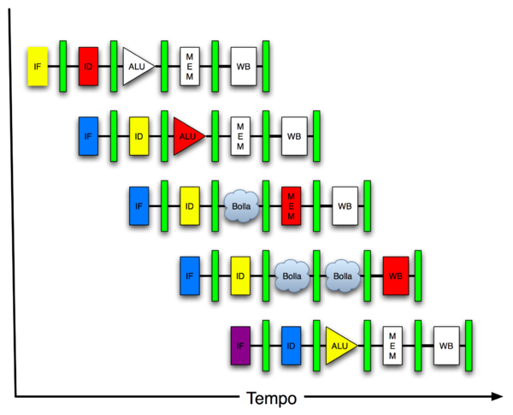
New-School Machine Structures (It’s a bit more complicated!)
Project 1
Software Hardware
Parallel Requests
Assigned to computer
e.g., Search “Katz”
Parallel Threads
Assigned to core
e.g., Lookup, Ads
Parallel Instructions
>1 instruction @ one time
e.g., 5 pipelined instructions
Parallel Data
>1 data item @ one time
e.g., Add of 4 pairs of words
Hardware descriptions
All gates functioning in parallel at same time
Warehouse Scale Computer
Smart Phone
Harness Parallelism &
Achieve High Performance
Project 2
Computer
Core
…
Core
Memory (Cache)
Project 3
Input/Output
Core
Instruction Unit(s)
Functional
Unit(s)
A₀+B₀
A₁+B₁
A₂+B₂
A₃+B₃
Main Memory
Logic Gates
Project 4

Slide 10
6 Great Ideas in Computer Architecture
Layers of Representation/Interpretation
Moore’s Law
Principle of Locality/Memory Hierarchy
Parallelism
Performance Measurement & Improvement
Dependability via Redundancy

Slide 11
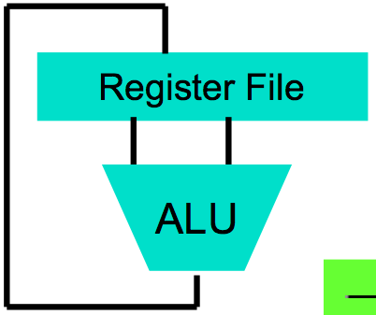
Great Idea #1: Levels of Representation/Interpretation
High Level Language Program (e.g., C)
temp = v[k];
v[k] = v[k+1];
v[k+1] = temp;
Compiler
Anything can be represented as a number, i.e., data or instructions
lw $t0, 0($2)
lw $t1, 4($2)
sw $t1, 0($2)
sw $t0, 4($2)
Assembly Language Program (e.g., MIPS)
Assembler
0000 1001 1100 0110 1010 1111 0101 1000
1010 1111 0101 1000 0000 1001 1100 0110
1100 0110 1010 1111 0101 1000 0000 1001
0101 1000 0000 1001 1100 0110 1010 1111
Machine Language Program (MIPS)
Machine Interpretation
Hardware Architecture Description (e.g., block diagrams)
Architecture Implementation
Logic Circuit Description (Circuit Schematic Diagrams)

Slide 12
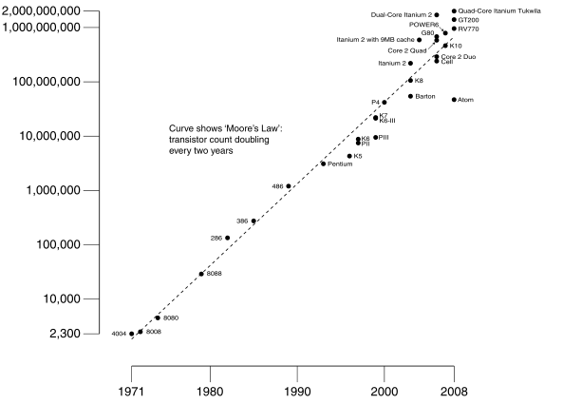
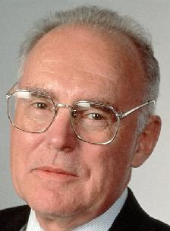
#2: Moore’s Law
Predicts: 2X Transistors / chip every 2 years
# of transistors on an integrated circuit (IC)
Gordon Moore Intel Cofounder B.S. Cal 1950!
Year

Slide 13
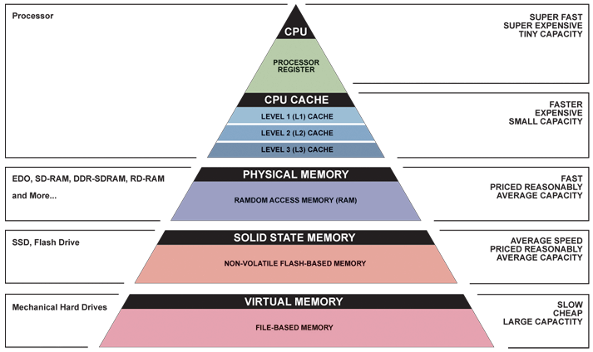
Great Idea #3: Principle of Locality/ Memory Hierarchy

Slide 14
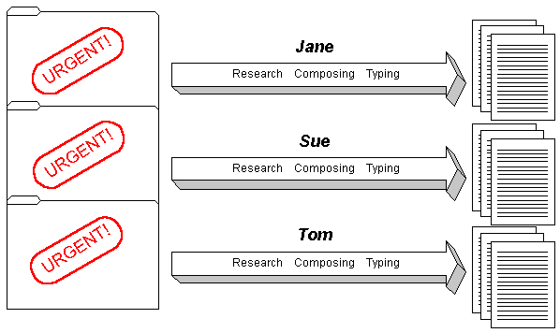
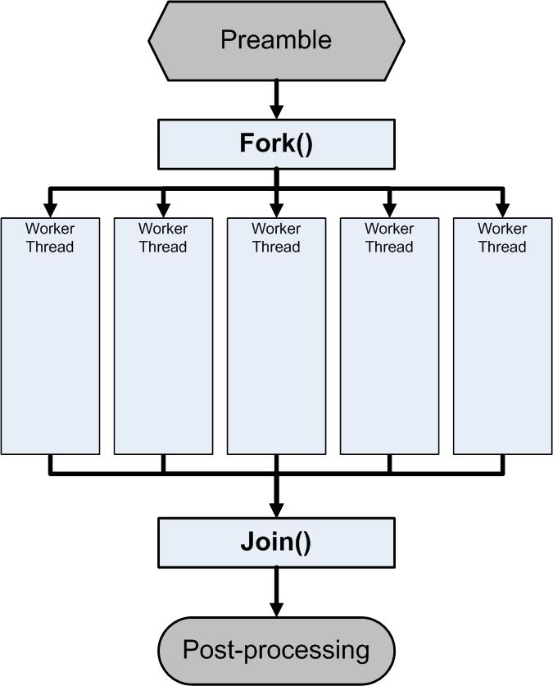
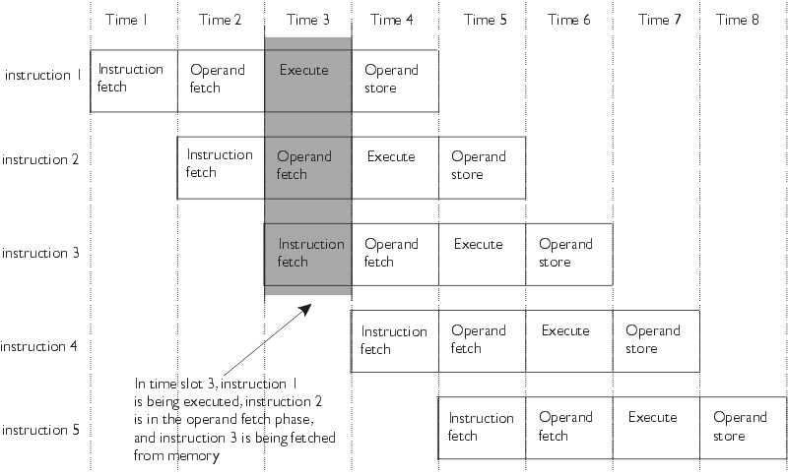
Great Idea #4: Parallelism

Slide 15
Great Idea #5: Performance Measurement and Improvement
Matching application to underlying hardware to exploit:
Locality
Parallelism
Special hardware features, like specialized instructions (e.g., matrix manipulation)
Latency
How long to set the problem up
How much faster does it execute once it gets going
It is all about time to finish

Slide 16
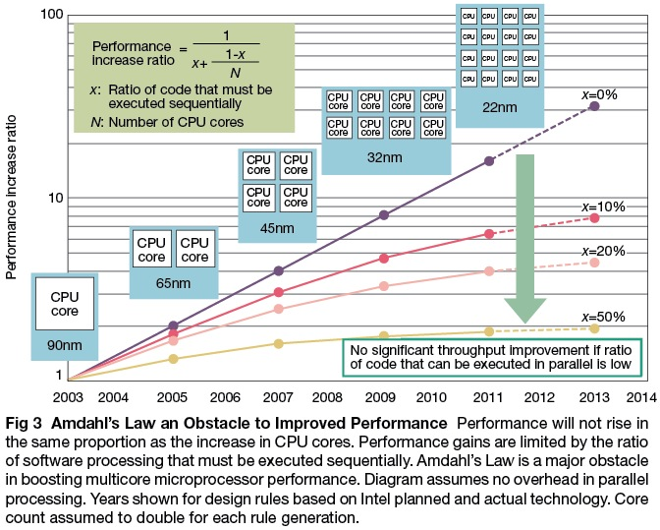

Slide 18
Great Idea #6: Dependability via Redundancy
Redundancy so that a failing piece doesn’t make the whole system fail
1+1=2
2 of 3 agree
1+1=2
1+1=2
1+1=1
FAIL!
Increasing transistor density reduces the cost of redundancy

Slide 19
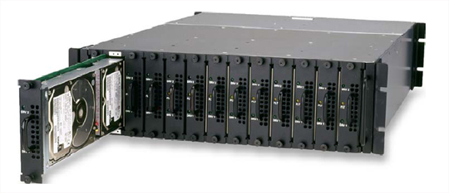
Great Idea #6: Dependability via Redundancy
Applies to everything from datacenters to storage to memory
Redundant datacenters so that can lose 1 datacenter but Internet service stays online
Redundant disks so that can lose 1 disk but not lose data (Redundant Arrays of Independent Disks/RAID)
Redundant memory bits of so that can lose 1 bit but no data (Error Correcting Code/ECC Memory)

Slide 20
Agenda
Great Ideas in Computer Architecture
Administrivia
From Phones to Datacenters

Slide 21
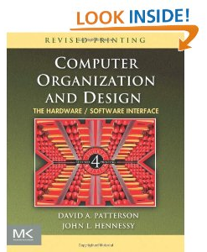
Course Information
Course Web: http://inst.eecs.Berkeley.edu/~cs61c/fa12
Instructors: Krste Asanovic, Randy Katz
Teaching Assistants:
Alan Christopher (Head TA), Loc Do, James Ferguson, Anirudh Garg, William Ku, Brandon Luong, Ravi Punj, Sung Roa Yoon
Textbooks: Average 15 pages of reading/week
Barroso & Holzle (B&H): The Datacenter as a Computer (free download from web page)
Patterson & Hennessey (P&H): Computer Organization and Design, Revised 4th Edition (not ≤3rd Edition, not Asian 4th edition)
Kernighan & Ritchie (K&R): The C Programming Language, 2nd Edition
Piazza for class announcements, Q&A:
Just go to Piazza web page and add yourself to the class
Staff reads them all; please keep it class related and professional

Slide 22
Course Information
The Good News:
Will accommodate as many people as possible
Should be able to add 2 to 3 new lab sections
Wednesday afternoon and evening
64-96 waitlisters!
The Bad News:
Still sorting through TA schedules
Will be posted on Piazza (hopefully this weekend)

Slide 23
Reminders
Labs start next week
Part of first lab is discussion relevant to first HW
Switching Sections: if you find another 61C student willing to swap discussion AND lab, talk to your TAs
Project Partners: only Project 3 and extra credit, OK if partners mix sections but have same TA
First homework assignment due 2 September by 11:59:59 PM
Reading assignment on course page

Slide 24
Course Organization
Grading
Participation and Altruism (5%)
Homework (5%)
Labs (20%)
Projects (40%)
Data Parallelism (Map-Reduce on Amazon EC2)
Computer Instruction Set Simulator (C)
Performance Tuning of a Parallel Application involving Matrix Calculations using cache blocking, SIMD, MIMD (OpenMP, work with partner)
Computer Processor Design (Logisim)
Extra Credit: Matrix Calculation Competition, anything goes
Midterm (10%): 8-10 PM Tuesday October 9
Final (20%): 1130-230PM Monday December 10 (conflicts with EECS 40 – we are bigger, so their problem!)

Slide 25
EECS Grading Policy
http://www.eecs.berkeley.edu/Policies/ugrad.grading.shtml
“A typical GPA for courses in the lower division is 2.7. This GPA would result, for example, from 17% A's, 50% B's, 20% C's, 10% D's, and 3% F's. A class whose GPA falls outside the range 2.5 - 2.9 should be considered atypical.”
Spring 2011: GPA 2.85 24% A's, 49% B's, 18% C's, 6% D's, 3% F's
Job/Intern Interviews: They grill you with technical questions, so it’s what you say, not your GPA
(61c gives you good stuff to say)
 | Fall | Spring
2011 | 2.72 | 2.85
2010 | 2.81 | 2.81
2009 | 2.71 | 2.81
2008 | 2.95 | 2.74
2007 | 2.67 | 2.76

Slide 26
Late Policy
Assignments due Sundays at 11:59:59 PM
Late homeworks not accepted (100% penalty)
Late projects get 20% penalty, accepted up to Tuesdays at 11:59:59 PM
No credit if more than 48 hours late
No “slip days” in 61C
Used by Dan Garcia and a few faculty to cope with 100s of students who often procrastinate without having to hear the excuses, but not widespread in EECS courses
More late assignments if everyone has no-cost options; better to learn now how to cope with real deadlines

Slide 27
Policy on Assignments and Independent Work
With the exception of laboratories and assignments that explicitly permit you to work in groups, all homeworks and projects are to be YOUR work and your work ALONE.
You are encouraged to discuss your assignments with other students, and extra credit will be assigned to students who help others, particularly by answering questions on Piazza, but we expect that what you hand is yours.
It is NOT acceptable to copy solutions from other students.
It is NOT acceptable to copy (or start your) solutions from the Web.
We have tools and methods, developed over many years, for detecting this. You WILL be caught, and the penalties WILL be severe.
At the minimum a ZERO for the assignment, possibly an F in the course, and a letter to your university record documenting the incidence of cheating.
(People are caught every semester!)

Slide 28
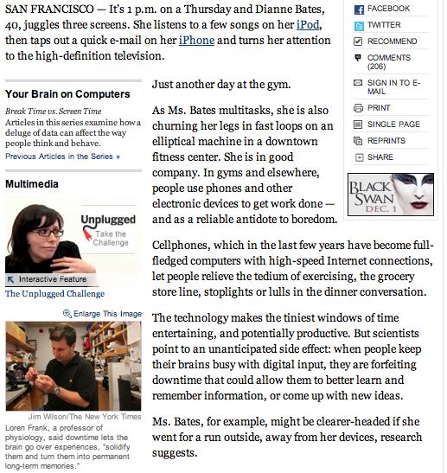
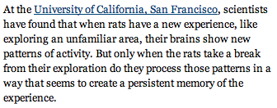

Slide 29
What are the Six Great Ideas in Computer Architecture?
1.
2.
3.
4.
5.
6.

Slide 30
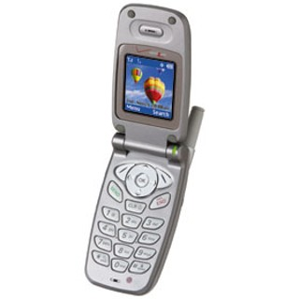
The Rules (and we really mean it!)

Slide 31
Architecture of a Lecture
Full
Administrivia
Tech Break
“And in conclusion…”
Attention
Low
0
15
20
35
37
50
Time (minutes)

Slide 32
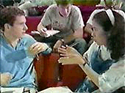
Peer Instruction
Increase real-time learning in lecture, test understanding of concepts vs. details mazur-www.harvard.edu/education/pi.phtml
As complete a “segment” ask multiple choice question
<1 minute: decide yourself, vote
<2 minutes: discuss in pairs, then team vote; flash card to pick answer
Try to convince partner; learn by teaching
Mark and save flash cards (get in discussion section)
1
2
3
4

Slide 33
Question: Which statements are TRUE about this class?
☐
The midterm is Wednesday October 10 during class (11-noon)
☐
The midterm is Tuesday October 9 in the evening (8-10 PM)
☐
We will accommodate EECS 40 students with a special late final examination sitting
☐
I can save money by buying Asian edition of Computer Organization and Design
Notes:
VertLeftWhiteCheck1

Slide 34
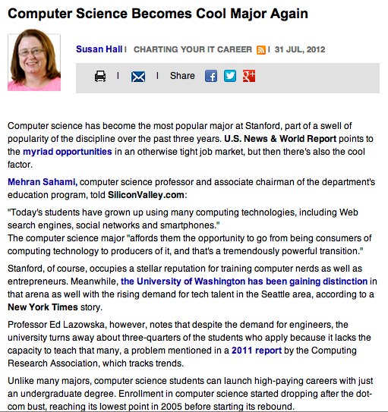
CS61c in the News

Slide 35
Agenda
Great Ideas in Computer Architecture
Administrivia
PostPC Era: From Phones to Datacenters

Slide 36
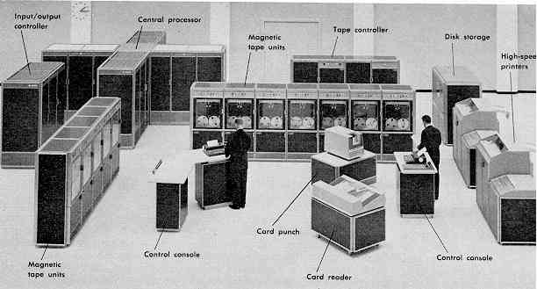
Computer Eras: Mainframe 1950s-60s
Processor (CPU)
I/O
“Big Iron”: IBM, UNIVAC, … build $1M computers for businesses => timesharing OS (Multics)

Slide 37
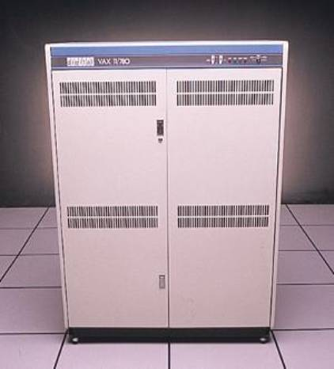
Minicomputer Eras: 1970s
Using integrated circuits, Digital, HP… build $10k computers for labs, universities => UNIX OS

Slide 38
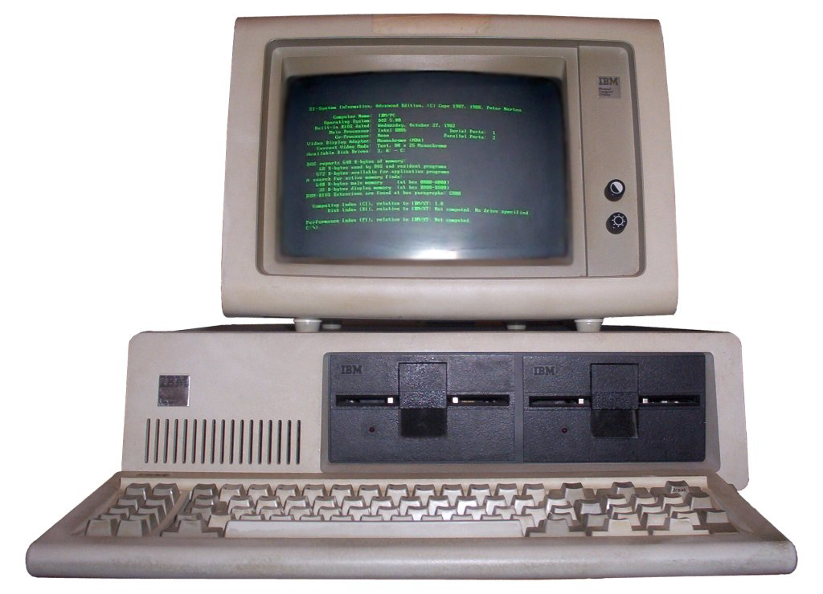
PC Era: Mid 1980s - Mid 2000s
Using microprocessors, Apple, IBM, … build $1k computers for individuals => Windows OS, Linux

Slide 39
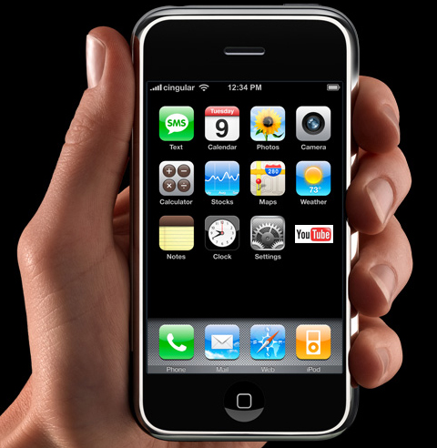
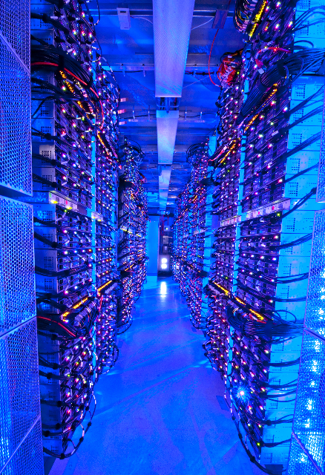
PostPC Era: Late 2000s - ??
Personal Mobile Devices (PMD): Relying on wireless networking, Apple, Nokia, … build $500 smartphone and tablet computers for individuals => Android OS
Cloud Computing: Using Local Area Networks, Amazon, Google, … build $200M Warehouse Scale Computers with 100,000 servers for Internet Services for PMDs
=> MapReduce/Hadoop

Slide 40
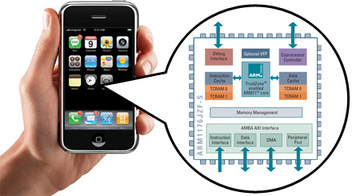
Advanced RISC Machine (ARM) instruction set inside the iPhone
You will how to design and program a related RISC computer: MIPS

Slide 41
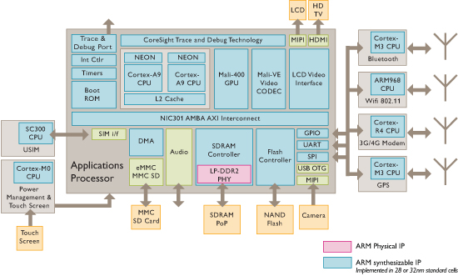
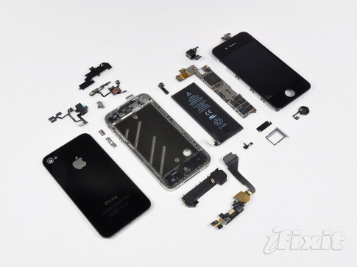
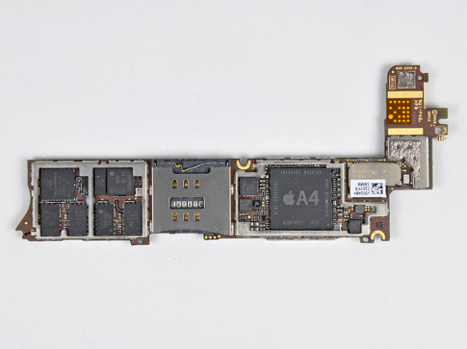
iPhone Innards
I/O
Processor
1 GHz ARM Cortex A8
I/O
I/O
Memory
You will about multiple processors, data level parallelism, caches in 61C

Slide 42
Why Not 80x86 vs. MIPS?
Once learn one, easy to pick up others
80x86 instruction set is not beautiful
≈ Full suitcase then add clothes on way to plane
Class time precious; why spend on minutiae?
MIPS represents energy efficient processor of client (PostPC era) vs. fast processor of desktop (PC era)
MIPS represents more popular instruction set:
2010: 6.1B ARM, 0.3B 80x86 (20X more)

Slide 43
Software as a Service: SaaS
Traditional SW: binary code installed and runs wholly on client device
SaaS delivers SW & data as service over Internet via thin program (e.g., browser) running on client device
Search, social networking, video
Now also SaaS version of traditional SW
E.g., Microsoft Office 365, TurboTax Online

Slide 44
6 Reasons for SaaS
No install worries about HW capability, OS
No worries about data loss (at remote site)
Easy for groups to interact with same data
If data is large or changed frequently, simpler to keep 1 copy at central site
1 copy of SW, controlled HW environment => no compatibility hassles for developers
1 copy => simplifies upgrades for developers and no user upgrade requests

Slide 45
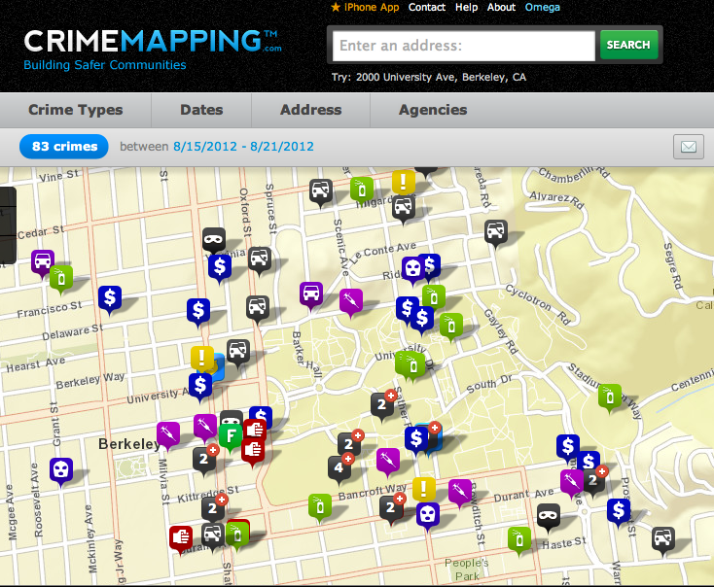
Platform as a Service

Slide 46
SaaS Infrastructure?
SaaS demands on infrastructure
Communication: allow customers to interact with service
Scalability: fluctuations in demand during + new services to add users rapidly
Dependability: service and communication continuously available 24x7

Slide 47
Clusters
Clusters: Commodity computers connected by commodity Ethernet switches
More scalable than conventional servers
Much cheaper than conventional servers
20X for equivalent vs. largest servers
Few operators for 1000s servers
Careful selection of identical HW/SW
Virtual Machine Monitors simplify operation
Dependability via extensive redundancy

Slide 48
The Big Switch: Cloud Computing
“A hundred years ago, companies stopped generating their own power with steam engines and dynamos and plugged into the newly built electric grid. The cheap power pumped out by electric utilities didn’t just change how businesses operate. It set off a chain reaction of economic and social transformations that brought the modern world into existence. Today, a similar revolution is under way. Hooked up to the Internet’s global computing grid, massive information-processing plants have begun pumping data and software code into our homes and businesses. This time, it’s computing that’s turning into a utility.”

Slide 49
“And In Conclusion, …”
CS61c: Learn 6 great ideas in computer architecture to enable high performance programming via parallelism, not just learn C
Layers of Representation/Interpretation
Moore’s Law
Principle of Locality/Memory Hierarchy
Parallelism
Performance Measurement and Improvement
Dependability via Redundancy
Post PC Era: Parallel processing, smart phone to WSC, Software that executes across the net

