Slide 1

In the news
"The cloud isn't this big fluffy area up in the sky," said Rich Miller, who edits Data Center Knowledge, a publication that follows the data center industry. "It's buildings filled with servers and generators."
“…. you'd be hard-pressed to go three miles here without passing some type of data center. "They're all over the place."

Slide 2
CS 61C: Great Ideas in Computer Architecture (Machine Structures)
Lecture 18 – Data Parallelism 1
Instructors:
Michael Franklin
Dan Garcia
http://inst.eecs.Berkeley.edu/~cs61c/fa11

Slide 3
Review
Great Ideas
  Layers of Representation/Interpretation
  Moore’s Law
  Principle of Locality/Memory Hierarchy
  Parallelism
  Performance Measurement and Improvement
  Dependability via Redundancy
Post PC Era: Parallel processing, smart phones to WSC
WSC SW must cope with failures, varying load, varying HW latency bandwidth
WSC HW sensitive to cost, energy efficiency

Slide 4





New-School Machine Structures
(It’s a bit more complicated!)
Today’s Lecture
Software Hardware
Parallel Requests
  Assigned to computer
  e.g., Search “Garcia”
Parallel Threads
  Assigned to core
  e.g., Lookup, Ads
Parallel Instructions
  >1 instruction @ one time
  e.g., 5 pipelined instructions
Parallel Data
  >1 data item @ one time
  e.g., Add of 4 pairs of words
Hardware descriptions
  All gates @ one time
Warehouse Scale Computer
Smart
Phone
Harness
Parallelism &
Achieve High
Performance
Computer
Core
…
Core
Memory (Cache)
Input/Output
Core
Instruction Unit(s)
Functional
Unit(s)
A₀+B₀
A₁+B₁
A₂+B₂
A₃+B₃
Main Memory
Logic Gates

Slide 5
Agenda
Request and Data Level Parallelism
MapReduce
MapReduce Examples

Slide 6
Request-Level Parallelism (RLP)
Hundreds or thousands of requests per second
  Not your laptop or cell-phone, but popular Internet services like web search, social networking,…
  Such requests are largely independent
    Often involve read-mostly databases
    Rarely involve strict read–write data sharing or synchronization across requests
Computation easily partitioned within a request and across different requests

Slide 7
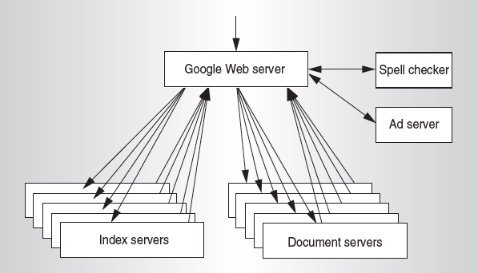
Google Query-Serving Architecture

Slide 8
Anatomy of a Web Search
Google “Dan Garcia”

Slide 9



Slide 10
Anatomy of a Web Search (1 of 3)
Google “Dan Garcia”
  Direct request to “closest” Google Warehouse Scale Computer
  Front-end load balancer directs request to one of many arrays (cluster of servers) within WSC
  Within array, select one of many Google Web Servers (GWS) to handle the request and compose the response pages
  GWS communicates with Index Servers to find documents that contain the search words, “Dan”, “Garcia”, uses location of search as well
  Return document list with associated relevance score

Slide 11
Anatomy of a Web Search (2 of 3)
In parallel,
  Ad system: run ad auction for bidders on search terms
  Get Images of various Dan Garcias
Use docids (document IDs) to access indexed documents
Compose the page
  Result document extracts (with keyword in context) ordered by relevance score
  Sponsored links (along the top) and advertisements (along the sides)

Slide 12
Anatomy of a Web Search (3 of 3)
Implementation strategy
  Randomly distribute the entries
  Make many copies of data (aka “replicas”)
  Load balance requests across replicas
Redundant copies of indices and documents
  Breaks up hot spots, e.g., “Justin Bieber”
  Increases opportunities for request-level parallelism
  Makes the system more tolerant of failures

Slide 13
Data-Level Parallelism (DLP)
2 kinds
  Lots of data in memory that can be operated on in parallel (e.g., adding together 2 arrays)
  Lots of data on many disks that can be operated on in parallel (e.g., searching for documents)
Future lecture and 3rd project does Data Level Parallelism (DLP) in memory
Today’s lecture and 2nd project does DLP across many servers and disks using MapReduce

Slide 14
What is MapReduce?
Simple data-parallel programming model designed for scalability and fault-tolerance
Pioneered by Google
  Processes >25 petabytes of data per day
Popularized by open-source Hadoop project
  Used at Yahoo!, Facebook, Amazon, …

Slide 15
What is MapReduce used for?
At Google:
  Index construction for Google Search
  Article clustering for Google News
  Statistical machine translation
  For computing multi-layer street maps
At Yahoo!:
  “Web map” powering Yahoo! Search
  Spam detection for Yahoo! Mail
At Facebook:
  Data mining
  Ad optimization
  Spam detection

Slide 16
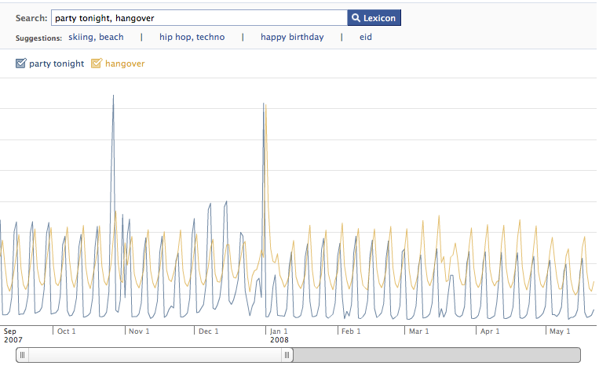
Example: Facebook Lexicon
www.facebook.com/lexicon
(no longer available)

Slide 17
MapReduce Design Goals
Scalability to large data volumes:
  1000’s of machines, 10,000’s of disks
Cost-efficiency:
  Commodity machines (cheap, but unreliable)
  Commodity network
  Automatic fault-tolerance (fewer administrators)
  Easy to use (fewer programmers)
Jeffrey Dean and Sanjay Ghemawat, “MapReduce: Simplified Data Processing on Large Clusters,” Communications of the ACM, Jan 2008.

Slide 18
MapReduce Solution
Apply Map function to user supplied record of key/value pairs
  Compute set of intermediate key/value pairs
Apply Reduce operation to all values that share same key in order to combine derived data properly
User supplies Map and Reduce operations in functional model
  so can parallelize,
  can use re-execution for fault tolerance

Slide 19
Data-Parallel “Divide and Conquer”
(MapReduce Processing)
Map:
  Slice data into “shards” or “splits”, distribute these to workers, compute sub-problem solutions
  map(in_key,in_value)->list(out_key,intermediate value)
    Processes input key/value pair
    Produces set of intermediate pairs
Reduce:
  Collect and combine sub-problem solutions
  reduce(out_key,list(intermediate_value))->list(out_value)
    Combines all intermediate values for a particular key
    Produces a set of merged output values (usually just one)
Fun to use: focus on problem, let MapReduce library deal with messy details

Slide 20
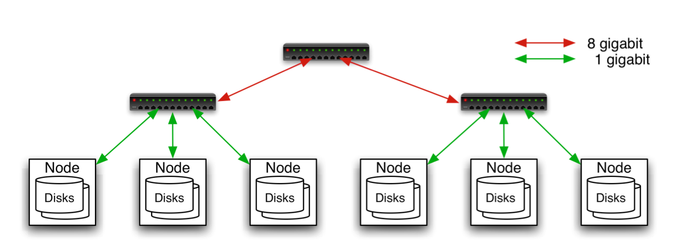
Typical Hadoop Cluster
Aggregation switch
Rack switch
40 nodes/rack, 1000-4000 nodes in cluster
1 Gbps bandwidth within rack, 8 Gbps out of rack
Node specs (Yahoo terasort):
8 x 2GHz cores, 8 GB RAM, 4 disks (= 4 TB?)
Image from http://wiki.apache.org/hadoop-data/attachments/HadoopPresentations/attachments/YahooHadoopIntro-apachecon-us-2008.pdf

Slide 21
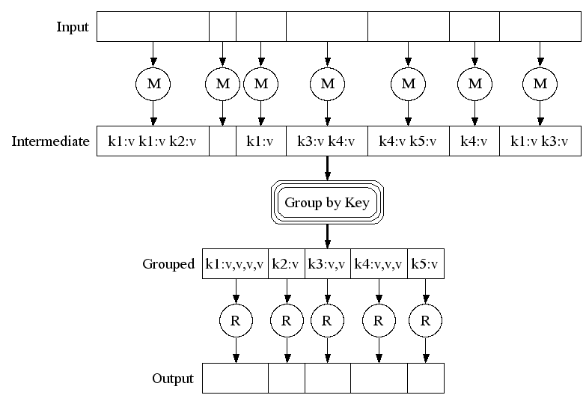
MapReduce Execution
Fine granularity tasks: many more map tasks than machines
2000 servers =>
≈ 200,000 Map Tasks, ≈ 5,000 Reduce tasks

Slide 22
MapReduce Processing
Example: Count Word Occurrences
map(String input_key, String input_value):
// input_key: document name
// input_value: document contents
for each word w in input_value:
EmitIntermediate(w, "1"); // Produce count of words
reduce(String output_key, Iterator intermediate_values):
// output_key: a word
// output_values: a list of counts
int result = 0;
for each v in intermediate_values:
result += ParseInt(v); // get integer from key-value
Emit(AsString(result));

Slide 23
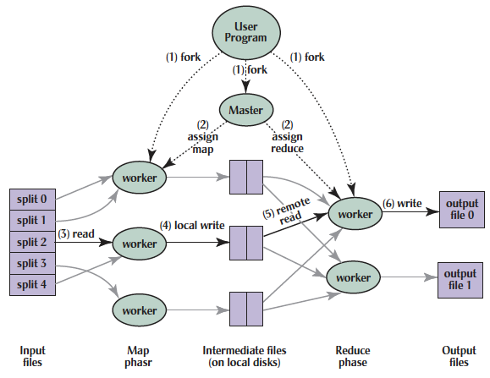
MapReduce Processing
Shuffle phase

Slide 24
MapReduce Processing
1. MR 1st splits the input files into M “splits” then starts many copies of
program on servers
Shuffle phase

Slide 25
MapReduce Processing
2. One copy—the master— is special. The rest
are workers. The master picks idle workers and
assigns each 1 of M map tasks or 1 of R reduce tasks.
Shuffle phase
Notes:
We subdivide the map phase into M pieces and the reduce phase into R pieces as described previously. Ideally, M and R should be much larger than the number of worker machines. Having each worker per- form many different tasks improves dynamic load balancing and also speeds up recovery when a worker fails: the many map tasks it has completed can be spread out across all the other worker machines.There are practical bounds on how large M and R can be in our imple- mentation since the master must make O(M+R) scheduling decisions and keep O(M*R) state in memory as described. (The constant factors for memory usage are small, however. The O(M*R) piece of the state consists of approximately one byte of data per map task/reduce task pair.)Furthermore, R is often constrained by users because the output of each reduce task ends up in a separate output file. In practice, we tend to choose M so that each individual task is roughly 16MB to 64MB of input data (so that the locality optimization described previously is most effective), and we make R a small multiple of the number of worker machines we expect to use. We often perform MapReduce computa- tions with M=200,000 and R=5,000, using 2,000 worker machines.

Slide 26
MapReduce Processing
3. A map worker reads the input split. It parses key/value pairs of the input data and passes each pair to the user-defined map function.
(The intermediate
key/value pairs produced by the map function are buffered in memory.)
Shuffle phase

Slide 27
MapReduce Processing
4. Periodically, the buffered pairs are written to local disk, partitioned
into R regions by the partitioning function.
Shuffle phase
Notes:
The locations of these
buffered pairs on the local disk are passed back to the master who is responsible for forwarding these locations to the reduce workers.
We subdivide the map phase into M pieces and the reduce phase into R pieces as described previously. Ideally, M and R should be much larger than the number of worker machines. Having each worker per- form many different tasks improves dynamic load balancing and also speeds up recovery when a worker fails: the many map tasks it has completed can be spread out across all the other worker machines.There are practical bounds on how large M and R can be in our imple- mentation since the master must make O(M+R) scheduling decisions and keep O(M*R) state in memory as described. (The constant factors for memory usage are small, however. The O(M*R) piece of the state consists of approximately one byte of data per map task/reduce task pair.)Furthermore, R is often constrained by users because the output of each reduce task ends up in a separate output file. In practice, we tend to choose M so that each individual task is roughly 16MB to 64MB of input data (so that the locality optimization described previously is most effective), and we make R a small multiple of the number of worker machines we expect to use. We often perform MapReduce computa- tions with M=200,000 and R=5,000, using 2,000 worker machines.

Slide 28
MapReduce Processing
5. When a reduce worker has read all intermediate data for its partition, it sorts it by the intermediate
keys so that all occurrences of the same key are grouped together.
(The sorting is needed because typically many different keys map to
the same reduce task )
Shuffle phase

Slide 29
MapReduce Processing
6. Reduce worker iterates over sorted intermediate data and for each unique intermediate key, it passes key and corresponding set of values to the user’s reduce function.
The output of the reduce function is appended to a final output file for this reduce partition.
Shuffle phase

Slide 30
MapReduce Processing
7. When all map tasks and reduce tasks have been completed, the master
wakes up the user program. The MapReduce call
In user program returns back to user code.
Output of MR is in R output files (1 per reduce task, with file names specified by user); often passed into another MR job.
Shuffle phase

Slide 31
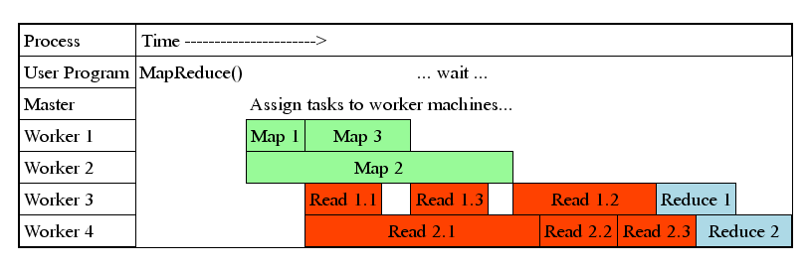
MapReduce Processing Time Line
Master assigns map + reduce tasks to “worker” servers
As soon as a map task finishes, worker server can be assigned a new map or reduce task
Data shuffle begins as soon as a given Map finishes
Reduce task begins as soon as all data shuffles finish
To tolerate faults, reassign task if a worker server “dies”

Slide 32
Another Example: Word Index
(How Often Does a Word Appear?)
Distribute
that that is is that that is not is not is that it it is
Map 1
Map 2
Map 3
Map 4
is 1, that 2
is 1, that 2
is 2, not 2
is 2, it 2, that 1
Shuffle
is 1
is 1,1
that 2
is 1,1,2,2
it 2
that 2,2
that 2,2,1
not 2
Reduce 1
Reduce 2
is 6; it 2
not 2; that 5
Collect
is 6; it 2; not 2; that 5

Slide 33
MapReduce Failure Handling
On worker failure:
  Detect failure via periodic heartbeats
  Re-execute completed and in-progress map tasks
  Re-execute in progress reduce tasks
  Task completion committed through master
Master failure:
  Protocols exist to handle (master failure unlikely)
Robust: lost 1600 of 1800 machines once, but finished fine (story from Google?)

Slide 34
MapReduce Redundant Execution
Slow workers significantly lengthen completion time
  Other jobs consuming resources on machine
  Bad disks with soft errors transfer data very slowly
  Weird things: processor caches disabled (!!)
Solution: Near end of phase, spawn backup copies of tasks
  Whichever one finishes first "wins"
Effect: Dramatically shortens job completion time
  3% more resources, large tasks 30% faster

Slide 35
Summary
Request-Level Parallelism
  High request volume, each largely independent of other
  Use replication for better request throughput, availability
MapReduce Data Parallelism
  Divide large data set into pieces for independent parallel processing
  Combine and process intermediate results to obtain final result

