Slide 1
CS 61C: Great Ideas in Computer Architecture (Machine Structures)
Thread Level Parallelism
Instructors:
Randy H. Katz
David A. Patterson
http://inst.eecs.Berkeley.edu/~cs61c/fa10

Slide 2
Agenda
Review
Data Races and Synchronization
Hardware Support for Multithreading
Atomic Operations in MIPS
Administrivia
Technology Break
OpenMP with Examples
Summary

Slide 3
Review
Sequential software is slow software
  SIMD and MIMD only path to higher performance
Multiprocessor (Multicore) uses Shared Memory (single address space)
Cache coherency implements shared memory even with multiple copies in multiple caches
  False sharing a concern
Thread: unit of execution that OS schedules
  Within one core + across multiple cores

Slide 4
Review: Potential Parallel Performance (assuming SW can use it)
Year | Cores | SIMD bits /Core | Core * SIMD bits | Peak DP FLOPs
2003 | 2 | 128 | 256 | 4
2005 | 4 | 128 | 512 | 8
2007 | 6 | 128 | 768 | 12
2009 | 8 | 128 | 1024 | 16
2011 | 10 | 256 | 2560 | 40
2013 | 12 | 256 | 3072 | 48
2015 | 14 | 512 | 7168 | 112
2017 | 16 | 512 | 8192 | 128
2019 | 18 | 1024 | 18432 | 288
2021 | 20 | 1024 | 20480 | 320
MIMD
SIMD
MIMD
*SIMD
+2/
2yrs
2X/
4yrs
2.5X
8X
20X

Slide 5
Lock and Unlock Synchronization
Lock used to create region (“critical section”) where only 1 processor can operate
Given shared memory, use memory location as synchronization point: “lock” or “semaphore”
Processors read lock to see if must wait, or OK to go into critical section (and set to locked)
0 => lock is free / open / unlocked / lock off
1 => lock is taken / closed / locked / lock on

Slide 6
Peer Instruction: What Happens?
  addiu $t1,$zero, 1 ; t1 = Locked value
  Tryagain: lw $t0, lock($s0) ; load lock
  beq $t0,$t1, Trygain ; loop if 1
  GetLock: sw $t1,lock($s0) ; Lock must be 0?
Implements lock correctly
Infinite Loop, since no change to lock before beq
Doesn’t work because another core could read lock in memory before sw changes it to 1, go to critical section
Doesn’t work because OS could schedule another thread on this core between lw and sw, and the other thread could go into critical section
A)(red) I only
B)(orange) II only
C)(green) III only
D)(yellow) IV only
E)(pink) III and IV
Notes:
2: 104 10 5 10 then 104 11 5 11
…because ints in this system are 4-bytes long and
the actual address increments by 4 even though it appears to only incrememt 1.

Slide 7
Hardware Synchronization
Hardware support required to prevent interloper (either thread on other core or thread on same core) from changing the value
  Atomic read/write memory operation
  No other access to the location allowed between the read and write
Could be a single instruction
  E.g., atomic swap of register ↔ memory
  But MIPS does have instructions that both read and write memory
Or an pair of instructions that acts atomically

Slide 8
Atomic Operation in MIPS
Load linked: ll rt, offset(rs)
Store conditional: sc rt, offset(rs)
  Succeeds if location not changed since the ll
    Returns 1 in rt (clobbers register value being stored)
  Fails if location is changed
    Returns 0 in rt (clobbers register value being stored)
Example: atomic swap (to test/set lock variable)
  try: add $t0,$zero,$s4 ;copy exchange value
  ll $t1,0($s1) ;load linked
  sc $t0,0($s1) ;store conditional
  beq $t0,$zero,try ;branch store fails
  add $s4,$zero,$t1 ;put load value in $s4

Slide 9
Synchronization in MIPS
Example: Check for lock using atomic sequence
  Try: addiu $t0,$zero,1 ;copy locked value
  ll $t1,0($s1) ;load linked
  bne $t1,$zero,try ;loop if lock was 1
  sc $t0,0($s1) ;==0, store conditional
  beq $t0,$zero,try ;branch store fails,
  ;try again
Store conditional: sc rt, offset(rs)
  Succeeds if location not changed since the ll
    Returns 1 in rt (clobbers register value being stored)
  Fails if location is changed
    Returns 0 in rt (clobbers register value being stored)

Slide 10
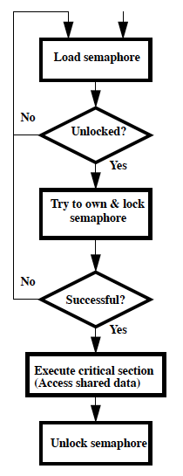
Test and Set
Test-and-set achieves synchronization where only 1 processor is allowed to access a critical section. In general, this technique involves using a variable called the semaphore and assigning values to this variable for the “lock-off” or “lock-on” state. Semaphore can be interpreted as a lock to some critical section. Each processor checks if the lock is off; if so, it tries to lock it by modifying the variable appropriately. Once a processor gets the lock, it is then allowed to modify restricted data or access the critical section. After it is done, it gets out of the critical section and modifies the semaphore to the “lock-off” state so that other processors can get a chance to access it.

Slide 11
Multithreading vs. Multicore
Basic idea: Processor resources are expensive and should not be left idle
Long memory latency to memory on cache miss?
Hardware switches threads to bring in other useful work while waiting for cache miss
Cost of thread context switch must be much less than cache miss latency
Put in redundant hardware so don’t have to save context on every thread switch:
  PC, Registers, L1 caches?
Attractive for apps with abundant TLP
  Commercial multi-user workloads

Slide 12
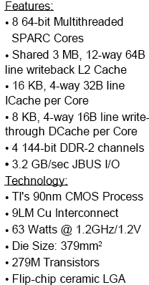
Ultrasparc T1 Die Photo
Reuse FPUs, L2 caches

Slide 13
Machines in 61C Lab
/usr/sbin/sysctl -a | grep hw\.
hw.model = MacPro4,1
…
hw.physicalcpu: 8
hw.logicalcpu: 16
…
hw.cpufrequency =
2,260,000,000
hw.physmem =
2,147,483,648
hw.cachelinesize = 64
hw.l1icachesize: 32,768
hw.l1dcachesize: 32,768
hw.l2cachesize: 262,144
hw.l3cachesize: 8,388,608
Therefore, should try up to 16 threads to see if performance gain even though only 8 cores

Slide 14
Agenda
Review
Data Races and Synchronization
Atomic Operations in MIPS
Hardware Support for Multithreading
Administrivia
Technology Break
OpenMP with Examples
Summary

Slide 15
Administrivia
Midterm answers and grading ruberic online
Turn in your written regrade petitions with your exam to your TA by next Tuesday Oct 19
Make sure all grades are correct but Project 4, Final by December 1
Final Exam 8-11AM (TBD) Monday Dec 13

Slide 16
61C In The News
“Intel CEO Tells Employees That Mobile Effort Will Be 'Marathon’” Bloomberg News/SF Chron, 10/15/10
Intel Corp. Chief Executive Officer Paul Otellini, working to get his company's chips into tablets and mobile phones, told employees that the effort will be a "marathon, not a sprint."
"The big question on many people's minds is how will we respond to new computing categories where we currently have little presence, specifically tablets and smartphones," he said yesterday in an e-mail to Intel workers obtained by Bloomberg News. "Winning an architectural contest can take time.”

Slide 17
OpenMP
OpenMP is an API used for multi-threaded, shared memory parallelism
  Compiler Directives
  Runtime Library Routines
  Environment Variables
Portable, Standardized
Works for C, C++, Fortran
gcc –fopenmp file.c

Slide 18
OpenMP Extends C with Pragmas
Pragmas are a mechanism C provides for language extensions
Commonly implemented pragmas:
structure packing, symbol aliasing, floating point exception modes
Good mechanism for OpenMP because compilers that don't recognize a pragma are supposed to ignore them
  Runs on sequential computer even with embedded pragmas

Slide 19
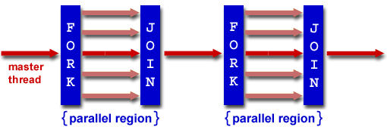
Fork/Join Parallelism
Start out executing the program with one master thread
Master thread forks worker threads
Worker threads die or suspend at end of parallel code
Image courtesy of http://www.llnl.gov/computing/tutorials/openMP/

Slide 20
Thread Creation
How many threads will OpenMP create?
Defined by OMP_NUM_THREADS environment variable
Set this variable to the maximum number of threads you want OpenMP to use
Presumably = number cores in HW running program

Slide 21
OMP_NUM_THREADS
Shell command to set number threads:
export OMP_NUM_THREADS=x
Shell command check number threads:
echo $OMP_NUM_THREADS
OpenMP intrinsic to get number of threads:
int num_th = omp_get_num_threads();
OpenMP intrinsic to get Thread ID number:
int th_ID = omp_get_thread_num();

Slide 22
Invoking Parallel Threads
#pragma omp parallel
{
int ID = omp_get_thread_num();
foo(ID);
}
Each thread executes a copy of the within the structured structured block

Slide 23
OpenMP Critical Section
float res;
#pragma omp parallel
{ float B;int i, id, nthrds;
id = omp_get_thread_num();
nthrds = omp_get_num_threads();
for(i=id;i<niters;i+nthrds){
B = big_job(i);
#pragma omp critical
consume (B, res);
}
}
Threads wait their turn –only one at a time calls consume()

Slide 24
Shared vs. Private Variables
OpenMP default is shared variables
To make private, need to declare with pragma
#pragma omp parallel private (x)
Now, some examples in OpenMP

Slide 25
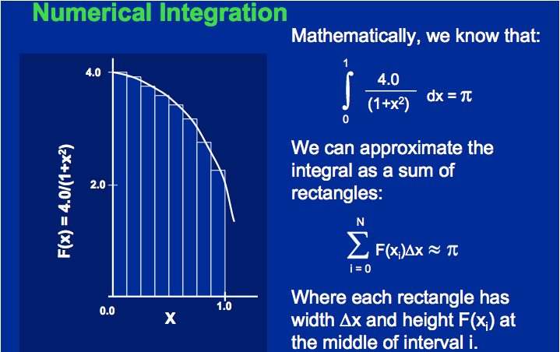
Calculating π

Slide 26
Sequential Calculation of π in C
#include <stdio.h>/* Serial Code */
static long num_steps = 100000; double step;
void main ()
{ int i; double x, pi, sum = 0.0;
step = 1.0/(double) num_steps;
for (i=1;i<= num_steps; i++){
x = (i-0.5)*step;
sum = sum + 4.0/(1.0+x*x);
}
pi = step/num_steps; printf ("pi = %6.12f\n", pi);
}

Slide 27
OpenMP Version (with bug)
#include <omp.h>
static long num_steps = 100000; double step;
#define NUM_THREADS 2
void main ()
{ int i; double x, pi, sum[NUM_THREADS];
step = 1.0/(double) num_steps;
#pragma omp parallel private (x)
{ int id = omp_get_thread_num();
for (i=id, sum[id]=0.0; i< num_steps; i=i+NUM_THREADS) {
x = (i+0.5)*step;
sum[id] += 4.0/(1.0+x*x);
}
}
for(i=0, pi=0.0; i<NUM_THREADS; i++)
pi += sum[i] ;
printf ("pi = %6.12f\n", pi / num_steps);
}

Slide 28
OpenMP Version 2 (with bug)
#include <omp.h>
static long num_steps = 100000; double step;
#define NUM_THREADS 2
void main ()
{ int i; double x, sum, pi=0.0;
step = 1.0/(double) num_steps;
#pragma omp parallel private (x, sum)
{ int id = omp_get_thread_num();
for (i=id,sum=0.0; i< num_steps; i=i+NUM_THREADS){
x = (i+0.5)*step;
sum += 4.0/(1.0+x*x);
}
#pragma omp critical
pi += sum;
}
printf ("pi = %6.12f,\n”,pi/num_steps);
}

Slide 29
Simple Parallelization
for (i=0; i<max; i++) zero[i] = 0;
  For loop must have canonical shape for OpenMP to parallelize it
    Necessary for run-time system to determine loop iterations
  No premature exits from the loop allowed
    i.e., No break, return, exit, goto statements

Slide 30
The parallel for pragma
#pragma omp parallel for
for (i=0; i<max; i++) zero[i] = 0;
Master thread creates additional threads, each with a separate execution context
All variables declared outside for loop are shared by default, except for loop index which is private per thread (Why?)
Implicit synchronization at end of for loop
Divide index regions sequentially per thread
  Thread 0 gets 0, 1, …, (max/n)-1;
  Thread 1 gets max/n, max/n+1, …, 2*(max/n)-1
  Why?

Slide 31
OpenMP Reduction
Reduction: specifies that 1 or more variables that are private to each thread are subject of reduction operation at end of parallel region:
reduction(operation:var) where
  Operation: operator to perform on the variables (var) at the end of the parallel region
  Var: One or more variables on which to perform scalar reduction.
#pragma omp for reduction(+ : nSum)
for (i = START ; i <= END ; ++i)
nSum += i;

Slide 32
OpenMP Version 3
#include <omp.h>
#include <stdio.h>
/static long num_steps = 100000;
double step;
void main ()
{ int i; double x, pi, sum = 0.0;
step = 1.0/(double) num_steps;
#pragma omp parallel for private(x) reduction(+:sum)
for (i=1; i<= num_steps; i++){
x = (i-0.5)*step;
sum = sum + 4.0/(1.0+x*x);
}
pi = sum / num_steps;
printf ("pi = %6.12f\n", pi);
}

Slide 33
Summary
Synchronization requires atomic operations
  Via Load Linked and Store Conditional in MIPS
Hardware multithreading to get more utilization from processor
OpenMP is a simple pragma extension to C
  Threads, Parallel for, private, critical sections, …
Data races lead to subtle parallel bugs
  Beware private variables vs. shared variables

