Slide 1
CS 61B Data Structures and Programming Methodology
July 7, 2008
David Sun

Slide 2
Announcements
You’ve started (or finished) project 1, right?

Slide 3
Package Visibility
public declarations represent specifications—what clients of a package
are supposed to rely on.
• package private declarations are part of the implementation of a
class that must be known to other classes that assist in the implementation.
• protected declarations are part of the implementation that subtypes
may need, but that clients of the subtypes generally won’t.
• private declarations are part of the implementation of a class that
only that class needs.
 | Same Package | Subclass | Everywhere
public | Yes | Yes | Yes
protected | Yes | Yes | No
default | Yes | No | No
private | No | No | No

Slide 4
Quiz
package SomePack;
public class A1 {
void f1() {
A1 a = ...
a.x1 = 3; // OK
}
protected int y1;
private int x1;
}
//default package
class A2 {
void g (SomePack.A1 x) {
x.f1 (); // OK?
x.y1 = 3; // OK?
}
}
class B2 extends SomePack.A1 {
void h (SomePack.A1 x) {
x.f1 (); //OK?
x.y1 = 3; //OK?
f1(); // OK?
y1 = 3; // OK?
x1 = 3; // OK?
}
void f1() { //does this //override?
}
}
ERROR
ERROR
ERROR
ERROR
ERROR
OK
ERROR
YES

Slide 5
Today
Exception Handling

Slide 6
In a Perfect World …
Users would never enter a data of the wrong format.
Files they want to open always exist.
And code would never have bugs.

Slide 7
The Bad News…
Exceptional cases will arise, and your will need to handle them.
Why?
If a user loses all the work she did during a session because of a programming mistake, that user may forever stay away from your program!
Professional quality/industrial strength programs devote a large amount of code to handle errors.
Safety/mission critical systems depend on the code to do something reasonable in the face of exceptions...

Slide 8
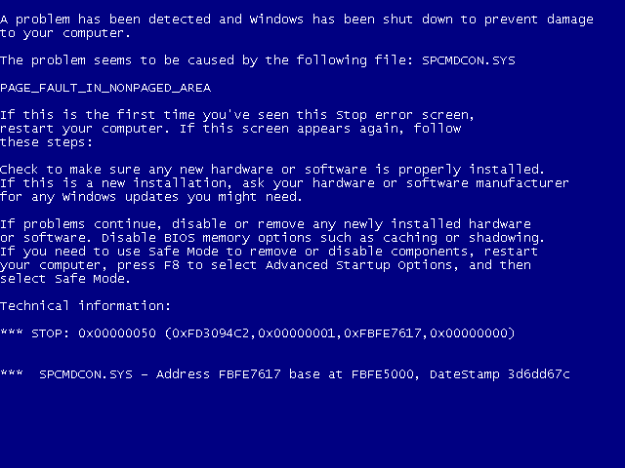

Slide 9
Dealing with Exceptions
When an exception occurs, the program ought to either
Return to a safe state and allow the user to execute other commands
Allow the user to save his/her work and gracefully exit the program.
This is not always easy.
Exception detection may be needed at multiple places in your code.
The code that restores the state of the application can be far removed from where exceptions can occur.

Slide 10
Types of Exceptions
External to the program
User Input Errors
Typos
Invalid format: expect a number when text characters are supplied.
Device Errors
Hardware don’t always what you want it to.
Printer may be turned off or run out of paper in the middle of a printout.
Connection to a remote server may die while your application is receiving data.
Physical Limitations
Disk running out of space.
Run out of available memory.

Slide 11
Types of Exceptions
Internal Exceptions:
Errors in your code.
Accessing an invalid array index.
Trying to find an nonexistent entry in a table.
Using other methods incorrectly.

Slide 12
Traditionally…
If a method detected an exception, e.g., an invalid input, the method returns a special error code that the calling method analyzes.
Example:
A file open method return a -1 if the file cannot be found.
Reading the end of a file returns -1 end-of-file value marker rather than a standard character.
What’s the drawback?

Slide 13
Exception Handling in Java
Java allows every method an alternative exit path if it is unable to complete its task in the normal way.
The method throws an object that encapsulates the error.
The method exits immediately, no value is returned.
The exception handling mechanism looks for an exception handler that can deal with the error condition.

Slide 14
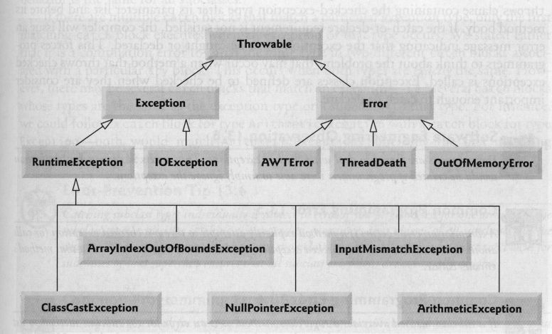
Exceptions
Exceptions are objects.
All exceptions extend from the Throwable class.

Slide 15
Pre-declared Subtypes
Error:
Internal errors and resource exhaustion inside the runtime environment
Usually unrecoverable.
Exception:
Intended for all other cases.
Exceptions that derive from RuntimeException:
usually because you made a programming error
Others that do not derive from RuntimeException:
bad things that happen to a good program, e.g. IOException

Slide 16
Unchecked Exception
Intended for programmer Errors
If it is a RuntimeExceptions it was your fault!
Examples:
Executing (String) x when x turns out not to point to a String: ClassCastException
Executing A[i] when i is out of bounds: ArrayIndexOutOfBoundsException
Executing x.y when x is null: NullPointerException

Slide 17
Checked Exceptions
Intended to indicate exceptional circumstances that are not necessarily programmer errors.
Examples:
Attempting to open a file that does not exist: FileNotFoundException
Input or output errors on a file: EOFException
Receiving an interrupt: InterruptedException

Slide 18
Throwing Checked Exceptions
One way to handle exceptions is to not handle it -- pass it on and let the user of the code handle it.
In this case you advertise that the method can throw an exception.
public FileInputStream(String name) throws FileNotFoundException
In this example, the constructor can initialize a new FileInputStream object or it can throw an exception if the file specified by the String is not found.
public int read() throws IOException
In this example, the method can return a byte of data from a FileInputStream or it can throw an exception if some Input-Output (IO) error occurs.

Slide 19
Example
class MyReader{
. . .
public void readSolution() throws FileNotFoundException, IOException
{
f = new FileInputStream("~cs61b/proj1.solution");
i = f.read();
}
}

Slide 20
When Exceptions are Thrown
In any of the four situations:
You called a method that throws a checked exception.
You detected an error and throw a checked exception.
An internal error occurs.
You made a programming error, causing an unchecked exception

Slide 21
When to Declare Exceptions
Cases 1 and 2 are checked exceptions
You need to tell the programmers who will use your method about the possibility of an exception:
If the exception is not dealt with, the program terminates.
Case 3 are errors
You do not need to advertise internal Java errors – exceptions derived from Error.
Any code can throw those exceptions; they are beyond your control.
Case 4 are unchecked exceptions
You should not advertise unchecked exceptions – those that inherit from RunTimeException.
These are completely under your control
//bad style
public void myMethod(int i) throws ArrayIndexOutOfBoundsException

Slide 22
Throwing Exceptions
If you detected something that’s potentially problematic in your code, you can throw an exception.
Example:
You have a method that reads a 16 digit credit card numbers. But you get a 12 digit number from the input file. You decide the situation is so abnormal that you want to through an exception.
String readBankAcctNumber(Reader r) throws DataFormatException
{
while (r.hasNext()) {
s = r.next();
if (numberOfDigits(s) != 16)
throw new DataFormatException();
. . .
}
return s;
}

Slide 23
Creating Your Own Exceptions
If one of the existing exception classes works for you, then just instantiate an exception object and throw it.
Otherwise, you can create your own:
class AccountNumberFormatException extends DataFormatException {
public AccountNumberFormatException (){}
public AccountNumberFormatException (String error) {
super(error);
}
}
if (numberOfDigits(s) != 16)
throw new AccountNumberFormatException (“ERROR: Account number not 16-digits”);
A convention to have two constructors: One takes no parameters, and one takes an error message in the form of a String.

Slide 24
Catching Exceptions
When an exception is thrown by a method, the calling method can either catch the exception or keep propagating it (by throwing).
If the exception doesn’t get handled by anyone, Java will try to handle it: terminate your program and print a stack trace.
To catch an exception, set up a try/catch block
try {
Stuff that might throw exception;
Other code;
} catch (SomeException e) {
Handler: do something reasonable;
}
Go on with life;

Slide 25
Example
class MyReader{
. . .
public void readSolution() throws FileNotFoundException, IOException
{
f = new FileInputStream("~cs61b/proj1.solution");
i = f.read();
}
}
class MyReader{
. . .
public void readSolution()
try {
f = new FileInputStream("~cs61b/proj1.solution ");
i = f.read();
} catch (FileNotFoundException e1) {
whine("Foiled!!");
} catch (IOException e2) {
f.close();
}
}
}

Slide 26
Scoping Rules
class MyReader{
. . .
public void readSolution()
try {
FileInputStream f = new FileInputStream("~cs61b/proj1.solution ");
i = f.read();
} catch (FileNotFoundException e1) {
whine("Foiled!!");
} catch (IOException e2) {
f.close();
}
}
}
f is only visible in the try block.

Slide 27
Catching Multiple Exceptions
You can catch multiple exception types:
try {
Stuff that might throw exception;
Othercode;
} catch (ExceptionType1 e) {
Handler: do something reasonable;
} catch (ExceptionType2 e2) {
Handler: do something reasonable;
} catch (ExceptionType3 e3) {
Handler: do something reasonable;
}
Go on with life;
The order in which the exception are processed matters:
ExceptionType1 needs to be less general than ExceptionType2.
You need to catch a FileNotFoundException object before catching an IOException object and before you catch a Exception object.
You can catch the most general exception with
catch (Exception e)
But you have less control on how to process the Exception

Slide 28
finally
When the code throws an exception, execution transfers to the exception handler or if no exception handler is found the method exits.
What if you want to clear up resources?
You put all the cleaning up code in the finally clause:
try {
Stuff that might throw exception;
Othercode;
} catch (SomeException e) {
Handler: do something reasonable;
} catch (SomeOtherException e2) {
Handler: do something reasonable;
} catch (SomeMoreException e3) {
Handler: do something reasonable;
} finally {
Release all resources, e.g. close files and network connections
}
Go on with life;

Slide 29
Next Time
Reading
Head First Java, pp. 315-338
Next Time:
Inner classes
Object Cloning
Loose Ends

