Slide 1
CS 61B Data Structures and Programming Methodology
July 2, 2008
David Sun

Slide 2
Announcements
Project 1 spec and code is available on the course website. Due July 15th. Start early!
Midterm I is next Wed in class from 11:00 – 1:00p.m. Open book: lecture notes, lab notes, but no laptop!

Slide 3
Today
Constants
Preventing Inheritance
Abstract Classes
Interfaces

Slide 4
Static Fields and Methods
class Parent {
int x = 0;
static int y = 1;
static void f() {
System.out.printf "Ahem!%n");
}
static int f(int x) {
return x+1;
}
}
class Child extends Parent {
String x = "no";
static String y = "way";
static void f() {
System.out.printf ("I wanna!%n");
}
}
Child dave = new Child();
Parent pDave = dave;
dave.x => no pDave.x => 0
dave.y => way pDave.y => 1
dave.f() => ? pDave.f() = ?
dave.f(1) => ? pDave.f(1) => 2
Fields hide inherited fields of same name; static methods hide methods of the same signature.

Slide 5
Constants
Adding final in front of a variable means that the value of the variable can never be changed.
You must initialize the value of the final variable when it is declared.
Use final variables to create constants.
class Math {
public static final double PI = 3.141592653…;
}
public class System {
public static final PrintStream out = … ;
}

Slide 6
Constants (cont.)
Numerical values that are used repeatedly should be turned into a final constant.
if (month == 3) { . . .} //BAD
public static final int MARCH = 3;
if (month == MARCH) { . . . }
Not all constants need to be static.
For an array x, x.length is a final field.

Slide 7
Preventing Inheritance
A class declared to be final cannot be extended by others
final class Executive extends Manager{
}
A method declared final cannot be overriden by subclasses
All methods in a final class are automatically final
class Employee
{
…
public final String getName()
{
return name;
}
…
}

Slide 8
Abstract Classes
As we move up the inheritance hierarchy, classes become more general or more abstract.
At the some point, the ancestor class becomes so general that it becomes a basis for other classes rather than a class with specific instances that you want to create.
Such ancestor classes are declared to be abstract. Their sole purpose is to be extended.

Slide 9
Example
Human
Employee
Student
Some attributes and methods make sense for every human, and these can be factored out into the Human class.
public class Human {
. . .
private int age;
private String name;
public int getAge() { return age};
public String getName() { return name};
. . .
}

Slide 10
Example (cont.)
public class Human {
. . .
public String introduce() { . . .} //how should we code this?
}
Student david = new Student( . . . );
david.introduce(); //”I’m David and I major in Computer Science”
Employee wendy = new Employee( . . . );
wendy.introduce(); //”I’m Wendy I work for Google”
The Human class knows nothing about the person except the name and age.
We can try:
public String introduce() {
return “”;
}
A better way:
public abstract String introduce(); //no implementation required

Slide 11
Abstract Class
public abstract class Human {
private String name;
public Human(String n);
public String getName() { return name; }
public abstract String introduce();
}
Any class with one or more abstract methods must be declared as abstract.
abstract classes can have concrete data and methods.
abstract methods act as placeholders for methods that are implemented in subclasses.

Slide 12
public abstract class Human {
private String name;
. . .
public abstract String introduce();
}
public class Student extends Human{
private String major;
public student(String name, String major) {. . .}
public String introduce() {
return “I’m “ + name + “and I major in” + major;
}
}
public class Employee extends Human{
private String company;
public student(String name, String company) {. . .}
public String introduce() {
return “I’m “ + name + “and I work for ” + company;
}
}

Slide 13
Rules for abstract Classes
The concrete classes Student and Employee must implement the abstract method introduce().
The compiler will generate an error if you don’t.
If you extend an abstract class without implementing an abstract method, the subclass must be declared as abstract.
You can create a variable of an abstract class:
Human student; //OK
You cannot create an object of an abstract class:
//Compile time ERROR!
Human student = new Human(“David”);
//OK!
Human student = new Student(“David”);
student.introduce();

Slide 14
Example
Human[] human = new Human[2];
human[0] = new Employee( ... );
human[1] = new Student( ... );
for (int i = 0; i < human.length; i++) {
human[i].introduce();
}
The call human[i].introduce(); is well defined because human[i] never refers to an object of the abstract human class, it must refer to a concrete subclass.
Notes:
Draw diagram.

Slide 15
What are Interfaces?
Describing what classes should do, without specifying how they would do it.
Think of it as a contract for a set of classes.
“If your class conforms to the requirements set in this contract (or this interface), then I’ll perform these services for the objects of your class”

Slide 16
Example
The sort method of the Array class promises to sort an array of objects, but under one condition: the objects in the array must implement the Comparable interface:
public interface Comparable {
int compareTo(Object other);
}
Like an abstract method, no implementation is provided

Slide 17
Example
public interface Comparable {
int compareTo(Object other);
}
public class Employee implements Comparable {
public int compareTo(Object other) {
...
}
}
The Employee class must implement the compareTo method. i.e., define a method named compareTo that takes an Object and returns an int.

Slide 18
compareTo
When we call x.compareTo(y), the method returns an indication whether x or y is larger:
return a negative number if y is larger
a positive number if x is larger,
zero otherwise.
Suppose we want to sort by salary:
public class Employee implements Comparable {
public int compareTo(Object other) {
Employee otherEmployee = (Employee) other;
if (salary < otherEmployee.salary) return -1;
if (salary > otherEmployee.salary) return 1;
return 0;
}
}

Slide 19
Example

Slide 20
compareTo
If the objects are not equal, it does not matter what negative or positive value your return.
For instance, to sort by employee ID number:
//negative if the first ID is less than the other,
//0 if they are the same;
//some positive value otherwise.
return id – other.id;
The subtraction trick works only for integers:
salary – other.salary can round to 0 if the salaries are close enough.

Slide 21
Comparable
An interface to describe Objects that have a natural order on them, such as String and Integer.
Might use in a general-purpose max function:
/** The largest value in array A, or null if A empty. */
public static Comparable max (Comparable[] A) {
if (A.length == 0) return null;
Comparable result = A[0];
for (int i = 1; i < A.length; i += 1)
if (result.compareTo(A[i]) < 0) result = A[i];
return result;
}
Now max(S) will return maximum value in S if S is an array of Strings, or any other kind of Object that implements Comparable.

Slide 22
Properties of Interfaces
Interfaces are not classes, you can’t construct objects:
x = new Comparable( … ); //ERROR
You can declare interface variables:
Comparable x; //OK
An interface variable must reference an object of a class that implements the interface.
x = new Employee(…); //OK

Slide 23
Properties of Interfaces
All methods in an interface are automatically public.
int compareTo(Object other); was not explicitly declared to be public. The implementation in Employee class must be
public int compareTo(Object other); otherwise the compiler will complain.
All fields in are automatically public static final.
Interfaces can contain only constants, never instance variables.

Slide 24
Extending Interfaces
You can extend interfaces to go from greater degree of generality to a greater degree of specialization.
Example: Java Collections Framework
public interface Set extends Collection{ . . .}

Slide 25
Interfaces and Abstract Classes
abstract class Comparable {
public abstract int compareTo(Object other);
}
public class Employee extends Comparable {
int compareTo(Object other) {
...
}
}
public class Employee extends Human, Comparable //ERROR
public class Employee extends Human implements Comparable //OK
A class can have one and only one superclass.

Slide 26
Implement Multiple Interfaces
interface Readable {
Object get();
}
interface Writeable {
void put (Object x);
}
class Source implements Readable
{
Object get() { . . .}
}
void copy (Readable r, Writeable w)
{
w.put(r.get());
}
class Sink implements Writeable
{
void put (Object x) { .. . }
}
class Variable implements Readable, Writeable {
Object get() { . . .}
Object put() { . . .}
}

Slide 27
Using Interfaces and Abstract Class
Example

Slide 28
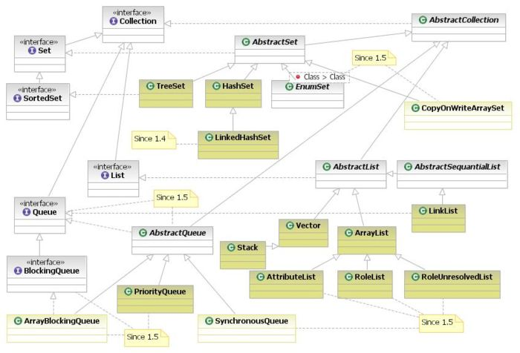
The Java Collections Framework

Slide 29
Next Lecture
Readings:
Head First Java, Chapter 7

