Slide 1
CS61A Lecture 2 Functions and Applicative Model of Computation
Tom Magrino and Jon Kotker UC Berkeley EECS
June 19, 2012

Slide 2
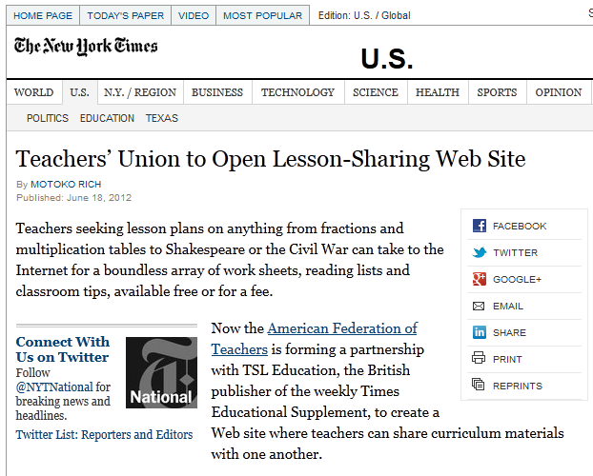
CS in the News
Teaching goes social!
http://www.nytimes.com/2012/06/19/us/teachers-union-to-open-lesson-sharing-web-site.html?_r=1&ref=education

Slide 3
Announcements
Project 1 is out, due 6/29.
Homework 1 is out, due 6/22.
Lab 1 solutions are up.
They will always be up the day after the lab.
You should all have lab accounts by now.
If you don’t, please talk to your TA.
CSUA will hold a UNIX help session on Tuesday, June 26 at 8pm in 310 Soda.

Slide 4
Today
Expressions and Statements
Functions
A Basic Model of Evaluation
Other Features

Slide 5
The Elements of Programming
Primitive Expressions and Statements
Simplest building blocks of language
Means of Combination
Compound elements are built from simpler ones
Means of Abstraction
Compound elements can be named and manipulated as units

Slide 6
The Elements of Programming
“Computer science deals with the theoretical foundations of information and computation, together with practical techniques for the implementation and application of these foundations”
– Wikipedia
DATA
FUNCTIONS,

Slide 7
Functions and Data
Data: Stuff we want to manipulate
Functions: Rules for manipulating data
“The Art of Computer Programming”
33
This slide
Alan Turing
Count the words in a line of text
Display a dancing bear
Pronounce someone’s name
Load the next slide

Slide 8
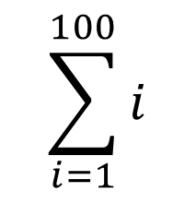
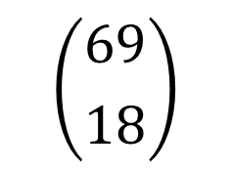
Expressions
An expression describes a computation and evaluates to a value.
$$\sum_{i=1}^{100}{i}$$
18 + 69
f(x)
$$\sqrt{3493161}$$
sin(π)
$$\left|−1984\right|$$
$$\left({69 \atop 18}\right)$$
$$f\left(f\left(f\left(x\right)\right)\right)+g(x)$$

Slide 9
Expressions
There are two kinds of expressions: primitive expressions and compound expressions.

Slide 10
Expressions
Primitive Expressions – expressions that directly describe their value.
2 x “The rain in Spain”
Numbers
Identifiers
Strings

Slide 11
Expressions
Compound Expressions – expressions that are composed of simpler expressions.
add(2, 3) 6 * (2 + 3)
mul(6, add(2, 3))
Infix Expressions
Function Calls
(Call Expressions)

Slide 12
Expressions
Compound Expressions – expressions that are composed of simpler expressions.
add ( 2, 3 )
2 + 3
Operator
Operands

Slide 13
Evaluating Expressions
If we are evaluating a primitive expression, simply use the value it represents.
3
x
3
<whatever x holds>

Slide 14
Evaluating Expressions
If we are evaluating a compound expression:
Evaluate the operator and operands.
Apply the operator to the operands.
5
add ( 2, 3 )
add
2
3

Slide 15
Evaluating Expressions
30
mul ( 6, add(2,3) )
5
add ( 2, 3 )
mul
6
add
2
3

Slide 16
Statements
A statement is executed by the program to perform an action. It can either be a single line of code (simple) or a series of lines (compound).
x = 6 # assignment statement
print(“5 is 2 + 3”) # expression statement

Slide 17
Compound Statements
Compound statements are statements that are composed of multiple statements.
Statement
<header>:
<statement>
<statement>
...
<separating header>:
<statement>
...
...
Clause
Suite

Slide 18
Evaluating Compound Statements
The first header determines the type of compound statement we have. The way a compound statement is evaluated depends on the type of compound statement you are using.
A suite is a series of statements, which are evaluated one by one in order.
Statement
<header>:
<statement>
<statement>
...
<separating header>:
<statement>
...
...
Clause
Suite

Slide 19
The while statement
while <boolean expression>:
<suite>

Slide 20
The while statement
Predict the output of the following:
>>> n = 7
>>> while n > 0:
... n = n - 1
... print(n)
...

Slide 21
The while statement
Predict the output of the following:
>>> n = 0
>>> while n < 0:
... n = n + 1
... print(n)
...

Slide 22
The while statement
Predict the output of the following:
>>> n = 1
>>> while n > 0:
... n = n + 1
... print(n)
...

Slide 23
The if statement
if <boolean expression>:
<suite>
elif <boolean expression>:
<suite>
...
else:
<suite>
Optional
Can have multiple elifs
Optional

Slide 24
The if statement
Predict the output of the following:
>>> n = 7
>>> while n > 0:
... if n % 2 == 0:
... n = n + 3
... else:
... n = n – 3
... print(n)
...

Slide 25
The if statement
Predict the output of the following:
>>> n = 1
>>> if n > 0:
... n = n + 1
... print(“A”)
... elif n > 1:
... n = n – 2
... print(“B”)
... else:
... print(“C”)
...

Slide 26
Functions
We’ve already seen a few!
f(x)

Slide 27
Defining Functions
def <function name>(<argument list>):
<suite>
The body can include a return statement, where a function can return a value and stop.
def add_three_nums(x, y, z):
return x + y + z

Slide 28
Evaluating User-Defined Functions
A function takes a series of arguments and returns some value. Calling a function evaluates to the value it returns.* We can approximate this by taking the argument value and substituting it in the body of the function for the argument name.**
def abs( n ):
if n > 0:
return n
elif n == 0:
return 0
else:
return - n
-2
-2
-2
-2
abs(n):
-2
2
* If you don’t return something, the function returns the None value by default.
** Later in the course we’ll learn a more accurate model to account for state.
-2

Slide 29
Functions
Are these functions the same? No!
def add_one(x):
return x + 1
def add_one(x):
x + 1
def add_one(x):
print(x + 1)

Slide 30
Non-Pure Functions
A function is called pure if it does not have any “side-effects.” Otherwise, the function is non-pure.
The one example we’ve seen so far is the print function. We’ll see this again later and talk about it more when we talk about state.
“Hello”
print
None
“side effect”
display “Hello”

Slide 31
Extras
Sometimes we may have too much for one lecture but we would like you to see the material nonetheless. These slides are for material that we might not have time for but that you are responsible for.

Slide 32
Extras – Optional Arguments
We can have optional arguments for our functions:
def greet(name=“Human”):
print(“Greetings”, name)
>>> greet()
Greetings Human
>>> greet(“Tom”)
Greetings Tom

Slide 33
Extras – Multiple Assignment
We can actually assign values to multiple variables at once, which is very useful in some cases:
>>> x, y = 6, 7
>>> x
6
>>> y
7
def fib(n):
“““Compute the nth Fibonacci number, for n >= 2.”””
pred, curr = 0, 1
k = 2
while k < n:
pred, curr = curr, pred + curr
k = k + 1
return curr

Slide 34
Extras – Multiple Return Values
You can actually return multiple values at the same time from a function:
from math import sqrt
def square_and_sqrt(x):
return x ** 2, sqrt(x)
two_sqrd, sqrt_two = square_and_sqrt(2)
If you do not put the right number of variables on the left hand side of the assignment, then you can run into an error. If you put only one variable on the left, then you’ll end up with a tuple, which we will talk about at the end of next week.

Slide 35
Extras – Docstrings
Whenever you program, it’s always a good idea to make a note explaining your functions in case others read your code (or if you read your code again after a long time). In Python, we do this by putting a “docstring” at the beginning of the function body:
def add_one(x):
“““Adds one to x.”””
return x + 1
You will see us do this with all code we hand you and encourage you to do the same: it is a good habit for programmers!

Slide 36
Extras – Doctests
In your docstrings, you can even put some examples of how your code is supposed to work. If you do that, you can use the doctest module to test to make sure your code behaves as you said:
def add_one(x):
“““Adds one to x.
>>> add_one(5)
6
”””
return x + 1
If you put this in a file named add_one.py, you can run the following in your terminal:
python3 –m doctest add_one.py
And it will run the code and indicate whether any of your examples don’t match what the code actually does in those cases!

