Slide 1
CS252 Graduate Computer Architecture Spring 2014 Lecture 17: I/O
Krste Asanovic
krste@eecs.berkeley.edu
http://inst.eecs.berkeley.edu/~cs252/sp14

Slide 2
Last Time in Lecture 16
Virtual Machines
User-Level
ABI = ISA + I/O
Emulating ISAs in software
System-Level (Virtual Machine Monitors)
Requirements for virtualizable ISA
Impact on virtual memory (page tables) and I/O

Slide 3
(I/O) Input/Output
Computers useless without I/O
Over time, literally thousands of forms of computer I/O: punch cards to brain interfaces
Broad categories:
Secondary/Tertiary storage (flash/disk/tape)
Network (Ethernet, WiFi, Bluetooth, LTE)
Human-machine interfaces (keyboard, mouse, touchscreen, graphics, audio, video, neural,…)
Printers (line, laser, inkjet, photo, 3D, …)
Sensors (process control, GPS, heartrate, …)
Actuators (valves, robots, car brakes, …)
Mix of I/O devices is highly application-dependent

Slide 4
Interfacing to I/O Devices
Two general strategies
Memory-mapped
I/O devices appear as memory locations to processor
Reads and writes to I/O device locations configure I/O and transfer data (using either programmed I/O or DMA)
I/O channels
Architecture specifies commands to execute I/O commands over defined channels
I/O channel structure can be layered over memory-mapped device structure
In addition to data transfer, have to define synchronization method
Polling: CPU checks status bits
Interrupts: Device interrupts CPU on event

Slide 5
Memory-Mapped I/O
Programmed I/O uses CPU to control I/O device using load and store instructions, with address specifying device register to access
Load and store can have side effect on device
Usually, only privileged code can access I/O devices directly, to provide secure multiprogramming
System calls sometimes provided for application to open and reserve a device for exclusive access
Processors provide “uncached” loads and stores to prevent caching of device registers
Usually indicated by bits in page table entries or by reserving portions of physical address space

Slide 6
Simple I/O Bus Structure
CPU
Caches
Memory Bus
I/O Bus Bridge
I/O Bus
DRAM
I/O Device #1
I/O Device #2
I/O Device #3
Some range of physical memory addresses map to I/O bus devices
I/O bus bridge reduces loading on critical CPU-DRAM bus
Devices can be “slaves”, only responding to I/O bus requests
Devices can be “masters”, initiating I/O bus transfers

Slide 7
DMA (Direct Memory Access)
CPU
Caches
DMA
Memory Bus
I/O Bus Bridge
I/O Bus
DMA
DRAM
I/O Device #1
I/O Device #2
I/O Device #3
DMA engines offload CPU by autonomously transferring data between I/O device and main memory. Interrupt/poll for done
DMA programmed through memory-mapped registers
Some systems use dedicated processors inside DMA engines
Often, many separate DMA engines in modern systems
Centralized in I/O bridge (usually supporting multiple concurrent channels to different devices), works on slave-only I/O busses
Directly attached to each peripheral (if I/O bus supports mastering)

Slide 8
More Complex Bus Structures
CPU
Graphics
I/O Device #1
I/O Device #2
Caches
DMA
DMA
DMA
I/O Bus Bridge
Fast I/O Bus
Memory Bus
DRAM
DMA
Slow I/O Bus
Slow I/O Bus Bridge
I/O Device #3
I/O Device #4
Match speed of I/O connection to device demands
Special direct connection for graphics
Fast I/O bus for disk drives, ethernet
Slow I/O bus for keyboard, mouse, touchscreen
Reduces load on fast I/O bus + less bus logic needed on device

Slide 9
Move from Parallel to Serial I/O Off-chip
CPU I/O IF
I/O 1
I/O 2
Central Bus Arbiter
Shared Parallel Bus Wires
Parallel bus clock rate limited by clock skew across long bus (~100MHz)
High power to drive large number of loaded bus lines
Central bus arbiter adds latency to each transaction, sharing limits throughput
Expensive parallel connectors and backplanes/cables (all devices pay costs)
Examples: VMEbus, Sbus, ISA bus, PCI, SCSI, IDE
Dedicated Point-to-point Serial Links
Point-to-point links run at multi-gigabit speed using advanced clock/signal encoding (requires lots of circuitry at each end)
Lower power since only one well-behaved load
Multiple simultaneous transfers
Cheap cables and connectors (trade greater endpoint transistor cost for lower physical wiring cost), customize bandwidth per device using multiple links in parallel
Examples: Ethernet, Infiniband, PCI Express, SATA, USB, Firewire, etc.
I/O 1
CPU I/O IF
I/O 2

Slide 10
Move from Bus to Crossbar On-Chip
Busses evolved in era where wires were expensive and had to be shared
Bus tristate drivers problematic in standard cell flows, so replace with combinational muxes
Crossbar exploits density of on-chip wiring, allows multiple simultaneous transactions
Tristated Bus
A
A
B
B
A
B
C
C
C
Crossbar

Slide 11
I/O and Memory Mapping
I/O busses can be coherent or not
Non-coherent simpler, but might require flushing caches or only non-cacheable accesses (much slower on modern processors)
Some I/O systems can cache coherently also (SGI Origin)
I/O can use virtual addresses
Simplifies DMA into user address space, otherwise contiguous user segment needs scatter/gather by DMA engine
Provides protection from bad device drivers
Adds complexity to I/O device

Slide 12
Interrupts versus Polling
Two ways to detect I/O device status:
Interrupts
No CPU overhead until event
Large context-switch overhead on each event (trap flushes pipeline, disturbs current working set in cache/TLB)
Can happen at awkward time
Polling
CPU overhead on every poll
Difficult to insert in all code
Can control when handler occurs, reduce working set hit
Hybrid approach:
Interrupt on first event, keep polling in kernel until sure no more events, then back to interrupts

Slide 13
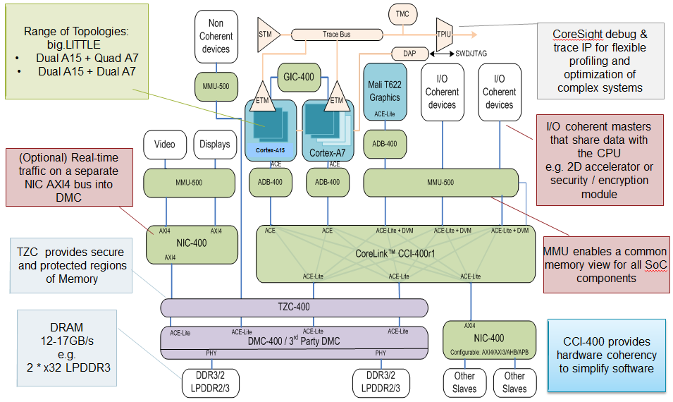
Example ARM SoC Structure
[©ARM]

Slide 14
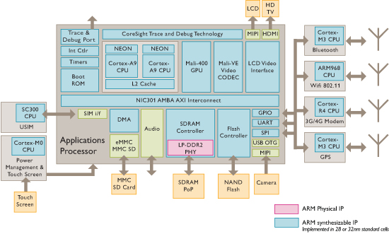
ARM Sample Smartphone Diagram
[©ARM]

Slide 15
Intel Ivy Bridge Server Chip I/O
[©Intel]

Slide 16
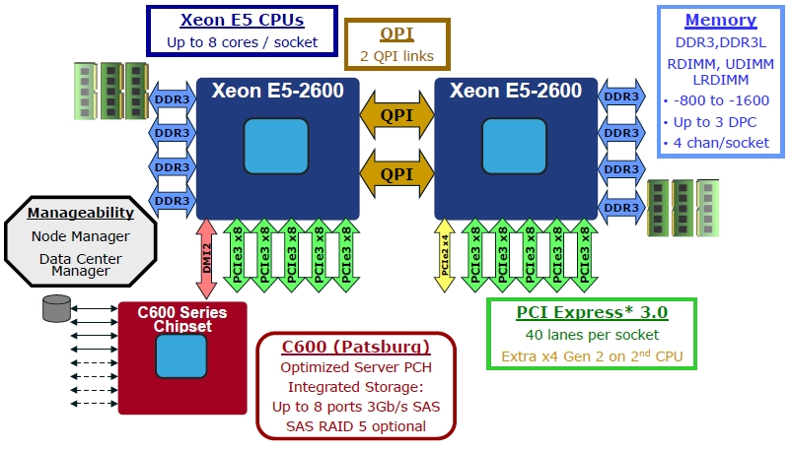
Intel Romley Server Platform
[©Intel]

Slide 17
Acknowledgements
This course is partly inspired by previous MIT 6.823 and Berkeley CS252 computer architecture courses created by my collaborators and colleagues:
Arvind (MIT)
Joel Emer (Intel/MIT)
James Hoe (CMU)
John Kubiatowicz (UCB)
David Patterson (UCB)

