Slide 1
CS252 Graduate Computer Architecture Spring 2014 Lecture 2: Instruction Set Architectures
Krste Asanovic
krste@eecs.berkeley.edu
http://inst.eecs.berkeley.edu/~cs252/sp14

Slide 2
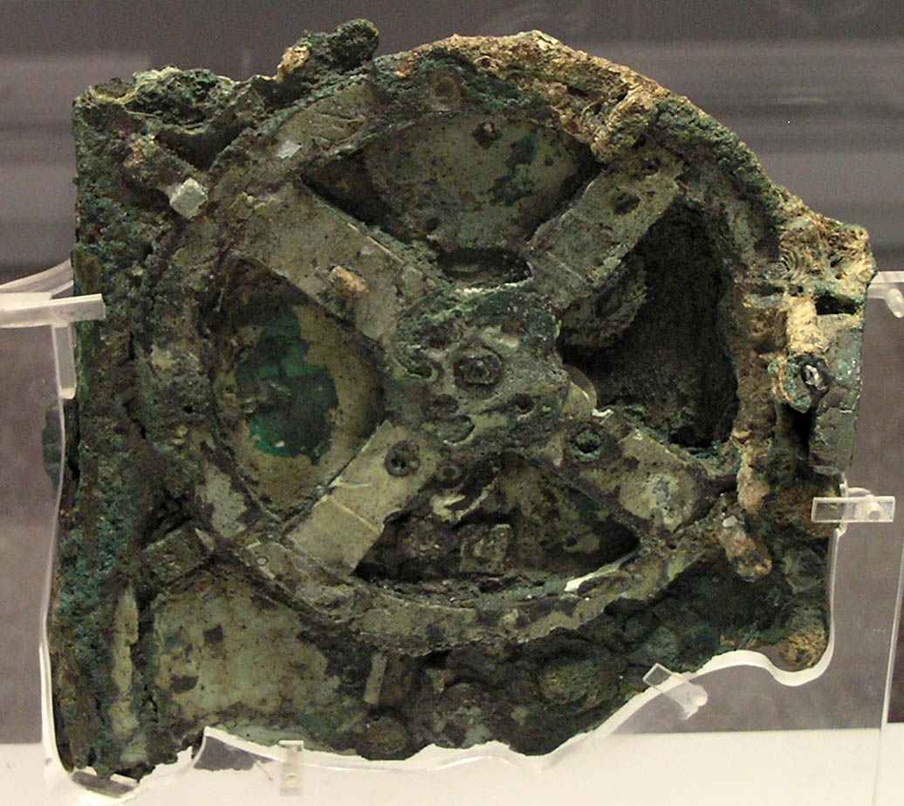
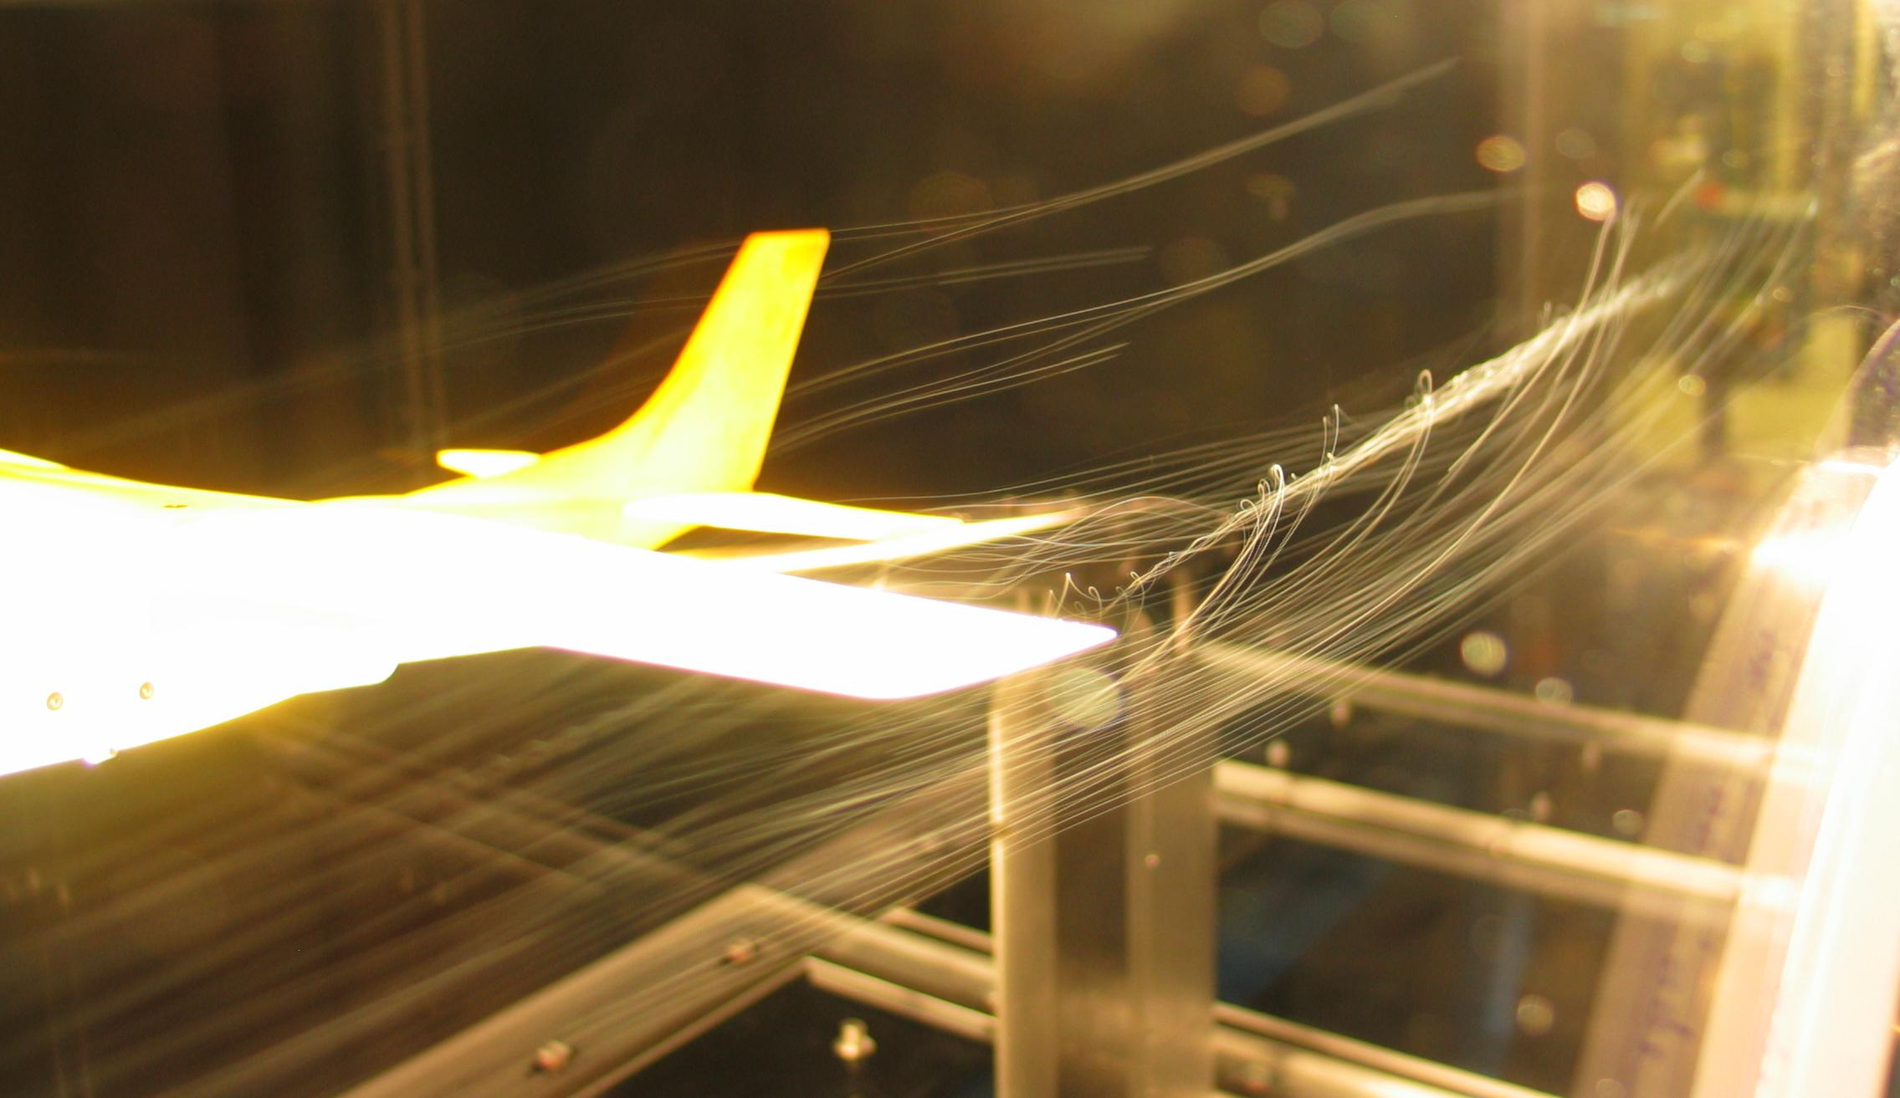
Analog Computers
Analog computer represents problem variables as some physical quantity (e.g., mechanical displacement, voltage on a capacitor) and uses scaled physical behavior to calculate results
[BenFrantzDale, Creative Commons BY-SA 3.0]
[Marsyas, Creative Commons BY-SA 3.0]
Wingtip vortices off Cesna tail in wind tunnel
Antikythera mechanism c.100BC

Slide 3
Digital Computers
Represent problem variables as numbers encoded using discrete steps
Discrete steps provide noise immunity
Enables accurate and deterministic calculations
Same inputs give same outputs exactly
Not constrained by physically realizable functions
Programmable digital computers are CS252 focus

Slide 4
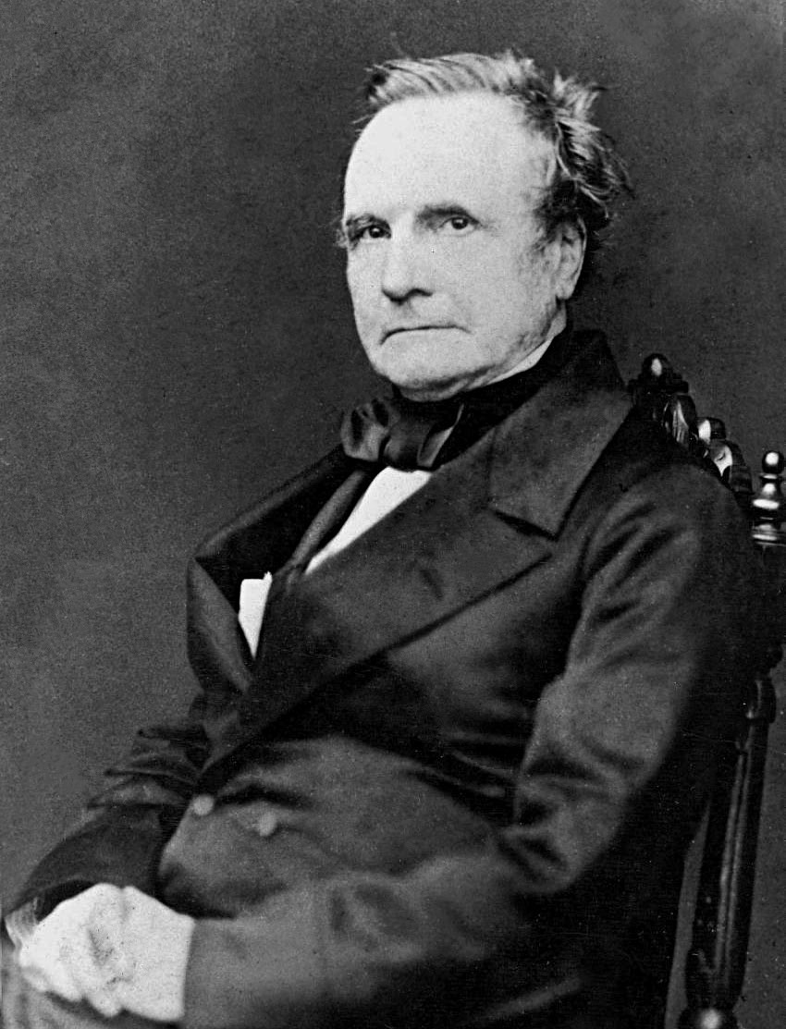
Charles Babbage (1791-1871)
Lucasian Professor of Mathematics, Cambridge University, 1828-1839
A true “polymath” with interests in many areas
Frustrated by errors in printed tables, wanted to build machines to evaluate and print accurate tables
Inspired by earlier work organizing human “computers” to methodically calculate tables by hand
[Copyright expired and in public domain.
Image obtained from Wikimedia Commons.]

Slide 5
Difference Engine 1822
Continuous functions can be approximated by polynomials, which can be computed from difference tables:
f(n) = n² + n + 41
d1(n) = f(n) – f(n-1) = 2n
d2(n) = d1(n) – d1(n-1) = 2
Can calculate using only a single adder:
n
0
1
2
3
4
d2(n)
2
2
2
d1(n)
2
4
6
8
f(n)
41
43
47
53
61

Slide 6
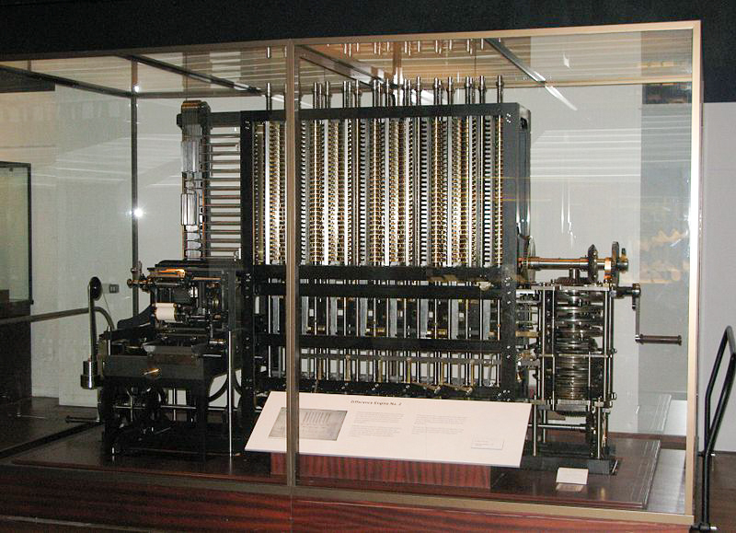
Realizing the Difference Engine
Mechanical calculator, hand-cranked, using decimal digits
Babbage did not complete the DE, moving on to the Analytical Engine (but used ideas from AE in improved DE 2 plan)
Scheutz completed working version in 1855, sold copy to British Government
Modern day recreation of DE2, including printer, showed entire design possible using original technology
first at British Science Museum
copy at Computer History Museum in San Jose
[Geni, Creative Commons BY-SA 3.0 ]

Slide 7
Analytical Engine 1837
Recognized as first general-purpose digital computer
Many iterations of the design (multiple Analytical Engines)
Contains the major components of modern computers:
“Store”: Main memory where numbers and intermediate results were held (1,000 decimal words, 40-digits each)
“Mill”: Arithmetic unit where processing was performed including addition, multiplication, and division
Also supported conditional branching and looping, and exceptions on overflow (machine jams and bell rings)
Had a form of microcode (the “Barrel”)
Program, input and output data on punched cards
Instruction cards hold opcode and address of operands in store
3-address format with two sources and one destination, all in store
Branches implemented by mechanically changing order cards were inserted into machine
Only small pieces were ever built

Slide 8
Analytical Engine Design Choices
Decimal, because storage on mechanical gears
Babbage considered binary and other bases, but no clear advantage over human-friendly decimal
40-digit precision (equivalent to >133 bits)
To reduce impact of scaling given lack of floating-point hardware
Used “locking” or mechanical amplification to overcome noise in transferring mechanical motion around machine
Similar to non-linear gain in digital electronic circuits
Had a fast “anticipating” carry
Mechanical version of pass-transistor carry propagate used in CMOS adders (and earlier in relay adders)

Slide 9
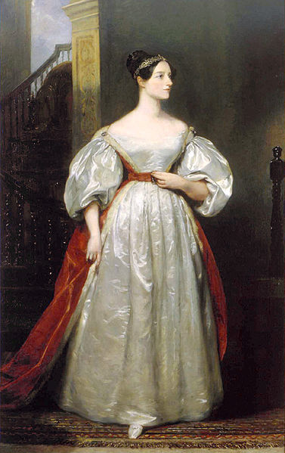
Ada Lovelace (1815-1852)
Translated lectures of Luigi Menabrea who published notes of Babbage’s lectures in Italy
Lovelace considerably embellished notes and described Analytical Engine program to calculate Bernoulli numbers that would have worked if AE was built
The first program!
Imagined many uses of computers beyond calculations of tables
Was interested in modeling the brain
[By Margaret Sarah Carpenter,
Copyright expired and in public domain]

Slide 10
Early Programmable Calculators
Analog computing was popular in first half of 20th century as digital computing was too expensive
But during late 30s and 40s, several programmable digital calculators were built (date when operational)
Atanasoff Linear Equation Solver (1939)
Zuse Z3 (1941)
Harvard Mark I (1944)
ENIAC (1946)

Slide 11
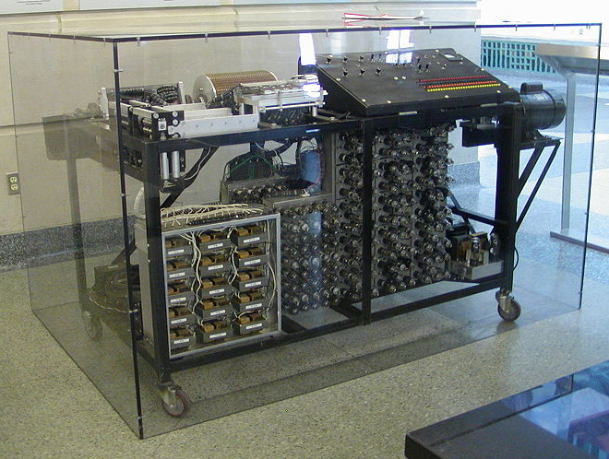
Atanasoff-Berry Linear Equation Solver (1939)
Fixed-function calculator for solving up to 29 simultaneous linear equations
Digital binary arithmetic (50-bit fixed-point words)
Dynamic memory (rotating drum of capacitors)
Vacuum tube logic for processing
In 1973, Atanasoff was credited as inventor of “automatic electronic digital computer” after patent dispute with Eckert and Mauchly (ENIAC)
[Manop, Creative Commons BY-SA 3.0 ]

Slide 12
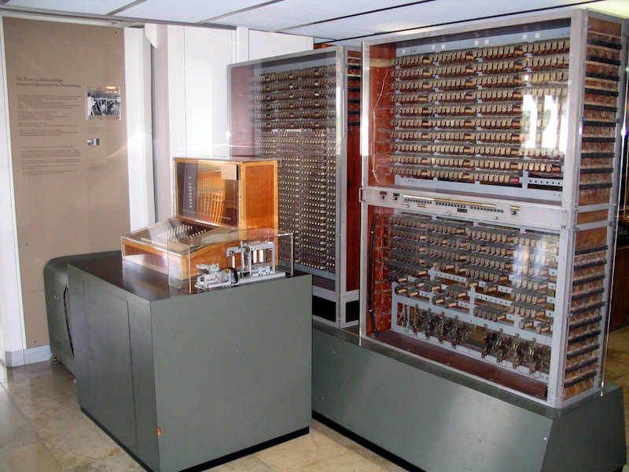
Zuse Z3 (1941)
Built by Konrad Zuse in wartime Germany using 2000 relays
Had normalized floating-point arithmetic with hardware handling of exceptional values (+/- infinity, undefined)
1-bit sign, 7-bit exponent, 14-bit significand
64 words of memory
Two-stage pipeline 1) fetch&execute 2) writeback
No conditional branch
Programmed via paper tape
Replica of the Zuse Z3 in the Deutsches Museum, Munich
[Venusianer, Creative Commons BY-SA 3.0 ]

Slide 13
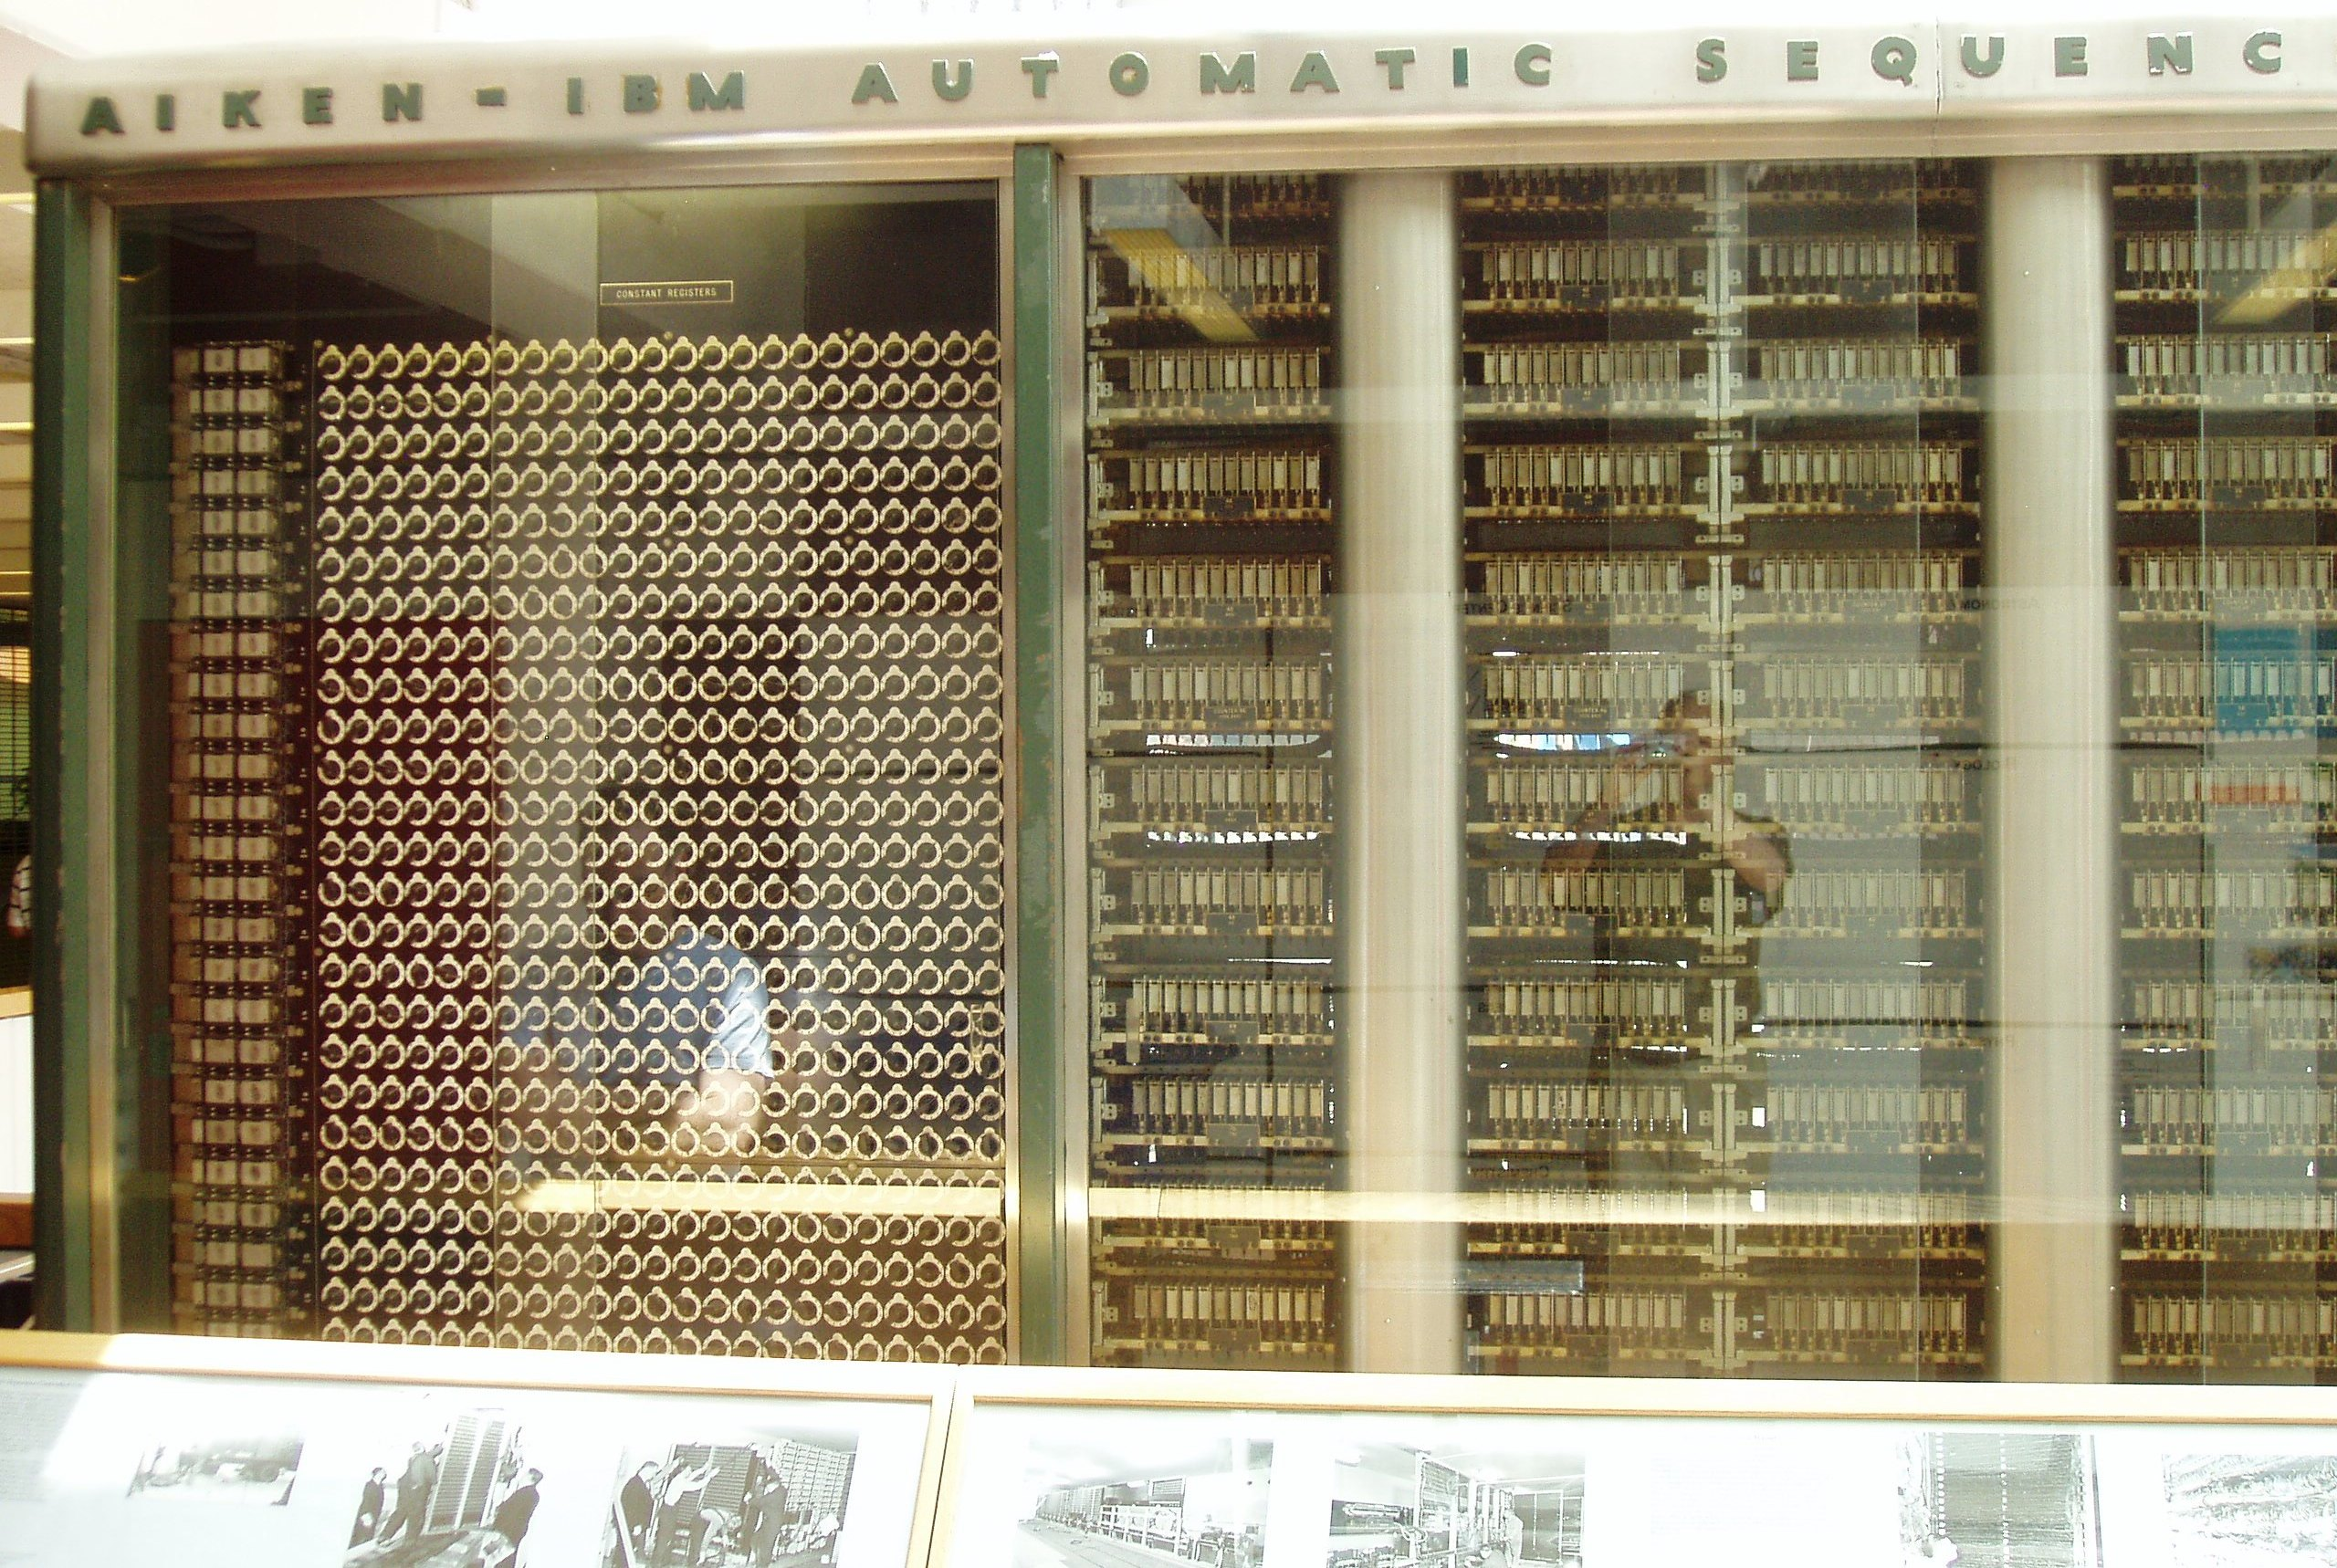
Harvard Mark I (1944)
Proposed by Howard Aiken at Harvard, and funded and built by IBM
Mostly mechanical with some electrically controlled relays and gears
Weighed 5 tons and had 750,000 components
Stored 72 numbers each of 23 decimal digits
Speed: adds 0.3s, multiplies 6s, divide 15s, trig >1 minute
Instructions on paper tape (2-address format)
Could run long programs automatically
Loops by gluing paper tape into loops
No conditional branch
Although mentioned Babbage in proposal, was more limited than analytical engine
[Waldir, Creative Commons BY-SA 3.0 ]

Slide 14
ENIAC (1946)
First electronic general-purpose computer
Construction started in secret at UPenn Moore School of Electrical Engineering during WWII to calculate firing tables for US Army, designed by Eckert and Mauchly
17,468 vacuum tubes
Weighed 30 tons, occupied 1800 sq ft, power 150kW
Twelve 10-decimal-digit accumulators
Had a conditional branch!
Programmed by plugboard and switches, time consuming!
Purely electronic instruction fetch and execution, so fast
10-digit x 10-digit multiply in 2.8ms (2000x faster than Mark-1)
As a result of speed, it was almost entirely I/O bound
As a result of large number of tubes, it was often broken (5 days was longest time between failures)

Slide 15
ENIAC
Changing the program could take days!
[Public Domain, US Army Photo]

Slide 16
EDVAC
ENIAC team started discussing stored-program concept to speed up programming and simplify machine design
John von Nuemann was consulting at UPenn and typed up ideas in “First Draft of a report on EDVAC”
Herman Goldstine circulated the draft June 1945 to many institutions, igniting interest in the stored-program idea
But also, ruined chances of patenting it
Report falsely gave sole credit to von Neumann for the ideas
Maurice Wilkes was excited by report and decided to come to US workshop on building computers
Later, in 1948, modifications to ENIAC allowed it to run in stored-program mode, but 6x slower than hardwired
Due to I/O limitations, this speed drop was not practically significant and improvement in productivity made it worthwhile
EDVAC eventually built and (mostly) working in 1951
Delayed by patent disputes with university

Slide 17
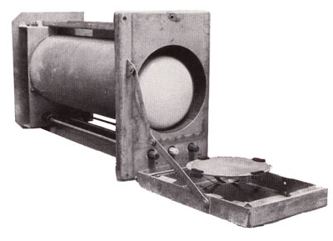
Manchester SSEM “Baby” (1948)
Manchester University group build small-scale experimental machine to demonstrate idea of using cathode-ray tubes (CRTs) for computer memory instead of mercury delay lines
Williams-Kilburn Tubes were first random access electronic storage devices
32 words of 32-bits, accumulator, and program counter
Machine ran world’s first stored-program in June 1948
Led to later Manchester Mark-1 full-scale machine
Mark-1 introduced index registers
Mark-1 commercialized by Ferranti
[Piero71, Creative Commons BY-SA 3.0 ]
Williams-Kilburn Tube Store

Slide 18
Cambridge EDSAC (1949)
Maurice Wilkes came back from workshop in US and set about building a stored-program computer in Cambridge
EDSAC used mercury-delay line storage to hold up to 1024 words (512 initially) of 17 bits (+1 bit of padding in delay line)
Two’s-complement binary arithmetic
Accumulator ISA with self-modifying code for indexing
David Wheeler, who earned the world’s first computer science PhD, invented the subroutine (“Wheeler jump”) for this machine
Users built a large library of useful subroutines
UK’s first commercial computer, LEO-I (Lyons Electronic Office), was based on EDSAC, ran business software in 1951
Software for LEO was still running in the 1980s in emulation on ICL mainframes!
EDSAC-II (1958) was first machine with microprogrammed control unit

Slide 19
Commercial computers: BINAC (1949) and UNIVAC (1951)
Eckert and Mauchly left U.Penn after patent rights disputes and formed the Eckert-Mauchly Computer Corporation
World’s first commercial computer was BINAC with two CPUs that checked each other
BINAC apparently never worked after shipment to first (only) customer
Second commercial computer was UNIVAC
Used mercury delay-line memory, 1000 words of 12 alpha characters
Famously used to predict presidential election in 1952
Eventually 46 units sold at >$1M each
Often, mistakingly called the IBM UNIVAC

Slide 20
Administrivia
Piazza for discussions – please sign up!
Who’s not enrolled in class yet?

Slide 21
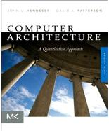
Required Textbook
For class, we’ll be using 5th edition of Hennessy and Patterson, “Computer Architecture: A Quantitative Approach”
Background reading will be listed on website for each class. Assumption is that this is read before class. No reviews required.

Slide 22
Reading Discussion

Slide 23
IBM 701 (1952)
IBM’s first commercial scientific computer
Main memory was 72 William’s Tubes, each 1Kib, for total of 2048 words of 36 bits each
Memory cycle time of 12µs
Accumulator ISA with multipler/quotient register
18-bit/36-bit numbers in sign-magnitude fixed-point
Misquote from Thomas Watson Sr/Jr:
“I think there is a world market for maybe five computers”
Actually TWJr said at shareholder meeting:
“as a result of our trip [selling the 701], on which we expected to get orders for five machines, we came home with orders for 18.”

Slide 24
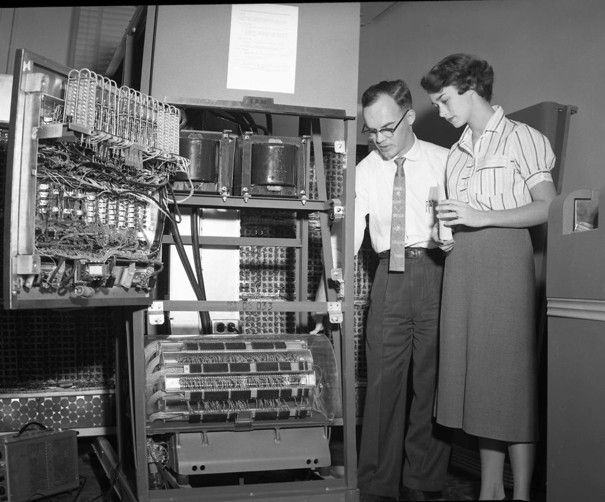
IBM 650 (1953)
The first mass-produced computer
Low-end system with drum-based storage and digit serial ALU
Almost 2,000 produced
[Cushing Memorial Library and Archives, Texas A&M,
Creative Commons Attribution 2.0 Generic ]

Slide 25
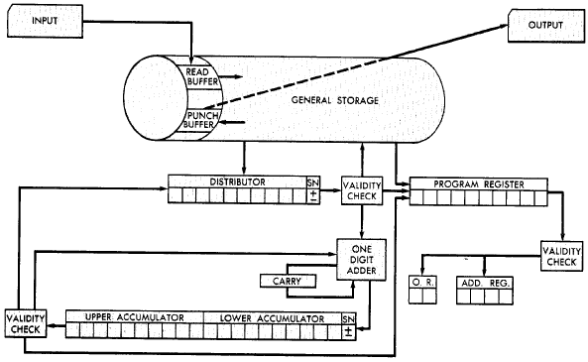
IBM 650 Architecture
Magnetic Drum (1,000 or 2,000
10-digit decimal words)
Active instruction (including next program counter)
Digit-serial ALU
20-digit accumulator
[From 650 Manual, © IBM]

Slide 26
IBM 650 Instruction Set
Address and data in 10-digit decimal words
Instructions encode:
Two-digit opcode encoded 44 instructions in base instruction set, expandable to 97 instructions with options
Four-digit data address
Four-digit next instruction address
Programmer’s arrange code to minimize drum latency!
Special instructions added to compare value to all words on track

Slide 27
Early Instruction Sets
Very simple ISAs, mostly single-address accumulator-style machines, as high-speed circuitry was expensive
Based on earlier “calculator” model
Over time, appreciation of software needs shaped ISA
Index registers (Kilburn, Mark-1) added to avoid need for self-modifying code to step through array
Over time, more index registers were added
And more operations on the index registers
Eventually, just provide general-purpose registers (GPRs) and orthogonal instruction sets
But some other options explored…

Slide 28
Burrough’s B5000 Stack Architecture: Robert Barton, 1960
Hide instruction set completely from programmer using high-level language (ALGOL)
Use stack architecture to simplify compilation, expression evaluation, recursive subroutine calls, interrupt handling,…

Slide 29
Evaluation of Expressions
(a + b * c) / (a + d * c - e)
/
+
-
a
*
+
e
b
c
a
*
d
c
c
*
b * c
b
Reverse Polish
a b c * + a d c * + e - /
a
Evaluation Stack
push a
push b
push c
multiply

Slide 30
Evaluation of Expressions
(a + b * c) / (a + d * c - e)
/
+
-
a
*
+
e
b
c
a
*
d
c
b * c
Reverse Polish
a b c * + a d c * + e - /
+
a + b * c
a
Evaluation Stack
add

Slide 31
Stacks post-1980
Inmos Transputers (1985-2000)
Designed to support many parallel processes in Occam language
Fixed-height stack design simplified implementation
Stack trashed on context swap (fast context switches)
Inmos T800 was world’s fastest microprocessor in late 80’s
Forth machines
Direct support for Forth execution in small embedded real-time environments
Several manufacturers (Rockwell, Patriot Scientific)
Java Virtual Machine
Designed for software emulation, not direct hardware execution
Sun PicoJava implementation + others
Intel x87 floating-point unit
Severely broken stack model for FP arithmetic
Deprecated in Pentium-4, replaced with SSE2 FP registers

Slide 32
Acknowledgements
This course is partly inspired by previous MIT 6.823 and Berkeley CS252 computer architecture courses created by my collaborators and colleagues:
Arvind (MIT)
Joel Emer (Intel/MIT)
James Hoe (CMU)
John Kubiatowicz (UCB)
David Patterson (UCB)

