Slide 1
Announcements
Robotics Lecture by Nathan Lambert
  Wednesday 8/5 (tomorrow)
  Robotics are an often adored and fascinating point of artificial intelligence. They are where autonomous agents meet the physical world and way more comes into play. In this lecture, we will cover themes in the course like search, games, and mapping and how advanced topics are taking them to the next level (DeepMind AlphaGo, autonomous cars, Berkeley Robot to Eliminate Trivial Tasks - BRETT). There'll be lots of fun videos of embodied AI, and hopefully a great discussion.
Homework 7
  Due Friday 8/7 at 11:59pm
Project 5
  Due Friday 8/7 at 11:59pm
Written Assessment 3 to be released later this week
  This is the last written assessment
Contest 2
  Ends Wednesday 8/5 at 11:59pm

Slide 2
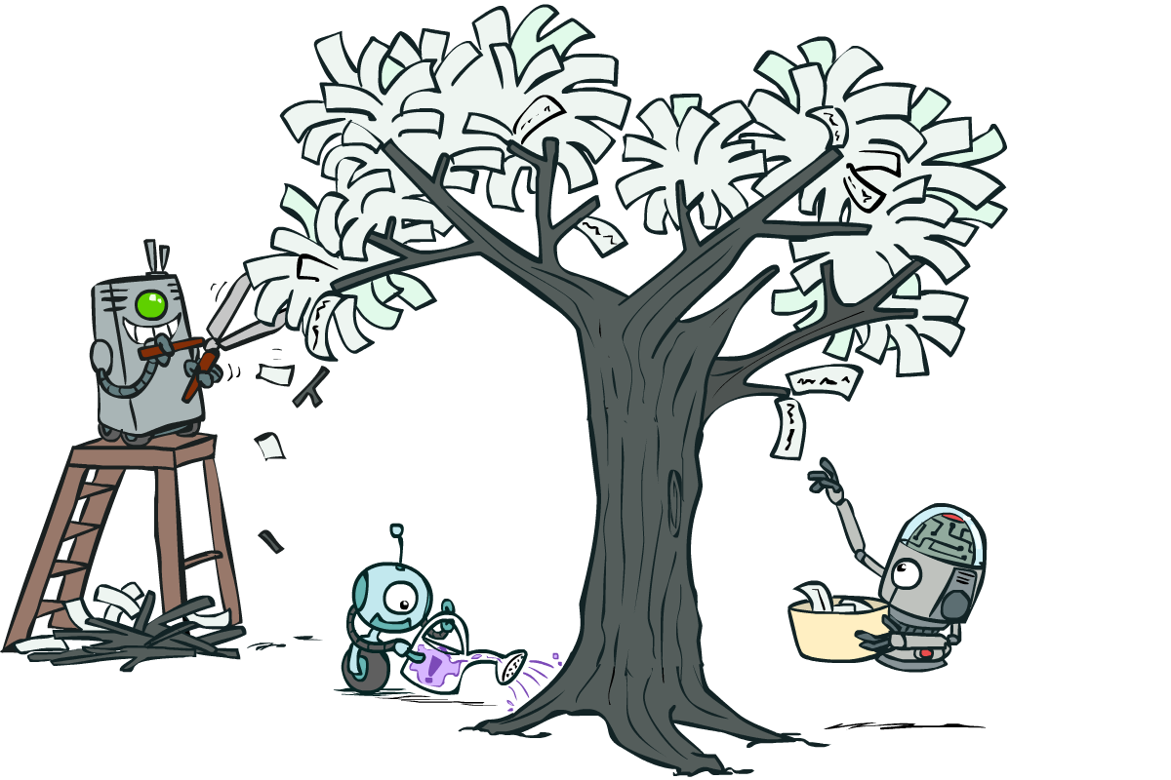
CS 188: Artificial Intelligence
Decision Trees
Instructor: Nikita Kitaev --- University of California, Berkeley
[These slides were created by Dan Klein and Pieter Abbeel for CS188 Intro to AI at UC Berkeley. All CS188 materials are available at http://ai.berkeley.edu.]
Notes:
Please retain proper attribution, including the reference to ai.berkeley.edu. Thanks!

Slide 3
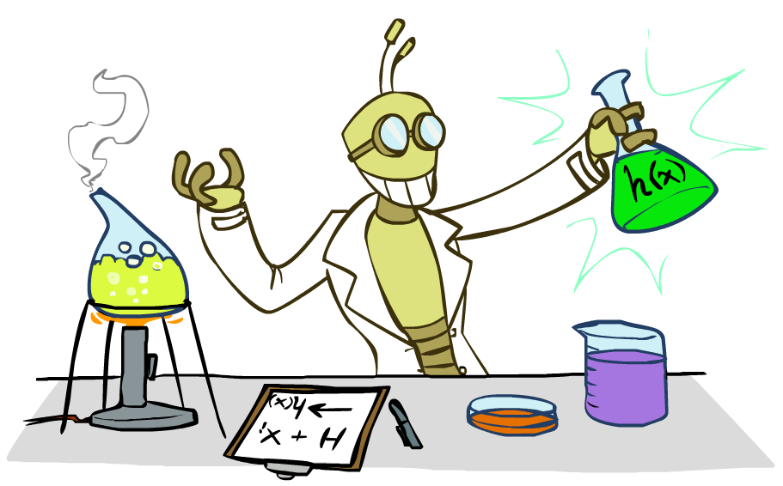
Inductive Learning

Slide 4



Inductive Learning (Science)
Simplest form: learn a function from examples
  A target function: g
  Examples: input-output pairs (x, g(x))
  E.g. x is an email and g(x) is spam / ham
  E.g. x is a house and g(x) is its selling price
Problem:
  Given a hypothesis space H
  Given a training set of examples x_{i}
  Find a hypothesis h(x) such that h ~ g
Includes:
  Classification (outputs = class labels)
  Regression (outputs = real numbers)
How do perceptron and naïve Bayes fit in? (H, h, g, etc.)

Slide 5
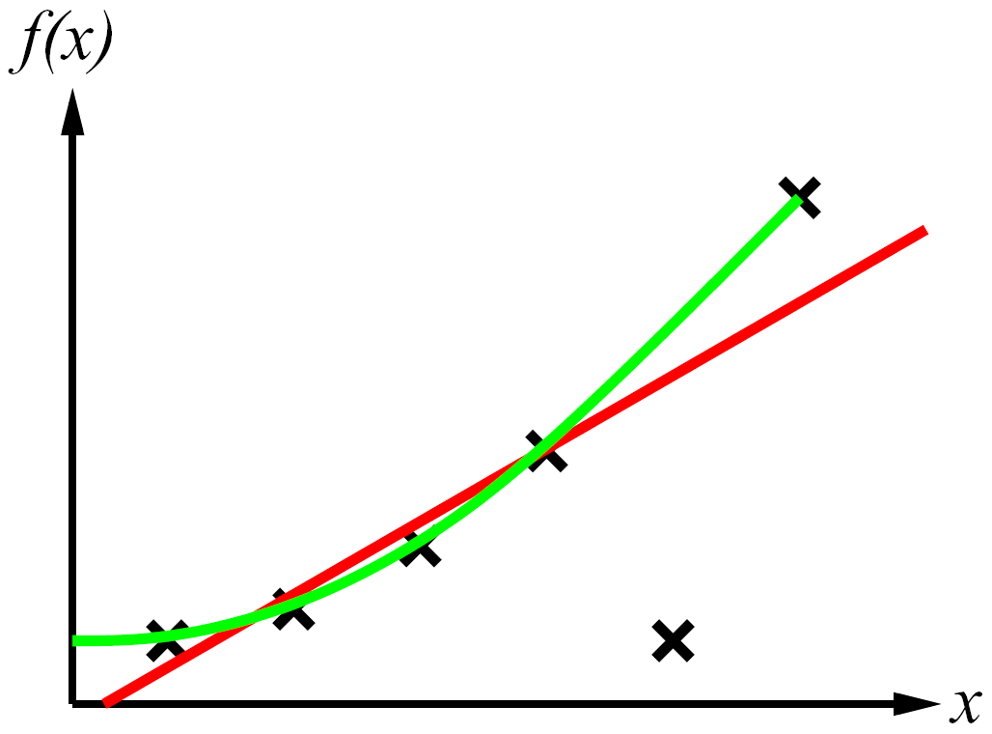
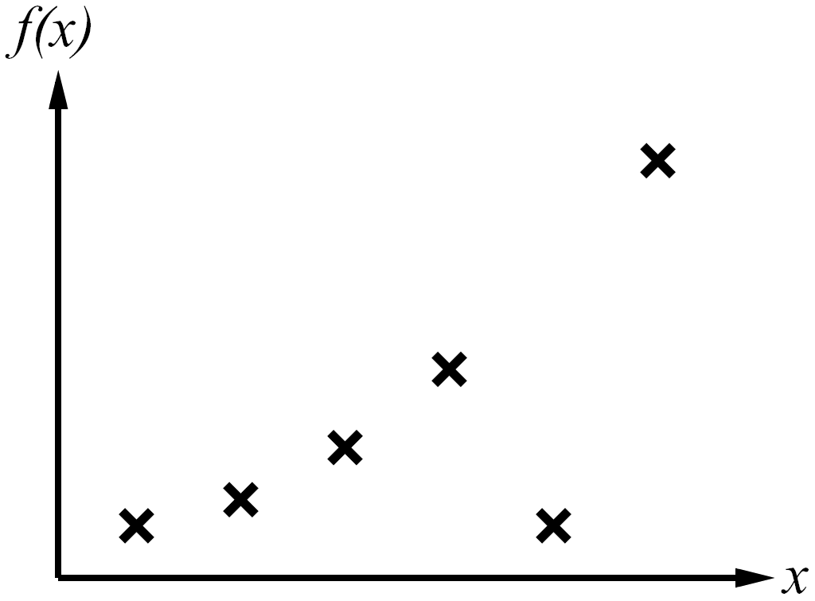
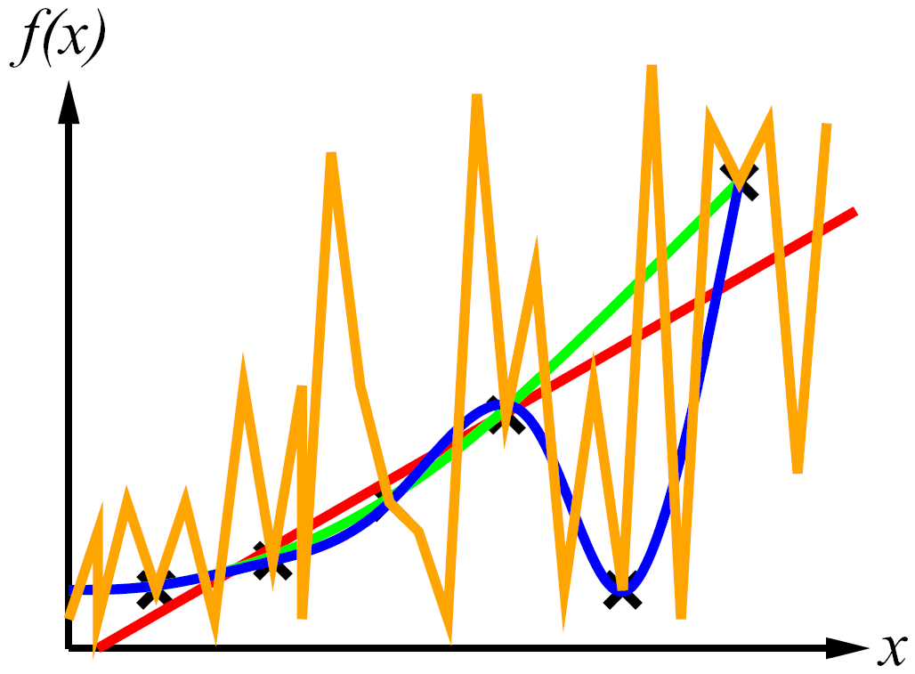
Inductive Learning
Curve fitting (regression, function approximation):
Consistency vs. simplicity
Ockham’s razor

Slide 6
Consistency vs. Simplicity
Fundamental tradeoff: bias vs. variance
Usually algorithms prefer consistency by default (why?)
Several ways to operationalize “simplicity”
  Reduce the hypothesis space
    Assume more: e.g. independence assumptions, as in naïve Bayes
    Have fewer, better features / attributes: feature selection
    Other structural limitations (decision lists vs trees)
  Regularization
    Smoothing: cautious use of small counts
    Many other generalization parameters (pruning cutoffs today)
    Hypothesis space stays big, but harder to get to the outskirts

Slide 7
Decision Trees

Slide 8
Reminder: Features
Features, aka attributes
  Sometimes: TYPE=French
  Sometimes: f_{TYPE=French}(x) = 1

Slide 9
Reminder: Features
Features, aka attributes
  Sometimes: TYPE=French
  Sometimes: f_{TYPE=French}(x) = 1

Slide 10
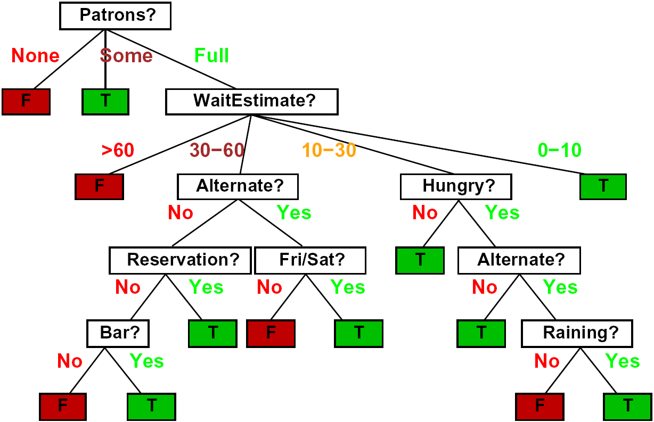
Decision Trees
Compact representation of a function:
  Truth table
  Conditional probability table
  Regression values
True function
  Realizable: in H

Slide 11

Expressiveness of DTs
Can express any function of the features
However, we hope for compact trees

Slide 12
Comparison: Perceptrons
What is the expressiveness of a perceptron over these features?
For a perceptron, a feature’s contribution is either positive or negative
  If you want one feature’s effect to depend on another, you have to add a new conjunction feature
  E.g. adding “PATRONS=full ∧ WAIT = 60” allows a perceptron to model the interaction between the two atomic features
DTs automatically conjoin features / attributes
  Features can have different effects in different branches of the tree!
Difference between modeling relative evidence weighting (NB) and complex evidence interaction (DTs)
  Though if the interactions are too complex, may not find the DT greedily

Slide 13
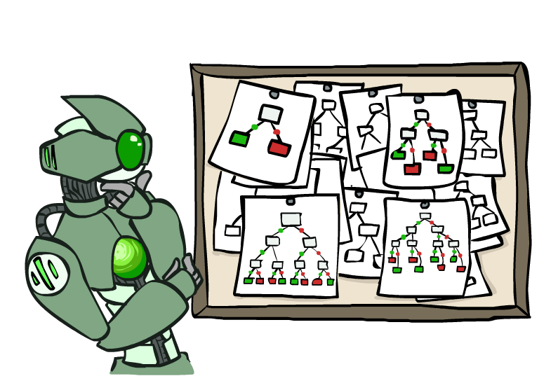
Hypothesis Spaces
How many distinct decision trees with n Boolean attributes?
  = number of Boolean functions over n attributes
  = number of distinct truth tables with 2^{n} rows
  = 2^(2^{n})
  E.g., with 6 Boolean attributes, there are
  18,446,744,073,709,551,616 trees
How many trees of depth 1 (decision stumps)?
  = number of Boolean functions over 1 attribute
  = number of truth tables with 2 rows, times n
  = 4n
  E.g. with 6 Boolean attributes, there are 24 decision stumps
More expressive hypothesis space:
  Increases chance that target function can be expressed (good)
  Increases number of hypotheses consistent with training set (bad, why?)
  Means we can get better predictions (lower bias)
  But we may get worse predictions (higher variance)

Slide 14
Decision Tree Learning
Aim: find a small tree consistent with the training examples
Idea: (recursively) choose “most significant” attribute as root of (sub)tree

Slide 15
Choosing an Attribute
Idea: a good attribute splits the examples into subsets that are (ideally) “all positive” or “all negative”
So: we need a measure of how “good” a split is, even if the results aren’t perfectly separated out

Slide 16
Entropy and Information
Information answers questions
  The more uncertain about the answer initially, the more information in the answer
  Scale: bits
    Answer to Boolean question with prior <1/2, 1/2>?
    Answer to 4-way question with prior <1/4, 1/4, 1/4, 1/4>?
    Answer to 4-way question with prior <0, 0, 0, 1>?
    Answer to 3-way question with prior <1/2, 1/4, 1/4>?
A probability p is typical of:
  A uniform distribution of size 1/p
  A code of length log 1/p

Slide 17
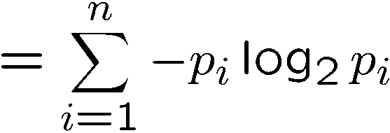
Entropy
General answer: if prior is <p₁,…,p_{n}>:
  Information is the expected code length
Also called the entropy of the distribution
  More uniform = higher entropy
  More values = higher entropy
  More peaked = lower entropy
  Rare values almost “don’t count”
1 bit
0 bits
0.5 bit

Slide 18
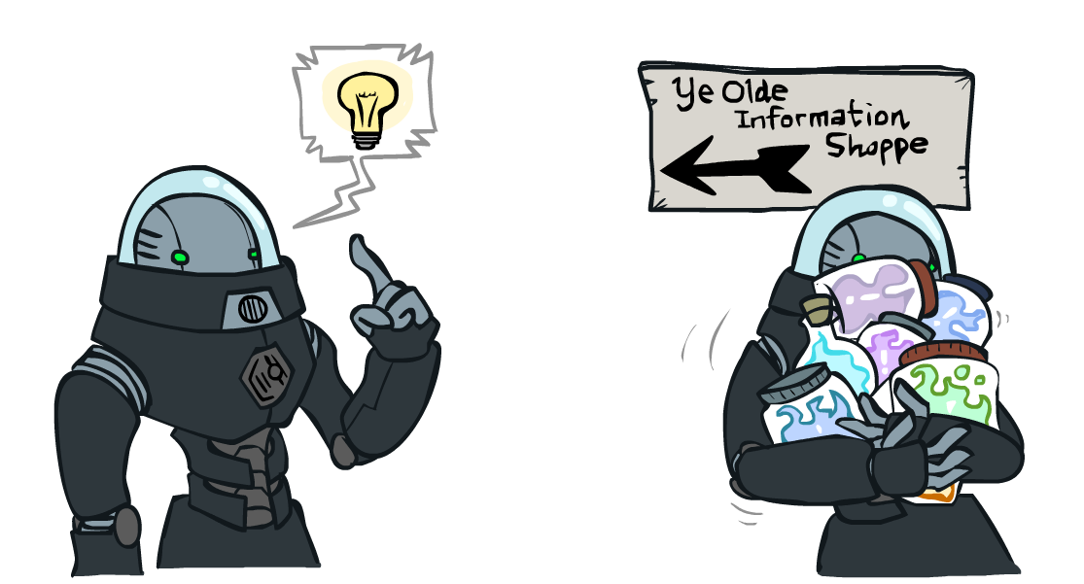
Information Gain
Back to decision trees!
For each split, compare entropy before and after
  Difference is the information gain
  Problem: there’s more than one distribution after split!
  Solution: use expected entropy, weighted by the number of examples

Slide 19
Information Gain
Back to decision trees!
For each split, compare entropy before and after
  Difference is the information gain
  Problem: there’s more than one distribution after split!
  Solution: use expected entropy, weighted by the number of examples
  Note: hidden problem here! Gain needs to be adjusted for large-domain splits – why?

Slide 20
Next Step: Recurse
Now we need to keep growing the tree!
Two branches are done (why?)
What to do under “full”?
  See what examples are there…

Slide 21
Example: Learned Tree
Decision tree learned from these 12 examples:
Substantially simpler than “true” tree
  A more complex hypothesis isn't justified by data
Also: it’s reasonable, but wrong

Slide 22
Example: Miles Per Gallon
40 Examples

Slide 23
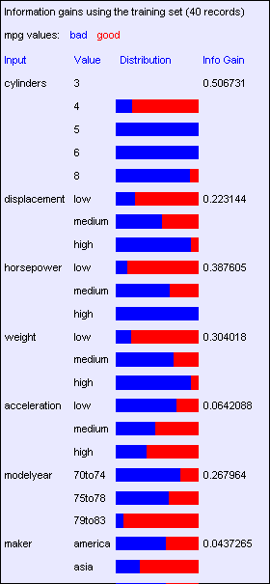
Find the First Split
Look at information gain for each attribute
Note that each attribute is correlated with the target!
What do we split on?

Slide 24
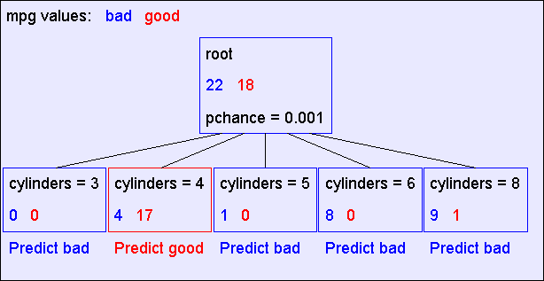
Result: Decision Stump

Slide 25
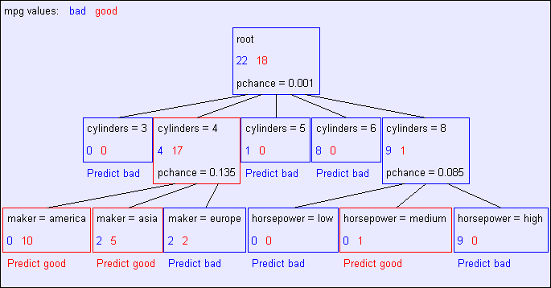
Second Level

Slide 26
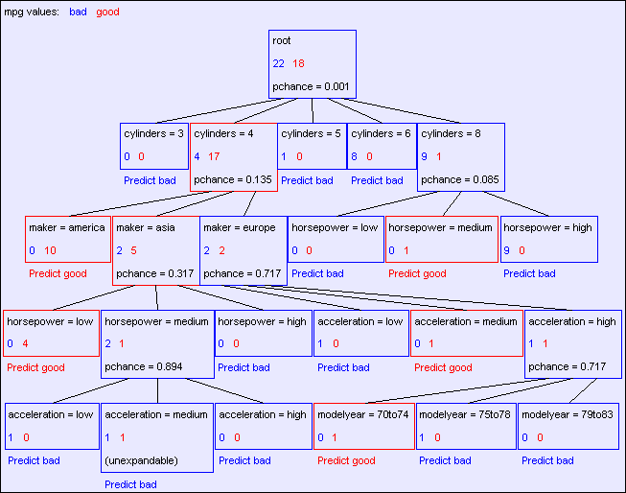
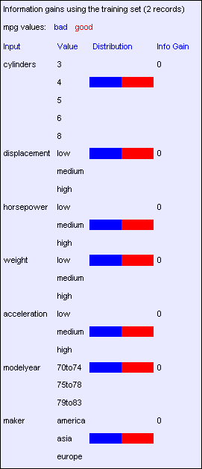
Final Tree

Slide 27
Reminder: Overfitting
Overfitting:
  When you stop modeling the patterns in the training data (which generalize)
  And start modeling the noise (which doesn’t)
We had this before:
  Naïve Bayes: needed to smooth
  Perceptron: early stopping

Slide 28

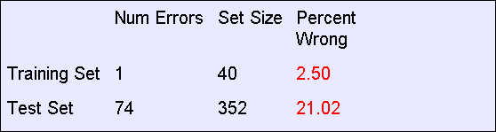
MPG Training Error
The test set error is much worse than the training set error…
…why?

Slide 29
Consider this split

Slide 30
Significance of a Split
Starting with:
  Three cars with 4 cylinders, from Asia, with medium HP
  2 bad MPG
  1 good MPG
What do we expect from a three-way split?
  Maybe each example in its own subset?
  Maybe just what we saw in the last slide?
Probably shouldn’t split if the counts are so small they could be due to chance
A chi-squared test can tell us how likely it is that deviations from a perfect split are due to chance*
Each split will have a significance value, p_{CHANCE}

Slide 31

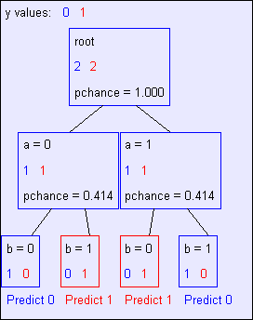
Keeping it General
Pruning:
  Build the full decision tree
  Begin at the bottom of the tree
  Delete splits in which
  p_{CHANCE} > MaxP_{CHANCE}
  Continue working upward until there are no more prunable nodes
  Note: some chance nodes may not get pruned because they were “redeemed” later
y = a XOR b

Slide 32
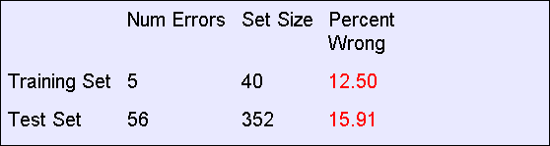
Pruning example
With MaxP_{CHANCE} = 0.1:
Note the improved test set accuracy compared with the unpruned tree

Slide 33
Regularization
MaxP_{CHANCE} is a regularization parameter
Generally, set it using held-out data (as usual)
Training
Held-out / Test
Accuracy
Decreasing
Increasing
MaxP_{CHANCE}
Small Trees
Large Trees
High Bias
High Variance

Slide 34
Forward Pointer: Random Forests
Ensemble method of learning trees
Very effective, used in industry and more

Slide 35
Two Ways of Controlling Overfitting
Limit the hypothesis space
  E.g. limit the max depth of trees
  Easier to analyze
Regularize the hypothesis selection
  E.g. chance cutoff
  Disprefer most of the hypotheses unless data is clear
  Usually done in practice

Slide 36
Next Lecture: Applications!

