Slide 1
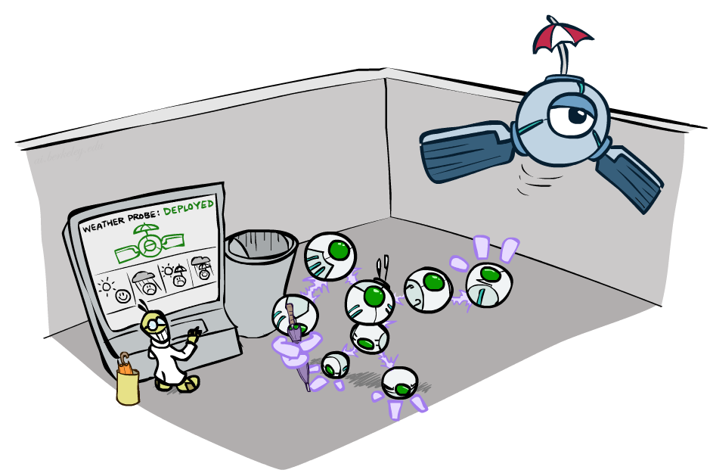
CS 188: Artificial Intelligence
Decision Networks and Value of Information
Instructor: Nikita Kitaev
University of California, Berkeley
[These slides were created by Dan Klein and Pieter Abbeel for CS188 Intro to AI at UC Berkeley. All CS188 materials are available at http://ai.berkeley.edu.]
Notes:
Please retain proper attribution, including the reference to ai.berkeley.edu. Thanks!

Slide 2
Ghostbusters Decision Network
Bust
U
Ghost Location
…
Sensor (1,1)
Sensor (1,2)
Sensor (1,3)
Sensor (1,n)
Sensor (2,1)
…
…
…
Sensor (m,1)
Sensor (m,n)

Slide 3
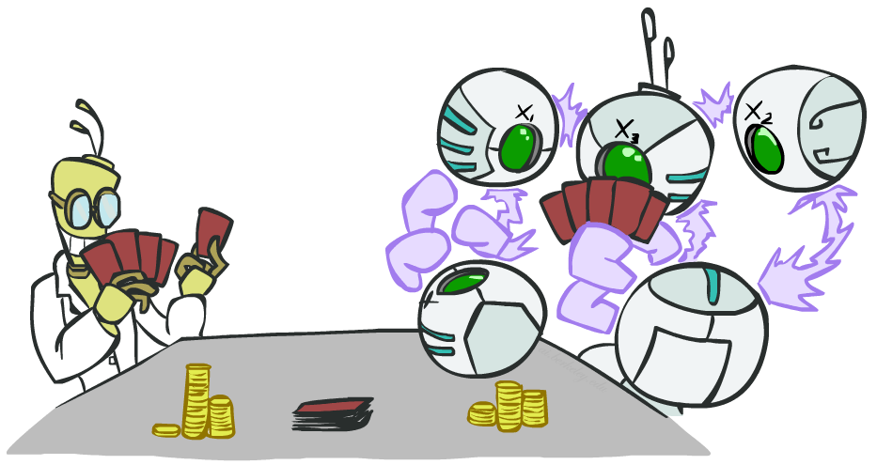
POMDPs

Slide 4
POMDPs
MDPs have:
  States S
  Actions A
  Transition function P(s’|s,a) (or T(s,a,s’))
  Rewards R(s,a,s’)
POMDPs add:
  Observations O
  Observation function P(o|s) (or O(s,o))
POMDPs are MDPs over belief
states b (distributions over S)
We’ll be able to say more in a few lectures
s
a
s, a
s,a,s’
s'
b
a
b, a
o
b'

Slide 5
Example: Ghostbusters
Demo: Ghostbusters with VPI
In (static) Ghostbusters:
  Belief state determined by evidence to date {e}
  Tree really over evidence sets
  Probabilistic reasoning needed to predict new evidence given past evidence
Solving POMDPs
  One way: use truncated expectimax to compute approximate value of actions
  What if you only considered busting or one sense followed by a bust?
  You get a VPI-based agent!
b
{e}
a
a
b, a
e, a
e’
e’
b’
{e, e’}
{e}
a_{bust}
a_{sense}
{e}, a_{sense}
U(a_{bust}, {e})
e’
{e, e’}
a_{bust}
U(a_{bust}, {e, e’})

Slide 6

Video of Demo Ghostbusters with VPI

Slide 7
Announcements
Written Assessment 2 is out!
  Due Friday 7/24 at 11:59pm
Homework 5
  Due Friday 7/24 at 11:59pm
Midterm 2
  Midterm 2 is on Wednesday 7/29, 12pm-2pm
Project 4
  Due Friday 7/31 at 11:59pm

Slide 8
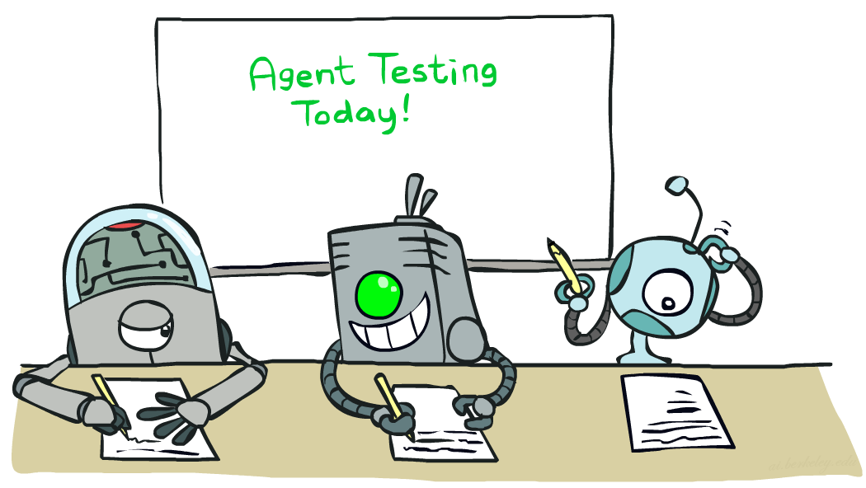

CS 188: Artificial Intelligence
Naïve Bayes
Instructor: Nikita Kitaev --- University of California, Berkeley
[These slides were created by Dan Klein and Pieter Abbeel for CS188 Intro to AI at UC Berkeley. All CS188 materials are available at http://ai.berkeley.edu.]
Notes:
Please retain proper attribution, including the reference to ai.berkeley.edu. Thanks!

Slide 9
Machine Learning
Up until now: how use a model to make optimal decisions
Machine learning: how to acquire a model from data / experience
  Learning parameters (e.g. probabilities)
  Learning structure (e.g. BN graphs)
  Learning hidden concepts (e.g. clustering, neural nets)
Today: model-based classification with Naive Bayes

Slide 10
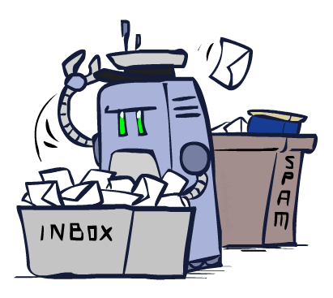
Classification

Slide 11
Example: Spam Filter
Input: an email
Output: spam/ham
Setup:
  Get a large collection of example emails, each labeled “spam” or “ham”
  Note: someone has to hand label all this data!
  Want to learn to predict labels of new, future emails
Features: The attributes used to make the ham / spam decision
  Words: FREE!
  Text Patterns: $dd, CAPS
  Non-text: SenderInContacts, WidelyBroadcast
  …
Dear Sir.
First, I must solicit your confidence in this transaction, this is by virture of its nature as being utterly confidencial and top secret. …
TO BE REMOVED FROM FUTURE MAILINGS, SIMPLY REPLY TO THIS MESSAGE AND PUT "REMOVE" IN THE SUBJECT.
99 MILLION EMAIL ADDRESSES
FOR ONLY $99
Ok, Iknow this is blatantly OT but I'm beginning to go insane. Had an old Dell Dimension XPS sitting in the corner and decided to put it to use, I know it was working pre being stuck in the corner, but when I plugged it in, hit the power nothing happened.

Slide 12




Example: Digit Recognition
Input: images / pixel grids
Output: a digit 0-9
Setup:
  Get a large collection of example images, each labeled with a digit
  Note: someone has to hand label all this data!
  Want to learn to predict labels of new, future digit images
Features: The attributes used to make the digit decision
  Pixels: (6,8)=ON
  Shape Patterns: NumComponents, AspectRatio, NumLoops
  …
  Features are increasingly induced rather than crafted
0
1
2
1
??

Slide 13
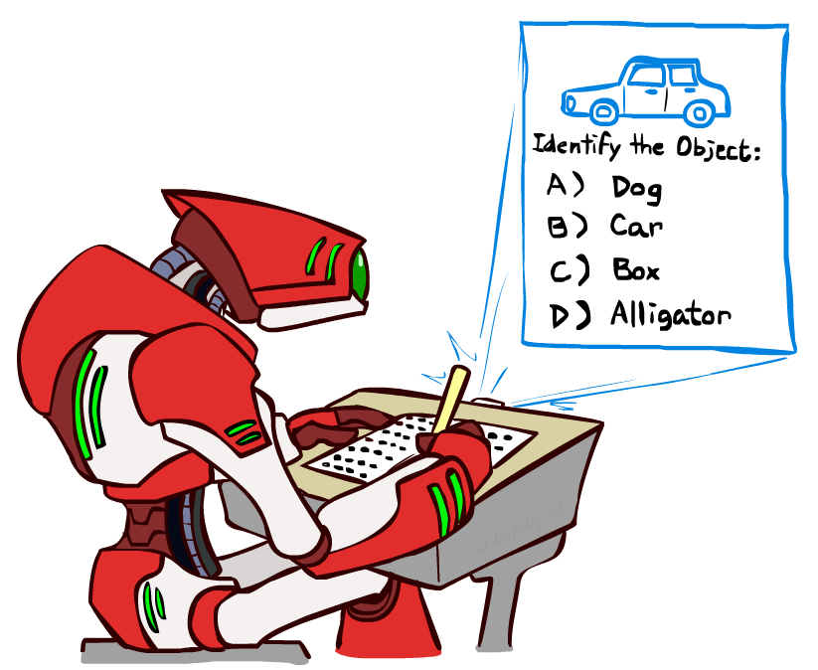
Other Classification Tasks
Classification: given inputs x, predict labels (classes) y
Examples:
  Medical diagnosis (input: symptoms,
  classes: diseases)
  Fraud detection (input: account activity,
  classes: fraud / no fraud)
  Automatic essay grading (input: document,
  classes: grades)
  Customer service email routing
  Review sentiment
  Language ID
  … many more
Classification is an important commercial technology!

Slide 14
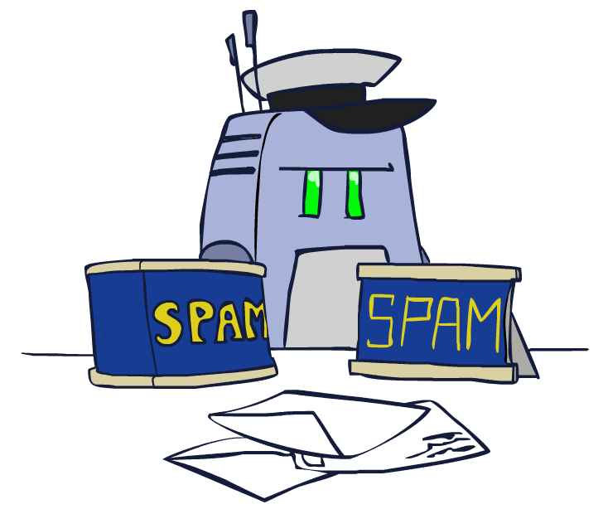
Model-Based Classification

Slide 15
Model-Based Classification
Model-based approach
  Build a model (e.g. Bayes’ net) where both the output label and input features are random variables
  Instantiate any observed features
  Query for the distribution of the label conditioned on the features
Challenges
  What structure should the BN have?
  How should we learn its parameters?

Slide 16



Naïve Bayes for Digits
Naïve Bayes: Assume all features are independent effects of the label
Simple digit recognition version:
  One feature (variable) F_{ij} for each grid position <i,j>
  Feature values are on / off, based on whether intensity
  is more or less than 0.5 in underlying image
  Each input maps to a feature vector, e.g.
  Here: lots of features, each is binary valued
Naïve Bayes model:
What do we need to learn?
Y
F₁
F₂
F_{n}

Slide 17

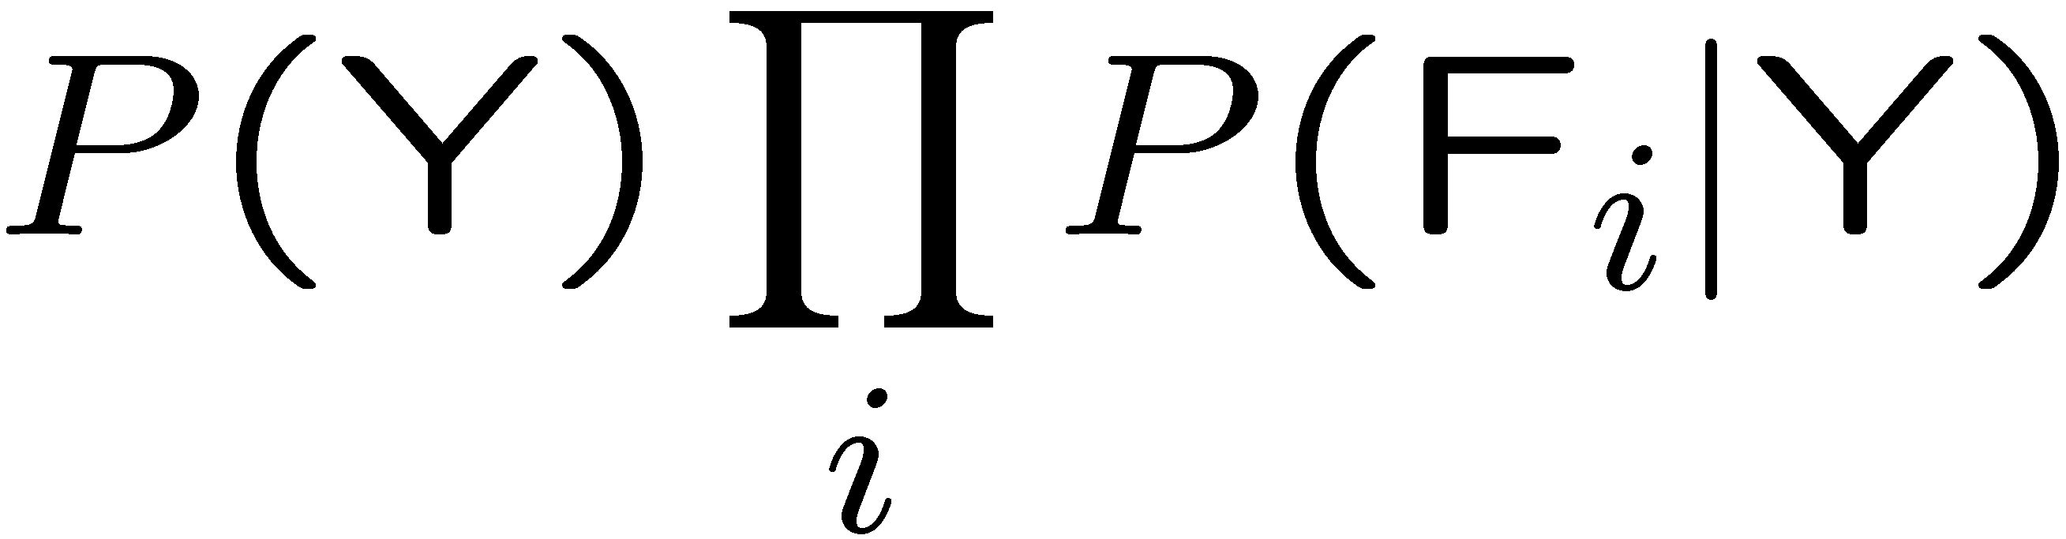
General Naïve Bayes
A general Naive Bayes model:
We only have to specify how each feature depends on the class
Total number of parameters is linear in n
Model is very simplistic, but often works anyway
Y
|Y| parameters
F₁
F₂
F_{n}
|Y| x |F|^{n} values
n x |F| x |Y| parameters

Slide 18
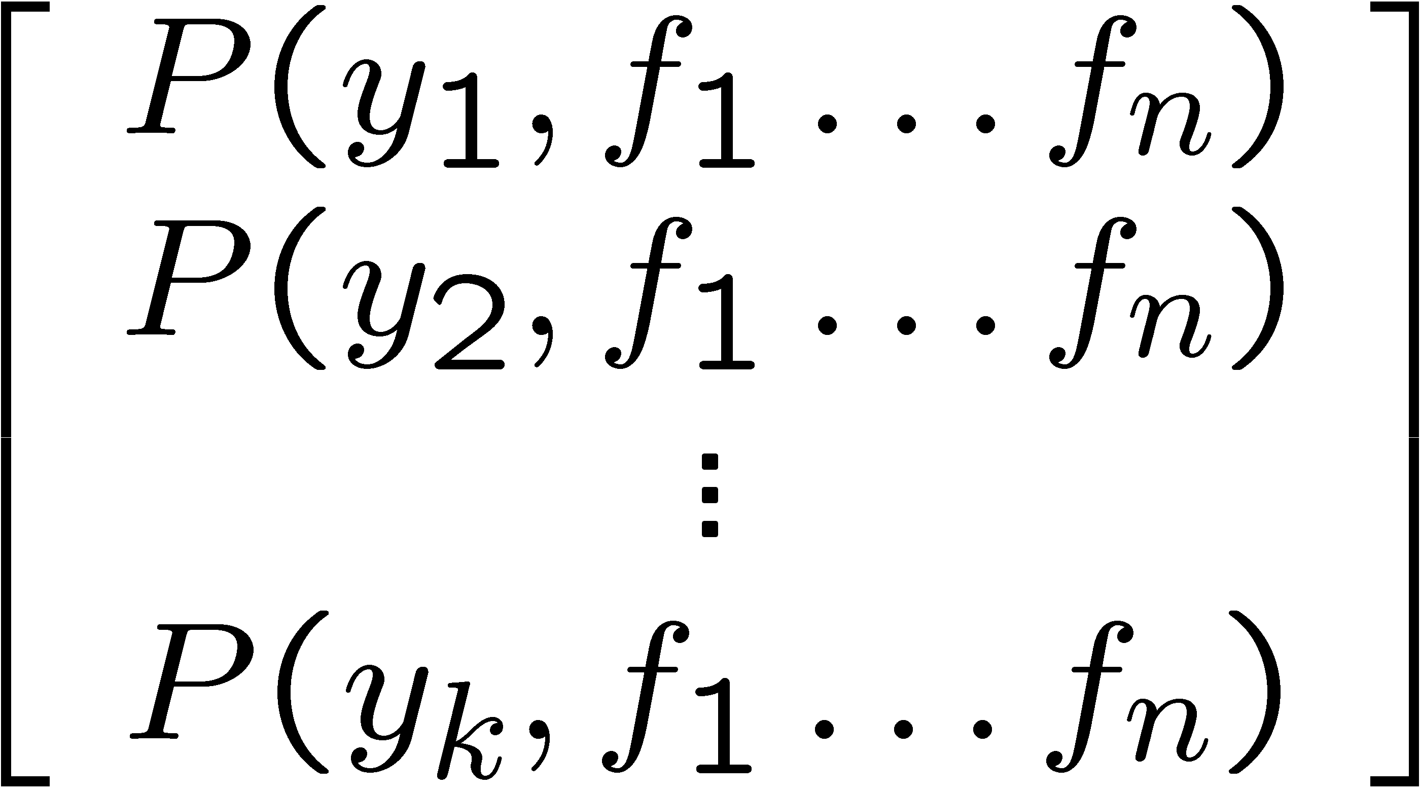
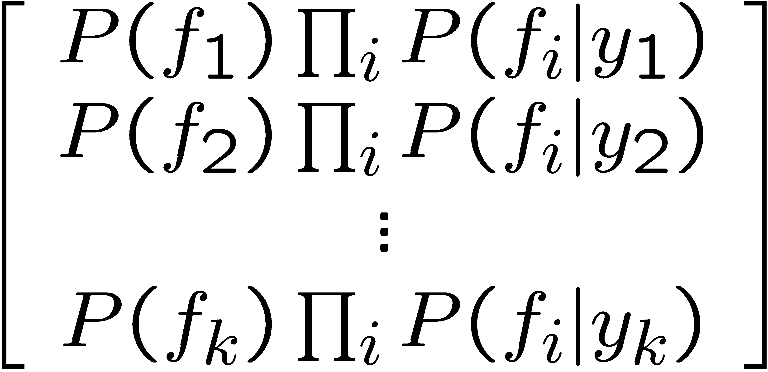

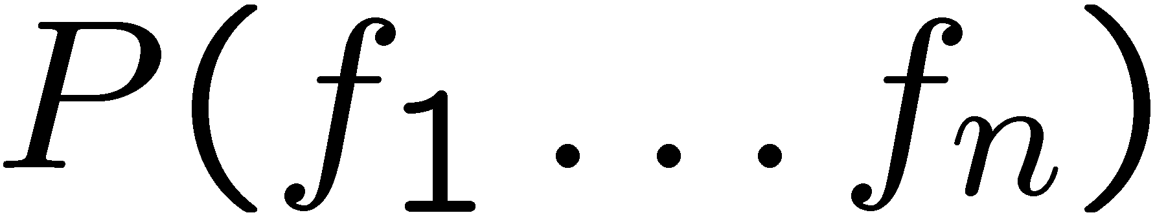
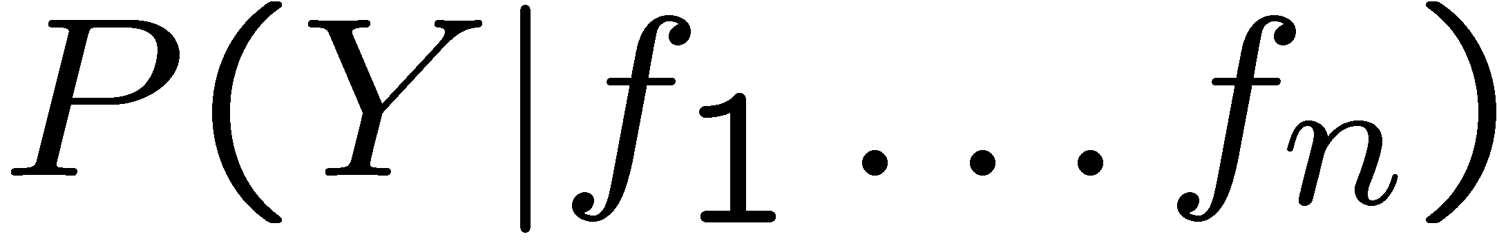
Inference for Naïve Bayes
Goal: compute posterior distribution over label variable Y
  Step 1: get joint probability of label and evidence for each label
  Step 2: sum to get probability of evidence
  Step 3: normalize by dividing Step 1 by Step 2
+

Slide 19
General Naïve Bayes
What do we need in order to use Naïve Bayes?
  Inference method (we just saw this part)
    Start with a bunch of probabilities: P(Y) and the P(F_{i}|Y) tables
    Use standard inference to compute P(Y|F₁…F_{n})
    Nothing new here
  Estimates of local conditional probability tables
    P(Y), the prior over labels
    P(F_{i}|Y) for each feature (evidence variable)
    These probabilities are collectively called the parameters of the model and denoted by θ
    Up until now, we assumed these appeared by magic, but…
    …they typically come from training data counts: we’ll look at this soon

Slide 20
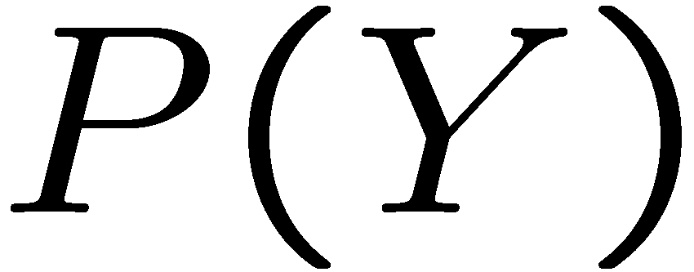


Example: Conditional Probabilities
1 | 0.1
2 | 0.1
3 | 0.1
4 | 0.1
5 | 0.1
6 | 0.1
7 | 0.1
8 | 0.1
9 | 0.1
0 | 0.1
1 | 0.01
2 | 0.05
3 | 0.05
4 | 0.30
5 | 0.80
6 | 0.90
7 | 0.05
8 | 0.60
9 | 0.50
0 | 0.80
1 | 0.05
2 | 0.01
3 | 0.90
4 | 0.80
5 | 0.90
6 | 0.90
7 | 0.25
8 | 0.85
9 | 0.60
0 | 0.80

Slide 21
A Spam Filter
Naïve Bayes spam filter
Data:
  Collection of emails, labeled spam or ham
  Note: someone has to hand label all this data!
  Split into training, held-out, test sets
Classifiers
  Learn on the training set
  (Tune it on a held-out set)
  Test it on new emails
Dear Sir.
First, I must solicit your confidence in this transaction, this is by virture of its nature as being utterly confidencial and top secret. …
TO BE REMOVED FROM FUTURE MAILINGS, SIMPLY REPLY TO THIS MESSAGE AND PUT "REMOVE" IN THE SUBJECT.
99 MILLION EMAIL ADDRESSES
FOR ONLY $99
Ok, Iknow this is blatantly OT but I'm beginning to go insane. Had an old Dell Dimension XPS sitting in the corner and decided to put it to use, I know it was working pre being stuck in the corner, but when I plugged it in, hit the power nothing happened.

Slide 22
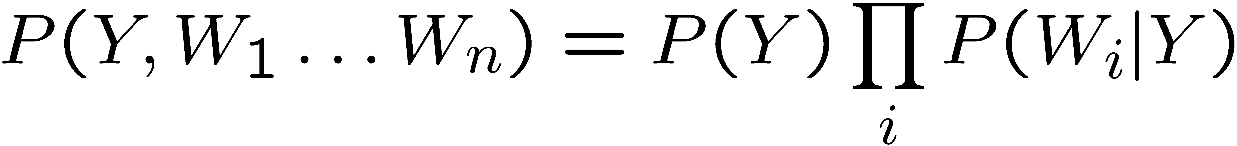
Naïve Bayes for Text
Bag-of-words Naïve Bayes:
  Features: W_{i} is the word at position i
  As before: predict label conditioned on feature variables (spam vs. ham)
  As before: assume features are conditionally independent given label
  New: each W_{i} is identically distributed
Generative model:
“Tied” distributions and bag-of-words
  Usually, each variable gets its own conditional probability distribution P(F|Y)
  In a bag-of-words model
    Each position is identically distributed
    All positions share the same conditional probs P(W|Y)
    Why make this assumption?
  Called “bag-of-words” because model is insensitive to word order or reordering
Word at position i, not i^{th} word in the dictionary!

Slide 23

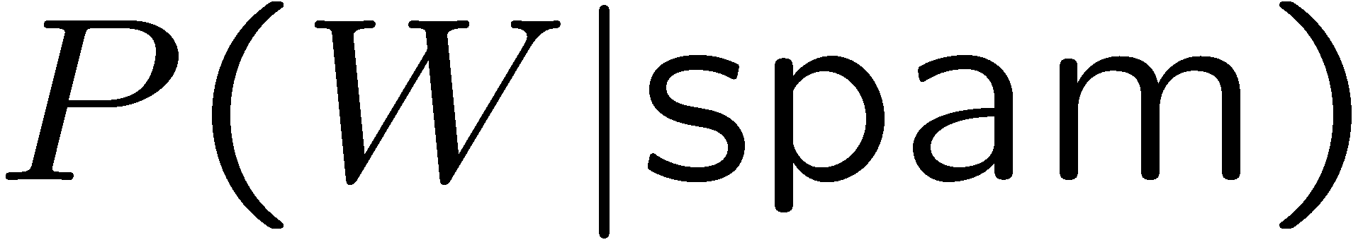
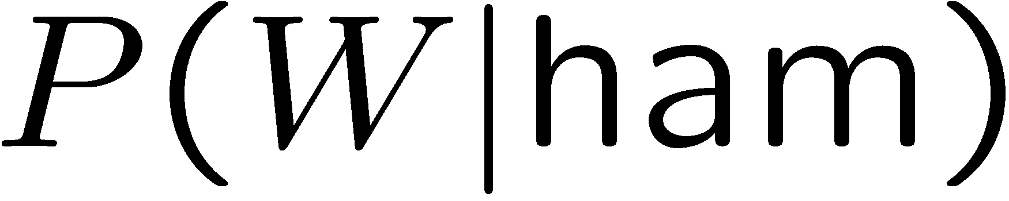
Example: Spam Filtering
Model:
What are the parameters?
Where do these tables come from?
ham : 0.66
spam: 0.33
the : 0.0156
to : 0.0153
and : 0.0115
of : 0.0095
you : 0.0093
a : 0.0086
with: 0.0080
from: 0.0075
...
the : 0.0210
to : 0.0133
of : 0.0119
2002: 0.0110
with: 0.0108
from: 0.0107
and : 0.0105
a : 0.0100
...

Slide 24
Spam Example
Word | P(w|spam) | P(w|ham) | Tot Spam | Tot Ham
(prior) | 0.33333 | 0.66666 | -1.1 | -0.4
Gary | 0.00002 | 0.00021 | -11.8 | -8.9
would | 0.00069 | 0.00084 | -19.1 | -16.0
you | 0.00881 | 0.00304 | -23.8 | -21.8
like | 0.00086 | 0.00083 | -30.9 | -28.9
to | 0.01517 | 0.01339 | -35.1 | -33.2
lose | 0.00008 | 0.00002 | -44.5 | -44.0
weight | 0.00016 | 0.00002 | -53.3 | -55.0
while | 0.00027 | 0.00027 | -61.5 | -63.2
you | 0.00881 | 0.00304 | -66.2 | -69.0
sleep | 0.00006 | 0.00001 | -76.0 | -80.5
P(spam | w) = 98.9

Slide 25
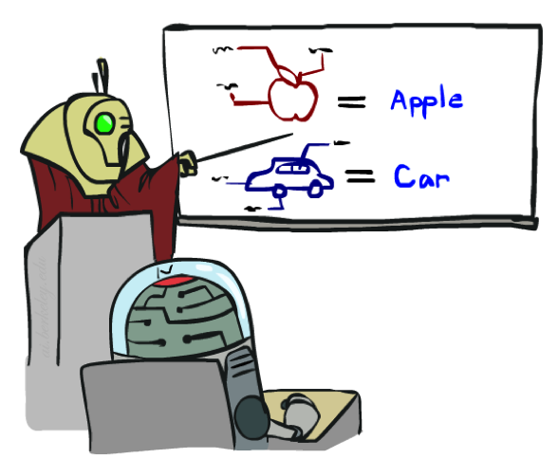

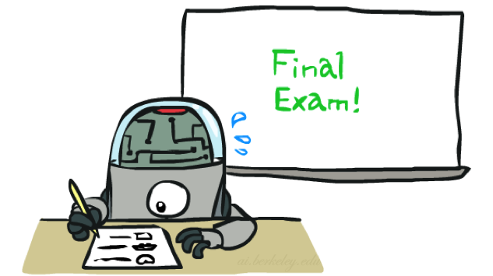
Training and Testing

Slide 26
Empirical Risk Minimization
Empirical risk minimization
  Basic principle of machine learning
  We want the model (classifier, etc) that does best on the true test distribution
  Don’t know the true distribution so pick the best model on our actual training set
  Finding “the best” model on the training set is phrased as an optimization problem
Potential worry: overfitting to the training set
  Better with more training data (less sampling variance, training more like test)
  Better if we limit the complexity of our hypotheses (regularization and/or small hypothesis spaces)

Slide 27


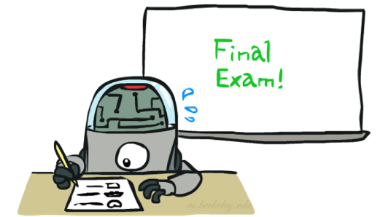
Important Concepts
Data: labeled instances (e.g. emails marked spam/ham)
  Training set
  Held out set
  Test set
Features: attribute-value pairs which characterize each x
Experimentation cycle
  Learn parameters (e.g. model probabilities) on training set
  (Tune hyperparameters on held-out set)
  Compute accuracy of test set
  Very important: never “peek” at the test set!
Evaluation (many metrics possible, e.g. accuracy)
  Accuracy: fraction of instances predicted correctly
Overfitting and generalization
  Want a classifier which does well on test data
  Overfitting: fitting the training data very closely, but not generalizing well
  We’ll investigate overfitting and generalization formally in a few lectures
Training
Data
Held-Out
Data
Test
Data

Slide 28

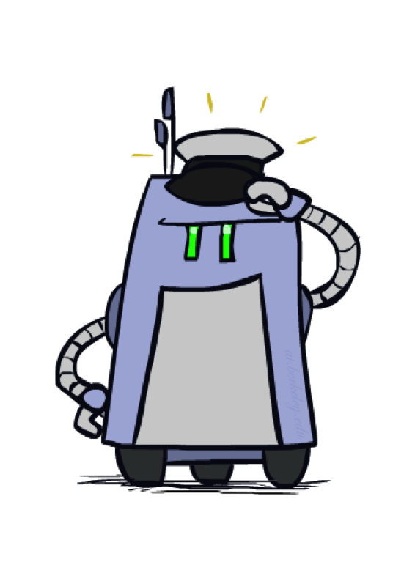
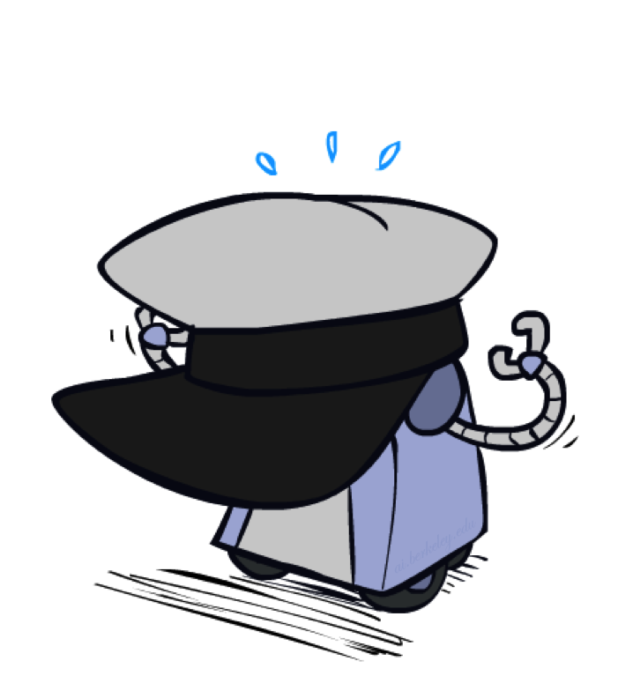
Generalization and Overfitting

Slide 29
Overfitting
30
25
20
Degree 15 polynomial
15
10
5
0
-5
-10
-15
0
2
4
6
8
10
12
14
16
18
20

Slide 30












Example: Overfitting
2 wins!!

Slide 31
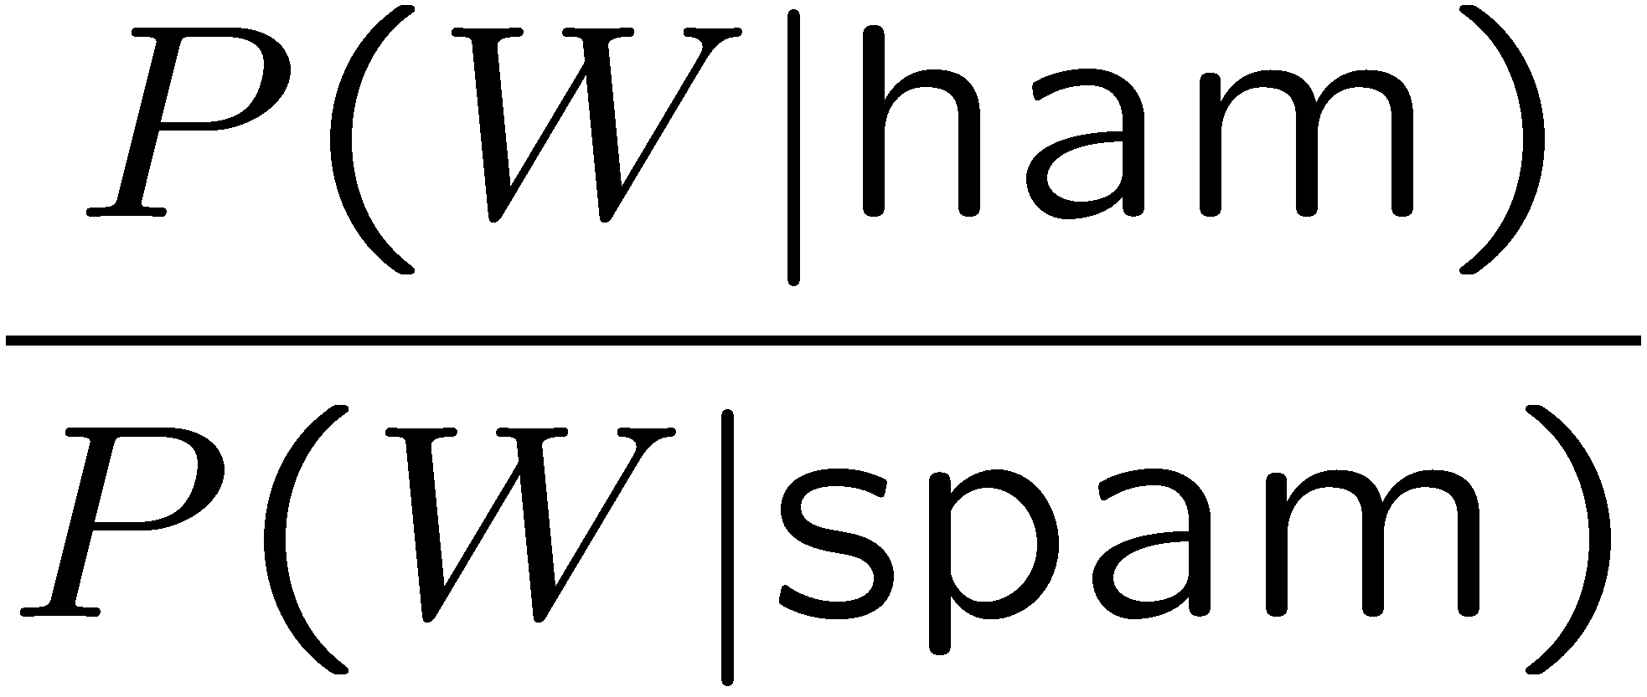
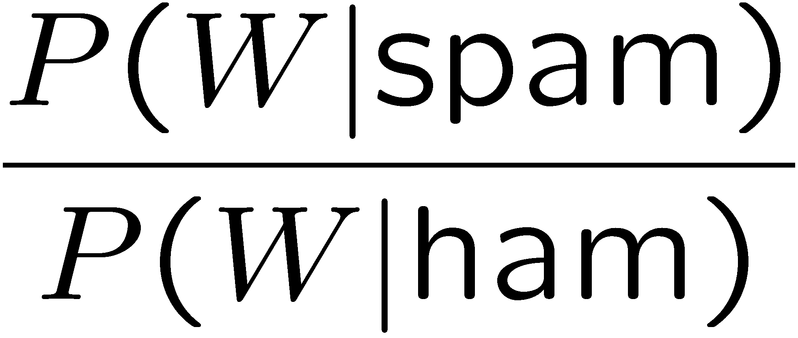
Example: Overfitting
Posteriors determined by relative probabilities (odds ratios):
south-west : inf
nation : inf
morally : inf
nicely : inf
extent : inf
seriously : inf
...
screens : inf
minute : inf
guaranteed : inf
$205.00 : inf
delivery : inf
signature : inf
...
What went wrong here?

Slide 32
Generalization and Overfitting
Relative frequency parameters will overfit the training data!
  Just because we never saw a 3 with pixel (15,15) on during training doesn’t mean we won’t see it at test time
  Unlikely that every occurrence of “minute” is 100% spam
  Unlikely that every occurrence of “seriously” is 100% ham
  What about all the words that don’t occur in the training set at all?
  In general, we can’t go around giving unseen events zero probability
As an extreme case, imagine using the entire email as the only feature (e.g. document ID)
  Would get the training data perfect (if deterministic labeling)
  Wouldn’t generalize at all
  Just making the bag-of-words assumption gives us some generalization, but isn’t enough
To generalize better: we need to smooth or regularize the estimates

Slide 33
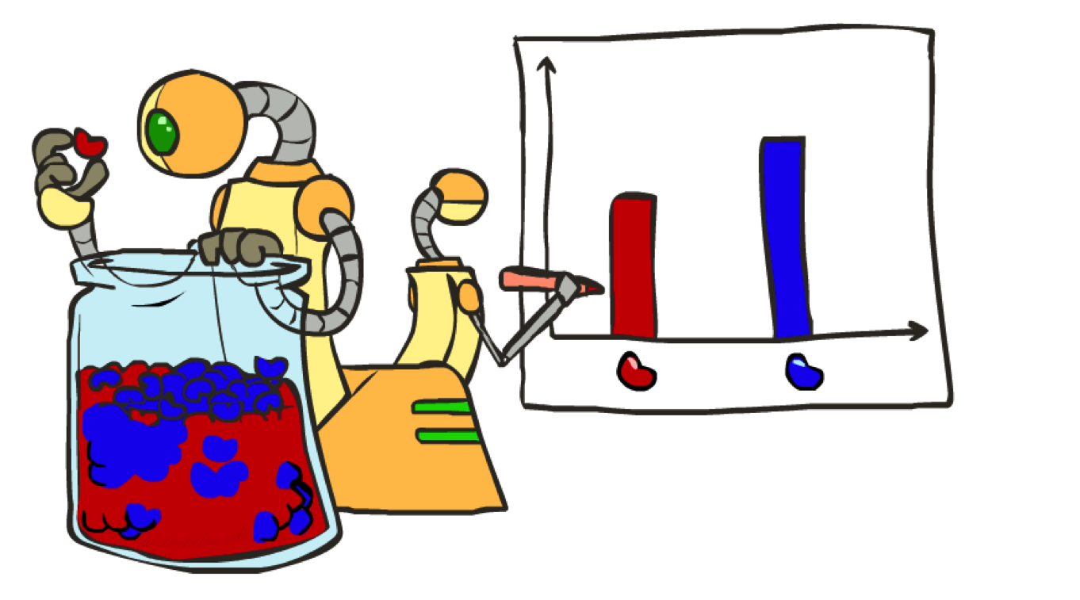
Parameter Estimation

Slide 34
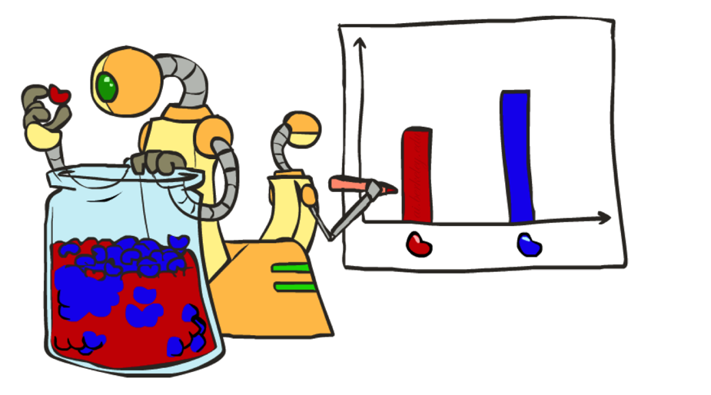
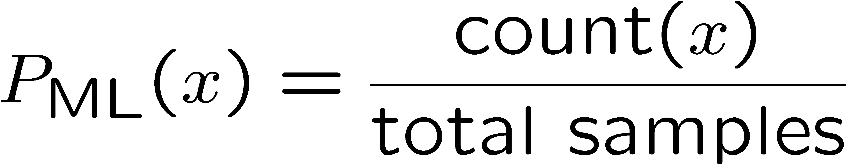

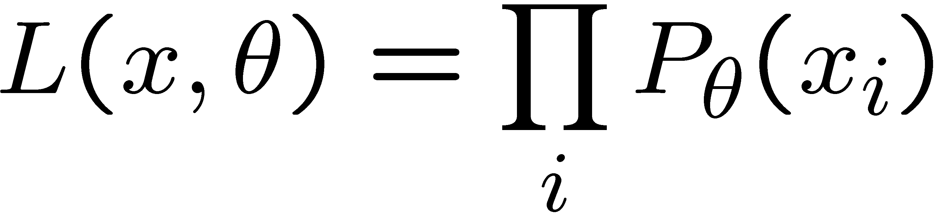





Parameter Estimation
Estimating the distribution of a random variable
Elicitation: ask a human (why is this hard?)
Empirically: use training data (learning!)
  E.g.: for each outcome x, look at the empirical rate of that value:
  This is the estimate that maximizes the likelihood of the data
r
b
b
b
r
r
b
b
b
r
r
b
b
b
b
r
r
b

Slide 35



Your First Consulting Job
A billionaire tech entrepreneur asks you a question:
  He says: I have thumbtack, if I flip it, what’s the probability it will fall with the nail up?
  You say: Please flip it a few times:
  You say: The probability is:
    P(H) = 3/5
  He says: Why???
  You say: Because…

Slide 36
Your First Consulting Job
P(Heads) = θ, P(Tails) = 1-θ
Flips are i.i.d.:
  Independent events
  Identically distributed according to unknown distribution
Sequence D of α_{H} Heads and α_{T} Tails
…
D={x_{i} | i=1…n}, P(D | θ ) = Π_{i}P(x_{i} | θ )

Slide 37
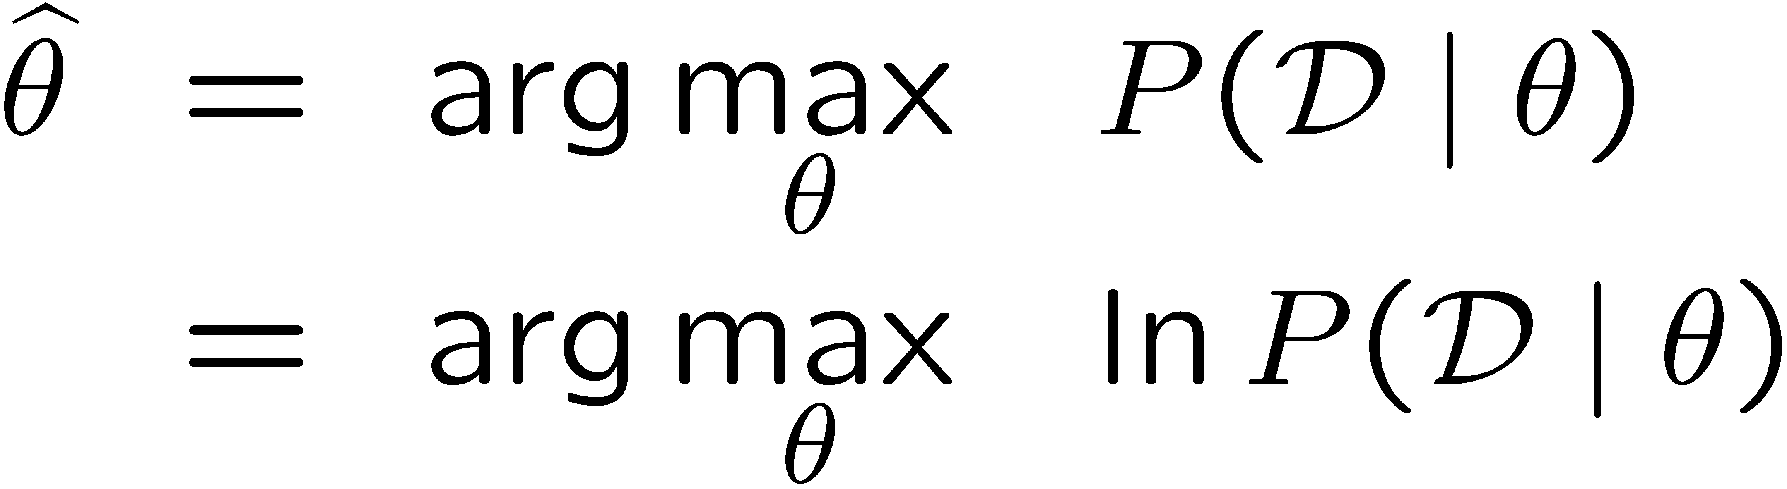
Maximum Likelihood Estimation
Data: Observed set D of α_{H} Heads and α_{T} Tails
Hypothesis space: Binomial distributions
Learning: finding θ is an optimization problem
  What’s the objective function?
MLE: Choose θ to maximize probability of D

Slide 38
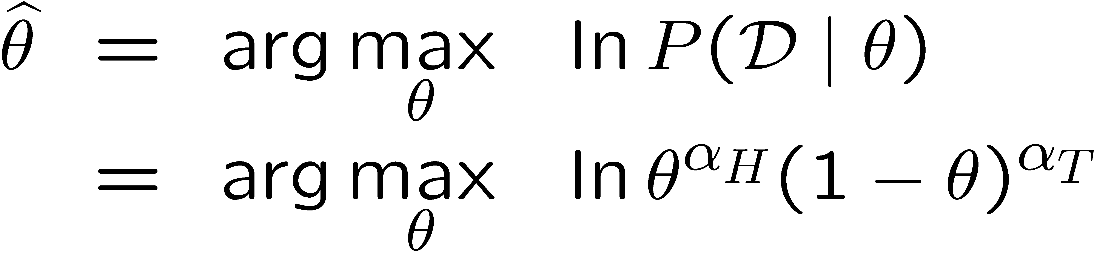
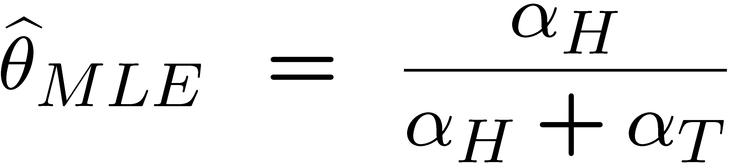
Maximum Likelihood Estimation
Set derivative to zero, and solve!

Slide 39
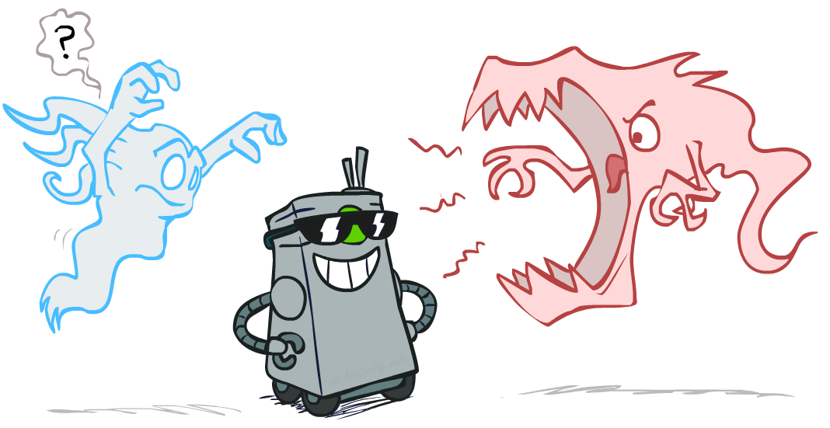
Smoothing

Slide 40
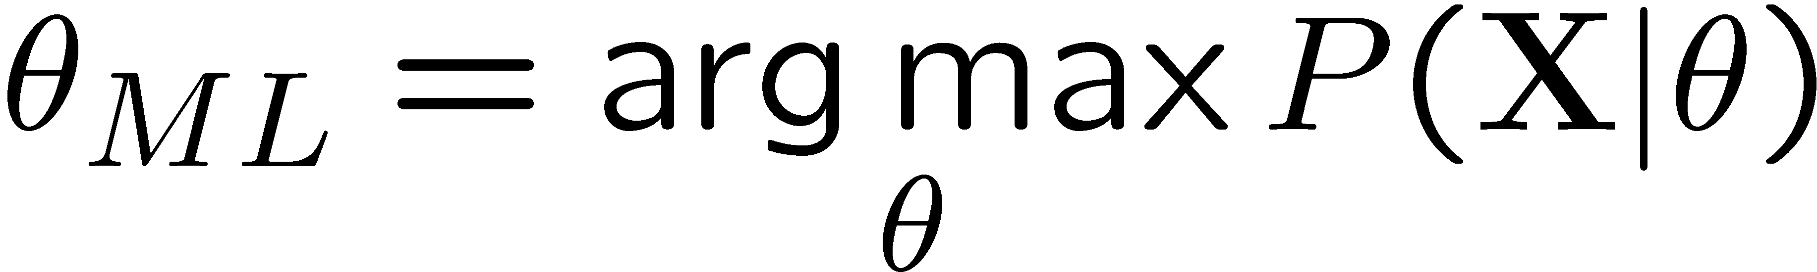
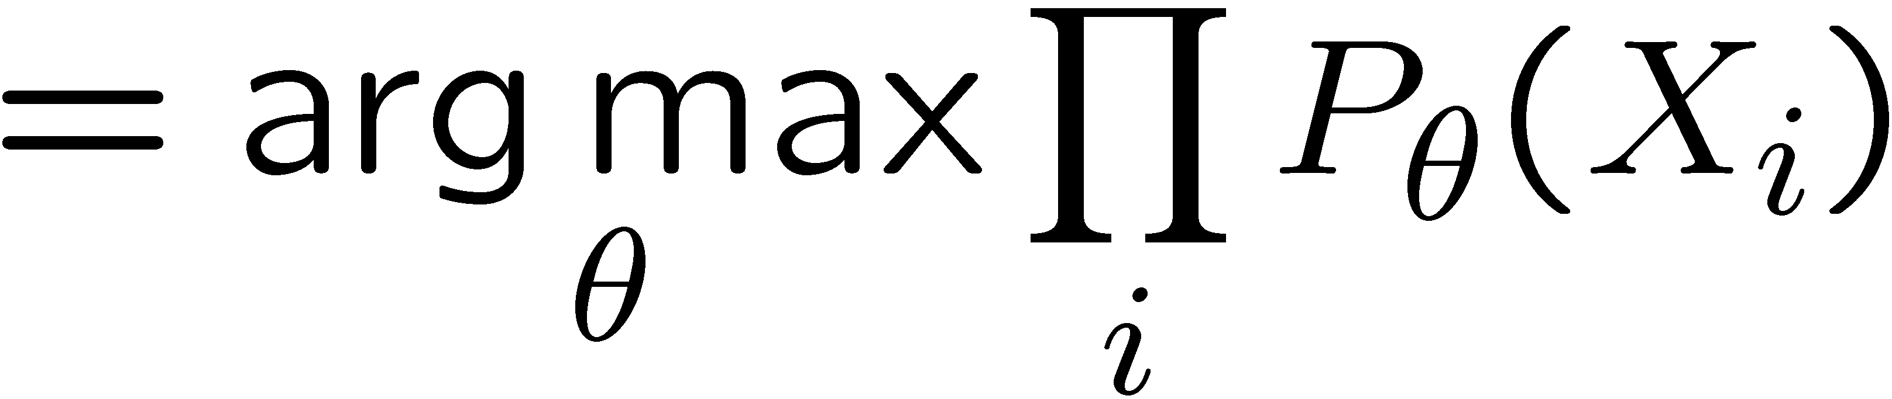
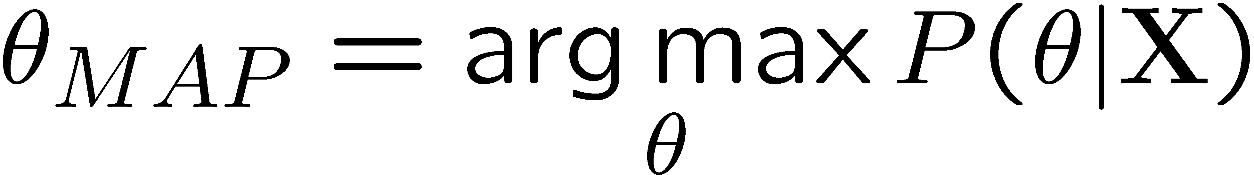
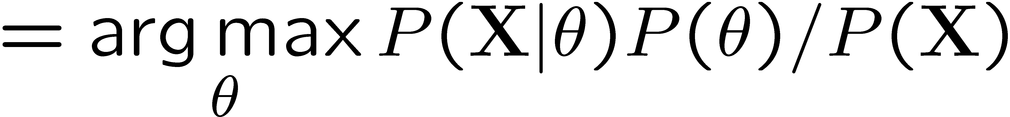
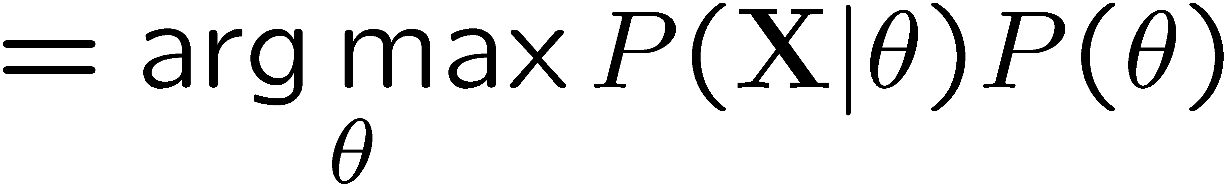
Maximum Likelihood?
Relative frequencies are the maximum likelihood estimates
Another option is to consider the most likely parameter value given the data
????

Slide 41

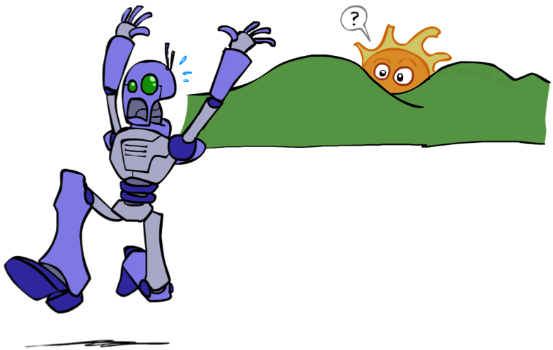
Unseen Events

Slide 42
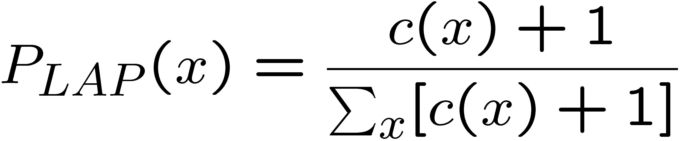
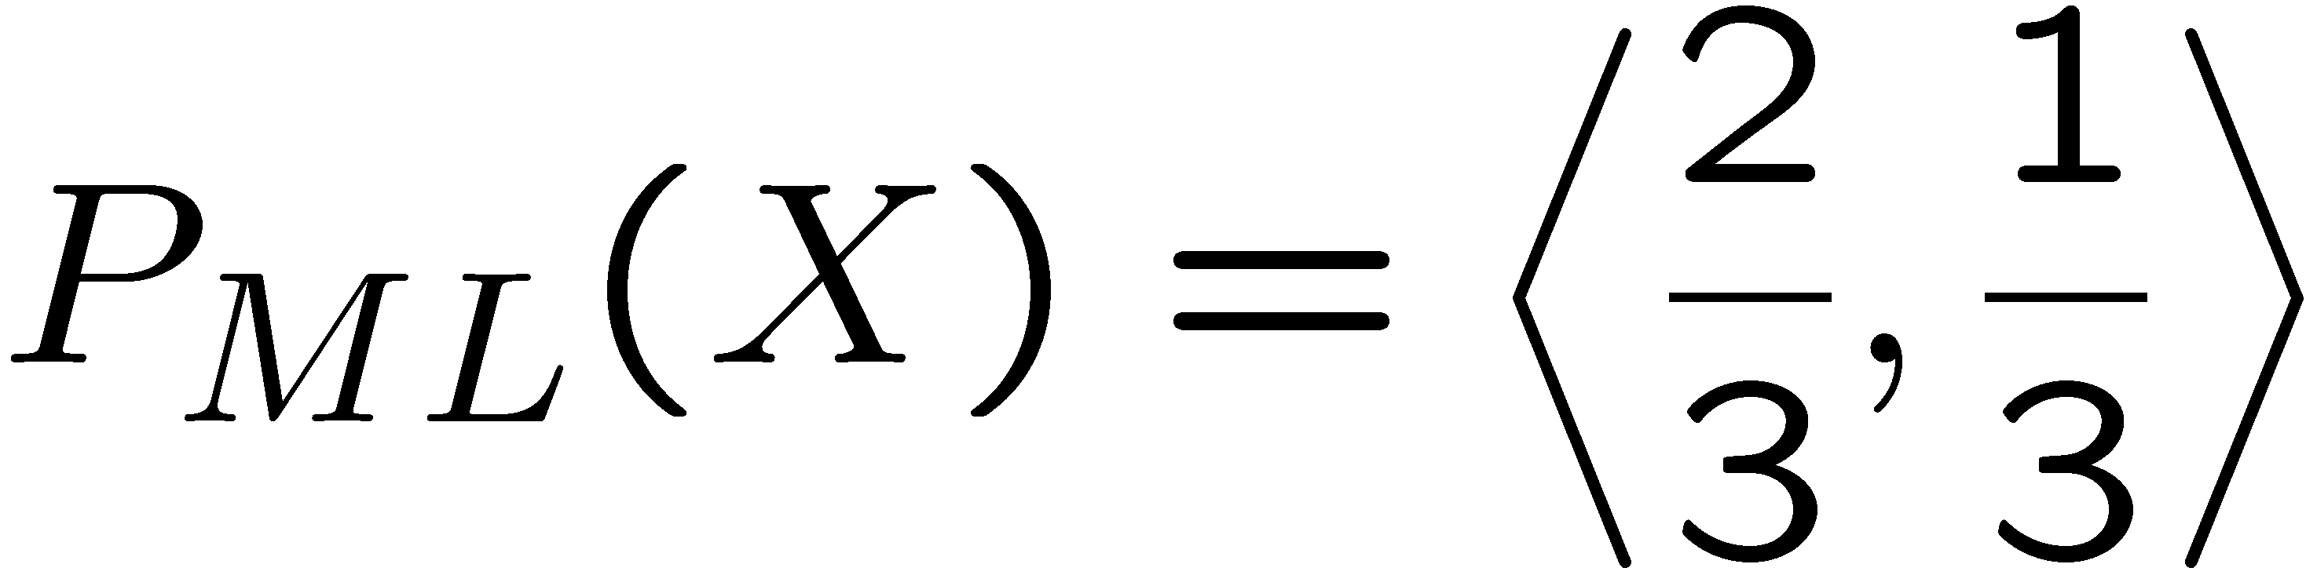
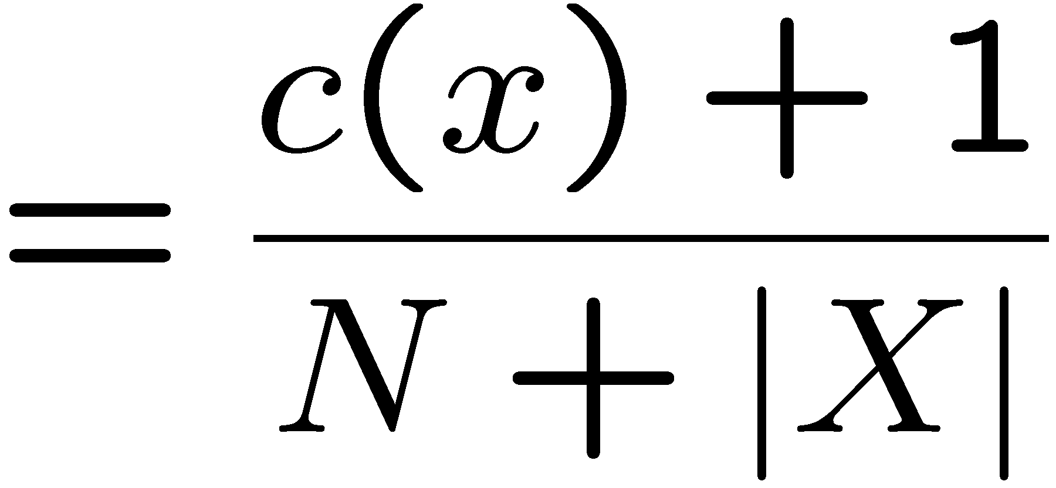
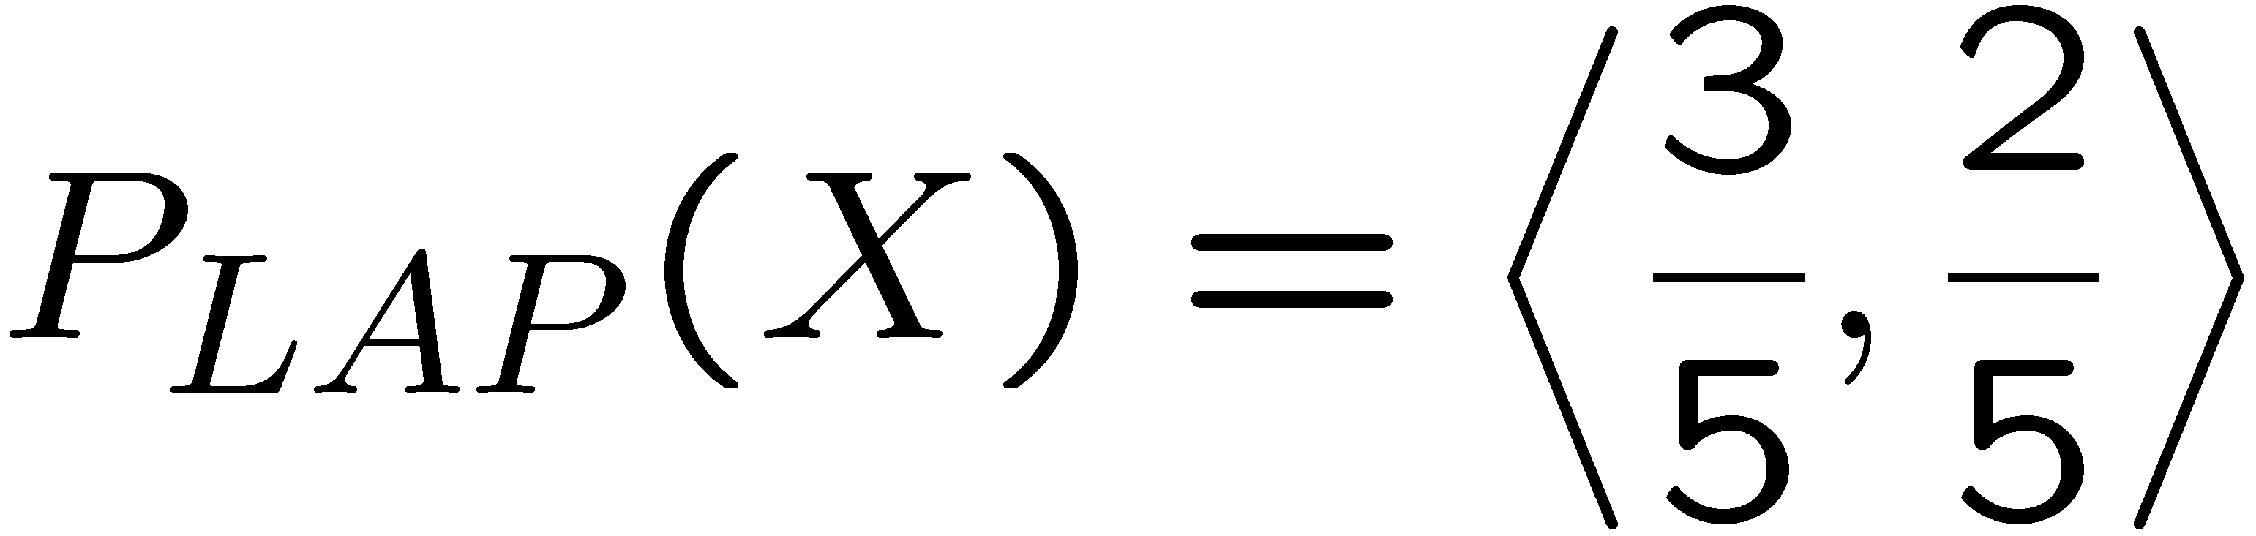
Laplace Smoothing
Laplace’s estimate:
  Pretend you saw every outcome once more than you actually did
  Can derive this estimate with Dirichlet priors (see cs281a)
r
r
b

Slide 43
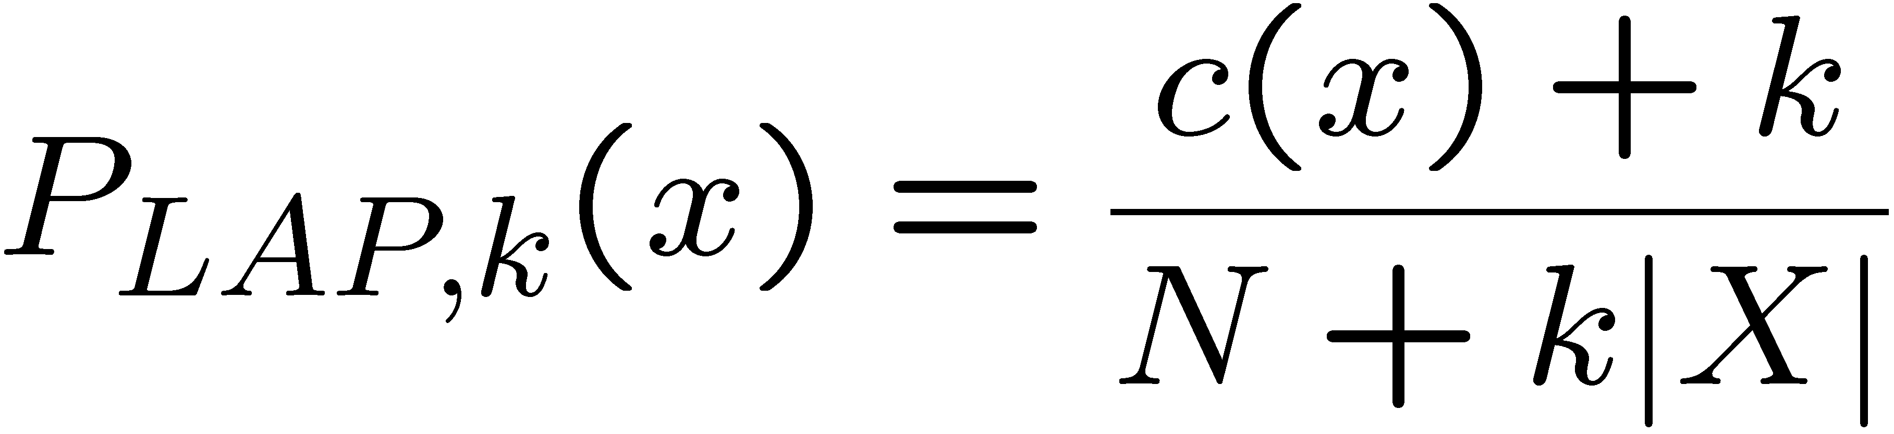
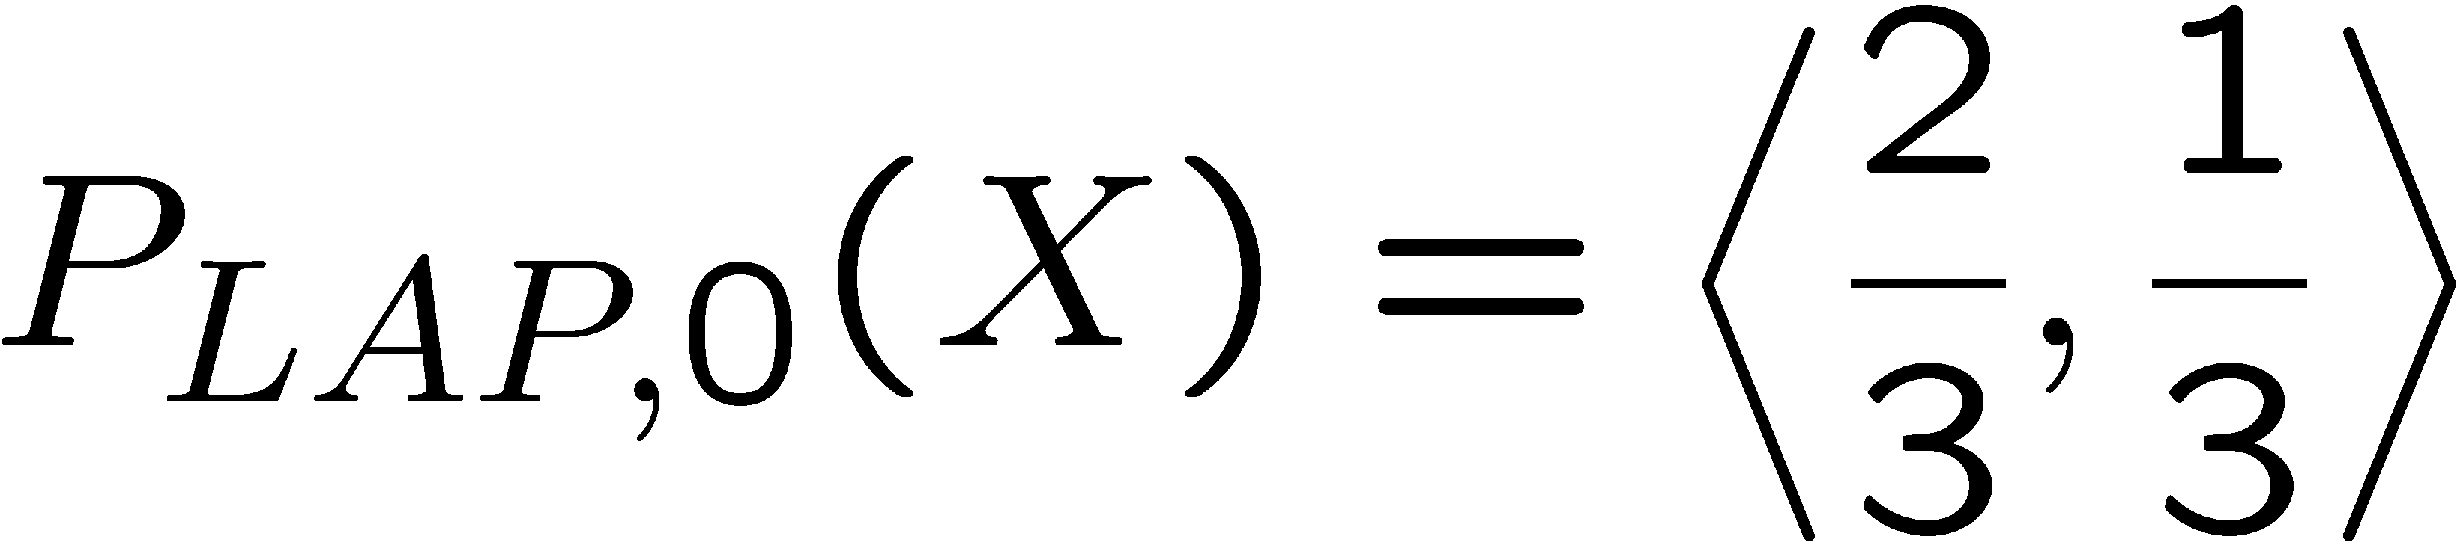
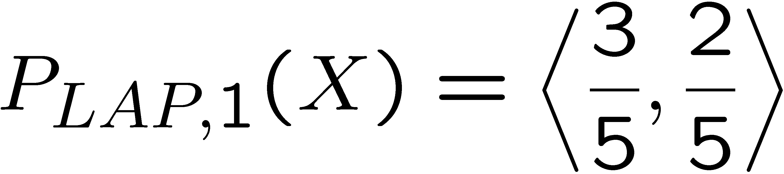
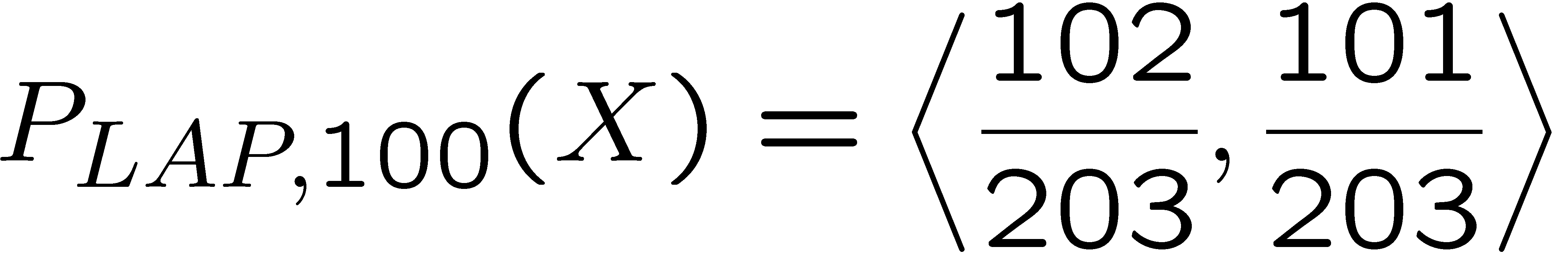
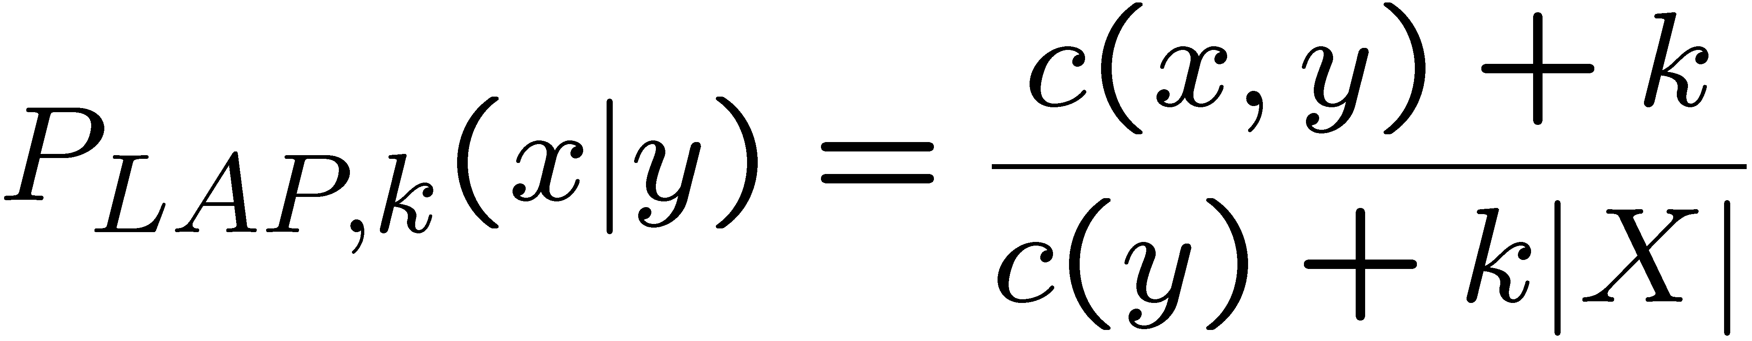
Laplace Smoothing
Laplace’s estimate (extended):
  Pretend you saw every outcome k extra times
  What’s Laplace with k = 0?
  k is the strength of the prior
Laplace for conditionals:
  Smooth each condition independently:
r
r
b

Slide 44
Estimation: Linear Interpolation*
In practice, Laplace can perform poorly for P(X|Y):
  When |X| is very large
  When |Y| is very large
Another option: linear interpolation
  Also get the empirical P(X) from the data
  Make sure the estimate of P(X|Y) isn’t too different from the empirical P(X)
  What if α is 0? 1?
For even better ways to estimate parameters, as well as details of the math, see cs281a, cs288

Slide 45
Real NB: Smoothing
For real classification problems, smoothing is critical
New odds ratios:
helvetica : 11.4
seems : 10.8
group : 10.2
ago : 8.4
areas : 8.3
...
verdana : 28.8
Credit : 28.4
ORDER : 27.2
<FONT> : 26.9
money : 26.5
...
Do these make more sense?

Slide 46
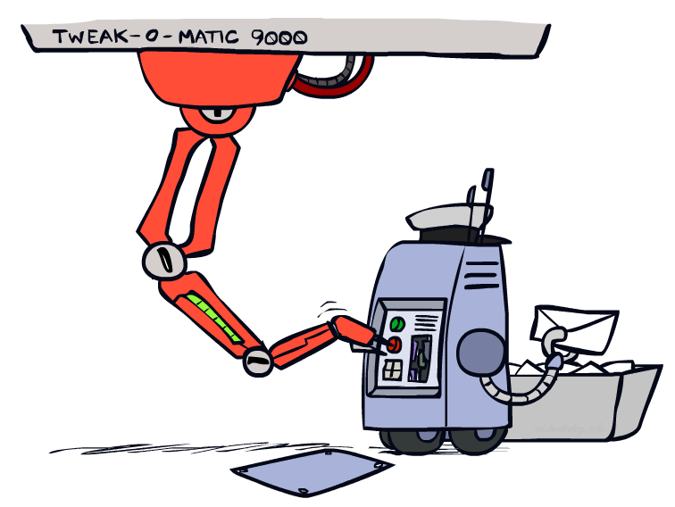
Tuning

Slide 47








Tuning on Held-Out Data
Now we’ve got two kinds of unknowns
  Parameters: the probabilities P(X|Y), P(Y)
  Hyperparameters: e.g. the amount / type of smoothing to do, k, α
What should we learn where?
  Learn parameters from training data
  Tune hyperparameters on different data
    Why?
  For each value of the hyperparameters, train and test on the held-out data
  Choose the best value and do a final test on the test data

Slide 48
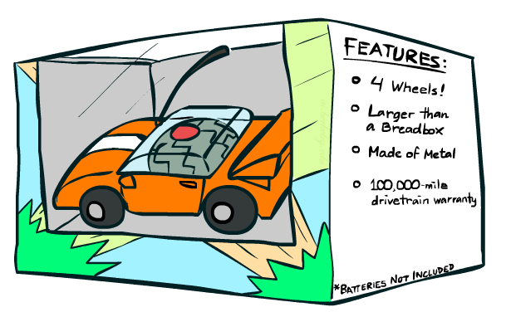
Features

Slide 49
Errors, and What to Do
Examples of errors
Dear GlobalSCAPE Customer,
GlobalSCAPE has partnered with ScanSoft to offer you the latest version of OmniPage Pro, for just $99.99* - the regular list price is $499! The most common question we've received about this offer is - Is this genuine? We would like to assure you that this offer is authorized by ScanSoft, is genuine and valid. You can get the . . .
. . . To receive your $30 Amazon.com promotional certificate, click through to
http://www.amazon.com/apparel
and see the prominent link for the $30 offer. All details are there. We hope you enjoyed receiving this message. However, if you'd rather not receive future e-mails announcing new store launches, please click . . .

Slide 50
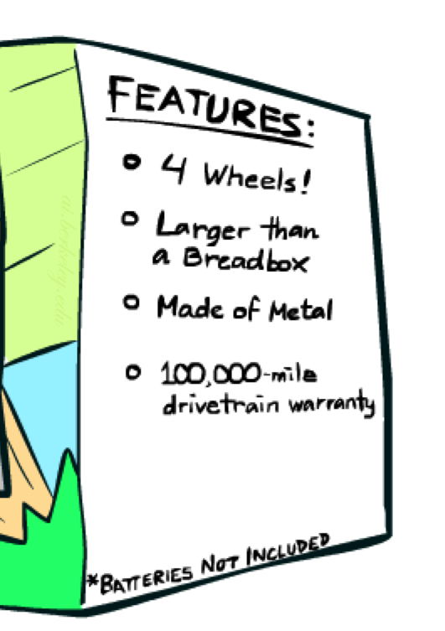
What to Do About Errors?
Need more features– words aren’t enough!
  Have you emailed the sender before?
  Have 1K other people just gotten the same email?
  Is the sending information consistent?
  Is the email in ALL CAPS?
  Do inline URLs point where they say they point?
  Does the email address you by (your) name?
Can add these information sources as new variables in the NB model
Next class we’ll talk about classifiers which let you easily add arbitrary features more easily, and, later, how to induce new features

Slide 51
Baselines
First step: get a baseline
  Baselines are very simple “straw man” procedures
  Help determine how hard the task is
  Help know what a “good” accuracy is
Weak baseline: most frequent label classifier
  Gives all test instances whatever label was most common in the training set
  E.g. for spam filtering, might label everything as ham
  Accuracy might be very high if the problem is skewed
  E.g. calling everything “ham” gets 66%, so a classifier that gets 70% isn’t very good…
For real research, usually use previous work as a (strong) baseline

Slide 52
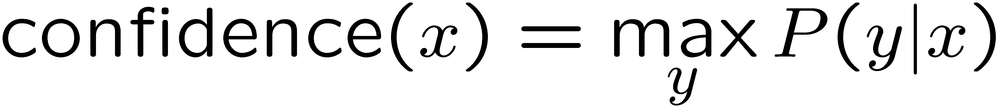

Confidences from a Classifier
The confidence of a probabilistic classifier:
  Posterior probability of the top label
  Represents how sure the classifier is of the classification
  Any probabilistic model will have confidences
  No guarantee confidence is correct
Calibration
  Weak calibration: higher confidences mean higher accuracy
  Strong calibration: confidence predicts accuracy rate
  What’s the value of calibration?

Slide 53
Summary
Bayes rule lets us do diagnostic queries with causal probabilities
The naïve Bayes assumption takes all features to be independent given the class label
We can build classifiers out of a naïve Bayes model using training data
Smoothing estimates is important in real systems
Classifier confidences are useful, when you can get them

Slide 54
Next Time: Discriminative Learning

