Slide 1
Announcements
Written Assessment 2 is out!
Due Friday 7/24 at 11:59pm
Homework 5
Due Friday 7/24 at 11:59pm
Project 4
Due Friday 7/31 at 11:59pm

Slide 2
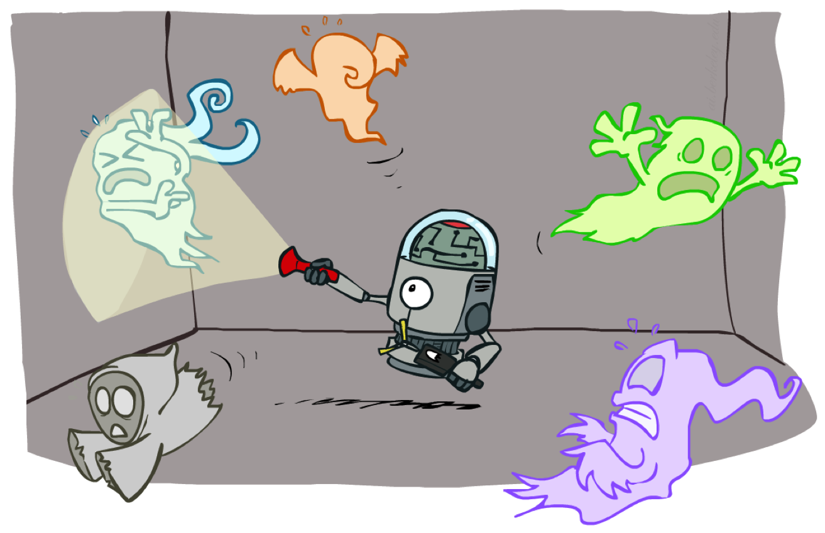
CS 188: Artificial Intelligence
HMMs, Particle Filters, and Applications
Instructor: Nikita Kitaev
University of California, Berkeley
[These slides were created by Dan Klein and Pieter Abbeel for CS188 Intro to AI at UC Berkeley. All CS188 materials are available at http://ai.berkeley.edu.]
Notes:
Please retain proper attribution, including the reference to ai.berkeley.edu. Thanks!

Slide 3
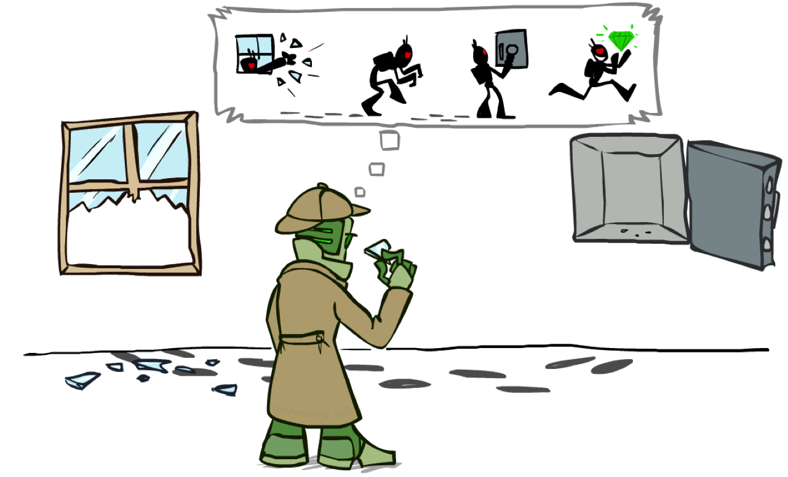
Most Likely Explanation

Slide 4
HMMs: MLE Queries
HMMs defined by
States X
Observations E
Initial distribution:
Transitions:
Emissions:
New query: most likely explanation:
New method: the Viterbi algorithm
X₁
X₂
X₃
X₄
X₅
E₁
E₂
E₃
E₄
E₅

Slide 5
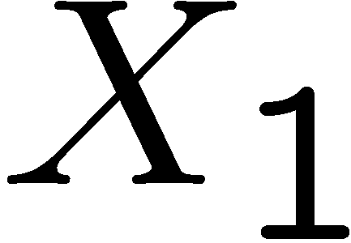
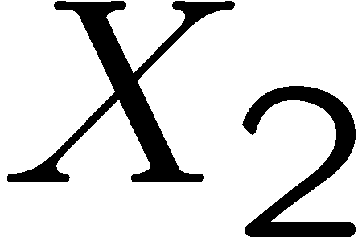
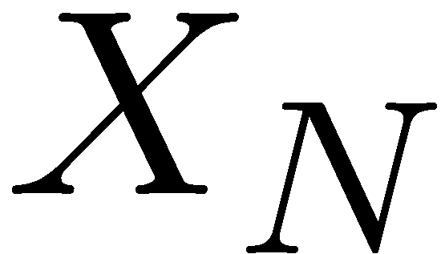
State Trellis
State trellis: graph of states and transitions over time
Each arc represents some transition
Each arc has weight
Each path is a sequence of states
The product of weights on a path is that sequence’s probability along with the evidence
Forward algorithm computes sums of paths, Viterbi computes best paths
sun
sun
sun
sun
rain
rain
rain
rain

Slide 6
Forward / Viterbi Algorithms
sun
sun
sun
sun
rain
rain
rain
rain
Forward Algorithm (Sum)
Viterbi Algorithm (Max)

Slide 7
Speech Recognition

Slide 8
Speech Recognition in Action
[Video: NLP – ASR tvsample.avi (from Lecture 1)]

Slide 9
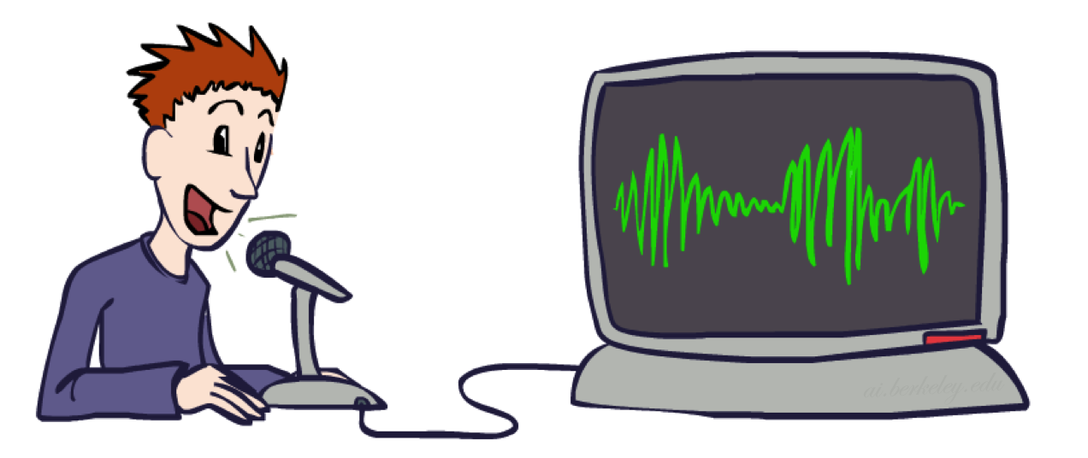
Digitizing Speech

Slide 10
Speech in an Hour
Speech input is an acoustic waveform
s p ee ch l a b
“l” to “a”
transition:
Figure: Simon Arnfield, http://www.psyc.leeds.ac.uk/research/cogn/speech/tutorial/

Slide 11
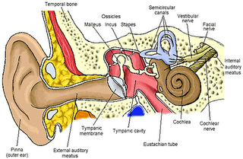
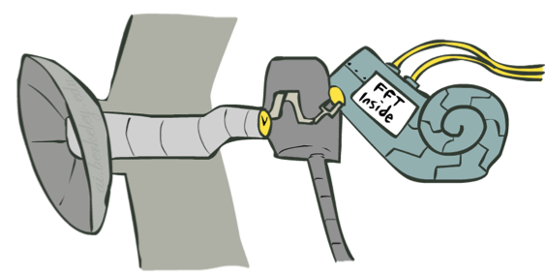
Spectral Analysis
Frequency gives pitch; amplitude gives volume
Sampling at ~8 kHz (phone), ~16 kHz (mic) (kHz=1000 cycles/sec)
Fourier transform of wave displayed as a spectrogram
Darkness indicates energy at each frequency
s p ee ch l a b
amplitude
frequency
Human ear figure: depion.blogspot.com

Slide 12
Part of [ae] from “lab”
Complex wave repeating nine times
Plus smaller wave that repeats 4x for every large cycle
Large wave: freq of 250 Hz (9 times in .036 seconds)
Small wave roughly 4 times this, or roughly 1000 Hz

Slide 13
Why These Peaks?
Articulator process:
Vocal cord vibrations create harmonics
The mouth is an amplifier
Depending on shape of mouth, some harmonics are amplified more than others

Slide 14
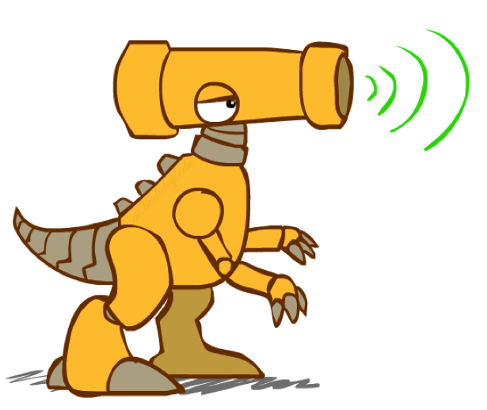
Resonances of the Vocal Tract
The human vocal tract as an open tube
Air in a tube of a given length will tend to vibrate at resonance frequency of tube
Constraint: Pressure differential should be maximal at (closed) glottal end and minimal at (open) lip end
Closed end
Open end
Length 17.5 cm.
Figure: W. Barry Speech Science slides

Slide 15
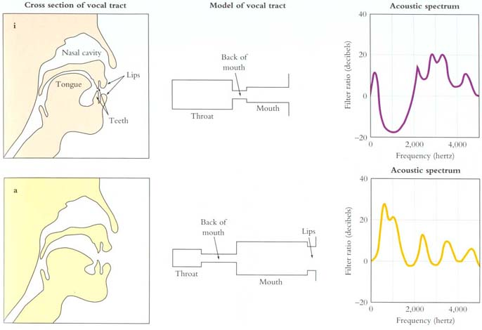
Spectrum Shapes
Figure: Mark Liberman
[Demo: speech synthesis ]

Slide 16
Video of Demo Speech Synthesis

Slide 17
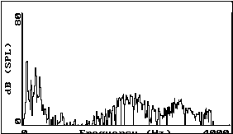
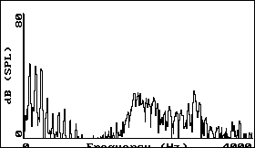
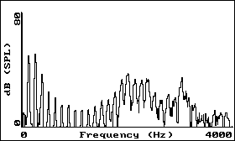
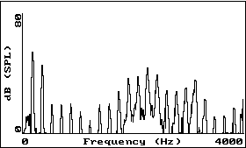
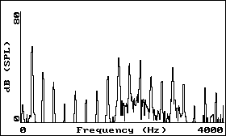
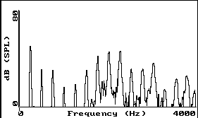
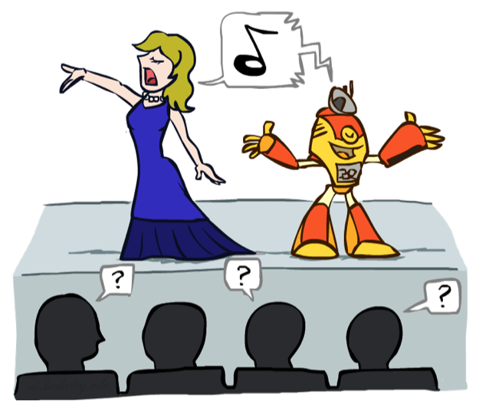
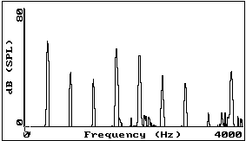
Vowel [i] sung at successively higher pitches
F#2
A2
C3
F#3
A3
C4 (middle C)
A4
Graphs: Ratree Wayland

Slide 18
Acoustic Feature Sequence
Time slices are translated into acoustic feature vectors (~39 real numbers per slice)
These are the observations E, now we need the hidden states X
frequency
……………………………………………..e₁₂e₁₃e₁₄e₁₅e₁₆………..

Slide 19
Speech State Space
HMM Specification
P(E|X) encodes which acoustic vectors are appropriate for each phoneme (each kind of sound)
P(X|X’) encodes how sounds can be strung together
State Space
We will have one state for each sound in each word
Mostly, states advance sound by sound
Build a little state graph for each word and chain them together to form the state space X

Slide 20
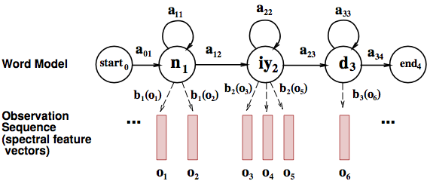
States in a Word

Slide 21
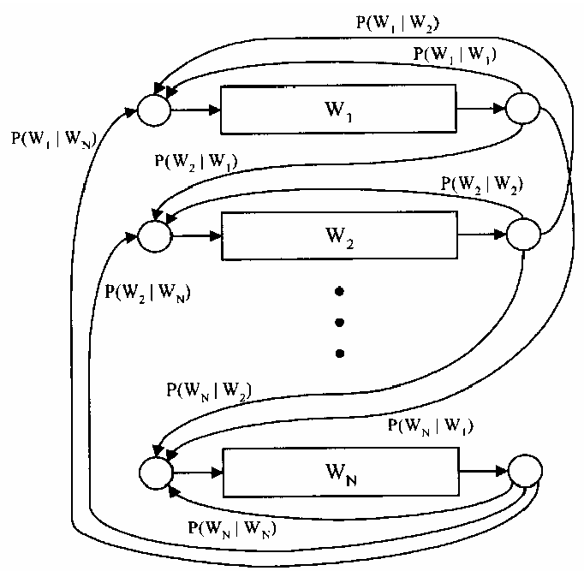
Transitions with a Bigram Model
198015222 the first
194623024 the same
168504105 the following
158562063 the world
…
14112454 the door
-----------------------------------
23135851162 the *
Training Counts
Figure: Huang et al, p. 618

Slide 22
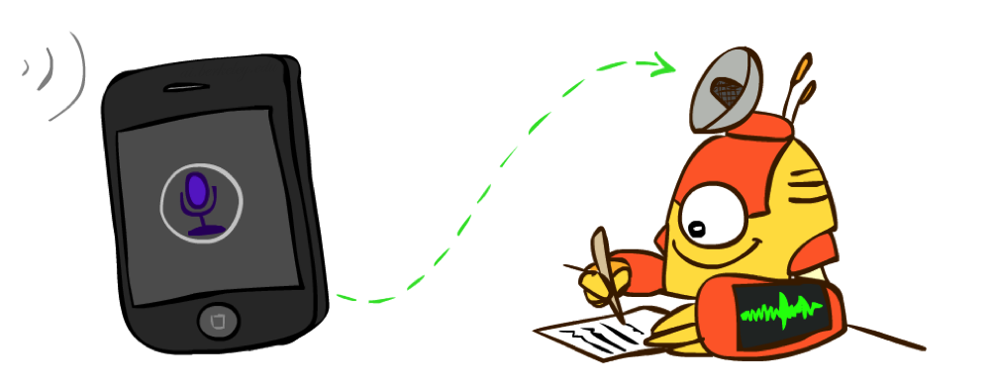
Decoding
Finding the words given the acoustics is an HMM inference problem
Which state sequence x_{1:T} is most likely given the evidence e_{1:T}?
From the sequence x, we can simply read off the words

Slide 23
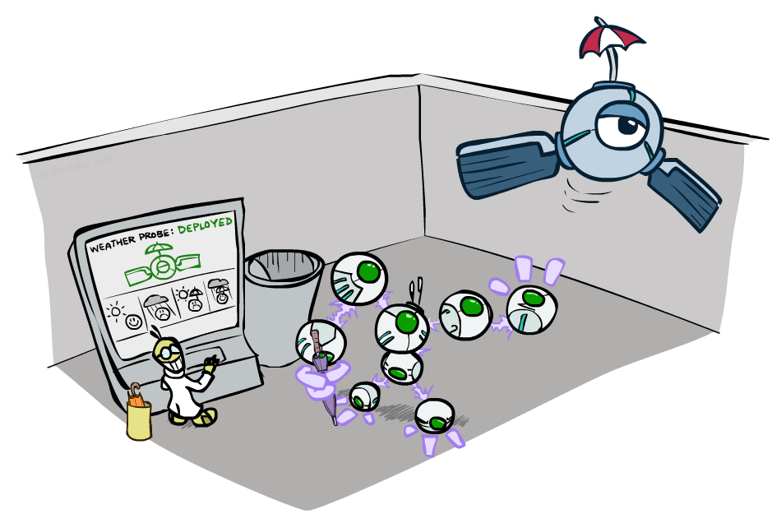
CS 188: Artificial Intelligence
Decision Networks and Value of Information
Instructor: Nikita Kitaev
University of California, Berkeley
[These slides were created by Dan Klein and Pieter Abbeel for CS188 Intro to AI at UC Berkeley. All CS188 materials are available at http://ai.berkeley.edu.]
Notes:
Please retain proper attribution, including the reference to ai.berkeley.edu. Thanks!

Slide 24
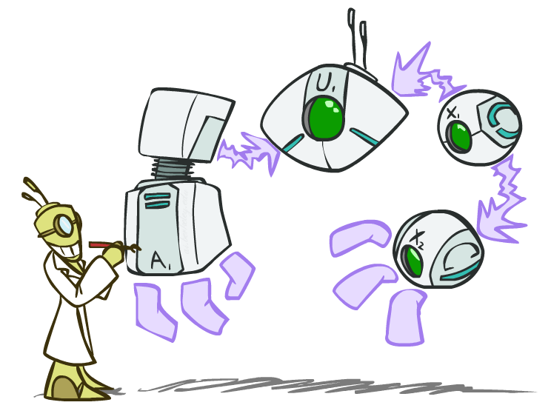
Decision Networks

Slide 25
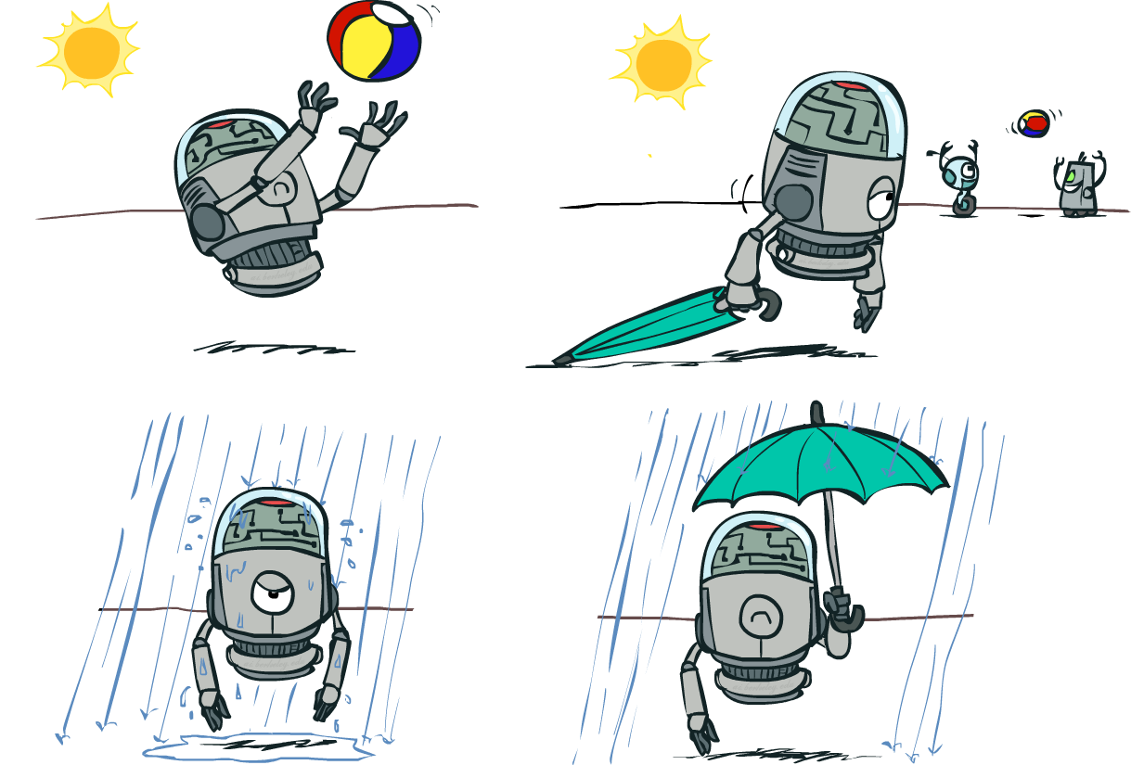
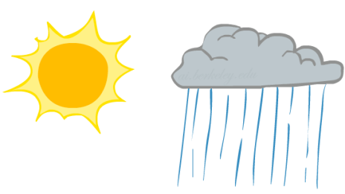
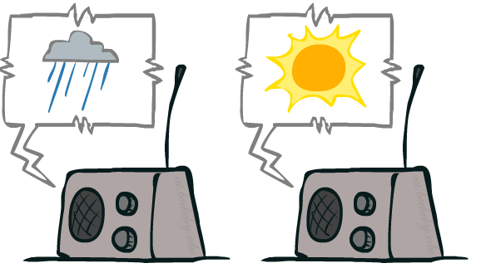
Decision Networks
Umbrella
U
Weather
Forecast
Notes:
There exists a ghostbusters demo

Slide 26
Decision Networks
MEU: choose the action which maximizes the expected utility given the evidence
Can directly operationalize this with decision networks
Bayes nets with nodes for utility and actions
Lets us calculate the expected utility for each action
New node types:
Chance nodes (just like BNs)
Actions (rectangles, cannot have parents, act as observed evidence)
Utility node (diamond, depends on action and chance nodes)
Umbrella
U
Weather
Forecast
Notes:
There exists a ghostbusters demo

Slide 27
Decision Networks
Action selection
Instantiate all evidence
Set action node(s) each possible way
Calculate posterior for all parents of utility node, given the evidence
Calculate expected utility for each action
Choose maximizing action
Umbrella
U
Weather
Forecast
Notes:
There exists a ghostbusters demo

Slide 28
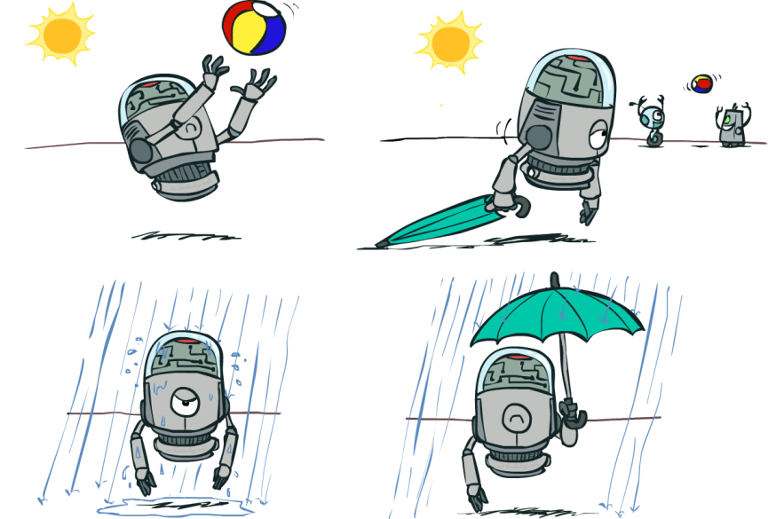
Decision Networks
Umbrella = leave
Umbrella
U
Umbrella = take
Weather
A | W | U(A,W)
leave | sun | 100
leave | rain | 0
take | sun | 20
take | rain | 70
W | P(W)
sun | 0.7
rain | 0.3
Optimal decision = leave
Notes:
There exists a ghostbusters demo

Slide 29
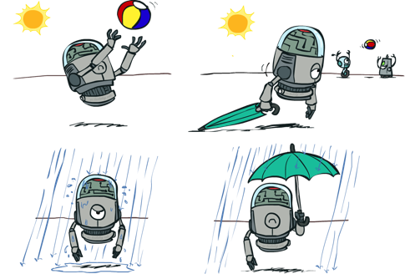
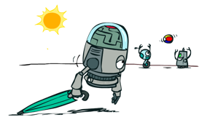
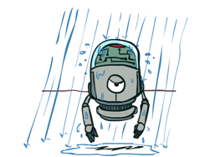
Decisions as Outcome Trees
{}
take
leave
Umbrella
Weather | {}
Weather | {}
U
sun
sun
Weather
rain
rain
U(t,s)
U(t,r)
U(l,s)
U(l,r)
Almost exactly like expectimax / MDPs
What’s changed?

Slide 30
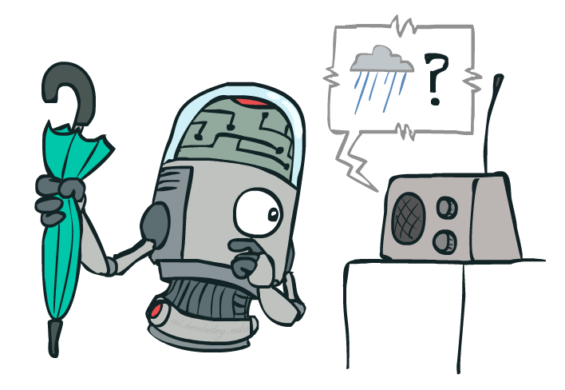
Example: Decision Networks
Umbrella = leave
A | W | U(A,W)
leave | sun | 100
leave | rain | 0
take | sun | 20
take | rain | 70
Umbrella
U
Umbrella = take
Weather
W | P(W|F=bad)
sun | 0.34
rain | 0.66
Optimal decision = take
Forecast
=bad

Slide 31
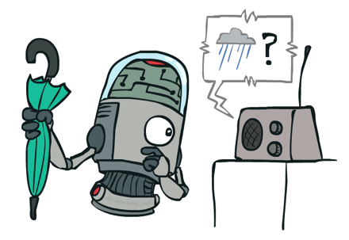
Decisions as Outcome Trees
Umbrella
{b}
take
leave
U
W | {b}
W | {b}
Weather
sun
sun
rain
rain
U(t,s)
U(t,r)
U(l,s)
U(l,r)
Forecast
=bad

Slide 32
Ghostbusters Decision Network
Demo: Ghostbusters with probability
Bust
U
Ghost Location
…
Sensor (1,1)
Sensor (1,2)
Sensor (1,3)
Sensor (1,n)
Sensor (2,1)
…
…
…
Sensor (m,1)
Sensor (m,n)

Slide 33
Video of Demo Ghostbusters with Probability

Slide 34
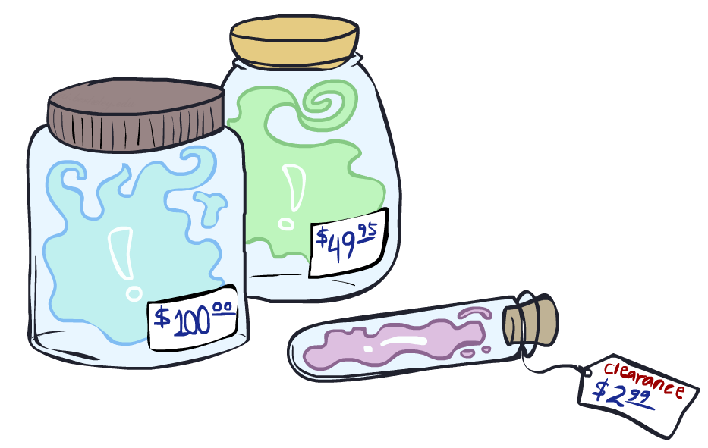
Value of Information

Slide 35
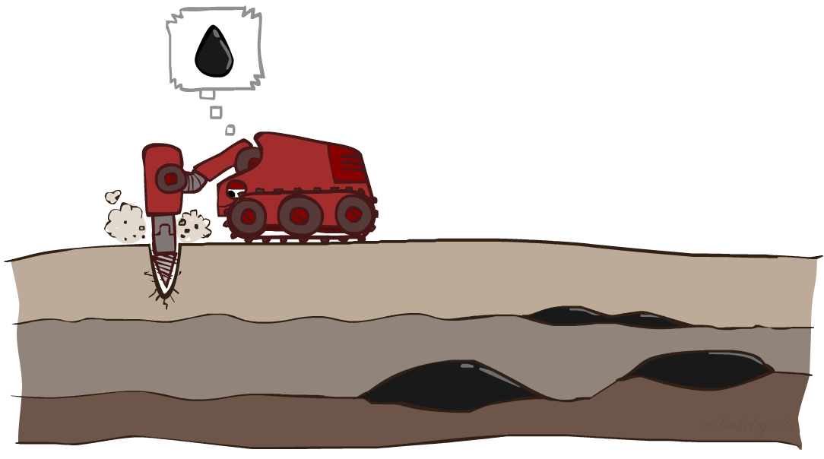
Value of Information
Idea: compute value of acquiring evidence
Can be done directly from decision network
Example: buying oil drilling rights
Two blocks A and B, exactly one has oil, worth k
You can drill in one location
Prior probabilities 0.5 each, & mutually exclusive
Drilling in either A or B has EU = k/2, MEU = k/2
Question: what’s the value of information of O?
Value of knowing which of A or B has oil
Value is expected gain in MEU from new info
Survey may say “oil in a” or “oil in b”, prob 0.5 each
If we know OilLoc, MEU is k (either way)
Gain in MEU from knowing OilLoc?
VPI(OilLoc) = k/2
Fair price of information: k/2
D | O | U
a | a | k
a | b | 0
b | a | 0
b | b | k
DrillLoc
U
O | P
a | 1/2
b | 1/2
OilLoc

Slide 36
VPI Example: Weather
MEU with no evidence
Umbrella
A | W | U
leave | sun | 100
leave | rain | 0
take | sun | 20
take | rain | 70
U
MEU if forecast is bad
Weather
MEU if forecast is good
Forecast
Forecast distribution
F | P(F)
good | 0.59
bad | 0.41

Slide 37
Value of Information
{+e}
Assume we have evidence E=e. Value if we act now:
Assume we see that E’ = e’. Value if we act then:
BUT E’ is a random variable whose value is
unknown, so we don’t know what e’ will be
Expected value if E’ is revealed and then we act:
Value of information: how much MEU goes up
by revealing E’ first then acting, over acting now:
a
P(s | +e)
U
{+e, +e’}
a
P(s | +e, +e’)
U
{+e}
P(+e’ | +e)
P(-e’ | +e)
{+e, +e’}
{+e, -e’}
a

Slide 38
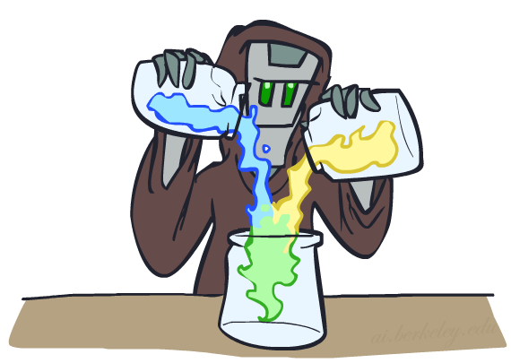
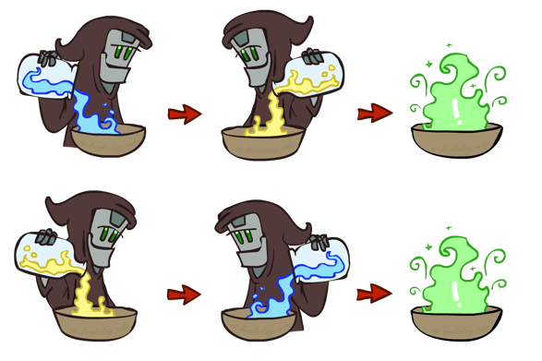
VPI Properties
Nonnegative
Nonadditive
(think of observing E_{j} twice)
Order-independent

Slide 39
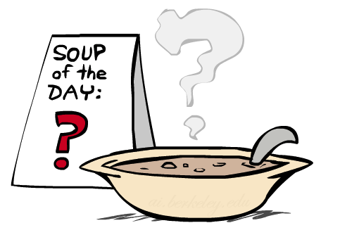
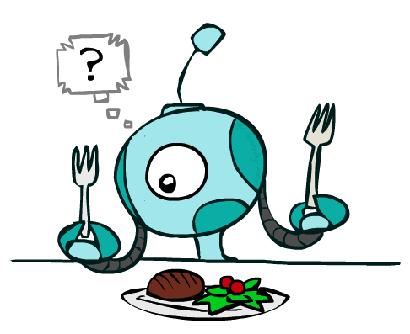
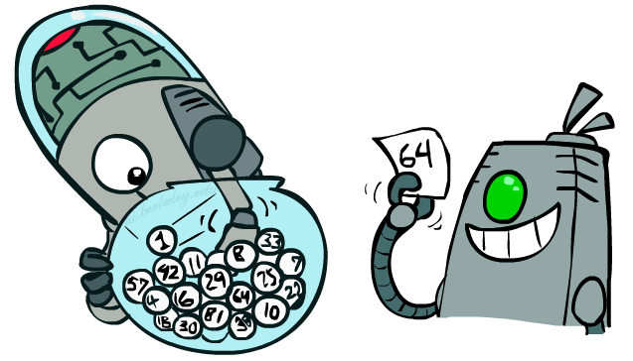
Quick VPI Questions
The soup of the day is either clam chowder or split pea, but you wouldn’t order either one. What’s the value of knowing which it is?
There are two kinds of plastic forks at a picnic. One kind is slightly sturdier. What’s the value of knowing which?
You’re playing the lottery. The prize will be $0 or $100. You can play any number between 1 and 100 (chance of winning is 1%). What is the value of knowing the winning number?

Slide 40
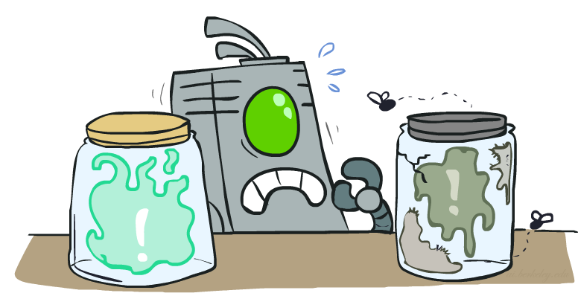
Value of Imperfect Information?
No such thing (as we formulate it)
Information corresponds to the observation of a node in the decision network
If data is “noisy” that just means we don’t observe the original variable, but another variable which is a noisy version of the original one

Slide 41
VPI Question
VPI(OilLoc) ?
VPI(ScoutingReport) ?
VPI(Scout) ?
VPI(Scout | ScoutingReport) ?
Generally:
If Parents(U) Z | CurrentEvidence
Then VPI( Z | CurrentEvidence) = 0
DrillLoc
U
Scout
OilLoc
Scouting
Report

Slide 42
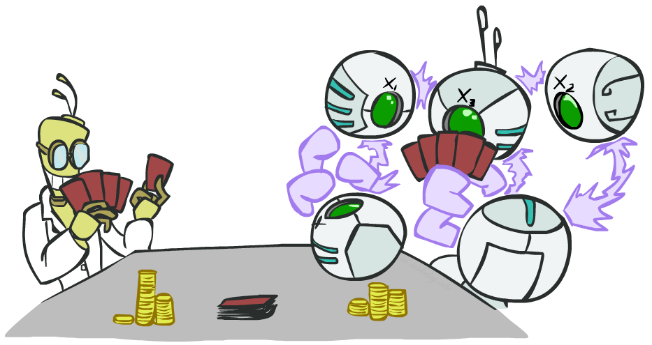
POMDPs

Slide 43
POMDPs
MDPs have:
States S
Actions A
Transition function P(s’|s,a) (or T(s,a,s’))
Rewards R(s,a,s’)
POMDPs add:
Observations O
Observation function P(o|s) (or O(s,o))
POMDPs are MDPs over belief
states b (distributions over S)
We’ll be able to say more in a few lectures
s
a
s, a
s,a,s’
s'
b
a
b, a
o
b'

Slide 44
Example: Ghostbusters
Demo: Ghostbusters with VPI
In (static) Ghostbusters:
Belief state determined by evidence to date {e}
Tree really over evidence sets
Probabilistic reasoning needed to predict new evidence given past evidence
Solving POMDPs
One way: use truncated expectimax to compute approximate value of actions
What if you only considered busting or one sense followed by a bust?
You get a VPI-based agent!
b
{e}
a
a
b, a
e, a
e’
e’
b’
{e, e’}
{e}
a_{bust}
a_{sense}
{e}, a_{sense}
U(a_{bust}, {e})
e’
{e, e’}
a_{bust}
U(a_{bust}, {e, e’})

Slide 45
Video of Demo Ghostbusters with VPI

