Slide 1
Announcements
Midterm 1
  Midterm 1 is on Monday 7/13, 12pm-2pm
    All alternate arrangements have been confirmed via email
  Practice midterm released (due 7/11 at 11:59pm)
  See Piazza for more information
Midterm Review Sections
  Today (7/9): MDP (2-3pm), Search (10-11pm)
Project 2: Games & Homework 3
  Due Friday 7/10 at 11:59pm
  Remember to submit project tokens to Gradescope

Slide 2
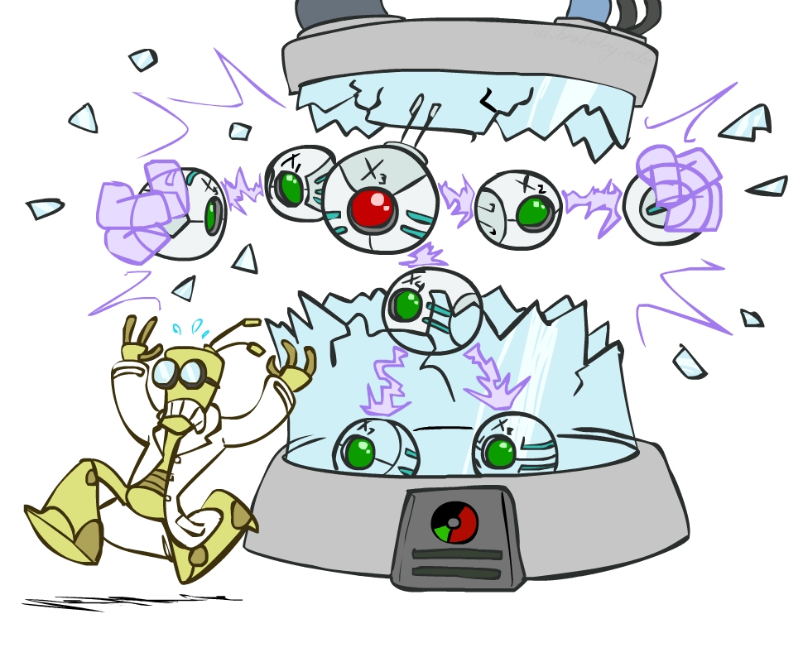
CS 188: Artificial Intelligence
Bayes Nets: Independence
Instructor: Nikita Kitaev --- University of California, Berkeley
[These slides were created by Dan Klein and Pieter Abbeel for CS188 Intro to AI at UC Berkeley. All CS188 materials are available at http://ai.berkeley.edu.]
Notes:
Please retain proper attribution, including the reference to ai.berkeley.edu. Thanks!

Slide 3


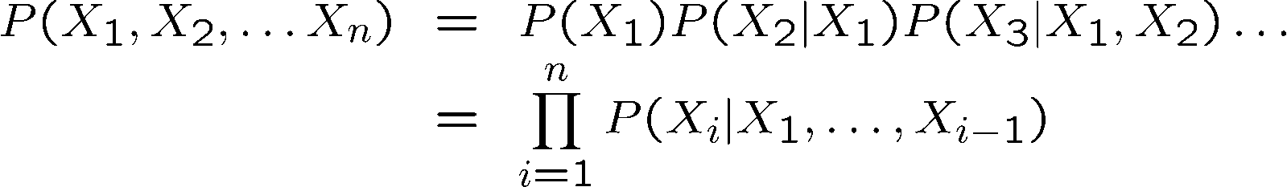

Probability Recap
Conditional probability
Product rule
Chain rule
X, Y independent if and only if:
X and Y are conditionally independent given Z if and only if:

Slide 4
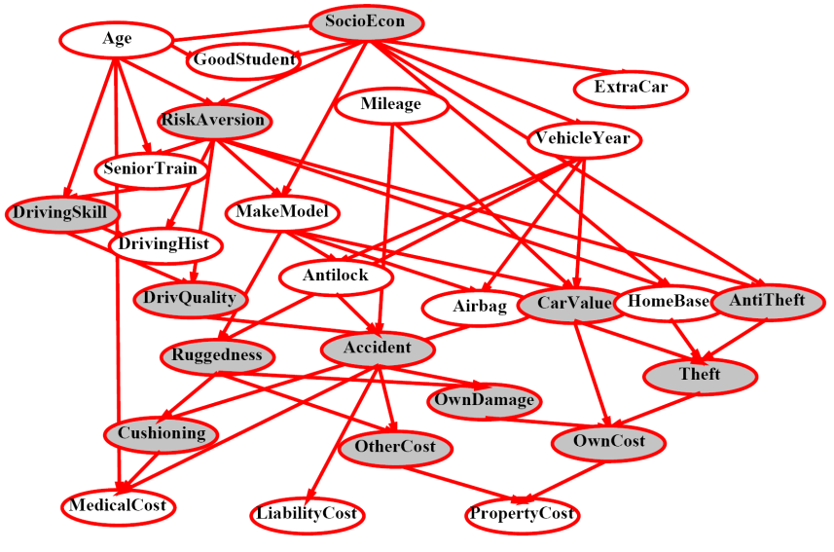
Bayes Nets
A Bayes net is an
efficient encoding
of a probabilistic
model of a domain
Questions we can ask:
  Inference: given a fixed BN, what is P(X | e)?
  Representation: given a BN graph, what kinds of distributions can it encode?
  Modeling: what BN is most appropriate for a given domain?

Slide 5


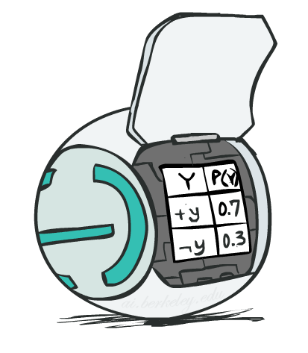
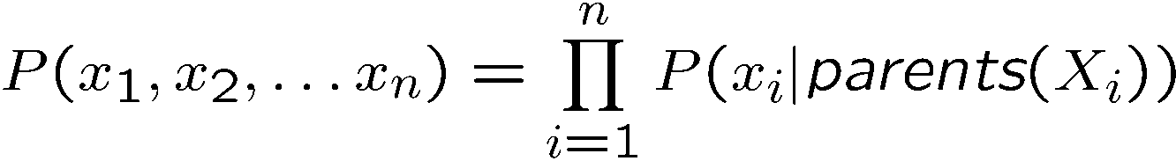
Bayes Net Semantics
A directed, acyclic graph, one node per random variable
A conditional probability table (CPT) for each node
  A collection of distributions over X, one for each combination of parents’ values
Bayes’ nets implicitly encode joint distributions
  As a product of local conditional distributions
  To see what probability a BN gives to a full assignment, multiply all the relevant conditionals together:

Slide 6
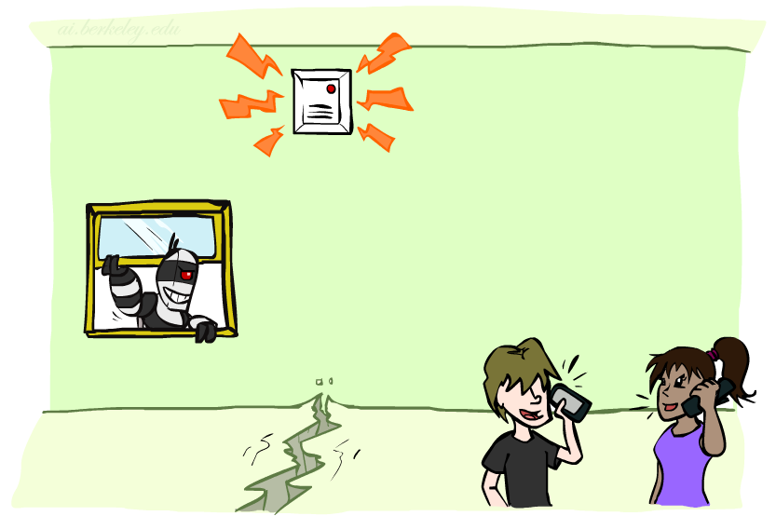

Example: Alarm Network
B | P(B)
+b | 0.001
-b | 0.999
B
E
E | P(E)
+e | 0.002
-e | 0.998
A
A | J | P(J|A)
+a | +j | 0.9
+a | -j | 0.1
-a | +j | 0.05
-a | -j | 0.95
A | M | P(M|A)
+a | +m | 0.7
+a | -m | 0.3
-a | +m | 0.01
-a | -m | 0.99
B | E | A | P(A|B,E)
+b | +e | +a | 0.95
+b | +e | -a | 0.05
+b | -e | +a | 0.94
+b | -e | -a | 0.06
-b | +e | +a | 0.29
-b | +e | -a | 0.71
-b | -e | +a | 0.001
-b | -e | -a | 0.999
J
M
Notes:
demo

Slide 7

Example: Alarm Network
B | P(B)
+b | 0.001
-b | 0.999
B
E
E | P(E)
+e | 0.002
-e | 0.998
A
A | J | P(J|A)
+a | +j | 0.9
+a | -j | 0.1
-a | +j | 0.05
-a | -j | 0.95
A | M | P(M|A)
+a | +m | 0.7
+a | -m | 0.3
-a | +m | 0.01
-a | -m | 0.99
B | E | A | P(A|B,E)
+b | +e | +a | 0.95
+b | +e | -a | 0.05
+b | -e | +a | 0.94
+b | -e | -a | 0.06
-b | +e | +a | 0.29
-b | +e | -a | 0.71
-b | -e | +a | 0.001
-b | -e | -a | 0.999
J
M
Notes:
demo

Slide 8

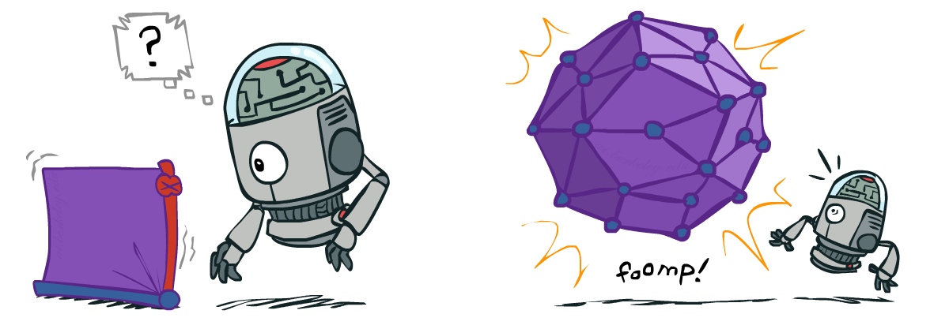
Size of a Bayes Net
How big is a joint distribution over N Boolean variables?
  2^{N}
How big is an N-node net if nodes have up to k parents?
  O(N * 2^{k+1})
Both give you the power to calculate
BNs: Huge space savings!
Also easier to elicit local CPTs
Also faster to answer queries (coming)

Slide 9

Bayes Nets
Representation
Conditional Independences
Probabilistic Inference
Learning Bayes’ Nets from Data

Slide 10

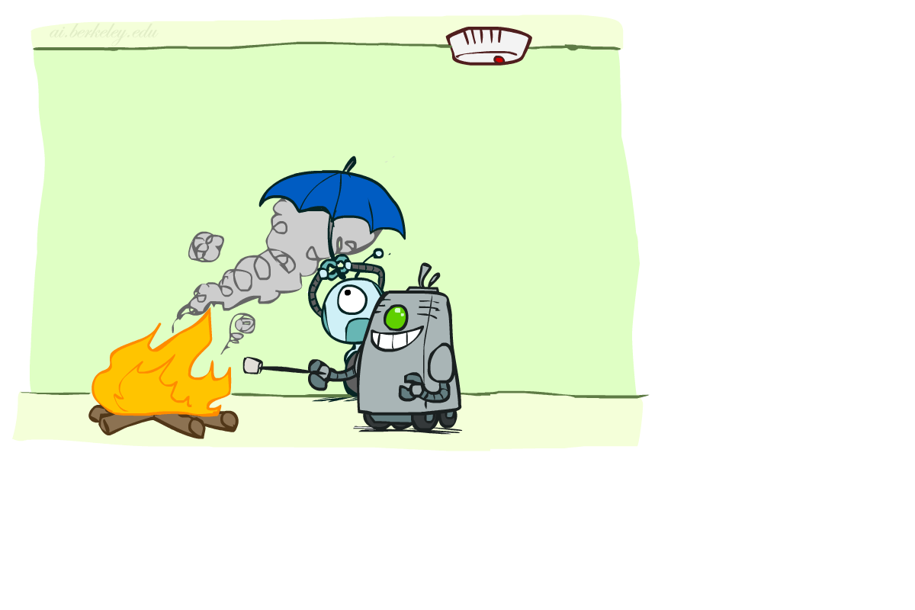

Conditional Independence
X and Y are independent if
X and Y are conditionally independent given Z
(Conditional) independence is a property of a distribution
Example:
Notes:
Alarm not independent of fire, but independent given smoke (whole point of fire alarm!)
Trade off between having more edges/direct dependencies and a simpler/cheaper model

Slide 11
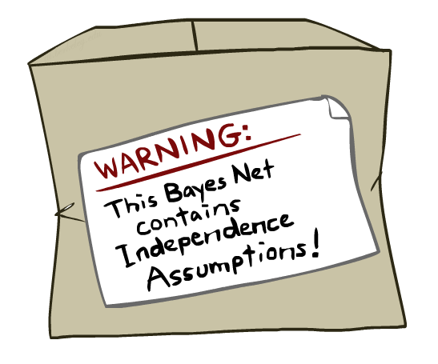
Bayes Nets: Assumptions
Assumptions we are required to make to define the Bayes net when given the graph:
Beyond above “chain rule → Bayes net” conditional independence assumptions
  Often additional conditional independences
  They can be read off the graph
Important for modeling: understand assumptions made when choosing a Bayes net graph
Notes:
Important for modeling: understanding which assumptions you are making!
These are independence assumptions that are *from the graph*. There can be more (due to the tables).

Slide 12
Example
X
Y
Z
W
Conditional independence assumptions directly from simplifications in chain rule:
Additional implied conditional independence assumptions?

Slide 13
Independence in a BN
Important question about a BN:
  Are two nodes independent given certain evidence?
  If yes, can prove using algebra (tedious in general)
  If no, can prove with a counter example
  Example:
  Question: are X and Z necessarily independent?
    Answer: no. Example: low pressure causes rain, which causes traffic.
    X can influence Z, Z can influence X (via Y)
    Addendum: they could be independent: how?
X
Y
Z

Slide 14
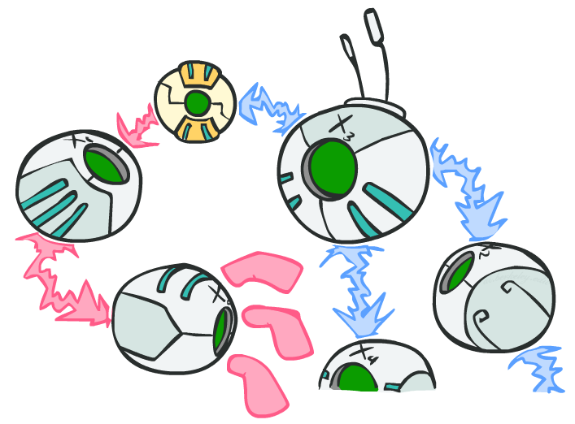
D-separation: Outline

Slide 15
D-separation: Outline
Study independence properties for triples
  Why triples?
Analyze complex cases in terms of member triples
D-separation: a condition / algorithm for answering such queries
Notes:
3 possible triples

Slide 16
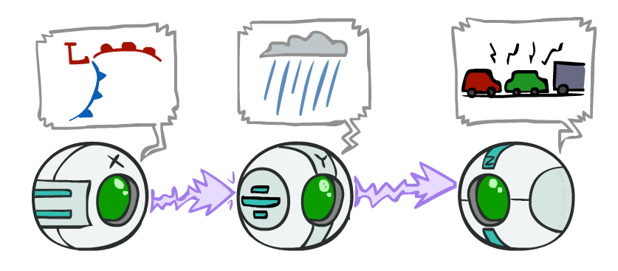
Causal Chains
This configuration is a “causal chain”
Guaranteed X independent of Z ?
No!
  One example set of CPTs for which X is not independent of Z is sufficient to show this independence is not guaranteed.
  Example:
    Low pressure causes rain causes traffic,
    high pressure causes no rain causes no
    traffic
    In numbers:
    P( +y | +x ) = 1, P( -y | - x ) = 1,
    P( +z | +y ) = 1, P( -z | -y ) = 1
X: Low pressure Y: Rain Z: Traffic

Slide 17
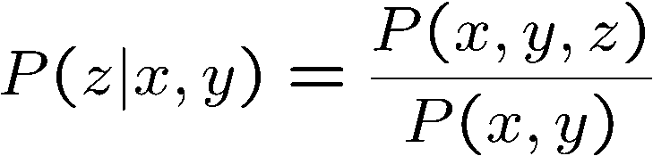
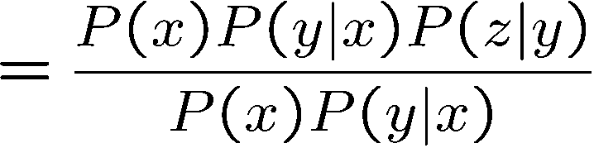

Causal Chains
This configuration is a “causal chain”
Guaranteed X independent of Z given Y?
  Evidence along the chain “blocks” the influence
X: Low pressure Y: Rain Z: Traffic
Yes!

Slide 18
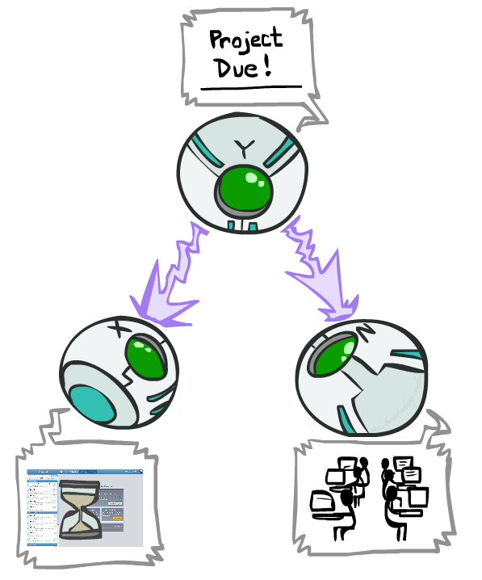
Common Causes
This configuration is a “common cause”
Guaranteed X independent of Z ?
No!
  One example set of CPTs for which X is not independent of Z is sufficient to show this independence is not guaranteed.
  Example:
    Project due causes both forums busy
    and lab full
    In numbers:
    P( +x | +y ) = 1, P( -x | -y ) = 1,
    P( +z | +y ) = 1, P( -z | -y ) = 1
Y: Project due
X: Forums busy
Z: Lab full

Slide 19
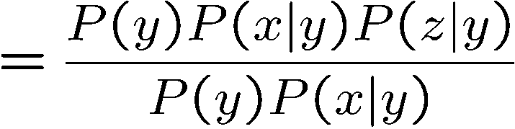
Common Cause
This configuration is a “common cause”
Guaranteed X and Z independent given Y?
  Observing the cause blocks influence between effects.
Y: Project due
X: Forums busy
Z: Lab full
Yes!

Slide 20
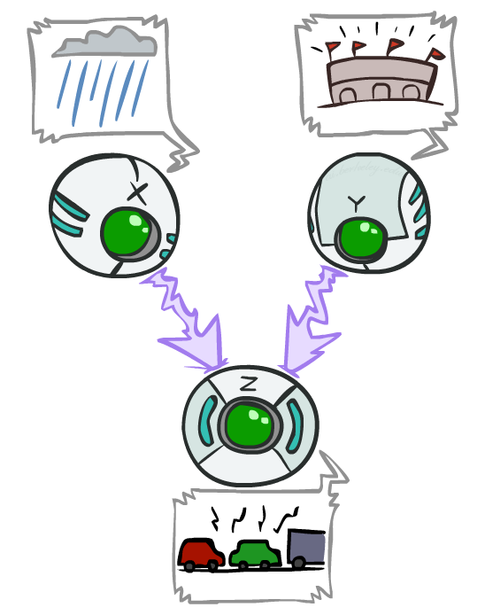
Common Effect
Last configuration: two causes of one effect (v-structures)
Are X and Y independent?
  Yes: the ballgame and the rain cause traffic, but they are not correlated
Proof:
X: Raining
Y: Ballgame
Z: Traffic

Slide 21
Common Effect
Last configuration: two causes of one effect (v-structures)
Are X and Y independent?
  Yes: the ballgame and the rain cause traffic, but they are not correlated
  (Proved previously)
Are X and Y independent given Z?
  No: seeing traffic puts the rain and the ballgame in competition as explanation.
This is backwards from the other cases
  Observing an effect activates influence between possible causes.
X: Raining
Y: Ballgame
Z: Traffic

Slide 22
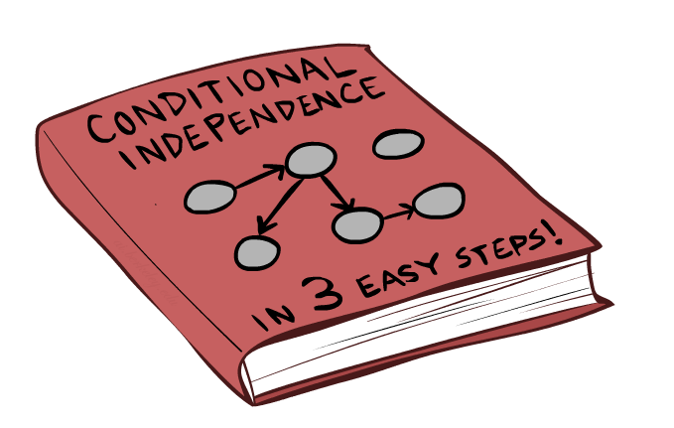
The General Case
Notes:
[timing: ~40min?]

Slide 23
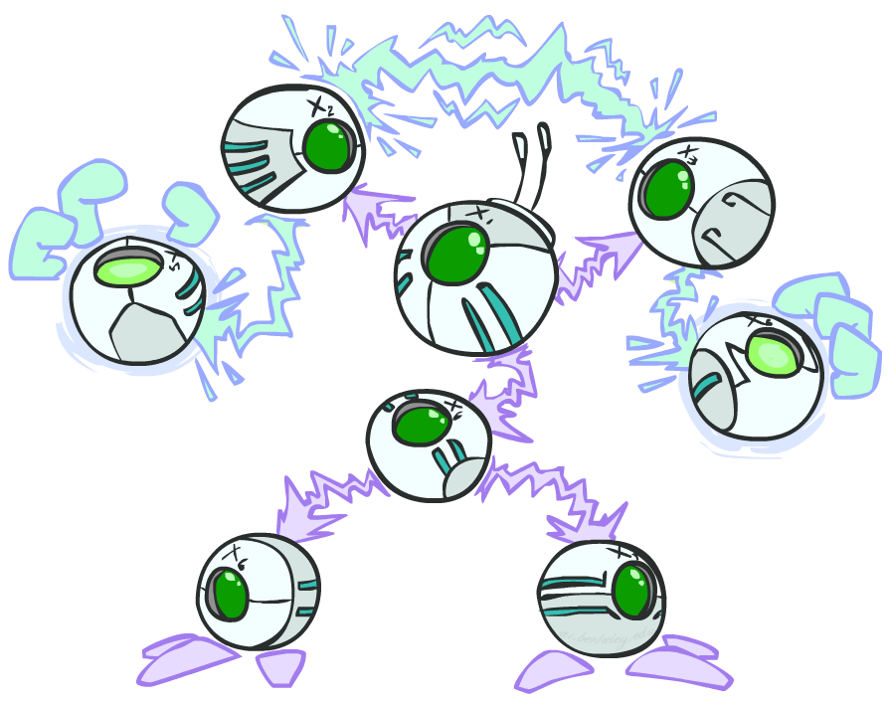
The General Case
General question: in a given BN, are two variables independent (given evidence)?
Solution: analyze the graph
Any complex example can be broken
into repetitions of the three canonical cases

Slide 24

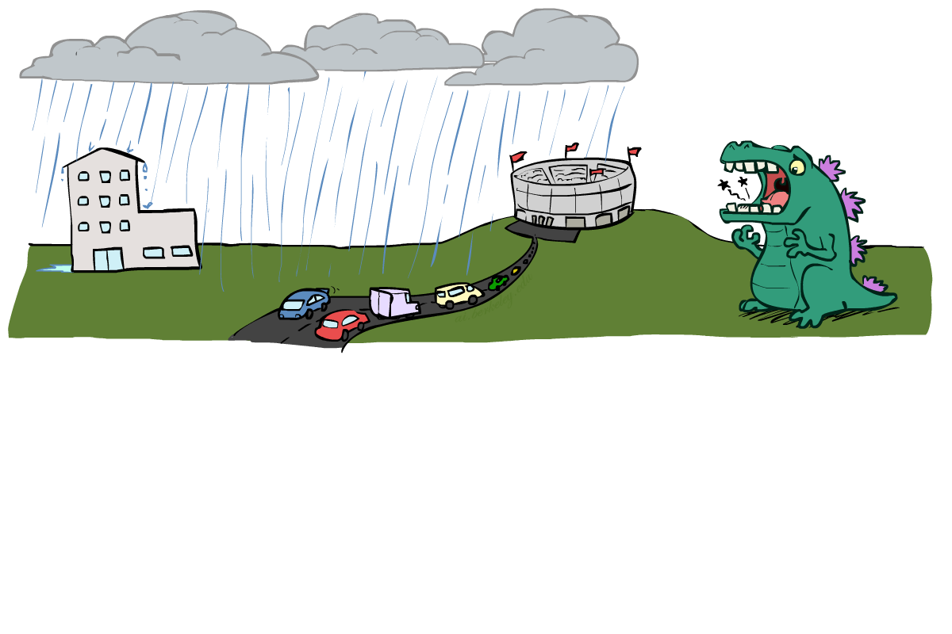
Reachability
L
Recipe: shade evidence nodes, look for paths in the resulting graph
Attempt 1: if two nodes are not connected by any undirected path not blocked by a shaded node, they are conditionally independent
Almost works, but not quite
  Where does it break?
  Answer: the v-structure at T doesn’t count as a link in a path unless “active”
R
B
D
T
Notes:
In this case, R and B are independent, unless we conditioon on t

Slide 25
Active / Inactive Paths
Question: Are X and Y conditionally independent given evidence variables {Z}?
  Yes, if X and Y “d-separated” by Z
  Consider all (undirected) paths from X to Y
  No active paths = independence!
A path is active if each triple is active:
  Causal chain A -> B -> C where B is unobserved (either direction)
  Common cause A <- B -> C where B is unobserved
  Common effect (aka v-structure)
  A -> B <- C where B or one of its descendants is observed
All it takes to block a path is a single inactive segment
Active Triples
Inactive Triples

Slide 26
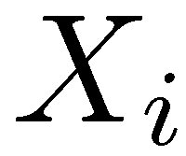
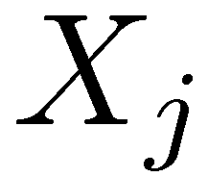

D-Separation
?
Query:
Check all (undirected!) paths between and
  If one or more active, then independence not guaranteed
  Otherwise (i.e. if all paths are inactive),
  then independence is guaranteed

Slide 27


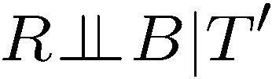
Example
Yes
R
B
T
T’
Notes:
T’: traffic report

Slide 28
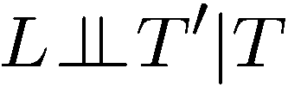


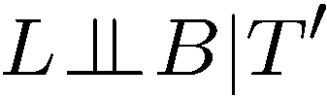

Example
L
Yes
R
B
Yes
D
T
Yes
T’

Slide 29



Example
Variables:
  R: Raining
  T: Traffic
  D: Roof drips
  S: I’m sad
Questions:
R
T
D
S
Yes

Slide 30

Structure Implications
Given a Bayes net structure, can run d-separation algorithm to build a complete list of conditional independences that are necessarily true of the form
This list determines the set of probability distributions that can be represented

Slide 31

Computing All Independences
Y
X
Z
Y
X
Z
X
Z
Y
Y
X
Z

Slide 32
Topology Limits Distributions
Given some graph topology G, only certain joint distributions can be encoded
The graph structure guarantees certain (conditional) independences
(There might be more independence)
Adding arcs increases the set of distributions, but has several costs
Full conditioning can encode any distribution
Y
Y
X
Z
X
Z
Y
X
Z
Y
X
Z
Y
Y
Y
X
Z
X
Z
X
Z
Y
Y
Y
X
Z
X
Z
X
Z

Slide 33
Bayes Nets Representation Summary
Bayes nets compactly encode joint distributions (by making use of conditional independences!)
Guaranteed independencies of distributions can be deduced from BN graph structure
D-separation gives precise conditional independence guarantees from graph alone
A Bayes net’s joint distribution may have further (conditional) independence that is not detectable until you inspect its specific distribution

Slide 34
Bayes’ Nets
Representation
Conditional Independences
Probabilistic Inference
  Enumeration (exact, exponential complexity)
  Variable elimination (exact, worst-case
  exponential complexity, often better)
  Probabilistic inference is NP-complete
  Sampling (approximate)
Learning Bayes’ Nets from Data

