Slide 1
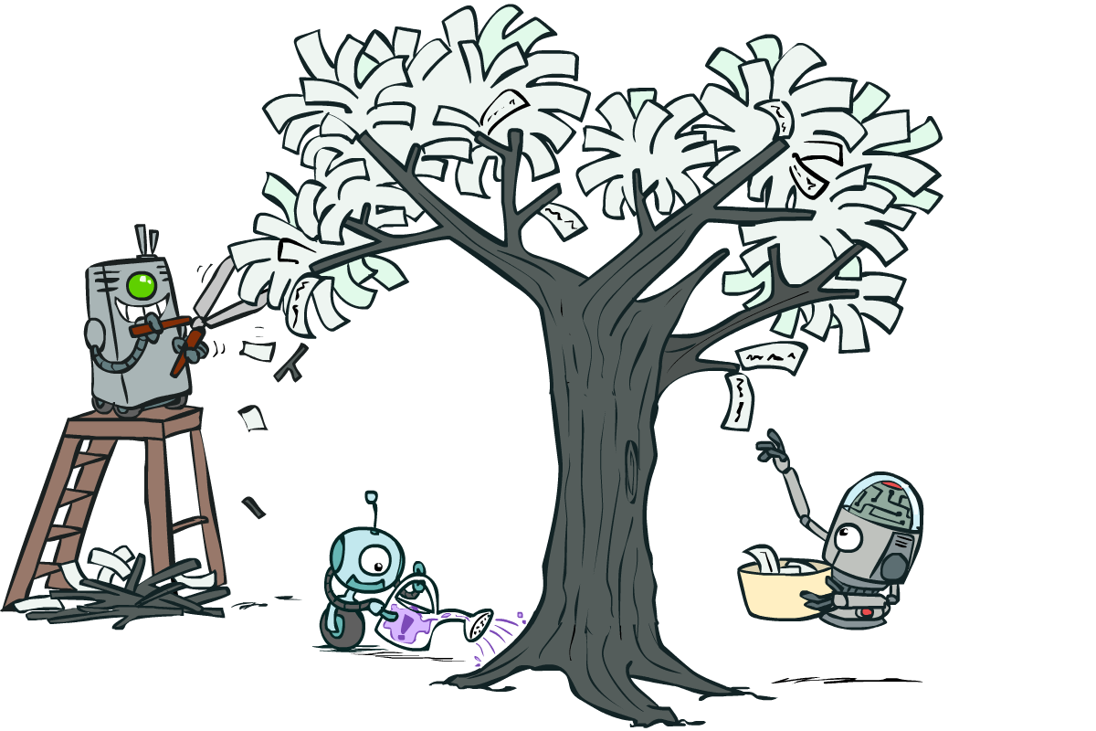
CS 188: Artificial Intelligence
Neural Nets and Decision Trees
Instructor: Nathan Lambert --- University of California, Berkeley
[These slides were created by Dan Klein, Pieter Abbeel, Sergey Levine. All CS188 materials are at http://ai.berkeley.edu.]
Notes:
Please retain proper attribution, including the reference to ai.berkeley.edu. Thanks!

Slide 2
Neural Net Demo!
https://playground.tensorflow.org/

Slide 3
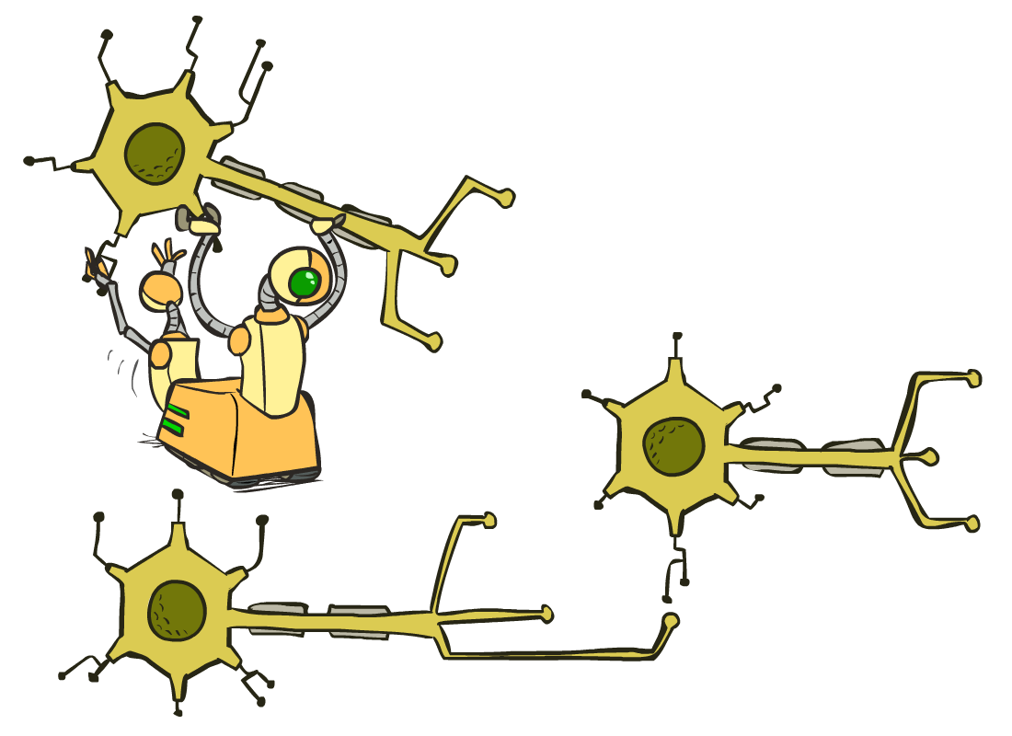
Neural Networks

Slide 4
Multi-class Logistic Regression
= special case of neural network
f₁(x)
z₁
softmax
f₂(x)
z₂
f₃(x)
…
z₃
f_{K}(x)

Slide 5
Deep Neural Network = Also learn the features!
f₁(x)
z₁
softmax
f₂(x)
z₂
f₃(x)
…
z₃
f_{K}(x)

Slide 6
Deep Neural Network = Also learn the features!
x₁
f₁(x)
softmax
x₂
f₂(x)
…
x₃
f₃(x)
…
…
…
…
…
x_{L}
f_{K}(x)
g = nonlinear activation function

Slide 7
Deep Neural Network = Also learn the features!
x₁
softmax
x₂
…
x₃
…
…
…
…
…
x_{L}
g = nonlinear activation function

Slide 8
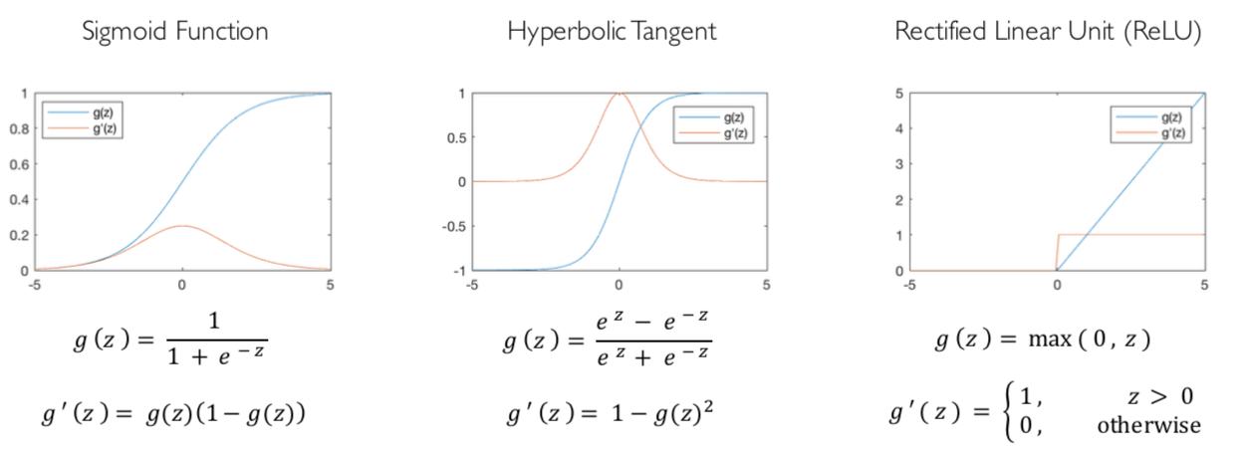
Common Activation Functions
[source: MIT 6.S191 introtodeeplearning.com]

Slide 9
Deep Neural Network: Also Learn the Features!
Training the deep neural network is just like logistic regression:
  just w tends to be a much, much larger vector ☺
  just run gradient ascent
  + stop when log likelihood of hold-out data starts to decrease

Slide 10
Neural Networks Properties
Theorem (Universal Function Approximators). A two-layer neural network with a sufficient number of neurons can approximate any continuous function to any desired accuracy.
Practical considerations
  Can be seen as learning the features
  Large number of neurons
    Danger for overfitting
    (hence early stopping!)

Slide 11
How about computing all the derivatives?
Derivatives tables:
[source: http://hyperphysics.phy-astr.gsu.edu/hbase/Math/derfunc.html

Slide 12
How about computing all the derivatives?
But neural net f is never one of those?
  No problem: CHAIN RULE:
    If
    Then
    → Derivatives can be computed by following well-defined procedures

Slide 13
Automatic Differentiation
Automatic differentiation software
  e.g. Theano, TensorFlow, PyTorch, Chainer
  Only need to program the function g(x,y,w)
  Can automatically compute all derivatives w.r.t. all entries in w
  This is typically done by caching info during forward computation pass of f, and then doing a backward pass = “backpropagation”
  Autodiff / Backpropagation can often be done at computational cost comparable to the forward pass
Need to know this exists
How this is done? -- outside of scope of CS188

Slide 14
Training a Network (setting weights)
x₁
softmax
x₂
…
x₃
…
…
…
…
…
x_{L}
g = nonlinear activation function

Slide 15
Training a Network
softmax
Key words:
Forward
Backwards
Gradient
Backprop
…
…
g = nonlinear activation function

Slide 16






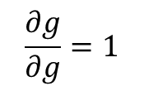

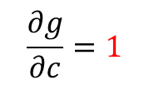






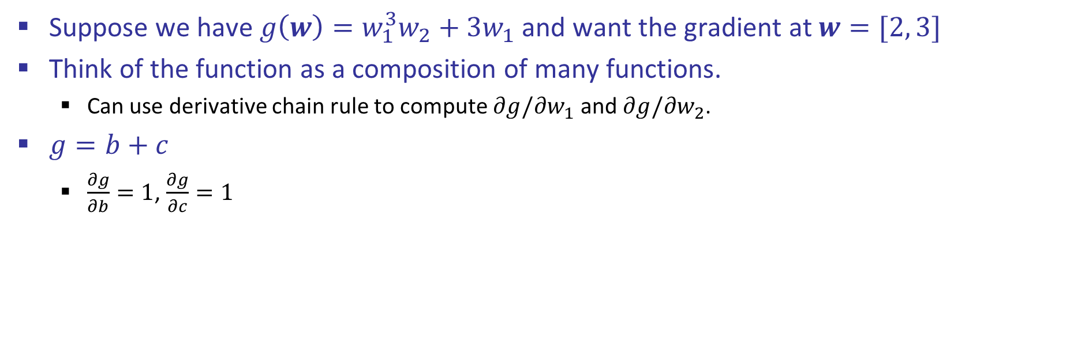


Back Propagation: $g\left(w\right)=w_{1}^{3}w_{2}+3w_{1}$
Suppose we have $g\left(w\right)=w_{1}^{3}w_{2}+3w_{1}$ and want the gradient at $w=[2, 3]$
Think of the function as a composition of many functions.
  Can use derivative chain rule to compute $∂g/∂w_{1}$ and $∂g/∂w_{2}$.
$g=b+c$
  $\frac{∂g}{∂b}=1$, $\frac{∂g}{∂c}=1$
2
$∎^{3}$
$$a=8$$
$$w_{1}$$
$×$
$$b=24$$
3
$$\frac{∂g}{∂b}=1$$
$$w_{2}$$
$$g=30$$
$+$
$$1$$
$$3$$
$×$
$$c=6$$
$$w_{1}$$
2
$$\frac{∂g}{∂c}=1$$
$$\frac{∂g}{∂g}=1$$

Slide 17
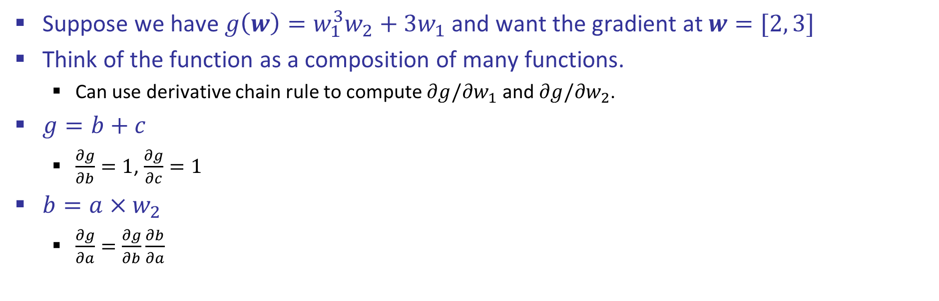
Back Propagation: $g\left(w\right)=w_{1}^{3}w_{2}+3w_{1}$
Suppose we have $g\left(w\right)=w_{1}^{3}w_{2}+3w_{1}$ and want the gradient at $w=[2, 3]$
Think of the function as a composition of many functions.
  Can use derivative chain rule to compute $∂g/∂w_{1}$ and $∂g/∂w_{2}$.
$g=b+c$
  $\frac{∂g}{∂b}=1$, $\frac{∂g}{∂c}=1$
$b=a×w_{2}$
  $\frac{∂g}{∂a}=\frac{∂g}{∂b}\frac{∂b}{∂a}$
2
$∎^{3}$
$$a=8$$
$$w_{1}$$
$×$
$$b=24$$
3
$$\frac{∂g}{∂b}=1$$
$$w_{2}$$
$$g=30$$
$+$
$$1$$
$$3$$
$×$
$$c=6$$
$$w_{1}$$
2
$$\frac{∂g}{∂c}=1$$
$$\frac{∂g}{∂g}=1$$

Slide 18
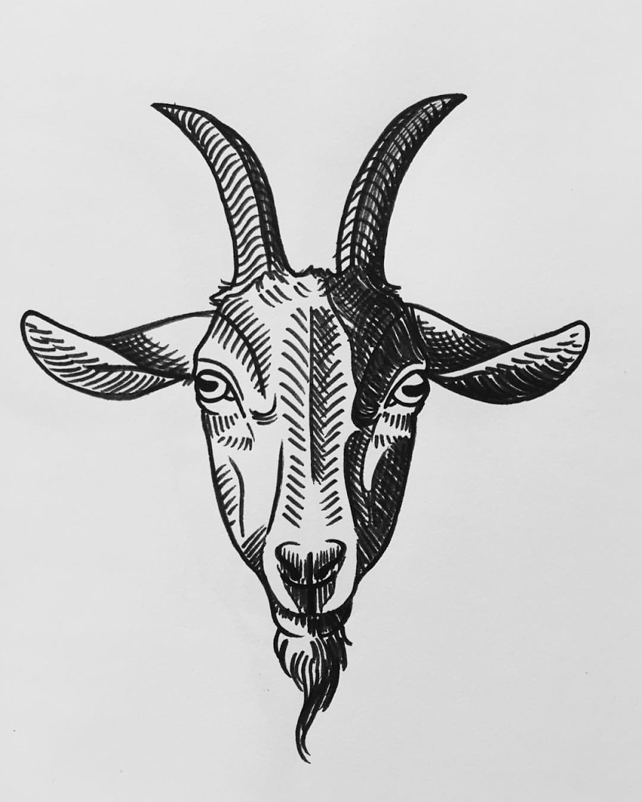

Back Propagation: $g\left(w\right)=w_{1}^{3}w_{2}+3w_{1}$
Suppose we have $g\left(w\right)=w_{1}^{3}w_{2}+3w_{1}$ and want the gradient at $w=[2, 3]$
Think of the function as a composition of many functions.
  Can use derivative chain rule to compute $∂g/∂w_{1}$ and $∂g/∂w_{2}$.
$g=b+c$
  $\frac{∂g}{∂b}=1$, $\frac{∂g}{∂c}=1$
$b=a×w_{2}$
  $\frac{∂g}{∂a}=\frac{∂g}{∂b}\frac{∂b}{∂a}=?????$
2
$∎^{3}$
$$a=8$$
$$w_{1}$$
$×$
$$b=24$$
3
$$\frac{∂g}{∂b}=1$$
$$w_{2}$$
$$g=30$$
$+$
$$1$$
$$3$$
$×$
$$c=6$$
$$w_{1}$$
2
$$\frac{∂g}{∂c}=1$$
$$\frac{∂g}{∂g}=1$$

Slide 19

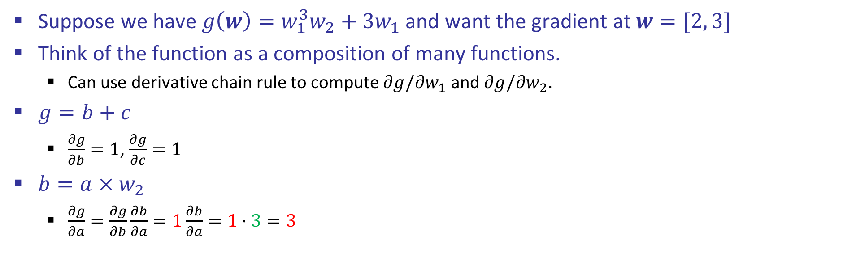
Back Propagation: $g\left(w\right)=w_{1}^{3}w_{2}+3w_{1}$
Suppose we have $g\left(w\right)=w_{1}^{3}w_{2}+3w_{1}$ and want the gradient at $w=[2, 3]$
Think of the function as a composition of many functions.
  Can use derivative chain rule to compute $∂g/∂w_{1}$ and $∂g/∂w_{2}$.
$g=b+c$
  $\frac{∂g}{∂b}=1$, $\frac{∂g}{∂c}=1$
$b=a×w_{2}$
  $\frac{∂g}{∂a}=\frac{∂g}{∂b}\frac{∂b}{∂a}=1\frac{∂b}{∂a}=1⋅3=3$
2
$∎^{3}$
$$a=8$$
$$w_{1}$$
$$3$$
$×$
$$b=24$$
3
$$\frac{∂g}{∂b}=1$$
$$w_{2}$$
$$g=30$$
$+$
$$1$$
$$3$$
$×$
$$c=6$$
$$w_{1}$$
2
$$\frac{∂g}{∂c}=1$$
$$\frac{∂g}{∂g}=1$$

Slide 20
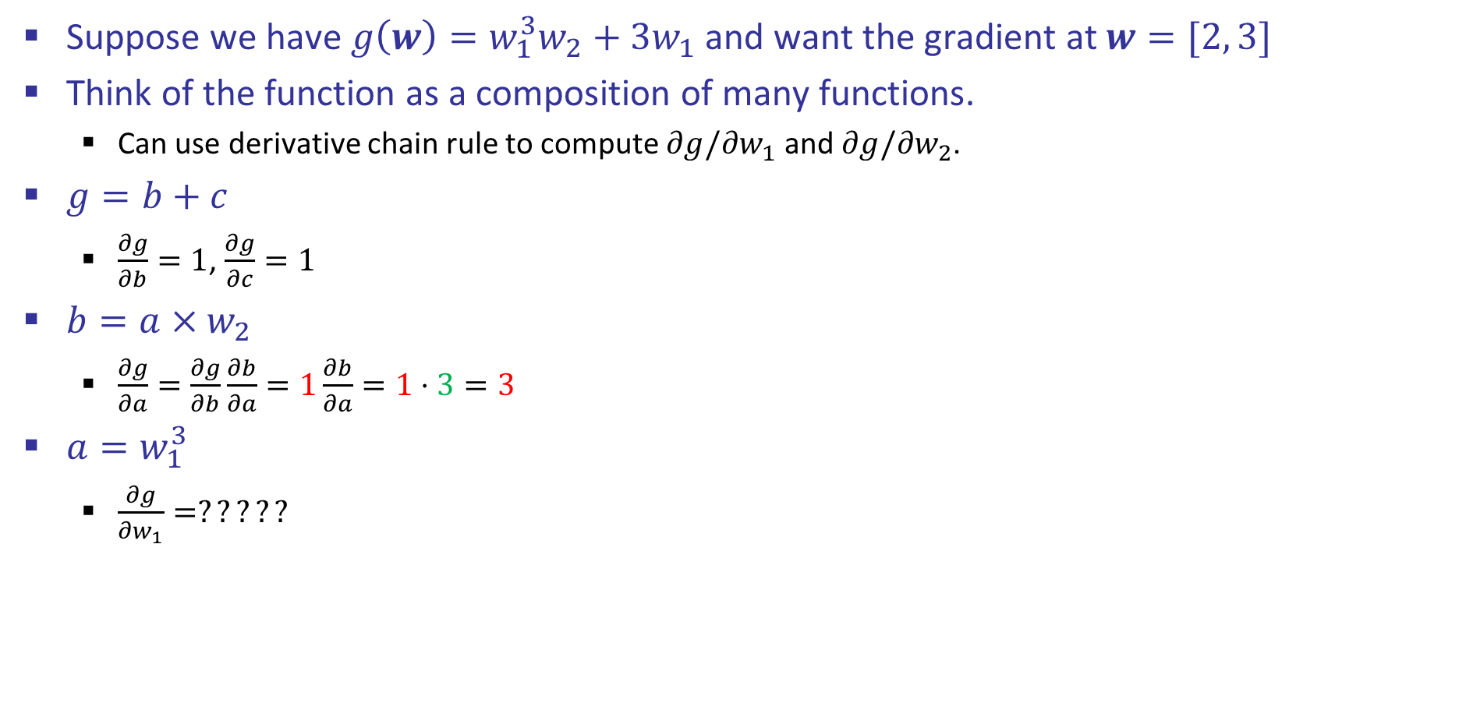
Back Propagation: $g\left(w\right)=w_{1}^{3}w_{2}+3w_{1}$
Suppose we have $g\left(w\right)=w_{1}^{3}w_{2}+3w_{1}$ and want the gradient at $w=[2, 3]$
Think of the function as a composition of many functions.
  Can use derivative chain rule to compute $∂g/∂w_{1}$ and $∂g/∂w_{2}$.
$g=b+c$
  $\frac{∂g}{∂b}=1$, $\frac{∂g}{∂c}=1$
$b=a×w_{2}$
  $\frac{∂g}{∂a}=\frac{∂g}{∂b}\frac{∂b}{∂a}=1\frac{∂b}{∂a}=1⋅3=3$
$a=w_{1}^{3}$
  $\frac{∂g}{∂w_{1}}=?????$
2
$∎^{3}$
$$a=8$$
$$w_{1}$$
$$3$$
$×$
$$b=24$$
3
$$\frac{∂g}{∂b}=1$$
$$w_{2}$$
$$g=30$$
$+$
$$1$$
$$3$$
$×$
$$c=6$$
$$w_{1}$$
2
$$\frac{∂g}{∂c}=1$$
$$\frac{∂g}{∂g}=1$$

Slide 21
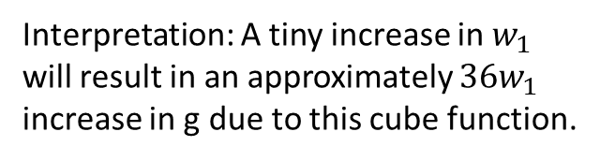
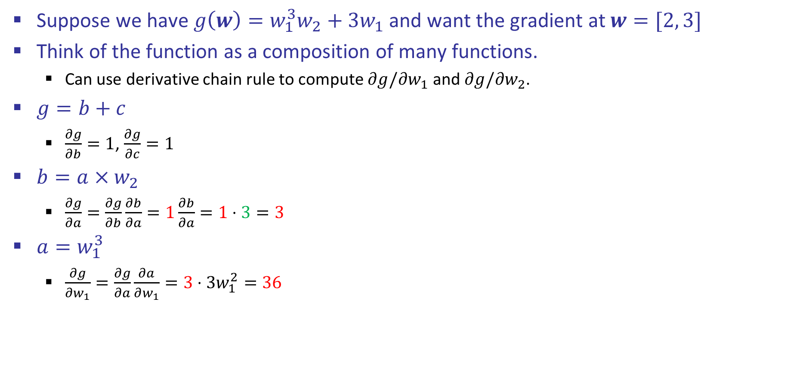

Back Propagation: $g\left(w\right)=w_{1}^{3}w_{2}+3w_{1}$
Suppose we have $g\left(w\right)=w_{1}^{3}w_{2}+3w_{1}$ and want the gradient at $w=[2, 3]$
Think of the function as a composition of many functions.
  Can use derivative chain rule to compute $∂g/∂w_{1}$ and $∂g/∂w_{2}$.
$g=b+c$
  $\frac{∂g}{∂b}=1$, $\frac{∂g}{∂c}=1$
$b=a×w_{2}$
  $\frac{∂g}{∂a}=\frac{∂g}{∂b}\frac{∂b}{∂a}=1\frac{∂b}{∂a}=1⋅3=3$
$a=w_{1}^{3}$
  $\frac{∂g}{∂w_{1}}=\frac{∂g}{∂a}\frac{∂a}{∂w_{1}}=3⋅3w_{1}^{2}=36$
2
$∎^{3}$
$$a=8$$
$$w_{1}$$
$$36$$
$$3$$
$×$
$$b=24$$
3
$$\frac{∂g}{∂b}=1$$
$$w_{2}$$
$$g=30$$
$+$
$$1$$
$$3$$
$×$
$$c=6$$
$$w_{1}$$
2
$$\frac{∂g}{∂c}=1$$
$$\frac{∂g}{∂g}=1$$
Interpretation: A tiny increase in $w_{1}$ will result in an approximately $36w_{1}$ increase in g due to this cube function.

Slide 22

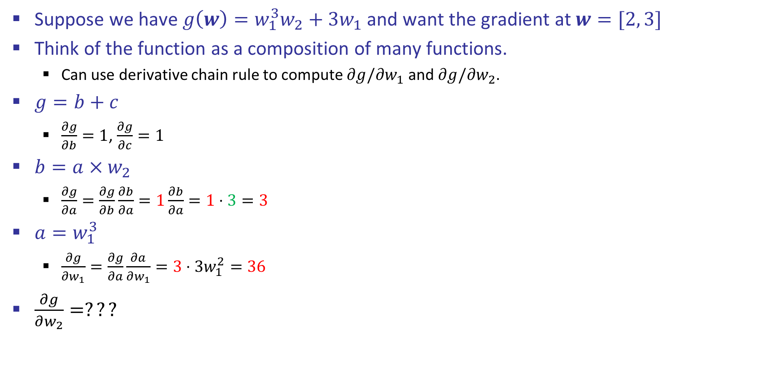
Back Propagation: $g\left(w\right)=w_{1}^{3}w_{2}+3w_{1}$
Suppose we have $g\left(w\right)=w_{1}^{3}w_{2}+3w_{1}$ and want the gradient at $w=[2, 3]$
Think of the function as a composition of many functions.
  Can use derivative chain rule to compute $∂g/∂w_{1}$ and $∂g/∂w_{2}$.
$g=b+c$
  $\frac{∂g}{∂b}=1$, $\frac{∂g}{∂c}=1$
$b=a×w_{2}$
  $\frac{∂g}{∂a}=\frac{∂g}{∂b}\frac{∂b}{∂a}=1\frac{∂b}{∂a}=1⋅3=3$
$a=w_{1}^{3}$
  $\frac{∂g}{∂w_{1}}=\frac{∂g}{∂a}\frac{∂a}{∂w_{1}}=3⋅3w_{1}^{2}=36$
$\frac{∂g}{∂w_{2}}=???$
2
$∎^{3}$
$$a=8$$
$$w_{1}$$
$$36$$
$$3$$
$×$
$$b=24$$
3
$$\frac{∂g}{∂b}=1$$
$$w_{2}$$
$$g=30$$
$+$
$$1$$
$$3$$
$×$
$$c=6$$
$$w_{1}$$
2
$$\frac{∂g}{∂c}=1$$
$$\frac{∂g}{∂g}=1$$
Hint: $b=a×3$ may be useful.

Slide 23

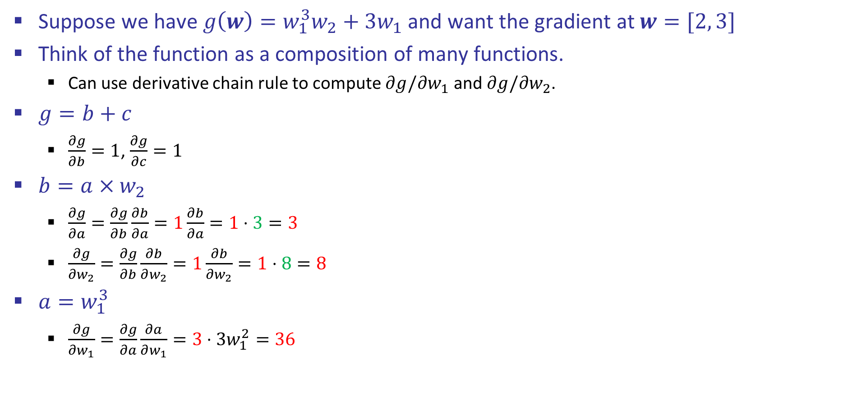
Back Propagation: $g\left(w\right)=w_{1}^{3}w_{2}+3w_{1}$
Suppose we have $g\left(w\right)=w_{1}^{3}w_{2}+3w_{1}$ and want the gradient at $w=[2, 3]$
Think of the function as a composition of many functions.
  Can use derivative chain rule to compute $∂g/∂w_{1}$ and $∂g/∂w_{2}$.
$g=b+c$
  $\frac{∂g}{∂b}=1$, $\frac{∂g}{∂c}=1$
$b=a×w_{2}$
  $\frac{∂g}{∂a}=\frac{∂g}{∂b}\frac{∂b}{∂a}=1\frac{∂b}{∂a}=1⋅3=3$
  $\frac{∂g}{∂w_{2}}=\frac{∂g}{∂b}\frac{∂b}{∂w_{2}}=1\frac{∂b}{∂w_{2}}=1⋅8=8$
$a=w_{1}^{3}$
  $\frac{∂g}{∂w_{1}}=\frac{∂g}{∂a}\frac{∂a}{∂w_{1}}=3⋅3w_{1}^{2}=36$
2
$∎^{3}$
$$a=8$$
$$w_{1}$$
$$36$$
$$3$$
$×$
$$b=24$$
3
$$\frac{∂g}{∂b}=1$$
$$w_{2}$$
$$g=30$$
$$8$$
$+$
$$1$$
$$3$$
$×$
$$c=6$$
$$w_{1}$$
2
$$\frac{∂g}{∂c}=1$$
$$\frac{∂g}{∂g}=1$$

Slide 24
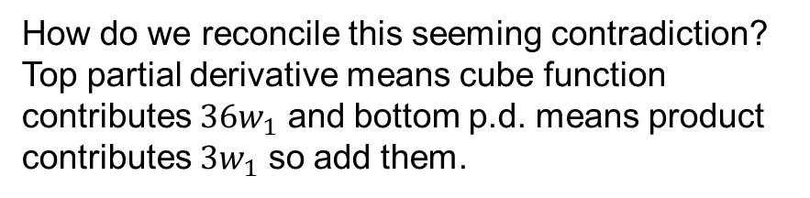

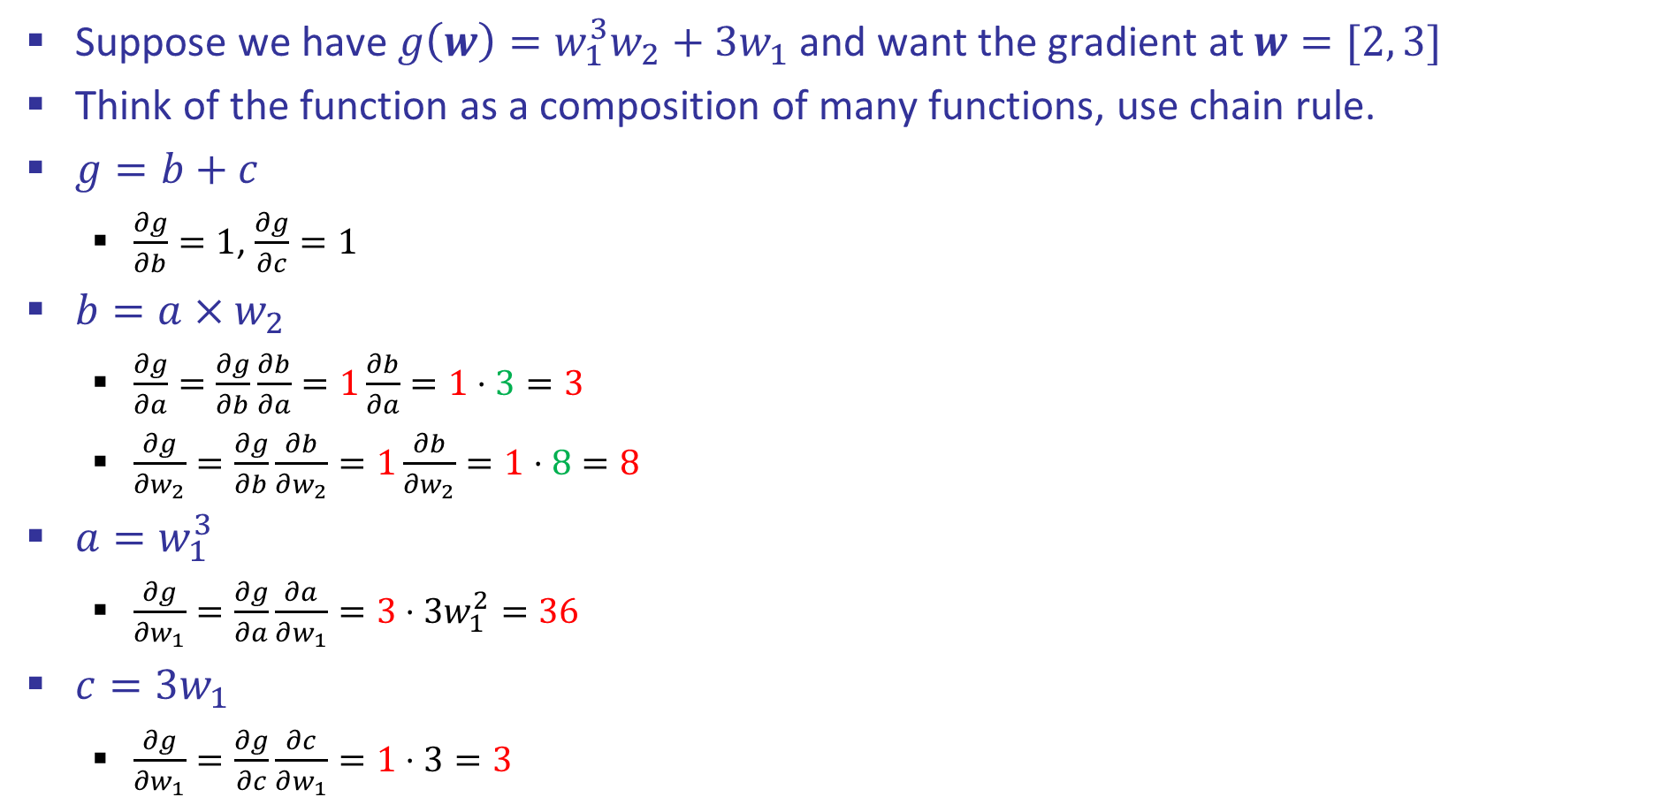
Back Propagation: $g\left(w\right)=w_{1}^{3}w_{2}+3w_{1}$
Suppose we have $g\left(w\right)=w_{1}^{3}w_{2}+3w_{1}$ and want the gradient at $w=[2, 3]$
Think of the function as a composition of many functions, use chain rule.
$g=b+c$
  $\frac{∂g}{∂b}=1$, $\frac{∂g}{∂c}=1$
$b=a×w_{2}$
  $\frac{∂g}{∂a}=\frac{∂g}{∂b}\frac{∂b}{∂a}=1\frac{∂b}{∂a}=1⋅3=3$
  $\frac{∂g}{∂w_{2}}=\frac{∂g}{∂b}\frac{∂b}{∂w_{2}}=1\frac{∂b}{∂w_{2}}=1⋅8=8$
$a=w_{1}^{3}$
  $\frac{∂g}{∂w_{1}}=\frac{∂g}{∂a}\frac{∂a}{∂w_{1}}=3⋅3w_{1}^{2}=36$
$c=3w_{1}$
  $\frac{∂g}{∂w_{1}}=\frac{∂g}{∂c}\frac{∂c}{∂w_{1}}=1⋅3=3$
2
$∎^{3}$
$$a=8$$
$$w_{1}$$
$$36$$
$$3$$
$×$
$$b=24$$
3
$$\frac{∂g}{∂b}=1$$
$$w_{2}$$
$$g=30$$
$$8$$
$+$
$$1$$
$$3$$
$×$
$$c=6$$
$$w_{1}$$
2
$$3$$
$$\frac{∂g}{∂c}=1$$
$$\frac{∂g}{∂g}=1$$
How do we reconcile this seeming contradiction?
Top partial derivative means cube function contributes $36w_{1}$ and bottom p.d. means product contributes $3w_{1}$ so add them.

Slide 25
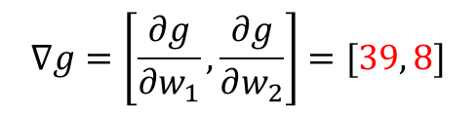
Back Propagation: $g\left(w\right)=w_{1}^{3}w_{2}+3w_{1}$
Suppose we have $g\left(w\right)=w_{1}^{3}w_{2}+3w_{1}$ and want the gradient at $w=[2, 3]$
Think of the function as a composition of many functions, use chain rule.
$g=b+c$
  $\frac{∂g}{∂b}=1$, $\frac{∂g}{∂c}=1$
$b=a×w_{2}$
  $\frac{∂g}{∂a}=\frac{∂g}{∂b}\frac{∂b}{∂a}=1\frac{∂b}{∂a}=1⋅3=3$
  $\frac{∂g}{∂w_{2}}=\frac{∂g}{∂b}\frac{∂b}{∂w_{2}}=1\frac{∂b}{∂w_{2}}=1⋅8=8$
$a=w_{1}^{3}$
  $\frac{∂g}{∂w_{1}}=\frac{∂g}{∂a}\frac{∂a}{∂w_{1}}=3⋅3w_{1}^{2}=36$
$c=3w_{1}$
  $\frac{∂g}{∂w_{1}}=\frac{∂g}{∂c}\frac{∂c}{∂w_{1}}=1⋅3=3$
2
$∎^{3}$
$$a=8$$
$$w_{1}$$
$$36$$
$$3$$
$×$
$$b=24$$
3
$$\frac{∂g}{∂b}=1$$
$$w_{2}$$
$$g=30$$
$$8$$
$+$
$$1$$
$$3$$
$×$
$$c=6$$
$$w_{1}$$
2
$$3$$
$$\frac{∂g}{∂c}=1$$
$$\frac{∂g}{∂g}=1$$
$$∇g=\left[\frac{∂g}{∂w_{1}},\frac{∂g}{∂w_{2}}\right]=[39, 8]$$

Slide 26
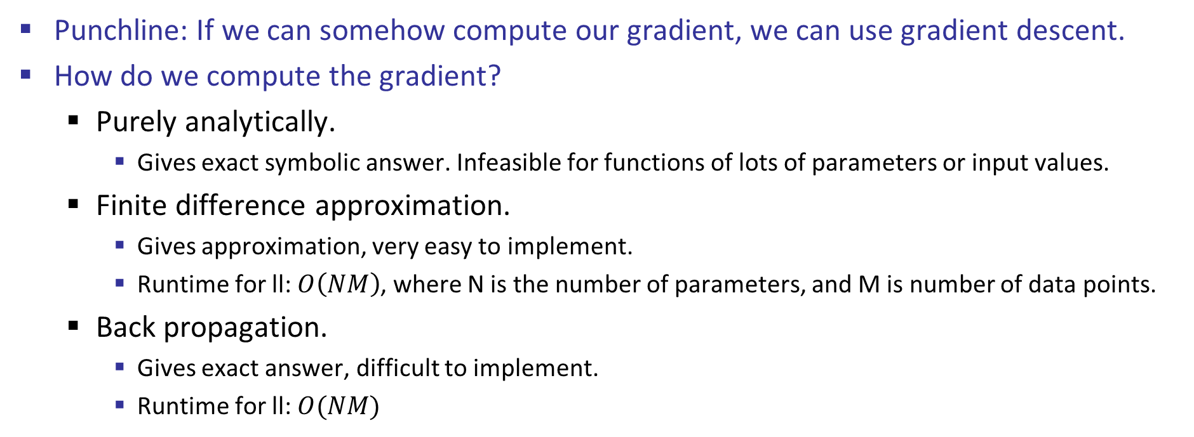
Gradient Descent
Punchline: If we can somehow compute our gradient, we can use gradient descent.
How do we compute the gradient?
  Purely analytically.
    Gives exact symbolic answer. Infeasible for functions of lots of parameters or input values.
  Finite difference approximation.
    Gives approximation, very easy to implement.
    Runtime for ll: $O\left(NM\right)$, where N is the number of parameters, and M is number of data points.
  Back propagation.
    Gives exact answer, difficult to implement.
    Runtime for ll: $O(NM)$

Slide 27
Summary of Key Ideas
Optimize probability of label given input
Continuous optimization
  Gradient ascent:
    Compute steepest uphill direction = gradient (= just vector of partial derivatives)
    Take step in the gradient direction
    Repeat (until held-out data accuracy starts to drop = “early stopping”)
Deep neural nets
  Last layer = still logistic regression
  Now also many more layers before this last layer
    = computing the features
    → the features are learned rather than hand-designed
  Universal function approximation theorem
    If neural net is large enough
    Then neural net can represent any continuous mapping from input to output with arbitrary accuracy
    But remember: need to avoid overfitting / memorizing the training data → early stopping!
  Automatic differentiation gives the derivatives efficiently (how? = outside of scope of 188)

Slide 28

Computer Vision
Notes:
28

Slide 29

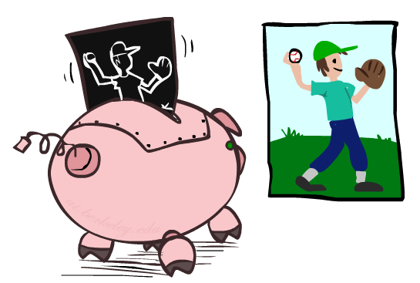

Manual Feature Design
Notes:
29

Slide 30
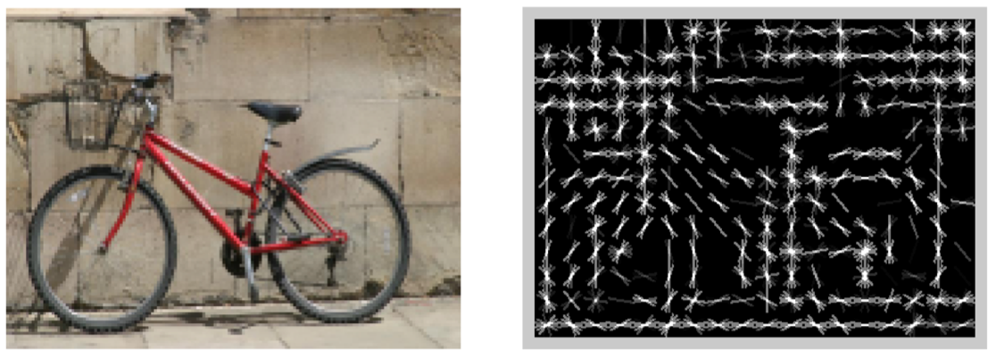
Features and Generalization
Image
HoG
Notes:
HoG, SIFT, Daisy
Deformable part models
30

Slide 31
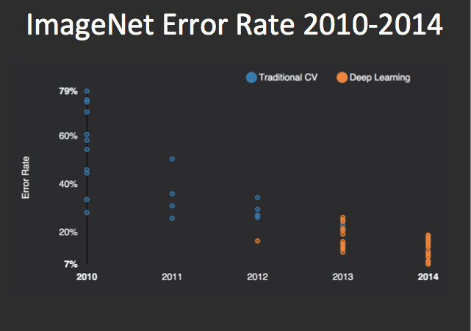
Performance
AlexNet
graph credit Matt Zeiler, Clarifai

Slide 32
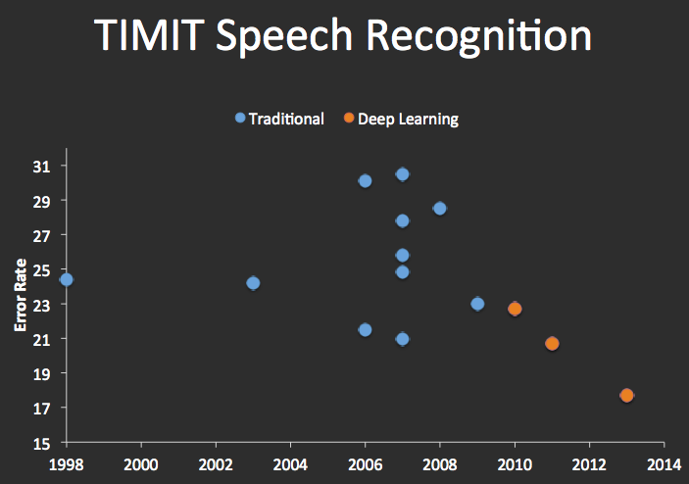


Speech Recognition
graph credit Matt Zeiler, Clarifai

Slide 33
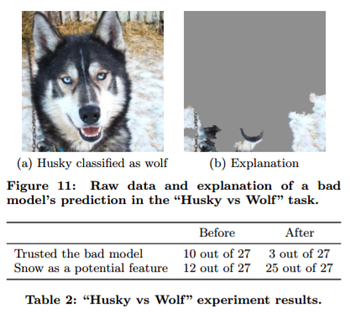
What’s still missing? – correlation \neq causation
[Ribeiro et al.]

Slide 34
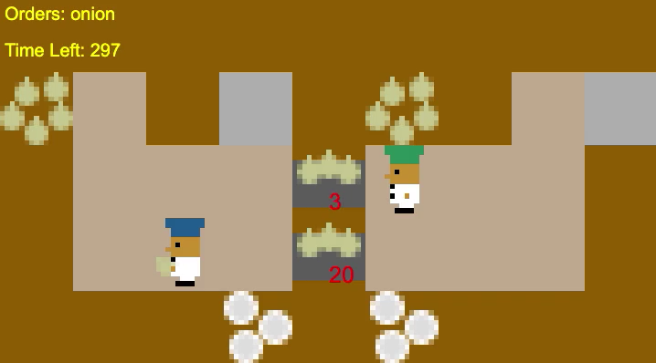
What’s still missing? – covariate shift
[Carroll et al.]

Slide 35
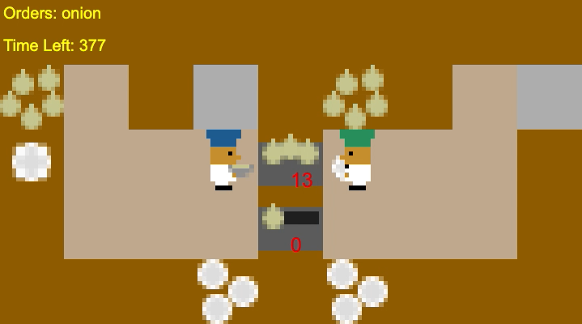
What’s still missing? – covariate shift
[Carroll et al.]

Slide 36
Decision Trees

Slide 37
Reminder: Features
Features, aka attributes
  Sometimes: TYPE=French
  Sometimes: f_{TYPE=French}(x) = 1

Slide 38
Reminder: Features
Features, aka attributes
  Sometimes: TYPE=French
  Sometimes: f_{TYPE=French}(x) = 1

Slide 39
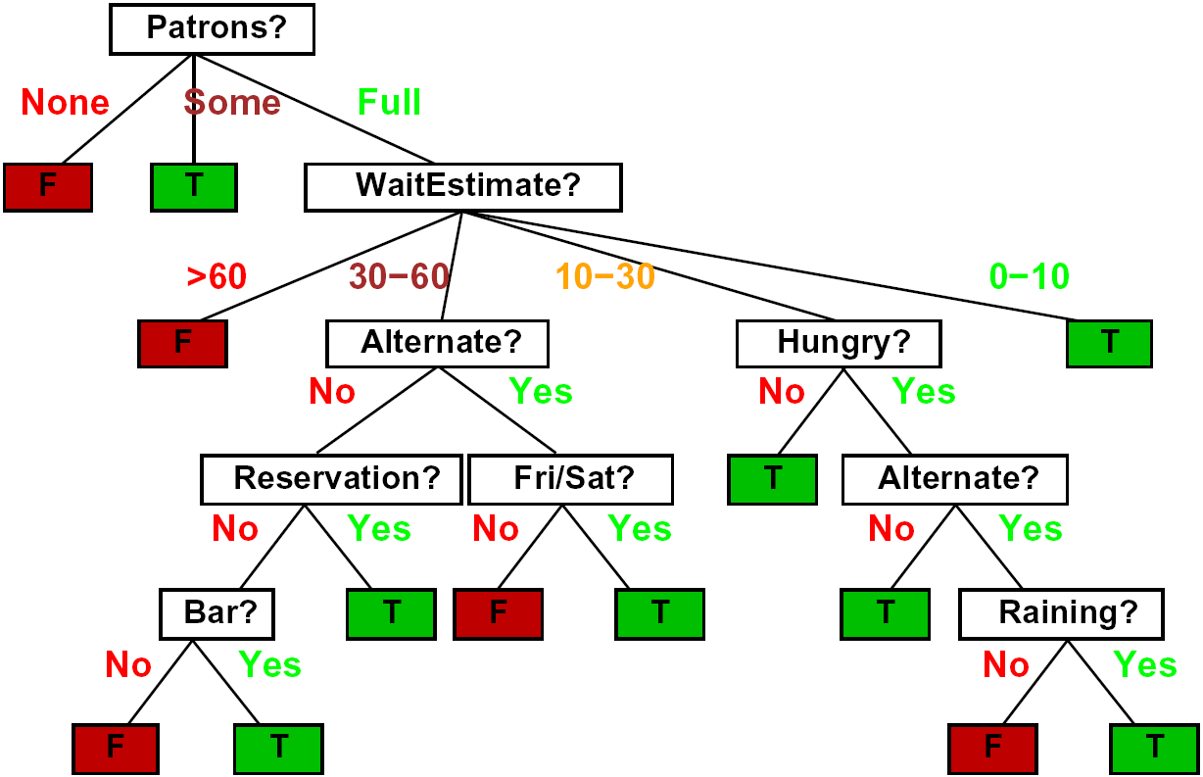
Decision Trees
Compact representation of a function:
  Truth table
  Conditional probability table
  Regression values
True function
  Realizable: in H

Slide 40

Expressiveness of DTs
Can express any function of the features
However, we hope for compact trees

Slide 41
Comparison: Perceptrons
What is the expressiveness of a perceptron over these features?
For a perceptron, a feature’s contribution is either positive or negative
  If you want one feature’s effect to depend on another, you have to add a new conjunction feature
  E.g. adding “PATRONS=full ∧ WAIT = 60” allows a perceptron to model the interaction between the two atomic features
DTs automatically conjoin features / attributes
  Features can have different effects in different branches of the tree!
Difference between modeling relative evidence weighting (NB) and complex evidence interaction (DTs)
  Though if the interactions are too complex, may not find the DT greedily

Slide 42
Decision Tree Learning
Aim: find a small tree consistent with the training examples
Idea: (recursively) choose “most significant” attribute as root of (sub)tree

Slide 43
Choosing an Attribute
Idea: a good attribute splits the examples into subsets that are (ideally) “all positive” or “all negative”
So: we need a measure of how “good” a split is, even if the results aren’t perfectly separated out

Slide 44
Entropy and Information
Information answers questions
  The more uncertain about the answer initially, the more information in the answer
  Scale: bits
    Answer to Boolean question with prior <1/2, 1/2>?
    Answer to 4-way question with prior <1/4, 1/4, 1/4, 1/4>?
    Answer to 4-way question with prior <0, 0, 0, 1>?
    Answer to 3-way question with prior <1/2, 1/4, 1/4>?
A probability p is typical of:
  A uniform distribution of size 1/p
  A code of length log 1/p

Slide 45
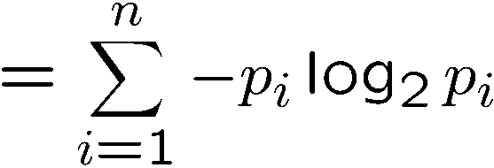
Entropy
General answer: if prior is <p₁,…,p_{n}>:
  Information is the expected code length
Also called the entropy of the distribution
  More uniform = higher entropy
  More values = higher entropy
  More peaked = lower entropy
1 bit
0 bits
0.5 bit

Slide 46
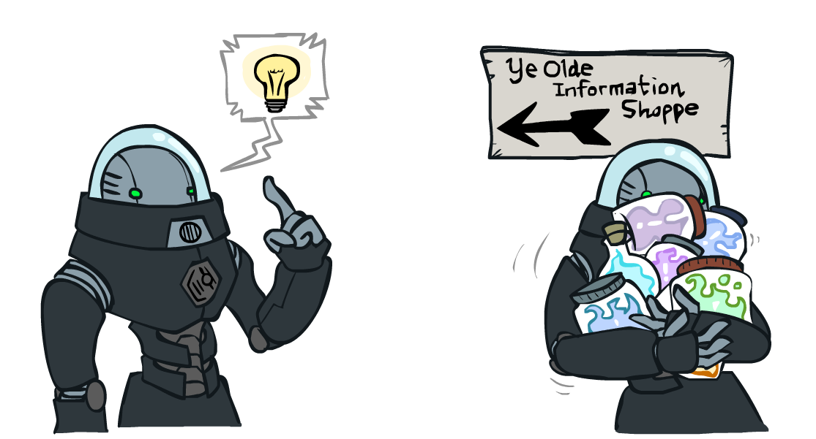
Information Gain
Back to decision trees!
For each split, compare entropy before and after
  Difference is the information gain
  Problem: there’s more than one distribution after split!
  Solution: use expected entropy, weighted by the number of examples

Slide 47
Next Step: Recurse
Now we need to keep growing the tree!
Two branches are done (why?)
What to do under “full”?
  See what examples are there…

Slide 48
Example: Learned Tree
Decision tree learned from these 12 examples:
Substantially simpler than “true” tree
  A more complex hypothesis isn't justified by data
Also: it’s reasonable, but wrong

Slide 49
Example: Miles Per Gallon
40 Examples

Slide 50
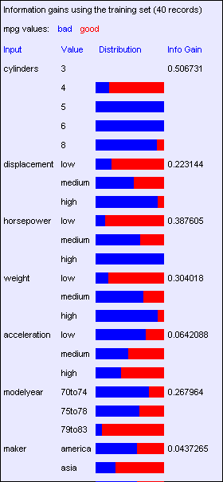
Find the First Split
Look at information gain for each attribute
Note that each attribute is correlated with the target!
What do we split on?

Slide 51
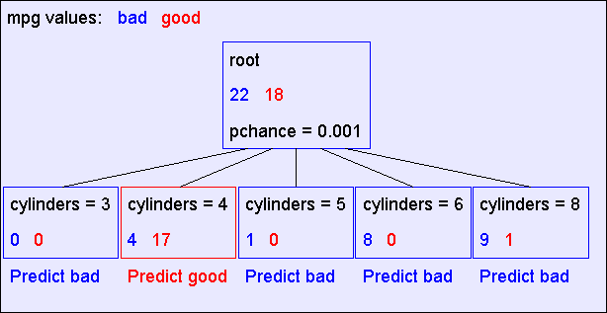
Result: Decision Stump

Slide 52
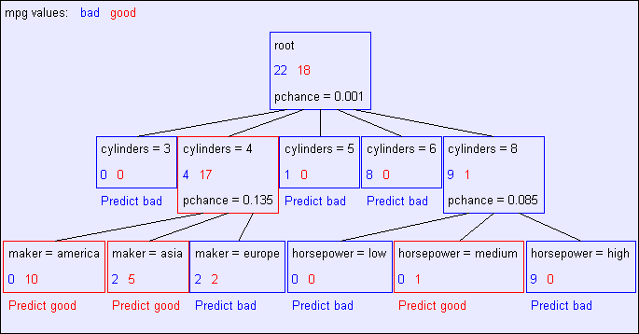
Second Level

Slide 53
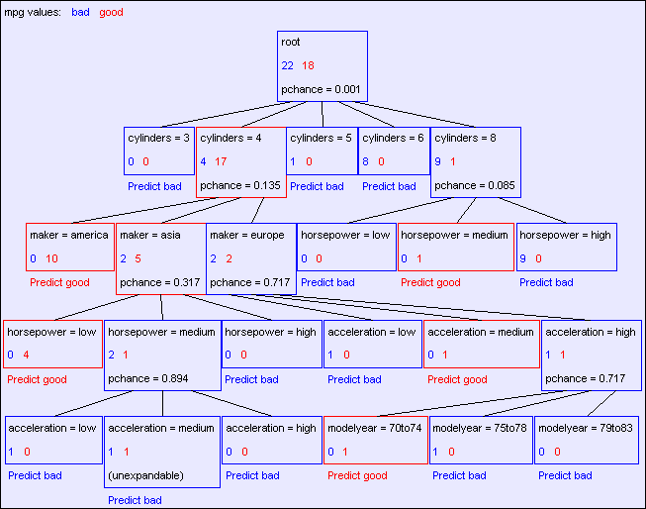
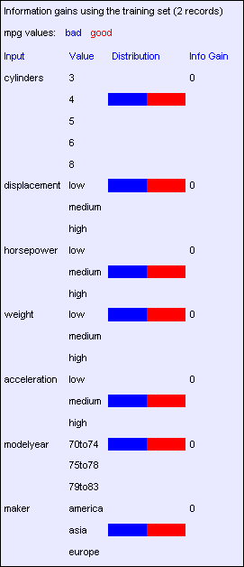
Final Tree

Slide 54
Reminder: Overfitting
Overfitting:
  When you stop modeling the patterns in the training data (which generalize)
  And start modeling the noise (which doesn’t)
We had this before:
  Naïve Bayes: needed to smooth
  Perceptron: early stopping

Slide 55

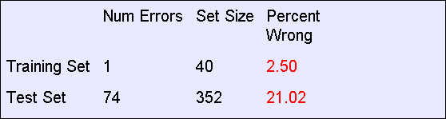
MPG Training Error
The test set error is much worse than the training set error…
…why?

Slide 56
Significance of a Split
Starting with:
  Three cars with 4 cylinders, from Asia, with medium HP
  2 bad MPG
  1 good MPG
What do we expect from a three-way split?
  Maybe each example in its own subset?
  Maybe just what we saw in the last slide?
Probably shouldn’t split if the counts are so small they could be due to chance
A chi-squared test can tell us how likely it is that deviations from a perfect split are due to chance*
Each split will have a significance value, p_{CHANCE}

Slide 57

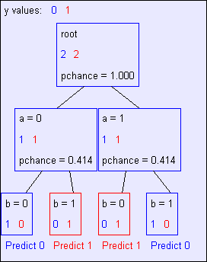
Keeping it General
Pruning:
  Build the full decision tree
  Begin at the bottom of the tree
  Delete splits in which
  p_{CHANCE} > MaxP_{CHANCE}
  Continue working upward until there are no more prunable nodes
y = a XOR b

Slide 58
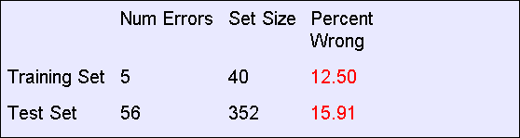
Pruning example
With MaxP_{CHANCE} = 0.1:
Note the improved test set accuracy compared with the unpruned tree

Slide 59
Regularization
MaxP_{CHANCE} is a regularization parameter
Generally, set it using held-out data (as usual)
Training
Held-out / Test
Accuracy
Decreasing
Increasing
MaxP_{CHANCE}
Small Trees
Large Trees
High Bias
High Variance

Slide 60
Forward Pointer: Random Forests
Ensemble method of learning trees
Very effective, used in industry and more
Related to Boosting

Slide 61
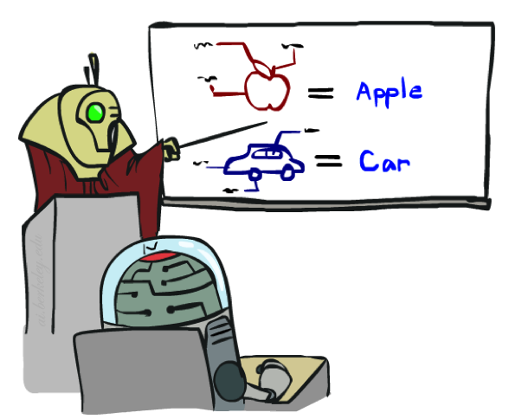


A few important points about learning
Data: labeled instances, e.g. emails marked spam/ham
  Training set
  Held out set
  Test set
Features: attribute-value pairs which characterize each x
Experimentation cycle
  Learn parameters (e.g. model probabilities) on training set
  (Tune hyperparameters on held-out set)
  Compute accuracy of test set
  Very important: never “peek” at the test set!
Evaluation
  Accuracy: fraction of instances predicted correctly
Overfitting and generalization
  Want a classifier which does well on test data
  Overfitting: fitting the training data very closely, but not generalizing well
  Underfitting: fits the training set poorly
Training
Data
Held-Out
Data
Test
Data

Slide 62








A few important points about learning
What should we learn where?
  Learn parameters from training data
  Tune hyperparameters on different data
    Why?
  For each value of the hyperparameters, train and test on the held-out data
  Choose the best value and do a final test on the test data
What are examples of hyperparameters?

Slide 63
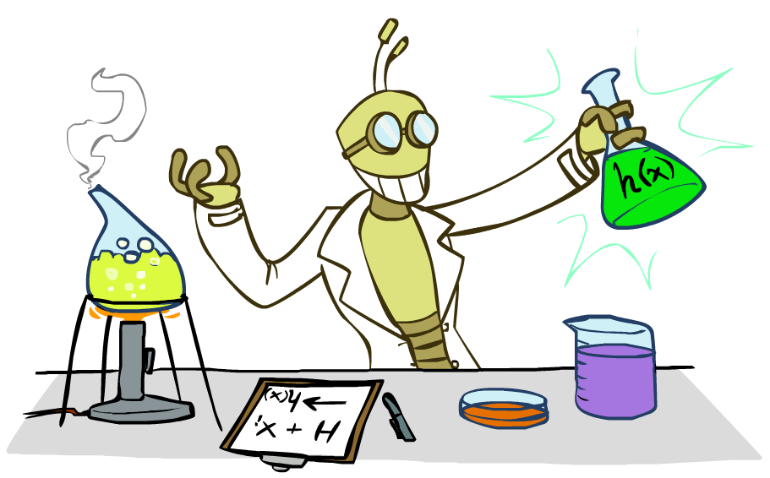
Inductive Learning

Slide 64



Inductive Learning (Science)
Simplest form: learn a function from examples
  A target function: g
  Examples: input-output pairs (x, g(x))
  E.g. x is an email and g(x) is spam / ham
  E.g. x is a house and g(x) is its selling price
Problem:
  Given a hypothesis space H
  Given a training set of examples x_{i}
  Find a hypothesis h(x) such that h ~ g
Includes:
  Classification (outputs = class labels)
  Regression (outputs = real numbers)
How do perceptron and naïve Bayes fit in? (H, h, g, etc.)

Slide 65
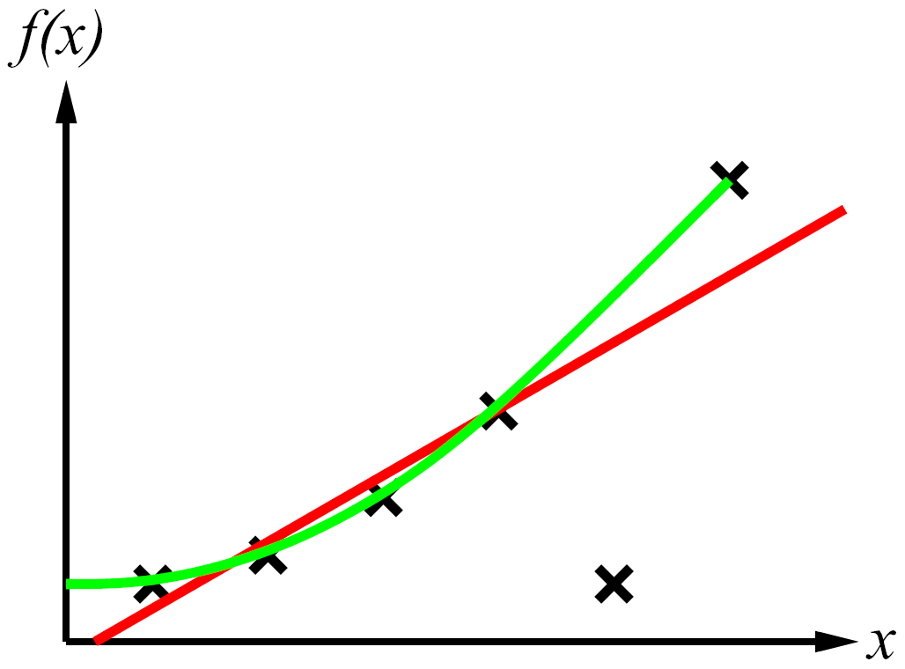
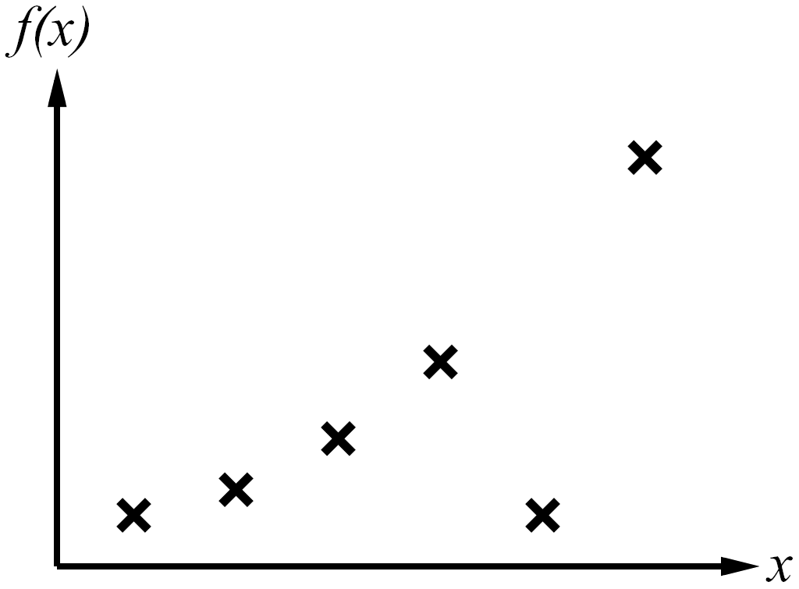
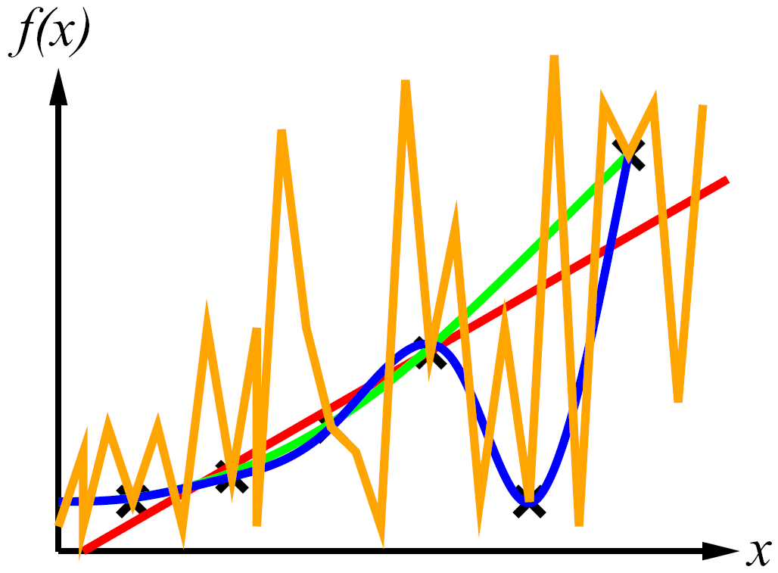
Inductive Learning
Curve fitting (regression, function approximation):
Consistency vs. simplicity
Ockham’s razor

Slide 66
Consistency vs. Simplicity
Fundamental tradeoff: bias vs. variance
Usually algorithms prefer consistency by default (why?)
Several ways to operationalize “simplicity”
  Reduce the hypothesis space
    Assume more: e.g. independence assumptions, as in naïve Bayes
    Have fewer, better features / attributes: feature selection
    Other structural limitations (decision lists vs trees)
  Regularization
    Smoothing: cautious use of small counts
    Many other generalization parameters (pruning cutoffs today)
    Hypothesis space stays big, but harder to get to the outskirts

