Slide 1
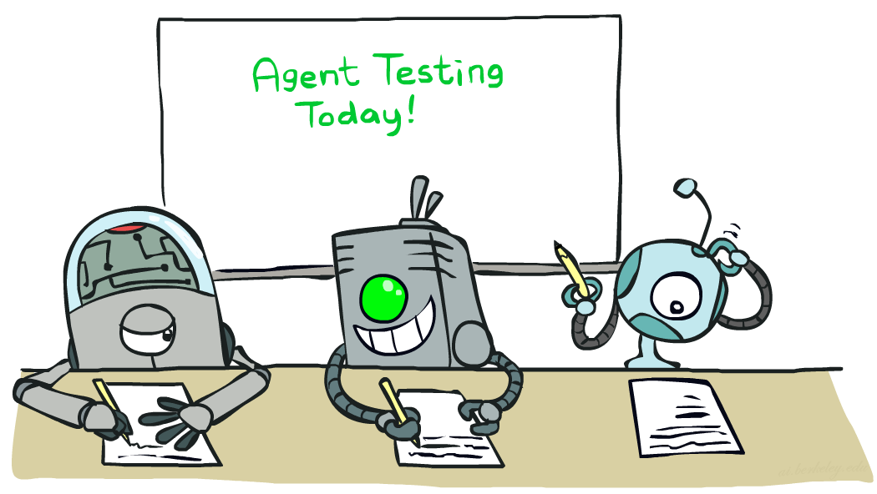

CS 188: Artificial Intelligence
Machine Learning: Parameter Estimation, Smoothing, …
Instructors: Nathan Lambert--- University of California, Berkeley
[These slides were created by Dan Klein, Pieter Abbeel, Sergey Levine, with some materials from A. Farhadi. All CS188 materials are at http://ai.berkeley.edu.]
Notes:
Please retain proper attribution, including the reference to ai.berkeley.edu. Thanks!

Slide 2
Machine Learning
Up until now: how use a model to make optimal decisions
Machine learning: how to acquire a model from data / experience
  Learning parameters (e.g. probabilities)
  Learning structure (e.g. BN graphs)
  Learning hidden concepts (e.g. clustering)
Today: Review Naïve Bayes, introduce:
  Smoothing
  Parameter Estimation
  Perceptron

Slide 3
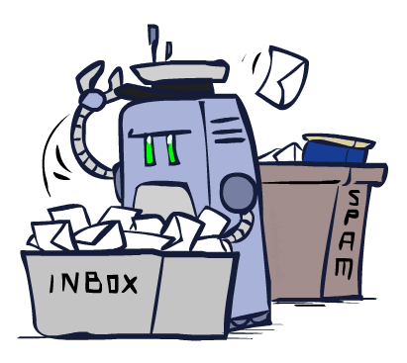
Classification

Slide 4

Model-Based Classification
Model-based approach
  Build a model (e.g. Bayes’ net) where both the label and features are random variables
  Instantiate any observed features
  Query for the distribution of the label conditioned on the features
Challenges
  What structure should the BN have?
  How should we learn its parameters?

Slide 5

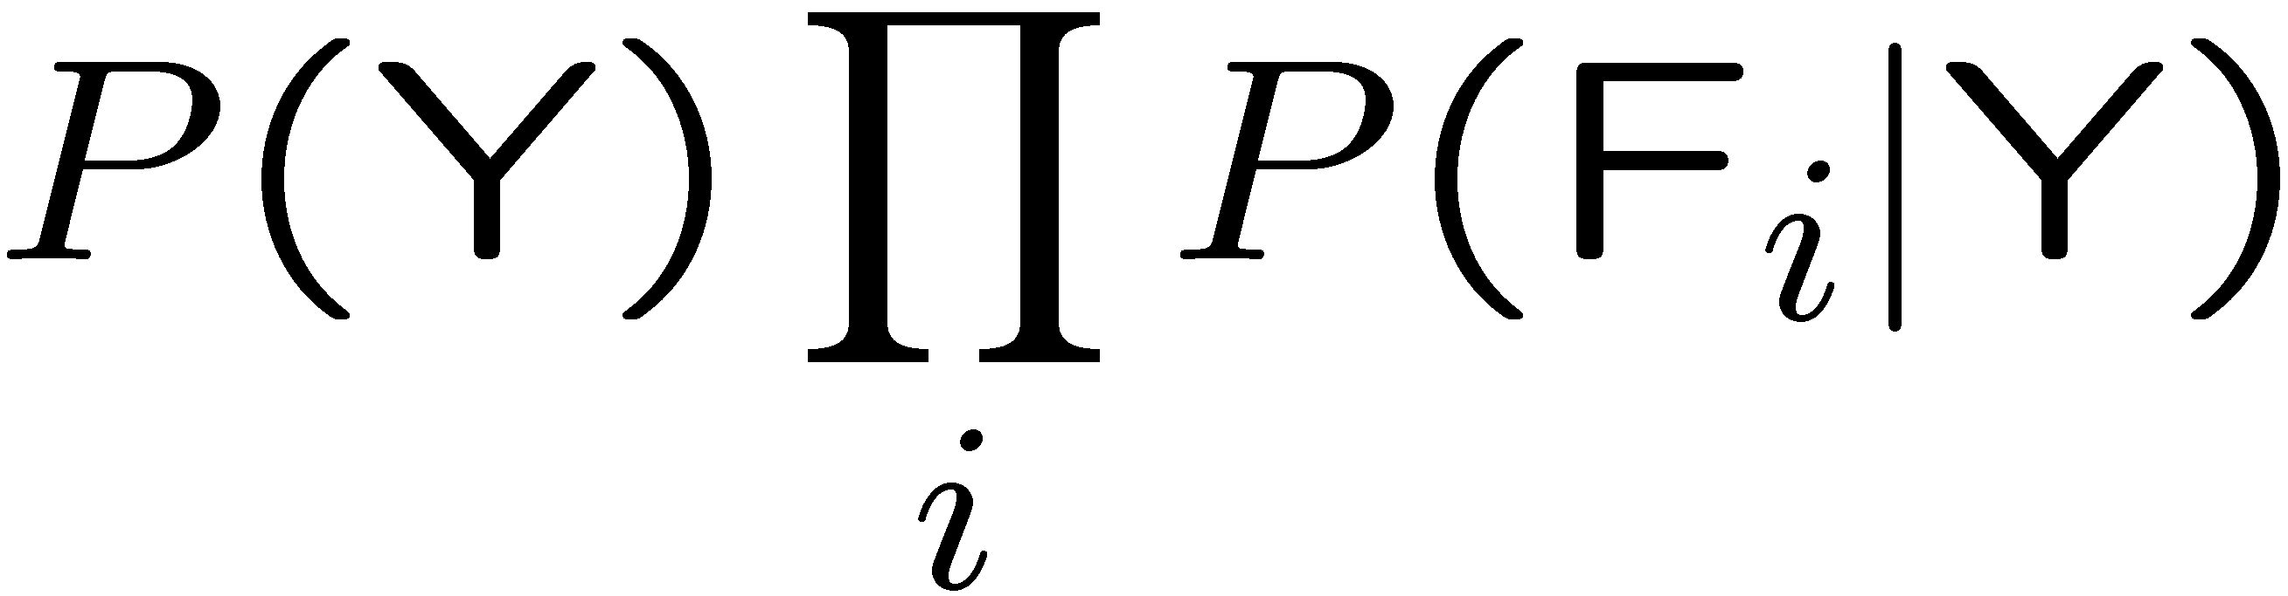

General Naïve Bayes
A general Naive Bayes model:
We only have to specify how each feature depends on the class
Total number of parameters is linear in n
Model is very simplistic, but often works anyway
Y
|Y| parameters
F₁
F₂
F_{n}
|Y| x |F|^{n} values
n x |F| x |Y| parameters

Slide 6
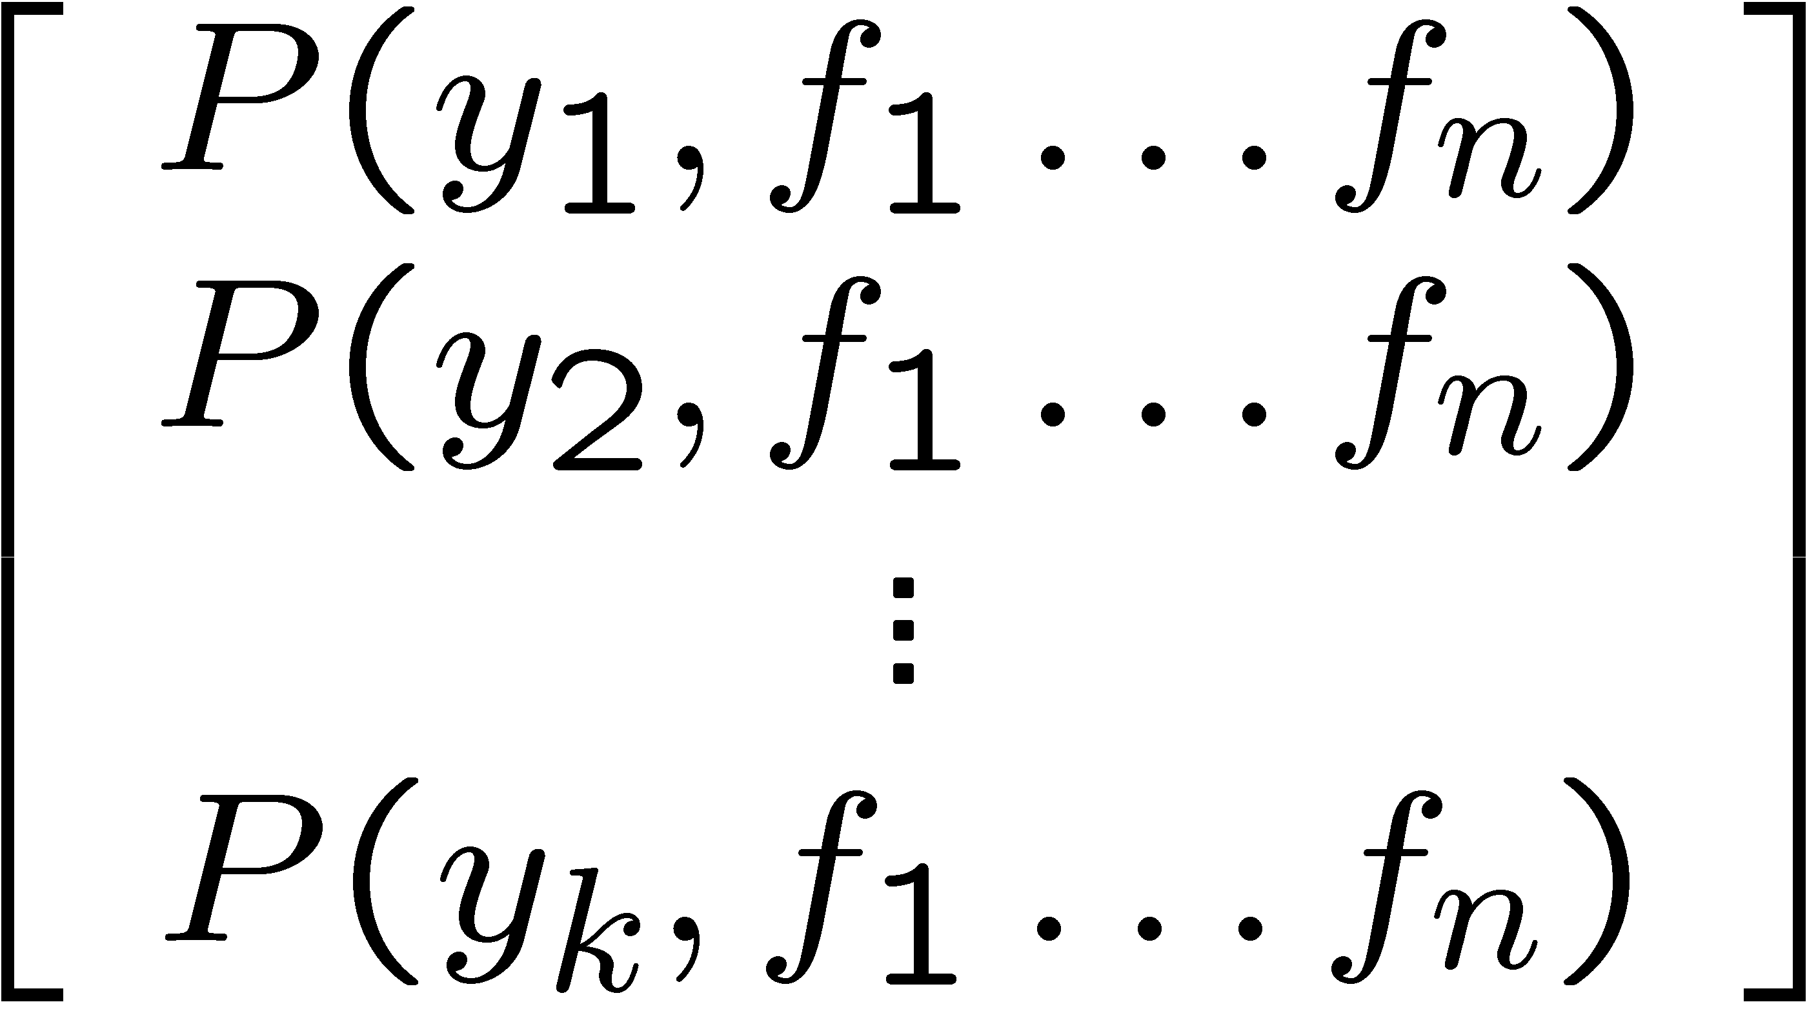
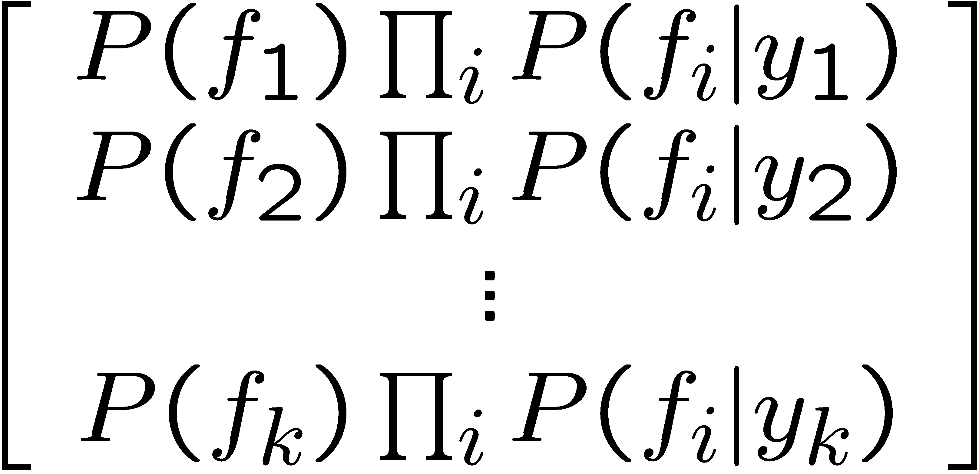

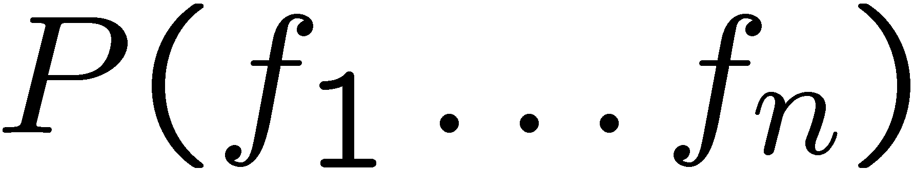
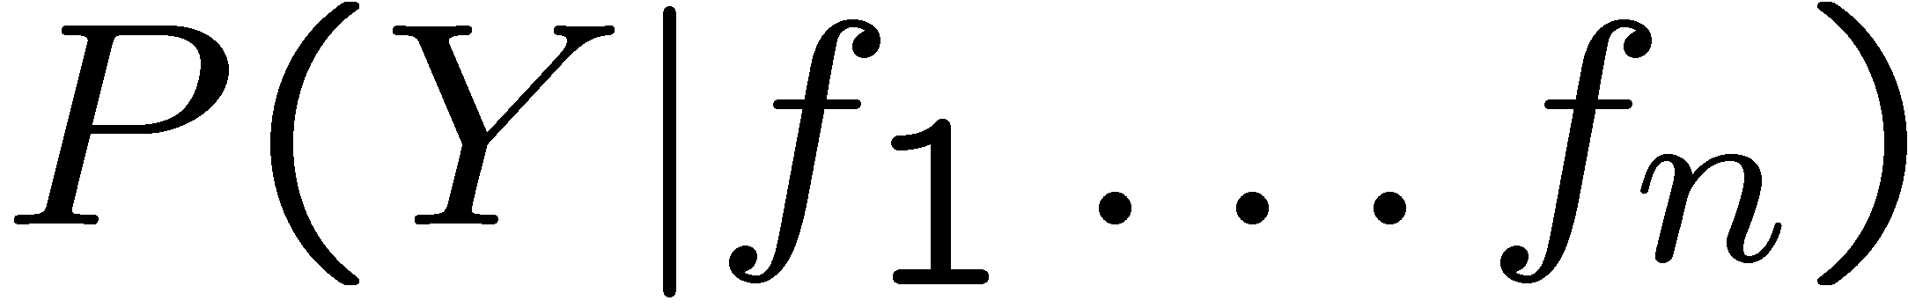
Inference for Naïve Bayes
Goal: compute posterior distribution over label variable Y
  Step 1: get joint probability of label and evidence for each label
  Step 2: sum to get probability of evidence
  Step 3: normalize by dividing Step 1 by Step 2
+

Slide 7
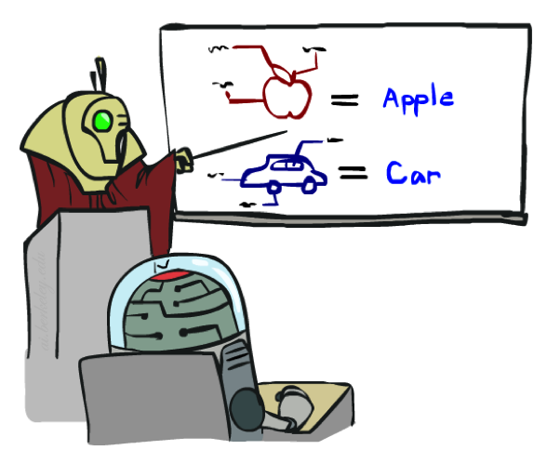

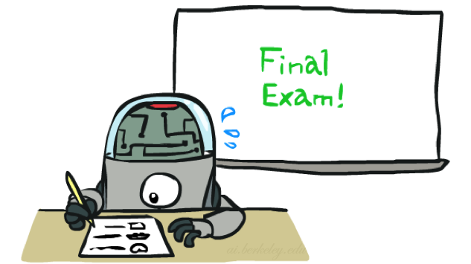
Training and Testing

Slide 8


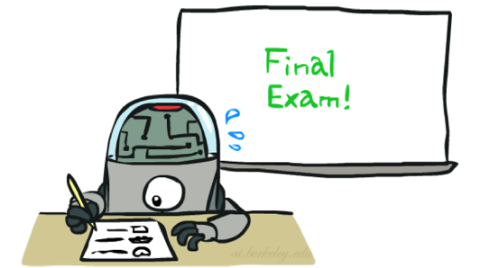
Important Concepts
Data: labeled instances, e.g. emails marked spam/ham
  Training set
  Held out set
  Test set
Features: attribute-value pairs which characterize each x
Experimentation cycle
  Learn parameters (e.g. model probabilities) on training set
  (Tune hyperparameters on held-out set)
  Compute accuracy of test set
  Very important: never “peek” at the test set!
Evaluation
  Accuracy: fraction of instances predicted correctly
Overfitting and generalization
  Want a classifier which does well on test data
  Overfitting: fitting the training data very closely, but not generalizing well
  Underfitting: fits the training set poorly
Training
Data
Held-Out
Data
Test
Data

Slide 9

Overfitting
30
25
20
Degree 15 polynomial
15
10
5
0
-5
-10
-15
0
2
4
6
8
10
12
14
16
18
20

Slide 10












Example: Overfitting
2 wins!!

Slide 11
Generalization and Overfitting
Relative frequency parameters will overfit the training data!
  Just because we never saw a 3 with pixel (15,15) on during training doesn’t mean we won’t see it at test time
  Unlikely that every occurrence of “minute” is 100% spam
  Unlikely that every occurrence of “seriously” is 100% ham
  What about all the words that don’t occur in the training set at all?
  In general, we can’t go around giving unseen events zero probability
As an extreme case, imagine using the entire email as the only feature
  Would get the training data perfect (if deterministic labeling)
  Wouldn’t generalize at all
  Just making the bag-of-words assumption gives us some generalization, but isn’t enough
To generalize better: we need to smooth or regularize the estimates

Slide 12
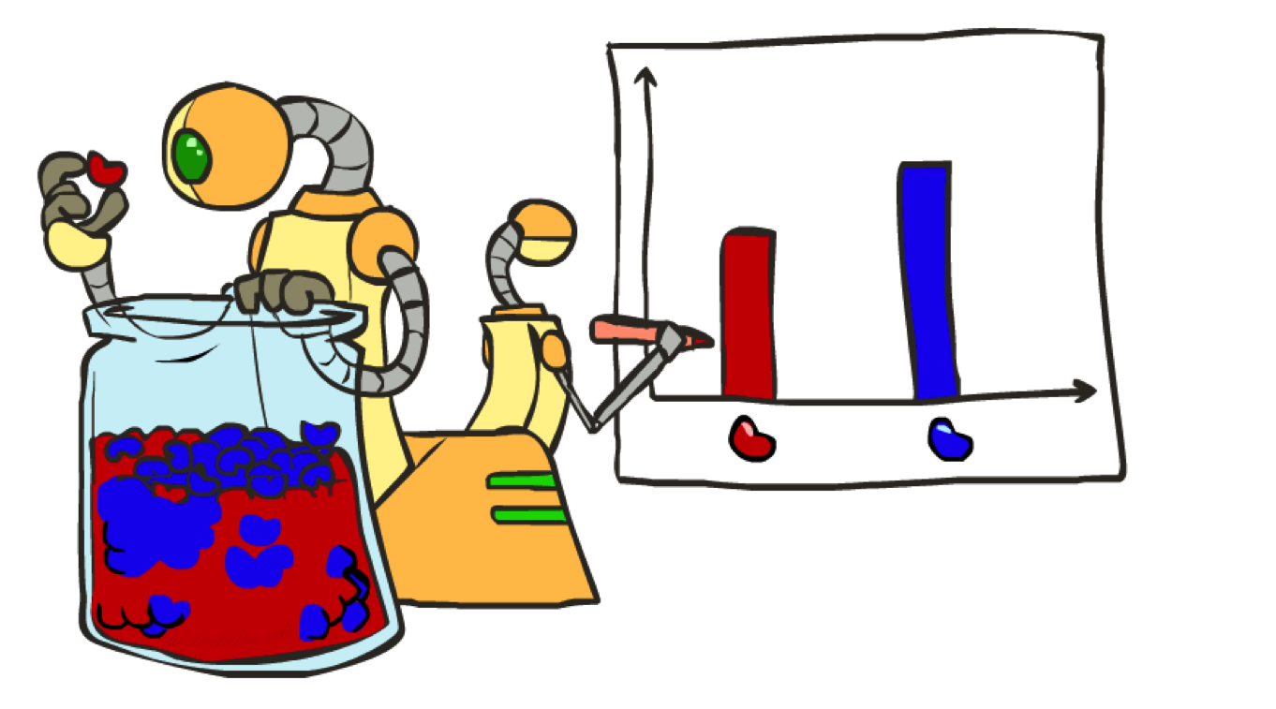
Parameter Estimation

Slide 13
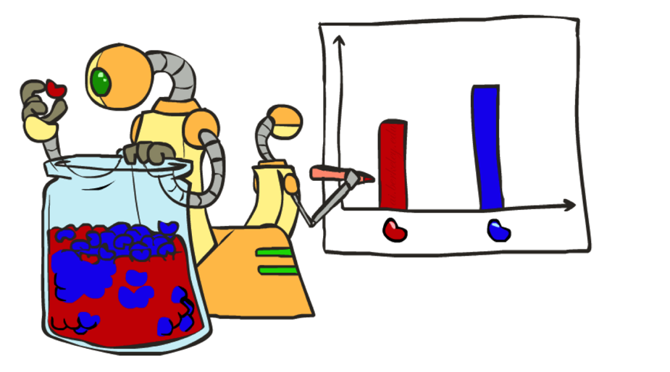
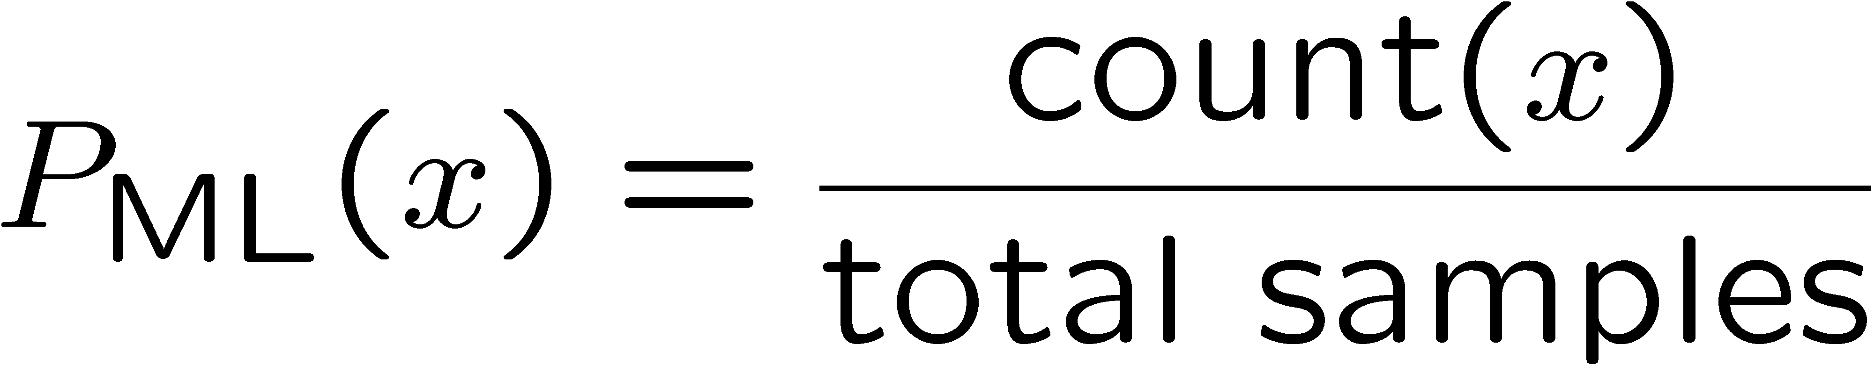

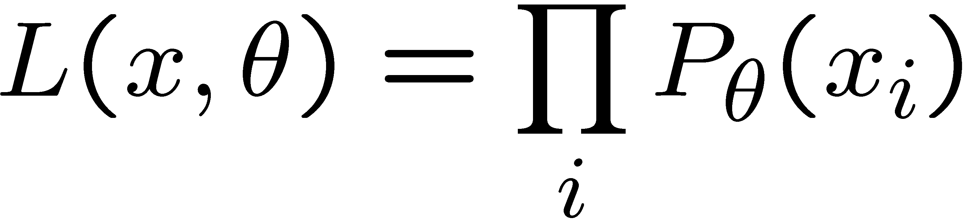





Parameter Estimation
Estimating the distribution of a random variable
Elicitation: ask a human (why is this hard?)
Empirically: use training data (learning!)
  E.g.: for each outcome x, look at the empirical rate of that value:
  This is the estimate that maximizes the likelihood of the data
r
b
b
b
r
r
b
b
b
r
r
b
b
b
b
r
r
b

Slide 14



Your First Consulting Job
A billionaire tech entrepreneur asks you a question:
  He says: I have thumbtack, if I flip it, what’s the probability it will fall with the nail up?
  You say: Please flip it a few times:
  You say: The probability is:
    P(H) = 3/5
  He says: Why???
  You say: Because…

Slide 15
Your First Consulting Job
P(Heads) = θ, P(Tails) = 1-θ
Flips are i.i.d.:
  Independent events
  Identically distributed according to unknown distribution
Sequence D of α_{H} Heads and α_{T} Tails
…
D={x_{i} | i=1…n}, P(D | θ ) = Π_{i}P(x_{i} | θ )

Slide 16
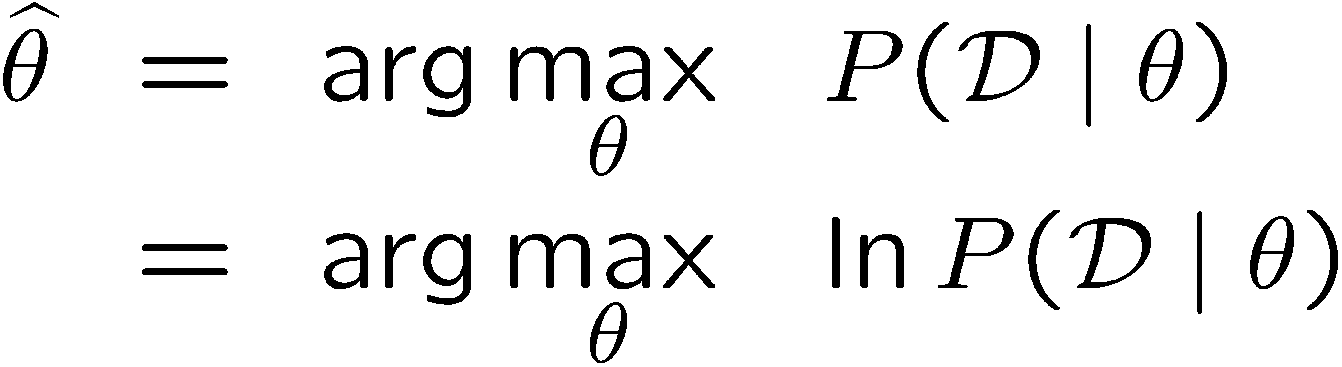
Maximum Likelihood Estimation
Data: Observed set D of α_{H} Heads and α_{T} Tails
Hypothesis space: Binomial distributions
Learning: finding θ is an optimization problem
  What’s the objective function?
MLE: Choose θ to maximize probability of D

Slide 17
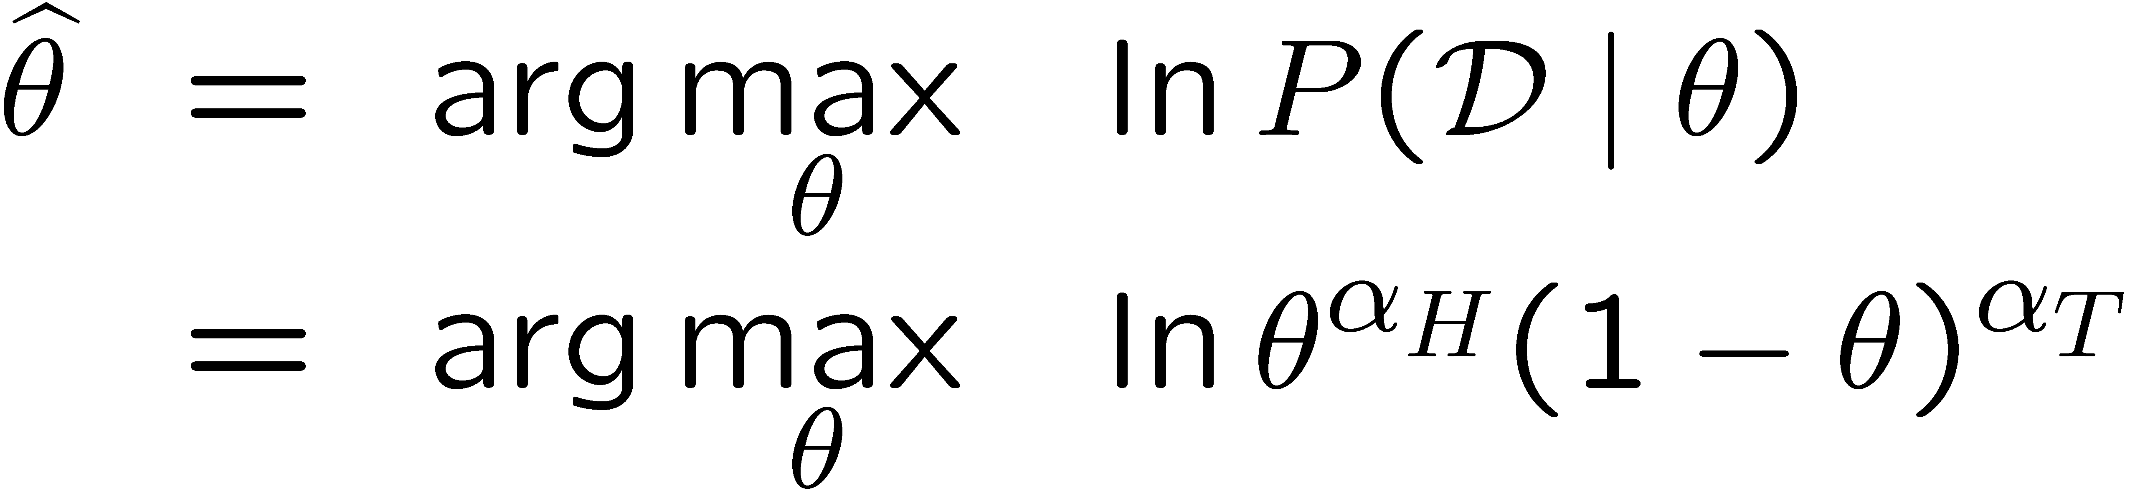
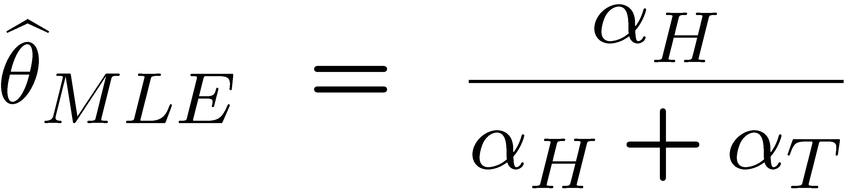
Maximum Likelihood Estimation
Set derivative to zero, and solve!

Slide 18
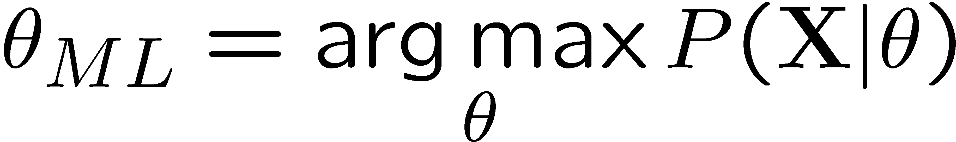
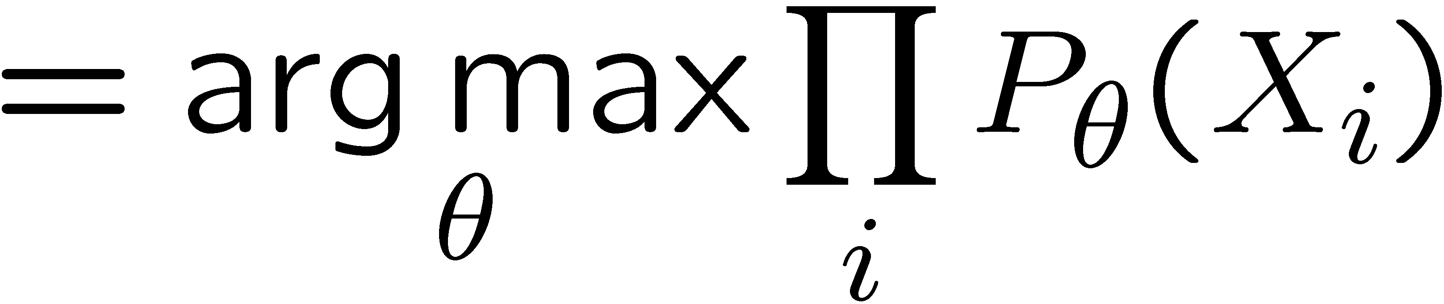
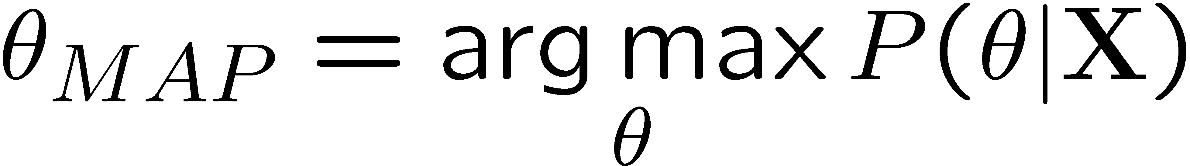
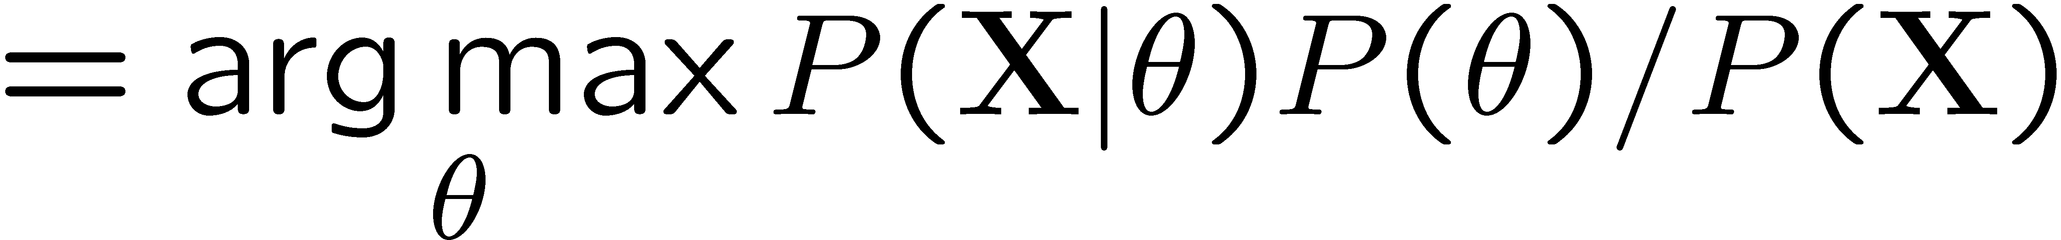
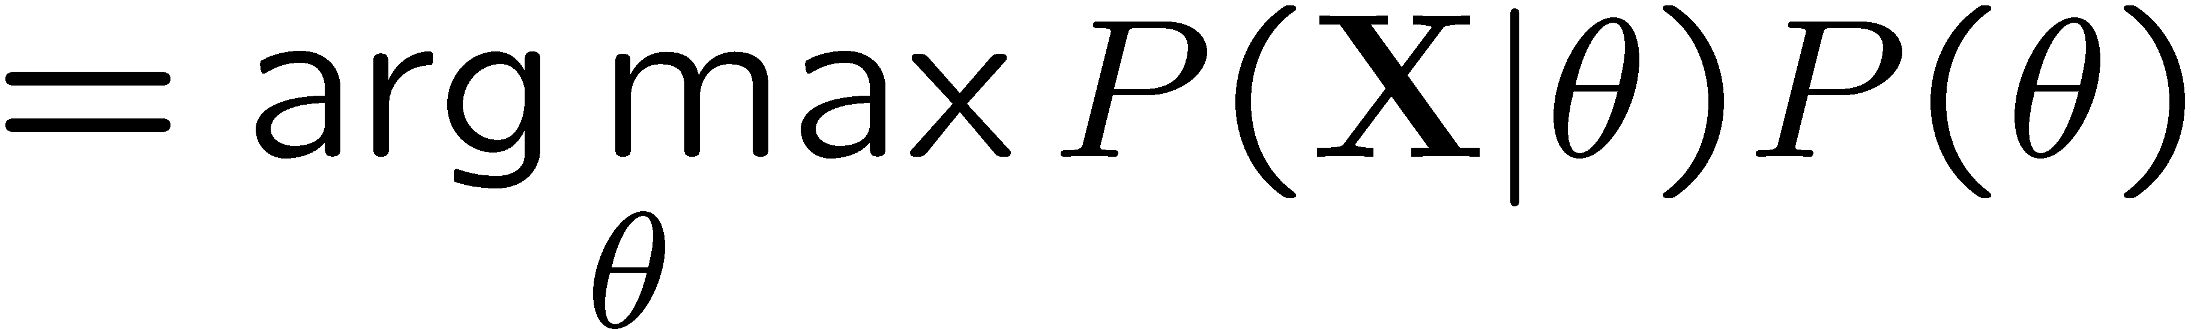
Maximum Likelihood?
Relative frequencies are the maximum likelihood estimates
Another option is to consider the most likely parameter value given the data
????

Slide 19

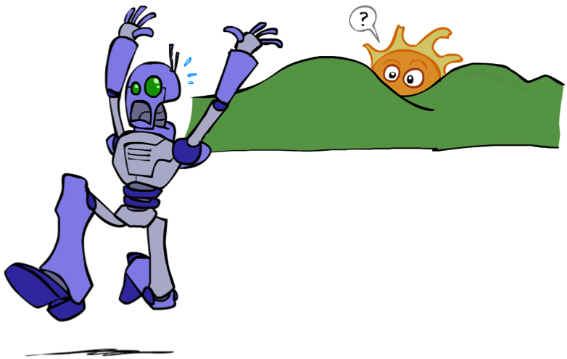
Unseen Events

Slide 20
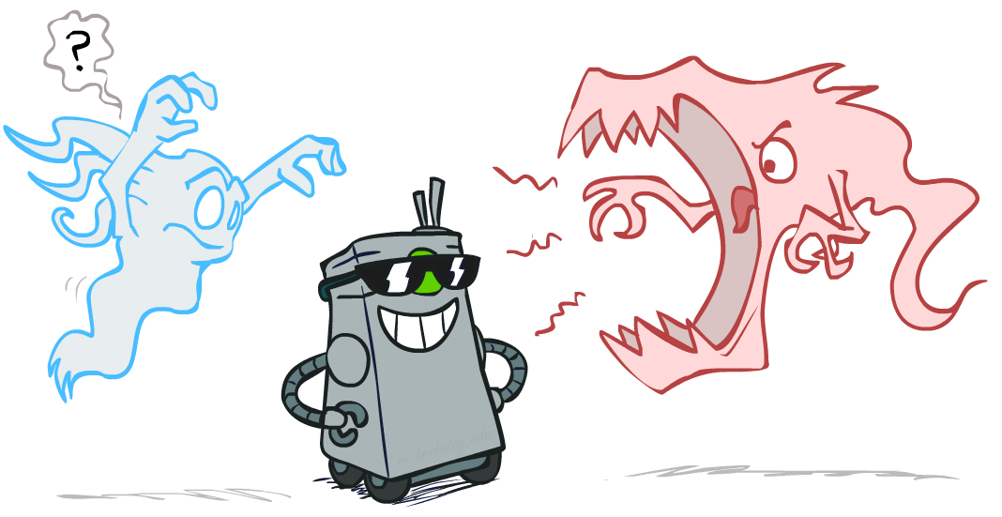
Smoothing

Slide 21
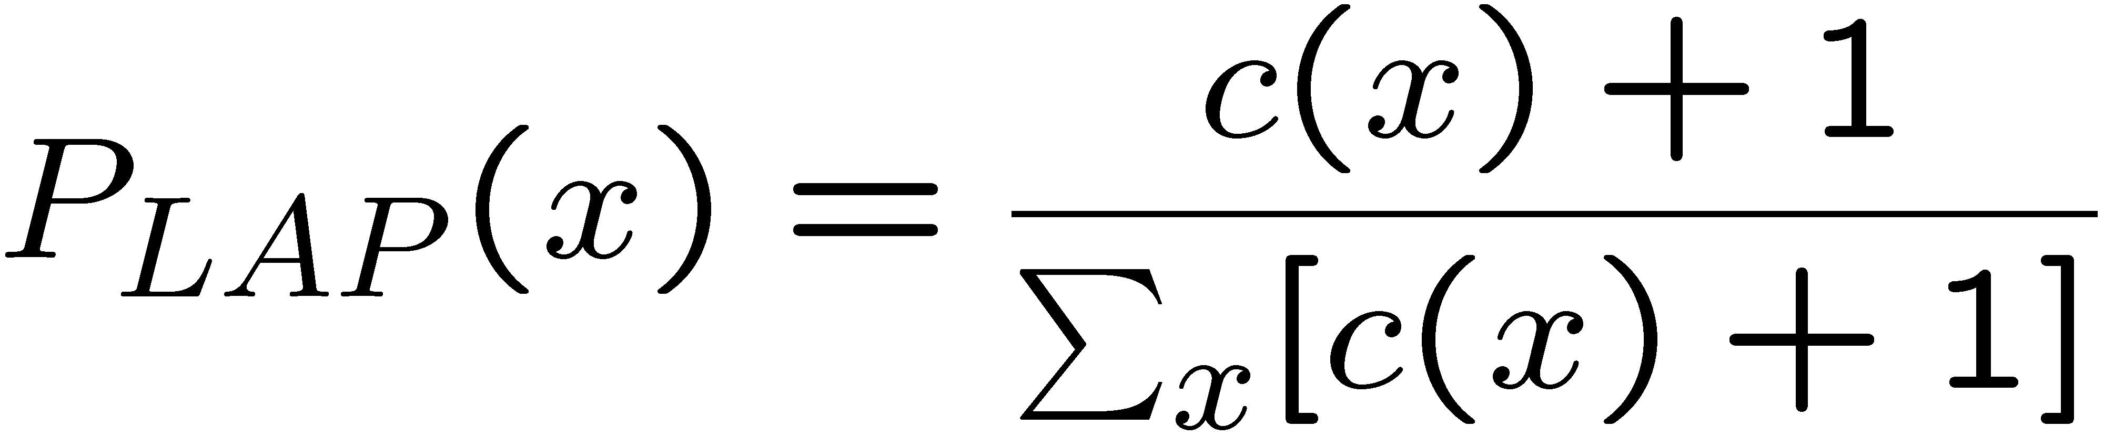
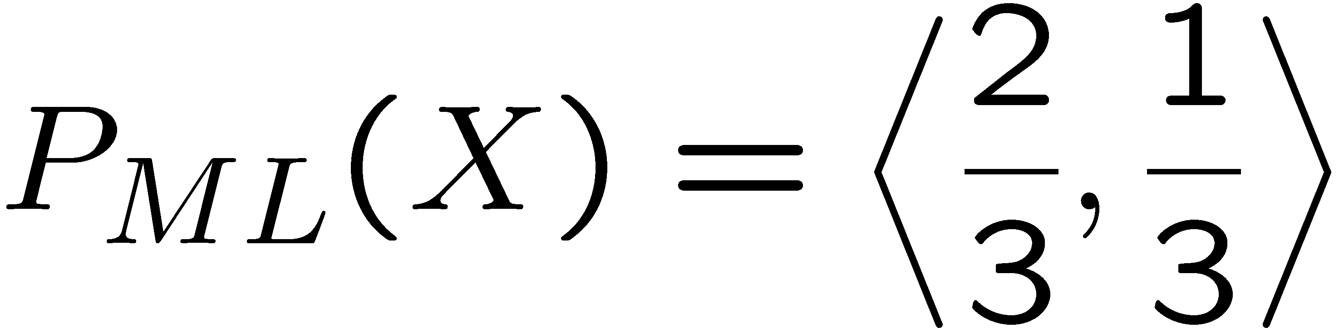
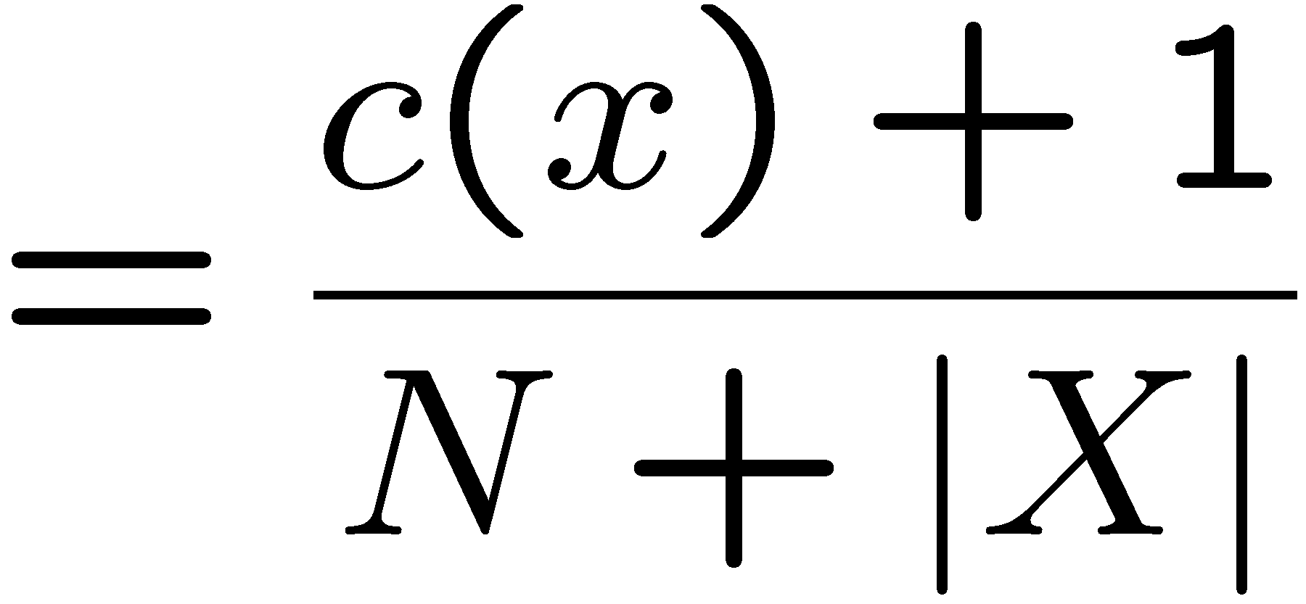
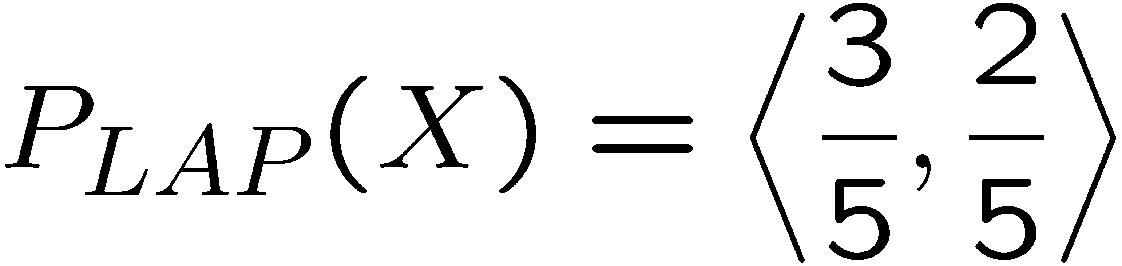
Laplace Smoothing
Laplace’s estimate:
  Pretend you saw every outcome once more than you actually did
  Can derive this estimate with Dirichlet priors (see cs281a)
r
r
b

Slide 22
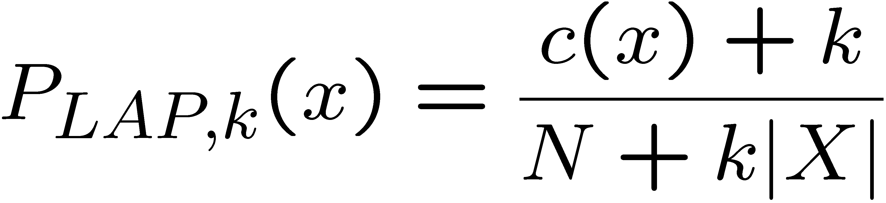
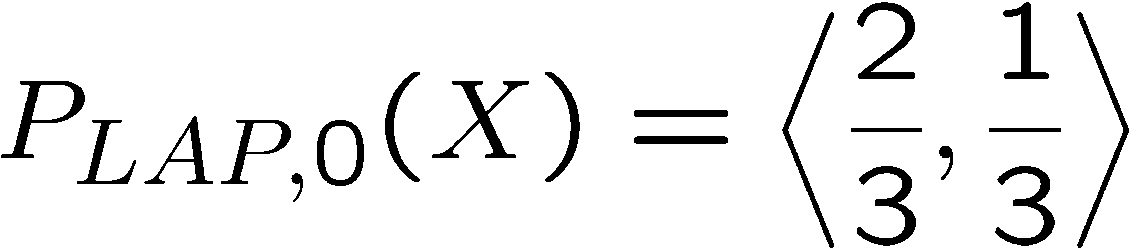
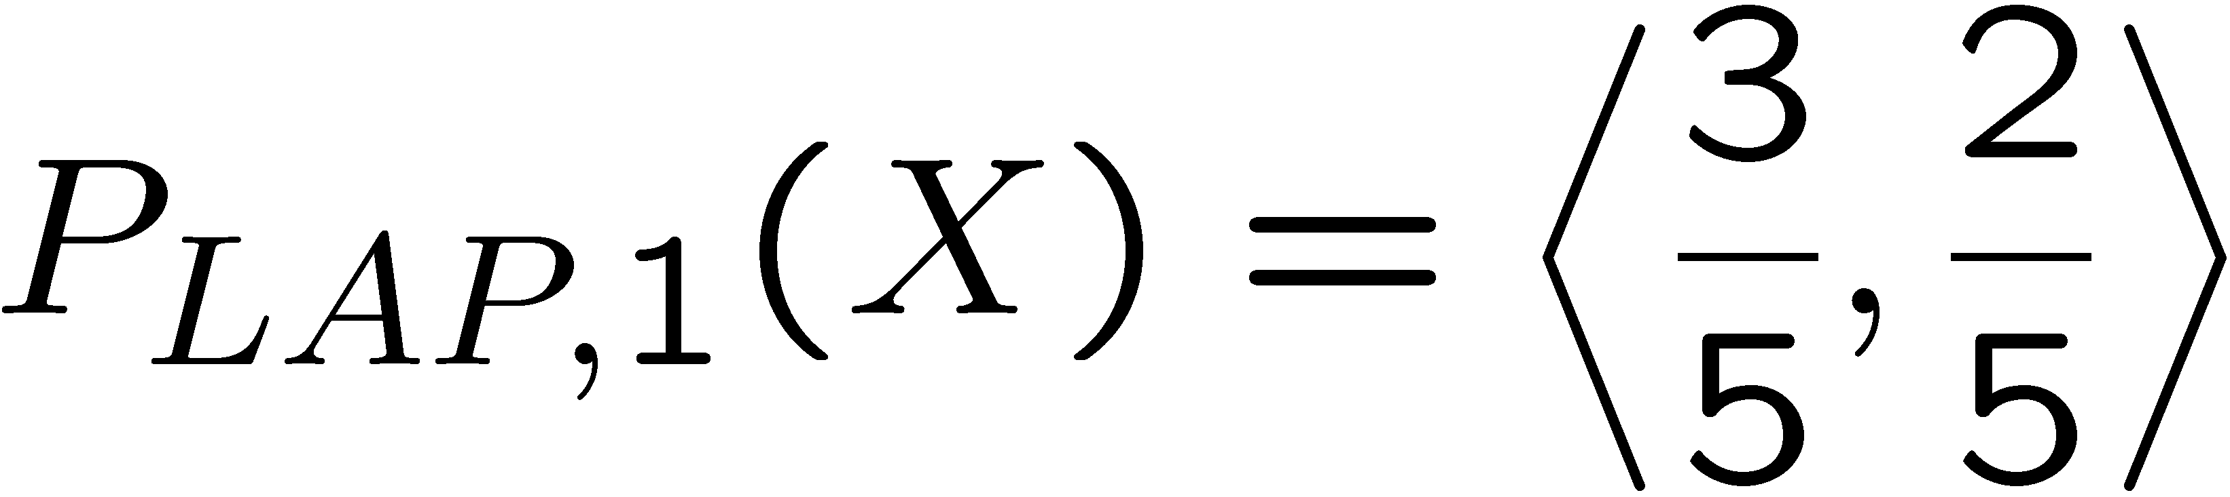
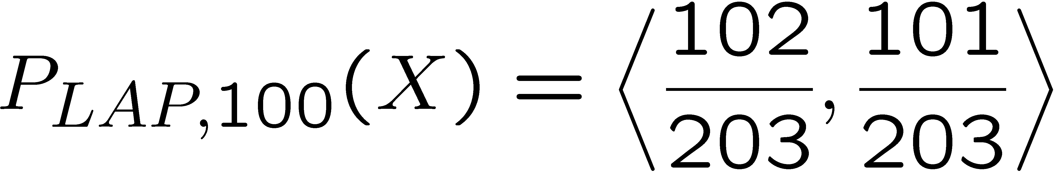
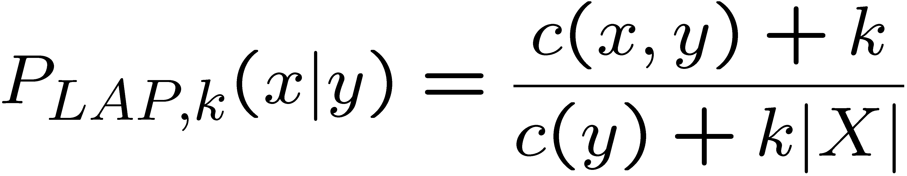
Laplace Smoothing
Laplace’s estimate (extended):
  Pretend you saw every outcome k extra times
  What’s Laplace with k = 0?
  k is the strength of the prior
Laplace for conditionals:
  Smooth each condition independently:
r
r
b

Slide 23
Estimation: Linear Interpolation*
In practice, Laplace can perform poorly for P(X|Y):
  When |X| is very large
  When |Y| is very large
Another option: linear interpolation
  Also get the empirical P(X) from the data
  Make sure the estimate of P(X|Y) isn’t too different from the empirical P(X)
  What if α is 0? 1?
For even better ways to estimate parameters, as well as details of the math, see cs281a, cs288

Slide 24

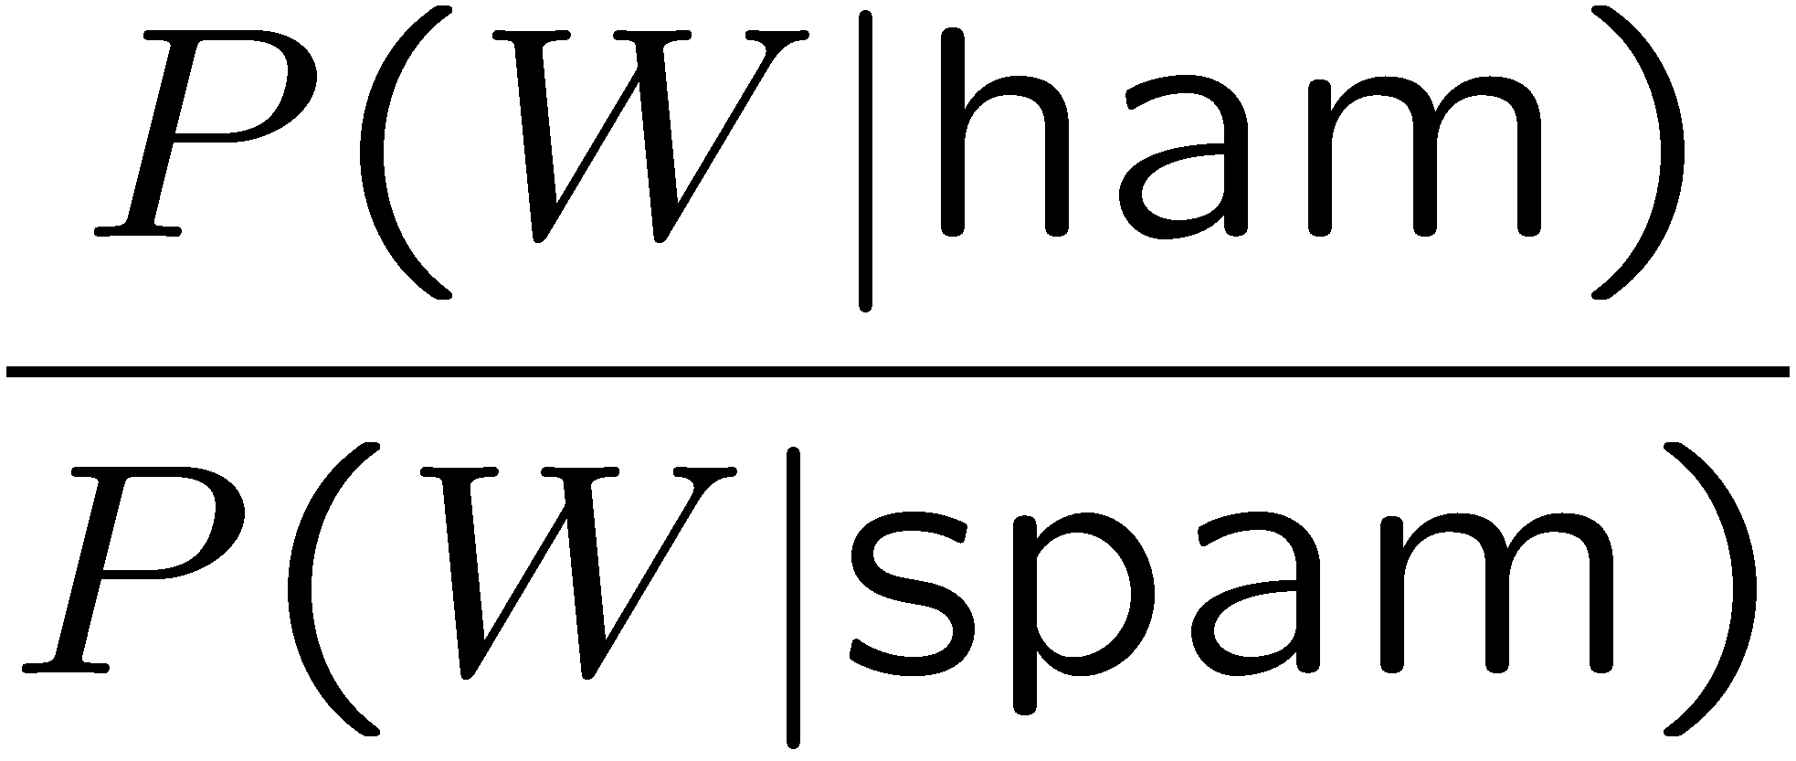
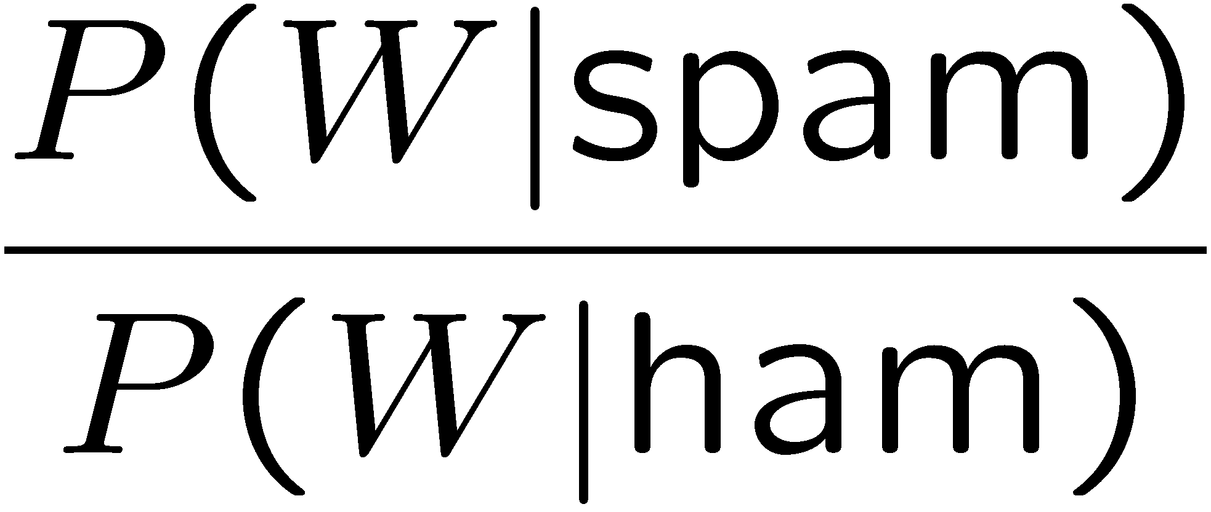
Real NB: Smoothing
For real classification problems, smoothing is critical
New odds ratios:
helvetica : 11.4
seems : 10.8
group : 10.2
ago : 8.4
areas : 8.3
...
verdana : 28.8
Credit : 28.4
ORDER : 27.2
<FONT> : 26.9
money : 26.5
...
Do these make more sense?

Slide 25
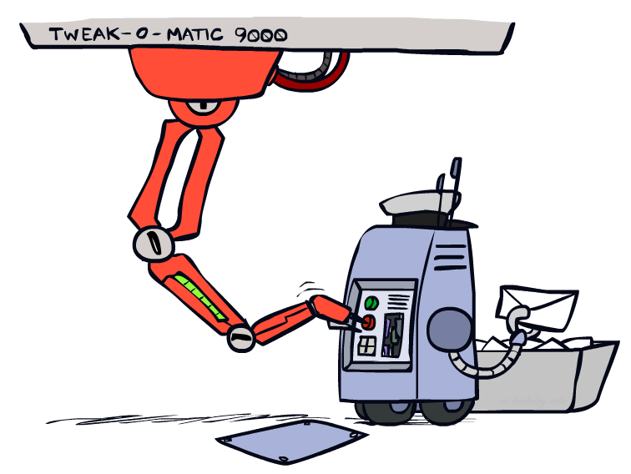
Tuning

Slide 26








Tuning on Held-Out Data
Now we’ve got two kinds of unknowns
  Parameters: the probabilities P(X|Y), P(Y)
  Hyperparameters: e.g. the amount / type of smoothing to do, k, α
What should we learn where?
  Learn parameters from training data
  Tune hyperparameters on different data
    Why?
  For each value of the hyperparameters, train and test on the held-out data
  Choose the best value and do a final test on the test data

Slide 27
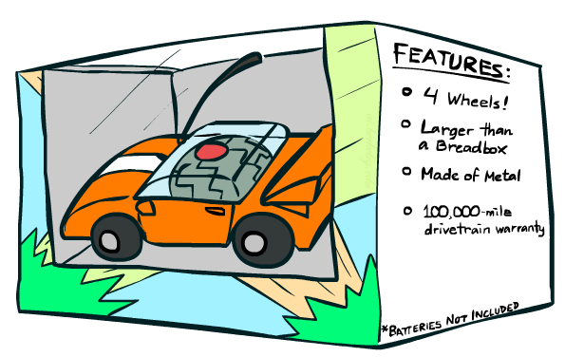
Features

Slide 28
Errors, and What to Do
Examples of errors
Dear GlobalSCAPE Customer,
GlobalSCAPE has partnered with ScanSoft to offer you the latest version of OmniPage Pro, for just $99.99* - the regular list price is $499! The most common question we've received about this offer is - Is this genuine? We would like to assure you that this offer is authorized by ScanSoft, is genuine and valid. You can get the . . .
. . . To receive your $30 Amazon.com promotional certificate, click through to
http://www.amazon.com/apparel
and see the prominent link for the $30 offer. All details are there. We hope you enjoyed receiving this message. However, if you'd rather not receive future e-mails announcing new store launches, please click . . .

Slide 29
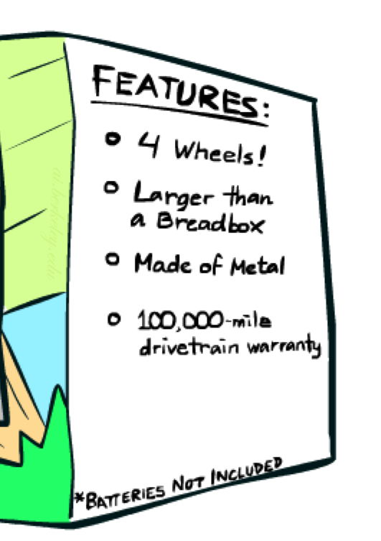
What to Do About Errors?
Need more features– words aren’t enough!
  Have you emailed the sender before?
  Have 1K other people just gotten the same email?
  Is the sending information consistent?
  Is the email in ALL CAPS?
  Do inline URLs point where they say they point?
  Does the email address you by (your) name?
Can add these information sources as new variables in the NB model
Next class we’ll talk about classifiers which let you easily add arbitrary features more easily

Slide 30
Baselines
First step: get a baseline
  Baselines are very simple “straw man” procedures
  Help determine how hard the task is
  Help know what a “good” accuracy is
Weak baseline: most frequent label classifier
  Gives all test instances whatever label was most common in the training set
  E.g. for spam filtering, might label everything as ham
  Accuracy might be very high if the problem is skewed
  E.g. calling everything “ham” gets 66%, so a classifier that gets 70% isn’t very good…
For real research, usually use previous work as a (strong) baseline

Slide 31
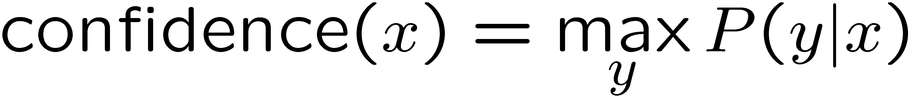

Confidences from a Classifier
The confidence of a probabilistic classifier:
  Posterior over the top label
  Represents how sure the classifier is of the classification
  Any probabilistic model will have confidences
  No guarantee confidence is correct
Calibration
  Weak calibration: higher confidences mean higher accuracy
  Strong calibration: confidence predicts accuracy rate
  What’s the value of calibration?

Slide 32
Summary
Bayes rule lets us do diagnostic queries with causal probabilities
The naïve Bayes assumption takes all features to be independent given the class label
We can build classifiers out of a naïve Bayes model using training data
Smoothing estimates is important in real systems
Classifier confidences are useful, when you can get them

Slide 33

Perceptrons and Logistic Regression

Slide 34
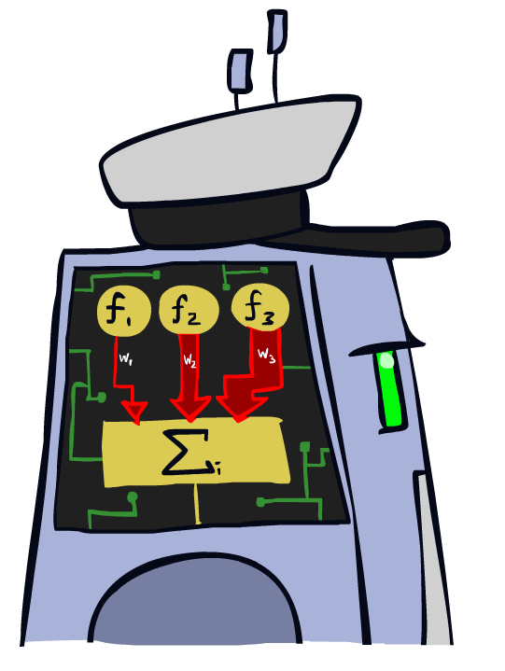
Linear Classifiers

Slide 35
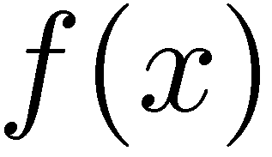

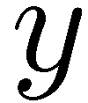

Feature Vectors
Hello,
Do you want free printr cartriges? Why pay more when you can get them ABSOLUTELY FREE! Just
# free : 2
YOUR_NAME : 0
MISSPELLED : 2
FROM_FRIEND : 0
...
SPAM
or
+
PIXEL-7,12 : 1
PIXEL-7,13 : 0
...
NUM_LOOPS : 1
...
“2”

Slide 36
Some (Simplified) Biology
Very loose inspiration: human neurons

Slide 37
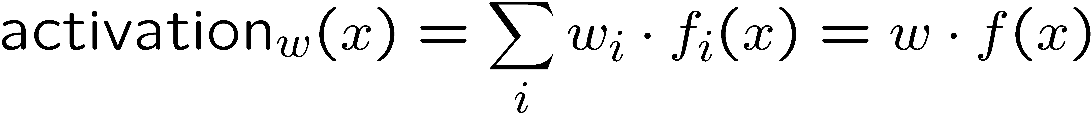
Linear Classifiers
Inputs are feature values
Each feature has a weight
Sum is the activation
If the activation is:
  Positive, output +1
  Negative, output -1
w₁
f₁
Σ
w₂
>0?
f₂
w₃
f₃

Slide 38

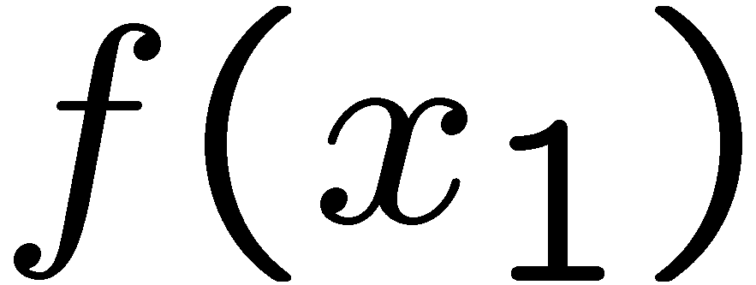
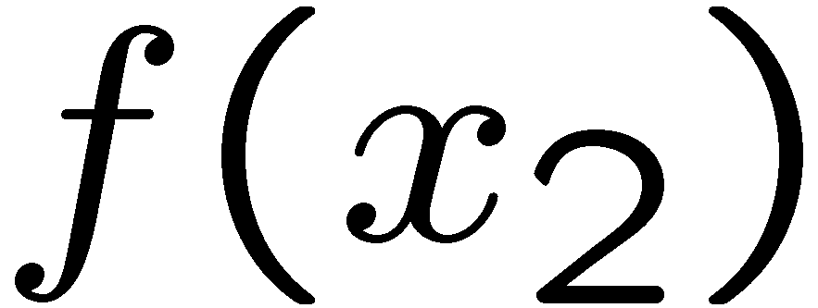
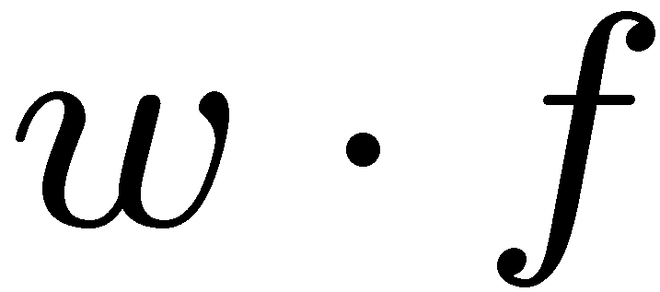
Weights
Binary case: compare features to a weight vector
Learning: figure out the weight vector from examples
# free : 4
YOUR_NAME :-1
MISSPELLED : 1
FROM_FRIEND :-3
...
# free : 2
YOUR_NAME : 0
MISSPELLED : 2
FROM_FRIEND : 0
...
# free : 0
YOUR_NAME : 1
MISSPELLED : 1
FROM_FRIEND : 1
...
Dot product positive means the positive class

Slide 39
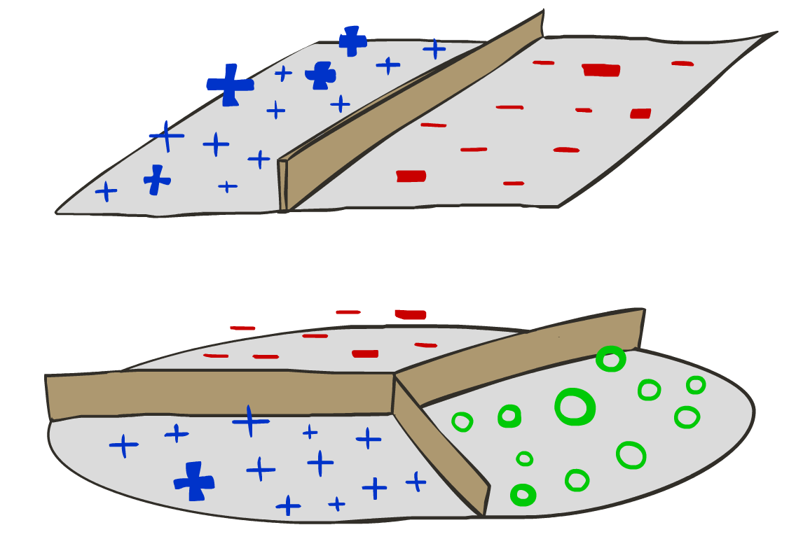
Decision Rules

Slide 40

Binary Decision Rule
In the space of feature vectors
  Examples are points
  Any weight vector is a hyperplane
  One side corresponds to Y=+1
  Other corresponds to Y=-1
money
2
1
BIAS : -3
free : 4
money : 2
...
0
0
1
free

Slide 41
Binary Decision Rule
In the space of feature vectors
  Examples are points
  Any weight vector is a hyperplane
  One side corresponds to Y=+1
  Other corresponds to Y=-1
money
2
1
BIAS : -3
free : 4
money : 2
...
0
0
1
free

Slide 42
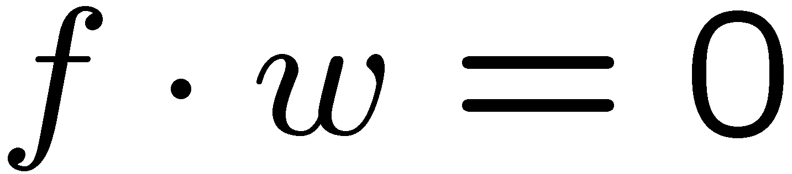
Binary Decision Rule
In the space of feature vectors
  Examples are points
  Any weight vector is a hyperplane
  One side corresponds to Y=+1
  Other corresponds to Y=-1
money
2
+1 = SPAM
1
BIAS : -3
free : 4
money : 2
...
0
-1 = HAM
0
1
free

Slide 43
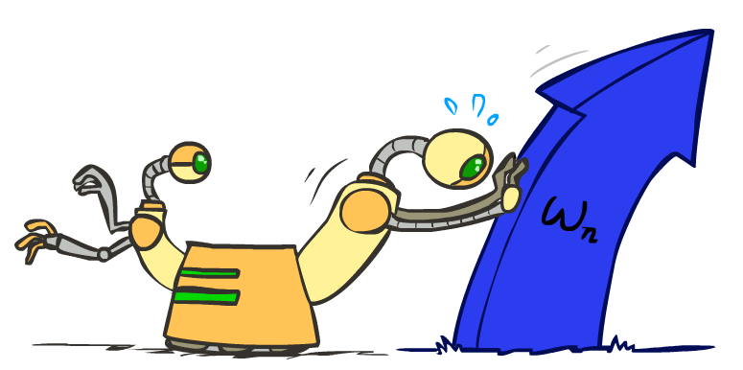
Weight Updates

Slide 44
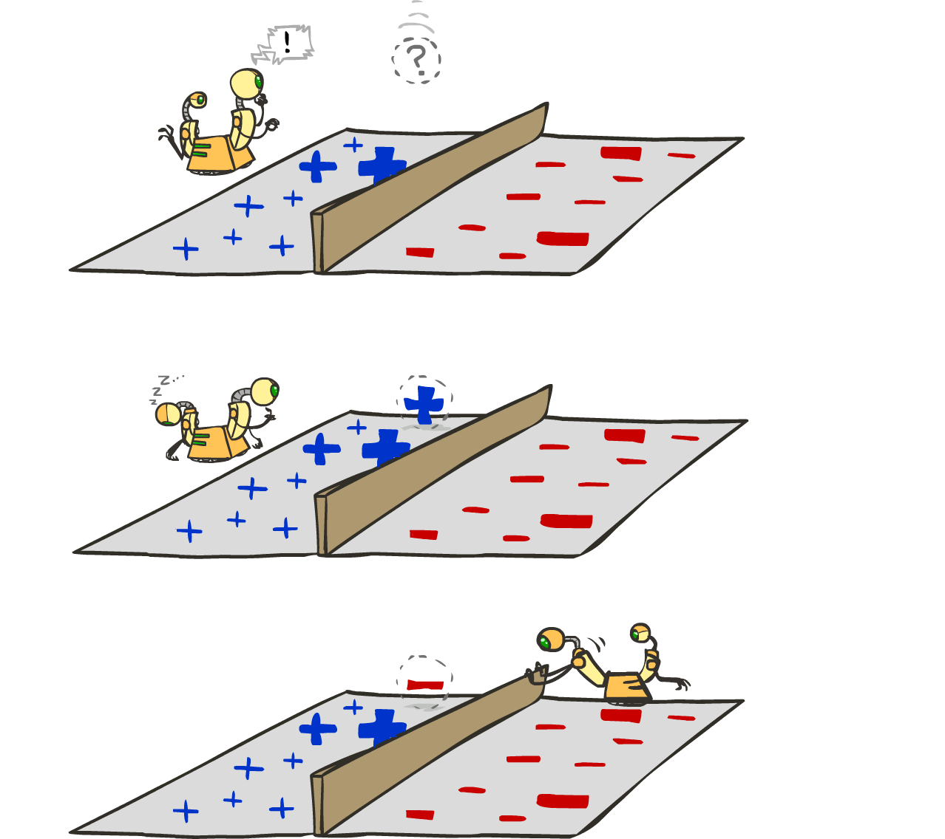
Learning: Binary Perceptron
Start with weights = 0
For each training instance:
  Classify with current weights
  If correct (i.e., y=y*), no change!
  If wrong: adjust the weight vector
Notes:
http://isl.ira.uka.de/neuralNetCourse/2004/VL_11_5/Perceptron.html

Slide 45




Learning: Binary Perceptron
Start with weights = 0
For each training instance:
  Classify with current weights
  If correct (i.e., y=y*), no change!
  If wrong: adjust the weight vector by adding or subtracting the feature vector. Subtract if y* is -1.
Before: w f
After: wf + y*f f
f f >=0
Notes:
http://isl.ira.uka.de/neuralNetCourse/2004/VL_11_5/Perceptron.html

Slide 46








Examples: Perceptron
Separable Case

Slide 47









Multiclass Decision Rule
If we have multiple classes:
  A weight vector for each class:
  Score (activation) of a class y:
  Prediction highest score wins
Binary = multiclass where the negative class has weight zero
Notes:
Picture only true for equal size ws; if we had a really big or really small w1 yellow are would change

Slide 48





Learning: Multiclass Perceptron
Start with all weights = 0
Pick up training examples one by one
Predict with current weights
If correct, no change!
If wrong: lower score of wrong answer, raise score of right answer

Slide 49



Example: Multiclass Perceptron
“win the vote”
[1 1 0 1 1]
“win the election”
[1 1 0 0 1]
“win the game”
[1 1 1 0 1]
3
0
1
-2
0
3
0
-2
BIAS : 1
win : 0
game : 0
vote : 0
the : 0
...
0
-1
0
-1
-1
1
0
1
-1
0
BIAS : 0
win : 0
game : 0
vote : 0
the : 0
...
1
1
0
1
1
0
0
-1
1
0
BIAS : 0
win : 0
game : 0
vote : 0
the : 0
...

Slide 50

Properties of Perceptrons
Separable
Separability: true if some parameters get the training set perfectly correct
Convergence: if the training is separable, perceptron will eventually converge (binary case)
Mistake Bound: the maximum number of mistakes (binary case) related to the margin or degree of separability
Non-Separable

Slide 51





Problems with the Perceptron
Noise: if the data isn’t separable, weights might thrash
  Averaging weight vectors over time can help (averaged perceptron)
Mediocre generalization: finds a “barely” separating solution
Overtraining: test / held-out accuracy usually rises, then falls
  Overtraining is a kind of overfitting

Slide 52

Improving the Perceptron

