Slide 1
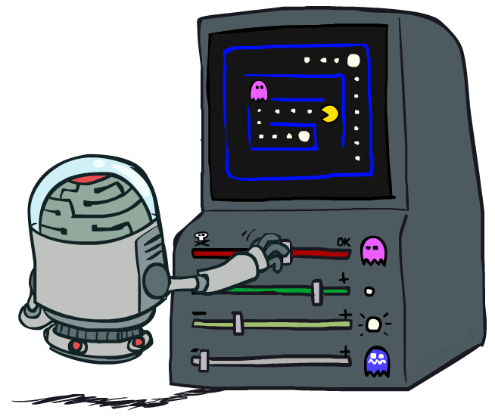
CS 188: Artificial Intelligence
Reinforcement Learning II
Instructor: Nathan Lambert, University of California, Berkeley
[These slides were created by Dan Klein, Pieter Abbeel, Anca Dragan, and Nathan Lambert. http://ai.berkeley.edu.]
Notes:
Please retain proper attribution and the reference to ai.berkeley.edu. Thanks!

Slide 2
Reinforcement Learning
We still assume an MDP:
A set of states s ∈ S
A set of actions (per state) A
A model T(s,a,s’)
A reward function R(s,a,s’)
Still looking for a policy π(s)
New twist: don’t know T or R, so must try out actions
Big idea: Compute all averages over T using sample outcomes

Slide 3
The Story So Far: MDPs and RL
Known MDP: Offline Solution
Goal Technique
Compute V*, Q*, π* Value / policy iteration
Evaluate a fixed policy π Policy evaluation
Unknown MDP: Model-Based
Unknown MDP: Model-Free
Goal Technique
Compute V*, Q*, π* VI/PI on approx. MDP
Evaluate a fixed policy π PE on approx. MDP
Goal Technique
Compute V*, Q*, π* Q-learning
Evaluate a fixed policy π Value Learning

Slide 4
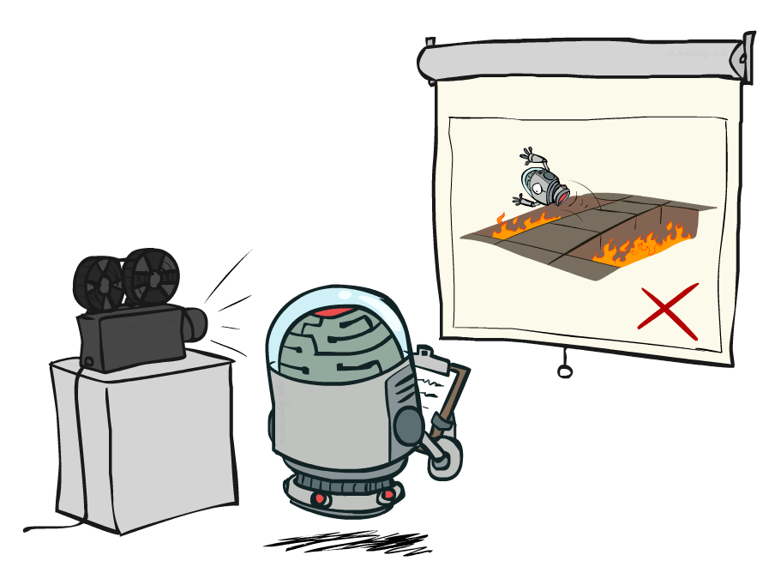
The Story So Far: Model-Free RL
Passive Reinforcement Learning
Goal: Learn state-values
Direct Evaluation
Learn state-values in a batch from samples
Temporal Difference Models
Iteratively learning state-values after each episode
Incremental update leans towards convergence
Q-Learning
Iterating on policy-conditioned values is challenging
What is a better way to get a policy from utility estimate?

Slide 5
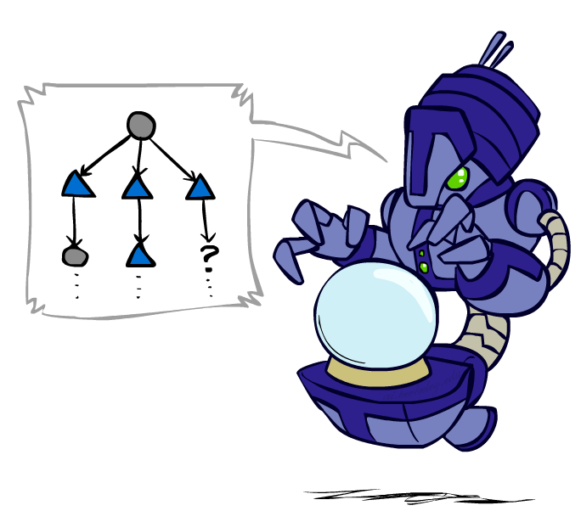
Sample-Based Policy Evaluation?
We want to improve our estimate of V by computing these averages:
Idea: Take samples of outcomes s’ (by doing the action!) and average
s
π(s)
s, π(s)
s, π(s),s’
s₁'
s₂'
s'
s₃'
Almost! But we can’t rewind time to get sample after sample from state s.
Notes:
If we could do this, we would be implementing the policy evaluation update

Slide 6
Model-Free Learning
s
Model-free (temporal difference) learning
Experience world through episodes
Update estimates each transition
Over time, updates will mimic Bellman updates
a
s, a
r
s’
a’
s’, a’
s’’

Slide 7
Temporal Difference Learning
Temporal difference learning of values
Policy still fixed, still doing evaluation!
Move values toward value of whatever successor occurs: running average
s
π(s)
s, π(s)
s’
Sample of V(s):
Update to V(s):

Slide 8
Example: Temporal Difference Learning
States
Observed Transitions
B, east, C, -2
C, east, D, -2
 | A
B | C | D
 | E
 | 0
0 | 0 | 8
 | 0
 | 0
-1 | 0 | 8
 | 0
 | 0
-1 | 3 | 8
 | 0
Assume: γ = 1, α = 1/2

Slide 9
Approximating Values through Samples
Policy Evaluation:
Value Iteration:
Q-Value Iteration:

Slide 10
Q-Learning
Q-Learning: sample-based Q-value iteration
Learn Q(s,a) values as you go
Receive a sample (s,a,s’,r)
Consider your old estimate:
Consider your new sample estimate:
Incorporate the new estimate into a running average:
no longer policy evaluation!
[Demo: Q-learning – gridworld (L10D2)]
[Demo: Q-learning – crawler (L10D3)]

Slide 11
Video of Demo Q-Learning -- Gridworld

Slide 12
Video of Demo Q-Learning -- Crawler

Slide 13
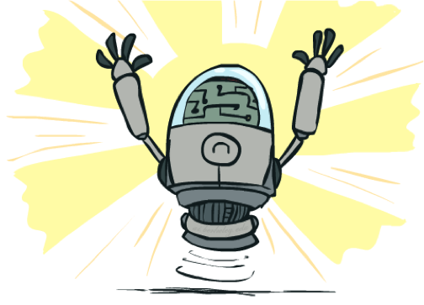
Q-Learning Properties
Amazing result: Q-learning converges to optimal policy -- even if you’re acting suboptimally!
This is called off-policy learning
Caveats:
You have to explore enough
You have to eventually make the learning rate
small enough
… but not decrease it too quickly
Basically, in the limit, it doesn’t matter how you select actions (!)
[Demo: Q-learning – auto – cliff grid (L11D1)]
Notes:
Ofc you can figure out how well youre doing; but q learning tells you how well optimal actions are doing

Slide 14
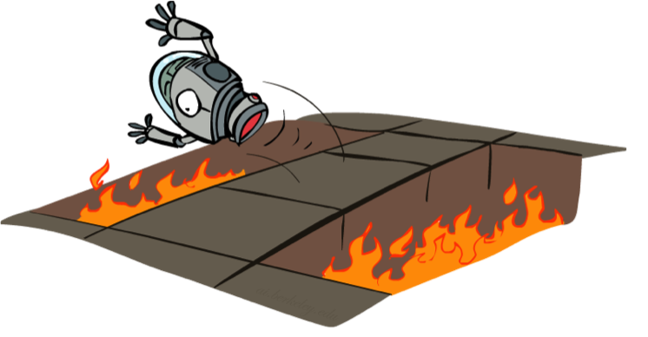
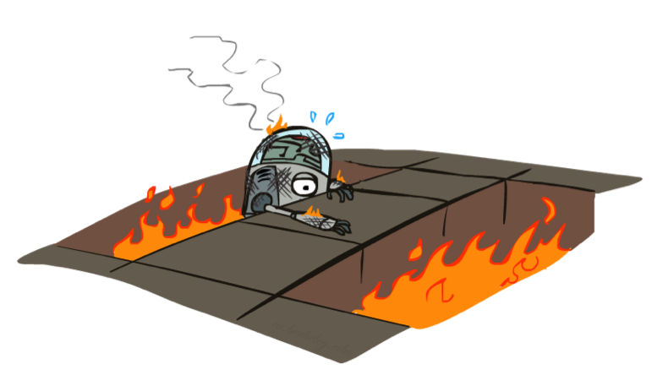
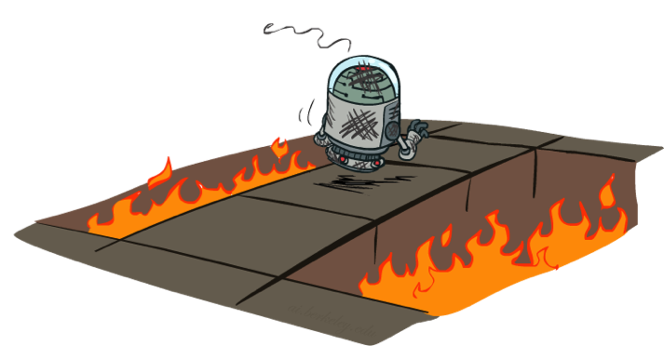
Active Reinforcement Learning

Slide 15
RL: Helicopter Flight
[Andrew Ng]
[Video: HELICOPTER]

Slide 16
RL: Learning Locomotion
[Schulman, Moritz, Levine, Jordan, Abbeel, ICLR 2016]
[Video: GAE]

Slide 17
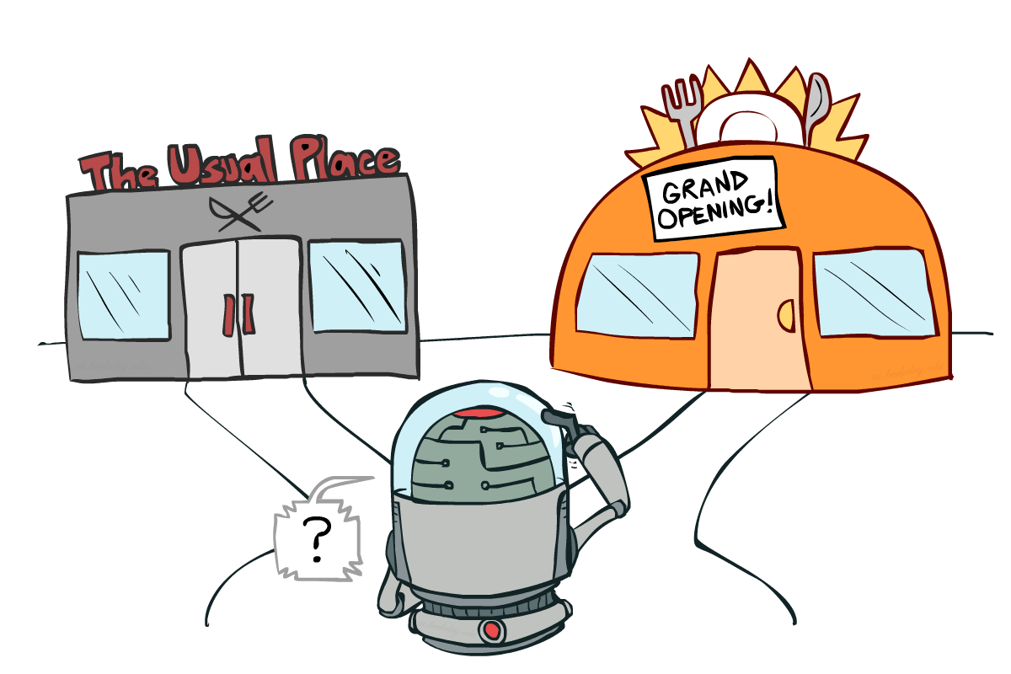
Exploration vs. Exploitation
http://bit.ly/188lec14explore
Notes:
might be missing out on your favorite restaurant till end of time

Slide 18
Video of Demo Q-learning – Manual Exploration – Bridge Grid
http://bit.ly/188lec14explore

Slide 19
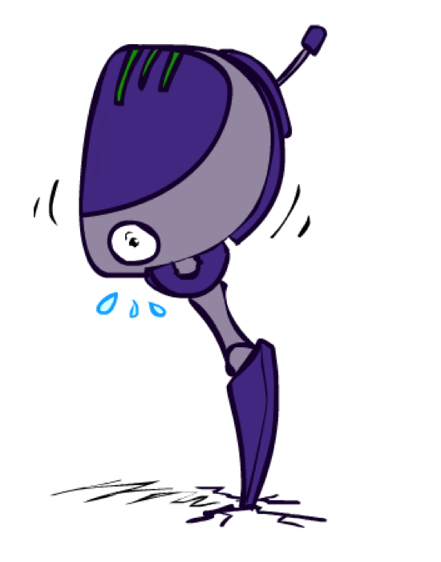
How to Explore?
http://bit.ly/188lec14explore
Several schemes for forcing exploration
Simplest: random actions (ε-greedy)
Every time step, flip a coin
With (small) probability ε, act randomly
With (large) probability 1-ε, act on current policy
Problems with random actions?
You do eventually explore the space, but keep thrashing around once learning is done
One solution: lower ε over time
Another solution: exploration functions
[Demo: Q-learning – manual exploration – bridge grid (L11D2)] [Demo: Q-learning – epsilon-greedy -- crawler (L11D3)]
Notes:
you eventually learn the right thing but still thrash around

Slide 20
Video of Demo Q-learning – Epsilon-Greedy – Crawler

Slide 21
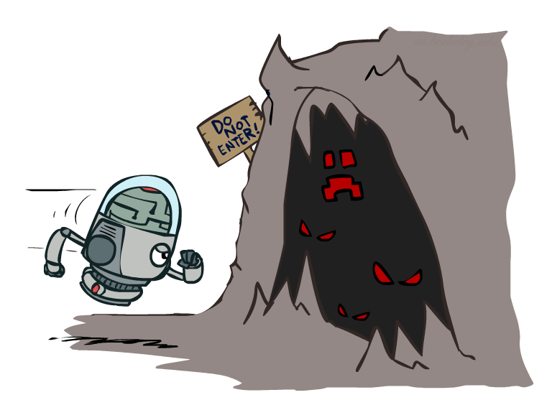
Exploration Functions
When to explore?
Random actions: explore a fixed amount
Better idea: explore areas whose badness is not
(yet) established, eventually stop exploring
Exploration function
Takes a value estimate u and a visit count n, and
returns an optimistic utility, e.g.
Note: this propagates the “bonus” back to states that lead to unknown states as well!
Regular Q-Update:
Modified Q-Update:
[Demo: exploration – Q-learning – crawler – exploration function (L11D4)]
Notes:
Optimism in the face of uncertainty

Slide 22
Video of Demo Q-learning – Exploration Function – Crawler

Slide 23
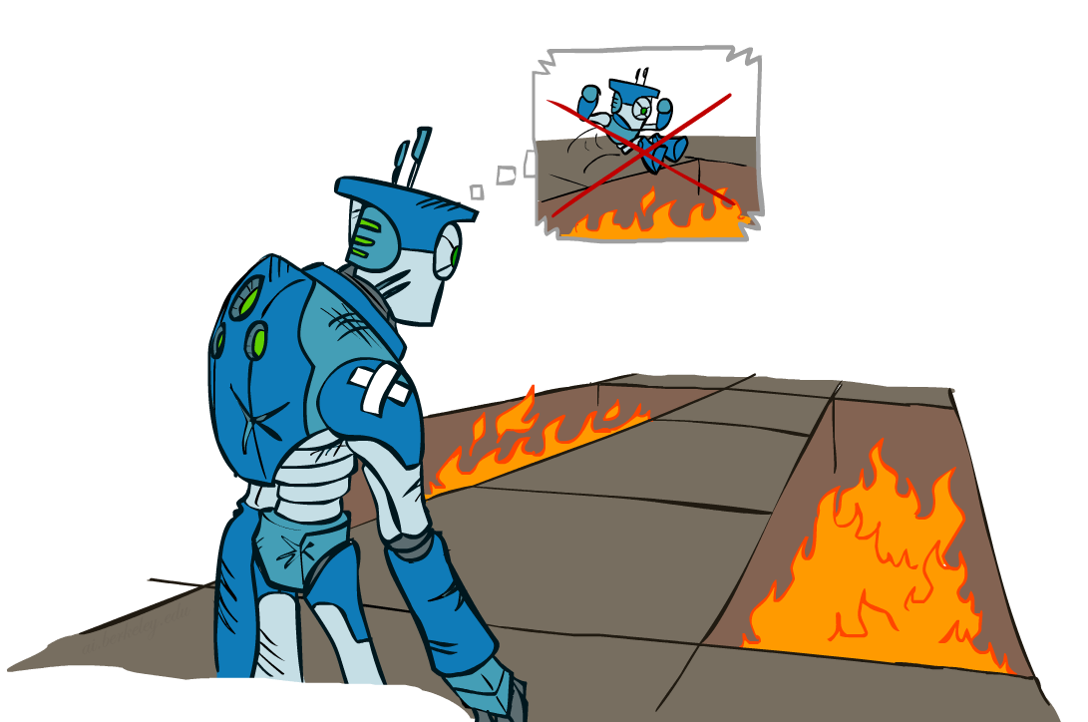
Regret
Even if you learn the optimal policy, you still make mistakes along the way!
Regret is a measure of your total mistake cost: the difference between your (expected) rewards, including youthful suboptimality, and optimal (expected) rewards
Minimizing regret goes beyond learning to be optimal – it requires optimally learning to be optimal
Example: random exploration and exploration functions both end up optimal, but random exploration has higher regret

Slide 24
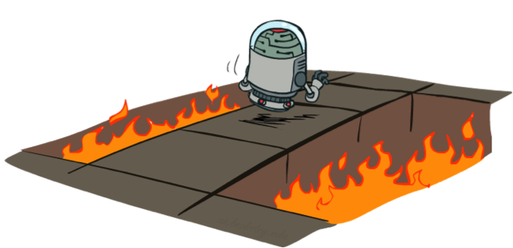
Discuss: Model-Free Learning
act according to current optimal (based on Q-Values)
but also explore…

Slide 25
Discuss: Model-Based Learning
Input Policy π
act according to current optimal
also explore!
 | A
B | C | D
 | E

Slide 26
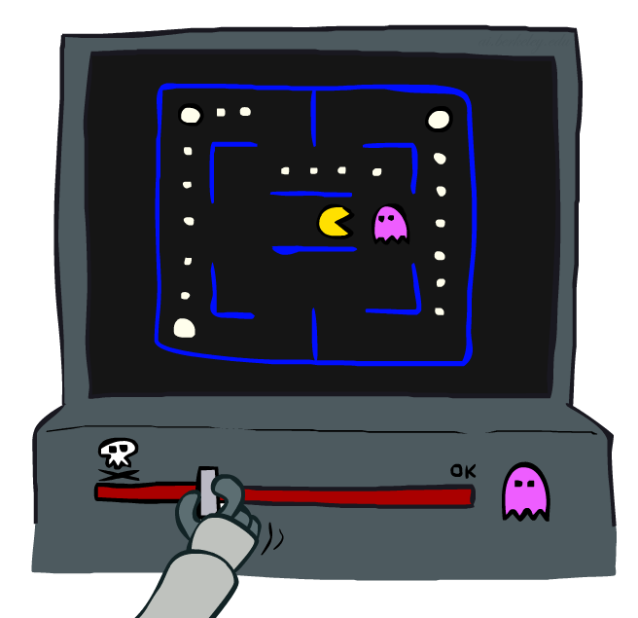
Approximate Q-Learning

Slide 27
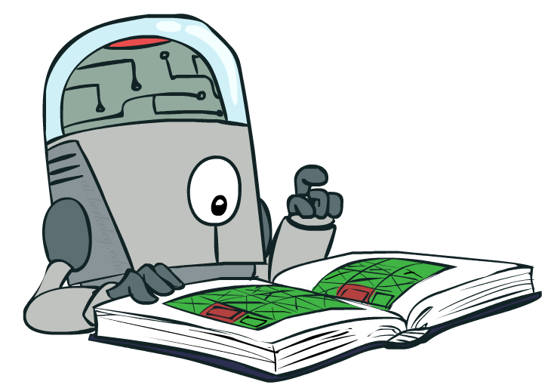
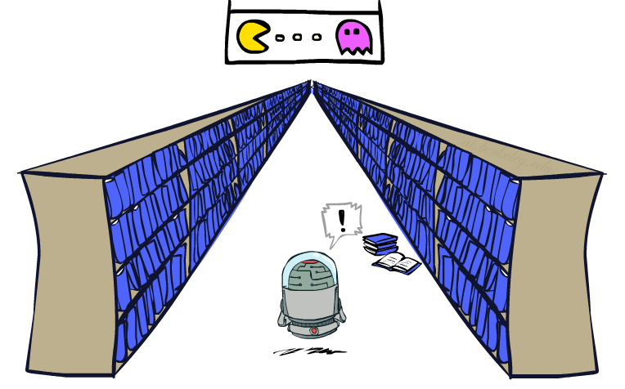
Generalizing Across States
Basic Q-Learning keeps a table of all q-values
In realistic situations, we cannot possibly learn about every single state!
Too many states to visit them all in training
Too many states to hold the q-tables in memory
Instead, we want to generalize:
Learn about some small number of training states from experience
Generalize that experience to new, similar situations
This is a fundamental idea in machine learning, and we’ll see it over and over again
[demo – RL pacman]

Slide 28
Example: Pacman
Let’s say we discover through experience that this state is bad:
In naïve q-learning, we know nothing about this state:
Or even this one!
[Demo: Q-learning – pacman – tiny – watch all (L11D5)]
[Demo: Q-learning – pacman – tiny – silent train (L11D6)]
[Demo: Q-learning – pacman – tricky – watch all (L11D7)]

Slide 29
Video of Demo Q-Learning Pacman – Tiny – Watch All

Slide 30
Video of Demo Q-Learning Pacman – Tiny – Silent Train

Slide 31
Video of Demo Q-Learning Pacman – Tricky – Watch All

