Slide 1
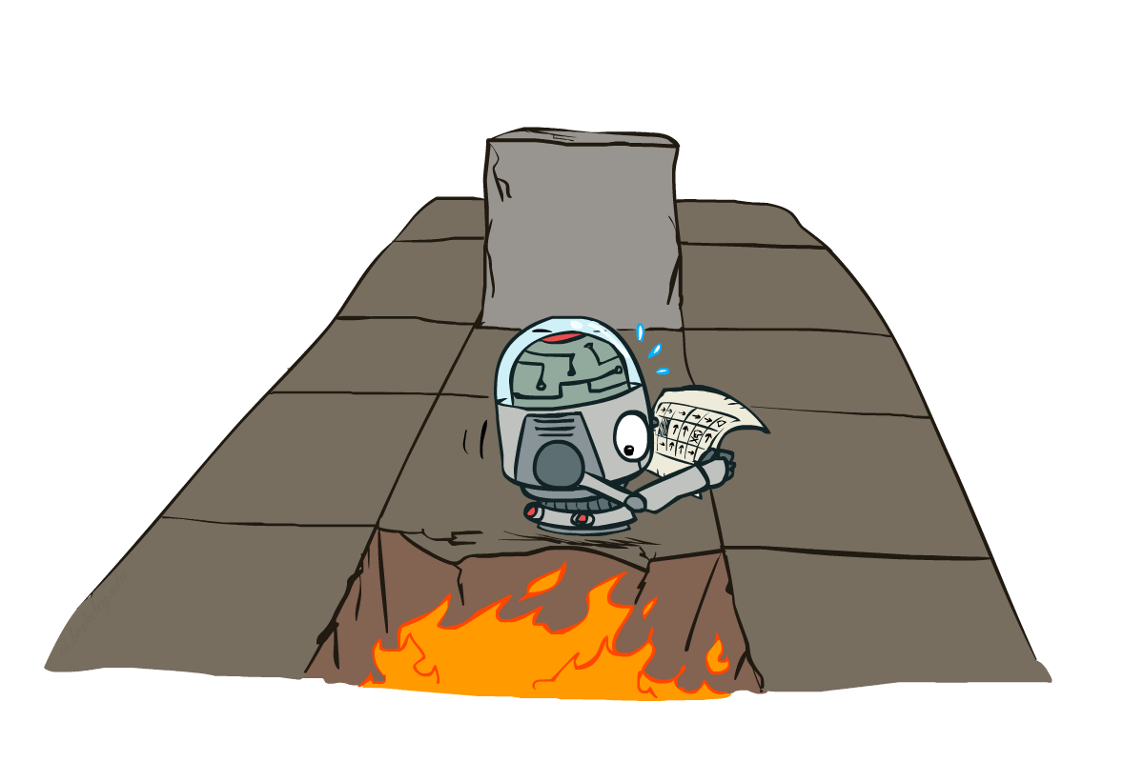
CS 188: Artificial Intelligence
Markov Decision Processes III + RL
Instructor: Nathan Lambert
University of California, Berkeley
Notes:
Please retain proper attribution, including the reference to ai.berkeley.edu. Thanks!

Slide 2

Recap: Defining MDPs
Markov decision processes:
  Set of states S
  Start state s₀
  Set of actions A
  Transitions P(s’|s,a) (or T(s,a,s’))
  Rewards R(s,a,s’) (and discount γ)
MDP quantities so far:
  Policy = Choice of action for each state
  Utility = sum of (discounted) rewards
s
a
s, a
s,a,s’
s’

Slide 3
Values of States
Recursive definition of value:
s
a
s, a
s,a,s’
s’

Slide 4
Value Iteration
Start with V₀(s) = 0: no time steps left means an expected reward sum of zero
Given vector of V_{k}(s) values, do one ply of expectimax from each state:
Repeat until convergence
(Complexity of each iteration: O(S²A) )
V_{k+1}(s)
a
s, a
s,a,s’
V_{k}(s’)
Notes:
Discuss computational complexity: S * A * S times number of iterations
Note: updates not in place

Slide 5
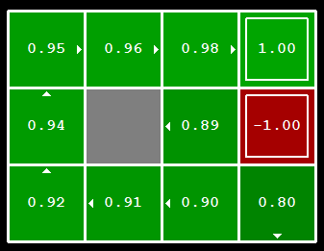


Computing Actions from Values
Let’s imagine we have the optimal values V*(s)
How should we act?
  It’s not obvious!
We need to do a mini-expectimax (one step)
This is called policy extraction, since it gets the policy implied by the values

Slide 6

Policy Evaluation
s
How do we calculate the V’s for a fixed policy π?
Idea 1: Turn recursive Bellman equations into updates
(like value iteration)
Efficiency: O(S²) per iteration
Idea 2: Without the maxes, the Bellman equations are just a linear system
  Solve with Matlab (or your favorite linear system solver)
π(s)
s, π(s)
s, π(s),s’
s’

Slide 7
Policy Iteration
Evaluation: For fixed current policy π, find values with policy evaluation:
  Iterate until values converge:
Improvement: For fixed values, get a better policy using policy extraction
  One-step look-ahead:

Slide 8
Comparison
Both value iteration and policy iteration compute the same thing (all optimal values)
In value iteration:
  Every iteration updates both the values and (implicitly) the policy
  We don’t track the policy, but taking the max over actions implicitly recomputes it
In policy iteration:
  We do several passes that update utilities with fixed policy (each pass is fast because we consider only one action, not all of them)
  After the policy is evaluated, a new policy is chosen (slow like a value iteration pass)
  The new policy will be better (or we’re done)
Both are dynamic programs for solving MDPs

Slide 9
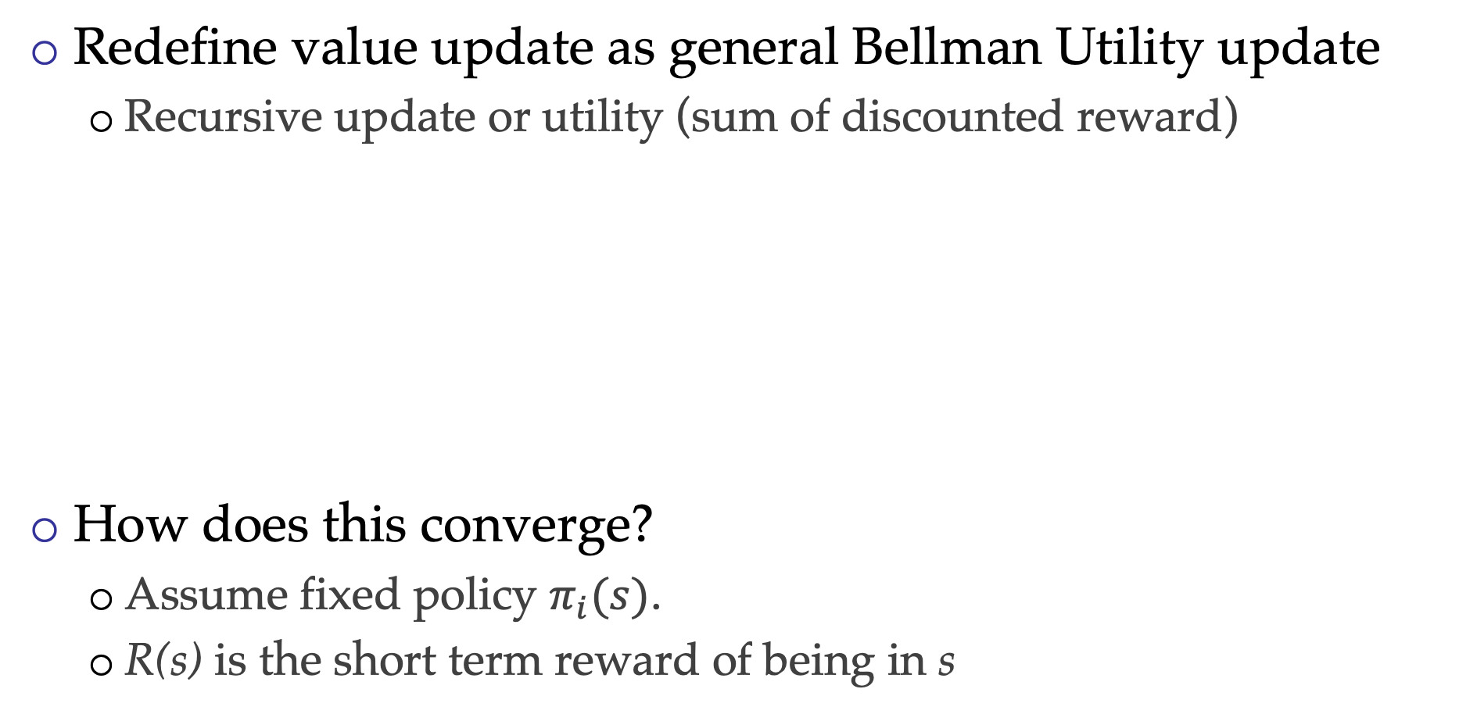
Convergence when Solving MDPs
Redefine value update as general Bellman Utility update
  Recursive update or utility (sum of discounted reward)
How does this converge?
  Assume fixed policy $π_{i}(s)$.
  R(s) is the short term reward of being in s

Slide 10
Convergence when Solving MDPs
How does this update rule converge?
Re-write update:
  B is a linear operator (like a matrix)
  U is a vector
Interested in delta between Utilities:

Slide 11
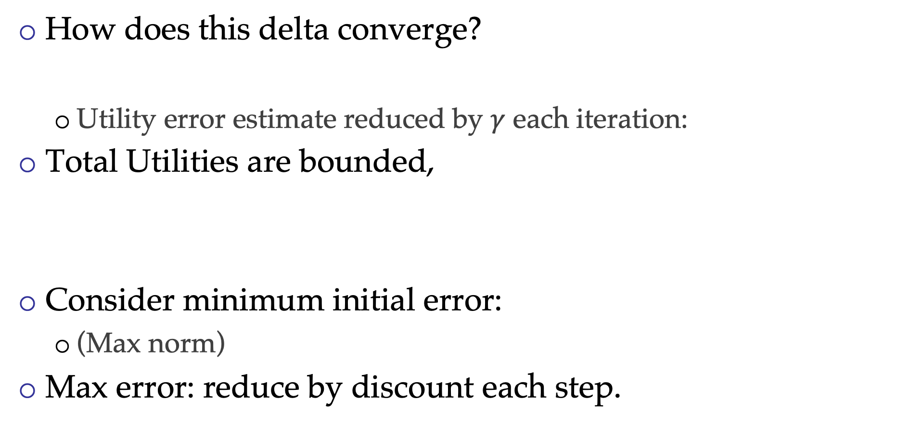
Convergence when Solving MDPs
How does this delta converge?
  Utility error estimate reduced by $γ$ each iteration:
Total Utilities are bounded,
Consider minimum initial error:
  (Max norm)
Max error: reduce by discount each step.

Slide 12

Utility Error Bound
Error at step 0:
Error at step N:
Steps for error below $ε$:

Slide 13
MDP Convergence Visualized
Value iteration converges exponentially (with discount factor)
Policy iteration will converge linearly to 0.

Slide 14
Summary: MDP Algorithms
So you want to….
  Compute optimal values: use value iteration or policy iteration
  Compute values for a particular policy: use policy evaluation
  Turn your values into a policy: use policy extraction (one-step lookahead)
These all look the same!
  They basically are – they are all variations of Bellman updates
  They all use one-step lookahead expectimax fragments
  They differ only in whether we plug in a fixed policy or max over actions

Slide 15
Partially Observed MDPs
How accurate is our model of MDPs?
  Example: Robot
  Example: Video game
Do the pixels constitute all the information of a system?
  Notion of observing some states!
  Belief distribution
Partially Observed MDP (POMDP)

Slide 16
Partially Observed MDPs
How accurate is our model of MDPs?
  Example: Robot
  Example: Video game
Do the pixels constitute all the information of a system?
  Notion of observing some states!
  Belief distribution over true states (from observations)
Partially Observed MDP (POMDP)

Slide 17
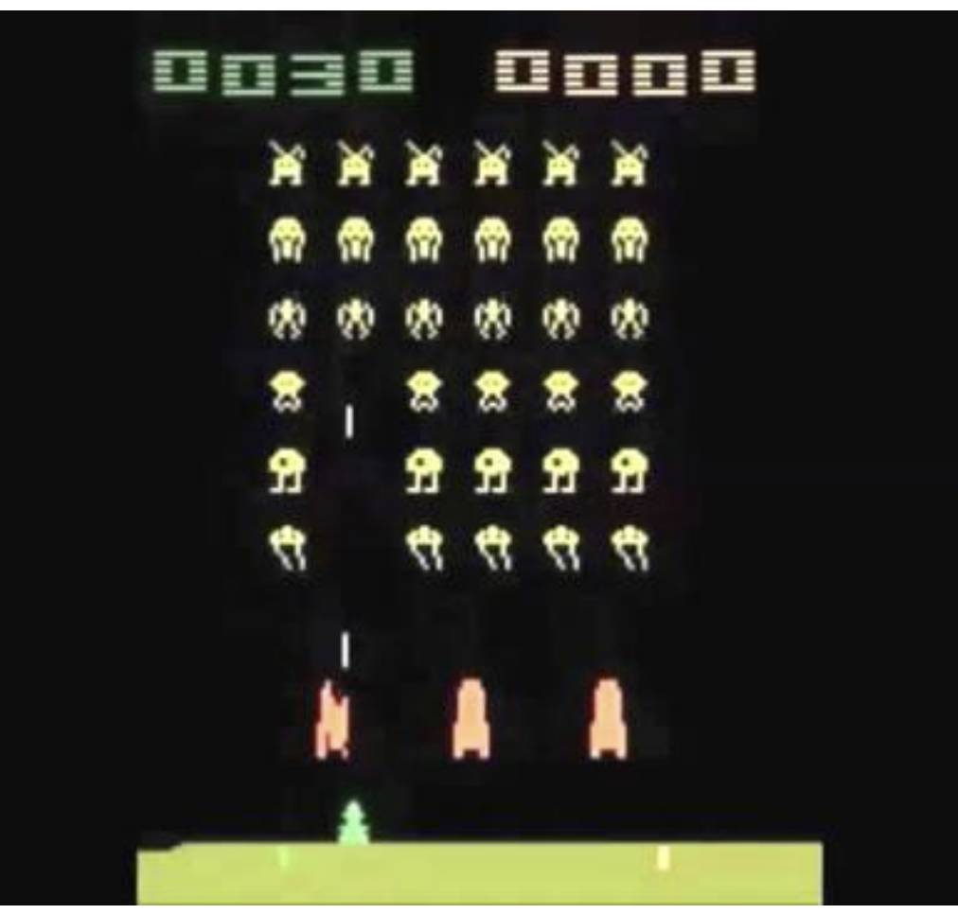
Partially Observed MDPs
Consider an example:
  Finite number of pixels
  Finite number of actions
  Finite number of timesteps
  Huge state-space.
Can we solve an MDP with observations instead of states?
  How is this solved?
  Deep Q-learning (approximate Q values)
  Are the transitions and reward functions known?

Slide 18
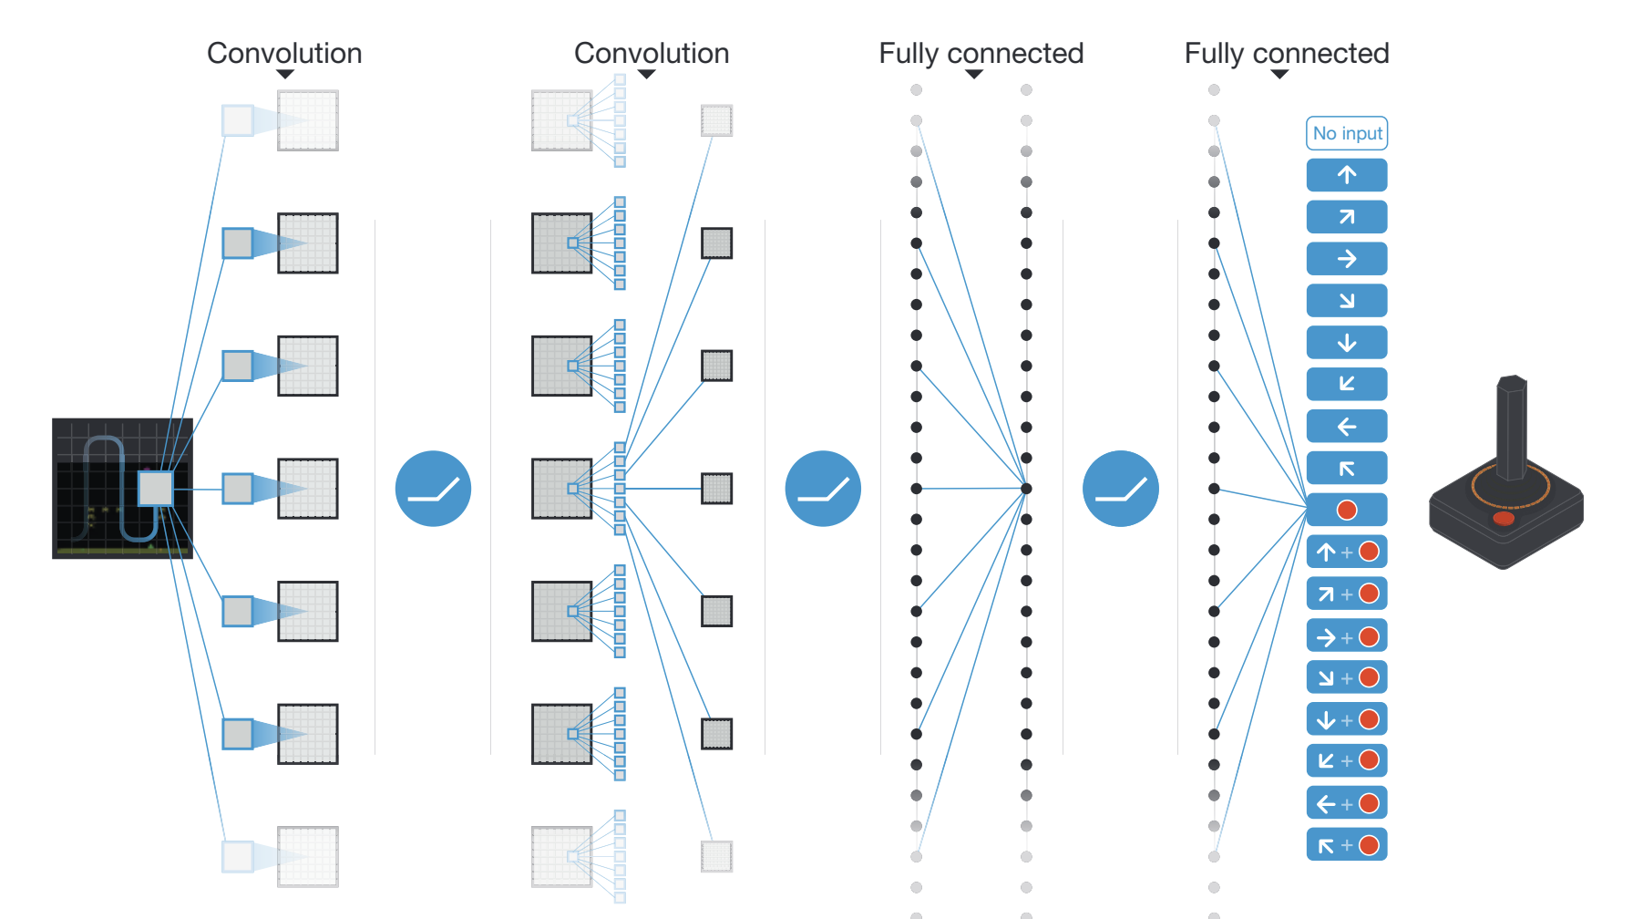
Seminal Paper
Mnih, Volodymyr, et al. "Human-level control through deep reinforcement learning." Nature 518.7540 (2015): 529-533.

Slide 19

DeepMind Atari (©Two Minute Lectures)

Slide 20
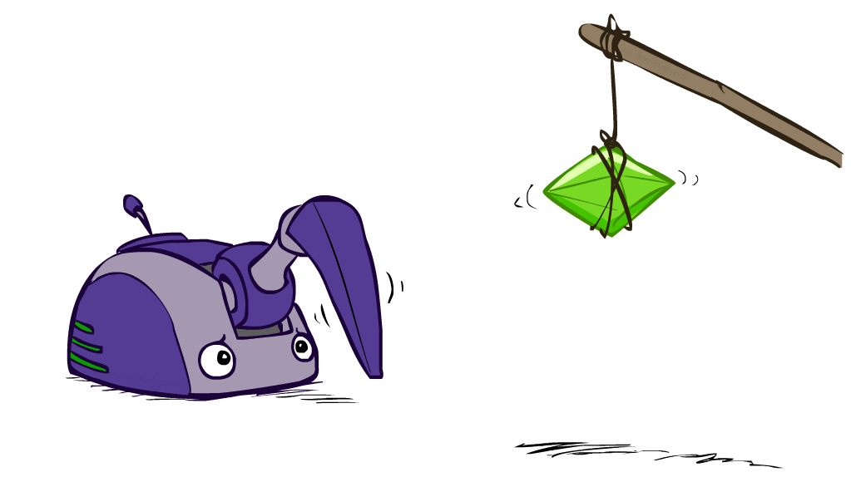
Reinforcement Learning

Slide 21
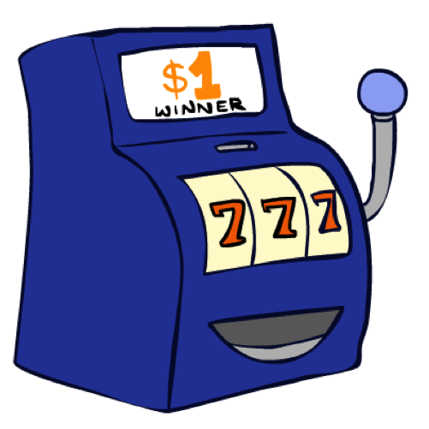
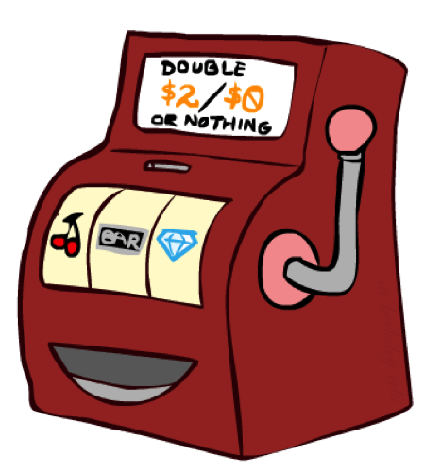

Double Bandits

Slide 22
Double-Bandit MDP
Actions: Blue, Red
States: Win, Lose
No discount
10 time steps
Both states have the same value
0.25 $0
0.75
$2
W
L
0.25
$0
$1
1.0
$1
1.0
0.75 $2

Slide 23
Offline Planning
Solving MDPs is offline planning
  You determine all quantities through computation
  You need to know the details of the MDP
  You do not actually play the game!
No discount
10 time steps
Both states have the same value
0.25 $0
Value
0.75
$2
W
0.25
$0
Play Red
15
L
$1
1.0
$1
1.0
0.75 $2
Play Blue
10
Notes:
Did we play the game yet? No, we just thought really hard about what to do. Did we get 150? No.

Slide 24
Let’s Play!
$2
$2
$0
$2
$2
$2
$2
$0
$0
$0
Notes:
The playing actually happened! Real fake money!

Slide 25
Online Planning
Rules changed! Red’s win chance is different.
?? $0
??
$2
W
L
??
$0
$1
1.0
$1
1.0
?? $2
Notes:
Whats the optimal policy? We don’t know the mdp so no offline planning. What do we do? Give up and go home?

Slide 26
Let’s Play!
$2
$2
$2
$0
$0
$0
$0
$0
$0
$2
Notes:
Need to spend money to figure out what’s optimal

Slide 27
What Just Happened?
That wasn’t planning, it was learning!
  Specifically, reinforcement learning
  There was an MDP, but you couldn’t solve it with just computation
  You needed to actually act to figure it out
Important ideas in reinforcement learning that came up
  Exploration: you have to try unknown actions to get information
  Exploitation: eventually, you have to use what you know
  Regret: even if you learn intelligently, you make mistakes
  Sampling: because of chance, you have to try things repeatedly
  Difficulty: learning can be much harder than solving a known MDP

Slide 28
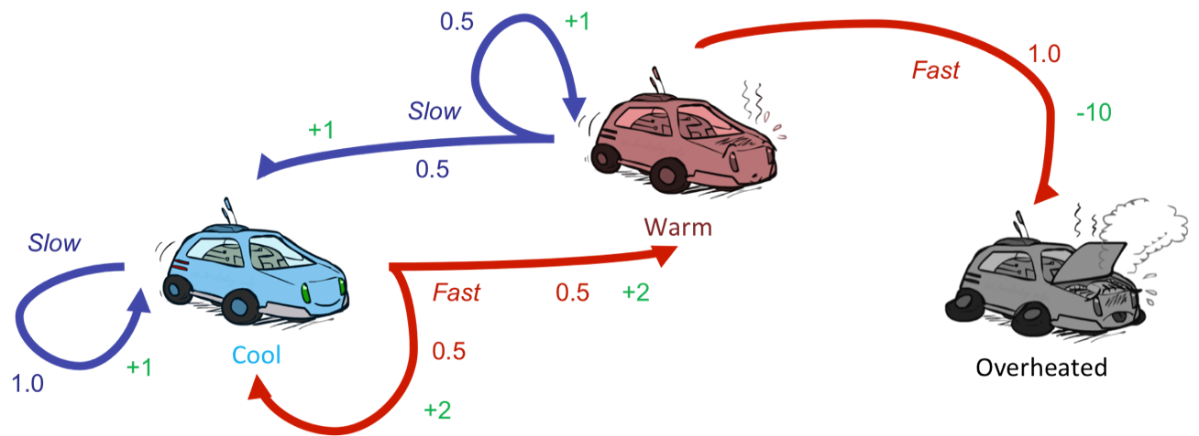
Reinforcement Learning
Still assume a Markov decision process (MDP):
  A set of states s ∈ S
  A set of actions (per state) A
  A model T(s,a,s’)
  A reward function R(s,a,s’)
Still looking for a policy π(s)
New twist: don’t know T or R
  I.e. we don’t know which states are good or what the actions do
  Must actually try actions and states out to learn

Slide 29
Reinforcement Learning
Agent
State: s
Reward: r
Actions: a
Environment
Basic idea:
  Receive feedback in the form of rewards
  Agent’s utility is defined by the reward function
  Must (learn to) act so as to maximize expected rewards
  All learning is based on observed samples of outcomes!

Slide 30
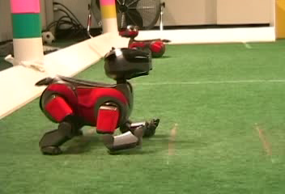
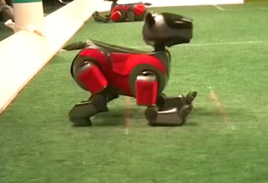
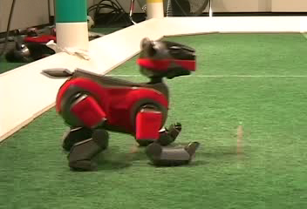
Example: Learning to Walk
Initial
A Learning Trial
After Learning [1K Trials]
[Kohl and Stone, ICRA 2004]

Slide 31

Example: Learning to Walk
Initial
[Kohl and Stone, ICRA 2004]
[Video: AIBO WALK – initial]

Slide 32

Example: Learning to Walk
Training
[Kohl and Stone, ICRA 2004]
[Video: AIBO WALK – training]

Slide 33

Example: Learning to Walk
Finished
[Kohl and Stone, ICRA 2004]
[Video: AIBO WALK – finished]

Slide 34
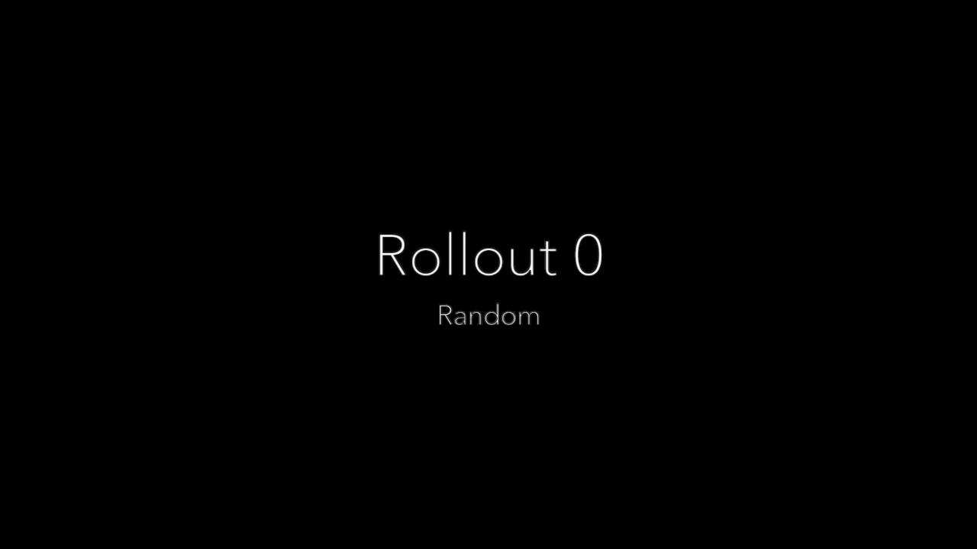
Example: Learning to Fly
[Lambert et. al, RA-L 2019]
[Video: quad-fly]

Slide 35
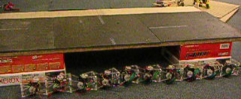
Example: Sidewinding
[Andrew Ng]
[Video: SNAKE – climbStep+sidewinding]

Slide 36
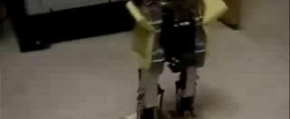
Example: Toddler Robot
[Tedrake, Zhang and Seung, 2005]
[Video: TODDLER – 40s]

Slide 37
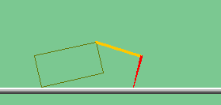
The Crawler!
[Demo: Crawler Bot (L10D1)] [You, in Project 3]
Notes:
Hard because at times it gets not reward as it is repositioning its arm

Slide 38
Video of Demo Crawler Bot

Slide 39
Reinforcement Learning
Still assume a Markov decision process (MDP):
  A set of states s ∈ S
  A set of actions (per state) A
  A model T(s,a,s’)
  A reward function R(s,a,s’)
Still looking for a policy π(s)
New twist: don’t know T or R
  I.e. we don’t know which states are good or what the actions do
  Must actually try actions and states out to learn
  Get ‘measurement’ of R at each step

Slide 40
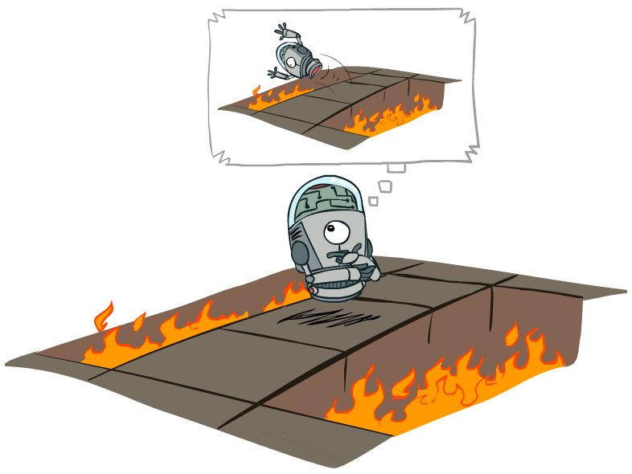
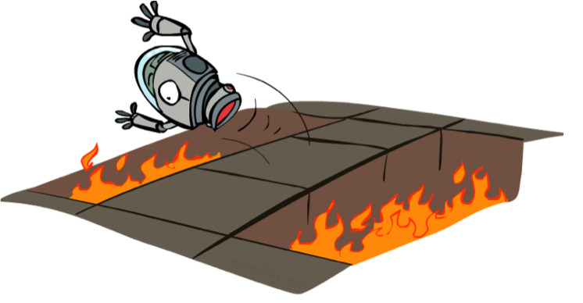
Offline (MDPs) vs. Online (RL)
Offline Solution
Online Learning

Slide 41
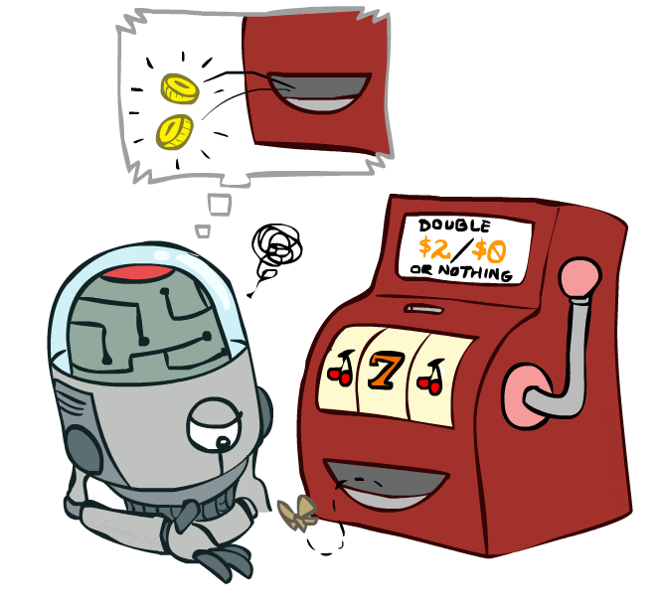
Model-Free Learning

Slide 42

Model-Based Learning

Slide 43
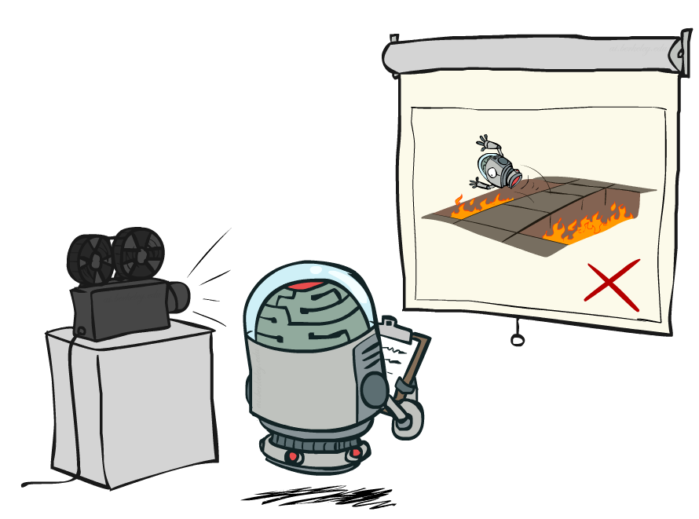
Passive Reinforcement Learning

