Slide 1

CS 188: Artificial Intelligence
Markov Decision Processes
Instructor: Nathan Lambert
University of California, Berkeley
Notes:
Please retain proper attribution, including the reference to ai.berkeley.edu. Thanks!
Community building, link gaming. Videos are hard.

Slide 2

Non-Deterministic Search
http://bit.ly/188lec10mdp
Notes:
Why uncertain? Maybe robot on the ledge, what will happen?

Slide 3

Recap: Defining MDPs
Markov decision processes:
  Set of states S
  Start state s₀
  Set of actions A
  Transitions P(s’|s,a) (or T(s,a,s’))
  Rewards R(s,a,s’) (and discount γ)
MDP quantities so far:
  Policy = Choice of action for each state
  Utility = sum of (discounted) rewards
s
a
s, a
s,a,s’
s’

Slide 4

Policies
In deterministic single-agent search problems, we wanted an optimal plan, or sequence of actions, from start to a goal
For MDPs, we want an optimal
policy π*: S → A
  A policy π gives an action for each state
  An optimal policy is one that maximizes expected utility if followed
  An explicit policy defines a reflex agent
Optimal policy when R(s, a, s’) = -0.03 for all non-terminals s
Notes:
In search, we could make a plan
Here, we think about what to do in a state.
Clear that it is a function mapping from states to actions.
Star means optimal (more later).

Slide 5





Discounting
How to discount?
  Each time we descend a level, we multiply in the discount once
Why discount?
  Think of it as a gamma chance of ending the process at every step
  Also helps our algorithms converge
Example: discount of 0.5
  U([1,2,3]) = 1*1 + 0.5*2 + 0.25*3
  U([1,2,3]) < U([3,2,1])
Notes:
Rewards in the future (deeper in the tree) matter less
Interesting: running expectimax, if having to truncate the search, then not losing much; e.g., less then \gamma^d / (1-\gamma)
Augment q states with another option: instant death!
Repeated loop, difference from search, is a win. Distinction of visiting a state.
Do the example.

Slide 6
Solving MDPs

Slide 7




Racing Search Tree

Slide 8




Racing Search Tree

Slide 9
Racing Search Tree
We’re doing way too much work with expectimax!
Problem: States are repeated
  Idea: Only compute needed quantities once
Problem: Tree goes on forever
  Idea: Do a depth-limited computation, but with increasing depths until change is small
  Note: deep parts of the tree eventually don’t matter if γ < 1

Slide 10
Optimal Quantities
The value (utility) of a state s:
  V*(s) = expected utility starting in s and acting optimally
The value (utility) of a q-state (s,a):
  Q*(s,a) = expected utility starting out having taken action a from state s and (thereafter) acting optimally
The optimal policy:
  π*(s) = optimal action from state s
s
s is a state
a
(s, a) is a q-state
s, a
s,a,s’
(s,a,s’) is a
transition
s’
[Demo – gridworld values (L8D4)]
Notes:
[Note: this demo doesn’t show anything in action, just pops up V and Q values.]

Slide 11

Snapshot of Demo – Gridworld V Values
Noise = 0.2
Discount = 0.9
Living reward = 0
Notes:
This demo doesn’t show anything in action, it just shows the V and Q values.

Slide 12

Snapshot of Demo – Gridworld Q Values
Noise = 0.2
Discount = 0.9
Living reward = 0
Notes:
This demo doesn’t show anything in action, it just shows the V and Q values.

Slide 13
Values of States
Recursive definition of value:
s
a
s, a
s,a,s’
s’

Slide 14
Bellman Equations
Recursive definition of value:
Bellman Equation:
Necessary condition for optimality in optimization problems formulated as Dynamic Programming
Dynamic Programing:
Process to simplify an optimization problem by breaking it down into an optimal substructure.
Richard E. Bellman
(1920–1984)
Notes:
Cs170 in algorithms course
Does bellman converge without discounting? No positive cycle.

Slide 15





Time-Limited Values
Key idea: time-limited values
Define V_{k}(s) to be the optimal value of s if the game ends in k more time steps
  Equivalently, it’s what a depth-k expectimax would give from s
[Demo – time-limited values (L8D6)]
Notes:
This demo generates the time-limited values for gridworld as snapshotted onto the next slides.
Relate better to expectimax
If you don’t have terminal nodes, you do not know value. Careful of terminal rewards formulation in game trees, verses the reward at each transition
Reward you collect over the next k steps (no need for additional evaluation functions)

Slide 16

k=0
Noise = 0.2
Discount = 0.9
Living reward = 0
Notes:
Assuming zero living reward

Slide 17

k=1
Noise = 0.2
Discount = 0.9
Living reward = 0
Notes:
Assuming zero living reward

Slide 18

k=2
Noise = 0.2
Discount = 0.9
Living reward = 0
Notes:
Assuming zero living reward

Slide 19

k=3
Noise = 0.2
Discount = 0.9
Living reward = 0
Notes:
Assuming zero living reward

Slide 20

k=4
Noise = 0.2
Discount = 0.9
Living reward = 0
Notes:
Assuming zero living reward

Slide 21

k=5
Noise = 0.2
Discount = 0.9
Living reward = 0
Notes:
Assuming zero living reward

Slide 22

k=6
Noise = 0.2
Discount = 0.9
Living reward = 0
Notes:
Assuming zero living reward

Slide 23

k=7
Noise = 0.2
Discount = 0.9
Living reward = 0
Notes:
Assuming zero living reward

Slide 24

k=8
Noise = 0.2
Discount = 0.9
Living reward = 0
Notes:
Assuming zero living reward

Slide 25

k=9
Noise = 0.2
Discount = 0.9
Living reward = 0
Notes:
Assuming zero living reward

Slide 26

k=10
Noise = 0.2
Discount = 0.9
Living reward = 0
Notes:
Assuming zero living reward

Slide 27

k=11
Noise = 0.2
Discount = 0.9
Living reward = 0
Notes:
Assuming zero living reward

Slide 28

k=12
Noise = 0.2
Discount = 0.9
Living reward = 0
Notes:
Assuming zero living reward

Slide 29

k=100
Noise = 0.2
Discount = 0.9
Living reward = 0
Notes:
Assuming zero living reward

Slide 30

Value Iteration

Slide 31
Value Iteration
Start with V₀(s) = 0: no time steps left means an expected reward sum of zero
Given vector of V_{k}(s) values, do one ply of expectimax from each state:
Repeat until convergence
Complexity of each iteration: O(S²A)
Theorem: will converge to unique optimal values
  Basic idea: approximations get refined towards optimal values
  Policy may converge long before values do
V_{k+1}(s)
a
s, a
s,a,s’
V_{k}(s’)
Notes:
Discuss computational complexity: S * A * S times number of iterations
Note: updates not in place [if in place, it means something else and not even clear what it means]

Slide 32



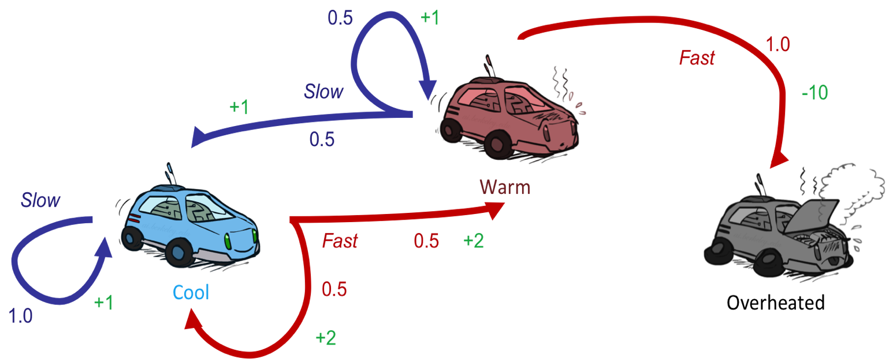



Example: Value Iteration
S: 1
F: .5*2+.5*2=2
Assume no discount!
0 0 0

Slide 33
Example: Value Iteration
2
S: .5*1+.5*1=1
F: -10
Assume no discount!
0 0 0

Slide 34
Example: Value Iteration
2
1
0
Assume no discount!
0 0 0

Slide 35
Example: Value Iteration
S: 1+2=3
F: .5*(2+2)+.5*(2+1)=3.5
2
1
0
Assume no discount!
0 0 0

Slide 36
Example: Value Iteration
3.5
2.5
0
2
1
0
Assume no discount!
0 0 0

Slide 37


Convergence*
How do we know the V_{k} vectors are going to converge?
Case 1: If the tree has maximum depth M, then V_{M} holds the actual untruncated values
Case 2: If the discount is less than 1
  Sketch: For any state V_{k} and V_{k+1} can be viewed as depth k+1 expectimax results in nearly identical search trees
  The difference is that on the bottom layer, V_{k+1} has actual rewards while V_{k} has zeros
  That last layer is at best all R_{MAX}
  It is at worst R_{MIN}
  But everything is discounted by γ^{k} that far out
  So V_{k} and V_{k+1} are at most γ^{k} max|R| different
  So as k increases, the values converge
Notes:
gamma^k goes to zero is the notion of convergencel.

Slide 38
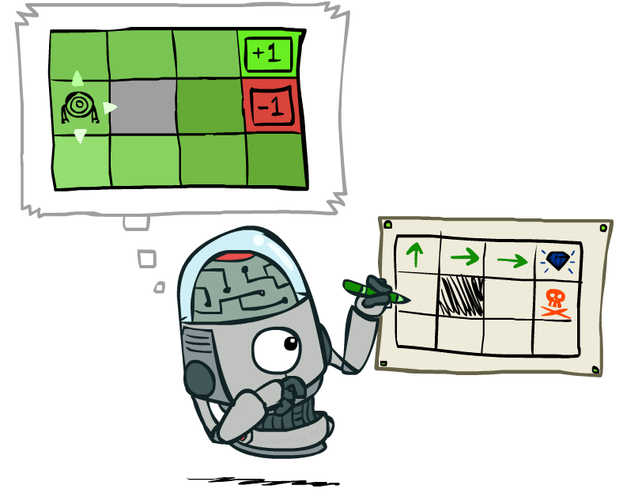
Policy Extraction

Slide 39
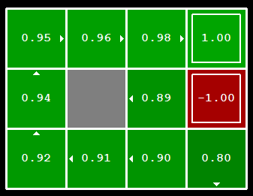


Computing Actions from Values
Let’s imagine we have the optimal values V*(s)
How should we act?
  It’s not obvious!
We need to do a mini-expectimax (one step)
This is called policy extraction, since it gets the policy implied by the values
Notes:
remind about argmax

Slide 40
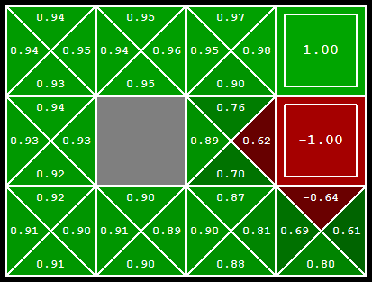
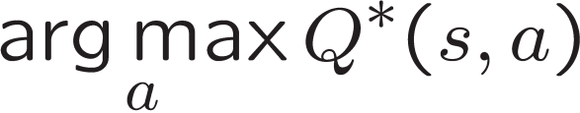
Computing Actions from Q-Values
Let’s imagine we have the optimal
q-values:
How should we act?
  Completely trivial to decide!
Important lesson: actions are easier to select from q-values than values!

Slide 41
Let’s think.
Take a minute, think about value iteration.
Write down the biggest question you have about it.

Slide 42

Policy Methods

Slide 43
Problems with Value Iteration
Value iteration repeats the Bellman updates:
Problem 1: It’s slow – O(S²A) per iteration
Problem 2: The “max” at each state rarely changes
Problem 3: The policy often converges long before the values
s
a
s, a
s,a,s’
s’
[Demo: value iteration (L9D2)]
Notes:
Demo steps through value iteration; snapshots of values shown on next slides.
Linear in size of transition table, normally not O(S^2 A)

Slide 44
k=12
Noise = 0.2
Discount = 0.9
Living reward = 0
Notes:
Assuming zero living reward

Slide 45
k=100
Noise = 0.2
Discount = 0.9
Living reward = 0
Notes:
Assuming zero living reward

Slide 46
Policy Iteration
Alternative approach for optimal values:
  Step 1: Policy evaluation: calculate utilities for some fixed policy (not optimal utilities!) until convergence
  Step 2: Policy improvement: update policy using one-step look-ahead with resulting converged (but not optimal!) utilities as future values
  Repeat steps until policy converges
This is policy iteration
  It’s still optimal!
  Can converge (much) faster under some conditions
Notes:
We are introducing the two sub components of another method for solving MDPS
Starting with evaluation, then iteration
Setting up for RL

Slide 47

Policy Evaluation

Slide 48
Fixed Policies
Do the optimal action
Do what π says to do
s
s
a
π(s)
s, a
s, π(s)
s,a,s’
s, π(s),s’
s’
s’
Expectimax trees max over all actions to compute the optimal values
If we fixed some policy π(s), then the tree would be simpler – only one action per state
  … though the tree’s value would depend on which policy we fixed

Slide 49
Utilities for a Fixed Policy
Another basic operation: compute the utility of a state s under a fixed (generally non-optimal) policy
Define the utility of a state s, under a fixed policy π:
  V^{π}(s) = expected total discounted rewards starting in s and following π
Recursive relation (one-step look-ahead / Bellman equation):
s
π(s)
s, π(s)
s, π(s),s’
s’

Slide 50

Policy Evaluation
s
How do we calculate the V’s for a fixed policy π?
Idea 1: Turn recursive Bellman equations into updates
(like value iteration)
Efficiency: O(S²) per iteration
Idea 2: Without the maxes, the Bellman equations are just a linear system
  Solve with Matlab (or your favorite linear system solver)
π(s)
s, π(s)
s, π(s),s’
s’

Slide 51
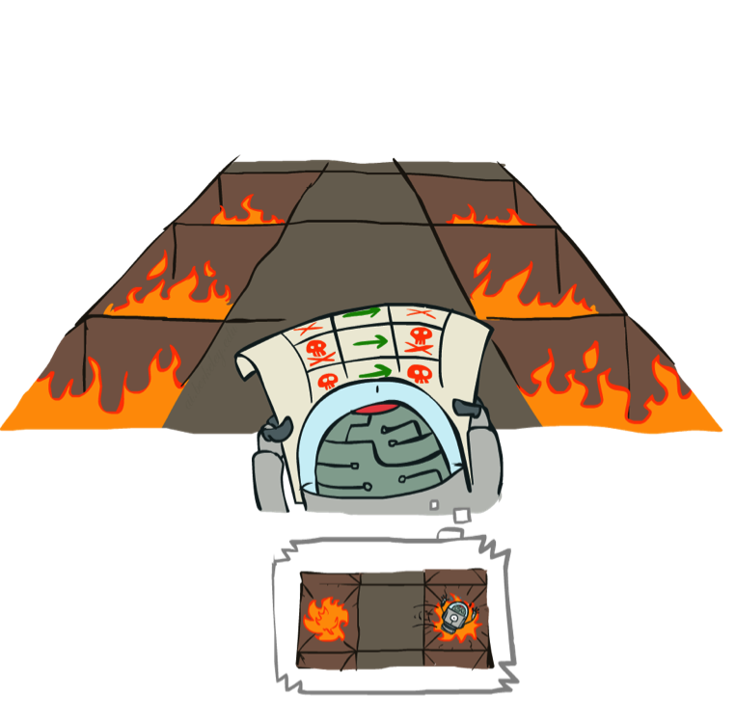
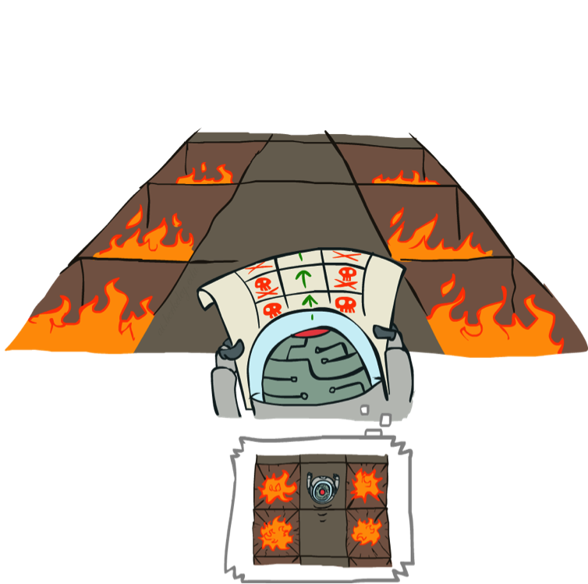
Example: Policy Evaluation
Always Go Right
Always Go Forward

Slide 52
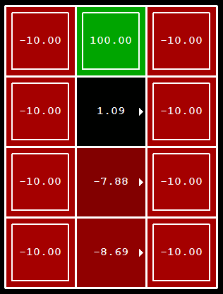
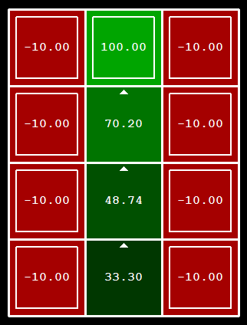
Example: Policy Evaluation
Always Go Right
Always Go Forward

Slide 53

Policy Iteration

Slide 54
Policy Iteration
Evaluation: For fixed current policy π, find values with policy evaluation:
  Iterate until values converge:
Improvement: For fixed values, get a better policy using policy extraction
  One-step look-ahead:

Slide 55
Comparison
Both value iteration and policy iteration compute the same thing (all optimal values)
In value iteration:
  Every iteration updates both the values and (implicitly) the policy
  We don’t track the policy, but taking the max over actions implicitly recomputes it
In policy iteration:
  We do several passes that update utilities with fixed policy (each pass is fast because we consider only one action, not all of them)
  After the policy is evaluated, a new policy is chosen (slow like a value iteration pass)
  The new policy will be better (or we’re done)
Both are dynamic programs for solving MDPs

Slide 56
Summary: MDP Equations
Value iteration equation:
Policy evaluation equation:
Policy iteration equation:

Slide 57
Summary: MDP Algorithms
So you want to….
  Compute optimal values: use value iteration or policy iteration
  Compute values for a particular policy: use policy evaluation
  Turn your values into a policy: use policy extraction (one-step lookahead)
These all look the same!
  They basically are – they are all variations of Bellman updates
  They all use one-step lookahead expectimax fragments
  They differ only in whether we plug in a fixed policy or max over actions

Slide 58

The Bellman Equations
How to be optimal:
Step 1: Take correct first action
Step 2: Keep being optimal

Slide 59
Next Time: Reinforcement Learning!

