Slide 1
Foundations of Computer Graphics (Fall 2012)
CS 184, Lecture 4: Transformations 2
http://inst.eecs.berkeley.edu/~cs184

Slide 2
To Do
Start doing HW 1
  Time is short, but needs only little code [Due Wed Sep 12]
  Ask questions or clear misunderstandings by next lecture
Specifics of HW 1
  Last lecture covered basic material on transformations in 2D Likely need this lecture to understand full 3D transformations
  Last lecture had full derivation of 3D rotations. You only need final formula
  gluLookAt derivation this lecture helps clarifying some ideas
Read and post on Piazza re questions

Slide 3
Outline
Translation: Homogeneous Coordinates
Combining Transforms: Scene Graphs
Transforming Normals
Rotations revisited: coordinate frames
gluLookAt (quickly)

Slide 4
Translation
E.g. move x by +5 units, leave y, z unchanged
We need appropriate matrix. What is it?
Transformations game demo

Slide 5
Homogeneous Coordinates
Add a fourth homogeneous coordinate (w=1)
4x4 matrices very common in graphics, hardware
Last row always 0 0 0 1 (until next lecture)

Slide 6
Representation of Points (4-Vectors)
Homogeneous coordinates
  Divide by 4th coord (w) to get (inhomogeneous) point
  Multiplication by w > 0, no effect
  Assume w ≥ 0. For w > 0, normal finite point. For w = 0, point at infinity (used for vectors to stop translation)

Slide 7
Advantages of Homogeneous Coords
Unified framework for translation, viewing, rot…
Can concatenate any set of transforms to 4x4 matrix
No division (as for perspective viewing) till end
Simpler formulas, no special cases
Standard in graphics software, hardware

Slide 8
General Translation Matrix

Slide 9
Combining Translations, Rotations
Order matters!! TR is not the same as RT (demo)
General form for rigid body transforms
We show rotation first, then translation (commonly used to position objects) on next slide. Slide after that works it out the other way
Demos with applet, homework 1

Slide 10
Combining Translations, Rotations
Transformations game demo

Slide 11
Combining Translations, Rotations
Transformations game demo

Slide 12
Outline
Translation: Homogeneous Coordinates
Combining Transforms: Scene Graphs
Transforming Normals
Rotations revisited: coordinate frames
gluLookAt (quickly)
Slides for this part courtesy Prof. O’Brien

Slide 13
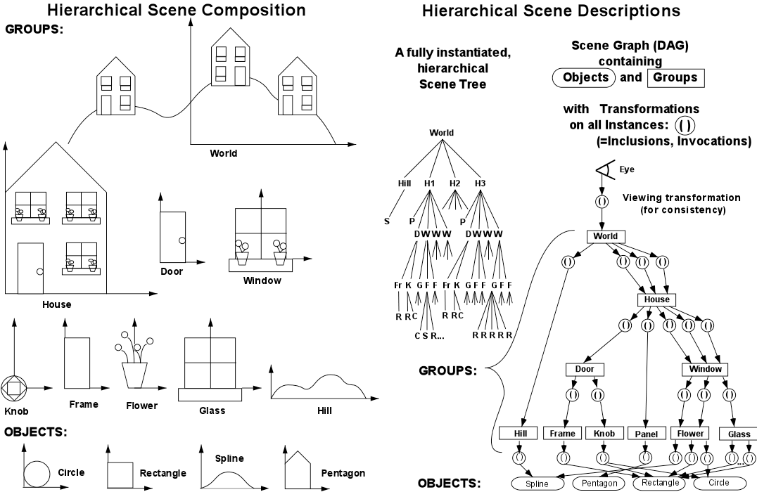
Hierarchical Scene Graph

Slide 14
Drawing a Scene Graph
Draw scene with pre-and-post-order traversal
  Apply node, draw children, undo node if applicable
Nodes can carry out any function
  Geometry, transforms, groups, color, …
Requires stack to “undo” post children
  Transform stacks in OpenGL
Caching and instancing possible
Instances make it a DAG, not strictly a tree

Slide 15
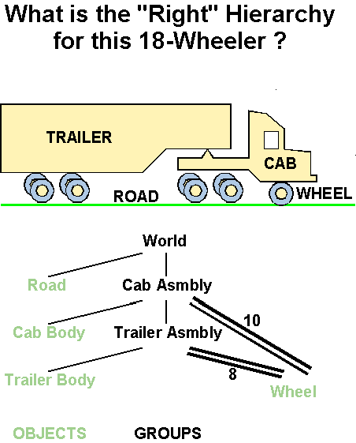
Example Scene-Graphs

Slide 16
Outline
Translation: Homogeneous Coordinates
Combining Transforms: Scene Graphs
Transforming Normals
Rotations revisited: coordinate frames
gluLookAt (quickly)

Slide 17
Normals
Important for many tasks in graphics like lighting
Do not transform like points e.g. shear
Algebra tricks to derive correct transform
Incorrect to
transform
like points

Slide 18
Finding Normal Transformation

Slide 19
Outline
Translation: Homogeneous Coordinates
Combining Transforms: Scene Graphs
Transforming Normals
Rotations revisited: coordinate frames
gluLookAt (quickly)

Slide 20
Coordinate Frames
All of discussion in terms of operating on points
But can also change coordinate system
Example, motion means either point moves backward, or coordinate system moves forward

Slide 21
Coordinate Frames: In general
Can differ both origin and orientation (e.g. 2 people)
One good example: World, camera coord frames (H1)
Camera
Camera
World
World

Slide 22
Coordinate Frames: Rotations

Slide 23
Outline
Translation: Homogeneous Coordinates
Combining Transforms: Scene Graphs
Transforming Normals
Rotations revisited: coordinate frames
gluLookAt (quickly)

Slide 24
Geometric Interpretation 3D Rotations
Rows of matrix are 3 unit vectors of new coord frame
Can construct rotation matrix from 3 orthonormal vectors

Slide 25
Axis-Angle formula (summary)

Slide 26
Outline
Translation: Homogeneous Coordinates
Combining Transforms: Scene Graphs
Transforming Normals
Rotations revisited: coordinate frames
gluLookAt (quickly)

Slide 27
Case Study: Derive gluLookAt
Defines camera, fundamental to how we view images
gluLookAt(eyex, eyey, eyez, centerx, centery, centerz, upx, upy, upz)
Camera is at eye, looking at center, with the up direction being up
May be important for HW1
Combines many concepts discussed in lecture
Core function in OpenGL for later assignments
Up vector
Eye
Center

Slide 28
Steps
gluLookAt(eyex, eyey, eyez, centerx, centery, centerz, upx, upy, upz)
Camera is at eye, looking at center, with the up direction being up
First, create a coordinate frame for the camera
Define a rotation matrix
Apply appropriate translation for camera (eye) location

Slide 29
Constructing a coordinate frame?
We want to associate w with a, and v with b
  But a and b are neither orthogonal nor unit norm
  And we also need to find u
from lecture 2

Slide 30
Constructing a coordinate frame
We want to position camera at origin, looking down –Z dirn
Hence, vector a is given by eye – center
The vector b is simply the up vector
Up vector
Eye
Center

Slide 31
Steps
gluLookAt(eyex, eyey, eyez, centerx, centery, centerz, upx, upy, upz)
Camera is at eye, looking at center, with the up direction being up
First, create a coordinate frame for the camera
Define a rotation matrix
Apply appropriate translation for camera (eye) location

Slide 32
Geometric Interpretation 3D Rotations
Rows of matrix are 3 unit vectors of new coord frame
Can construct rotation matrix from 3 orthonormal vectors

Slide 33
Steps
gluLookAt(eyex, eyey, eyez, centerx, centery, centerz, upx, upy, upz)
Camera is at eye, looking at center, with the up direction being up
First, create a coordinate frame for the camera
Define a rotation matrix
Apply appropriate translation for camera (eye) location

Slide 34
Translation
gluLookAt(eyex, eyey, eyez, centerx, centery, centerz, upx, upy, upz)
Camera is at eye, looking at center, with the up direction being up
Cannot apply translation after rotation
The translation must come first (to bring camera to origin) before the rotation is applied

Slide 35
Combining Translations, Rotations

Slide 36
gluLookAt final form

