Slide 1
Foundations of Computer Graphics (Fall 2012)
CS 184, Lecture 23: Texture Mapping
http://inst.eecs.berkeley.edu/~cs184
Many slides from Greg Humphreys, UVA and
Rosalee Wolfe, DePaul tutorial teaching texture mapping visually
Chapter 11 in text book covers some portions

Slide 2
To Do
Submit HW5 milestone
Prepare for final push on HW 5, HW 6

Slide 3
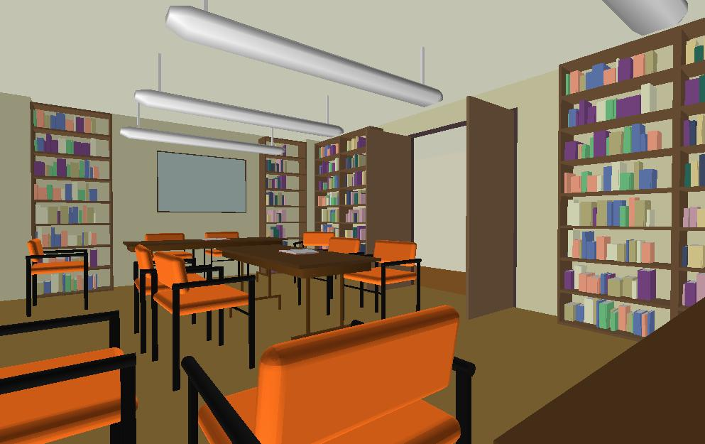
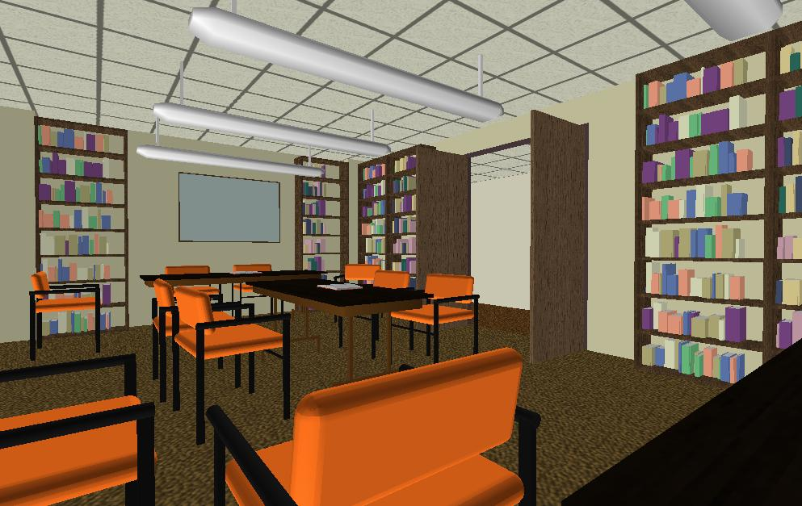
Texture Mapping
Important topic: nearly all objects textured
  Wood grain, faces, bricks and so on
  Adds visual detail to scenes
Meant as a fun and practically useful lecture
Polygonal model
With surface texture

Slide 4
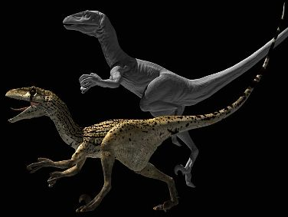
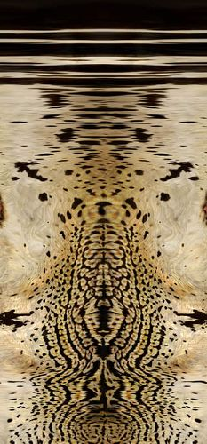
Adding Visual Detail
Basic idea: use images instead of more polygons to represent fine scale color variation

Slide 5
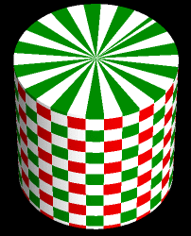
Parameterization
+
=
geometry
image
texture map
Q: How do we decide where on the geometry
each color from the image should go?

Slide 6
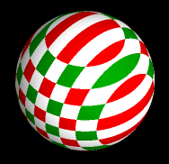
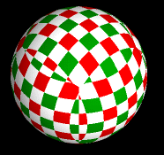
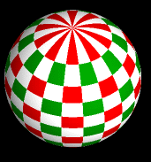
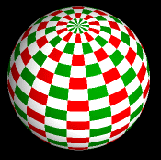
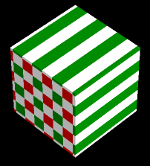
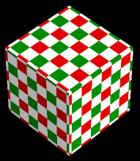
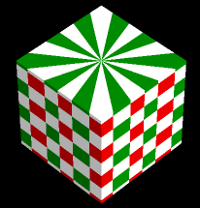
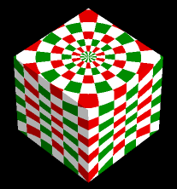
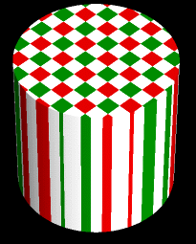
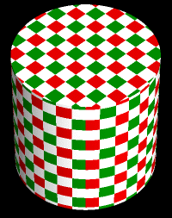
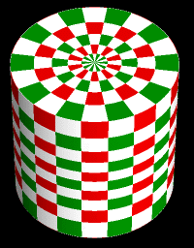
Option: Varieties of projections
[Paul Bourke]

Slide 7
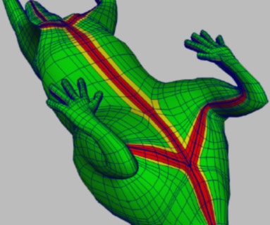
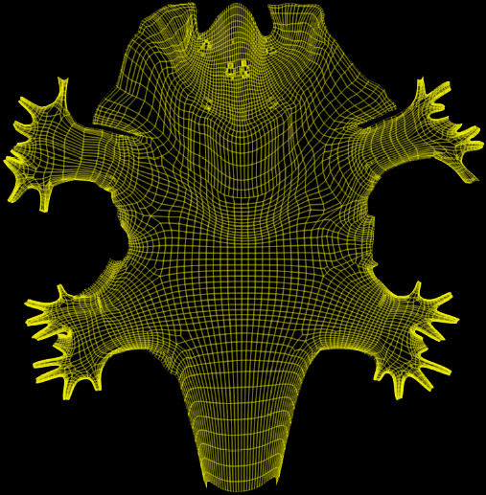
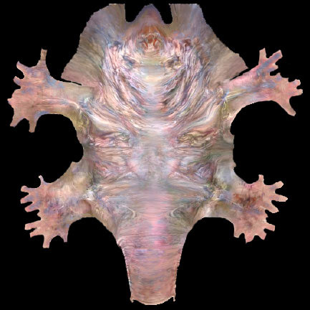
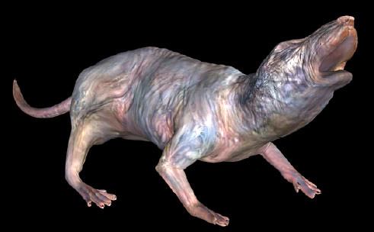
Option: unfold the surface
[Piponi2000]

Slide 8
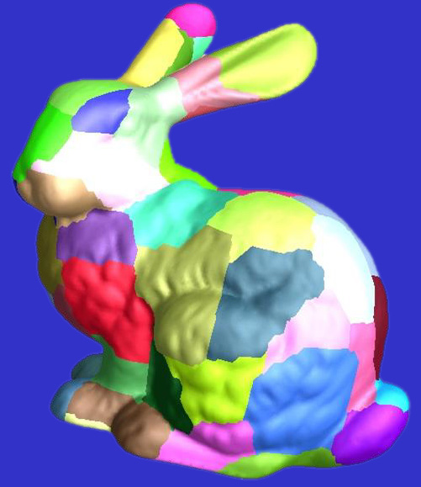
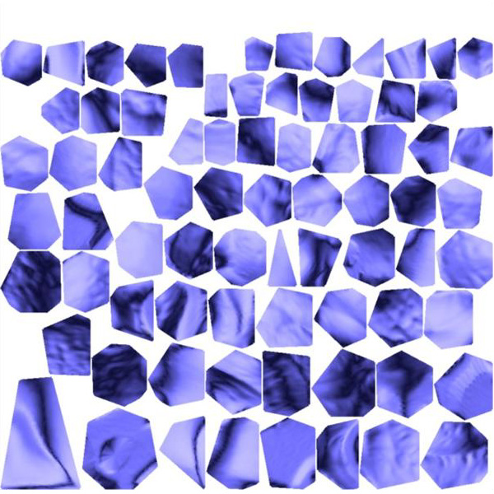
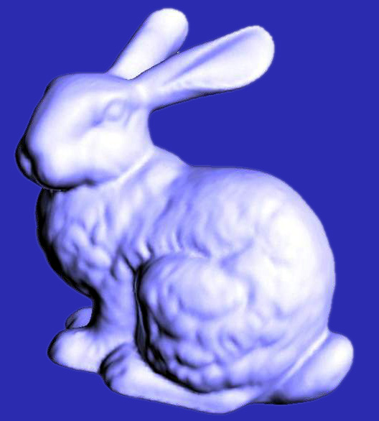
Option: make an atlas
charts
atlas
surface
[Sander2001]

Slide 9
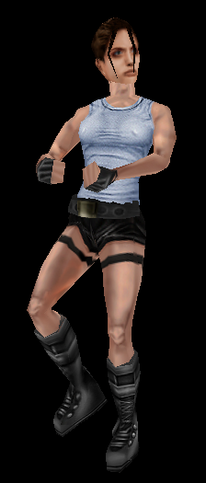
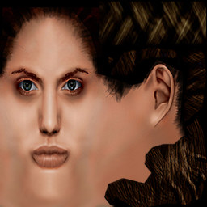
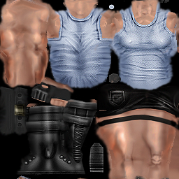
Option: it’s the artist’s problem

Slide 10
Outline
Types of projections
Interpolating texture coordinates
Broader use of textures

Slide 11
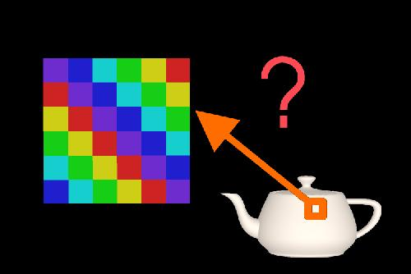
How to map object to texture?
To each vertex (x,y,z in object coordinates), must associate 2D texture coordinates (s,t)
So texture fits “nicely” over object

Slide 12
Idea: Use Map Shape
Map shapes correspond to various projections
  Planar, Cylindrical, Spherical
First, map (square) texture to basic map shape
Then, map basic map shape to object
  Or vice versa: Object to map shape, map shape to square
Usually, this is straightforward
  Maps from square to cylinder, plane, sphere well defined
  Maps from object to these are simply spherical, cylindrical, cartesian coordinate systems

Slide 13
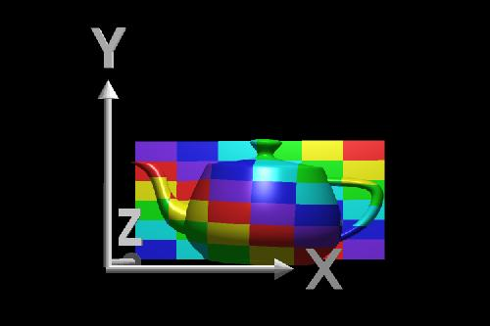
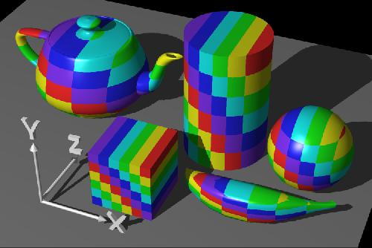
Planar mapping
Like projections, drop z coord (s,t) = (x,y)
Problems: what happens near z = 0?

Slide 14
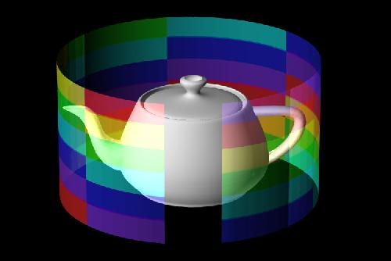
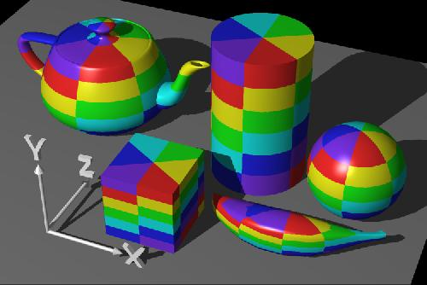
Cylindrical Mapping
Cylinder: r, θ, z with (s,t) = (θ/(2π),z)
  Note seams when wrapping around (θ = 0 or 2π)

Slide 15
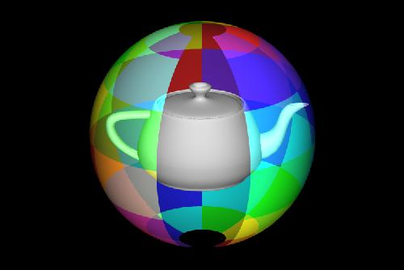
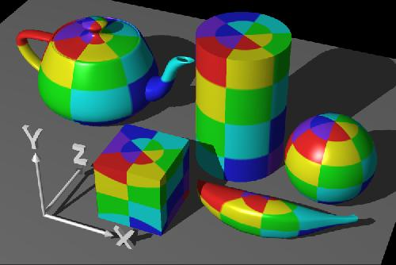
Spherical Mapping
Convert to spherical coordinates: use latitude/long.
  Singularities at north and south poles

Slide 16
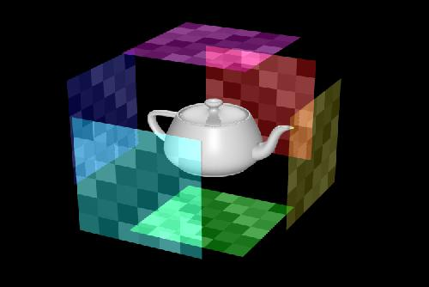
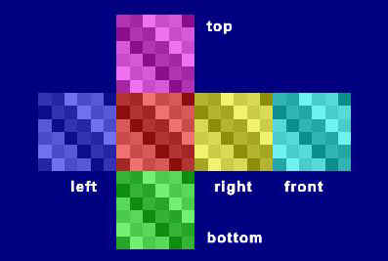
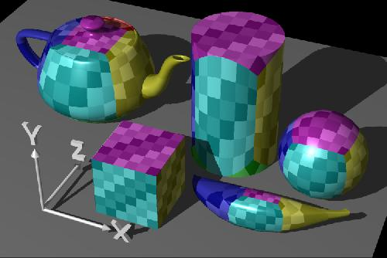
Cube Mapping

Slide 17
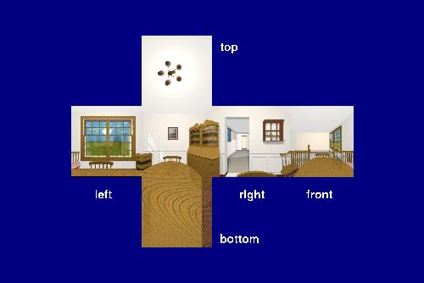
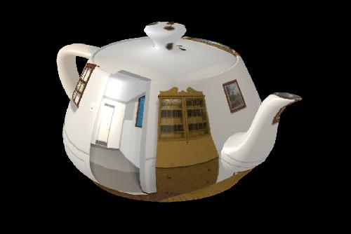
Cube Mapping

Slide 18
Outline
Types of projections
Interpolating texture coordinates
Broader use of textures

Slide 19
1st idea: Gouraud interp. of texcoords
Scan line
Actual implementation efficient: difference
equations while scan converting

Slide 20
Artifacts
McMillan’s demo of this is at http://graphics.lcs.mit.edu/classes/6.837/F98/Lecture21/Slide05.html
Another example
http://graphics.lcs.mit.edu/classes/6.837/F98/Lecture21/Slide06.html
What artifacts do you see?
Why?
Why not in standard Gouraud shading?
Hint: problem is in interpolating parameters
Wikipedia page

Slide 21
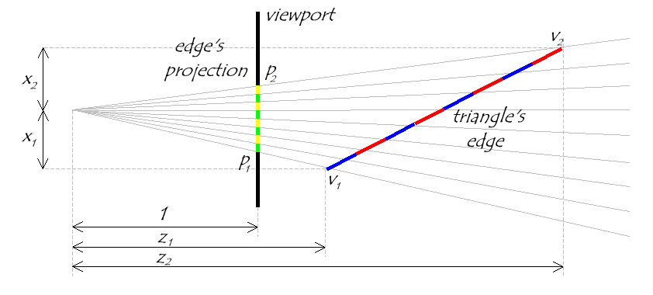
Interpolating Parameters
The problem turns out to be fundamental to interpolating parameters in screen-space
  Uniform steps in screen space ≠ uniform steps in world space

Slide 22
Texture Mapping
Linear interpolation
of texture coordinates
Correct interpolation
with perspective divide
Hill Figure 8.42

Slide 23
Interpolating Parameters
Perspective foreshortening is not getting applied to our interpolated parameters
  Parameters should be compressed with distance
  Linearly interpolating them in screen-space doesn’t do this

Slide 24
Perspective-Correct Interpolation
Skipping a bit of math to make a long story short…
  Rather than interpolating u and v directly, interpolate u/z and v/z
    These do interpolate correctly in screen space
    Also need to interpolate z and multiply per-pixel
  Problem: we don’t know z anymore
  Solution: we do know w ~ 1/z
  So…interpolate uw and vw and w, and compute
  u = uw/w and v = vw/w for each pixel
    This unfortunately involves a divide per pixel
http://graphics.lcs.mit.edu/classes/6.837/F98/Lecture21/Slide14.html

Slide 25
Texture Map Filtering
Naive texture mapping aliases badly
Look familiar?
int uval = (int) (u * denom + 0.5f);
int vval = (int) (v * denom + 0.5f);
int pix = texture.getPixel(uval, vval);
Actually, each pixel maps to a region in texture
  |PIX| < |TEX|
    Easy: interpolate (bilinear) between texel values
  |PIX| > |TEX|
    Hard: average the contribution from multiple texels
  |PIX| ~ |TEX|
    Still need interpolation!

Slide 26
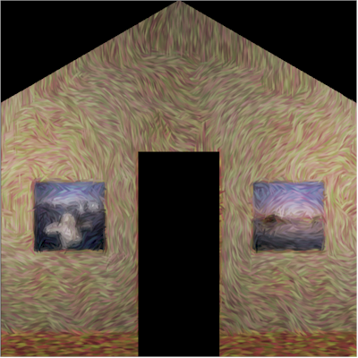
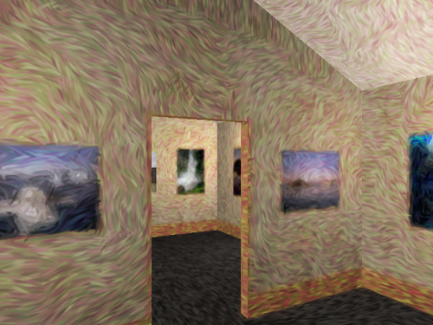
Mip Maps
Keep textures prefiltered at multiple resolutions
  For each pixel, linearly interpolate between
  two closest levels (e.g., trilinear filtering)
  Fast, easy for hardware
Why “Mip” maps?

Slide 27
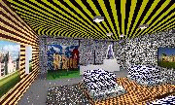
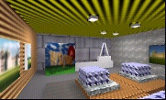
MIP-map Example
AAAAAAAGH
MY EYES ARE BURNING
No filtering:
MIP-map texturing:
Where are my glasses?

Slide 28
Outline
Types of projections
Interpolating texture coordinates
Broader use of textures

Slide 29
Texture Mapping Applications
Modulation, light maps
Bump mapping
Displacement mapping
Illumination or Environment Mapping
Procedural texturing
And many more

Slide 30
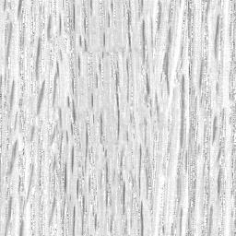
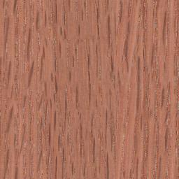
Modulation textures
Map texture values to scale factor
Wood texture
Texture
value

Slide 31
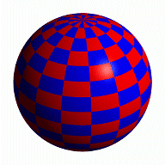
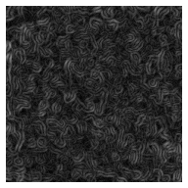
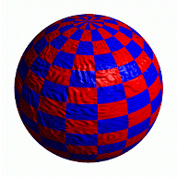
Bump Mapping
Texture = change in surface normal!
Sphere w/ diffuse texture
Swirly bump map
Sphere w/ diffuse texture
and swirly bump map

Slide 32
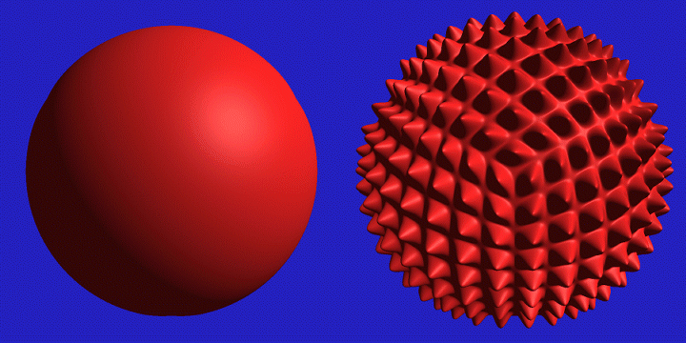
Displacement Mapping

Slide 33
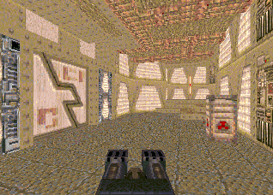




Illumination Maps
Quake introduced illumination maps or light maps to capture lighting effects in video games
Texture map:
Light map
Texture map
+ light map:

Slide 34


Environment Maps
Images from Illumination and Reflection Maps:
Simulated Objects in Simulated and Real Environments
Gene Miller and C. Robert Hoffman
SIGGRAPH 1984 “Advanced Computer Graphics Animation” Course Notes

Slide 35

Solid textures
Texture values indexed by 3D location (x,y,z)
  Expensive storage, or
  Compute on the fly,
  e.g. Perlin noise →

Slide 36

Procedural Texture Gallery

Slide 37


Slide 38


Slide 39


Slide 40


Slide 41


