Slide 1
Foundations of Computer Graphics (Fall 2012)
CS 184, Lecture 16: Ray Tracing
http://inst.eecs.berkeley.edu/~cs184

Slide 2
Effects needed for Realism
(Soft) Shadows
Reflections (Mirrors and Glossy)
Transparency (Water, Glass)
Interreflections (Color Bleeding)
Complex Illumination (Natural, Area Light)
Realistic Materials (Velvet, Paints, Glass)
And many more

Slide 3
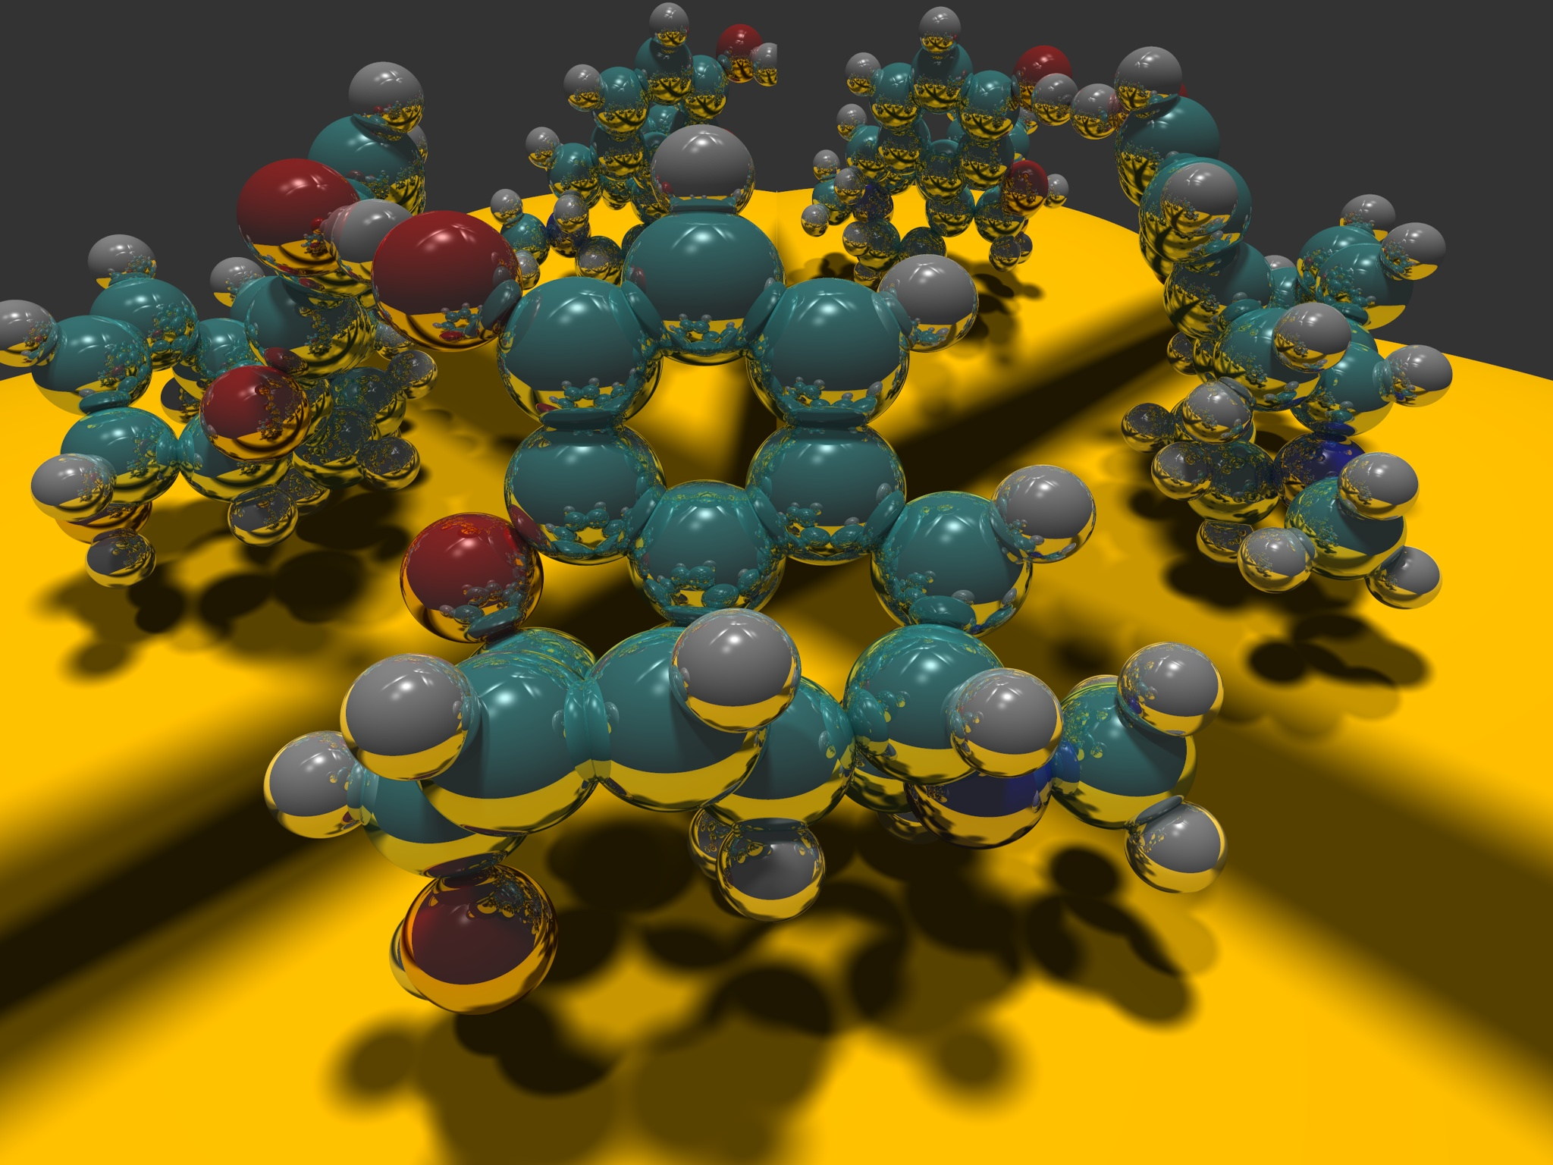
Image courtesy Paul Heckbert 1983

Slide 4
Ray Tracing
Different Approach to Image Synthesis as compared to Hardware pipeline (OpenGL)
Pixel by Pixel instead of Object by Object
Easy to compute shadows/transparency/etc

Slide 5
Outline
History
Basic Ray Casting (instead of rasterization)
  Comparison to hardware scan conversion
Shadows / Reflections (core algorithm)
Ray-Surface Intersection
Optimizations
Current Research

Slide 6
Ray Tracing: History
Appel 68
Whitted 80 [recursive ray tracing]
  Landmark in computer graphics
Lots of work on various geometric primitives
Lots of work on accelerations
Current Research
  Real-Time raytracing (historically, slow technique)
  Ray tracing architecture

Slide 7
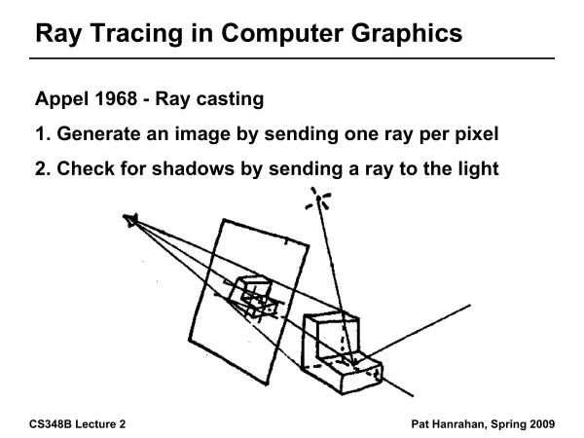
Ray Tracing History

Slide 8
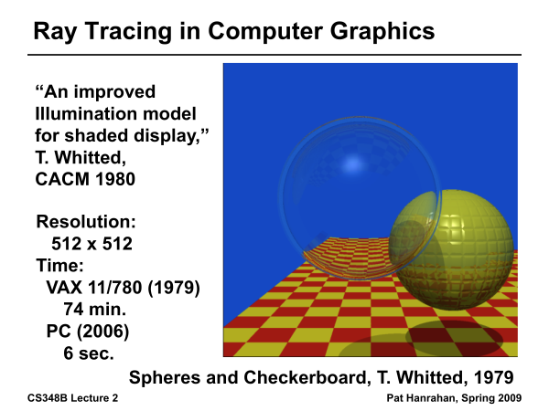
Ray Tracing History

Slide 9
Outline in Code
Image Raytrace (Camera cam, Scene scene, int width, int height)
{
Image image = new Image (width, height) ;
for (int i = 0 ; i < height ; i++)
for (int j = 0 ; j < width ; j++) {
Ray ray = RayThruPixel (cam, i, j) ;
Intersection hit = Intersect (ray, scene) ;
image[i][j] = FindColor (hit) ;
}
return image ;
}

Slide 10
Outline
History
Basic Ray Casting (instead of rasterization)
  Comparison to hardware scan conversion
Shadows / Reflections (core algorithm)
Ray-Surface Intersection
Optimizations
Current Research

Slide 11
Ray Casting
Produce same images as with OpenGL
  Visibility per pixel instead of Z-buffer
  Find nearest object by shooting rays into scene
  Shade it as in standard OpenGL

Slide 12
Ray Casting
Virtual Viewpoint
Virtual Screen
Objects
Multiple intersections: Use closest one (as does OpenGL)
Ray misses all objects: Pixel colored black
Ray intersects object: shade using color, lights, materials

Slide 13
Comparison to hardware scan-line
Per-pixel evaluation, per-pixel rays (not scan-convert each object). On face of it, costly
But good for walkthroughs of extremely large models (amortize preprocessing, low complexity)
More complex shading, lighting effects possible

Slide 14
Outline
History
Basic Ray Casting (instead of rasterization)
  Comparison to hardware scan conversion
Shadows / Reflections (core algorithm)
Ray-Surface Intersection
Optimizations
Current Research

Slide 15
Shadows
Light Source
Virtual Viewpoint
Virtual Screen
Objects
Shadow ray to light is blocked: object in shadow
Shadow ray to light is unblocked: object visible

Slide 16
Shadows: Numerical Issues
Numerical inaccuracy may cause intersection to be
below surface (effect exaggerated in figure)
Causing surface to incorrectly shadow itself
Move a little towards light before shooting shadow ray

Slide 17
Mirror Reflections/Refractions
Virtual Viewpoint
Virtual Screen
Objects
Generate reflected ray in mirror direction,
Get reflections and refractions of objects

Slide 18
Recursive Ray Tracing
For each pixel
  Trace Primary Eye Ray, find intersection
  Trace Secondary Shadow Ray(s) to all light(s)
    Color = Visible ? Illumination Model : 0 ;
  Trace Reflected Ray
    Color += reflectivity * Color of reflected ray

Slide 19
Problems with Recursion
Reflection rays may be traced forever
Generally, set maximum recursion depth
Same for transmitted rays (take refraction into account)

Slide 20
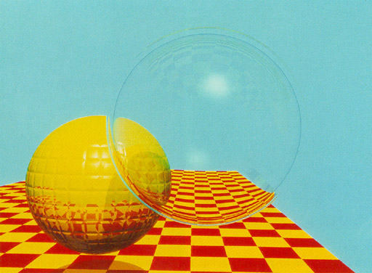
Turner Whitted 1980

Slide 21
Effects needed for Realism
(Soft) Shadows
Reflections (Mirrors and Glossy)
Transparency (Water, Glass)
Interreflections (Color Bleeding)
Complex Illumination (Natural, Area Light)
Realistic Materials (Velvet, Paints, Glass)
Discussed in this lecture
Not discussed but possible with distribution ray tracing (13)
Hard (but not impossible) with ray tracing; radiosity methods

Slide 22
Outline
History
Basic Ray Casting (instead of rasterization)
  Comparison to hardware scan conversion
Shadows / Reflections (core algorithm)
Ray-Surface Intersection
Optimizations
Current Research

Slide 23
Ray/Object Intersections
Heart of Ray Tracer
  One of the main initial research areas
  Optimized routines for wide variety of primitives
Various types of info
  Shadow rays: Intersection/No Intersection
  Primary rays: Point of intersection, material, normals
  Texture coordinates
Work out examples
  Triangle, sphere, polygon, general implicit surface

Slide 24
Ray-Sphere Intersection
C
P₀

Slide 25
Ray-Sphere Intersection
Substitute
Simplify

Slide 26
Ray-Sphere Intersection
2 real positive roots: pick smaller root
Both roots same: tangent to sphere
One positive, one negative root: ray origin inside sphere (pick + root)
Complex roots: no intersection (check discriminant of equation first)
Solve quadratic equations for t

Slide 27
Ray-Sphere Intersection
Intersection point:
Normal (for sphere, this is same as coordinates in sphere frame of reference, useful other tasks)

Slide 28
Ray-Triangle Intersection
One approach: Ray-Plane intersection, then check if inside triangle
Plane equation:
B
A
C

Slide 29
Ray-Triangle Intersection
One approach: Ray-Plane intersection, then check if inside triangle
Plane equation:
Combine with ray equation:
B
A
C

Slide 30
Ray inside Triangle
Once intersect with plane, still need to find if in triangle
Many possibilities for triangles, general polygons (point in polygon tests)
We find parametrically [barycentric coordinates]. Also useful for other applications (texture mapping)
B
A
α
β
P
γ
C

Slide 31
Ray inside Triangle
B
A
α
β
P
γ
C

Slide 32
Other primitives
Much early work in ray tracing focused on ray-primitive intersection tests
Cones, cylinders, ellipsoids
Boxes (especially useful for bounding boxes)
General planar polygons
Many more
Many references. For example, chapter in Glassner introduction to ray tracing (see me if interested)

Slide 33
Ray-Tracing Transformed Objects
We have an optimized ray-sphere test
  But we want to ray trace an ellipsoid…
Solution: Ellipsoid transforms sphere
  Apply inverse transform to ray, use ray-sphere
  Allows for instancing (traffic jam of cars)
Mathematical details worked out in class

Slide 34
Transformed Objects
Consider a general 4x4 transform M
  Will need to implement matrix stacks like in OpenGL
Apply inverse transform M⁻¹ to ray
  Locations stored and transform in homogeneous coordinates
  Vectors (ray directions) have homogeneous coordinate set to 0 [so there is no action because of translations]
Do standard ray-surface intersection as modified
Transform intersection back to actual coordinates
  Intersection point p transforms as Mp
  Distance to intersection if used may need recalculation
  Normals n transform as M^{-t}n. Do all this before lighting

Slide 35
Outline
History
Basic Ray Casting (instead of rasterization)
  Comparison to hardware scan conversion
Shadows / Reflections (core algorithm)
Ray-Surface Intersection
Optimizations
Current Research

Slide 36
Acceleration
Testing each object for each ray is slow
  Fewer Rays
    Adaptive sampling, depth control
  Generalized Rays
    Beam tracing, cone tracing, pencil tracing etc.
  Faster Intersections
    Optimized Ray-Object Intersections
    Fewer Intersections
We just discuss some approaches at high level; chapter 13 briefly covers

Slide 37
Acceleration Structures
Bounding boxes (possibly hierarchical)
  If no intersection bounding box, needn’t check objects
Bounding Box
Ray
Spatial Hierarchies (Oct-trees, kd trees, BSP trees)

Slide 38
Acceleration Structures: Grids

Slide 39
Acceleration and Regular Grids
Simplest acceleration, for example 5x5x5 grid
For each grid cell, store overlapping triangles
March ray along grid (need to be careful with this), test against each triangle in grid cell
More sophisticated: kd-tree, oct-tree bsp-tree
Or use (hierarchical) bounding boxes
Try to implement some acceleration in HW 5

Slide 40
Outline
History
Basic Ray Casting (instead of rasterization)
  Comparison to hardware scan conversion
Shadows / Reflections (core algorithm)
Ray-Surface Intersection
Optimizations
Current Research

Slide 41
Interactive Raytracing
Ray tracing historically slow
Now viable alternative for complex scenes
  Key is sublinear complexity with acceleration; need not process all triangles in scene
Allows many effects hard in hardware
OpenRT project real-time ray tracing (http://www.openrt.de)
NVIDIA OptiX ray-tracing API like OpenGL

Slide 42
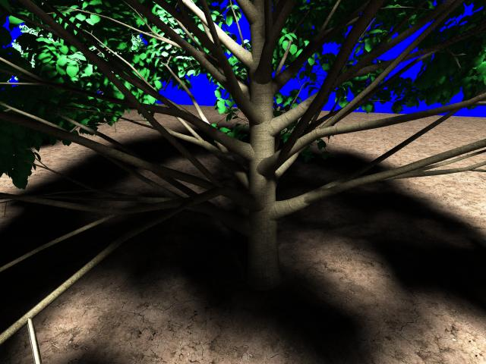
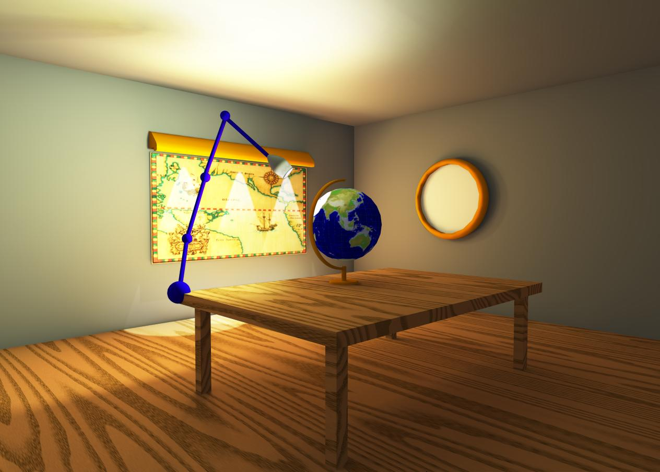
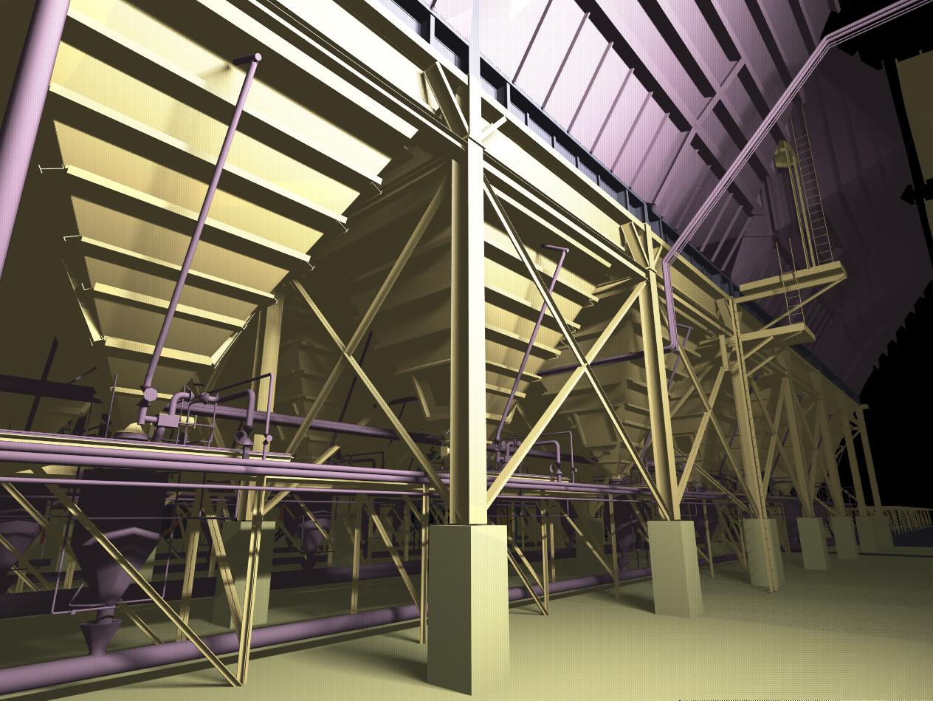
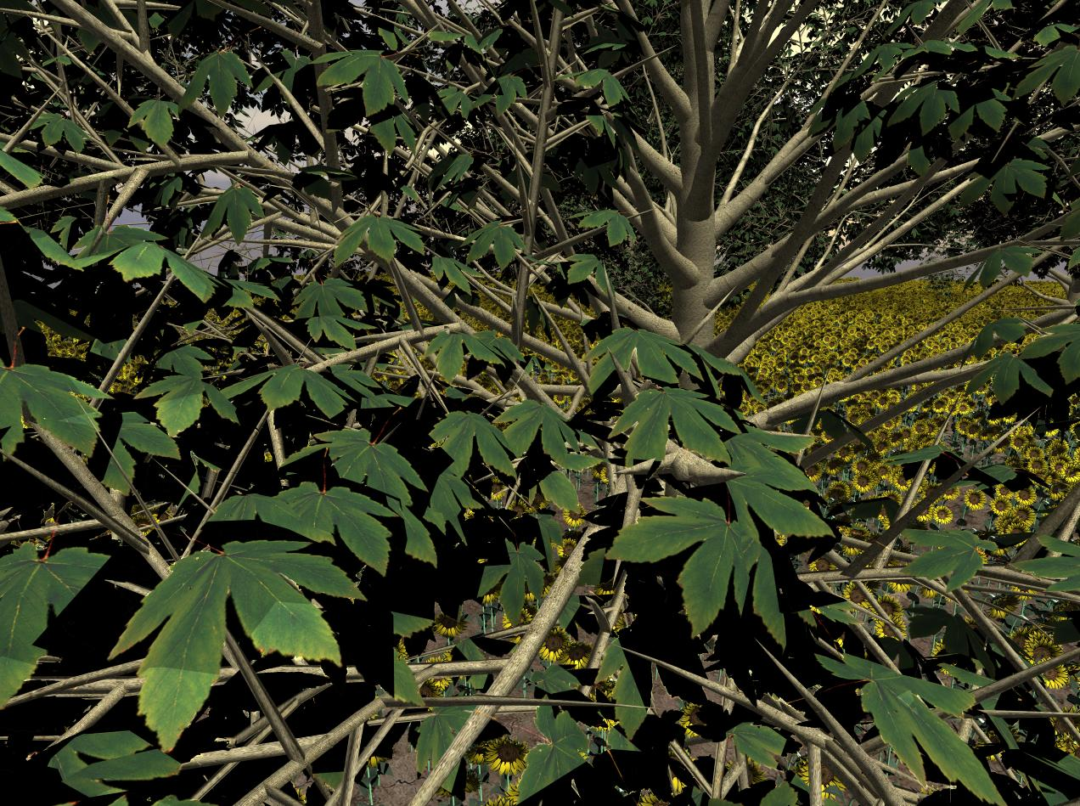

Slide 43
Raytracing on Graphics Hardware
Modern Programmable Hardware general streaming architecture
Can map various elements of ray tracing
Kernels like eye rays, intersect etc.
In vertex or fragment programs
Convergence between hardware, ray tracing
[Purcell et al. 2002, 2003]
http://graphics.stanford.edu/papers/photongfx

Slide 44
