Slide 1
Foundations of Computer Graphics (Fall 2012)
CS 184, Lecture 12: Raster Graphics and Pipeline
http://inst.eecs.berkeley.edu/~cs184

Slide 2
Lecture Overview
Many basic things tying together course
  Is part of the material, will be covered on midterm
Raster graphics
Gamma Correction
Color
Hardware pipeline and rasterization
Displaying Images: Ray Tracing and Rasterization
  Essentially what this course is about (HW 2 and HW 5)
Introduced now so could cover basics for HW 1,2,3
  Course will now “breathe” to review some topics
Some images from wikipedia

Slide 3
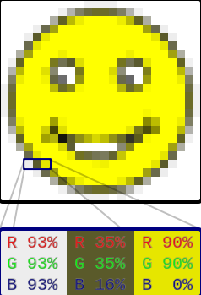
Images and Raster Graphics
Real world is continuous (almost)
How to represent images on a display?
Raster graphics: use a bitmap with discrete pixels
Raster scan CRT (paints image line by line)
Cannot be resized without loss
Compare to vector graphics
  Resized arbitrarily. For drawings
  But how to represent photos, CG?

Slide 4
Displays and Raster Devices
CRT, flat panel, television (rect array of pixels)
Printers (scanning: no physical grid but print ink)
Digital cameras (grid light-sensitive pixels)
Scanner (linear array of pixels swept across)
Store image as 2D array (of RGB [sub-pixel] values)
  In practice, there may be resolution mismatch, resize
  Resize across platforms (phone, screen, large TV)
Vector image: description of shapes (line, circle, …)
  E.g., line art such as in Adobe Illustrator
  Resolution-Independent but must rasterize to display
  Doesn’t work well for photographs, complex images

Slide 5
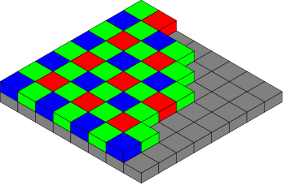
Resolutions
Size of grid (1920x1200 = 2,304,000 pixels)
  32 bit of memory for RGBA framebuffer 8+ MB
For printers, pixel density (300 dpi or ppi)
  Printers often binary or CMYK, require finer grid
  iPhone “retina display” > 300 dpi. At 12 inches, pixels closer than retina’s ability to distinguish angles
Digital cameras in Mega-Pixels (often > 10 MP)
  Color filter array (Bayer Mosaic)
  Pixels really small (micron)

Slide 6
Monitor Intensities
Intensity usually stored with 8 bits [0…255]
HDR can be 16 bits or more [0…65535]
Resolution-independent use [0…1] intermediate
Monitor takes input value [0…1] outputs intensity
  Non-zero intensity for 0, black level even when off
  1.0 is maximum intensity (output 1.0/0.0 is contrast)
  Non-linear response (as is human perception)
  0.5 may map to 0.25 times the response of 1.0
  Gamma characterization and gamma correction
  Some history from CRT physics and exponential forms

Slide 7
Lecture Overview
Many basic things tying together course
Raster graphics
Gamma Correction
Color
Hardware pipeline and rasterization
Displaying Images: Ray Tracing and Rasterization
  Essentially what this course is about (HW 2 and HW 5)
Some images from wikipedia

Slide 8
Nonlinearity and Gamma
Exponential function
I is displayed intensity, a is pixel value
For many monitors γ is between 1.8 and 2.2
In computer graphics, most images are linear
  Lighting and material interact linearly
Gamma correction
Examples with γ = 2
  Input a = 0 leads to final intensity I = 0, no correction
  Input a = 1 leads to final intensity I = 1, no correction
  Input a = 0.5 final intensity 0.25. Correct to 0.707107
  Makes image “brighter” [brightens mid-tones]

Slide 9
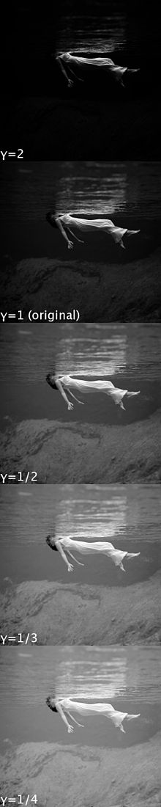
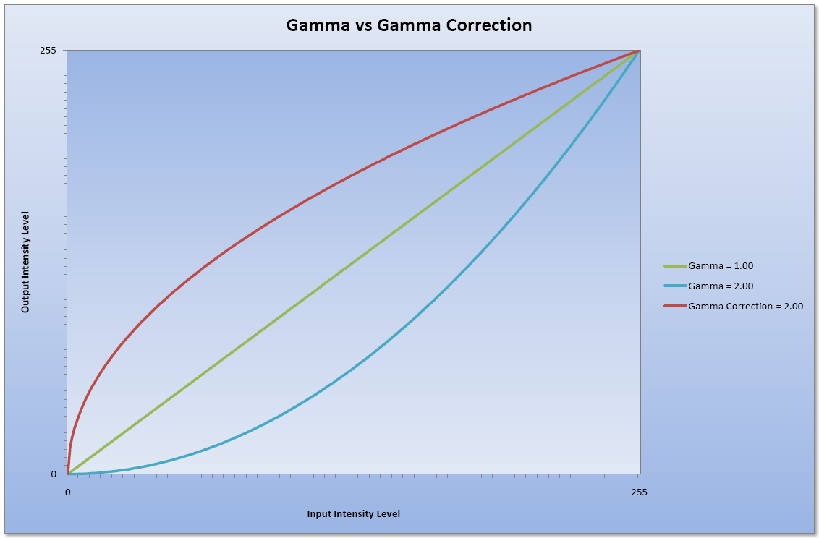
Gamma Correction
Can be messy for images. Usually gamma on one monitor, but viewed on others…
For television, encode with gamma (often 0.45, decode with gamma 2.2)
CG, encode gamma is usually 1, correct
www.dfstudios.co.uk/wp-content/
uploads/2010/12/graph_gamcor.png

Slide 10
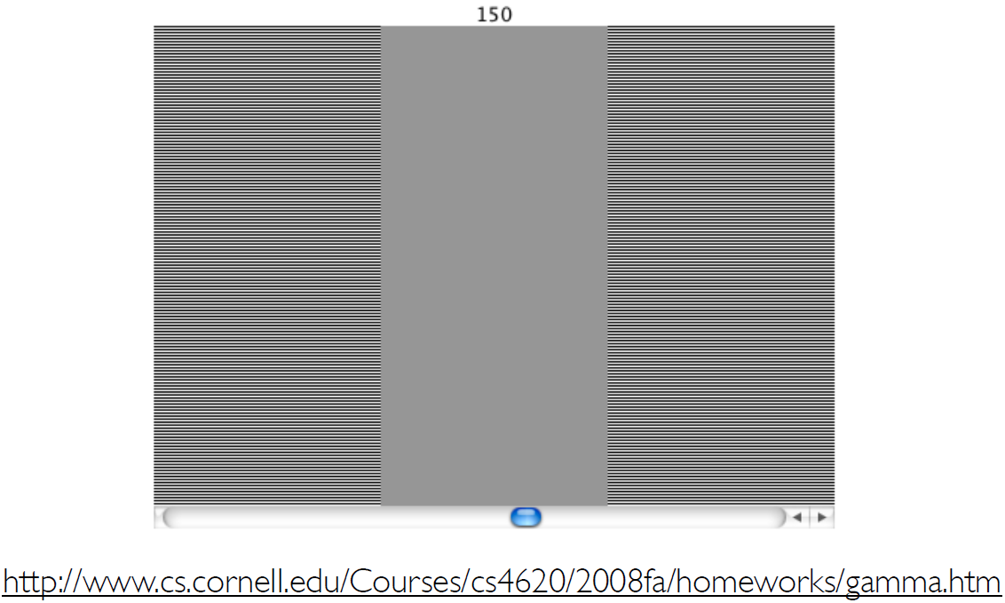
Finding Monitor Gamma
Adjust grey until match 0-1 checkerboard to find mid-point a value i.e., a for I = 0.5

Slide 11
Human Perception
Why not just make everything linear, avoid gamma
Ideally, 256 intensity values look linear
But human perception itself non-linear
  Gamma between 1.5 and 3 depending on conditions
  Gamma is (sometimes) a feature
  Equally spaced input values are perceived roughly equal

Slide 12
Lecture Overview
Many basic things tying together course
Raster graphics
Gamma Correction
Color
Hardware pipeline and rasterization
Displaying Images: Ray Tracing and Rasterization
  Essentially what this course is about (HW 2 and HW 5)
Some images from wikipedia

Slide 13
Color
Huge topic (can read textbooks)
  Schrodinger much more work on this than quantum
For this course, RGB (red green blue), 3 primaries
Additive (not subtractive) mixing for arbitrary colors
Grayscale: 0.3 R + 0.6 G + 0.1 B
Secondary Colors (additive, not paints etc.)
  Red + Green = Yellow, Red + Blue = Magenta, Blue + Green = Cyan, R+G+B = White
Many other color spaces
  HSV, CIE etc.

Slide 14
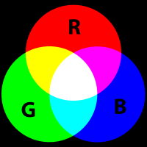
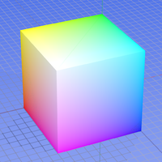
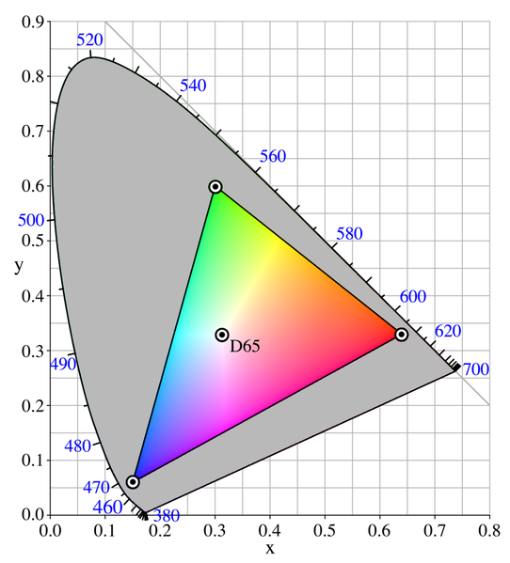
RGB Color
Venn, color cube
Not all colors possible
Images from wikipedia

Slide 15
Eyes as Sensors
Slides courtesy Prof. O’Brien

Slide 16
Cones (Trichromatic)

Slide 17
Cone Response

Slide 18
Color Matching Functions

Slide 19
CIE XYZ

Slide 20
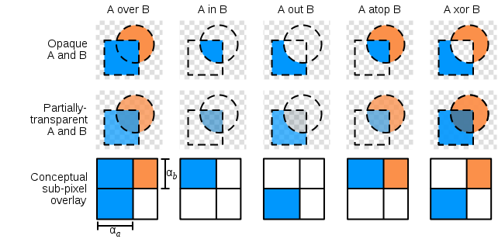
Alpha Compositing
RGBA (32 bits including alpha transparency)
  You mostly use 1 (opaque)
  Can simulate sub-pixel coverage and effects
Compositing algebra

Slide 21
Lecture Overview
Many basic things tying together course
Raster graphics
Gamma Correction
Color
Hardware pipeline and rasterization
Displaying Images: Ray Tracing and Rasterization
  Essentially what this course is about (HW 2 and HW 5)
Read chapter 8 more details

Slide 22
Hardware Pipeline
Application generates stream of vertices
Vertex shader called for each vertex
  Output is transformed geometry
OpenGL rasterizes transformed vertices
  Output are fragments
Fragment shader for each fragment
  Output is Framebuffer image

Slide 23
Rasterization
In modern OpenGL, really only OpenGL function
  Almost everything is user-specified, programmable
  Basically, how to draw (2D) primitive on screen
Long history
  Bresenham line drawing
  Polygon clipping
  Antialiasing
What we care about
  OpenGL generates a fragment for each pixel in triangle
  Colors, values interpolated from vertices (Gouraud)

Slide 24
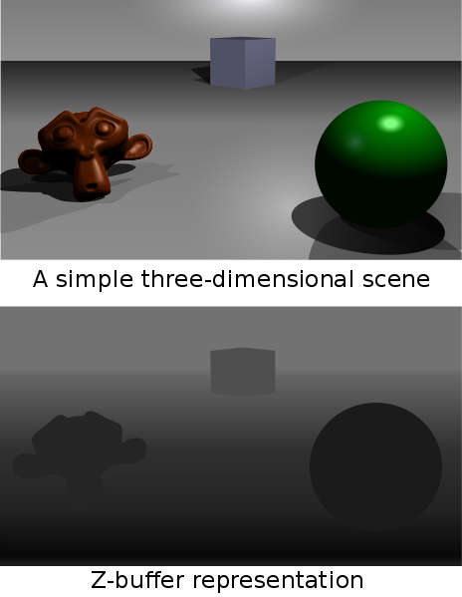
Z-Buffer
Sort fragments by depth (only draw closest one)
New fragment replaces old if depth test works
OpenGL does this auto can override if you want
Must store z memory
Simple, easy to use

Slide 25
Lecture Overview
Many basic things tying together course
Raster graphics
Gamma Correction
Color
Hardware pipeline and rasterization
Displaying Images: Ray Tracing and Rasterization
  Essentially what this course is about (HW 2 and HW 5)

Slide 26
What is the core of 3D pipeline?
For each object (triangle), for each pixel, compute shading (do fragment program)
Rasterization (OpenGL) in HW 2
  For each object (triangle)
    For each pixel spanned by that triangle
      Call fragment program
Ray Tracing in HW 5: flip loops
  For each pixel
    For each triangle
      Compute shading (rough equivalent of fragment program)
HW 2, 5 take almost same input. Core of class

Slide 27
Ray Tracing vs Rasterization
Rasterization complexity is N * d
  (N = objs, p = pix, d = pix/object)
  Must touch each object (but culling possible)
Ray tracing naïve complexity is p * N
  Much higher since p >> d
  But acceleration structures allow p * log (N)
  Must touch each pixel
  Ray tracing can win if geometry very complex
Historically, OpenGL real-time, ray tracing slow
  Now, real-time ray tracers, OpenRT, NVIDIA Optix
  Ray tracing has advantage for shadows, interreflections
  Hybrid solutions now common

Slide 28
Course Goals and Overview
Generate images from 3D graphics
Using both rasterization (OpenGL) and Raytracing
  HW 2 (OpenGL), HW 5 (Ray Tracing)
Both require knowledge of transforms, viewing
  HW 1
Need geometric model for rendering
  Splines for modeling (HW 3)
Having fun and writing “real” 3D graphics programs
  HW 4 (real-time scene in OpenGL)
  HW 6 (final project)

