Slide 1
CS162
Operating Systems and
Systems Programming
Lecture 6
Concurrency (Continued),
Thread and Processes
September 13, 2017
Prof. Ion Stoica
http://cs162.eecs.Berkeley.edu

Slide 2
Recall: Use of Threads
Version of program with Threads (loose syntax):
main() {
ThreadFork(ComputePI, ̎pi.txt̎));
ThreadFork(PrintClassList, ̎classlist.txt̎));
}
What does ThreadFork() do?
  Start independent thread running given procedure
What is the behavior here?
  Now, you would actually see the class list
  This should behave as if there are two separate CPUs
CPU1
CPU2
CPU1
CPU2
CPU1
CPU2
Time

Slide 3
Recall: Memory Footprint: Two-Threads
If we stopped this program and examined it with a debugger, we would see
  Two sets of CPU registers
  Two sets of Stacks
Questions:
  How do we position stacks relative to
  each other?
  What maximum size should we choose
  for the stacks?
  What happens if threads violate this?
  How might you catch violations?
Stack 1
Stack 2
Address Space
Heap
Global Data
Code

Slide 4
Actual Thread Operations
thread_fork(func, args)
  Create a new thread to run func(args)
  Pintos: thread_create
thread_yield()
  Relinquish processor voluntarily
  Pintos: thread_yield
thread_join(thread)
  In parent, wait for forked thread to exit, then return
  Pintos: thread_join
thread_exit()
  Quit thread and clean up, wake up joiner if any
  Pintos: thread_exit
pThreads: POSIX standard for thread programming
[POSIX.1c, Threads extensions (IEEE Std 1003.1c-1995)]

Slide 5
Dispatch Loop
Conceptually, the dispatching loop of the operating system looks as follows:
Loop {
RunThread();
newTCB = ChooseNextThread();
SaveStateOfCPU(curTCB);
LoadStateOfCPU(newTCB);
}
This is an infinite loop
  One could argue that this is all that the OS does
Should we ever exit this loop???
  When would that be?
Notes:
Emergency crash of operating system called “panic()”

Slide 6
Running a thread
Consider:
RunThread()
…
LoadStateOfCPU(newTCB)
How do I run a thread?
  Load its state (registers, PC, stack pointer) into CPU
  Load environment (virtual memory space, etc)
  Jump to the PC
How does the dispatcher get control back?
  Internal events: thread returns control voluntarily
  External events: thread gets preempted
Notes:
OS’s have almost human characteristics – unpredictable, hard to understand, …
Different things share the same CPU – one thread, then another
Similar to schizophrenia, like the movie Sybil, one body shared by several people, say we start with Dave Patterson
Threads are like the personalities of the CPU. First one thread/personality uses the CPU, then another,…

Slide 7
Internal Events
Blocking on I/O
  The act of requesting I/O implicitly yields the CPU
Waiting on a “signal” from other thread
  Thread asks to wait and thus yields the CPU
Thread executes a yield()
  Thread volunteers to give up CPU
  computePI() {
  while(TRUE) {
  ComputeNextDigit();
  yield();
  }
  }
Notes:
Yield is for really nice people – Ever see two people at the supermarket checkout line? You first, no you first, …

Slide 8
Stack for Yielding Thread
ComputePI
yield
Trap to OS
kernel_yield
Stack growth
run_new_thread
switch
How do we run a new thread?
run_new_thread() {
newThread = PickNewThread();
switch(curThread, newThread);
ThreadHouseKeeping(); /* Do any cleanup */
}
How does dispatcher switch to a new thread?
  Save anything next thread may trash: PC, regs, stack pointer
  Maintain isolation for each thread

Slide 9
What Do the Stacks Look Like?
Consider the following code blocks:
proc A() {
B();
}
proc B() {
while(TRUE) {
yield();
}
}
Suppose we have 2 threads:
  Threads S and T
Thread S
Thread T
A
A
B(while)
B(while)
Stack growth
yield
yield
run_new_thread
run_new_thread
switch
switch

Slide 10
Saving/Restoring state (often called “Context Switch)
switch(tCur,tNew) {
/* Unload old thread */
TCB[tCur].regs.r7 = CPU.r7;
…
TCB[tCur].regs.r0 = CPU.r0;
TCB[tCur].regs.sp = CPU.sp;
TCB[tCur].regs.retpc = CPU.retpc; /*return addr*/
/* Load and execute new thread */
CPU.r7 = TCB[tNew].regs.r7;
…
CPU.r0 = TCB[tNew].regs.r0;
CPU.sp = TCB[tNew].regs.sp;
CPU.retpc = TCB[tNew].regs.retpc;
return; /* Return to CPU.retpc */
}

Slide 11
Switch Details (continued)
What if you make a mistake in implementing switch?
  Suppose you forget to save/restore register 32
  Get intermittent failures depending on when context switch occurred and whether new thread uses register 32
  System will give wrong result without warning
Can you devise an exhaustive test to test switch code?
  No! Too many combinations and inter-leavings
Cautionary tale:
  For speed, Topaz kernel saved one instruction in switch()
  Carefully documented! Only works as long as kernel size < 1MB
  What happened?
    Time passed, People forgot
    Later, they added features to kernel (no one removes features!)
    Very weird behavior started happening
  Moral of story: Design for simplicity

Slide 12
Some Numbers
Frequency of performing context switches: 10-100ms
Context switch time in Linux: 3-4 μsecs (Intel i7 & E5)
  Thread switching faster than process switching (100 ns)
  But switching across cores ~2x more expensive than within-core
Context switch time increases sharply with size of working set*
  Can increase 100x or more
  *The working set is subset of memory used by process in a time window
Moral: context switching depends mostly on cache limits and the process or thread’s hunger for memory

Slide 13
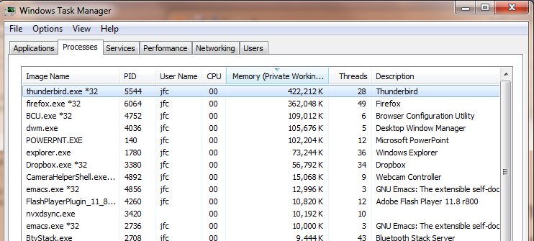
Some Numbers
Many process are multi-threaded, so thread context switches may be either within-process or across-processes

Slide 14
What happens when thread blocks on I/O?
CopyFile
read
Trap to OS
Stack growth
kernel_read
run_new_thread
switch
What happens when a thread requests a block of data from the file system?
  User code invokes a system call
  Read operation is initiated
  Run new thread/switch
Thread communication similar
  Wait for Signal/Join
  Networking

Slide 15
External Events
What happens if thread never does any I/O, never waits, and never yields control?
  Could the ComputePI program grab all resources and never release the processor?
    What if it didn’t print to console?
  Must find way that dispatcher can regain control!
Answer: utilize external events
  Interrupts: signals from hardware or software that stop the running code and jump to kernel
  Timer: like an alarm clock that goes off every some milliseconds
If we make sure that external events occur frequently enough, can ensure dispatcher runs
Notes:
Patterson’s a nice guy, so he gives up the body after using it for awhile and let’s John Kubitowicz have it.
But Kubi’s not so nice, so he won’t give up control…
If you want to wake up for a final, you set your clock, or ask your roommate to pour water over your head – OS does the same

Slide 16
Example: Network Interrupt
Raise priority
Reenable All Ints
Save registers
Dispatch to Handler
…
Transfer Network Packet from hardware
to Kernel Buffers
…
Restore registers
Clear current Int
Disable All Ints
Restore priority
RTI
...
add $r1,$r2,$r3
subi $r4,$r1,#4
slli $r4,$r4,#2
...
PC saved
Disable All Ints
Kernel Mode
External Interrupt
Pipeline Flush
“Interrupt Handler”
...
lw $r2,0($r4)
lw $r3,4($r4)
add $r2,$r2,$r3
sw 8($r4),$r2
...
Restore PC
User Mode
An interrupt is a hardware-invoked context switch
  No separate step to choose what to run next
  Always run the interrupt handler immediately

Slide 17
Use of Timer Interrupt to Return Control
Solution to our dispatcher problem
  Use the timer interrupt to force scheduling decisions
Timer Interrupt routine:
TimerInterrupt() {
DoPeriodicHouseKeeping();
run_new_thread();
}
Some Routine
Interrupt
TimerInterrupt
Stack growth
run_new_thread
switch

Slide 18
Thread Abstraction
Illusion: Infinite number of processors
Notes:
Execution model: each thread runs on a dedicated virtual processor with unpredictable and variable speed.

Slide 19
Thread Abstraction
Illusion: Infinite number of processors
Reality: Threads execute with variable speed
  Programs must be designed to work with any schedule
Notes:
Execution model: each thread runs on a dedicated virtual processor with unpredictable and variable speed.

Slide 20
Programmer vs. Processor View

Slide 21
Programmer vs. Processor View

Slide 22
Programmer vs. Processor View

Slide 23
Possible Executions

Slide 24
Thread Lifecycle

Slide 25
Administrivia
Your section is your home for CS162
  The TA needs to get to know you to judge participation
  All design reviews will be conducted by your TA
  You can attend alternate section by same TA, but try to keep the amount of such cross-section movement to a minimum
First midterm: Thursday, September 28, 6:30-8pm
  Barrows Hall, Room 166 (65 seats)
  Barrows Hall, Room 170 (65 seats)
  Barrows Hall, Room 20 (75 seats)
  Moffitt Undergraduate Library, Room 102 (84 seats)
  Mulford Hall, Room 159 (141 seats)
  Mulford Hall, Room 240 (50 seats)
  Wurster Hall, Room 102 (61 seats)

Slide 26
Per Thread Descriptor
(Kernel Supported Threads)
Each Thread has a Thread Control Block (TCB)
  Execution State: CPU registers, program counter (PC), pointer to stack (SP)
  Scheduling info: state, priority, CPU time
  Various Pointers (for implementing scheduling queues)
  Pointer to enclosing process (PCB) – user threads
  Etc (add stuff as you find a need)
OS Keeps track of TCBs in “kernel memory”
  In Array, or Linked List, or …
  I/O state (file descriptors, network connections, etc)

Slide 27
ThreadFork(): Create a New Thread
ThreadFork() is a user-level procedure that creates a new thread and places it on ready queue
Arguments to ThreadFork()
  Pointer to application routine (fcnPtr)
  Pointer to array of arguments (fcnArgPtr)
  Size of stack to allocate
Implementation
  Sanity check arguments
  Enter Kernel-mode and Sanity Check arguments again
  Allocate new Stack and TCB
  Initialize TCB and place on ready list (Runnable)

Slide 28
How do we initialize TCB and Stack?
Initialize Register fields of TCB
  Stack pointer made to point at stack
  PC return address ⇒ OS (asm) routine ThreadRoot()
  Two arg registers (a0 and a1) initialized to fcnPtr and fcnArgPtr, respectively
Initialize stack data?
  No. Important part of stack frame is in registers (ra)
  Think of stack frame as just before body of ThreadRoot() really gets started
ThreadRoot stub
Stack growth
Initial Stack

Slide 29
How does Thread get started?
Other Thread
ThreadRoot
A
B(while)
Stack growth
yield
run_new_thread
New Thread
switch
ThreadRoot stub
Eventually, run_new_thread() will select this TCB and return into beginning of ThreadRoot()
  This really starts the new thread

Slide 30
What does ThreadRoot() look like?
ThreadRoot() is the root for the thread routine:
ThreadRoot() {
DoStartupHousekeeping();
UserModeSwitch(); /* enter user mode */
Call fcnPtr(fcnArgPtr);
ThreadFinish();
}
Startup Housekeeping
  Includes things like recording
  start time of thread
  Other statistics
Stack will grow and shrink with
execution of thread
Final return from thread returns into ThreadRoot()
which calls ThreadFinish()
  ThreadFinish() wake up sleeping threads
ThreadRoot
Thread Code
Stack growth
Running Stack

Slide 31
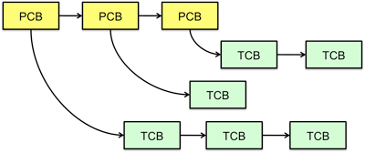
Multithreaded Processes
Process Control Block (PCBs) points to multiple Thread Control Blocks (TCBs):
Switching threads within a block is a simple thread switch
Switching threads across blocks requires changes to memory and I/O address tables

Slide 32
Examples multithreaded programs
Embedded systems
  Elevators, planes, medical systems, smart watches
  Single program, concurrent operations
Most modern OS kernels
  Internally concurrent because have to deal with concurrent requests by multiple users
  But no protection needed within kernel
Database servers
  Access to shared data by many concurrent users
  Also background utility processing must be done
Notes:
DB servers very important – provide “shared data” view to users.
Many users can read/write at once – how is consistency managed?

Slide 33
Example multithreaded programs (con’t)
Network servers
  Concurrent requests from network
  Again, single program, multiple concurrent operations
  File server, Web server, and airline reservation systems
Parallel programming (more than one physical CPU)
  Split program into multiple threads for parallelism
  This is called Multiprocessing
Some multiprocessors are actually uniprogrammed:
  Multiple threads in one address space but one program at a time

Slide 34
A Typical Use Case
Client Browser
- process for each tab
- thread to render page
- GET in separate thread
- multiple outstanding GETs
- as they complete, render
portion
Web Server
- fork process for each client connection
- thread to get request and issue response
- fork threads to read data, access DB, etc
- join and respond

Slide 35
Kernel Use Cases
Thread for each user process
Thread for sequence of steps in processing I/O
Threads for device drivers
…

Slide 36
Putting it Together: Process
(Unix) Process
A(int tmp) {
if (tmp<2)
B();
printf(tmp);
}
B() {
C();
}
C() {
A(2);
}
A(1);
…
Memory
Stack
Resources
I/O State
(e.g., file, socket contexts)
Sequential stream of instructions
CPU state (PC, SP, registers..)
Stored in OS

Slide 37
Putting it Together: Processes
Process 1
Process 2
Process N
Switch overhead: high
  CPU state: low
  Memory/IO state: high
Process creation: high
Protection
  CPU: yes
  Memory/IO: yes
Sharing overhead: high (involves at least a context switch)
Mem.
Mem.
Mem.
IO
state
IO
state
…
IO
state
CPU
state
CPU
state
CPU
state
CPU sched.
OS
1 process at a time
CPU
(1 core)

Slide 38
Putting it Together: Threads
Process 1
Process N
Switch overhead: medium
  CPU state: low
Thread creation: medium
Protection
  CPU: yes
  Memory/IO: No
Sharing overhead: low(ish) (thread switch overhead low)
threads
threads
Mem.
Mem.
…
IO
state
…
…
IO
state
CPU
state
CPU
state
CPU
state
CPU
state
CPU sched.
OS
1 thread at a time
CPU
(1 core)

Slide 39
Kernel versus User-Mode Threads
We have been talking about kernel threads
  Native threads supported directly by the kernel
  Every thread can run or block independently
  One process may have several threads waiting on different things
Downside of kernel threads: a bit expensive
  Need to make a crossing into kernel mode to schedule
Lighter weight option: User Threads

Slide 40
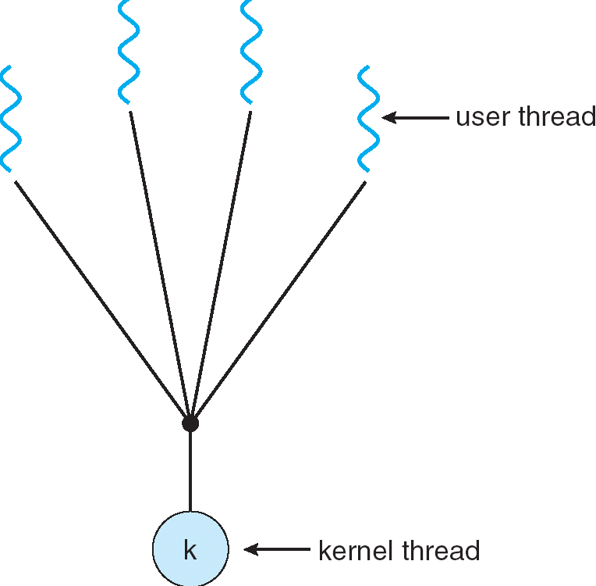
User-Mode Threads
Lighter weight option:
  User program provides scheduler and thread package
  May have several user threads per kernel
  thread
  User threads may be scheduled
  non-preemptively relative to each other
  (only switch on yield())
  Cheap
Downside of user threads:
  When one thread blocks on I/O, all threads block
  Kernel cannot adjust scheduling among all threads
  Option: Scheduler Activations
    Have kernel inform user level when thread blocks…

Slide 41
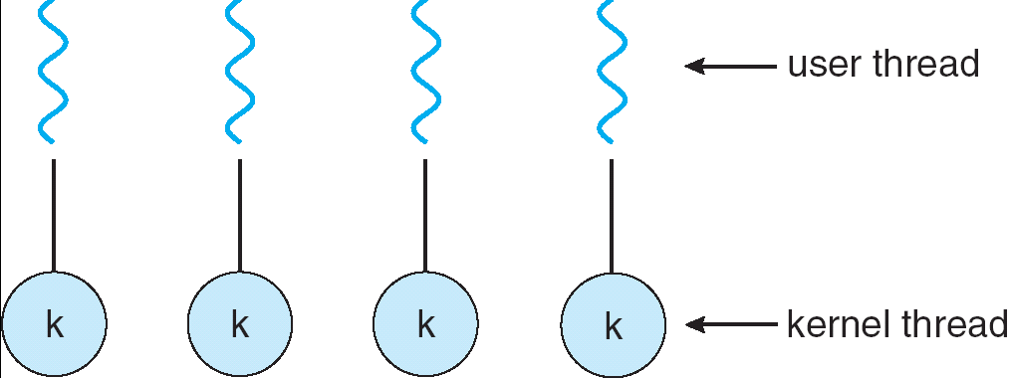
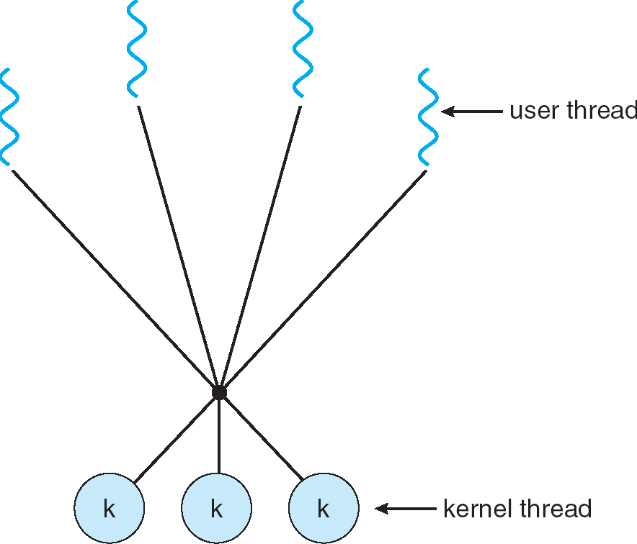
Some Threading Models
Simple One-to-One
Threading Model
Many-to-One
Many-to-Many

Slide 42
Threads in a Process
Threads are useful at user-level: parallelism, hide I/O latency, interactivity
Option A (early Java): user-level library, within a single-threaded process
  Library does thread context switch
  Kernel time slices between processes, e.g., on system call I/O
Option B (SunOS, Linux/Unix variants): green threads
  User-level library does thread multiplexing
Option C (Windows): scheduler activations
  Kernel allocates processors to user-level library
  Thread library implements context switch
  System call I/O that blocks triggers upcall
Option D (Linux, MacOS, Windows): use kernel threads
  System calls for thread fork, join, exit (and lock, unlock,…)
  Kernel does context switching
  Simple, but a lot of transitions between user and kernel mode

Slide 43
Putting it Together: Multi-Cores
Process 1
Process N
threads
threads
Switch overhead: low (only CPU state)
Thread creation: low
Protection
  CPU: yes
  Memory/IO: No
Sharing overhead: low (thread switch overhead low, may not need to switch at all!)
Mem.
Mem.
…
IO
state
…
…
IO
state
CPU
state
CPU
state
CPU
state
CPU
state
CPU sched.
OS
4 threads at a time
Core 1
Core 2
Core 3
Core 4
CPU

Slide 44
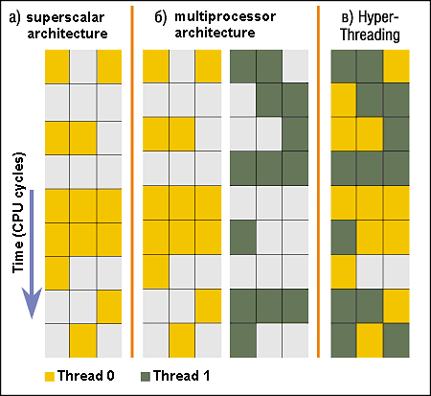
Simultaneous MultiThreading/Hyperthreading
Hardware technique
  Superscalar processors can
  execute multiple instructions
  that are independent
  Hyperthreading duplicates
  register state to make a
  second “thread,” allowing
  more instructions to run
Can schedule each thread
as if were separate CPU
  But, sub-linear speedup!
Original called “Simultaneous Multithreading”
  http://www.cs.washington.edu/research/smt/index.html
  Intel, SPARC, Power (IBM)
  A virtual core on AWS’ EC2 is basically a hyperthread
Colored blocks show
instructions executed
Notes:
Intel seems to be discarding SMT in Silvermont because of power problems

Slide 45
Putting it Together: Hyper-Threading
Process 1
Process N
threads
threads
Switch overhead between hardware-threads: very-low (done in hardware)
Contention for ALUs/FPUs may hurt performance
Mem.
Mem.
…
IO
state
…
…
IO
state
CPU
state
CPU
state
CPU
state
CPU
state
CPU sched.
OS
hardware-threads
(hyperthreading)
8 threads at a time
Core 1
Core 2
Core 3
Core 4
CPU

Slide 46
Classification
One
Many
# of addr spaces:
# threads
Per AS:
One
MS/DOS, early Macintosh
Traditional UNIX
Many
Embedded systems (Geoworks, VxWorks, JavaOS,etc)
JavaOS, Pilot(PC)
Mach, OS/2, Linux
Windows 10
Win NT to XP, Solaris, HP-UX, OS X
Most operating systems have either
  One or many address spaces
  One or many threads per address space

Slide 47
Summary
Processes have two parts
  Threads (Concurrency)
  Address Spaces (Protection)
Various textbooks talk about processes
  When this concerns concurrency, really talking about thread portion of a process
  When this concerns protection, talking about address space portion of a process
Concurrent threads are a very useful abstraction
  Allow transparent overlapping of computation and I/O
  Allow use of parallel processing when available
Concurrent threads introduce problems when accessing shared data
  Programs must be insensitive to arbitrary interleavings
  Without careful design, shared variables can become completely inconsistent

