Slide 1
CS162
Operating Systems and
Systems Programming
Lecture 16
General I/O
October 18th, 2017
Neeraja J. Yadwadkar
http://cs162.eecs.Berkeley.edu

Slide 2
The Requirements of I/O
So far in this course:
  We have learned how to manage CPU and memory
What about I/O?
  Without I/O, computers are useless (disembodied brains?)
  But… thousands of devices, each slightly different
    How can we standardize the interfaces to these devices?
  Devices unreliable: media failures and transmission errors
    How can we make them reliable???
  Devices unpredictable and/or slow
    How can we manage them if we don’t know what they will do or how they will perform?

Slide 3




OS Basics: I/O
Threads
Address Spaces
Windows
Processes
Files
Sockets
Software
OS Hardware Virtualization
Hardware
ISA
Memory
Processor
Protection Boundary
OS
Ctrlr
storage
Networks
Displays
Inputs

Slide 4
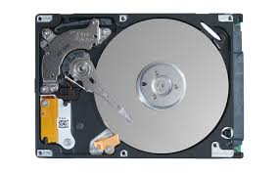
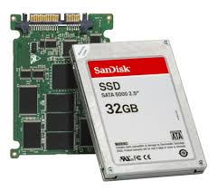
In a Picture
Read / Write
wires
Processor
I/O
Controllers
Secondary
Storage
(Disk)
Core
L2 Cache
Registers
L1 Cache
interrupts
Secondary
Storage
(SSD)
Main
Memory
(DRAM)
Read / Write
DMA transfer
L3 Cache
(shared)
Core
L2 Cache
Registers
L1 Cache
I/O devices you recognize are supported by I/O Controllers
Processors accesses them by reading and writing IO registers as if they were memory
  Write commands and arguments, read status and results

Slide 5
Operational Parameters for I/O
Data granularity: Byte vs. Block
  Some devices provide single byte at a time (e.g., keyboard)
  Others provide whole blocks (e.g., disks, networks, etc.)
Access pattern: Sequential vs. Random
  Some devices must be accessed sequentially (e.g., tape)
  Others can be accessed “randomly” (e.g., disk, cd, etc.)
    Fixed overhead to start transfers
  Some devices require continual monitoring
  Others generate interrupts when they need service
Transfer Mechanism: Programmed IO and DMA

Slide 6

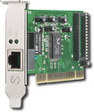
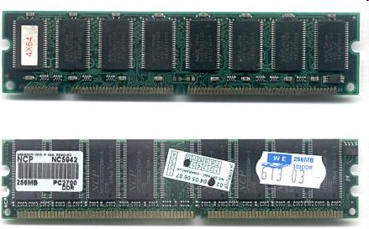
Kernel Device Structure
The System Call Interface
Process
Management
Memory
Management
Filesystems
Device
Control
Networking
Concurrency,
multitasking
Virtual
memory
Files and dirs:
the VFS
TTYs and
device access
Connectivity
Architecture
Dependent
Code
Memory
Manager
File System Types
Device
Control
Network
Subsystem
Block
Devices
IF drivers

Slide 7
The Goal of the I/O Subsystem
Provide Uniform Interfaces, Despite Wide Range of Different Devices
  This code works on many different devices:
  FILE fd = fopen("/dev/something", "rw");
  for (int i = 0; i < 10; i++) {
  fprintf(fd, "Count %d\n", i);
  }
  close(fd);
  Why? Because code that controls devices (“device driver”) implements standard interface
We will try to get a flavor for what is involved in actually controlling devices in rest of lecture
  Can only scratch surface!

Slide 8
Want Standard Interfaces to Devices
Block Devices: e.g. disk drives, tape drives, DVD-ROM
  Access blocks of data
  Commands include open(), read(), write(), seek()
  Raw I/O or file-system access
  Memory-mapped file access possible
Character Devices: e.g. keyboards, mice, serial ports, some USB devices
  Single characters at a time
  Commands include get(), put()
  Libraries layered on top allow line editing
Network Devices: e.g. Ethernet, Wireless, Bluetooth
  Different enough from block/character to have own interface
  Unix and Windows include socket interface
    Separates network protocol from network operation
    Includes select() functionality
  Usage: pipes, FIFOs, streams, queues, mailboxes

Slide 9
How Does User Deal with Timing?
Blocking Interface: “Wait”
  When request data (e.g. read() system call), put process to sleep until data is ready
  When write data (e.g. write() system call), put process to sleep until device is ready for data
Non-blocking Interface: “Don’t Wait”
  Returns quickly from read or write request with count of bytes successfully transferred
  Read may return nothing, write may write nothing
Asynchronous Interface: “Tell Me Later”
  When request data, take pointer to user’s buffer, return immediately; later kernel fills buffer and notifies user
  When send data, take pointer to user’s buffer, return immediately; later kernel takes data and notifies user

Slide 10
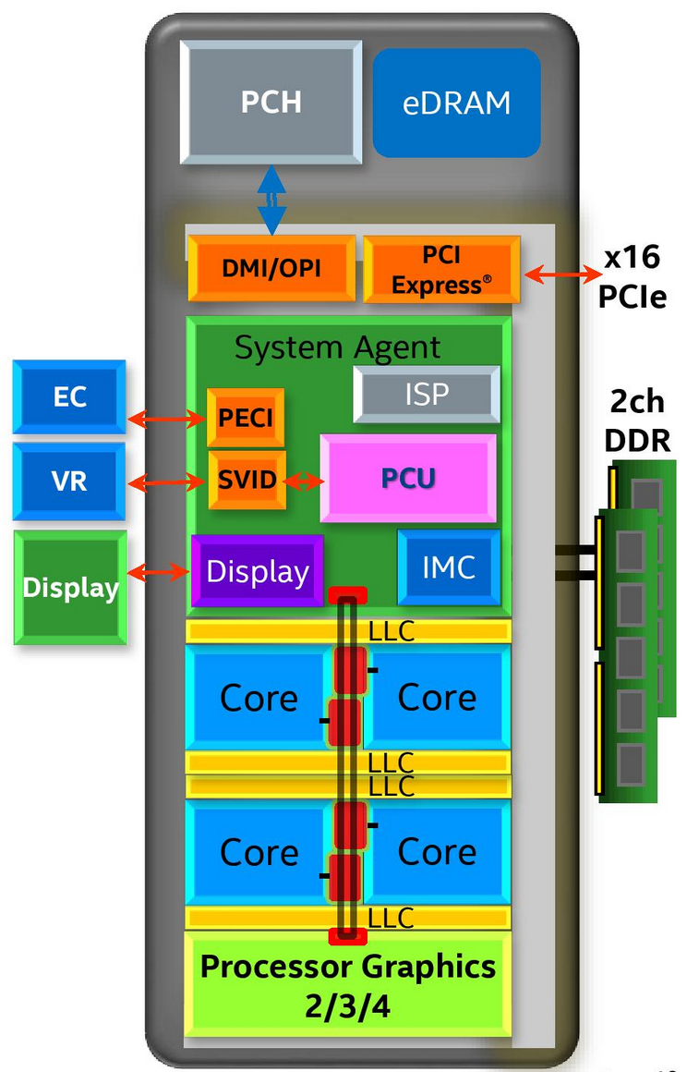
Chip-scale Features of 2015 x86 (Sky Lake)
Significant pieces:
  Four OOO cores with deeper buffers
    New Intel MPX (Memory Protection Extensions)
    New Intel SGX (Software Guard Extensions)
    Issue up to 6 μ-ops/cycle
  Integrated GPU, System Agent (Mem, Fast I/O)
  Large shared L3 cache with on-chip ring bus
    2 MB/core instead of 1.5 MB/core
    High-BW access to L3 Cache
Integrated I/O
  Integrated memory controller (IMC)
    Two independent channels of DDR3L/DDR4 DRAM
  High-speed PCI-Express (for Graphics cards)
  Direct Media Interface (DMI) Connection to PCH (Platform Control Hub)
Notes:
Let’s look at I/O in a modern processor.

Slide 11
Sky Lake I/O: PCH
Platform Controller Hub
  Connected to processor with proprietary bus
    Direct Media Interface
Types of I/O on PCH:
  USB, Ethernet
  Thunderbolt 3
  Audio, BIOS support
  More PCI Express (lower speed than on Processor)
  SATA (for Disks)
Sky Lake
System Configuration

Slide 12
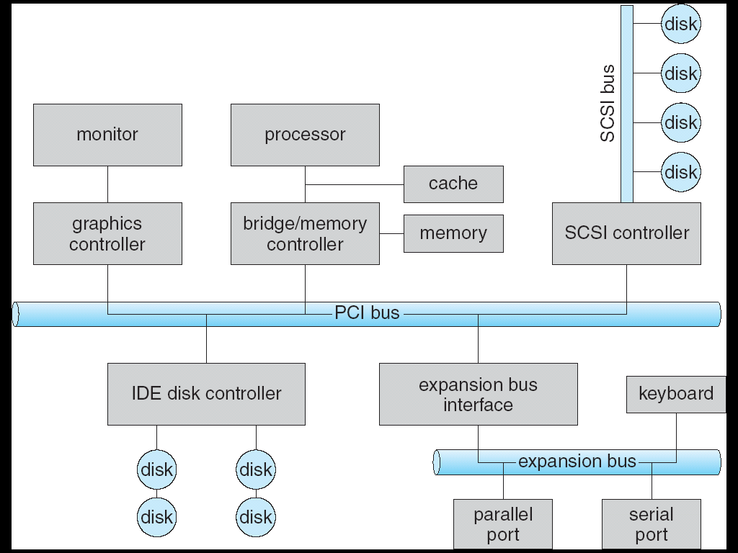

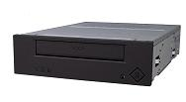
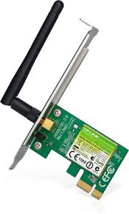
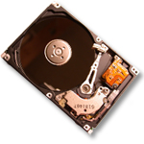

Modern I/O Systems
network

Slide 13
Example: PCI Architecture
RAM
Memory
Bus
CPU
Host Bridge
PCI #0
ISA Bridge
PCI Bridge
PCI #1
ISA
Controller
PCI Slots
USB
Controller
SATA
Controller
Scanner
Legacy
Devices
Root Hub
Hard Disk
DVD ROM
Hub
Webcam
Mouse
Keyboard

Slide 14
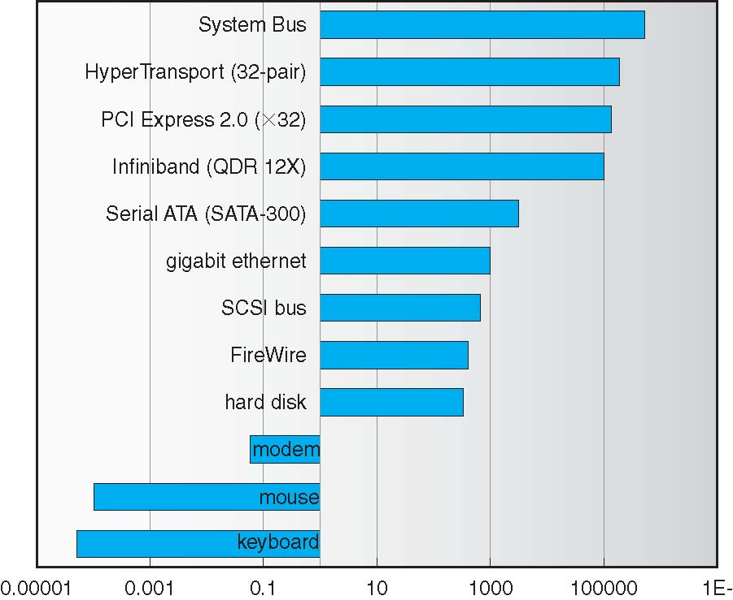
Example Device-Transfer Rates in Mb/s
(Sun Enterprise 6000)
10m
Device Rates vary over 12 orders of magnitude !!!
  System better be able to handle this wide range
  Better not have high overhead/byte for fast devices!
  Better not waste time waiting for slow devices

Slide 15
How does the processor actually talk to the device?
Processor Memory Bus
Regular
Memory
CPU
Bus
Adaptor
Bus
Adaptor
Device
Controller
Address +
Data
Other Devices
or Buses
Bus
Interface
Hardware
Controller
Interrupt
Controller
Interrupt Request
read
Addressable
Memory
and/or
Queues
write
CPU interacts with a Controller
  Contains a set of registers that
  can be read and written
  May contain memory for request
  queues or bit-mapped images
Regardless of the complexity of the connections and buses, processor accesses registers in two ways:
  I/O instructions: in/out instructions
    Example from the Intel architecture: out 0x21,AL
  Memory mapped I/O: load/store instructions
    Registers/memory appear in physical address space
    I/O accomplished with load and store instructions
control
status
Registers
(port 0x20)
Memory Mapped
Region: 0x8f008020

Slide 16
Example: Memory-Mapped Display Controller
Memory-Mapped:
  Hardware maps control registers and display memory into physical address space
    Addresses set by HW jumpers or at boot time
  Simply writing to display memory (also called the “frame buffer”) changes image on screen
    Addr: 0x8000F000 — 0x8000FFFF
  Writing graphics description to cmd queue
    Say enter a set of triangles describing some scene
    Addr: 0x80010000 — 0x8001FFFF
  Writing to the command register may cause on-board graphics hardware to do something
    Say render the above scene
    Addr: 0x0007F004
Can protect with address translation
0x80020000
Graphics
Command
Queue
0x80010000
Display
Memory
0x8000F000
0x0007F004
Command
0x0007F000
Status
Physical
Address
Space

Slide 17
Administrivia
Midterm 2 coming up on Mon 10/23 6:30-8:00PM
  All topics up to and including Lecture 16
    Focus will be on Lectures 10 – 16 and associated readings
    Projects 1 and 2
    Homework 0 – 2
  Closed book
  2 pages hand-written notes both sides
  Room assignment
    Li Ka Shing, GPB 100, Kreober 160
Project 2 Design Documents due today!
Sign up: Project 2 Design Reviews!

Slide 18
break

Slide 19
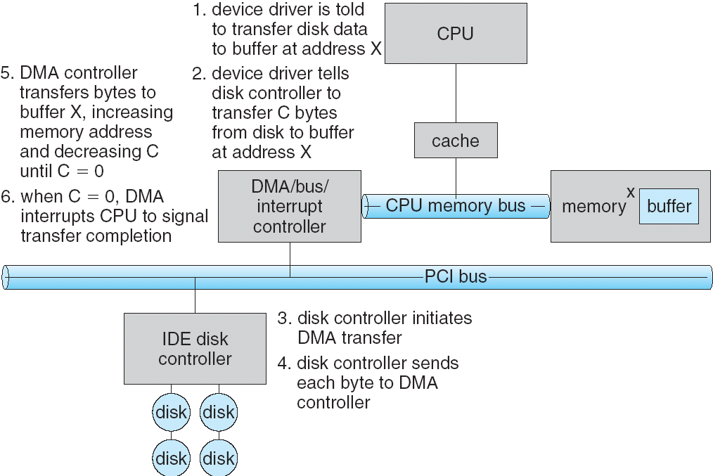
Transferring Data To/From Controller
Programmed I/O:
  Each byte transferred via processor in/out or load/store
  Pro: Simple hardware, easy to program
  Con: Consumes processor cycles proportional to data size
Direct Memory Access:
  Give controller access to memory bus
  Ask it to transfer
  data blocks to/from
  memory directly
Sample interaction
with DMA controller
(from OSC book):
1
2
3

Slide 20
Transferring Data To/From Controller
Programmed I/O:
  Each byte transferred via processor in/out or load/store
  Pro: Simple hardware, easy to program
  Con: Consumes processor cycles proportional to data size
Direct Memory Access:
  Give controller access to memory bus
  Ask it to transfer
  data blocks to/from
  memory directly
Sample interaction
with DMA controller
(from OSC book):
6
5
4

Slide 21
I/O Device Notifying the OS
The OS needs to know when:
  The I/O device has completed an operation
  The I/O operation has encountered an error
I/O Interrupt:
  Device generates an interrupt whenever it needs service
  Pro: handles unpredictable events well
  Con: interrupts relatively high overhead
Polling:
  OS periodically checks a device-specific status register
    I/O device puts completion information in status register
  Pro: low overhead
  Con: may waste many cycles on polling if infrequent or unpredictable I/O operations
Actual devices combine both polling and interrupts
  For instance – High-bandwidth network adapter:
    Interrupt for first incoming packet
    Poll for following packets until hardware queues are empty
Notes:
After the OS has issued a command to the I/O device either via a special I/O instruction or by writing to a location in the I/O address space, the OS needs to be notified when:
(a) The I/O device has completed the operation.
(b) Or when the I/O device has encountered an error.
This can be accomplished in two different ways: Polling and I/O interrupt.
+1 = 58 min. (Y:38)

Slide 22
Device Drivers
Device Driver: Device-specific code in the kernel that interacts directly with the device hardware
  Supports a standard, internal interface
  Same kernel I/O system can interact easily with different device drivers
  Special device-specific configuration supported with the ioctl() system call
Device Drivers typically divided into two pieces:
  Top half: accessed in call path from system calls
    implements a set of standard, cross-device calls like open(), close(), read(), write(), ioctl(), strategy()
    This is the kernel’s interface to the device driver
    Top half will start I/O to device, may put thread to sleep until finished
  Bottom half: run as interrupt routine
    Gets input or transfers next block of output
    May wake sleeping threads if I/O now complete

Slide 23
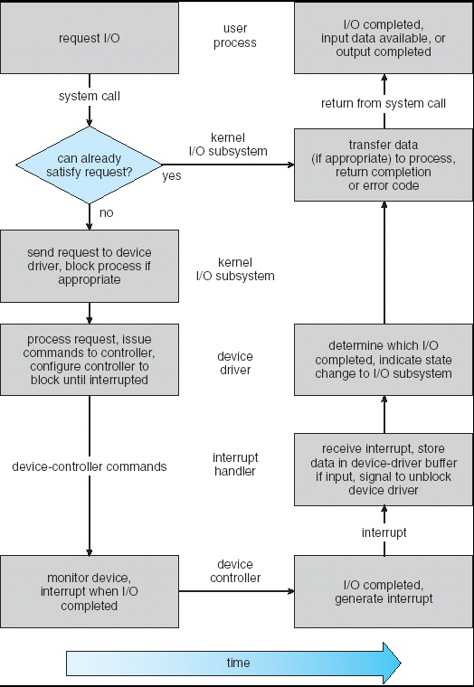
Life Cycle of An I/O Request
User
Program
Kernel I/O
Subsystem
Device Driver
Top Half
Device Driver
Bottom Half
Device
Hardware

Slide 24
Basic Performance Concepts
Response Time or Latency: Time to perform an operation(s)
Bandwidth or Throughput: Rate at which operations are performed (op/s)
  Files: MB/s, Networks: Mb/s, Arithmetic: GFLOP/s
Start up or “Overhead”: time to initiate an operation
Most I/O operations are roughly linear in n bytes
  Latency(n) = Overhead + n/TransferCapacity

Slide 25
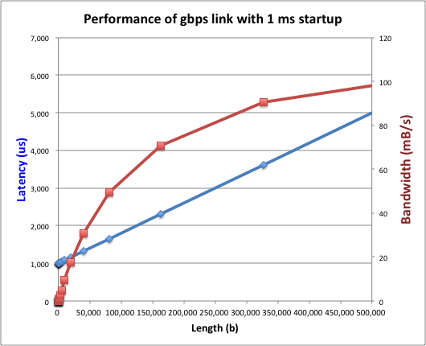
Example (Fast Network)
Consider a 1 Gb/s link (B = 125 MB/s)
  With a startup cost S = 1 ms
  Latency(n) = S + n/B
  Bandwidth = n/(S + n/B) = B*n/(B*S + n) = B/(B*S/n + 1)

Slide 26
Example (Fast Network)
Consider a 1 Gb/s link (B = 125 MB/s)
  With a startup cost S = 1 ms
  Bandwidth = B/(B*S/n + 1)
  half-power point occurs at n=S*B → Bandwidth = B/2

Slide 27
Example: at 10 ms startup (like Disk)
  n = 1,250,000 bytes!

Slide 28
What Determines Peak BW for I/O ?
Bus Speed
  PCI-X: 1064 MB/s = 133 MHz x 64 bit (per lane)
  ULTRA WIDE SCSI: 40 MB/s
  Serial Attached SCSI & Serial ATA & IEEE 1394 (firewire): 1.6 Gb/s full duplex (200 MB/s)
  USB 3.0 – 5 Gb/s
  Thunderbolt 3 – 40 Gb/s
Device Transfer Bandwidth
  Rotational speed of disk
  Write / Read rate of NAND flash
  Signaling rate of network link
Whatever is the bottleneck in the path…

Slide 29
Storage Devices
Magnetic disks
  Storage that rarely becomes corrupted
  Large capacity at low cost
  Block level random access (except for SMR – later!)
  Slow performance for random access
  Better performance for sequential access
Flash memory
  Storage that rarely becomes corrupted
  Capacity at intermediate cost (5-20x disk)
  Block level random access
  Good performance for reads; worse for random writes
  Erasure requirement in large blocks
  Wear patterns issue

Slide 30
The Amazing Magnetic Disk
Unit of Transfer: Sector
  Ring of sectors form a track
  Stack of tracks form a cylinder
  Heads position on cylinders
Disk Tracks ~ 1µm (micron) wide
  Wavelength of light is ~ 0.5µm
  Resolution of human eye: 50µm
  100K tracks on a typical 2.5” disk
Separated by unused guard regions
  Reduces likelihood neighboring tracks are corrupted during writes (still a small non-zero chance)

Slide 31
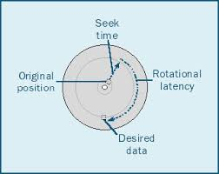
Review: Magnetic Disks
Track
Cylinders: all the tracks under the
head at a given point on all surface
Read/write data is a three-stage process:
  Seek time: position the head/arm over the proper track
  Rotational latency: wait for desired sector to rotate under r/w head
  Transfer time: transfer a block of bits (sector) under r/w head
Sector
Head
Cylinder
Platter
Seek time = 4-8ms
One rotation = 1-2ms
(3600-7200 RPM)

Slide 32
Review: Magnetic Disks
Track
Cylinders: all the tracks under the
head at a given point on all surface
Read/write data is a three-stage process:
  Seek time: position the head/arm over the proper track
  Rotational latency: wait for desired sector to rotate under r/w head
  Transfer time: transfer a block of bits (sector) under r/w head
Sector
Head
Cylinder
Platter
Disk Latency = Queueing Time + Controller time +
Seek Time + Rotation Time + Xfer Time
Software
Queue
(Device Driver)
Hardware
Controller
Media Time
(Seek+Rot+Xfer)
Request
Result

Slide 33
Disk Performance Example
Assumptions:
  Ignoring queuing and controller times for now
  Avg seek time of 5ms,
  7200RPM ⇒ Time for rotation: 60000 (ms/minute) / 7200(rev/min) ~= 8ms
  Transfer rate of 4MByte/s, sector size of 1 Kbyte ⇒
  1024 bytes/4×10⁶ (bytes/s) = 256 × 10⁻⁶ sec ≅ .26 ms
Read sector from random place on disk:
  Seek (5ms) + Rot. Delay (4ms) + Transfer (0.26ms)
  Approx 10ms to fetch/put data: 100 KByte/sec
Read sector from random place in same cylinder:
  Rot. Delay (4ms) + Transfer (0.26ms)
  Approx 5ms to fetch/put data: 200 KByte/sec
Read next sector on same track:
  Transfer (0.26ms): 4 MByte/sec
Key to using disk effectively (especially for file systems) is to minimize seek and rotational delays

Slide 34
Typical Numbers for Magnetic Disk
Parameter | Info / Range
Space/Density | Space: 8TB (Seagate), 10TB (Hitachi) in 3½ inch form factor! Areal Density: ≥ 1Terabit/square inch! (SMR, Helium, …)
Average seek time | Typically 5-10 milliseconds. Depending on reference locality, actual cost may be 25-33% of this number.
Average rotational latency | Most laptop/desktop disks rotate at 3600-7200 RPM (16-8 ms/rotation). Server disks up to 15,000 RPM. Average latency is halfway around disk so 8-4 milliseconds
Controller time | Depends on controller hardware
Transfer time | Typically 50 to 100 MB/s. Depends on: Transfer size (usually a sector): 512B – 1KB per sector Rotation speed: 3600 RPM to 15000 RPM Recording density: bits per inch on a track Diameter: ranges from 1 in to 5.25 in
Cost | Used to drop by a factor of two every 1.5 years (or even faster); now slowing down
Notes:
As far as rotational latency is concerned, most disks rotate at 3,600 RPM or approximately 16 ms per revolution.
Since on average, the information you desired is half way around the disk, the average rotational latency will be 8ms.
The transfer time is a function of transfer size, rotation speed, and recording density.
The typical transfer speed is 2 to 4 MB per second.
Notice that the transfer time is much faster than the rotational latency and seek time.
This is similar to the DRAM situation where the DRAM access time is much shorter than the DRAM cycle time.
***** Do anybody remember what we did to take advantage of the short access time versus cycle time? Well, we interleave!
New International Disk Drive, Equipment, and Materials Association standard is 4KB sectors instead of 512 byte sectors
+2 = 36 min. (Y:16)

Slide 35
(Lots of) Intelligence in the Controller
Sectors contain sophisticated error correcting codes
  Disk head magnet has a field wider than track
  Hide corruptions due to neighboring track writes
Sector sparing
  Remap bad sectors transparently to spare sectors on the same surface
Slip sparing
  Remap all sectors (when there is a bad sector) to preserve sequential behavior
Track skewing
  Sector numbers offset from one track to the next, to allow for disk head movement for sequential ops
…

Slide 36
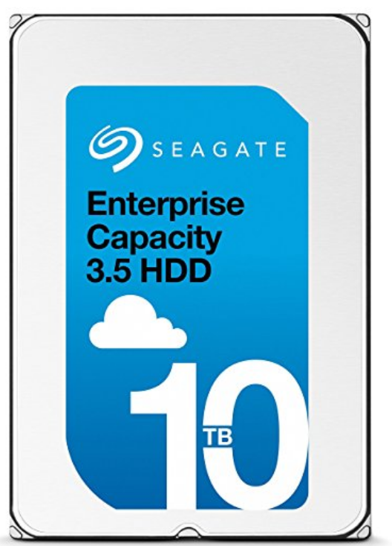
Seagate Enterprise
10 TB (2016)
7 platters, 14 heads
7200 RPMs
6 Gbps SATA /12Gbps SAS interface
220MB/s transfer rate, cache size: 256MB
Helium filled: reduce friction and power usage
Price: $500 ($0.05/GB)
IBM Personal Computer/AT (1986)
30 MB hard disk
30-40ms seek time
0.7-1 MB/s (est.)
Price: $500 ($17K/GB, 340,000x more expensive !!)

Slide 37
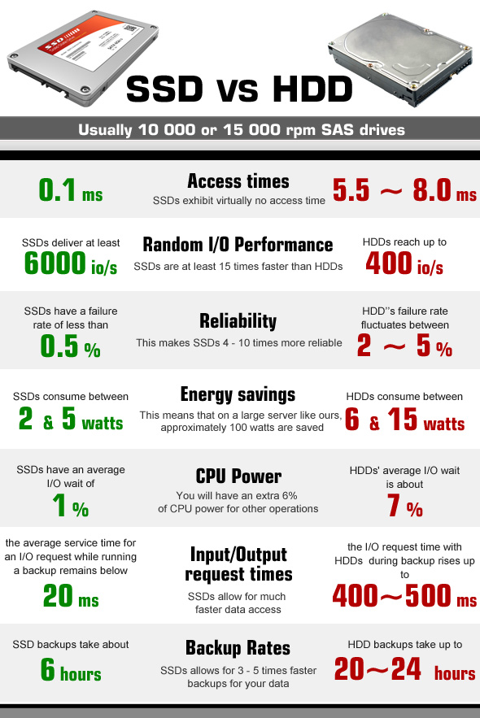
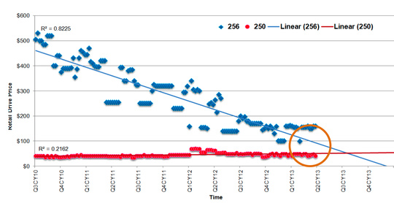
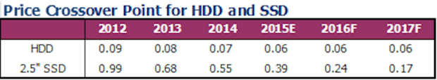
HDD vs SSD Comparison
SSD prices drop much faster than HDD

Slide 38
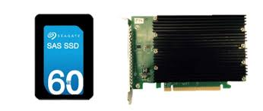
Largest SSDs
60TB (2016)
Dual port: 16Gbs
Seq reads: 1.5GB/s
Seq writes: 1GB/s
Random Read Ops (IOPS): 150K
Price: ~ $20K ($0.33/GB)

Slide 39
Summary
I/O Devices Types:
  Many different speeds (0.1 bytes/sec to GBytes/sec)
  Different Access Patterns:
    Block Devices, Character Devices, Network Devices
  Different Access Timing:
    Blocking, Non-blocking, Asynchronous
I/O Controllers: Hardware that controls actual device
  Processor Accesses through I/O instructions, load/store to special physical memory
Notification mechanisms
  Interrupts
  Polling: Report results through status register that processor looks at periodically
Device drivers interface to I/O devices
  Provide clean Read/Write interface to OS above
  Manipulate devices through PIO, DMA & interrupt handling
  Three types: block, character, and network

