Slide 1
CS162
Operating Systems and
Systems Programming
Lecture 11
Scheduling (finished),
Deadlock, Address Translation
October 2nd, 2017
Prof. Ion Stoica
http://cs162.eecs.Berkeley.edu

Slide 2
Real-Time Scheduling (RTS)
Efficiency is important but predictability is essential:
  We need to predict with confidence worst case response times for systems
  In RTS, performance guarantees are:
    Task- and/or class centric and often ensured a priori
  In conventional systems, performance is:
    System/throughput oriented with post-processing (… wait and see …)
  Real-time is about enforcing predictability, and does not equal fast computing!!!

Slide 3
Real-Time Scheduling (RTS)
Hard Real-Time
  Attempt to meet all deadlines
  EDF (Earliest Deadline First), LLF (Least Laxity First),
  RM (Rate-Monotonic), DM (Deadline Monotonic)
Soft Real-Time
  Attempt to meet deadlines with high probability
  Minimize miss ratio / maximize completion ratio (firm real-time)
  Important for multimedia applications
  CBS (Constant Bandwidth Server)

Slide 4
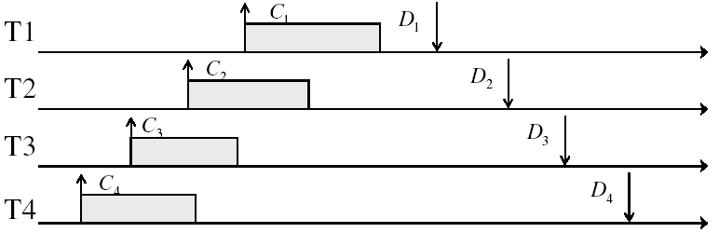
Example: Workload Characteristics
Tasks are preemptable, independent with arbitrary arrival (=release) times
Tasks have deadlines (D) and known computation times (C)
Example Setup:

Slide 5
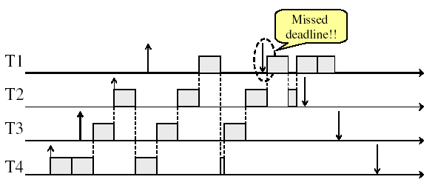
Example: Round-Robin Scheduling Doesn’t Work
Time

Slide 6
Earliest Deadline First (EDF)
Tasks periodic with period P and computation C in each period: (P, C)
Preemptive priority-based dynamic scheduling
Each task is assigned a (current) priority based on how close the absolute deadline is
The scheduler always schedules the active task with the closest absolute deadline
0
5
10
15

Slide 7
A Final Word On Scheduling
When do the details of the scheduling policy and fairness really matter?
  When there aren’t enough resources to go around
When should you simply buy a faster computer?
  (Or network link, or expanded highway, or …)
  One approach: Buy it when it will pay
  for itself in improved response time
    Assuming you’re paying for worse response time
    in reduced productivity, customer angst, etc…
    Might think that you should buy a faster X when
    X is utilized 100%, but usually, response time
    goes to infinity as utilization⇒100%
An interesting implication of this curve:
  Most scheduling algorithms work fine in the “linear” portion of the load curve, fail otherwise
  Argues for buying a faster X when hit “knee” of curve
Response
time
100%
Utilization

Slide 8
Starvation vs Deadlock
Starvation vs. Deadlock
  Starvation: thread waits indefinitely
    Example, low-priority thread waiting for resources constantly in use by high-priority threads
  Deadlock: circular waiting for resources
    Thread A owns Res 1 and is waiting for Res 2
    Thread B owns Res 2 and is waiting for Res 1
  Deadlock ⇒ Starvation but not vice versa
    Starvation can end (but doesn’t have to)
    Deadlock can’t end without external intervention
Thread
A
Wait
For
Owned
By
Res 1
Res 2
Owned
By
Wait
For
Thread
B

Slide 9
Conditions for Deadlock
Deadlock not always deterministic – Example 2 mutexes:
Thread A Thread B
x.P(); y.P();
y.P(); x.P();
y.V(); x.V();
x.V(); y.V();
  Deadlock won’t always happen with this code
    Have to have exactly the right timing (“wrong” timing?)
    So you release a piece of software, and you tested it, and there it is, controlling a nuclear power plant…
Deadlocks occur with multiple resources
  Means you can’t decompose the problem
  Can’t solve deadlock for each resource independently
Example: System with 2 disk drives and two threads
  Each thread needs 2 disk drives to function
  Each thread gets one disk and waits for another one

Slide 10
Bridge Crossing Example
Honk!
Each segment of road can be viewed as a resource
  Car must own the segment under them
  Must acquire segment that they are moving into
For bridge: must acquire both halves
  Traffic only in one direction at a time
  Problem occurs when two cars in opposite directions on bridge: each acquires one segment and needs next
If a deadlock occurs, it can be resolved if one car backs up (preempt resources and rollback)
  Several cars may have to be backed up
Starvation is possible
  East-going traffic really fast ⇒ no one goes west

Slide 11
Train Example (Wormhole-Routed Network)
Circular dependency (Deadlock!)
  Each train wants to turn right
  Blocked by other trains
  Similar problem to multiprocessor networks
Fix? Imagine grid extends in all four directions
  Force ordering of channels (tracks)
    Protocol: Always go east-west first, then north-south
  Called “dimension ordering” (X then Y)
Disallowed
By Rule

Slide 12
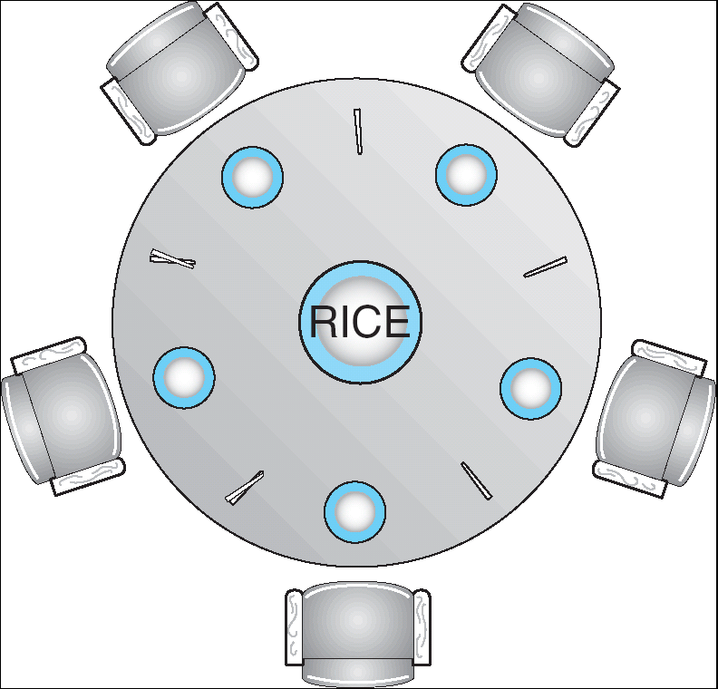
Dining Lawyers Problem
Five chopsticks/Five lawyers (really cheap restaurant)
  Free-for all: Lawyer will grab any one they can
  Need two chopsticks to eat
What if all grab at same time?
  Deadlock!
How to fix deadlock?
  Make one of them give up a chopstick (Hah!)
  Eventually everyone will get chance to eat
How to prevent deadlock?
  Never let lawyer take last chopstick if no hungry lawyer has two chopsticks afterwards

Slide 13
Four requirements for Deadlock
Mutual exclusion
  Only one thread at a time can use a resource.
Hold and wait
  Thread holding at least one resource is waiting to acquire additional resources held by other threads
No preemption
  Resources are released only voluntarily by the thread holding the resource, after thread is finished with it
Circular wait
  There exists a set {T₁, …, T_{n}} of waiting threads
    T₁ is waiting for a resource that is held by T₂
    T₂ is waiting for a resource that is held by T₃
    …
    T_{n} is waiting for a resource that is held by T₁

Slide 14
Resource-Allocation Graph
Symbols
System Model
  A set of Threads T₁, T₂, . . ., T_{n}
  Resource types R₁, R₂, . . ., R_{m}
    CPU cycles, memory space, I/O devices
  Each resource type R_{i} has W_{i} instances
  Each thread utilizes a resource as follows:
    Request() / Use() / Release()
Resource-Allocation Graph:
  V is partitioned into two types:
    T = {T₁, T₂, …, T_{n}}, the set threads in the system.
    R = {R₁, R₂, …, R_{m}}, the set of resource types in system
  request edge – directed edge T₁ → R_{j}
  assignment edge – directed edge R_{j} → T_{i}
T₁
T₂
R₁
R₂

Slide 15
Resource Allocation Graph Examples
Recall:
  request edge – directed edge T₁ → R_{j}
  assignment edge – directed edge R_{j} → T_{i}
R₁
R₂
R₁
R₂
R₁
T₂
T₁
T₂
T₃
T₁
T₂
T₃
T₁
T₃
R₃
T₄
R₄
R₃
R₂
R₄
Simple Resource
Allocation Graph
Allocation Graph
With Deadlock
Allocation Graph
With Cycle, but
No Deadlock

Slide 16
Methods for Handling Deadlocks
Allow system to enter deadlock and then recover
  Requires deadlock detection algorithm
  Some technique for forcibly preempting resources and/or terminating tasks
Ensure that system will never enter a deadlock
  Need to monitor all lock acquisitions
  Selectively deny those that might lead to deadlock
Ignore the problem and pretend that deadlocks never occur in the system
  Used by most operating systems, including UNIX

Slide 17
Deadlock Detection Algorithm
Only one of each type of resource ⇒ look for loops
More General Deadlock Detection Algorithm
  Let [X] represent an m-ary vector of non-negative
  integers (quantities of resources of each type):
  [FreeResources]: Current free resources each type
  [Request_{X}]: Current requests from thread X
  [Alloc_{X}]: Current resources held by thread X
  See if tasks can eventually terminate on their own
[Avail] = [FreeResources]
Add all nodes to UNFINISHED
do {
done = true
Foreach node in UNFINISHED {
if ([Request_{node}] <= [Avail]) {
remove node from UNFINISHED
[Avail] = [Avail] + [Alloc_{node}]
done = false
}
}
} until(done)
  Nodes left in UNFINISHED ⇒ deadlocked
R₁
T₂
T₁
T₃
T₄
R₂

Slide 18
What to do when detect deadlock?
Terminate thread, force it to give up resources
  In Bridge example, Godzilla picks up a car, hurls it into the river. Deadlock solved!
  Shoot a dining lawyer
  But, not always possible – killing a thread holding a mutex leaves world inconsistent
Preempt resources without killing off thread
  Take away resources from thread temporarily
  Doesn’t always fit with semantics of computation
Roll back actions of deadlocked threads
  Hit the rewind button on TiVo, pretend last few minutes never happened
  For bridge example, make one car roll backwards (may require others behind him)
  Common technique in databases (transactions)
  Of course, if you restart in exactly the same way, may reenter deadlock once again
Many operating systems use other options

Slide 19
Administrivia
Ion out next week (travelling to China):
  11/9: lecture will be given by Anthony Joseph (tentatively)
  11/11: lecture will be given by Neeraja
Deadline for 1st midterm regrades: Friday, 10/6

Slide 20
BREAK

Slide 21
Techniques for Preventing Deadlock
Infinite resources
  Include enough resources so that no one ever runs out of resources. Doesn’t have to be infinite, just large
  Give illusion of infinite resources (e.g. virtual memory)
  Examples:
    Bay bridge with 12,000 lanes. Never wait!
    Infinite disk space (not realistic yet?)
No Sharing of resources (totally independent threads)
  Not very realistic
Don’t allow waiting
  How the phone company avoids deadlock
    Call to your Mom in Toledo, works its way through the phone lines, but if blocked get busy signal.
  Technique used in Ethernet/some multiprocessor nets
    Everyone speaks at once. On collision, back off and retry
  Inefficient, since have to keep retrying
    Consider: driving to San Francisco; when hit traffic jam, suddenly you’re transported back home and told to retry!

Slide 22
Techniques for Preventing Deadlock (cont’d)
Make all threads request everything they’ll need at the beginning.
  Problem: Predicting future is hard, tend to over-estimate resources
  Example:
    If need 2 chopsticks, request both at same time
    Don’t leave home until we know no one is using any intersection between here and where you want to go; only one car on the Bay Bridge at a time
Force all threads to request resources in a particular order preventing any cyclic use of resources
  Thus, preventing deadlock
  Example (x.P, y.P, z.P,…)
    Make tasks request disk, then memory, then…
    Keep from deadlock on freeways around SF by requiring everyone to go clockwise

Slide 23
Review: Train Example (Wormhole-Routed Network)
Circular dependency (Deadlock!)
  Each train wants to turn right
  Blocked by other trains
  Similar problem to multiprocessor networks
Fix? Imagine grid extends in all four directions
  Force ordering of channels (tracks)
    Protocol: Always go east-west first, then north-south
  Called “dimension ordering” (X then Y)
Disallowed
By Rule

Slide 24
Banker’s Algorithm for Preventing Deadlock
Toward right idea:
  State maximum (max) resource needs in advance
  Allow particular thread to proceed if:
    (available resources - #requested) ≥ max
    remaining that might be needed by any thread
Banker’s algorithm (less conservative):
  Allocate resources dynamically
    Evaluate each request and grant if some
    ordering of threads is still deadlock free afterward
    Technique: pretend each request is granted, then run deadlock detection algorithm, substituting
    ([Max_{node}]-[Alloc_{node}] ≤ [Avail]) for ([Request_{node}] ≤ [Avail])
    Grant request if result is deadlock free (conservative!)

Slide 25
Banker’s Algorithm for Preventing Deadlock
Toward right idea:
  State maximum resource needs in advance
  Allow particular thread to proceed if:
    (available resources - #requested) ≥ max
    remaining that might be needed by any thread
Banker’s algorithm (less conservative):
  Allocate resources dynamically
    Evaluate each request and grant if some
    ordering of threads is still deadlock free afterward
    Technique: pretend each request is granted, then run deadlock detection algorithm, substituting
    ([Max_{node}]-[Alloc_{node}] ≤ [Avail]) for ([Request_{node}] ≤ [Avail])
    Grant request if result is deadlock free (conservative!)
[Avail] = [FreeResources]
Add all nodes to UNFINISHED
do {
done = true
Foreach node in UNFINISHED {
if ([Request_{node}] <= [Avail]) {
remove node from UNFINISHED
[Avail] = [Avail] + [Alloc_{node}]
done = false
}
}
} until(done)

Slide 26
Banker’s Algorithm for Preventing Deadlock
Toward right idea:
  State maximum resource needs in advance
  Allow particular thread to proceed if:
    (available resources - #requested) ≥ max
    remaining that might be needed by any thread
Banker’s algorithm (less conservative):
  Allocate resources dynamically
    Evaluate each request and grant if some
    ordering of threads is still deadlock free afterward
    Technique: pretend each request is granted, then run deadlock detection algorithm, substituting
    ([Max_{node}]-[Alloc_{node}] ≤ [Avail]) for ([Request_{node}] ≤ [Avail])
    Grant request if result is deadlock free (conservative!)
[Avail] = [FreeResources]
Add all nodes to UNFINISHED
do {
done = true
Foreach node in UNFINISHED {
if ([Max_{node}]-[Alloc_{node}] <= [Avail]) {
remove node from UNFINISHED
[Avail] = [Avail] + [Alloc_{node}]
done = false
}
}
} until(done)

Slide 27
Banker’s Algorithm for Preventing Deadlock
Toward right idea:
  State maximum resource needs in advance
  Allow particular thread to proceed if:
    (available resources - #requested) ≥ max
    remaining that might be needed by any thread
Banker’s algorithm (less conservative):
  Allocate resources dynamically
    Evaluate each request and grant if some
    ordering of threads is still deadlock free afterward
    Technique: pretend each request is granted, then run deadlock detection algorithm, substituting
    ([Max_{node}]-[Alloc_{node}] ≤ [Avail]) for ([Request_{node}] ≤ [Avail])
    Grant request if result is deadlock free (conservative!)
    Keeps system in a “SAFE” state, i.e. there exists a sequence {T₁, T₂, … T_{n}} with T₁ requesting all remaining resources, finishing, then T₂ requesting all remaining resources, etc..
  Algorithm allows the sum of maximum resource needs of all current threads to be greater than total resources

Slide 28
Banker’s Algorithm Example
Banker’s algorithm with dining lawyers
  “Safe” (won’t cause deadlock) if when try to grab chopstick either:
    Not last chopstick
    Is last chopstick but someone will have two afterwards
  What if k-handed lawyers? Don’t allow if:
    It’s the last one, no one would have k
    It’s 2nd to last, and no one would have k-1
    It’s 3rd to last, and no one would have k-2
    …

Slide 29
Virtualizing Resources
Physical Reality:
Different Processes/Threads share the same hardware
  Need to multiplex CPU (Just finished: scheduling)
  Need to multiplex use of Memory (starting today)
  Need to multiplex disk and devices (later in term)
Why worry about memory sharing?
  The complete working state of a process and/or kernel is defined by its data in memory (and registers)
  Consequently, cannot just let different threads of control use the same memory
    Physics: two different pieces of data cannot occupy the same locations in memory
  Probably don’t want different threads to even have access to each other’s memory (protection)

Slide 30
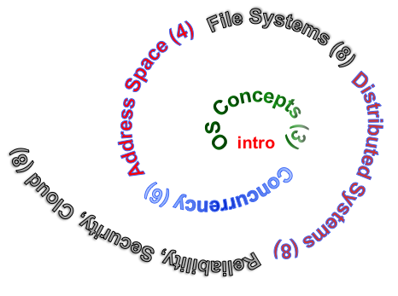
Next Objective
Dive deeper into the concepts and mechanisms of memory sharing and address translation
Enabler of many key aspects of operating systems
  Protection
  Multi-programming
  Isolation
  Memory resource management
  I/O efficiency
  Sharing
  Inter-process communication
  Debugging
  Demand paging
Today: Translation

Slide 31

Recall: Single and Multithreaded Processes
Threads encapsulate concurrency
  “Active” component of a process
Address spaces encapsulate protection
  Keeps buggy program from trashing the system
  “Passive” component of a process

Slide 32
Important Aspects of Memory Multiplexing
Protection:
  Prevent access to private memory of other processes
    Different pages of memory can be given special behavior (Read Only, Invisible to user programs, etc).
    Kernel data protected from User programs
    Programs protected from themselves
Controlled overlap:
  Separate state of threads should not collide in physical memory. Obviously, unexpected overlap causes chaos!
  Conversely, would like the ability to overlap when desired (for communication)
Translation:
  Ability to translate accesses from one address space (virtual) to a different one (physical)
  When translation exists, processor uses virtual addresses, physical memory uses physical addresses
  Side effects:
    Can be used to avoid overlap
    Can be used to give uniform view of memory to programs

Slide 33




Recall: Loading
Threads
Address Spaces
Windows
Processes
Files
Sockets
Software
OS Hardware Virtualization
Hardware
ISA
Memory
Processor
Protection Boundary
OS
Ctrlr
storage
Networks
Displays
Inputs

Slide 34
Binding of Instructions and Data to Memory
Assume 4byte words
0x300 = 4 * 0x0C0
0x0C0 = 0000 1100 0000
0x300 = 0011 0000 0000
Process view of memory
Physical addresses
  data1: dw 32
  …
  start: lw r1,0(data1)
  jal checkit
  loop: addi r1, r1, -1
  bnz r1, loop …
  checkit: …
  0x0300 00000020
  … …
  0x0900 8C2000C0
  0x0904 0C000280
  0x0908 2021FFFF
  0x090C 14200242
  …
  0x0A00

Slide 35
Binding of Instructions and Data to Memory
Physical
Memory
0x0000
0x0300
  00000020
Process view of memory
Physical addresses
  data1: dw 32
  …
  start: lw r1,0(data1)
  jal checkit
  loop: addi r1, r1, -1
  bnz r1, loop …
  checkit: …
  0x0300 00000020
  … …
  0x0900 8C2000C0
  0x0904 0C000280
  0x0908 2021FFFF
  0x090C 14200242
  …
  0x0A00
0x0900
  8C2000C0
  0C000340
  2021FFFF
  14200242
0xFFFF

Slide 36
Second copy of program from previous example
Physical
Memory
0x0000
0x0300
App X
Process view of memory
Physical addresses
  data1: dw 32
  …
  start: lw r1,0(data1)
  jal checkit
  loop: addi r1, r1, -1
  bnz r1, loop …
  checkit: …
  0x0300 00000020
  … …
  0x0900 8C2000C0
  0x0904 0C000280
  0x0908 2021FFFF
  0x090C 14200242
  …
  0x0A00
0x0900
?
0xFFFF
Need address translation!

Slide 37
Second copy of program from previous example
Physical
Memory
0x0000
0x0300
App X
Process view of memory
Physical addresses
  data1: dw 32
  …
  start: lw r1,0(data1)
  jal checkit
  loop: addi r1, r1, -1
  bnz r1, loop …
  checkit: …
  0x1300 00000020
  … …
  0x1900 8C2004C0
  0x1904 0C000680
  0x1908 2021FFFF
  0x190C 14200642
  …
  0x1A00
0x0900
0x1300
  00000020
0x1900
  8C2004C0
  0C000680
  2021FFFF
  14200642
One of many possible translations!
Where does translation take place?
    Compile time, Link/Load time, or Execution time?
0xFFFF

Slide 38
Summary
Real-time scheduling
  Need to meet a deadline, predictability essential
  Earliest Deadline First (EDF) and Rate Monotonic (RM) scheduling
Four requirements for deadlock:
  Mutual exclusion
  Hold and wait
  No preemption
  Circular wait
Simple Protection through segmentation
  Base + Limit registers restrict memory accessible to user
  Can be used to translate as well

