Slide 1
CS 152 Computer Architecture and Engineering CS252 Graduate Computer Architecture Lecture 16 – RISC-V Vectors
Krste Asanovic
Electrical Engineering and Computer Sciences
University of California at Berkeley
http://www.eecs.berkeley.edu/~krste
http://inst.eecs.berkeley.edu/~cs152

Slide 2
Last Time in Lecture 16
GPU architecture
Evolved from graphics-only, to more general-purpose computing
GPUs programmed as attached accelerators, with software required to separate GPU from CPU code, move memory
Many cores, each with many lanes
thousands of lanes on current high-end GPUs
SIMT model has hardware management of conditional execution
code written as scalar code with branches, executed as vector code with predication

Slide 3
New RISC-V “V” Vector Extension
Being added as a standard extension to the RISC-V ISA
An updated form of Cray-style vectors for modern microprocessors
Today, a short tutorial on current draft standard, v0.7
v0.7 is intended to be close to final version of RISC-V vector extension
Still a work in progress, so details might change before standardization
https://github.com/riscv/riscv-v-spec
WARNING: Lab 4 uses older version of vector ISA, since new tools not available yet
Most concepts carry over, if not programming details

Slide 4
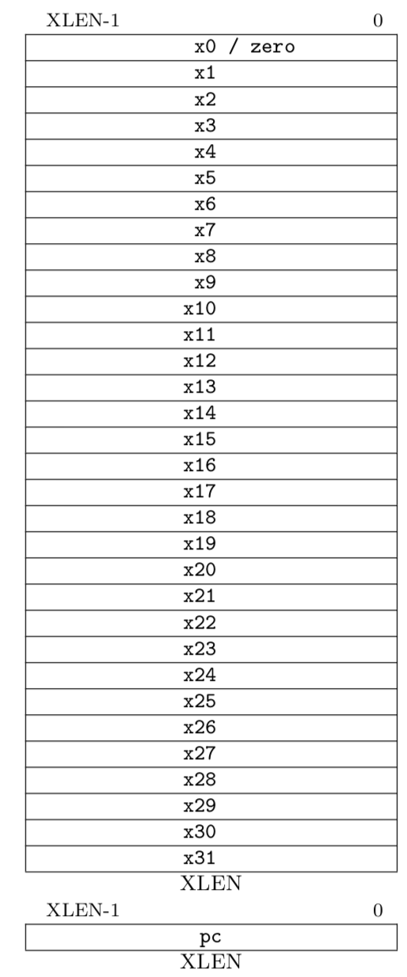
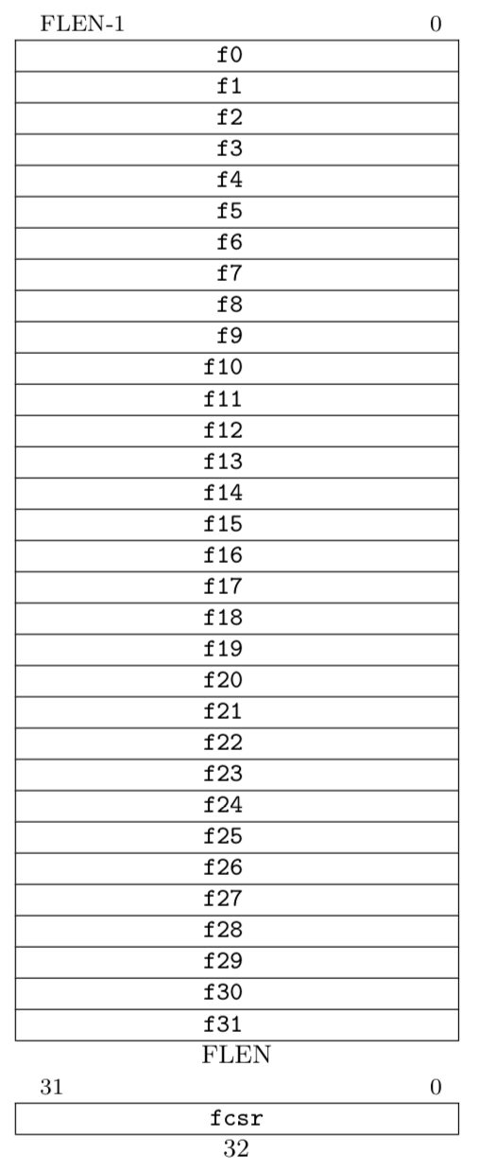
RISC-V Scalar State
Program counter (pc)
32x32/64-bit integer registers (x0-x31)
x0 always contains a 0
Floating-point (FP), adds 32 registers (f0-f31)
each can contain a single- or double-precision FP value (32-bit or 64-bit IEEE FP)
FP status register (fcsr), used for FP rounding mode & exception reporting
ISA string options:
RV32I (XLEN=32, no FP)
RV32IF (XLEN=32, FLEN=32)
RV32ID (XLEN=32, FLEN=64)
RV64I (XLEN=64, no FP)
RV64IF (XLEN=64, FLEN=32)
RV64ID (XLEN=64, FLEN=64)

Slide 5
Vector Extension Additional State
32 vector data registers, v0-v31, each VLEN bits long
Vector length register vl
Vector type register vtype
Other control registers:
vstart
For trap handling
vrm/vxsat
Fixed-point rounding mode/saturation
Also appear in fcsr
Vector data registers
VLEN bits per vector register, (implementation-dependent)
v0
v31
Vector length register
vl
Vector type register
vtype

Slide 6
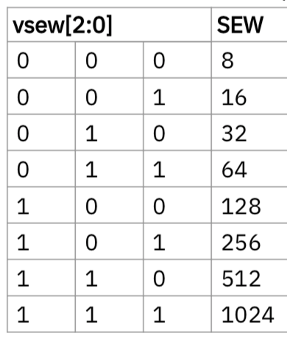
Vector Type Register
vsew[2:0] field encodes standard element width (SEW) in bits of elements in vector register (SEW = 8*2^{vsew} )
vlmul[1:0] encodes vector register length multiplier (LMUL = 2^{vlmul} = 1-8)
vediv[1:0] encodes how vector elements are divided into equal sub-elements (EDIV = 2^{vediv} = 1-8)

Slide 7
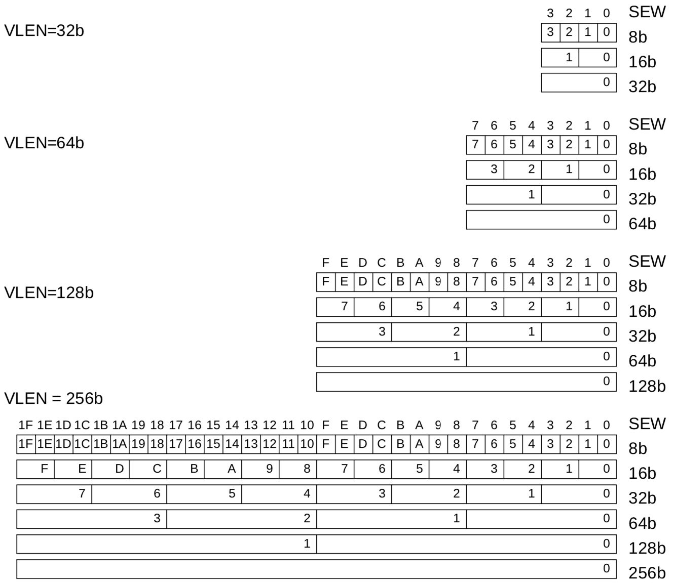
Example Vector Register Data Layouts (LMUL=1)

Slide 8
Setting vector configuration, vsetvli/vsetvl
The vsetvl{i} configuration instructions set the vtype register, and also set the vl register, returning the vl value in a scalar register
vsetvli rd, rs1, e8 # Set SEW=8, vl=min(VLEN/SEW,rs1), rd=vl
vtype parameters (SEW,LMUL,EDIV) encoded as immediate in instruction
Resulting machine vector length setting
Requested application vector length
Instruction encoding
Usually use immediate form, vsetvli, to set vtype parameters.
The register version vsetvl is usually used for context save/restore

Slide 9
vsetvl{i} operation
The first scalar register argument, rs1, is the requested application vector length (AVL)
The type argument (either immediate or second register) indicates how the vector registers should be configured
Configuration includes size of each element
The vector length is set to the minimum of requested AVL and the maximum supported vector length (VLMAX) in the new configuration
VLMAX = LMUL*VLEN/SEW
vl = min(AVL, VLMAX)
The value placed in vl is also written to the scalar destination register rd

Slide 10
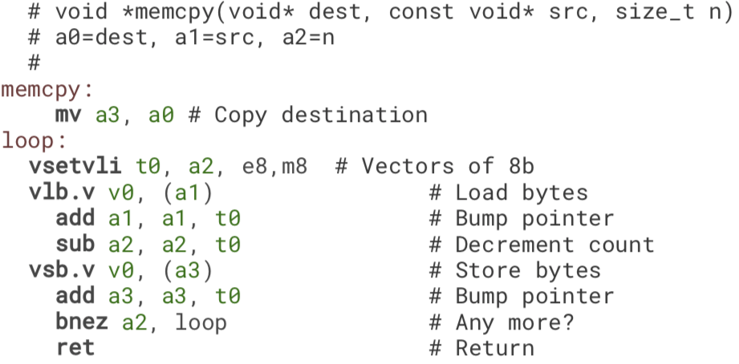
Simple stripmined vector memcpy example
Set configuration, calculate vector strip length
Unit-stride vector load bytes
Unit-stride vector store bytes
Binary machine code can run on machines with any VLEN!

Slide 11
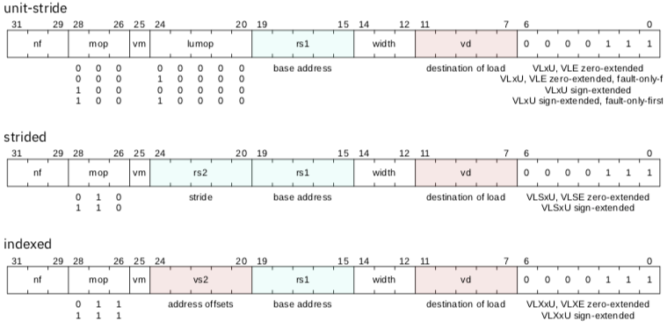
Vector Load Instructions
Vector destination
Scalar stride (bytes)
Vector of offsets (bytes)
Scalar base address

Slide 12
Vector Store Instructions
Vector store data

Slide 13
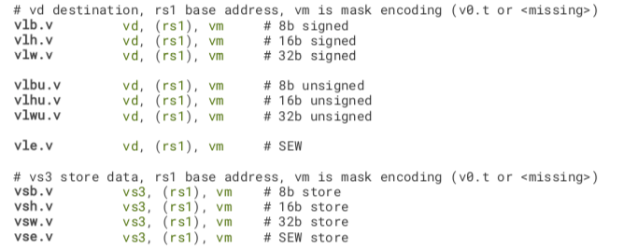
Vector Unit-Stride Loads/Stores

Slide 14
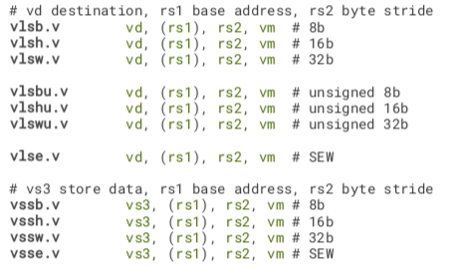
Vector Strided Load/Store Instructions

Slide 15
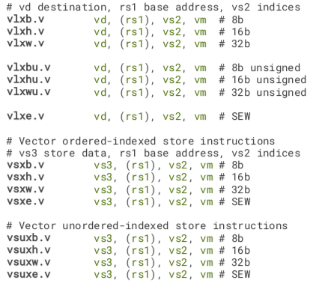
Vector Indexed Loads/Stores

Slide 16
Vector Length Multiplier, LMUL
Gives fewer but longer vector registers
Set by vlmul[1:0]field in vtype during setvli
LMUL=2
LMUL=4

Slide 17
LMUL=8 stripmined vector memcpy example
Combine eight vector registers into group
(v0,v1,…,v7)
Set configuration, calculate vector strip length
Unit-stride vector load bytes
Unit-stride vector store bytes
Binary machine code can run on machines with any VLEN!

Slide 18
Mixed-Width Loops
Have different element widths in one loop, even in one instruction
Want same number of elements in each vector register, even if different bits/element
Solution: Keep SEW/LMUL constant

Slide 19
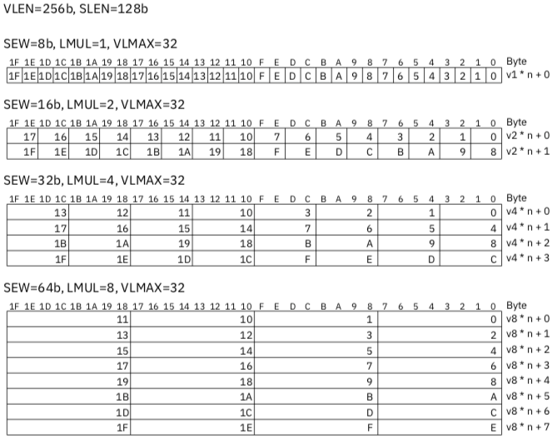

Slide 20
CS152 Administrivia
PS 4 due Friday April 5 in Section
Lab 4 out on Friday
Lab 3 due Monday April 8

Slide 21
CS252 Administrivia
Next week readings: Cray-1, VLIW & Trace Scheduling

