Slide 1
Final Review part1
Howard Mao

Slide 2
Pipelining

Slide 3
“Iron Law” of Processor Performance
Time = Instructions Cycles Time
Program Program * Instruction * Cycle
Instructions per program depends on source code, compiler technology, and ISA
Cycles per instructions (CPI) depends on ISA and µarchitecture
Time per cycle depends upon the µarchitecture and base technology
Microarchitecture | CPI | cycle time
Microcoded | >1 | short
Single-cycle unpipelined | 1 | long
Pipelined | 1 | short

Slide 4
Instructions interact with each other in pipeline
An instruction in the pipeline may need a resource being used by another instruction in the pipeline → structural hazard
An instruction may depend on something produced by an earlier instruction
Dependence may be for a data value → data hazard
Dependence may be for the next instruction’s address → control hazard (branches, exceptions)
Handling hazards generally introduces bubbles into pipeline and reduces ideal CPI > 1

Slide 5
Interlocking Versus Bypassing
add x1, x3, x5
sub x2, x1, x4
F
D
X
M
W
add x1, x3, x5
F
D
X
M
W
bubble
Instruction interlocked in decode stage
F
D
X
M
W
bubble
F
D
X
M
W
bubble
F
D
X
M
W
sub x2, x1, x4
F
D
X
M
W
add x1, x3, x5
Bypass around ALU with no bubbles
F
D
X
M
W
sub x2, x1, x4

Slide 6
Example Bypass Path
Fetch
Decode
EXecute
Memory
Writeback
Imm
Data Cache
Store
Instruction Cache
Inst. Register
B
PC
Registers
ALU
A

Slide 7
Fully Bypassed Data Path
Fetch
Decode
EXecute
Memory
Writeback
Imm
Data Cache
Store
Instruction Cache
Inst. Register
B
PC
Registers
ALU
A
F
D
X
M
W
[ Assumes data written to registers in a W cycle is readable in parallel D cycle (dotted line). Extra write data register and bypass paths required if this is not possible. ]
F
D
X
M
W
F
D
X
M
W
F
D
X
M
W

Slide 8
Exception Handling 5-Stage Pipeline
Commit Point
PC
Inst. Mem
D
Decode
E
M
Data Mem
W
+
Illegal Opcode
Overflow
Data address Exceptions
PC address Exception
Exc
D
Exc
E
Exc
M
Cause
PC
D
PC
E
PC
M
EPC
Select Handler PC
Kill F Stage
Kill D Stage
Kill E Stage
Asynchronous
Interrupts
Kill Writeback

Slide 9
In-Order Superscalar Pipeline
PC
Inst. Mem
D
Dual
Decode
GPRs
X1
X2
Data Mem
X3
W
2
+
FPRs
X1
X2
X3
W
FAdd
Fetch two instructions per cycle; issue both simultaneously if one is integer/memory and other is floating point
Inexpensive way of increasing throughput, examples include Alpha 21064 (1992) & MIPS R5000 series (1996)
Same idea can be extended to wider issue by duplicating functional units (e.g. 4-issue UltraSPARC & Alpha 21164) but regfile ports and bypassing costs grow quickly
X2
X3
FMul
FDiv
X2
X3
Unpipelined divider
Commit Point

Slide 10
Out-of-Order Processor

Slide 11
Scoreboard for In-order Issues
Busy[FU#] : a bit-vector to indicate FU’s availability.
(FU = Int, Add, Mult, Div)
These bits are hardwired to FU's.
WP[reg#] : a bit-vector to record the registers for which writes are pending.
These bits are set by Issue stage and cleared by WB stage
Issue checks the instruction (opcode dest src1 src2)
against the scoreboard (Busy & WP) to dispatch
FU available?
RAW?
WAR?
WAW?
Busy[FU#]
WP[src1] or WP[src2]
cannot arise
WP[dest]

Slide 12
Renaming Structures
Renaming
table &
regfile
Ins# use exec op p1 src1 p2 src2
t₁
t₂
.
.
t_{n}
Reorder
buffer
Replacing the
tag by its value
is an expensive
operation
Load
Unit
FU
FU
Store
Unit
< t, result >
Instruction template (i.e., tag t) is allocated by the Decode stage, which also associates tag with register in regfile
When an instruction completes, its tag is deallocated

Slide 13
IBM 360/91 Floating-Point Unit R. M. Tomasulo, 1967
Floating-Point
Regfile
1
2
3
4
5
6
p
tag/data
load
buffers
(from
memory)
instructions
1
2
3
4
p
tag/data
p
tag/data
p
tag/data
p
tag/data
p
tag/data
p
tag/data
...
p
tag/data
p
tag/data
p
tag/data
Distribute
instruction
templates
by
functional
units
1
2
3
p
tag/data
p
tag/data
p
tag/data
p
tag/data
1
p
tag/data
p
tag/data
p
tag/data
p
tag/data
2
p
tag/data
p
tag/data
Adder
Mult
< tag, result >
Common bus ensures that data is made available immediately to all the instructions waiting for it.
Match tag, if equal, copy value & set presence “p”.
store buffers
(to memory)
p
tag/data
p
tag/data
p
tag/data

Slide 14
In-Order Commit for Precise Traps
In-order
Out-of-order
In-order
Fetch
Decode
Reorder Buffer
Commit
Kill
Kill
Kill
Trap?
Execute
Inject handler PC
In-order instruction fetch and decode, and dispatch to reservation stations inside reorder buffer
Instructions issue from reservation stations out-of-order
Out-of-order completion, values stored in temporary buffers
Commit is in-order, checks for traps, and if none updates architectural state

Slide 15
“Data-in-ROB” Design (HP PA8000, Pentium Pro, Core2Duo, Nehalem)
Oldest
v
i
Opcode
p
Tag
Src1
p
Tag
Src2
p
Reg
Result
Except?
v
i
Opcode
p
Tag
Src1
p
Tag
Src2
p
Reg
Result
Except?
Free
v
i
Opcode
p
Tag
Src1
p
Tag
Src2
p
Reg
Result
Except?
v
i
Opcode
p
Tag
Src1
p
Tag
Src2
p
Reg
Result
Except?
v
i
Opcode
p
Tag
Src1
p
Tag
Src2
p
Reg
Result
Except?
Managed as circular buffer in program order, new instructions dispatched to free slots, oldest instruction committed/reclaimed when done (“p” bit set on result)
Tag is given by index in ROB (Free pointer value)
In dispatch, non-busy source operands read from architectural register file and copied to Src1 and Src2 with presence bit “p” set. Busy operands copy tag of producer and clear “p” bit.
Set valid bit “v” on dispatch, set issued bit “i” on issue
On completion, search source tags, set “p” bit and copy data into src on tag match. Write result and exception flags to ROB.
On commit, check exception status, and copy result into architectural register file if no trap.
On trap, flush machine and ROB, set free=oldest, jump to handler

Slide 16
Data Movement in Data-in-ROB Design
Architectural Register File
Write results at commit
Read operands during decode
Read results for commit
Write sources in dispatch
Bypass newer values at dispatch
ROB
Source Operands
Result Data
Read operands at issue
Write results at completion
Functional Units

Slide 17
Unified Physical Register File (MIPS R10K, Alpha 21264, Intel Pentium 4 & Sandy/Ivy Bridge)
Rename all architectural registers into a single physical register file during decode, no register values read
Functional units read and write from single unified register file holding committed and temporary registers in execute
Commit only updates mapping of architectural register to physical register, no data movement
Decode Stage Register Mapping
Unified Physical Register File
Committed Register Mapping
Read operands at issue
Write results at completion
Functional Units

Slide 18
Speculative Store Buffer
Store Address
Store Data
Just like register updates, stores should not modify the memory until after the instruction is committed. A speculative store buffer is a structure introduced to hold speculative store data.
During decode, store buffer slot allocated in program order
Stores split into “store address” and “store data” micro-operations
“Store address” execution writes tag
“Store data” execution writes data
Store commits when oldest instruction and both address and data available:
clear speculative bit and eventually move data to cache
On store abort:
clear valid bit
Speculative Store Buffer
V
S
Tag
Data
V
S
Tag
Data
V
S
Tag
Data
V
S
Tag
Data
V
S
Tag
Data
V
S
Tag
Data
Store Commit Path
Tags
Data
L1 Data Cache

Slide 19
Conservative O-o-O Load Execution
sd x1, (x2)
ld x3, (x4)
Can execute load before store, if addresses known and x4 != x2
Each load address compared with addresses of all previous uncommitted stores
can use partial conservative check i.e., bottom 12 bits of address, to save hardware
Don’t execute load if any previous store address not known
(MIPS R10K, 16-entry address queue)

Slide 20
Address Speculation
sd x1, (x2)
ld x3, (x4)
Guess that x4 != x2
Execute load before store address known
Need to hold all completed but uncommitted load/store addresses in program order
If subsequently find x4==x2, squash load and all following instructions
=> Large penalty for inaccurate address speculation

Slide 21
Branch Prediction

Slide 22
Static Branch Prediction
Overall probability a branch is taken is ~60-70% but:
backward
90%
forward
50%
ISA can attach preferred direction semantics to branches, e.g., Motorola MC88110
bne0 (preferred taken) beq0 (not taken)
ISA can allow arbitrary choice of statically predicted direction, e.g., HP PA-RISC, Intel IA-64 typically reported as ~80% accurate

Slide 23
Branch Prediction Bits
Assume 2 BP bits per instruction
Change the prediction after two consecutive mistakes!
¬take
wrong
¬ taken
taken
taken
taken
¬ taken
take
right
¬take
right
taken
¬ taken
¬ taken
take
wrong
BP state:
(predict take/¬take) x (last prediction right/wrong)

Slide 24
Branch History Table (BHT)
Fetch PC
0
0
I-Cache
k
2^{k}-entry
BHT,
2 bits/entry
BHT Index
Instruction
Opcode
offset
+
Branch?
Target PC
Taken/¬Taken?
4K-entry BHT, 2 bits/entry, ~80-90% correct predictions

Slide 25
Two-Level Branch Predictor
Pentium Pro uses the result from the last two branches
to select one of the four sets of BHT bits (~95% correct)
0
0
Fetch PC
k
2-bit global branch history shift register
Shift in Taken/¬Taken results of each branch
Taken/¬Taken?

Slide 26
Branch Target Buffer (BTB)
I-Cache
2^{k}-entry direct-mapped BTB
(can also be associative)
PC
Entry PC
Valid
predicted
target PC
k
=
match
valid
target
Keep both the branch PC and target PC in the BTB
PC+4 is fetched if match fails
Only taken branches and jumps held in BTB
Next PC determined before branch fetched and decoded

Slide 27
Subroutine Return Stack
Small structure to accelerate JR for subroutine returns, typically much more accurate than BTBs.
fa() { fb(); }
fb() { fc(); }
fc() { fd(); }
Push call address when function call executed
Pop return address when subroutine return decoded
&fd()
k entries
(typically k=8-16)
&fc()
&fb()

Slide 28
Multithreading

Slide 29
Multithreading
How can we guarantee no dependencies between instructions in a pipeline?
One way is to interleave execution of instructions from different program threads on same pipeline
Interleave 4 threads, T1-T4, on non-bypassed 5-stage pipe
t0
t1
t2
t3
t4
t5
t6
t7
t8
t9
T1:LD x1,0(x2)
T2:ADD x7,x1,x4
T3:XORI x5,x4,12
T4:SD 0(x7),x5
T1:LD x5,12(x1)
F
D
X
M
W
Prior instruction in a thread always completes write-back before next instruction in same thread reads register file
F
D
X
M
W
F
D
X
M
W
F
D
X
M
W
F
D
X
M
W

Slide 30
Thread Scheduling Policies
Fixed interleave (CDC 6600 PPUs, 1964)
Each of N threads executes one instruction every N cycles
If thread not ready to go in its slot, insert pipeline bubble
Software-controlled interleave (TI ASC PPUs, 1971)
OS allocates S pipeline slots amongst N threads
Hardware performs fixed interleave over S slots, executing whichever thread is in that slot
Hardware-controlled thread scheduling (HEP, 1982)
Hardware keeps track of which threads are ready to go
Picks next thread to execute based on hardware priority scheme
Notes:
Software-controlled interleave, S > N. Wheel with the threads in each slot. If thread is ready to go
It goes, else NOP, I.e., pipeline bubble.

Slide 31
Coarse-Grain Multithreading
Tera MTA designed for supercomputing applications with large data sets and low locality
No data cache
Many parallel threads needed to hide large memory latency
Other applications are more cache friendly
Few pipeline bubbles if cache mostly has hits
Just add a few threads to hide occasional cache miss latencies
Swap threads on cache misses
Notes:
Tera --- 256 mem-ops/cycle * 150 cycles/mem-op = 38K instructions-in-flight…
Tera not very successful, 2 machines sold.
Changed their name back to Cray!

Slide 32
Superscalar Machine Efficiency
Issue width
Instruction issue
Completely idle cycle (vertical waste)
Time
Partially filled cycle, i.e., IPC < 4
(horizontal waste)
Notes:
Focus is switching to function unit efficiency (as a measure of throughput).

Slide 33
Vertical Multithreading
Issue width
Instruction issue
Second thread interleaved cycle-by-cycle
Time
Partially filled cycle, i.e., IPC < 4
(horizontal waste)
Cycle-by-cycle interleaving removes vertical waste, but leaves some horizontal waste

Slide 34
Chip Multiprocessing (CMP)
Issue width
Time
What is the effect of splitting into multiple processors?
reduces horizontal waste,
leaves some vertical waste, and
puts upper limit on peak throughput of each thread.

Slide 35
SMT adaptation to parallelism type
For regions with high thread-level parallelism (TLP) entire machine width is shared by all threads
For regions with low thread-level parallelism (TLP) entire machine width is available for instruction-level parallelism (ILP)
Issue width
Issue width
Time
Time
Notes:
Amdahl’s law…

Slide 36
Icount Choosing Policy
Fetch from thread with the least instructions in flight.
Why does this enhance throughput?
Notes:
Fetch unit that can keep up with the simultaneous multithreaded execution engine
have the fewest instructions waiting to be executed
making the best progress through the machine
40% increase in IPC over RR
Don’t want to clog instruction window with thread with many stalls ➔ try to fetch from thread that has fewest insts in window

Slide 37
Summary: Multithreaded Categories
Simultaneous
Multithreading
Time (processor cycle)
Superscalar
Fine-Grained
Coarse-Grained
Multiprocessing
Thread 1
Thread 3
Thread 5
Thread 2
Thread 4
Idle slot

Slide 38
CS152 Administrivia
Lab 5 due Friday Aril 27
Friday April 27, discussion will cover multiprocessor review
Final exam, Tuesday May 8, 306 Soda, 11:30am-2:30pm

Slide 39
CS252 Administrivia
Project presentations, May 2nd, 2:30pm-5pm, 511 Soda
Final project papers , May 11th

Slide 40
final Review part2
Donggyu Kim

Slide 41
Memory Hierarchy
Why does it matter?

Slide 42
Processor-DRAM Gap (latency)
µProc 60%/year
1000
CPU
Processor-Memory
Performance Gap: (growing 50%/yr)
100
Performance
10
DRAM
7%/year
DRAM
1
1986
1988
1987
1989
1990
1991
1992
1993
1994
1995
1980
1996
1981
1982
1983
1984
1985
1997
1998
1999
2000
Time
Four-issue 3GHz superscalar accessing 100ns DRAM could execute 1,200 instructions during time for one memory access!
Notes:
Why doesn’t DRAM get faster?

Slide 43
Physical Size Affects Latency
CPU
Big Memory
CPU
Small Memory
Signals have further to travel
Fan out to more locations
More complex address decoder

Slide 44
Memory Hierarchy
Big, Slow Memory
(DRAM)
A
Small,
Fast Memory
(RF, SRAM)
B
CPU
holds frequently used data
capacity: Register << SRAM << DRAM
latency: Register << SRAM << DRAM
bandwidth: on-chip >> off-chip
On a data access:
if data ∈ fast memory ⇒ low latency access (SRAM)
if data ∉ fast memory ⇒ high latency access (DRAM)
Notes:
Due to cost
Due to size of DRAM
Due to cost and wire delays (wires on-chip cost much less, and are faster)

Slide 45
Performance Models
Average Memory Access Time(AMAT)
Hit Time + Miss Rate $×$ Miss Penalty
Iron Law
Goal
Reduce the hit time
Reduce the miss rate
Reduce the miss penalty
Increase the cache bandwidth → effectively decrease the hit time
$$\frac{Time}{Program}=\frac{Instructions}{Program}×\frac{Cycles}{Instruction}×\frac{Time}{Cycle}$$
$${CPI}_{total}={CPI}_{CPU}+\sum_{e:event}{{Misses/Instruction}_{e}×{MissPenalty}_{e}}$$

Slide 46
Causes of Cache Misses: The 3+1 C’s
Compulsory: first reference to a line (a.k.a. cold start misses)
misses that would occur even with infinite cache
Capacity: cache is too small to hold all data needed by the program
misses that would occur even under perfect replacement policy
Conflict: misses that occur because of collisions due to line-placement strategy
misses that would not occur with ideal full associativity
Coherence: misses that occur when a line is invalidated due to a remote write to another word (false sharing)
misses that would not occur without shared lines

Slide 47
Effect of Cache Parameters on Performance
Larger cache size
reduces capacity and conflict misses
hit time will increase
Higher associativity
reduces conflict misses
may increase hit time
Larger line size
reduces compulsory misses
increases conflict & coherence misses and miss penalty
Notes:
Requested line first….
The following could be in the slide…
spatial locality reduces compulsory misses and capacity reload misses
fewer lines may increase conflict miss rate
larger lines may increase miss penalty

Slide 48
Multilevel Caches
Problem: A memory cannot be large and fast
Solution: Increasing sizes of cache at each level
DRAM
CPU
L2$
L1$
Local miss rate = misses in cache / accesses to cache
Global miss rate = misses in cache / CPU memory accesses
Misses per instruction = misses in cache / number of instructions
Notes:
MPI makes it easier to compute overall performance (jse)

Slide 49
Hardware Instruction Prefetching
Instruction prefetch in Alpha AXP 21064
Fetch two lines on a miss; the requested line (i) and the next consecutive line (i+1)
Requested line placed in cache, and next line in instruction stream buffer
If miss in cache but hit in stream buffer, move stream buffer line into cache and prefetch next line (i+2)
Req
line
Stream
Buffer
Prefetched
instruction line
CPU
Unified L2 Cache
L1 Instruction
RF
Req
line
Notes:
Need to check the stream buffer if the requested line is in there.
Never more than one 32-byte line in the stream buffer.

Slide 50
Reducing Write Hit Time (or Bandwidth)
Problem: Writes take two cycles in memory stage, one cycle for tag check plus one cycle for data write if hit
Solutions:
Design data RAM that can perform read and write in one cycle, restore old value after tag miss
Fully-associative (CAM Tag) caches: Word line only enabled if hit
Pipelined writes: Hold write data for store in single buffer ahead of cache, write cache data during next store’s tag check
Notes:
Need to bypass from write buffer if read address matches write buffer tag!

Slide 51
Write Buffer to Reduce Read Miss Penalty
Data Cache
Unified L2 Cache
CPU
RF
Write
buffer
Evicted dirty lines for writeback cache
OR All writes in writethrough cache
Processor is not stalled on writes, and read misses can go ahead of write to main memory
Problem: Write buffer may hold updated value of location needed by a read miss
Simple solution: on a read miss, wait for the write buffer to go empty
Faster solution: Check write buffer addresses against read miss addresses, if no match, allow read miss to go ahead of writes, else, return value in write buffer
→ This breaks sequential consistency (SC) !
Notes:
Deisgners of the MIPS M/1000 estimated that waiting for a four-word buffer to empty
increased the read miss penalty by a factor of 1.5.

Slide 52
Cache Summary
Technique | Hit Time | Miss Penalty | Miss Rate | Hardware
Small and simple caches | Decrease | ⎯ | Increase (Capacity) | Decrease
Multi-level caches | ⎯ | Increase | Decrease | Increase
Pipelined writes | Decrease (Write BW) | ⎯ | ⎯ | Increase
Write buffer | ⎯ | Decrease | ⎯ | Increase
Sub-blocks | ⎯ | Decrease | Increase (Compulsory) | Increase
Code optimization | ⎯ | ⎯ | Decrease | ⎯
Compiler prefetching | ⎯ | ⎯ | Decrease (Compulsory, But possible cache / bandwidth pollution) | Increase (non-blocking cache, additional instructions)
Hardware prefetching (Stream buffer) | ⎯ | ⎯ | Decrease (Compulsory) | Increase
Victim cache | ⎯ | Increase | Decrease (Conflict, compared to direct-mapped) | Decrease (Compared to set-associative)

Slide 53
Virtual Memory
Why do we care hardware support?

Slide 54
Page Tables Live in Memory
Physical Memory
Pages
1
0
Simple linear page tables are too large, so hierarchical page tables are commonly used (see later)
1
3
3
0
1
2
2
3
0
Virtual Address Space Pages for Job 2
2
Common for modern OS to place page tables in kernel’s virtual memory (page tables can be swapped to secondary storage)
0
Page Table
1
for Job 2
2
3
Virtual Address Space Pages for Job 1
Page Table
for Job 1
How many memory accesses per instruction?
Notes:
Relaxes the contiguous allocation requirement.

Slide 55
Address Translation & Protection
Virtual Address
Virtual Page No. (VPN)
offset
Kernel/User Mode
Read/Write
Protection Check
Address
Translation
Exception?
Physical Page No. (PPN)
offset
Physical Address
Every instruction and data access needs address
translation and protection checks
A good VM design needs to be fast (~ one cycle) and space efficient

Slide 56
Translation-Lookaside Buffers (TLB)
Address translation is very expensive!
In a two-level page table, each reference becomes several memory accesses
Solution: Cache translations in TLB
TLB hit ⇒ Single-Cycle Translation
TLB miss ⇒ Page-Table Walk to refill
virtual address
VPN offset
V R W D tag PPN
(VPN = virtual page number)
(PPN = physical page number)
hit?
physical address
PPN offset
Notes:
3 memory references
2 page faults (disk accesses) + ..
Actually used in IBM before paged memory.

Slide 57
Address Translation: putting it all together
Virtual Address
hardware
hardware or software
software
TLB
Lookup
miss
hit
Page Table
Walk
Protection
Check
the page is
∉ memory ∈ memory
denied
permitted
Page Fault
(OS loads page)
Update TLB
Protection
Fault
Physical
Address
(to cache)
Where?
SEGFAULT
Notes:
Need to restart instruction.
Soft and hard page faults.

Slide 58
Handling a TLB Miss
Software (MIPS, Alpha)
TLB miss causes an exception and the operating system walks the page tables and reloads TLB. A privileged “untranslated” addressing mode used for walk.
Software TLB miss can be very expensive on out-of-order superscalar processor as requires a flush of pipeline to jump to trap handler.
Hardware (SPARC v8, x86, PowerPC, RISC-V)
A memory management unit (MMU) walks the page tables and reloads the TLB.
If a missing (data or PT) page is encountered during the TLB reloading, MMU gives up and signals a Page Fault exception for the original instruction.
NOTE: A given ISA can use either TLB miss strategy

Slide 59
Virtual-Address Caches
VA
TLB
PA
Physical
Cache
PA
Primary
Memory
CPU
Alternative: place the cache before the TLB
VA
Primary
Memory
CPU
Virtual Cache
VA
PA
(StrongARM)
TLB
one-step process in case of a hit (+)
cache needs to be flushed on a context switch unless address space identifiers (ASIDs) included in tags (-)
aliasing problems due to the sharing of pages (-)
maintaining cache coherence (-)

Slide 60
Concurrent Access to TLB & Cache (Virtual Index/Physical Tag)
Virtual
Index
VA
VPN L b
TLB
k
Direct-map Cache
2^{L} blocks
2^{b}-byte block
PA
PPN Page Offset
Tag
=
Physical Tag
Data
hit?
Index L is available without consulting the TLB
➔ cache and TLB accesses can begin simultaneously!
Tag comparison is made after both accesses are completed
Condition: L + b <= k

Slide 61
VLIW Machine
Simple HW + Smart Compilers

Slide 62
Performance Models, Again
Goal
Take advance of instruction-level parallelism (ILP)
Limited by data dependencies
Varies across applications
Reschedule instructions
By hardware (OoO processors)
By software (compiler optimizations)
$$\frac{Time}{Program}=\frac{Instructions}{Program}×\frac{Cycles}{Instruction}×\frac{Time}{Cycle}$$
$${CPI}_{total}={CPI}_{CPU}+\sum_{e:event}{{Misses/Instruction}_{e}×{MissPenalty}_{e}}$$

Slide 63
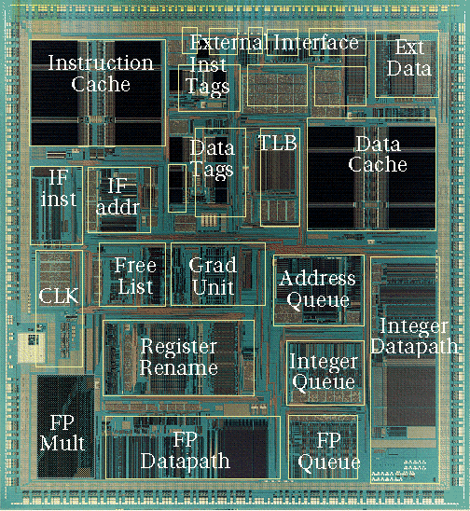
Out-of-Order Control Complexity: MIPS R10000
Control Logic
[ SGI/MIPS Technologies Inc., 1995 ]

Slide 64
VLIW: Very Long Instruction Word
Int Op 1
Int Op 2
Mem Op 1
Mem Op 2
FP Op 1
FP Op 2
Two Integer Units,
Single-Cycle Latency
Two Load/Store Units,
Three-Cycle Latency
Two Floating-Point Units,
Four-Cycle Latency
Multiple operations packed into one instruction
Each operation slot is for a fixed function
Constant operation latencies are specified
HW doesn’t check data dependencies across instructions (no pipeline stalls)

Slide 65
VLIW Compiler Responsibilities
Schedule operations to maximize parallel execution
Guarantees intra-instruction parallelism
Schedule to avoid data hazards (no interlocks)
Typically separates operations with explicit NOPs

Slide 66
Loop Execution
for (i=0; i<N; i++)
B[i] = A[i] + C;
Int1
Int 2
M1
M2
FP+
FPx
loop:
add x1
fld
Compile
loop: fld f1, 0(x1)
add x1, 8
fadd f2, f0, f1
fsd f2, 0(x2)
add x2, 8
bne x1, x3, loop
fadd
Schedule
add x2
bne
fsd
How many FP ops/cycle?
1 fadd / 8 cycles = 0.125

Slide 67
Scheduling Loop Unrolled Code
Unroll 4 ways
loop: fld f1, 0(x1)
fld f2, 8(x1)
fld f3, 16(x1)
fld f4, 24(x1)
add x1, 32
fadd f5, f0, f1
fadd f6, f0, f2
fadd f7, f0, f3
fadd f8, f0, f4
fsd f5, 0(x2)
fsd f6, 8(x2)
fsd f7, 16(x2)
fsd f8, 24(x2)
add x2, 32
bne x1, x3, loop
Int1
Int2
M1
M2
FP+
FPx
loop:
fld f1
fld f2
fld f3
add x1
fld f4
fadd f5
Schedule
fadd f6
fadd f7
fadd f8
fsd f5
fsd f6
fsd f7
add x2
bne
fsd f8
How many FLOPS/cycle?
4 fadds / 11 cycles = 0.36

Slide 68
Dependence Graph
for (i=0; i<N; i++)
B[i] = A[i] + C;
Iteration i:
Iteration i+1:
Iteration i+2:
prologue
fld
Compile
loop: fld f1, 0(x1)
add x1, 8
fadd f2, f0, f1
fsd f2, 0(x2)
add x2, 8
bne x1, x3, loop
fadd
fld
loop:
fsd
fadd
fld
fsd
fadd
epilogue
fsd

Slide 69
Software Pipelining
Int1
Int 2
M1
M2
FP+
FPx
add x1
fld f1
prolog
add x1
fld f1
fadd f5
loop: fld f1, 0(x1)
add x1, 8
fadd f2, f0, f1
fsd f2, 0(x2)
add x2, 8
bne x1, x3, loop
loop:
add x1
fld f1
fadd f5
add x2
fsd f5
bne
fadd f5
add x2
fsd f5
epilog
add x2
fsd f5
How many FLOPS/cycle?
1 fadd / 3 cycles = 0.333

Slide 70
Software Pipelining + Loop Unrolling
Unroll 4 ways first
Int1
Int 2
M1
M2
FP+
FPx
loop: fld f1, 0(x1)
fld f2, 8(x1)
fld f3, 16(x1)
fld f4, 24(x1)
add x1, 32
fadd f5, f0, f1
fadd f6, f0, f2
fadd f7, f0, f3
fadd f8, f0, f4
fsd f5, 0(x2)
fsd f6, 8(x2)
fsd f7, 16(x2)
add x2, 32
fsd f8, -8(x2)
bne x1, x3, loop
fld f1
fld f2
fld f3
add x1
fld f4
prolog
fld f1
fadd f5
fld f2
fadd f6
fld f3
fadd f7
add x1
fld f4
fadd f8
loop:
fld f1
fsd f5
fadd f5
iterate
fld f2
fsd f6
fadd f6
add x2
fld f3
fsd f7
fadd f7
add x1
bne
fld f4
fsd f8
fadd f8
fsd f5
fadd f5
fsd f6
fadd f6
epilog
add x2
fsd f7
fadd f7
bne
fsd f8
fadd f8
How many FLOPS/cycle?
4 fadds / 4 cycles = 1
fsd f5

Slide 71
Trace Scheduling [ Fisher,Ellis]
Pick string of basic blocks, a trace, that represents most frequent branch path
Use profiling feedback or compiler heuristics to find common branch paths
Schedule whole “trace” at once
Add fixup code to cope with branches jumping out of trace

Slide 72
Limits of Static Scheduling
Unpredictable branches
Variable memory latency (unpredictable cache misses)
Code size explosion
Compiler complexity (compiler runtime)
Despite several attempts, VLIW has failed in general-purpose computing arena (so far).
More complex VLIW architectures are close to in-order superscalar in complexity, no real advantage on large complex apps.
Successful in embedded DSP market
Simpler VLIWs with more constrained environment, friendlier code.

Slide 73
SIMD vs. Vector vs. GPU
Towards Data-Level Parallelism (DLP)

Slide 74
Performance Models, Again
Goal
Take advantage of data-level parallelism
Same operations on large data arrays
Present in scientific/machine-learning applications
Increase the bandwidth of each instruction
Less dynamic instruction counts while keeping CPI & cycle time constant
$$\frac{Time}{Program}=\frac{Instructions}{Program}×\frac{Cycles}{Instruction}×\frac{Time}{Cycle}$$
$${CPI}_{total}={CPI}_{CPU}+\sum_{e:event}{{Misses/Instruction}_{e}×{MissPenalty}_{e}}$$

Slide 75
Vector Programming Model
Scalar Registers
Vector Registers
x31
v31
x0
v0
[0]
[1]
[2]
[MAXVL-1]
Vector Length Register
vl
v1
Vector Arithmetic Instructions
vadd v3, v1, v2
v2
+
+
+
+
+
+
v3
[0]
[1]
[vl-1]
Vector Load and Store Instructions
vlds v1, x1, x2
Vector Register
v1
Memory
Base, x1
Stride, x2

Slide 76
Vector Code Example
# C code
for (i=0; i<64; i++)
C[i] = A[i] + B[i];
# Scalar Code
li x4, 64
loop:
fld f1, 0(x1)
fld f2, 0(x2)
fadd.d f3,f1,f2
fsd f3, 0(x3)
addi x1, 8
addi x2, 8
addi x3, 8
subi x4, 1
bnez x4, loop
# Vector Code
li x4, 64
setvl x5, x4
vld v1, x1
vld v2, x2
vadd v3,v1,v2
vst v3, x3

Slide 77
Vector Instruction Set Advantages
Compact
one short instruction encodes N operations
Expressive
Unit-stride load/store for a contiguous block
Strided load/store for a known pattern
Indexed load/store for indirect accesses
Scalable
Same code on more parallel pipelines (lanes)

Slide 78
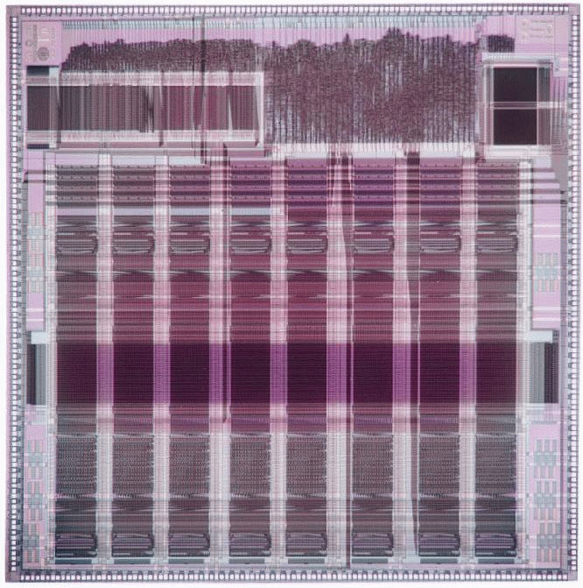
T0 Vector Microprocessor (UCB/ICSI, 1995)
Built by Prof. Krste Asanovic
Vector register elements striped over lanes
Lane
[24]
[25]
[26]
[27]
[28]
[29]
[30]
[31]
[16]
[17]
[18]
[19]
[20]
[21]
[22]
[23]
[8]
[9]
[10]
[11]
[12]
[13]
[14]
[15]
[0]
[1]
[2]
[3]
[4]
[5]
[6]
[7]

Slide 79
Interleaved Vector Memory System
Bank busy time: Time before bank ready to accept next request
Cray-1, 16 banks, 4 cycle bank busy time, 12 cycle latency
Base
Stride
Vector Registers
Address Generator
+
0
1
2
3
4
5
6
7
8
9
A
B
C
D
E
F
Memory Banks

Slide 80
HW/SW Techniques for Vector Machine
Chaining
Bypassing the results to the dependent instructions to start the following instructions as soon as possible
Stripmining
Compiler optimization that breaks loops to fit in vector registers
Vector masks
To support conditional code for vectorizable loop
Vector reduction
For reduction operations across vector elements
Gather/Scatter
To support indirect (indexed) memory operations for vectorizable loop

Slide 81
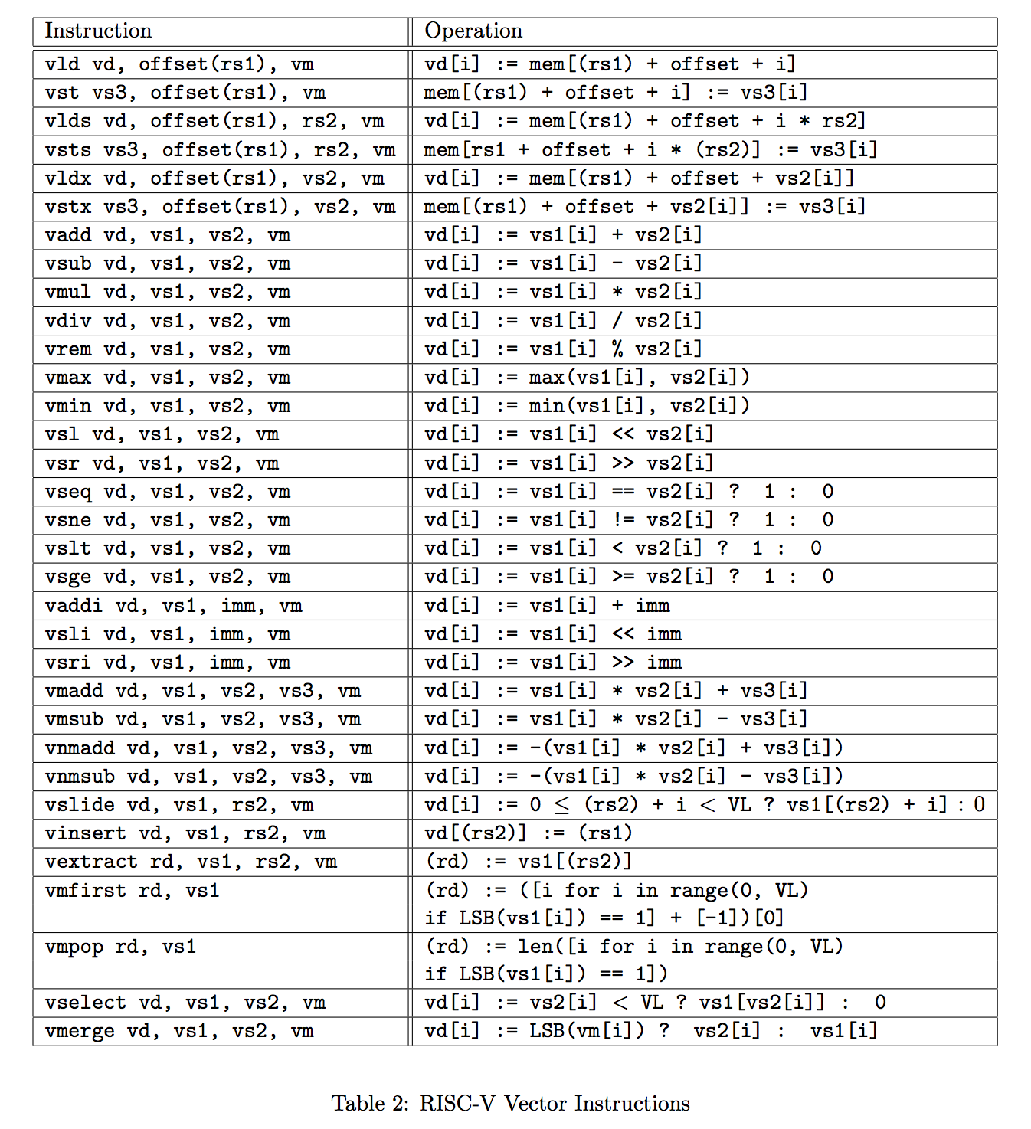
RISC-V Vector ISA
Enjoy Lab4?
Ready for another coding question?

Slide 82
Packed SIMD vs. Vectors?
Big problem of SIMD
Vector lengths are encoded in instructions
Need different instructions for different vector lengths (recall 61C labs)
Rewrite your code for wider vectors!
Vector: the VL register + stripmining

Slide 83
GPU vs. Vectors?
 | GPU | Vector
Programing Model | SPMD(CUDA, OpenCL) Should reason threads | C code + Auto Vectorization SPMD(OpenCL) (RISC-V Vector Assembly)
Execution Model | SIMT (Single instruction Multiple threads) → Context-switching overhead | SIMD
Memory Hierarchy | Scratchpad + Caches | Transparent Caches
Memory Operations | Scatter/Gather + Hardware Coalescing Unit | Unit-stride, Strided, Scatter/gather
Conditional Execution | Thread Mask + Divergence Stack | Vector mask
Hardware Complexity | High | Low

Slide 84
Summary
Memory hierarchy
To cope with the speed gap between CPU and main memory
Various cache optimizations
Virtual memory (paging)
No programs run in bare-metal
Each program runs as if it has its own contiguous memory space
OS + HW (TLB, virtually-indexed physically-tagged)
Very Long Instruction Word (VLIW)
Simple HW + very smart compilers
Loop unrolling, SW pipelining, trace scheduling
Predictability: variable memory latency, branches, exceptions
Data-level Parallelism
Vector Processor vs. SIMD vs. GPU
HW & SW techniques for vector machines
RISC-V Vector Programming

