Slide 1
CS 152 Computer Architecture and Engineering CS252 Graduate Computer Architecture Lecture 21 I/O & Warehouse-Scale Computing
Krste Asanovic
Electrical Engineering and Computer Sciences
University of California at Berkeley
http://www.eecs.berkeley.edu/~krste
http://inst.eecs.berkeley.edu/~cs152

Slide 2
Last Time in Lecture 20
Implementing Mutual Exclusion synchronization is possible using regular loads and stores, but is complicated an inefficient
Most architectures add atomic read-modify-write synchronization primitives to support mutual-exclusion
Lock-based synchronization is susceptible to lock-owning thread being descheduled while holding lock
Non-blocking synchronization tries to provide mutual exclusion without holding a lock
Compare-and-swap, makes forward progress but complex instruction and susceptible to ABA problem
Double-wide compare-and-swap prevents ABA problem but is now even more complex instruction
Load-Reserved/Store-Conditional pair reduces instruction complexity
Protects based on address not values, so not susceptible to ABA
Can livelock, unless add forward progress guarantee
Transactional Memory is slowly entering commercial use
Complex portability/compatibility story

Slide 3
(I/O) Input/Output
Computers useless without I/O
Over time, literally thousands of forms of computer I/O: punch cards to brain interfaces
Broad categories:
Secondary/Tertiary storage (flash/disk/tape)
Network (Ethernet, WiFi, Bluetooth, LTE)
Human-machine interfaces (keyboard, mouse, touchscreen, graphics, audio, video, neural,…)
Printers (line, laser, inkjet, photo, 3D, …)
Sensors (process control, GPS, heartrate, …)
Actuators (valves, robots, car brakes, …)
Mix of I/O devices is highly application-dependent

Slide 4
Interfacing to I/O Devices
Two general strategies
Memory-mapped
I/O devices appear as memory locations to processor
Reads and writes to I/O device locations configure I/O and transfer data (using either programmed I/O or DMA)
I/O channels
Architecture specifies commands to execute I/O commands over defined channels
I/O channel structure can be layered over memory-mapped device structure
In addition to data transfer, have to define synchronization method
Polling: CPU checks status bits
Interrupts: Device interrupts CPU on event

Slide 5
Memory-Mapped I/O
Programmed I/O uses CPU to control I/O device using load and store instructions, with address specifying device register to access
Load and store can have side effect on device
Usually, only privileged code can access I/O devices directly, to provide secure multiprogramming
System calls sometimes provided for application to open and reserve a device for exclusive access
Processors provide “uncached” loads and stores to prevent caching of device registers
Usually indicated by bits in page table entries or by reserving portions of physical address space

Slide 6
Simple I/O Bus Structure
CPU
Caches
Memory Bus
I/O Bus Bridge
I/O Bus
DRAM
I/O Device #1
I/O Device #2
I/O Device #3
Some range of physical addresses map to I/O bus devices
I/O bus bridge reduces loading on critical CPU-DRAM bus
Devices can be “slaves”, only responding to I/O bus requests
Devices can be “masters”, initiating I/O bus transfers

Slide 7
DMA (Direct Memory Access)
CPU
Caches
DMA
Memory Bus
I/O Bus Bridge
I/O Bus
DMA
DRAM
I/O Device #1
I/O Device #2
I/O Device #3
DMA engines offload CPU by autonomously transferring data between I/O device and main memory. Interrupt/poll for done
DMA programmed through memory-mapped registers
Some systems use dedicated processors inside DMA engines
Often, many separate DMA engines in modern systems:
Centralized in I/O bridge (usually supporting multiple concurrent channels to different devices), works on slave-only I/O busses
Directly attached to each peripheral (if I/O bus supports mastering)

Slide 8
More Complex Bus Structures
CPU
Graphics
I/O Device #1
I/O Device #2
Caches
DMA
DMA
DMA
I/O Bus Bridge
Fast I/O Bus
Memory Bus
DRAM
DMA
Slow I/O Bus
Slow I/O Bus Bridge
I/O Device #3
I/O Device #4
Match speed of I/O connection to device demands
Special direct connection for graphics
Fast I/O bus for disk drives, ethernet
Slow I/O bus for keyboard, mouse, touchscreen
Reduces load on fast I/O bus + less bus logic needed on device

Slide 9
Move from Parallel to Serial I/O Off-chip
CPU I/O IF
I/O 1
I/O 2
Central Bus Arbiter
Shared Parallel Bus Wires
Parallel bus clock rate limited by clock skew across long bus (~100MHz)
High power to drive large number of loaded bus lines
Central bus arbiter adds latency to each transaction, sharing limits throughput
Expensive parallel connectors and backplanes/cables (all devices pay costs)
Examples: VMEbus, Sbus, ISA bus, PCI, SCSI, IDE
Dedicated Point-to-point Serial Links
Point-to-point links run at multi-gigabit speed using advanced clock/signal encoding (requires lots of circuitry at each end)
Lower power since only one well-behaved load
Multiple simultaneous transfers
Cheap cables and connectors (trade greater endpoint transistor cost for lower physical wiring cost), customize bandwidth per device using multiple links in parallel
Examples: Ethernet, Infiniband, PCI Express, SATA, USB, Firewire, etc.
I/O 1
CPU I/O IF
I/O 2

Slide 10
Move from Bus to Crossbar On-Chip
Busses evolved in era where wires were expensive and had to be shared
Bus tristate drivers problematic in standard cell flows, so replace with combinational muxes
Crossbar exploits density of on-chip wiring, allows multiple simultaneous transactions
Tristated Bus
A
A
B
B
A
B
C
C
C
Crossbar

Slide 11
I/O and Memory Mapping
I/O busses can be coherent or not
Non-coherent simpler, but might require flushing caches or only non-cacheable accesses (much slower on modern processors)
Some I/O systems can cache coherently also (SGI Origin, TileLink)
I/O can use virtual addresses and an IOMMU
Simplifies DMA into user address space, otherwise contiguous user segment needs scatter/gather by DMA engine
Provides protection from bad device drivers
Adds complexity to I/O device

Slide 12
Interrupts versus Polling
Two ways to detect I/O device status:
Interrupts
No CPU overhead until event
Large context-switch overhead on each event (trap flushes pipeline, disturbs current working set in cache/TLB)
Can happen at awkward time
Polling
CPU overhead on every poll
Difficult to insert in all code
Can control when handler occurs, reduce working set hit
Hybrid approach:
Interrupt on first event, keep polling in kernel until sure no more events, then back to interrupts

Slide 13
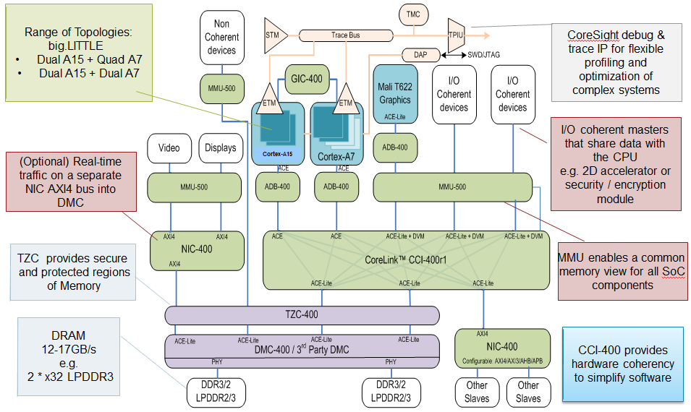
Example ARM SoC Structure
[©ARM]

Slide 14
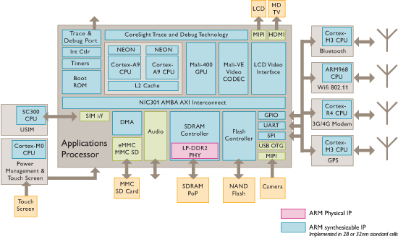
ARM Sample Smartphone Diagram
[©ARM]

Slide 15
Intel Ivy Bridge Server Chip I/O
[©Intel]

Slide 16
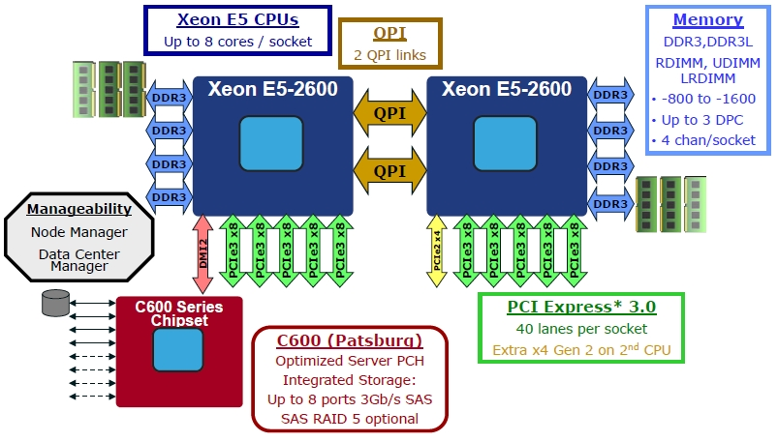
Intel Romley Server Platform
[©Intel]

Slide 17
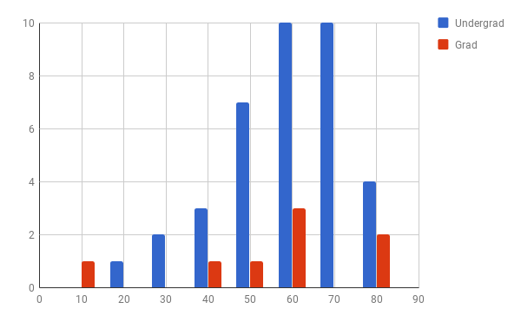
CS152 Administrivia
Midterm results, regrade requests by Friday section
Average: 63.8
Standard deviation: 14.4
Max: 88.75

Slide 18
CS152 Administrivia
Wednesday April 18, Guest lecture, Dr. Lisa Wu
Monday April 23, last lecture, class eval
Wednesday April 25, lecture time will be review session

Slide 19
CS252 Administrivia
Monday April 23rd, last Project Checkpoint, 4-5pm, 405 Soda
Prepare 10-minute presentation on current status

Slide 20
Warehouse-scale computers (WSCs)
Introduction
Provides Internet services
Search, social networking, online maps, video sharing, online shopping, email, cloud computing, etc.
Differences with high-performance computing (HPC) “clusters”:
Clusters have higher performance processors and network
Clusters emphasize thread-level parallelism, WSCs emphasize request-level parallelism
Differences with datacenters:
Datacenters consolidate different machines and software into one location
Datacenters emphasize virtual machines and hardware heterogeneity in order to serve varied customers

Slide 21
WSC Characteristics
Introduction
Ample computational parallelism is not important
Most jobs are totally independent
“Request-level parallelism”
Operational costs count
Power consumption is a primary, not secondary, constraint when designing system
Scale and its opportunities and problems
Can afford to build customized systems since WSC require volume purchase
Location counts
Real estate, power cost; Internet, end-user, and workforce availability
Computing efficiently at low utilization
Scale and the opportunities/problems associated with scale
Unique challenges: custom hardware, failures
Unique opportunities: bulk discounts

Slide 22
Efficiency and Cost of WSC
Location of WSC
Proximity to Internet backbones, electricity cost, property tax rates, low risk from earthquakes, floods, and hurricanes
Efficiency and Cost of WSC

Slide 23
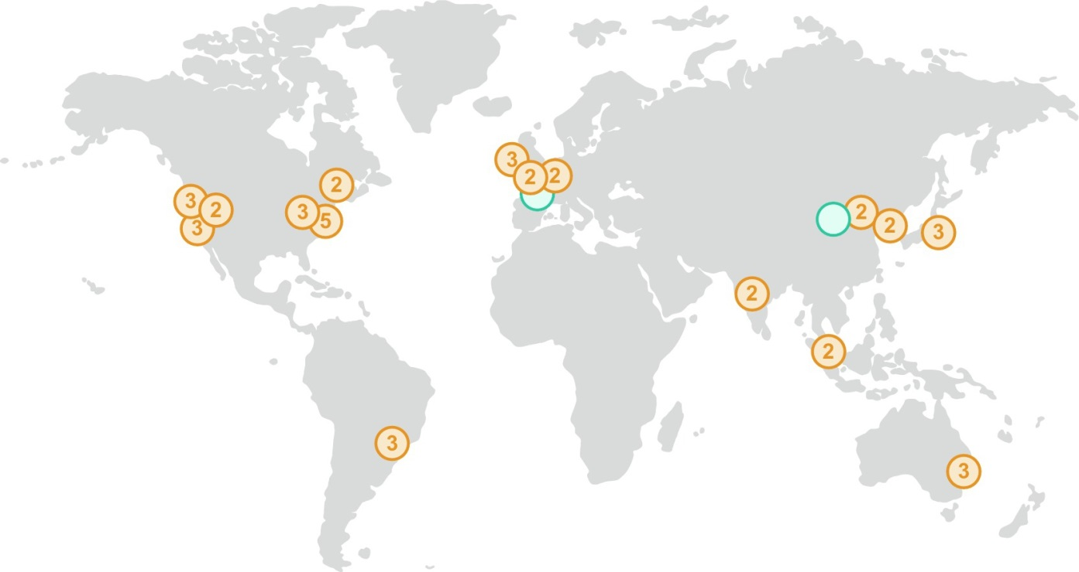
Amazon Sites
Figure 6.18 In 2017 AWS had 16 sites (“regions”), with two more opening soon. Most sites have two to three availability zones, which are located nearby but are unlikely to be affected by the same natural disaster or power outage, if one were to occur. (The number of availability zones are listed inside each circle on the map.) These 16 sites or regions collectively have 42 availability zones. Each availability zone has one or more WSCs. https://aws.amazon.com/about-aws/global-infrastructure/.

Slide 24
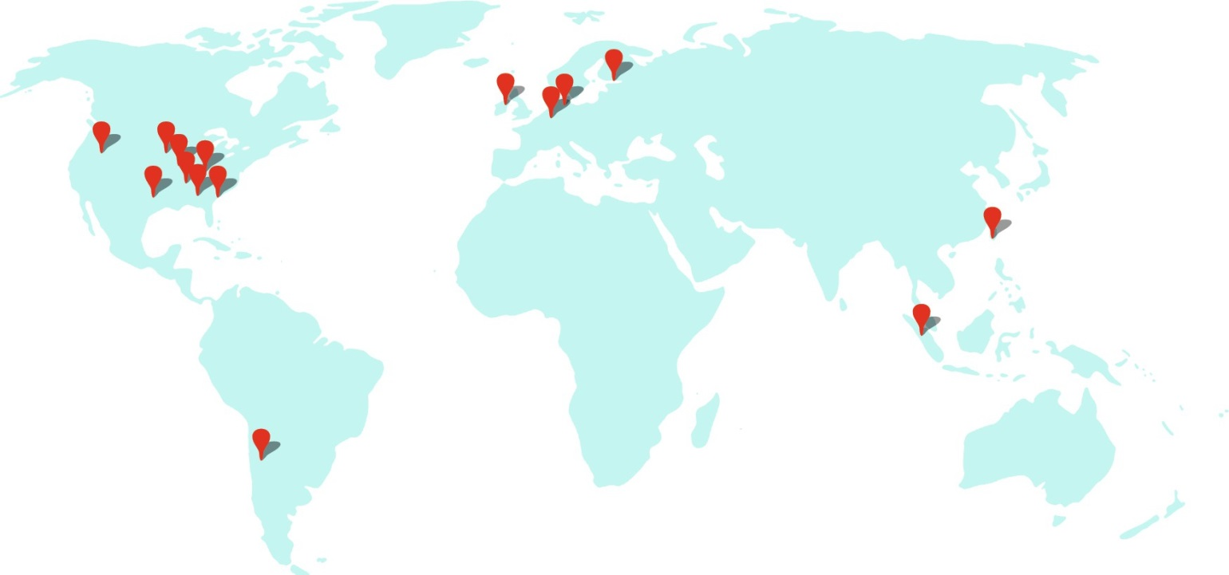
Google Sites
Figure 6.19 In 2017 Google had 15 sites. In the Americas: Berkeley County, South Carolina; Council Bluffs, Iowa; Douglas County, Georgia; Jackson County, Alabama; Lenoir, North Carolina; Mayes County, Oklahoma; Montgomery County, Tennessee; Quilicura, Chile; and The Dalles, Oregon. In Asia: Changhua County, Taiwan; Singapore. In Europe: Dublin, Ireland; Eemshaven, Netherlands; Hamina, Finland; St. Ghislain, Belgium. https://www.google.com/about/datacenters/inside/locations/.

Slide 25
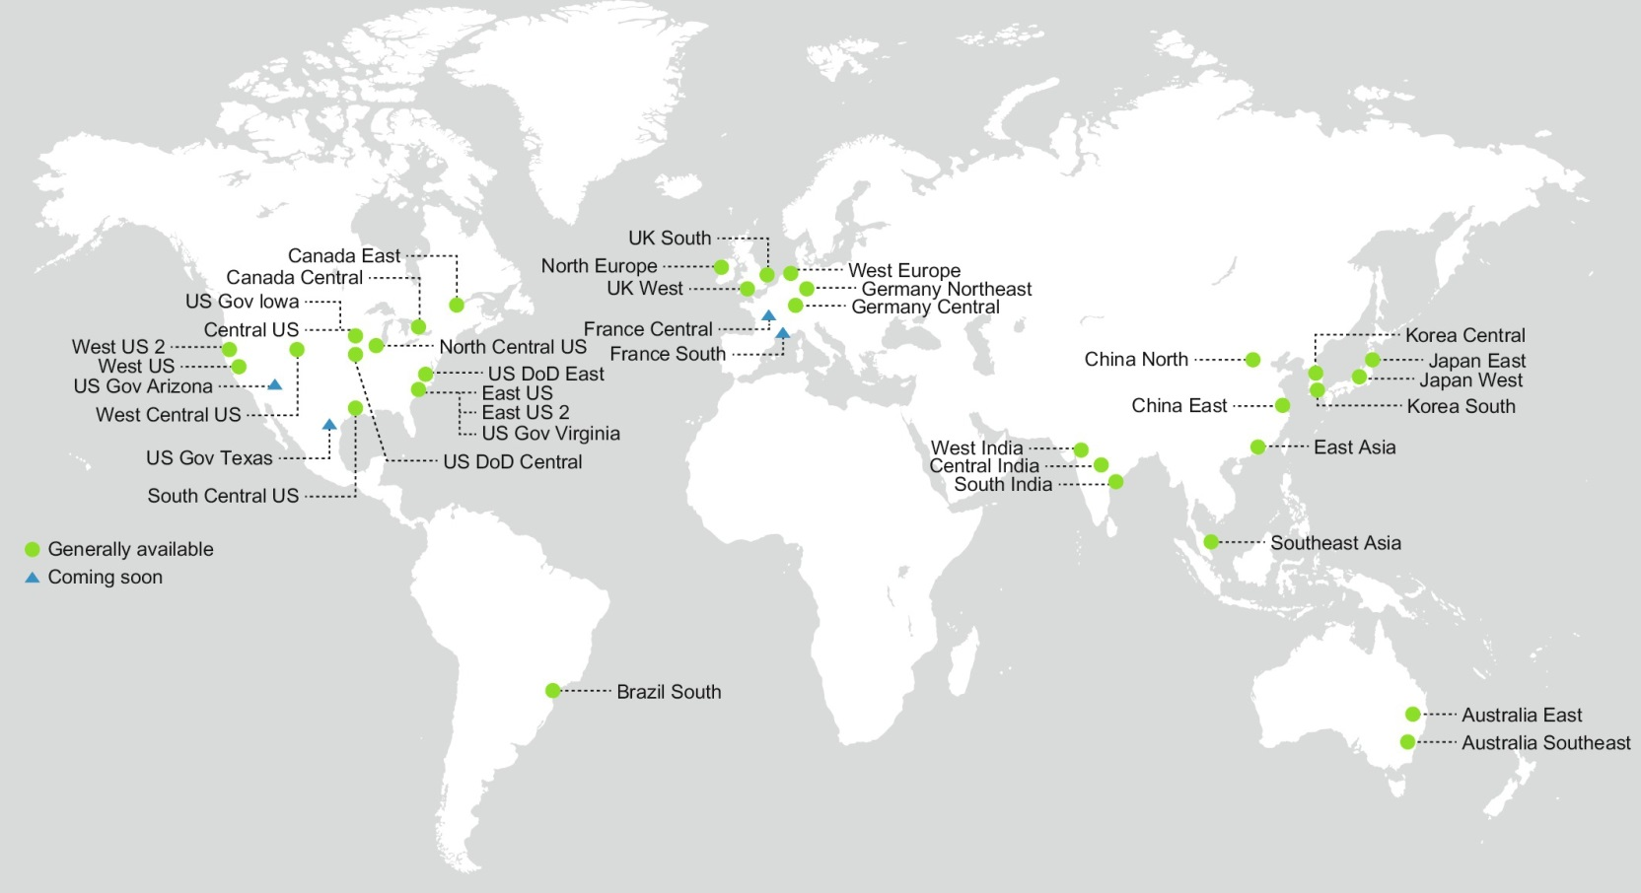
Microsoft Sites
Figure 6.20 In 2017 Microsoft had 34 sites, with four more opening soon. https://azure.microsoft.com/en-us/regions/.

Slide 26
Power Distribution
Efficiency and Cost of WSC

Slide 27
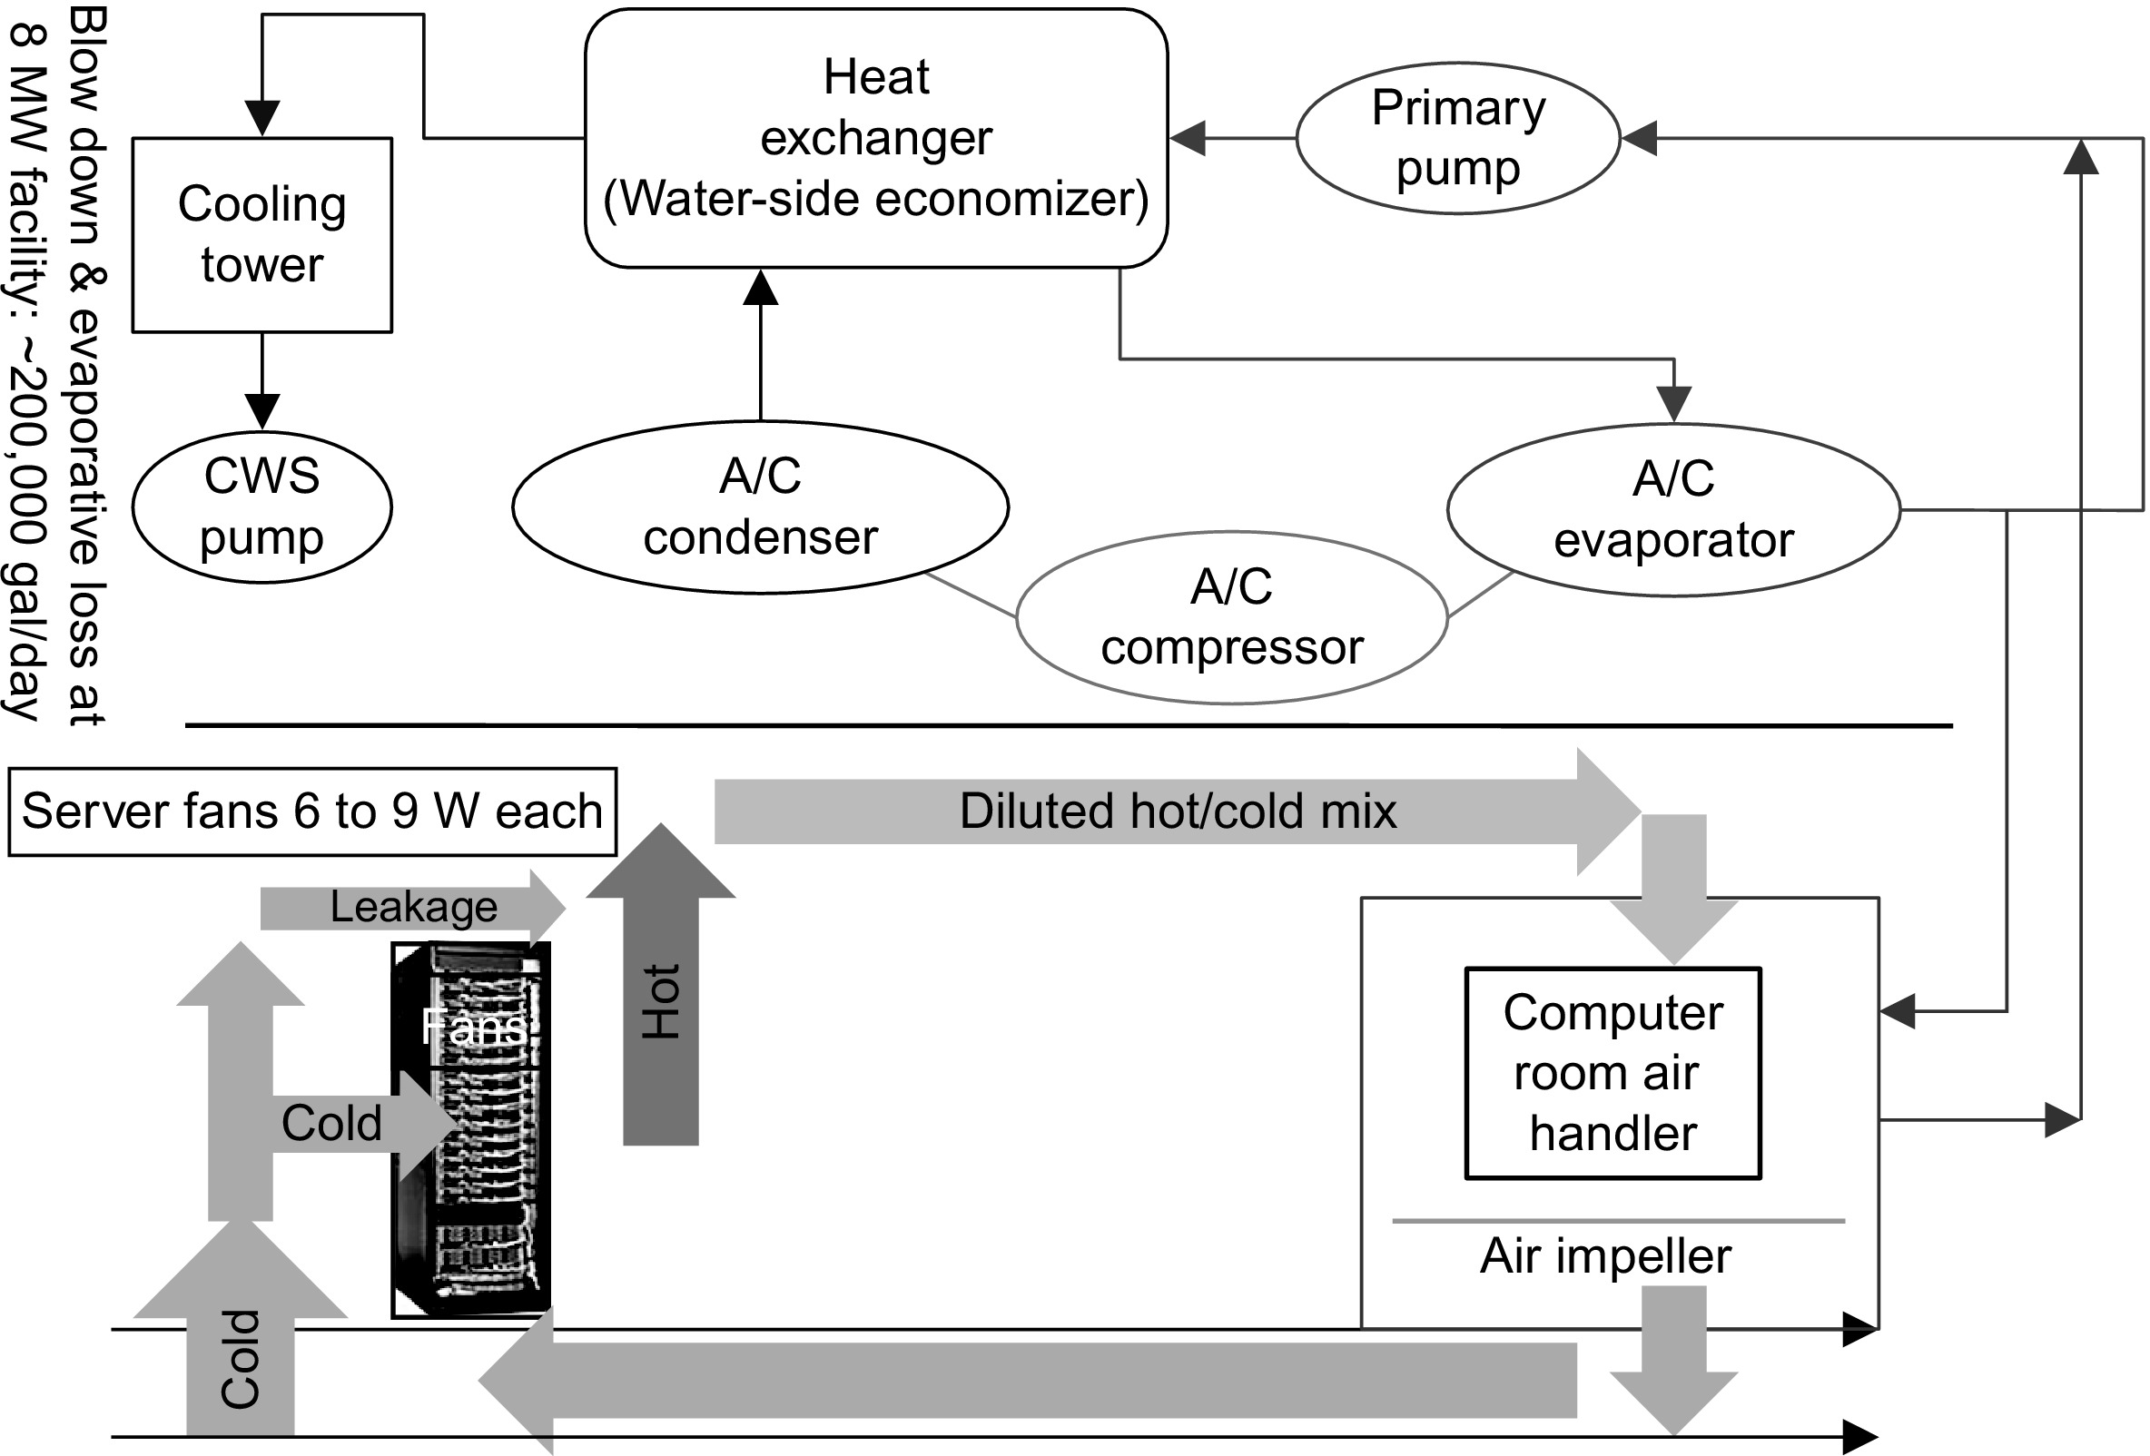
Cooling
Figure 6.9 Mechanical design for cooling systems. CWS stands for circulating water system. From Hamilton, J., 2010. Cloud computing economies of scale. In: Paper Presented at the AWS Workshop on Genomics and Cloud Computing, June 8, 2010, Seattle, WA. http://mvdirona.com/jrh/TalksAndPapers/JamesHamilton_GenomicsCloud20100608.pdf.

Slide 28
Infrastructure and Costs of WSC
Cooling system also uses water (evaporation and spills)
E.g. 70,000 to 200,000 gallons per day for an 8 MW facility
Power cost breakdown:
Chillers: 30-50% of the power used by the IT equipment
Air conditioning: 10-20% of the IT power, mostly due to fans
How many servers can a WSC support?
Each server:
“Nameplate power rating” gives maximum power consumption
To get actual, measure power under actual workloads
Oversubscribe cumulative server power by 40%, but monitor power closely
Physcical Infrastrcuture and Costs of WSC

Slide 29
Infrastructure and Costs of WSC
Determining the maximum server capacity
Nameplate power rating: maximum power that a server can draw
Better approach: measure under various workloads
Oversubscribe by 40%
Typical power usage by component:
Processors: 42%
DRAM: 12%
Disks: 14%
Networking: 5%
Cooling: 15%
Power overhead: 8%
Miscellaneous: 4%
Physcical Infrastrcuture and Costs of WSC

Slide 30
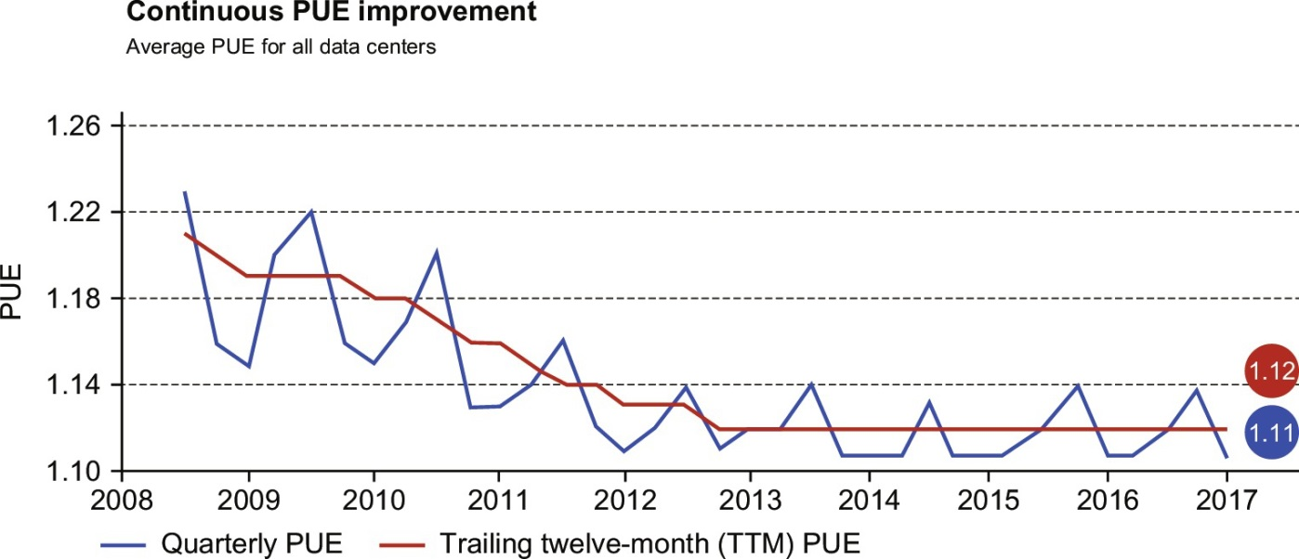
Power Utilization Effectiveness (PEU)
= Total facility power / IT equipment power
Physcical Infrastrcuture and Costs of WSC
Figure 6.11 Average power utilization efficiency (PUE) of the 15 Google WSCs between 2008 and 2017. The spiking line is the quarterly average PUE, and the straighter line is the trailing 12-month average PUE. For Q4 2016, the averages were 1.11 and 1.12, respectively.

Slide 31
Performance, Latency
Latency is important metric because it is seen by users
Bing study: users will use search less as response time increases
Service Level Objectives (SLOs)/Service Level Agreements (SLAs)
E.g. 99% of requests be below 100 ms
Physcical Infrastrcuture and Costs of WSC

Slide 32
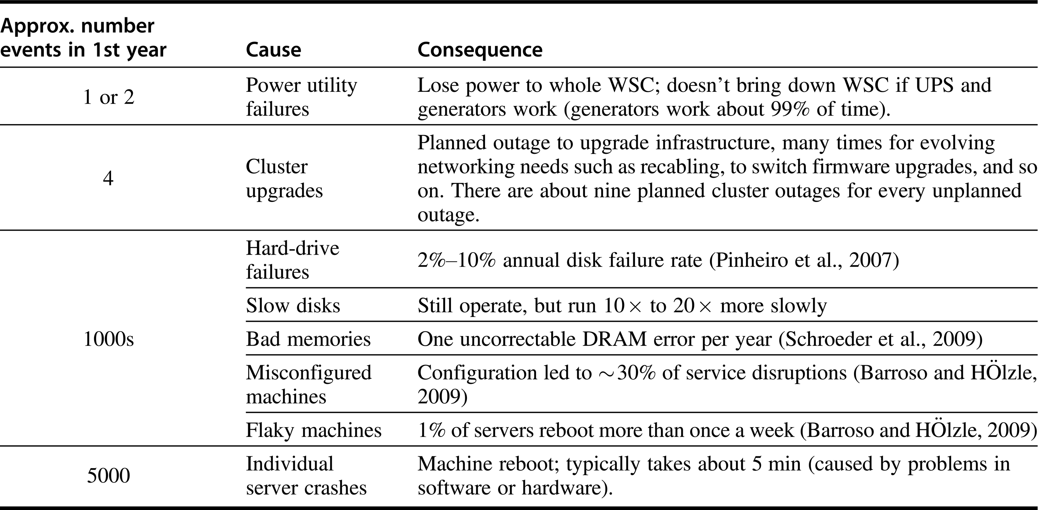
Outages and Anomalies
Figure 6.1 List of outages and anomalies with the approximate frequencies of occurrences in the first year of a new cluster of 2400 servers. We label what Google calls a cluster an array; see Figure 6.5. Based on Barroso, L.A., 2010. Warehouse Scale Computing [keynote address]. In: Proceedings of ACM SIGMOD, June 8–10, 2010, Indianapolis, IN.

Slide 33
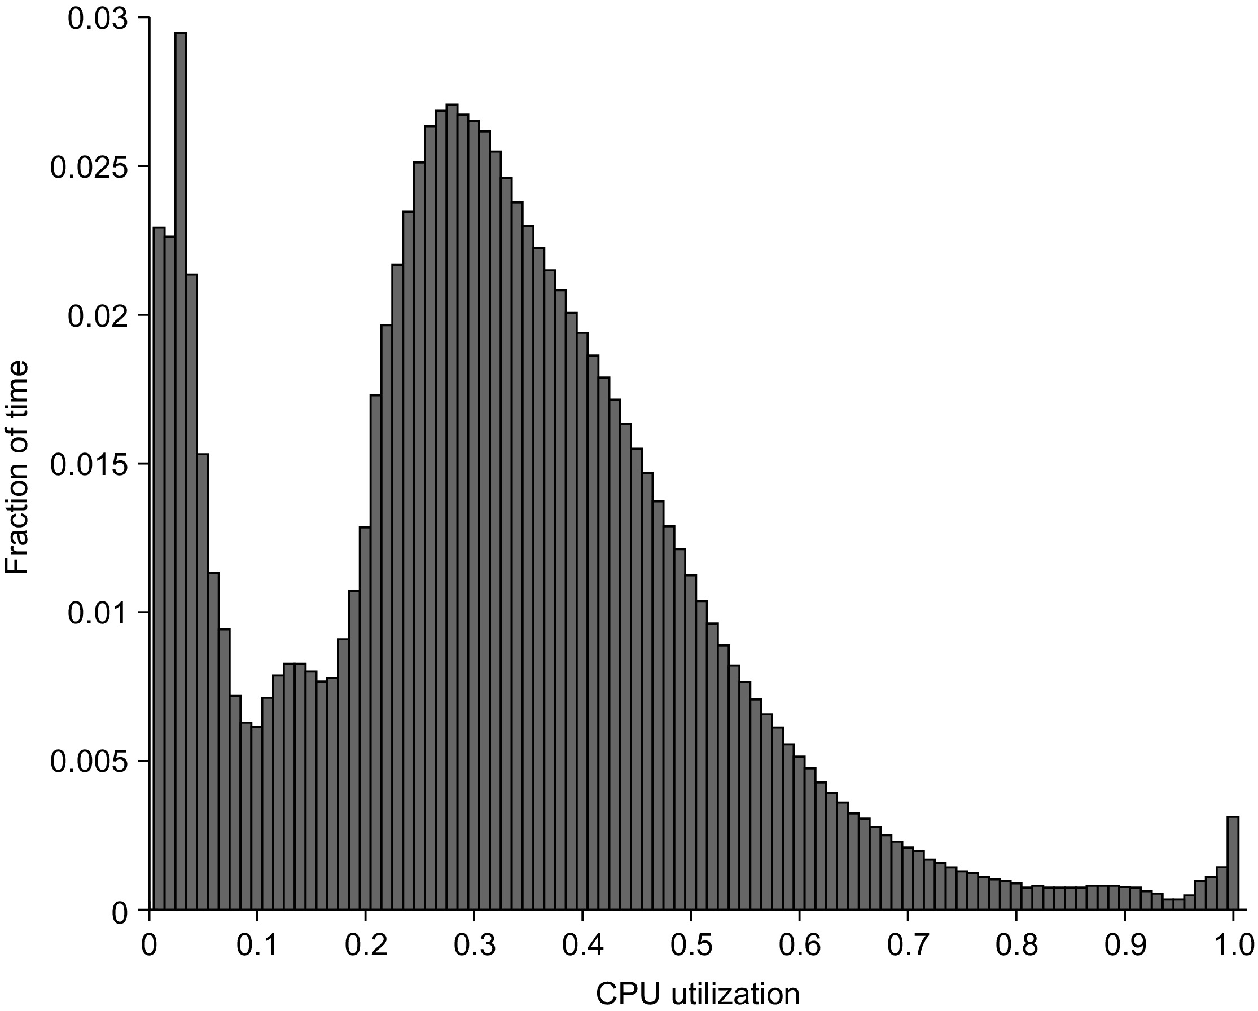
CPU Utilization is Usually Low
Figure 6.3 Average CPU utilization of more than 5000 servers during a 6-month period at Google. Servers are rarely completely idle or fully utilized, instead operating most of the time at between 10% and 50% of their maximum utilization. The third column from the right in Figure 6.4 calculates percentages plus or minus 5% to come up with the weightings; thus 1.2% for the 90% row means that 1.2% of servers were between 85% and 95% utilized.
From Figure 1 in Barroso, L.A., Hölzle, U., 2007. The case for energy-proportional computing. IEEE Comput. 40 (12), 33–37.

Slide 34
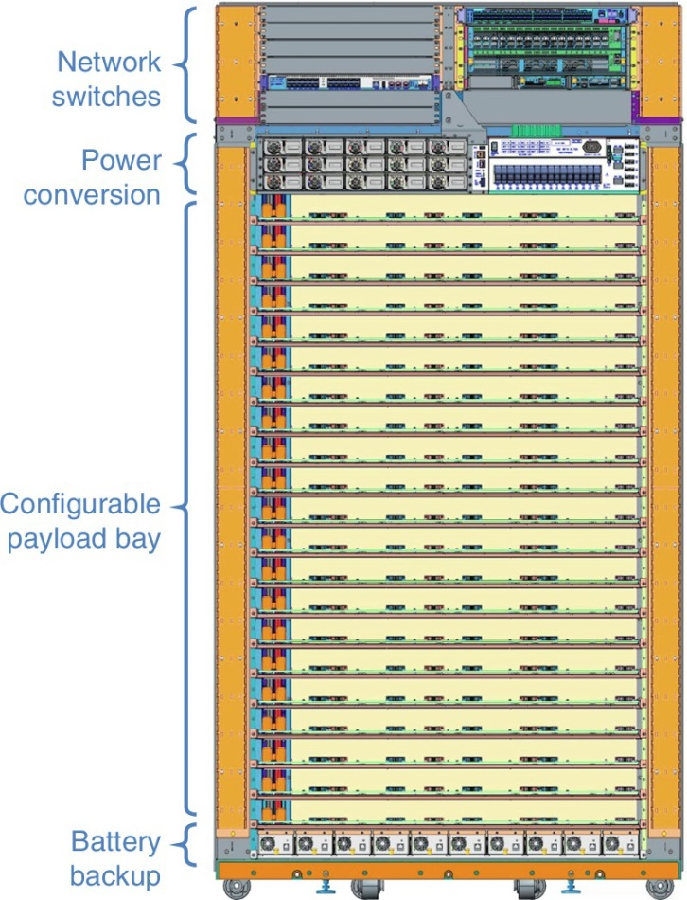
Google WSC Rack
Figure 6.30 A Google rack for its WSC. Its dimensions are about 7 ft high, 4 ft wide, and 2 ft deep (2 m × 1.2 m × 0.5 m). The Top of Rack switches are indeed at the top of this rack. Next comes the power converter that converts from 240 V AC to 48 V DC for the servers in the rack using a bus bar at the back of the rack. Next is the 20 slots (depending on the height of the server) that can be configured for the various types of servers that can be placed in the rack. Up to four servers can be placed per tray. At the bottom of the rack are high-efficiency distributed modular DC uninterruptible power supply (UPS) batteries.

Slide 35
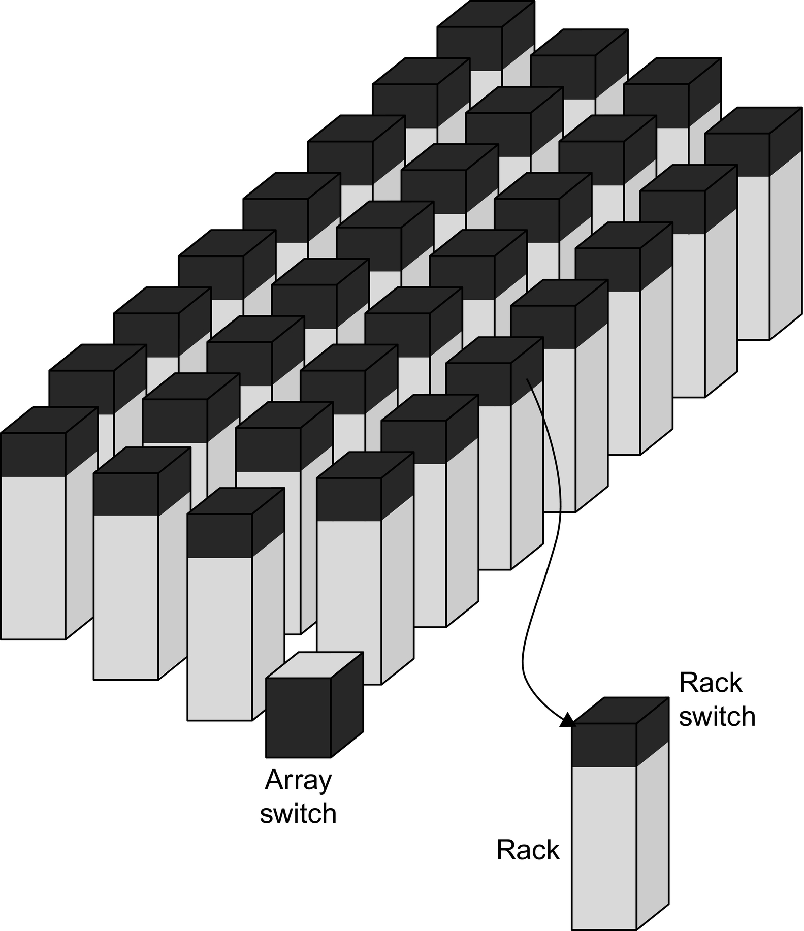
Array of Racks
Figure 6.5 Hierarchy of switches in a WSC. Based on Figure 1.1 in Barroso, L.A., Clidaras, J., Hölzle, U., 2013. The datacenter as a computer: an introduction to the design of warehouse-scale machines. Synth. Lect. Comput. Architect. 8 (3), 1–154.

Slide 36
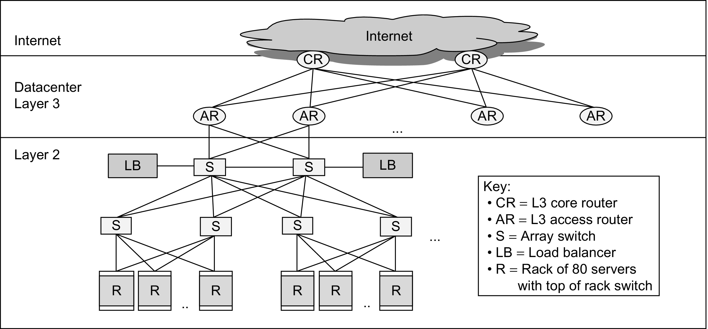
Older WCS Network Structure
Figure 6.8 A Layer 3 network used to link arrays together and to the Internet (Greenberg et al., 2009). A load balancer monitors how busy a set of servers is and directs traffic to the less loaded ones to try to keep the servers approximately equally utilized. Another option is to use a separate border router to connect the Internet to the data center Layer 3 switches. As we will see in Section 6.6, many modern WSCs have abandoned the conventional layered networking stack of traditional switches.

Slide 37
Array Switch
Switch that connects an array of racks
Array switch should have 10 X the bisection bandwidth of rack switch
Cost of n-port switch grows as n²
Often utilize content addressible memory chips and FPGAs
Computer Ar4chitecture of WSC

Slide 38
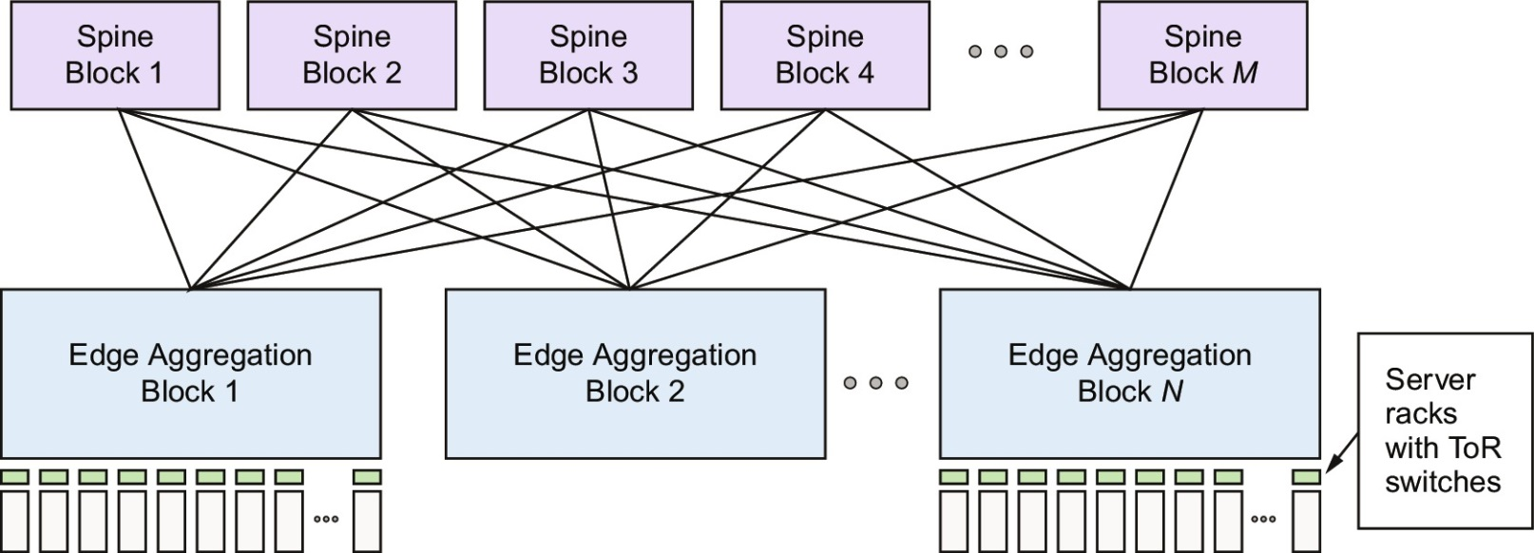
Newer Clos Network Structure
Figure 6.31 A Clos network has three logical stages containing crossbar switches: ingress, middle, and egress. Each input to the ingress stage can go through any of the middle stages to be routed to any output of the egress stage. In this figure, the middle stages are the M Spine Blocks, and the ingress and egress stages are in the N Edge Activation Blocks. Figure 6.22 shows the changes in the Spine Blocks and the Edge Aggregation Blocks over many generations of Clos networks in Google WSCs.

Slide 39
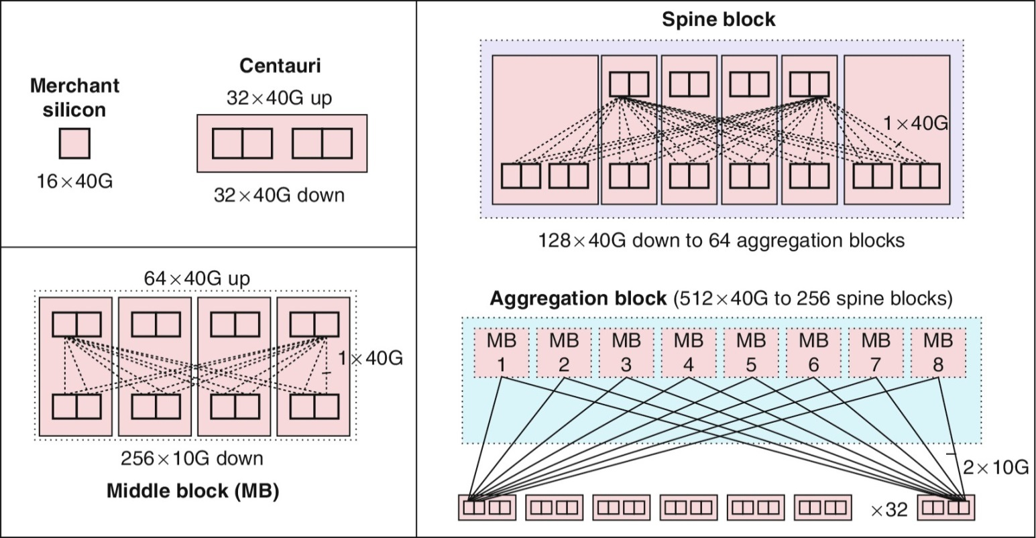
Google Jupiter Clos Network
Figure 6.32 Building blocks of the Jupiter Clos network.

Slide 40
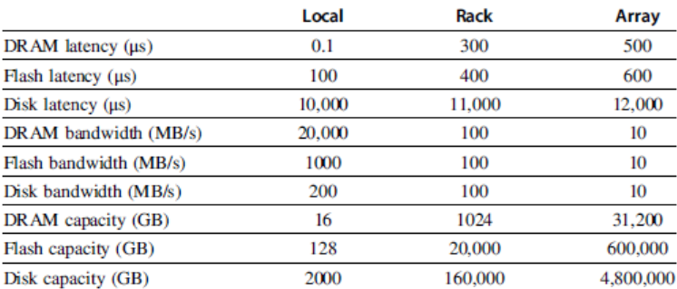
WSC Memory Hierarchy
Servers can access DRAM and disks on other servers using a NUMA-style interface
Computer Ar4chitecture of WSC

Slide 41
Storage options
Use disks inside the servers, or
Network attached storage through Infiniband
WSCs generally rely on local disks
Google File System (GFS) uses local disks and maintains at least three replicas
Computer Ar4chitecture of WSC

Slide 42
Cost of a WSC
Capital expenditures (CAPEX)
Cost to build a WSC
$9 to 13/watt
Operational expenditures (OPEX)
Cost to operate a WSC
Physcical Infrastrcuture and Costs of WSC

Slide 43
Prgrm’g Models and Workloads
Batch processing framework: MapReduce
Map: applies a programmer-supplied function to each logical input record
Runs on thousands of computers
Provides new set of key-value pairs as intermediate values
Reduce: collapses values using another programmer-supplied function
Programming Models and Workloads for WSCs

Slide 44
Prgrm’g Models and Workloads
Example:
map (String key, String value):
// key: document name
// value: document contents
for each word w in value
EmitIntermediate(w,”1”); // Produce list of all words
reduce (String key, Iterator values):
// key: a word
// value: a list of counts
int result = 0;
for each v in values:
result += ParseInt(v); // get integer from key-value pair
Emit(AsString(result));
Programming Models and Workloads for WSCs

Slide 45
Prgrm’g Models and Workloads
Availability:
Use replicas of data across different servers
Use relaxed consistency:
No need for all replicas to always agree
File systems: GFS and Colossus
Databases: Dynamo and BigTable
Programming Models and Workloads for WSCs

Slide 46
Prgrm’g Models and Workloads
MapReduce runtime environment schedules map and reduce task to WSC nodes
Workload demands often vary considerably
Scheduler assigns tasks based on completion of prior tasks
Tail latency/execution time variability: single slow task can hold up large MapReduce job
Runtime libraries replicate tasks near end of job
Don’t wait for stragglers, repeat task somewhere else
Programming Models and Workloads for WSCs

