Slide 1
CS 152 Computer Architecture and Engineering CS252 Graduate Computer Architecture Lecture 5 – Memory
Krste Asanovic
Electrical Engineering and Computer Sciences
University of California at Berkeley
http://www.eecs.berkeley.edu/~krste
http://inst.eecs.berkeley.edu/~cs152

Slide 2
Last time in Lecture 4
Handling exceptions in pipelined machines by passing exceptions down pipeline until instructions cross commit point in order
Can use values before commit through bypass network
Pipeline hazards can be avoided through software techniques: scheduling, loop unrolling
Decoupled architectures use queues between “access” and “execute” pipelines to tolerate long memory latency
Regularizing all functional units to have same latency simplifies more complex pipeline design by avoiding structural hazards, can be expanded to in-order superscalar designs

Slide 3
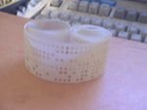
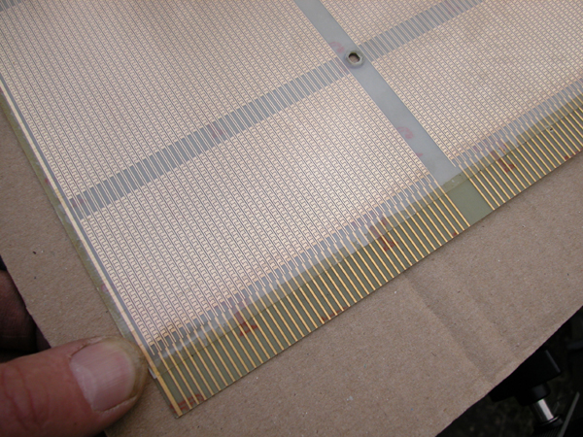
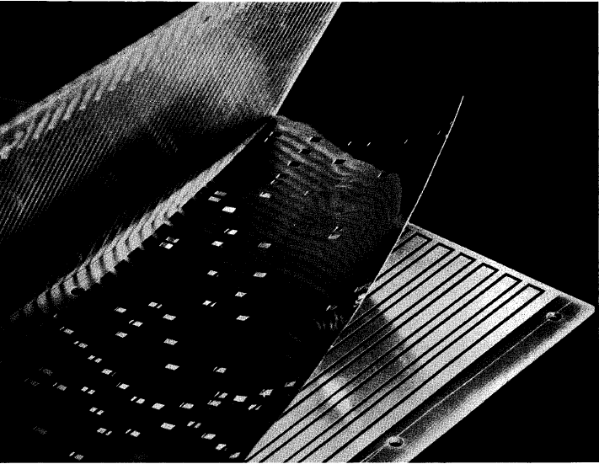
Early Read-Only Memory Technologies
Punched cards, From early 1700s through Jaquard Loom, Babbage, and then IBM
Punched paper tape, instruction stream in Harvard Mk 1
Diode Matrix, EDSAC-2 µcode store
IBM Balanced Capacitor ROS
IBM Card Capacitor ROS

Slide 4
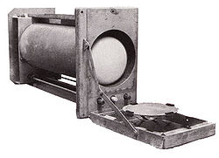
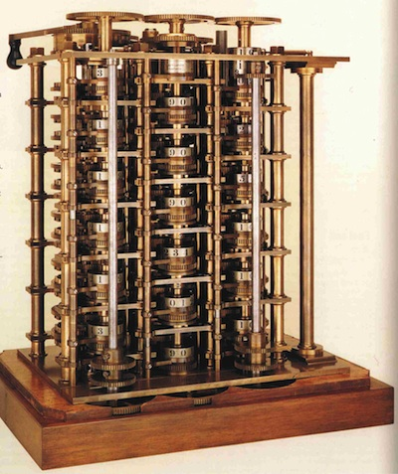
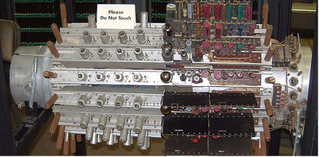
Early Read/Write Main Memory Technologies
Babbage, 1800s: Digits stored on mechanical wheels
Williams Tube, Manchester Mark 1, 1947
Mercury Delay Line, Univac 1, 1951
Also, regenerative capacitor memory on Atanasoff-Berry computer, and rotating magnetic drum memory on IBM 650

Slide 5
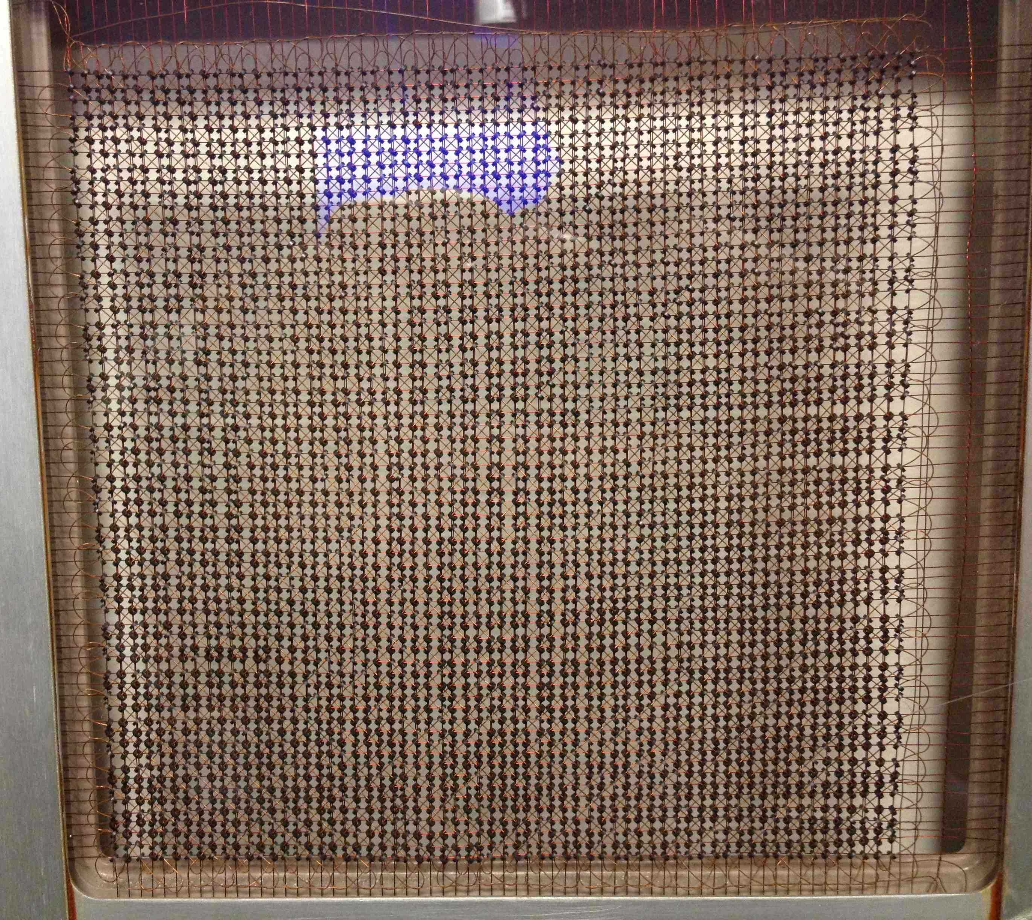
MIT Whirlwind Core Memory

Slide 6
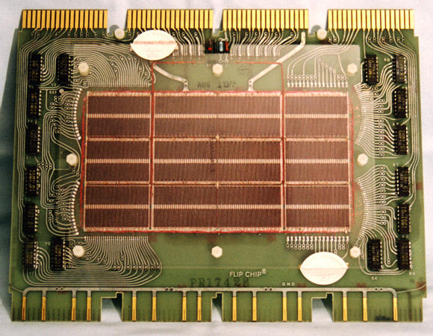
Core Memory
Core memory was first large scale reliable main memory
invented by Forrester in late 40s/early 50s at MIT for Whirlwind project
Bits stored as magnetization polarity on small ferrite cores threaded onto two-dimensional grid of wires
Coincident current pulses on X and Y wires would write cell and also sense original state (destructive reads)
Robust, non-volatile storage
Used on space shuttle computers
Cores threaded onto wires by hand (25 billion a year at peak production)
Core access time ~ 1µs
DEC PDP-8/E Board,
4K words x 12 bits, (1968)
Notes:
Early machines had things like mercury delay lines (jse)
Photo from David Gesswein djg@pdp8.net

Slide 7
Semiconductor Memory
Semiconductor memory began to be competitive in early 1970s
Intel formed to exploit market for semiconductor memory
Early semiconductor memory was Static RAM (SRAM). SRAM cell internals similar to a latch (cross-coupled inverters).
First commercial Dynamic RAM (DRAM) was Intel 1103
1Kbit of storage on single chip
charge on a capacitor used to hold value
Semiconductor memory quickly replaced core in ‘70s

Slide 8
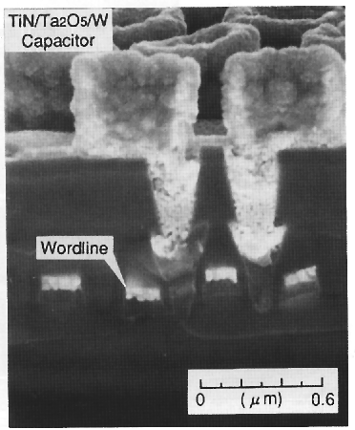
One-Transistor Dynamic RAM [Dennard, IBM]
1-T DRAM Cell
word
access transistor
TiN top electrode (V_{REF})
V_{REF}
Ta₂O₅ dielectric
bit
Storage
capacitor (FET gate, trench, stack)
poly
word
line
W bottom
electrode
access transistor

Slide 9
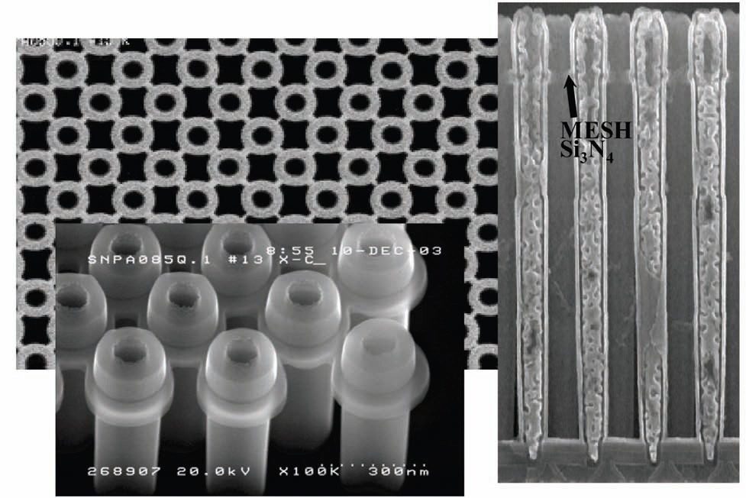
Modern DRAM Structure
[Samsung, sub-70nm DRAM, 2004]

Slide 10
DRAM Architecture
bit lines
Col.
1
Col. 2^{M}
word lines
Row 1
N
Row Address Decoder
Row 2^{N}
Memory cell (one bit)
M
Column Decoder & Sense Amplifiers
N+M
Data
D
Bits stored in 2-dimensional arrays on chip
Modern chips have around 4-8 logical banks on each chip
each logical bank physically implemented as many smaller arrays

Slide 11
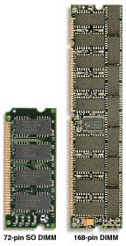
DRAM Packaging (Laptops/Desktops/Servers)
~7
Clock and control signals
DRAM chip
Address lines multiplexed row/column address
~12
Data bus
(4b,8b,16b,32b)
DIMM (Dual Inline Memory Module) contains multiple chips with clock/control/address signals connected in parallel (sometimes need buffers to drive signals to all chips)
Data pins work together to return wide word (e.g., 64-bit data bus using 16x4-bit parts)

Slide 12
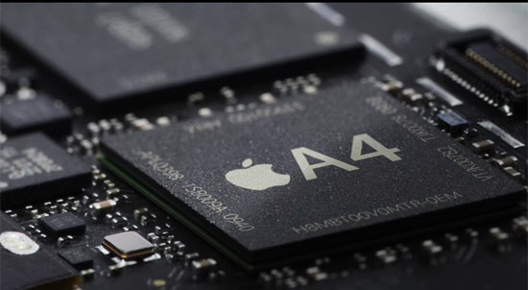
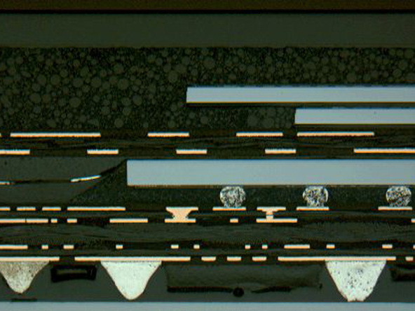
DRAM Packaging, Mobile Devices
[ Apple A4 package on circuit board]
Two stacked DRAM die
Processor plus logic die
[ Apple A4 package cross-section, iFixit 2010 ]

Slide 13
DRAM Packaging Apple A10

Slide 14
DRAM Operation
Three steps in read/write access to a given bank
Row access (RAS)
decode row address, enable addressed row (often multiple Kb in row)
bitlines share charge with storage cell
small change in voltage detected by sense amplifiers which latch whole row of bits
sense amplifiers drive bitlines full rail to recharge storage cells
Column access (CAS)
decode column address to select small number of sense amplifier latches (4, 8, 16, or 32 bits depending on DRAM package)
on read, send latched bits out to chip pins
on write, change sense amplifier latches which then charge storage cells to required value
can perform multiple column accesses on same row without another row access (burst mode)
Precharge
charges bit lines to known value, required before next row access
Each step has a latency of around 15-20ns in modern DRAMs
Various DRAM standards (DDR, RDRAM) have different ways of encoding the signals for transmission to the DRAM, but all share same core architecture
Notes:
Use RAS/CAS to reduce average latency.

Slide 15
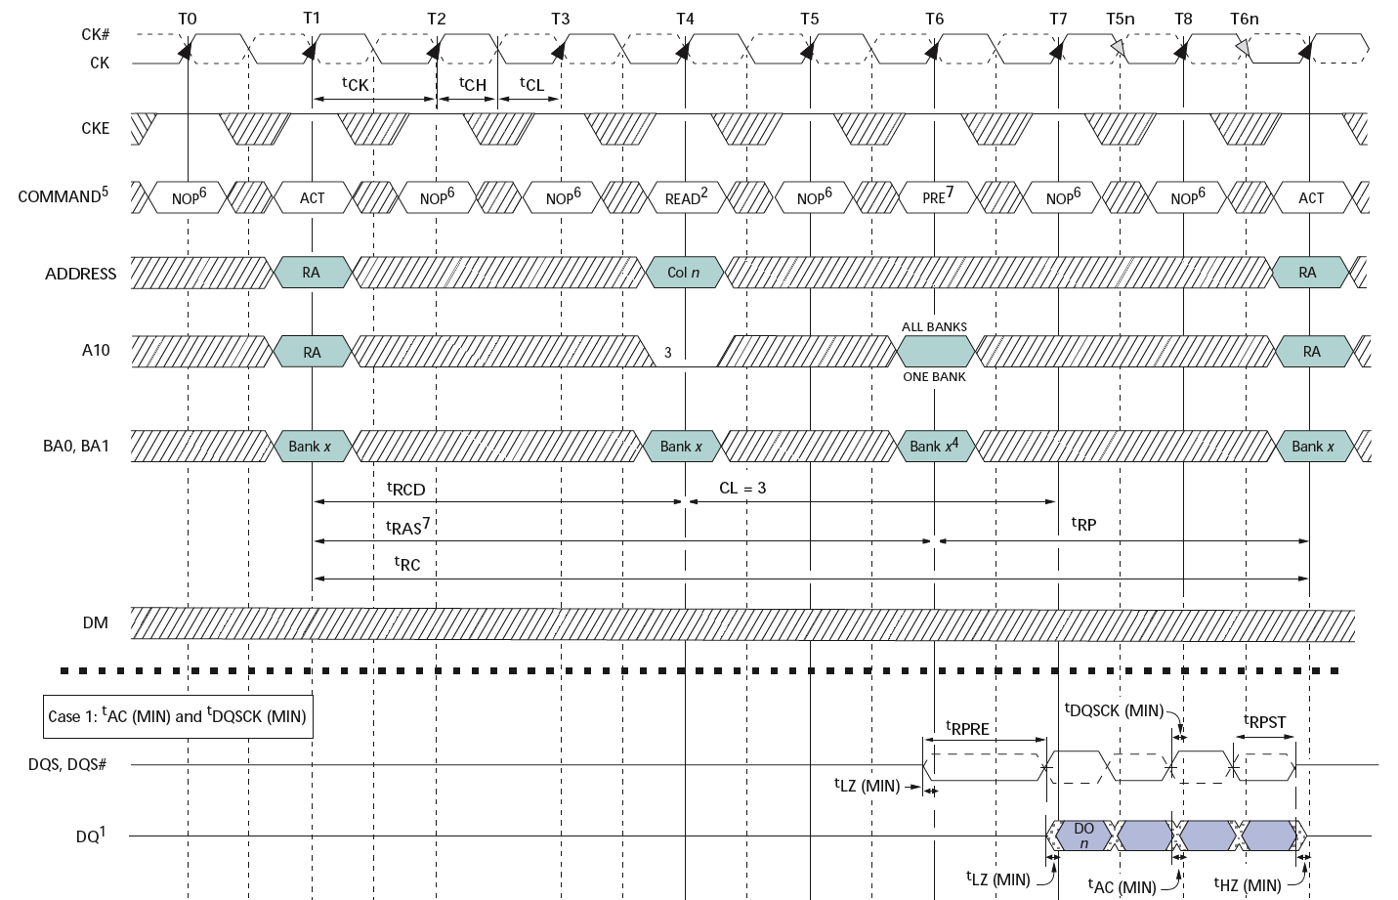
Double-Data Rate (DDR2) DRAM
200MHz Clock
Row
Column
Precharge
Row’
Data
400Mb/s Data Rate
[ Micron, 256Mb DDR2 SDRAM datasheet ]

Slide 16
CPU-Memory Bottleneck
Memory
CPU
Performance of high-speed computers is usually limited by memory bandwidth & latency
Latency (time for a single access)
Memory access time >> Processor cycle time
Bandwidth (number of accesses per unit time)
if fraction m of instructions access memory
⇒ 1+m memory references / instruction
⇒ CPI = 1 requires 1+m memory refs / cycle (assuming RISC-V ISA)

Slide 17
Processor-DRAM Gap (latency)
µProc 60%/year
1000
CPU
Processor-Memory
Performance Gap: (growing 50%/yr)
100
Performance
10
DRAM
7%/year
DRAM
1
1986
1988
1987
1989
1990
1991
1992
1993
1994
1995
1980
1996
1981
1982
1983
1984
1985
1997
1998
1999
2000
Time
Four-issue 3GHz superscalar accessing 100ns DRAM could execute 1,200 instructions during time for one memory access!
Notes:
Why doesn’t DRAM get faster?

Slide 18
Physical Size Affects Latency
CPU
Big Memory
CPU
Small Memory
Signals have further to travel
Fan out to more locations

Slide 19
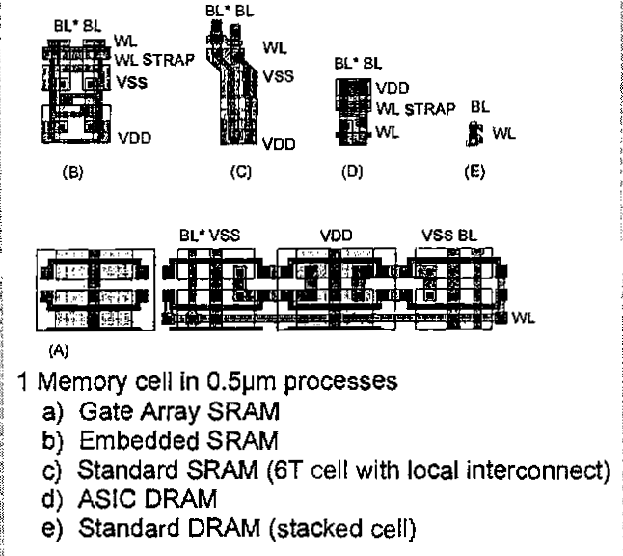
Relative Memory Cell Sizes
On-Chip SRAM in logic chip
DRAM on memory chip
[ Foss, “Implementing Application-Specific Memory”, ISSCC 1996 ]

Slide 20
Memory Hierarchy
Big, Slow Memory
(DRAM)
A
Small,
Fast Memory
(RF, SRAM)
B
CPU
holds frequently used data
capacity: Register << SRAM << DRAM
latency: Register << SRAM << DRAM
bandwidth: on-chip >> off-chip
On a data access:
if data ∈ fast memory ⇒ low latency access (SRAM)
if data ∉ fast memory ⇒ high latency access (DRAM)
Notes:
Due to cost
Due to size of DRAM
Due to cost and wire delays (wires on-chip cost much less, and are faster)

Slide 21
CS152 Administrivia

Slide 22
CS252 Administrivia

Slide 23
Management of Memory Hierarchy
Small/fast storage, e.g., registers
Address usually specified in instruction
Generally implemented directly as a register file
but hardware might do things behind software’s back, e.g., stack management, register renaming
Larger/slower storage, e.g., main memory
Address usually computed from values in register
Generally implemented as a hardware-managed cache hierarchy (hardware decides what is kept in fast memory)
but software may provide “hints”, e.g., don’t cache or prefetch
Notes:
Secondary characteristic:
Some machines (PDP-10) have overlain the registers on memory (jse)

Slide 24
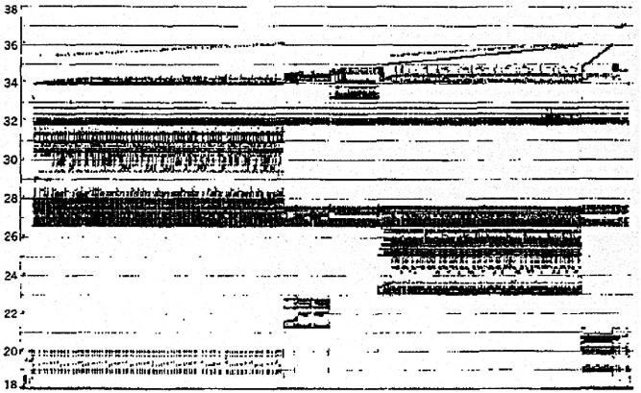
Real Memory Reference Patterns
Memory Address (one dot per access)
Donald J. Hatfield, Jeanette Gerald: Program Restructuring for Virtual Memory. IBM Systems Journal 10(3): 168-192 (1971)
Time

Slide 25
Typical Memory Reference Patterns
Address
n loop iterations
Instruction
fetches
subroutine call
subroutine return
Stack
accesses
argument access
vector access
Data
accesses
scalar accesses
Time

Slide 26
Two predictable properties of memory references:
Temporal Locality: If a location is referenced it is likely to be referenced again in the near future.
Spatial Locality: If a location is referenced it is likely that locations near it will be referenced in the near future.

Slide 27
Memory Reference Patterns
Temporal
Locality
Memory Address (one dot per access)
Spatial
Locality
Time
Donald J. Hatfield, Jeanette Gerald: Program Restructuring for Virtual Memory. IBM Systems Journal 10(3): 168-192 (1971)

Slide 28
Caches exploit both types of predictability:
Exploit temporal locality by remembering the contents of recently accessed locations.
Exploit spatial locality by fetching blocks of data around recently accessed locations.

Slide 29
Inside a Cache
Address
Address
Processor
CACHE
Main
Memory
Data
Data
copy of main
memory
location 100
copy of main
memory
location 101
100
Data
Byte
Data
Byte
Line
304
Data
Byte
Address
Tag
6848
416
Data Block
Notes:
Tag only needs enough bits to uniquely identify the block (jse)

Slide 30
Cache Algorithm (Read)
Look at Processor Address, search cache tags to find match. Then either
Found in cache
a.k.a. HIT
Not in cache
a.k.a. MISS
Return copy
of data from
cache
Read block of data from
Main Memory
Wait …
Return data to processor
and update cache
Q: Which line do we replace?

Slide 31
Placement Policy
Block Number
1 1 1 1 1 1 1 1 1 1 0 1 2 3 4 5 6 7 8 9
2 2 2 2 2 2 2 2 2 2 0 1 2 3 4 5 6 7 8 9
3 3
0 1
0 1 2 3 4 5 6 7 8 9
Memory
Set Number
0 1 2 3
0 1 2 3 4 5 6 7
Cache
Fully (2-way) Set Direct
Associative Associative Mapped
anywhere anywhere in only into
set 0 block 4
(12 mod 4) (12 mod 8)
block 12
can be placed
Notes:
Simplest scheme is to extract bits from ‘block number’ to determine ‘set’ (jse)
More sophisticated schemes will hash the block number ---- why could that be good/bad?

Slide 32
Direct-Mapped Cache
Tag
Index
Block
Offset
t
k
b
V
Tag
Data Block
2^{k}
lines
t
=
HIT
Data Word or Byte

Slide 33
Direct Map Address Selection higher-order vs. lower-order address bits
Index
Tag
Block
Offset
k
t
b
V
Tag
Data Block
2^{k}
lines
t
=
HIT
Data Word or Byte
Notes:
Index and tag reversed

Slide 34
2-Way Set-Associative Cache
Tag
Index
Block
Offset
b
t
k
V
Tag
Data Block
V
Tag
Data Block
t
=
=
Data
Word
or Byte
HIT
Notes:
Compare latency to direct mapped case? (jse)

Slide 35
Fully Associative Cache
V
Tag
Data Block
t
=
Tag
t
=
HIT
Block
Offset
Data
Word
or Byte
=
b

Slide 36
Replacement Policy
In an associative cache, which block from a set should be evicted when the set becomes full?
Random
Least-Recently Used (LRU)
LRU cache state must be updated on every access
true implementation only feasible for small sets (2-way)
pseudo-LRU binary tree often used for 4-8 way
First-In, First-Out (FIFO) a.k.a. Round-Robin
used in highly associative caches
Not-Most-Recently Used (NMRU)
FIFO with exception for most-recently used block or blocks
This is a second-order effect. Why?
Replacement only happens on misses
Notes:
NLRU used in Alpha TLBs (jse)

Slide 37
Block Size and Spatial Locality
Block is unit of transfer between the cache and memory
4 word block, b=2
Tag
Word0
Word1
Word2
Word3
Split CPU address
block address offset_{b}
32-b bits
b bits
2^{b} = block size a.k.a line size (in bytes)
Larger block size has distinct hardware advantages
less tag overhead
exploit fast burst transfers from DRAM
exploit fast burst transfers over wide busses
What are the disadvantages of increasing block size?
Fewer blocks => more conflicts. Can waste bandwidth.
Notes:
Larger block size will reduce compulsory misses (first miss to a block).
Larger blocks may increase conflict misses since the number of blocks
is smaller.

Slide 38
Acknowledgements
This course is partly inspired by previous MIT 6.823 and Berkeley CS252 computer architecture courses created by my collaborators and colleagues:
Arvind (MIT)
Joel Emer (Intel/MIT)
James Hoe (CMU)
John Kubiatowicz (UCB)
David Patterson (UCB)

