Slide 1
CS 152 Computer Architecture and Engineering
Lecture 20: Datacenters
Dr. George Michelogiannakis
EECS, University of California at Berkeley
CRD, Lawrence Berkeley National Laboratory
http://inst.eecs.berkeley.edu/~cs152
Thanks to Christina Delimitrou, Christos Kozyrakis

Slide 2
Administrivia
PS 5 due NOW
Quiz 5 on Wednesday next week
Please show up on Monday April 21st (last lecture)
  Neuromorphic, quantum
  Parting thoughts that have nothing to do with architecture
  Class evaluation

Slide 3
What Is A Datacenter?
The compute infrastructure for internet-scale services & cloud computing
  x10k of servers, x100k hard disks
  Examples: Google, Facebook, Microsoft, Amazon (+ Amazon Web Services), Twitter, Yahoo, …
Both consumer and enterprise services
  Windows Live, Gmail, Hotmail, Dropbox, bing, Google, Adcenter, GoogleApps, Web apps, Exchange online, salesforce.com, Azure, …

Slide 4
Other Definitions
Centralized repository for the storage, management, and dissemination of data and information, pertaining to a particular business or service
Datacenters involve large quantities of data and their processing
Largely made up of commodity components

Slide 5
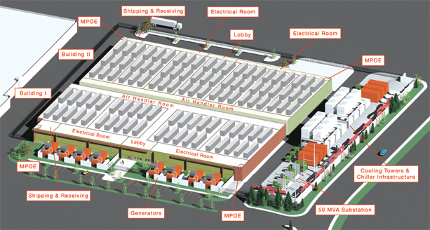
Components
Apart from computers & network switches, you need:
  Power infrastructure: voltage converters and regulators, generators and UPSs, …
  Cooling infrastructure: A/C, cooling towers, heat exchangers, air impellers,…
Everything is co-designed!

Slide 6
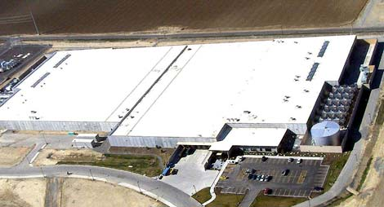
Example: MS Quincy Datacenter
470k sq feet (10 football fields)
Next to a hydro-electric generation plant
  At up to 40 MegaWatts, $0.02/kWh is better than $0.15/kWh ☺
  That’s equal to the power consumption of 30,000 homes

Slide 7
Example: MS Chicago Datacenter
[K. Vaid, Microsoft Global Foundation Services, 2010]
Notes:
Slightly outdated, although systems have become more, they haven’t become a lot larger in the past 3 years because there aren’t enough electricity plants to power them…
One of the biggest ones, uses containers
Not water pipes in every single isle, one has and one doesn’t…
Hot isle, cold isle and elevated floors so the air can circulate.

Slide 8
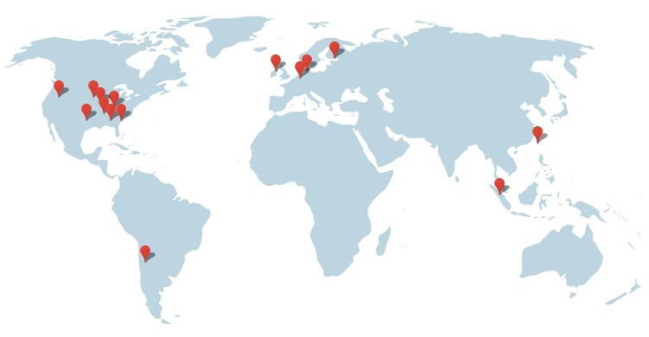
Google’s Datacenter Locations

Slide 9
Applications That Use Datacenters
Storage
  Large and small files (e.g., phone contacts)
Search engines
Compute time rental & web hosting
  Amazon EC2 – virtual server hosting
Cloud gaming
  File or video streaming

Slide 10
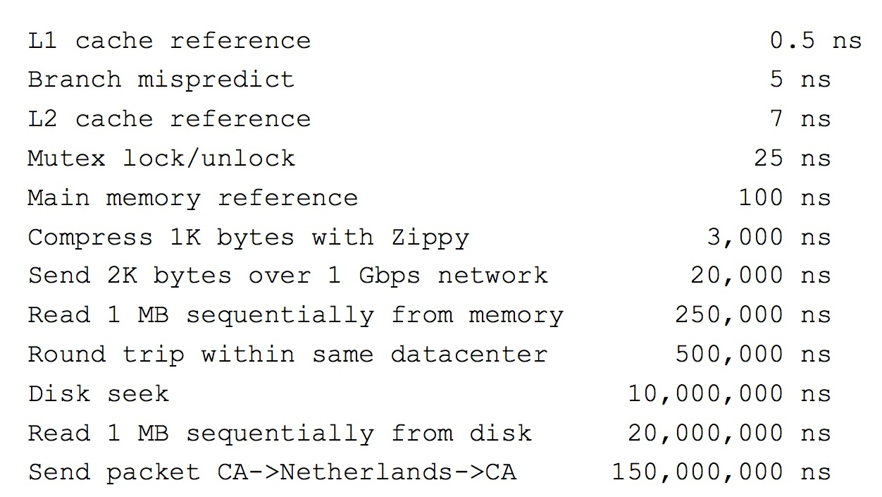
Why Is Cloud Gaming Possible?

Slide 11
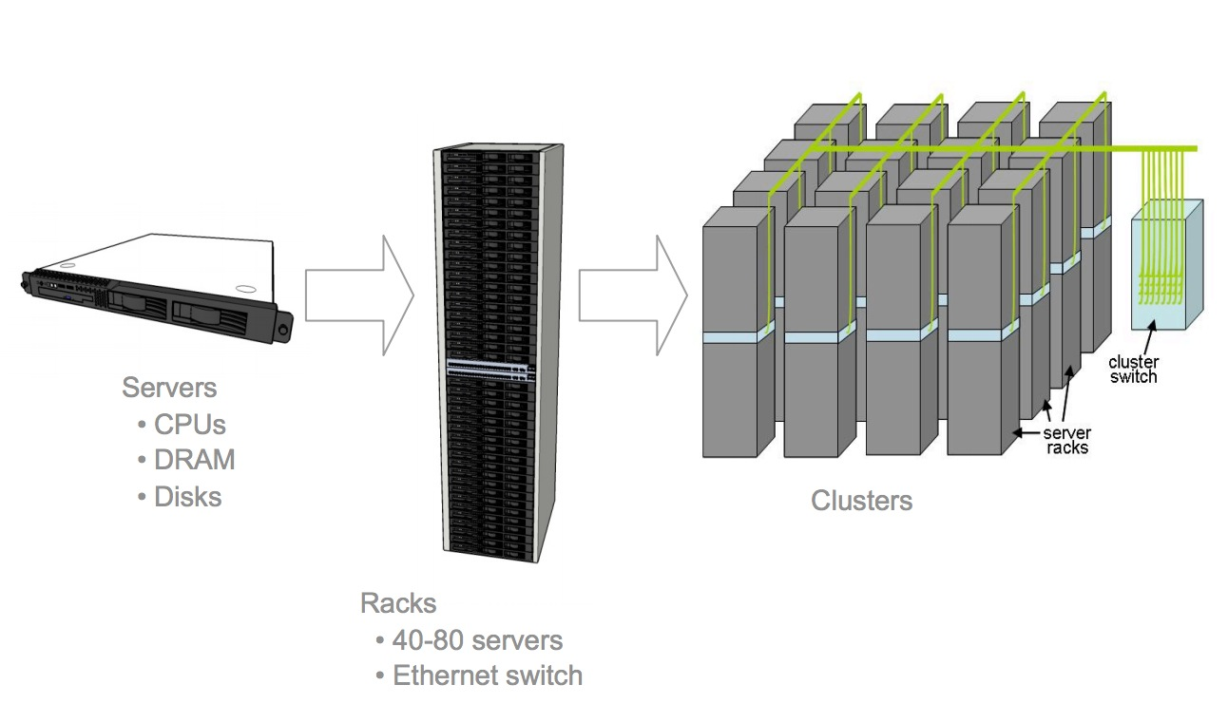
The Inside

Slide 12
Example: FB Datacenter Racks

Slide 13
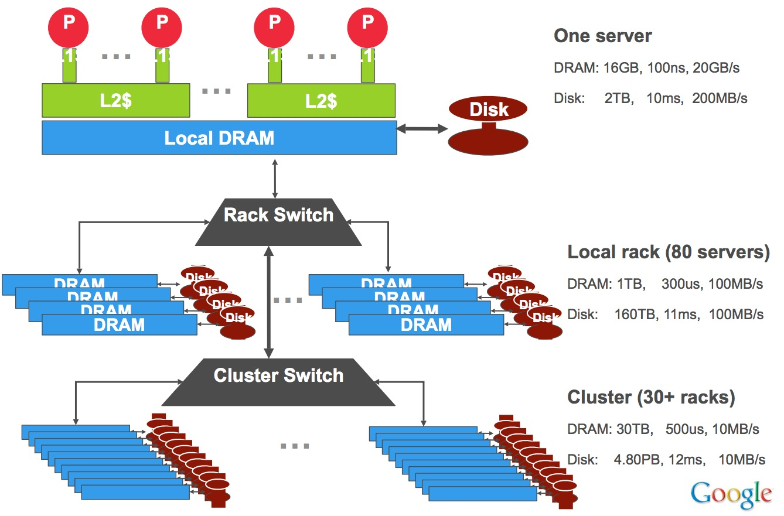
Storage Hierarchy

Slide 14
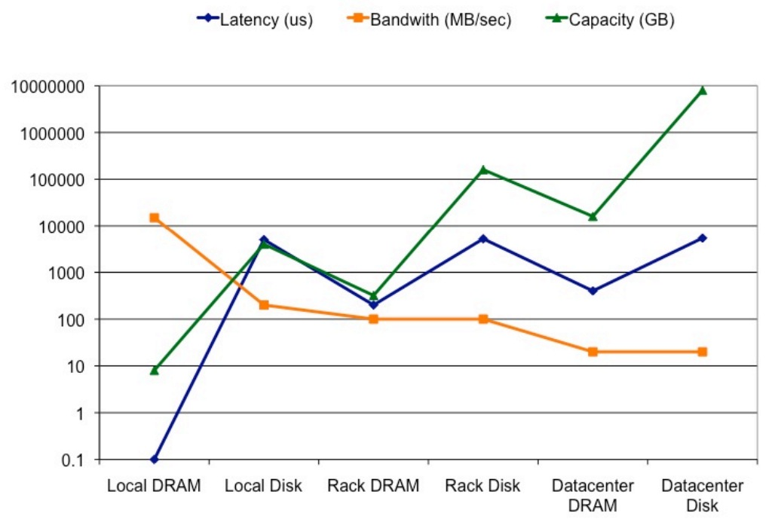
Storage Hierarchy

Slide 15
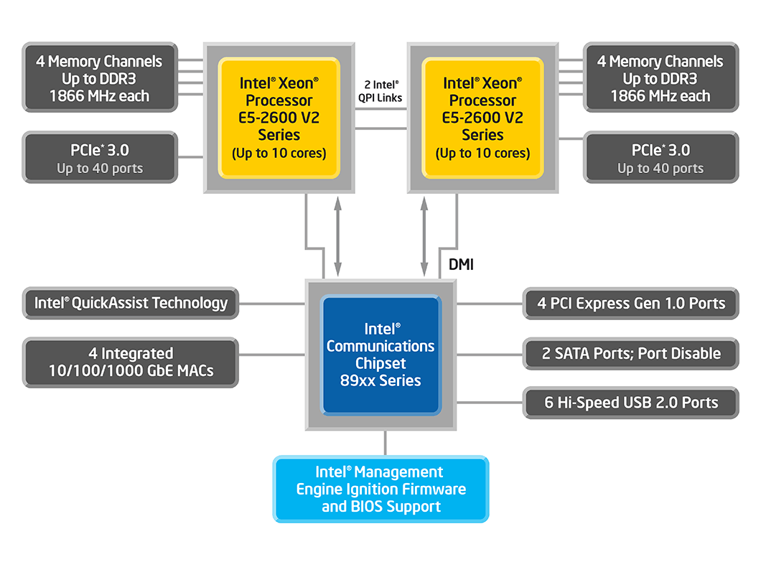
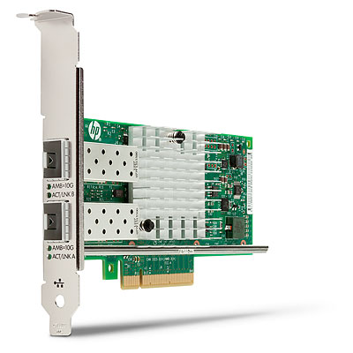
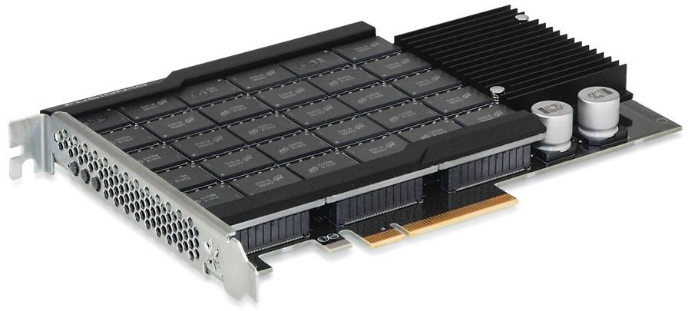
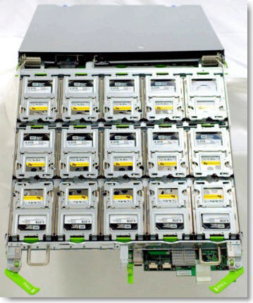
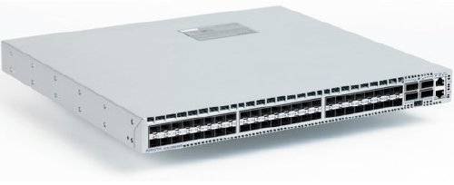
Commodity Hardware
2-socket server
10GbE NIC
Flash Storage
JBOD disk array
Low-latency 10GbE Switch

Slide 16
Basic Unit: 2-socket Server
1-2 multi-core chips
8-16 DRAM DIMMS
1-2 ethernet ports
  10Gbps or higher
Storage
  Internal SATA/SAS disks (2-6)
  External storage expansion
Configuration/size vary
  Depending on tier role
  1U - 2U (1U = 1.67 inches)

Slide 17
Example: FB 2-socket Server
Characteristics
  Upgradable CPUs & memory, boot on LAN, external PCIe link, feature reduced
  Similar design for AMD servers (why?)

Slide 18
Application Mapping
(FB Example)

Slide 19
Servers Used for a FB Request

Slide 20
What Server Should We
Use in a Datacenter?
Many options
  1-socket server
  2-socket server
  4-socket server
  …
  64-socket server
  …
What are the issues to consider?

Slide 21
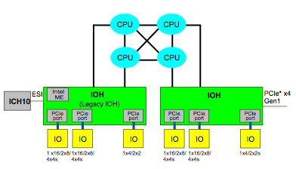
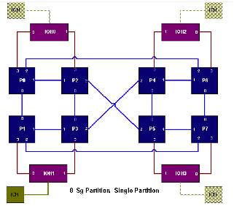
2 vs 4 vs 8 Sockets per Server
What is great about 2 vs 1 socket?
Why not 4 or 8 sockets then?

Slide 22
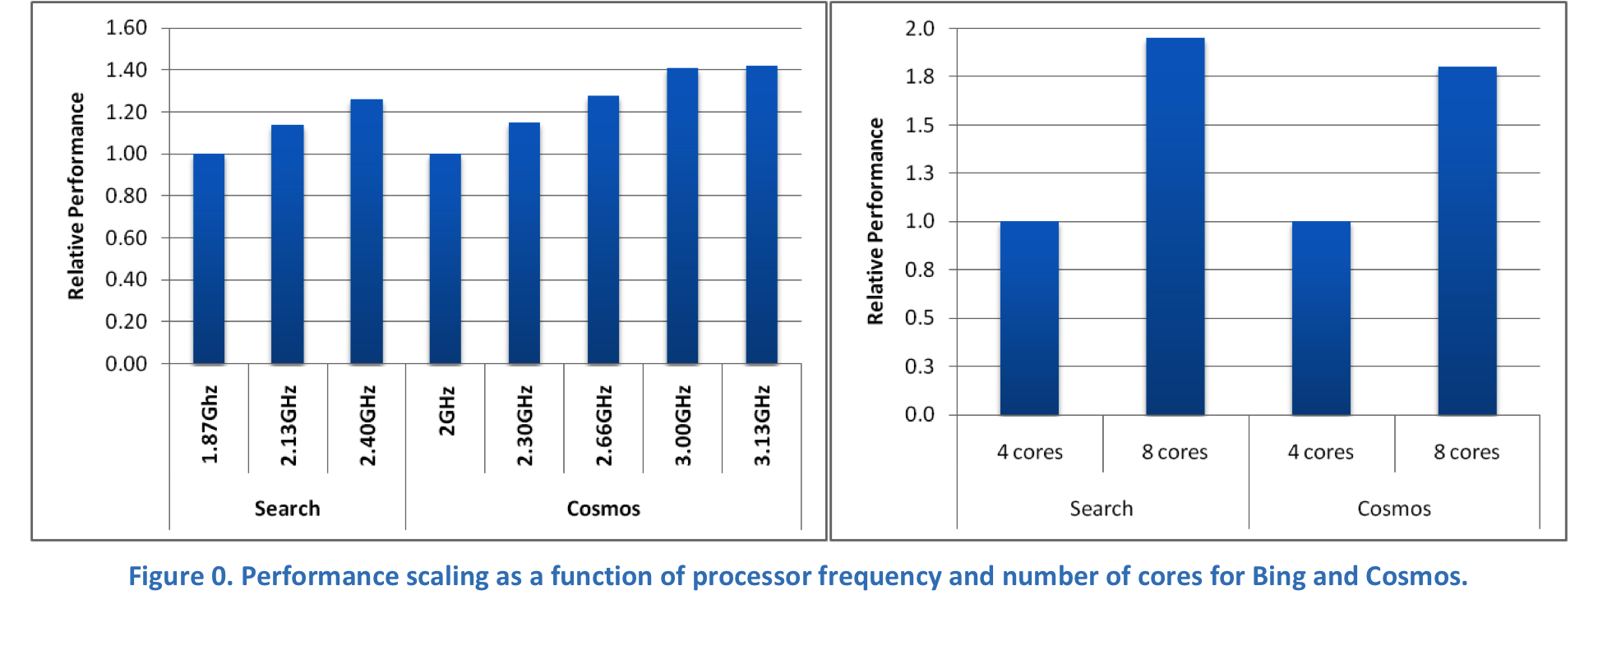
Performance Scaling of Internet Scale Applications
[IEEE Micro’11]
Scaling analysis for Search & MapReduce at Microsoft
Any observations?
Notes:
Cosmos is a petabyte storage and computation system. Parallel processing.

Slide 23
Performance Metrics
Completion time (e.g., how fast)
  Of a certain operations
Availability
Power/energy
Total cost of ownership (TCO)

Slide 24
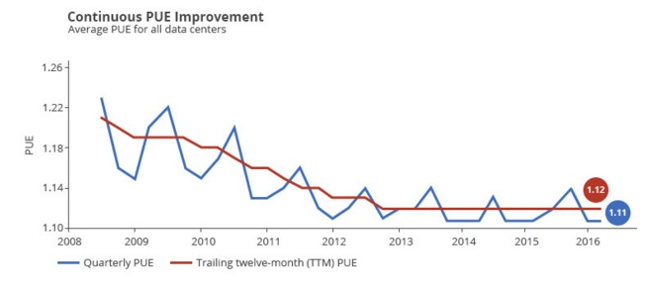
Power Usage Effectiveness
PUE = Total datacenter power / IT equipment power
Notes:
Source: https://www.google.com/about/datacenters/efficiency/internal/

Slide 25
Total Cost of Ownership (TCO)
Capital expenses
  Land, building, generators, air conditioning, computing equipment
Operating expenses
  Electricity repairs
Cost of unavailability

Slide 26
TCO Breakdown
Observations
  >50% of cost in buying the hardware
  ~30% costs related to power
  Networking ~10% of overall costs (including cost for servers)
Notes:
Servers not used very well…

Slide 27
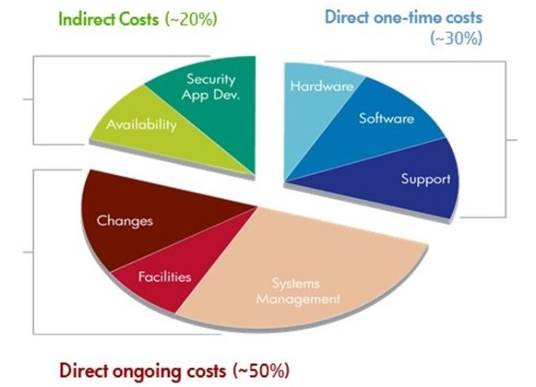
TCO Breakdown (2)

Slide 28
Cost Analysis
Cost model powerful tool for design tradeoffs
  Evaluate “what-if” scenarios
E.g., can we reduce power cost with different disk?
A 1TB disk uses 10W of power, costs $90. An alternate disk consumes only 5W, but costs $150. If you were the data center architect, what would you do?
Notes:
Facility (765) + machines (475)

Slide 29
Answer
A 1TB disk uses 10W of power, costs $90. An alternate disk consumes only 5W, but costs $150. If you were the data center architect, what would you do?
@ $2/Watt – even if we saved the entire 10W of power for disk, we would save $20 per year. We are paying $60 more for the disk – probably not worth it.
  What is this analysis missing?
Notes:
Impact on performance, rest of the system

Slide 30
Reliability & Availability
Common goal for services: 99.99% availability
  1 hour of down-time per year
But with thousands of nodes, things will crash
  Example: with 10K servers rated at 30 years of MTBF, you should expect to have 1 failure per day
Notes:
5 9s is not realistic for now… 9 minutes…
If fact this is what the different failure types look like in a datacenter

Slide 31
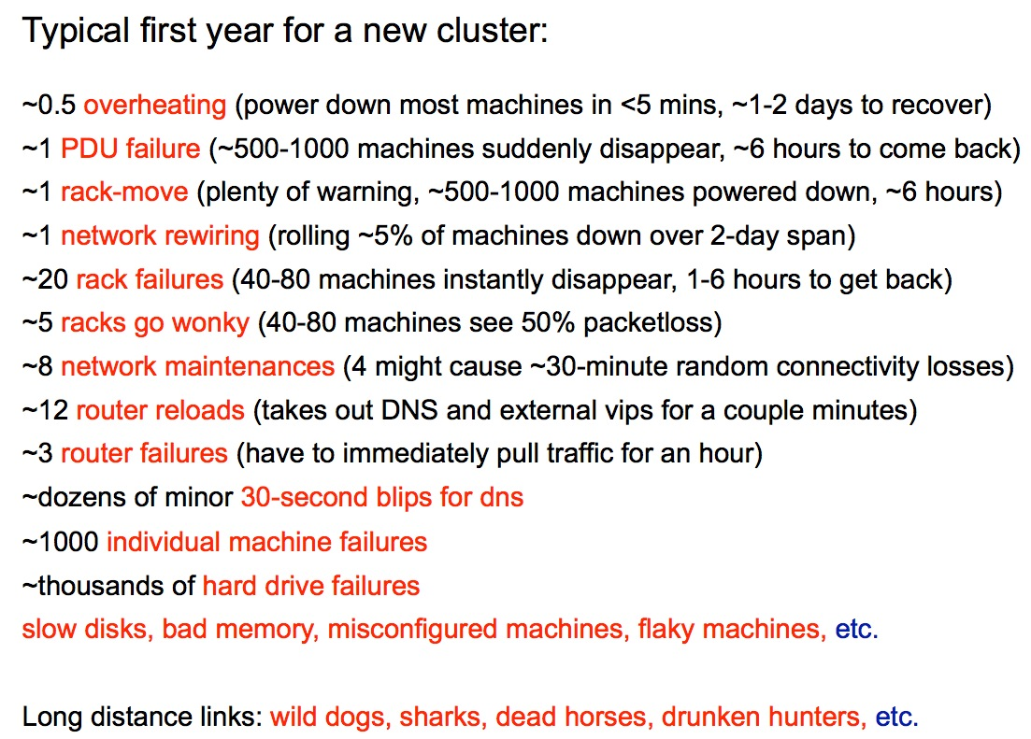
Reliability Challenges

Slide 32
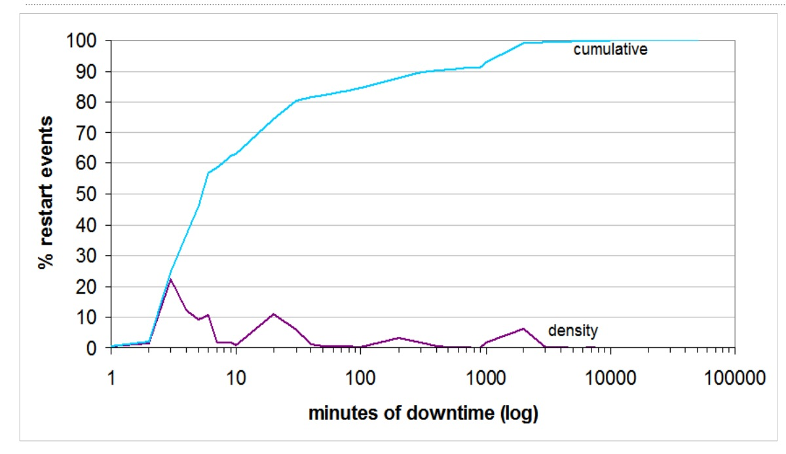
Downtime Density

Slide 33
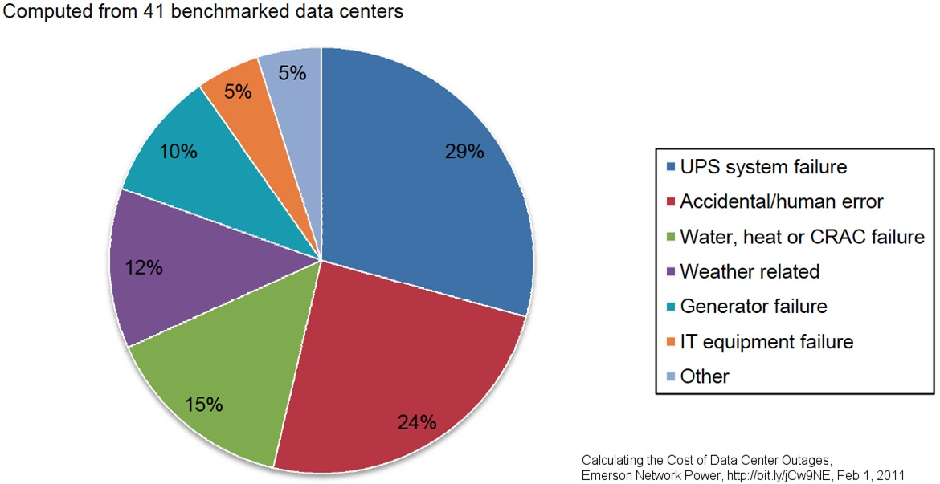
Sources of Outages

Slide 34
Robustness to Failures
Failover to other replicas/datacenters
Bad backend detection
  Stop using for live requests until behavior gets better
More aggressive load balancing when imbalance is more severe
Make your apps do something reasonable even if not all is right
  Better to give users limited functionality than an error page

Slide 35
Consistency
Multiple data centers implies dealing with consistency issues
  Disconnected/partitioned operation relatively common, e.g., datacenter down for maintenance
  Insisting on strong consistency likely undesirable
  "We have your data but can't show it to you because one of the replicas is unavailable"
  Most products with mutable state gravitating towards "eventual consistency" model
  A bit harder to think about, but better from an availability standpoint
Notes:
Failures can result in temporary loss of consistency…

Slide 36
Performance/Availability Techniques in DCs
Technique | Performance | Availability
Replication | ✔ | ✔
Partitioning (sharding) | ✔ | ✔
Load-balancing | ✔
Watchdog timers |  | ✔
Integrity checks |  | ✔
App-specific compression | ✔
Eventual consistency | ✔ | ✔
Notes:
Watchdog timer: During normal operation the hardware resets it. If the timer reaches a maximum value, it expires and initiates corrective action. Such as restart.

Slide 37
Characteristics of Internet-scale Services
Huge datasets, user sets, …
High request level parallelism
  Without much read-write sharing
High workload churn
  New releases of code on a weekly basis
Require fault-free operation
Notes:
For example, email
High workload churn, both for private and public clouds

Slide 38
Performance Metrics
Throughput
  User requests per second (RPS)
  Scale-out address this (more servers)
Quality of Service (QoS)
  Latency of individual requests (90th, 95th, or 95th percentile)
  Scale-out does not necessarily help
Interesting notes
  The distribution matters, not just the averages
  Optimizing throughput often hurts latency
    And optimizing latency often hurts power consumption
  At the end, it is RPS/$ within some QoS constraints
Notes:
Example of improving throughput and hurting latency: switch from big to small cores for the same cost budget

Slide 39
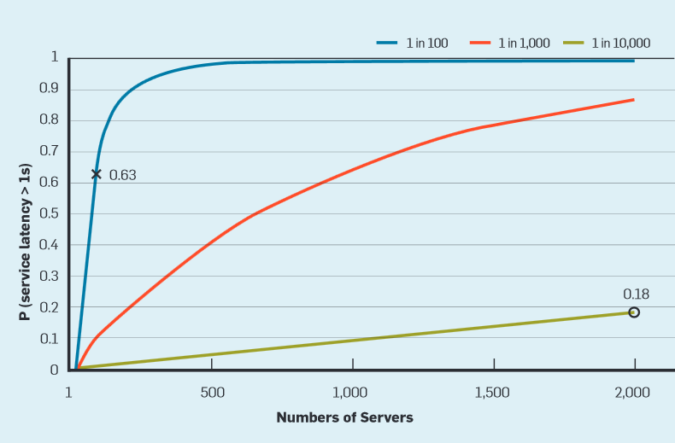
Tail At Scale
Larger clusters → more prone to high tail latency
¹The Tail at Scale. Jeffrey Dean, Luiz André Barroso. CACM, Vol. 56 No. 2, Pages 74-80, 2013
Notes:
Even in a single server tail latency can be high, if we now move to a large cluster it becomes a lot more likely…
Taken from the tail at scale paper where they describe reasons why tail latency can be high and ways to address it or work around it…
1-0.99^100=0.63

Slide 40






Resource Assignment Options
How do we assign resources to apps?
Two major options: private vs shared assignment

Slide 41
Private Resource Assignment
Each app receives a private, static set of resources
Also known as static partitioning
Notes:
Issues: Load balancing. Tail latency.

Slide 42
Shared Resource Assignment
Shared resources: flexibility → high utilization
  Common case: user-facing services + analytics on same servers
  Also helps with failures, maintenance, and provisioning

Slide 43
Shared Cluster Management
The manager schedules apps on shared resources
  Apps request resource reservations (cores, DRAM, …)
  Manager allocates and assigns specific resources
    Considering performance, utilization, fault tolerance, priorities, …
    Potentially, multiple apps on each server
  Multiple manager architectures (see Borg paper for example)

Slide 44

Autoscaling
Load balancer
Monitor app performance or server load
  [Chase’01, AWS AutoScale, Lim’10, Shen’11, Gandhi’12, …]
Adjust resources given to app
  Add or remove to meet performance goal
  Feedback-based control loop

Slide 45
Map+Reduce
Map:
  Accepts input key/value pair
  Emits intermediate key/value pair
R
E
D
U
C
E
Reduce :
  Accepts intermediate key/value* pair
  Emits output key/value pair
Very
big
data
M
A
P
Partitioning
Function
Result
Notes:
Examples: Search, Pagerank.

Slide 46
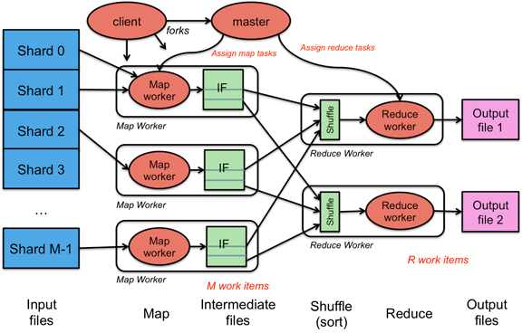
Analytics Example: MapReduce
[Figure credit: Paul Krzyzanowski]
Single-tier architecture
  Distributed FS, worker servers, coordinator
  Disk based or in-memory
Metric: throughput

Slide 47
Example 3-tier App: WebMail
May include thousands of machines, PetaBytes of data, and billions of users
1st tier: protocol processing
  Typically stateless
  Use a load balancer
2nd tier: application logic
  Often caches state from 3rd tier
3rd tier: data storage
  Heavily stateful
  Often includes bulk of machines
Load Balancer
Front-end tier
(HTTP, POP, IMAP…)
Middle tier
(Mail delivery, user info, stats, …)
Back-end tier
(Mail metadata & files)

Slide 48
Example: Social Networking
3 tier system
  Web server, fast user data storage, persistent storage
  2rd tier: latency critical, large number of servers
User data storage
  Using memcached for distributed caching
  10s of Tbytes in memory (Facebook 150TB)
  Sharded and replicated across many servers
  Read/write (unlike search), bulk is read-dominated
From in-memory caching to in-memory FS
  RAMcloud @Stanford, Sinfonia @HP, …
Front-end tier
(HTTP, presentation, …)
Middle tier
(memcached or in-memory FS)
Back-end tier
(persistent DB)

Slide 49
Acknowledgements
Christos Kozyrakis, Christina Delimitrou
  Based on EE282 @ Stanford
“Designs, Lessons, and Advice from Building Large Distributed Systems” by Jeff Dean, Google Fellow
“A thousand chickens or two oxen? Part 1: TCO” by Isabel Martin
“UPS as a service could be an economic breakthrough” by Mark Monroe
“Take a close look at MapReduce” by Xuanhua Shi

Slide 50
Reducing Tail Latency
Reduce queuing (reduce head of line blocking)
Separate different types of requests
Coordinate background activities
Hedged requests to replicas
Tied requests to replicas
Micro-sharding & selective replication
Latency induced probation , canary requests
See The Tail @ Scale paper for details

