Slide 1
CS 152 Computer Architecture and Engineering Lecture 3 - From CISC to RISC
Krste Asanovic
Electrical Engineering and Computer Sciences
University of California at Berkeley
http://www.eecs.berkeley.edu/~krste
http://inst.eecs.berkeley.edu/~cs152

Slide 2
Last Time in Lecture 2
ISA is the hardware/software interface
Defines set of programmer visible state
Defines instruction format (bit encoding) and instruction semantics
Examples: IBM 360, MIPS, RISC-V, x86, JVM
Many possible implementations of one ISA
360 implementations: model 30 (c. 1964), z11 (c. 2010)
x86 implementations: 8086 (c. 1978), 80186, 286, 386, 486, Pentium, Pentium Pro, Pentium-4 (c. 2000), Core 2 Duo, Nehalem, Sandy Bridge, Atom, AMD Athlon, Transmeta Crusoe, SoftPC
MIPS implementations: R2000, R4000, R10000, R18K, …
JVM: HotSpot, PicoJava, ARM Jazelle, …
Microcoding: straightforward methodical way to implement machines with low logic gate count and complex instructions

Slide 3
Horizontal vs Vertical μCode
Bits per μInstruction
# μInstructions
Horizontal μcode has wider μinstructions
Multiple parallel operations per μinstruction
Fewer microcode steps per macroinstruction
Sparser encoding ⇒ more bits
Vertical μcode has narrower μinstructions
Typically a single datapath operation per μinstruction
separate μinstruction for branches
More microcode steps per macroinstruction
More compact ⇒ less bits
Nanocoding
Tries to combine best of horizontal and vertical μcode

Slide 4
Nanocoding
Exploits recurring control signal patterns in μcode, e.g.,
ALU₀ A ← Reg[rs1]
...
ALUi₀ A ← Reg[rs1]
...
μcode
next-state
μPC (state)
μaddress
μcode ROM
nanoaddress
nanoinstruction ROM
data
MC68000 had 17-bit μcode containing either 10-bit μjump or 9-bit nanoinstruction pointer
Nanoinstructions were 68 bits wide, decoded to give 196 control signals

Slide 5
Microprogramming in IBM 360
 | M30 | M40 | M50 | M65
Datapath width (bits) | 8 | 16 | 32 | 64
μinst width (bits) | 50 | 52 | 85 | 87
μcode size (K µinsts) | 4 | 4 | 2.75 | 2.75
μstore technology | CCROS | TCROS | BCROS | BCROS
μstore cycle (ns) | 750 | 625 | 500 | 200
memory cycle (ns) | 1500 | 2500 | 2000 | 750
Rental fee ($K/month) | 4 | 7 | 15 | 35
Only the fastest models (75 and 95) were hardwired

Slide 6
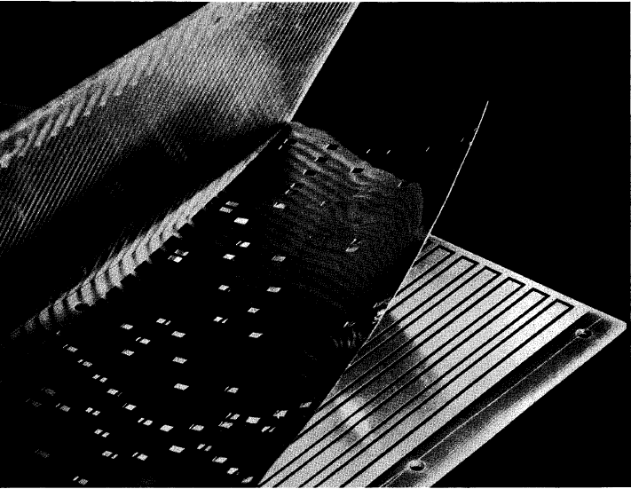
IBM Card Capacitor Read-Only Storage
Punched Card with metal film
Fixed sensing plates
[ IBM Journal, January 1961]

Slide 7
Microcode Emulation
IBM initially miscalculated the importance of software compatibility with earlier models when introducing the 360 series
Honeywell stole some IBM 1401 customers by offering translation software (“Liberator”) for Honeywell H200 series machine
IBM retaliated with optional additional microcode for 360 series that could emulate IBM 1401 ISA, later extended for IBM 7000 series
one popular program on 1401 was a 650 simulator, so some customers ran many 650 programs on emulated 1401s
(650 simulated on 1401 emulated on 360)

Slide 8
Microprogramming thrived in the Seventies
Significantly faster ROMs than DRAMs were available
For complex instruction sets, datapath and controller were cheaper and simpler
New instructions , e.g., floating point, could be supported without datapath modifications
Fixing bugs in the controller was easier
ISA compatibility across various models could be achieved easily and cheaply
Except for the cheapest and fastest machines, all computers were microprogrammed

Slide 9
Performance Issues
Microprogrammed control
⇒ multiple cycles per instruction
Cycle time ?
t_{C} > max(t_{reg-reg}, t_{ALU}, t_{μROM})
Suppose 10 * t_{μROM} < t_{RAM}
Good performance, relative to a single-cycle
hardwired implementation, can be achieved
even with a CPI of 10

Slide 10
Writable Control Store (WCS)
Implement control store in RAM not ROM
MOS SRAM memories now almost as fast as control store (core memories/DRAMs were 2-10x slower)
Bug-free microprograms difficult to write
User-WCS provided as option on several minicomputers
Allowed users to change microcode for each processor
User-WCS failed
Little or no programming tools support
Difficult to fit software into small space
Microcode control tailored to original ISA, less useful for others
Large WCS part of processor state - expensive context switches
Protection difficult if user can change microcode
Virtual memory required restartable microcode

Slide 11
Modern Usage
Microprogramming is far from extinct
Played a crucial role in micros of the Eighties
DEC uVAX, Motorola 68K series, Intel 286/386
Microcode pays an assisting role in most modern
micros (AMD Bulldozer, Intel Sandy Bridge, Intel Atom, IBM PowerPC)
Most instructions are executed directly, i.e., with hard-wired
control
Infrequently-used and/or complicated instructions invoke the
microcode engine
Patchable microcode common for post-fabrication
bug fixes, e.g. Intel processors load µcode patches
at bootup

Slide 12
“Iron Law” of Processor Performance
Time = Instructions Cycles Time
Program Program * Instruction * Cycle
Instructions per program depends on source code, compiler technology, and ISA
Cycles per instructions (CPI) depends upon the ISA and the microarchitecture
Time per cycle depends upon the microarchitecture and the base technology

Slide 13
CPI for Microcoded Machine
7 cycles
5 cycles
10 cycles
Inst 1
Inst 2
Inst 3
Time
Total clock cycles = 7+5+10 = 22
Total instructions = 3
CPI = 22/3 = 7.33
CPI is always an average over a large number of instructions.

Slide 14
Technology Influence
When microcode appeared in 50s, different technologies for:
Logic: Vacuum Tubes
Main Memory: Magnetic cores
Read-Only Memory: Diode matrix, punched metal cards,…
Logic very expensive compared to ROM or RAM
ROM cheaper than RAM
ROM much faster than RAM
But seventies brought advances in integrated circuit technology and semiconductor memory…

Slide 15
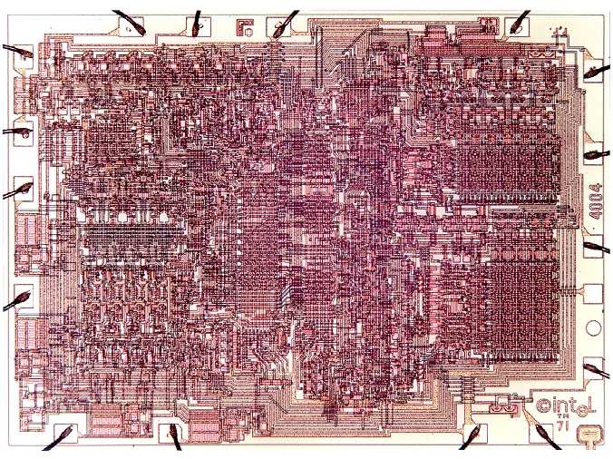
First Microprocessor Intel 4004, 1971
4-bit accumulator architecture
8μm pMOS
2,300 transistors
3 x 4 mm²
750kHz clock
8-16 cycles/inst.
Made possible by new integrated circuit technology

Slide 16
Microprocessors in the Seventies
Initial target was embedded control
First micro, 4-bit 4004 from Intel, designed for a desktop printing calculator
Constrained by what could fit on single chip
Single accumulator architectures similar to earliest computers
Hardwired state machine control
8-bit micros (8085, 6800, 6502) used in hobbyist personal computers
Micral, Altair, TRS-80, Apple-II
Usually had 16-bit address space (up to 64KB directly addressable)
Often came with simple BASIC language interpreter built into ROM or loaded from cassette tape.
16

Slide 17
VisiCalc – the first “killer” app for micros
Microprocessors had little impact on conventional computer market until VisiCalc spreadsheet for Apple-II
Apple-II used Mostek 6502 microprocessor running at 1MHz
Floppy disks were originally invented by IBM as a way of shipping IBM 360 microcode patches to customers!
[ Personal Computing Ad, 1979 ]

Slide 18
DRAM in the Seventies
Dramatic progress in semiconductor memory technology
1970, Intel introduces first DRAM, 1Kbit 1103
1979, Fujitsu introduces 64Kbit DRAM
=> By mid-Seventies, obvious that PCs would soon have >64KBytes physical memory
18

Slide 19
Microprocessor Evolution
Rapid progress in size and speed through 70s fueled by advances in MOSFET technology and expanding markets
Intel i432
Most ambitious seventies’ micro; started in 1975 - released 1981
32-bit capability-based object-oriented architecture
Instructions variable number of bits long
Severe performance, complexity, and usability problems
Motorola 68000 (1979, 8MHz, 68,000 transistors)
Heavily microcoded (and nanocoded)
32-bit general purpose register architecture (24 address pins)
8 address registers, 8 data registers
Intel 8086 (1978, 8MHz, 29,000 transistors)
“Stopgap” 16-bit processor, architected in 10 weeks
Extended accumulator architecture, assembly-compatible with 8080
20-bit addressing through segmented addressing scheme
19

Slide 20
IBM PC, 1981
Hardware
Team from IBM building PC prototypes in 1979
Motorola 68000 chosen initially, but 68000 was late
IBM builds “stopgap” prototypes using 8088 boards from Display Writer word processor
8088 is 8-bit bus version of 8086 => allows cheaper system
Estimated sales of 250,000
100,000,000s sold
Software
Microsoft negotiates to provide OS for IBM. Later buys and modifies QDOS from Seattle Computer Products.
Open System
Standard processor, Intel 8088
Standard interfaces
Standard OS, MS-DOS
IBM permits cloning and third-party software

Slide 21
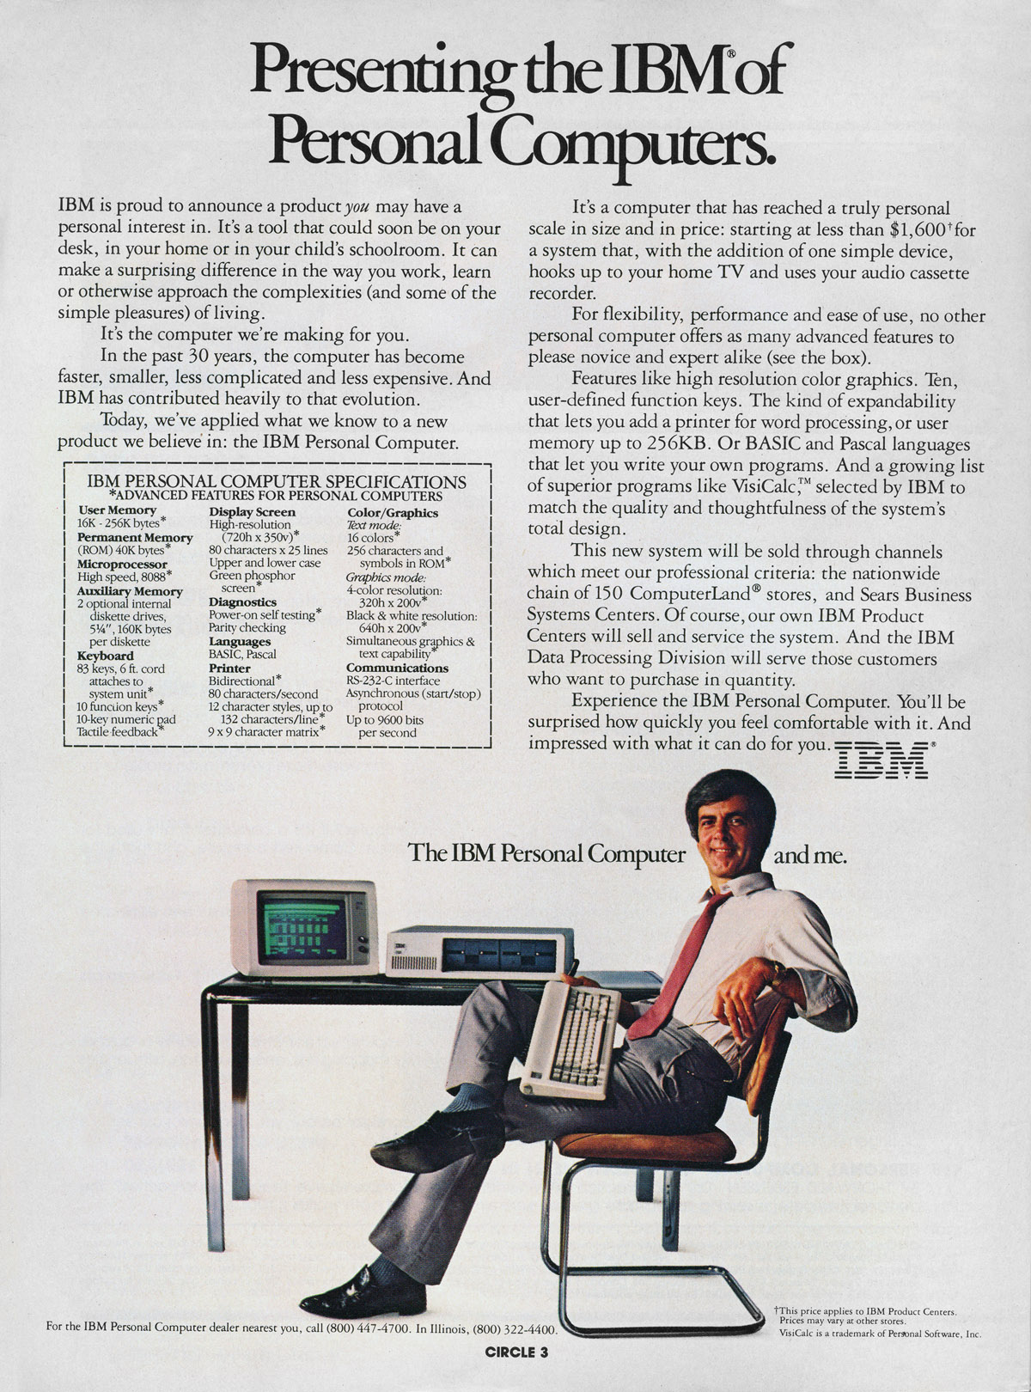
[ Personal Computing Ad, 11/81]

Slide 22
Microprogramming: early Eighties
Evolution bred more complex micro-machines
Complex instruction sets led to need for subroutine and call stacks in µcode
Need for fixing bugs in control programs was in conflict with read-only nature of µROM
➔WCS (B1700, QMachine, Intel i432, …)
With the advent of VLSI technology assumptions about ROM & RAM speed became invalid →more complexity
Better compilers made complex instructions less important.
Use of numerous micro-architectural innovations, e.g., pipelining, caches and buffers, made multiple-cycle execution of reg-reg instructions unattractive

Slide 23
Analyzing Microcoded Machines
John Cocke and group at IBM
Working on a simple pipelined processor, 801, and advanced compilers inside IBM
Ported experimental PL.8 compiler to IBM 370, and only used simple register-register and load/store instructions similar to 801
Code ran faster than other existing compilers that used all 370 instructions! (up to 6MIPS whereas 2MIPS considered good before)
Emer, Clark, at DEC
Measured VAX-11/780 using external hardware
Found it was actually a 0.5MIPS machine, although usually assumed to be a 1MIPS machine
Found 20% of VAX instructions responsible for 60% of microcode, but only account for 0.2% of execution!
VAX8800
Control Store: 16K*147b RAM, Unified Cache: 64K*8b RAM
4.5x more microstore RAM than cache RAM!

Slide 24
IC Technology Changes Tradeoffs
Logic, RAM, ROM all implemented using MOS transistors
Semiconductor RAM ~same speed as ROM

Slide 25
Nanocoding
RISC
User PC
Exploits recurring control signal patterns in μcode, e.g.,
ALU₀ A ← Reg[rs]
...
ALUi₀ A ← Reg[rs]
...
μcode
next-state
μPC (state)
μaddress
Inst. Cache
μcode ROM
nanoaddress
Hardwired Decode
nanoinstruction ROM
data
MC68000 had 17-bit μcode containing either 10-bit μjump or 9-bit nanoinstruction pointer
Nanoinstructions were 68 bits wide, decoded to give 196 control signals

Slide 26
From CISC to RISC
Use fast RAM to build fast instruction cache of user-visible instructions, not fixed hardware microroutines
Can change contents of fast instruction memory to fit what application needs right now
Use simple ISA to enable hardwired pipelined implementation
Most compiled code only used a few of the available CISC instructions
Simpler encoding allowed pipelined implementations
Further benefit with integration
In early ‘80s, could finally fit 32-bit datapath + small caches on a single chip
No chip crossings in common case allows faster operation

Slide 27
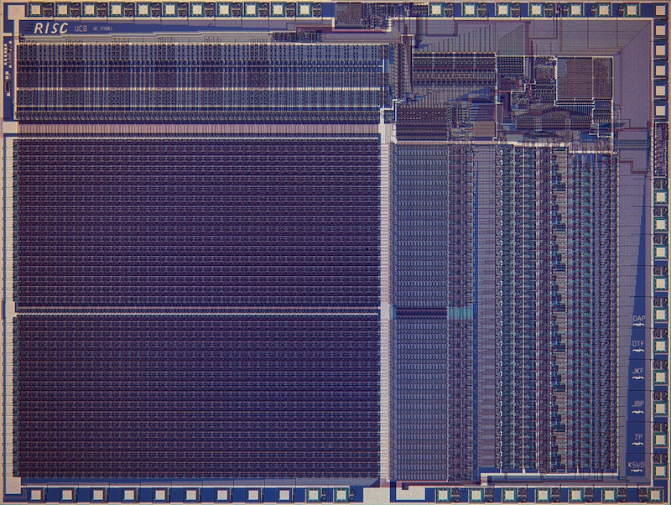
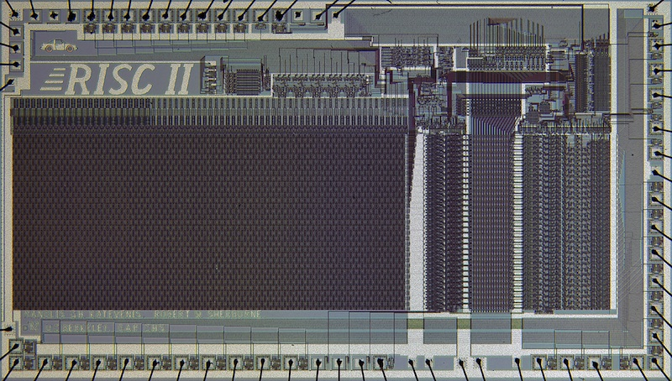
Berkeley RISC Chips
RISC-I (1982) Contains 44,420 transistors, fabbed in 5 µm NMOS, with a die area of 77 mm², ran at 1 MHz. This chip is probably the first VLSI RISC.
RISC-II (1983) contains 40,760 transistors, was fabbed in 3 µm NMOS, ran at 3 MHz, and the size is 60 mm².
Stanford built some too…

Slide 28
CS152 Administrivia
PS1 and Lab 1 available on website

Slide 29
“Iron Law” of Processor Performance
Time = Instructions Cycles Time
Program Program * Instruction * Cycle
Instructions per program depends on source code, compiler technology, and ISA
Cycles per instructions (CPI) depends upon the ISA and the microarchitecture
Time per cycle depends upon the microarchitecture and the base technology
Microarchitecture | CPI | cycle time
Microcoded | >1 | short
Single-cycle unpipelined | 1 | long
Pipelined | 1 | short
this lecture

Slide 30
Hardware Elements
Combinational circuits
Mux, Decoder, ALU, ...
OpSelect
- Add, Sub, ...
- And, Or, Xor, Not, ...
- GT, LT, EQ, Zero, ...
Sel
A₀
A₁
A_{n-1}
lg(n)
O₀
O₁
O_{n-1}
A
.
Result
.
O
A
.
ALU
Decoder
.
Mux
.
.
lg(n)
Comp?
B
Synchronous state elements
Flipflop, Register, Register file, SRAM, DRAM
D
Clk
En
En
ff
Clk
D
Q
Q
Edge-triggered: Data is sampled at the rising edge

Slide 31
Register Files
register
D₀
D₁
D₂
...
D_{n-1}
En
...
Clk
ff
ff
ff
ff
Q₀
Q₁
Q₂
...
Q_{n-1}
Clock
WE
ReadSel1
rs1
we
rd1
ReadData1
ReadSel2
rs2
Register
file
2R+1W
rd2
ReadData2
WriteSel
ws
WriteData
wd
Reads are combinational

Slide 32
Register File Implementation
rd
clk
wdata
rs1
rdata1
rdata2
rs2
32
32
32
5
5
5
reg 0
we
reg 1
…
…
…
reg 31
RISC-V integer instructions have at most 2 register source operands
Register files with a large number of ports are difficult to design
Intel’s Itanium, GPR File has 128 registers with 8 read ports and 4 write ports to support 4 integer operations per cycle!!!

Slide 33
A Simple Memory Model
WriteEnable
Clock
Address
MAGIC
RAM
ReadData
WriteData
Reads and writes are always completed in one cycle
a Read can be done any time (i.e. combinational)
a Write is performed at the rising clock edge
if it is enabled
⇒ the write address and data
must be stable at the clock edge
Later in the course we will present a more realistic model of memory

Slide 34
Implementing RISC-V: Single-cycle per instruction datapath & control logic (Should be review of CS61C)

Slide 35
Instruction Execution
Execution of an instruction involves
1. instruction fetch
2. decode and register fetch
3. ALU operation
4. memory operation (optional)
5. write back
and the computation of the address of the
next instruction

Slide 36
Datapath: Reg-Reg ALU Instructions
RegWriteEn
0x4
Add
clk
Inst<26:22>
we
Inst<21:17>
rs1
PC
addr
rs2
inst
Inst<31:27>
rd1
ALU
wa
Inst.
Memory
wd
rd2
clk
GPRs
Inst<16:0>
ALU
Control
RegWrite Timing?
OpCode
5 5 5 10 7
rd rs1 rs2 func opcode rd ← (rs1) func (rs2)
31 27 26 22 21 17 16 7 6 0

Slide 37
Datapath: Reg-Imm ALU Instructions
RegWriteEn
0x4
Add
clk
inst<26:22>
we
rs1
addr
rs2
PC
inst
inst<31:27>
wa
rd1
ALU
Inst.
Memory
wd
rd2
clk
GPRs
inst<21:10>
Imm
Select
inst<9:0>
ALU
Control
OpCode
ImmSel
5 5 12 3 7
rd rs1 immediate12 func opcode rd ← (rs1) op immediate
31 27 26 22 21 10 9 7 6 0

Slide 38
Conflicts in Merging Datapath
RegWrite
Introduce
muxes
0x4
Add
clk
inst<26:22>
we
Inst<21:17>
rs1
addr
rs2
PC
inst
Inst<31:27>
wa
rd1
ALU
Inst.
Memory
wd
rd2
clk
GPRs
Inst<21:10>
Imm
Select
Inst<16:0>
ALU
Control
Inst<9:0>
OpCode
ImmSel
5 5 5 10 7
rd rs1 rs2 func10 opcode rd ← (rs1) func (rs2)
rd rs1 immediate12 func3 opcode rd ← (rs1) op immediate

Slide 39
Datapath for ALU Instructions
0x4
RegWriteEn
Add
clk
<26:22>
we
<21:17>
rs1
addr
rs2
PC
inst
<31:27>
wa
rd1
ALU
Inst.
Memory
wd
rd2
clk
GPRs
Imm
Select
<16:0>
ALU
Control
<6:0>
OpCode
ImmSel
FuncSel
Op2Sel
Reg / Imm
5 5 5 10 7
rd rs1 rs2 func10 opcode rd ← (rs1) func (rs2)
rd rs1 immediate12 func3 opcode rd ← (rs1) op immediate

Slide 40
Load/Store Instructions
RegWriteEn
MemWrite
0x4
clk
WBSel
ALU / Mem
Add
we
“base”
rs1
clk
rs2
PC
addr
rd1
we
inst
wa
ALU
addr
wd
rd2
Inst.
Memory
GPRs
rdata
clk
Data
Memory
disp
Imm
Select
wdata
ALU
Control
OpCode
ImmSel
FuncSel
Op2Sel
5 5 5 7 3 7 Addressing Mode
imm rs1 rs2 imm func3 opcode Store (rs) + displacement
rd rs1 immediate12 func3 opcode Load
rs1 is the base register
rd is the destination of a Load, rs2 is the data source for a Store

Slide 41
RISC-V Conditional Branches
BEQ/BNE
BLT/BGE
BLTU/BGEU
5
5
5
7
3
7
imm[11:7]
rs1
rs2
imm[6:0]
func3
opcode
31
27
26
22
21
17
16
10
9
7
6
0
Compare two integer registers for equality (BEQ/BNE) or signed magnitude (BLT/BGE) or unsigned magnitude (BLTU/BGEU)
12-bit immediate encodes branch target address as a signed offset from PC, in units of 16-bits (i.e., shift left by 1 then add to PC).

Slide 42
Conditional Branches (BEQ/BNE/BLT/BGE/BLTU/BGEU)
PCSel
RegWrEn
br
MemWrite
WBSel
pc+4
0x4
Add
Add
clk
we
Br Logic
Bcomp?
rs1
clk
addr
rs2
PC
inst
rd1
we
wa
ALU
addr
Inst.
Memory
wd
rd2
clk
GPRs
rdata
Data
Memory
Imm
Select
wdata
ALU
Control
OpCode
ImmSel
FuncSel
Op2Sel

Slide 43
RISC-V Unconditional Jumps
25
7
J
JAL
Jump Offset[24:0]
opcode
31
7
6
0
25-bit immediate encodes jump target address as a signed offset from PC, in units of 16-bits (i.e., shift left by 1 then add to PC). (+/- 16MB)
JAL is a subroutine call that also saves return address (PC+4) in register x1

Slide 44
RISC-V Register Indirect Jumps
5
5
12
3
7
JALR
RDNPC
rd
rs1
Imm[11:0]
func3
opcode
31
27
26
22
21
10
9
7
6
0
Jumps to target address given by adding 12-bit offset (not shifted by 1 bit) to register rs1
The return address (PC+4) is written to rd (can be x0 if value not needed)
The RDNPC instruction simply writes return address to register rd without jumping (used for dynamic linking)

Slide 45
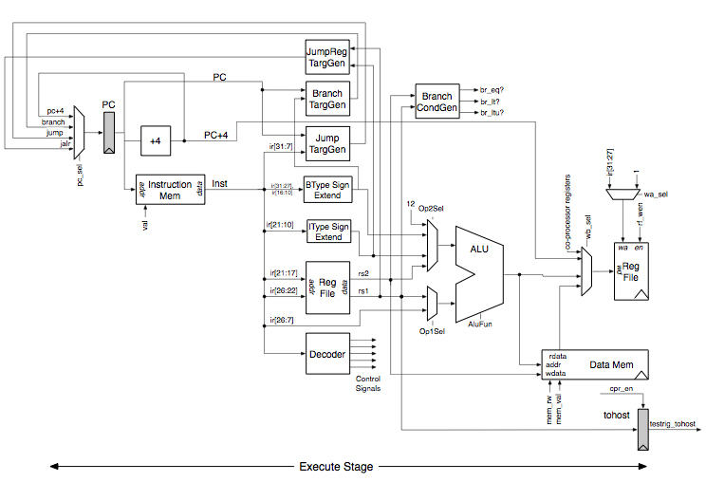
Full RISCV1Stage Datapath (Lab1)

Slide 46
Hardwired Control is pure Combinational Logic
combinational
logic
ImmSel
Op2Sel
FuncSel
op code
MemWrite
WBSel
Equal?
WASel
RegWriteEn
PCSel

Slide 47
ALU Control & Immediate Extension
Inst<16:7> (Func)
Inst<6:0> (Opcode)
ALUop
+
0?
FuncSel
( Func, Op, +, 0? )
Decode Map
ImmSel
( IType₁₂, BsType₁₂,
BrType₁₂)

Slide 48
Hardwired Control Table
Opcode | ImmSel | Op2Sel | FuncSel | MemWr | RFWen | WBSel | WASel | PCSel
ALU
ALUi
LW
SW
BEQ_{true}
BEQ_{false}
J
JAL
JALR
*
Reg
Func
no
yes
ALU
rd
pc+4
IType₁₂
Imm
Op
no
yes
ALU
rd
pc+4
IType₁₂
Imm
+
no
yes
Mem
rd
pc+4
BsType₁₂
Imm
+
yes
no
*
*
pc+4
BrType₁₂
*
*
no
no
*
*
br
BrType₁₂
*
*
no
no
*
*
pc+4
*
*
*
no
no
*
*
jabs
*
*
*
no
yes
PC
X1
jabs
*
*
*
no
yes
PC
rd
rind
Op2Sel= Reg / Imm WBSel = ALU / Mem / PC
WASel = rd / X1 PCSel = pc+4 / br / rind / jabs

Slide 49
Single-Cycle Hardwired Control: Harvard architecture
We will assume
clock period is sufficiently long for all of
the following steps to be “completed”:
1. instruction fetch
2. decode and register fetch
3. ALU operation
4. data fetch if required
5. register write-back setup time
⇒     t_{C} > t_{IFetch} + t_{RFetch} + t_{ALU}+ t_{DMem}+ t_{RWB}
At the rising edge of the following clock, the PC,
the register file and the memory are updated

Slide 50
Summary
Microcoding became less attractive as gap between RAM and ROM speeds reduced, and logic implemented in same technology as memory
Complex instruction sets difficult to pipeline, so difficult to increase performance as gate count grew
Iron Law explains architecture design space
Trade instruction/program, cycles/instruction, and time/cycle
Load-Store RISC ISAs designed for efficient pipelined implementations
Very similar to vertical microcode
Inspired by earlier Cray machines
RISC-V ISA will be used in lectures, problems, and labs. SPARC ISA in some SIMICS labs (two very similar ISAs)

Slide 51
Acknowledgements
These slides contain material developed and copyright by:
Arvind (MIT)
Krste Asanovic (MIT/UCB)
Joel Emer (Intel/MIT)
James Hoe (CMU)
John Kubiatowicz (UCB)
David Patterson (UCB)
MIT material derived from course 6.823
UCB material derived from course CS252

