Slide 1
CS 152 Computer Architecture and Engineering Lecture 1 - Introduction
Krste Asanovic
Electrical Engineering and Computer Sciences
University of California at Berkeley
http://www.eecs.berkeley.edu/~krste
http://inst.eecs.berkeley.edu/~cs152

Slide 2
What is Computer Architecture?
Application
Gap too large to bridge in one step
(but there are exceptions, e.g. magnetic compass)
Physics
In its broadest definition, computer architecture is the design of the abstraction layers that allow us to implement information processing applications efficiently using available manufacturing technologies.

Slide 3
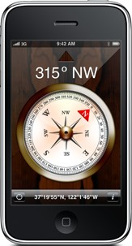
Abstraction Layers in Modern Systems
UCB EECS Courses
Application
Algorithm
CS170
Programming Language
CS164
Operating System/Virtual Machines
CS162
Instruction Set Architecture (ISA)
CS152
Microarchitecture
Gates/Register-Transfer Level (RTL)
CS150
Circuits
EE141
Devices
EE143
Physics

Slide 4
Architecture continually changing
Applications suggest how to improve technology, provide revenue to fund development
Improved technologies make new applications possible
Applications
Technology
Cost of software development makes compatibility a major force in market
Compatibility

Slide 5
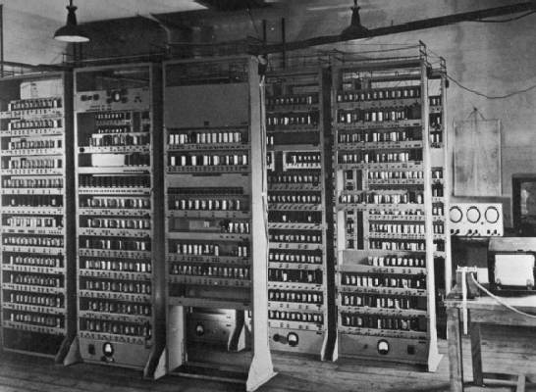
Computing Devices Then…
EDSAC, University of Cambridge, UK, 1949

Slide 6
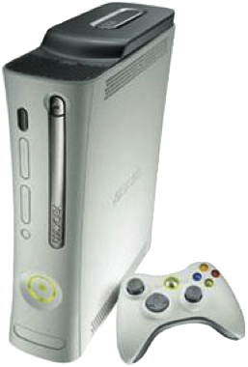
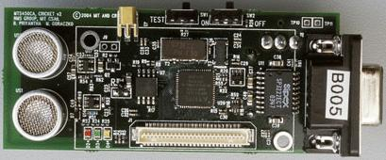
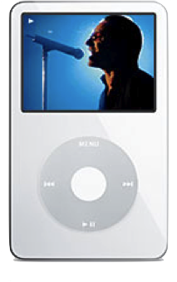
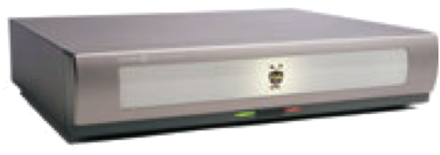
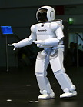
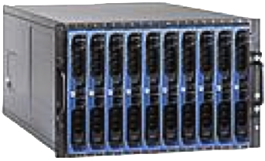
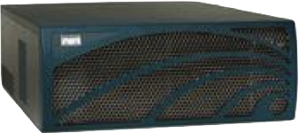
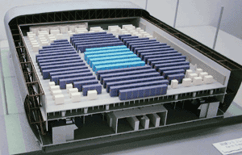
Computing Devices Now
Sensor Nets
Cameras
Games
Set-top boxes
Media Players
Laptops
Servers
Routers
Robots
Smart phones
Automobiles
Supercomputers

Slide 7
Uniprocessor Performance
From Hennessy and Patterson, Computer Architecture: A Quantitative Approach, 4th edition, October, 2006
What happened????
VAX : 25%/year 1978 to 1986
RISC + x86: 52%/year 1986 to 2002
RISC + x86: ??%/year 2002 to present

Slide 8
The End of the Uniprocessor Era
Single biggest change in the history of computing systems

Slide 9
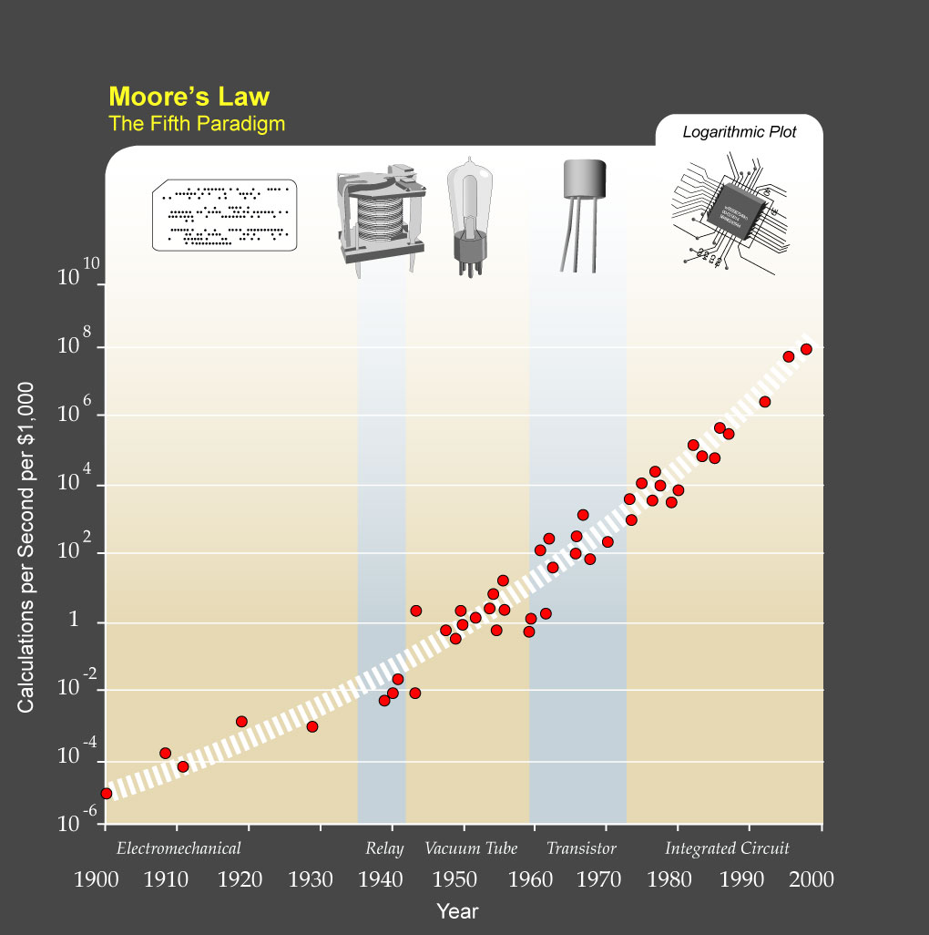
?
Major Technology Generations
CMOS
Bipolar
nMOS
Vacuum Tubes
pMOS
Relays
[from Kurzweil]
Electromechanical

Slide 10
CS 152 Course Focus
Understanding the design techniques, machine structures, technology factors, evaluation methods that will determine the form of computers in 21st Century
Technology
Parallelism
Programming
Languages
Applications
Interface Design
(ISA)
Computer Architecture:
• Organization
• Hardware/Software Boundary
Compilers
Operating
Measurement & Evaluation
Systems
History

Slide 11
The “New” CS152
No FPGA design component
Take CS150 for digital engineering with FPGAs
Or CS250 for digital VLSI design with ASIC technology
New CS152 focuses on interaction of software and hardware
more architecture and less digital engineering
more useful for OS developers, compiler writers, performance programmers
Much of the material you’ll learn this term was previously in CS252
Some of the current CS61C, I first saw in CS252 over 20 years ago!
Maybe every 10 years, shift CS252->CS152->CS61C?
Class contains labs based on various different machine designs
Experiment with how architectural mechanisms work in practice on real software.

Slide 12
Related Courses
CS 258
Parallel Architectures,
Languages, Systems
CS61C
Strong
Prerequisite
CS 152
CS 252
Basic computer organization, first look at pipelines + caches
Computer Architecture, First look at parallel architectures
Graduate Computer Architecture, Advanced Topics
CS 150
CS 250
Digital Logic Design, FPGAs
VLSI Systems Design

Slide 13
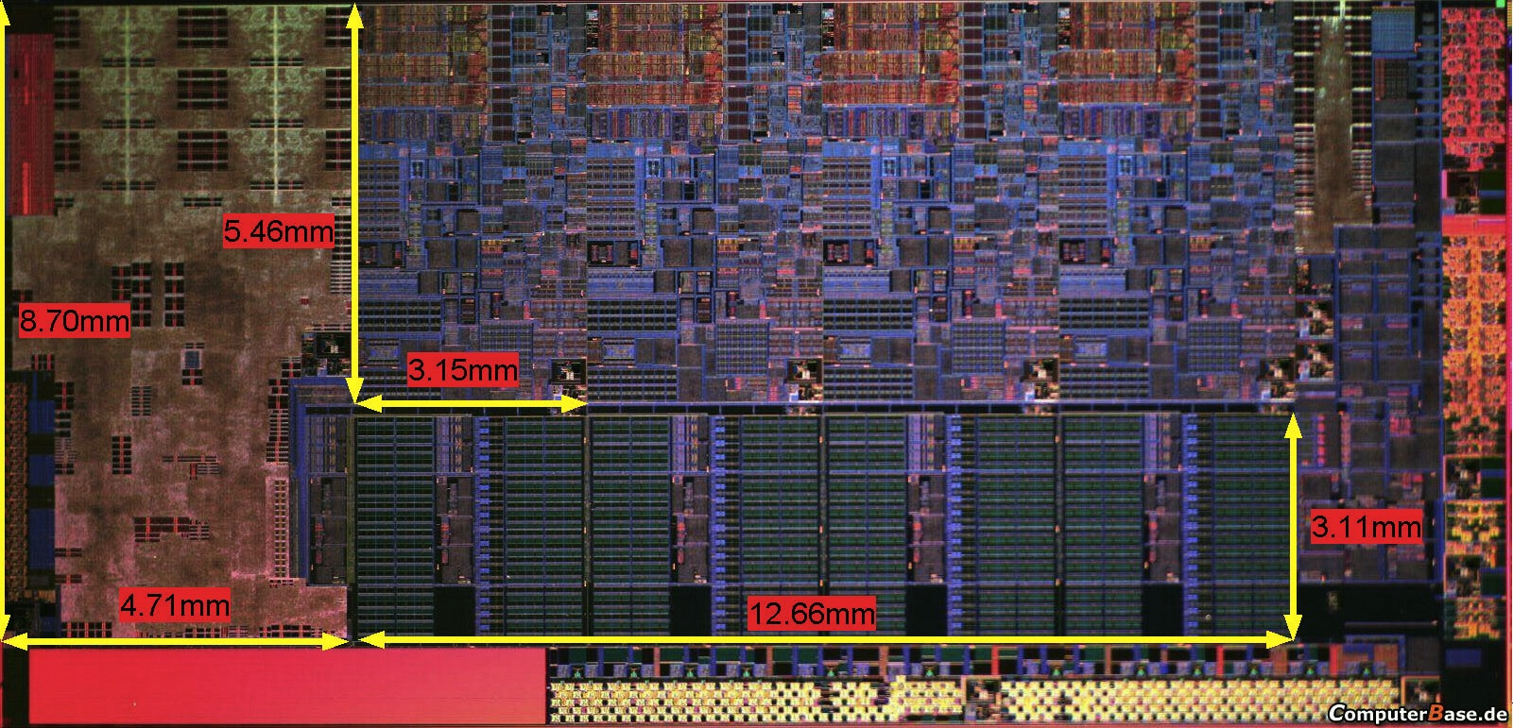
The “New” CS152 Executive Summary
What you’ll understand and experiment with in the new CS152
The processor your predecessors built in old CS152
Plus, the technology behind chip-scale multiprocessors (CMPs) and graphics processing units (GPUs)
Notes:
Photo is of an Intel Conroe (Core 2 Duo Desktop processor). Photo taken from Intel web site.

Slide 14
CS152 Administrivia
Instructor: Prof. Krste Asanovic, krste@eecs
Office: 579 Soda Hall (inside Par Lab)
Office Hours: Wed. 5:00-6:00PM (email to confirm), 579 Soda
T. A.: Chris Celio, celio@eecs
Office Hours: TBD
Lectures: Tu/Th, 2-3:30PM, 310 Soda (Possible room change!)
Section: F 9-10AM, 71 Evans (Possible room change!)
Text: Computer Architecture: A Quantitative Approach,
Hennessey and Patterson, 5th Edition (2012)
Readings assigned from this edition, some readings available in older editions –see web page.
Web page: http://inst.eecs.berkeley.edu/~cs152
Lectures available online by noon before class
Piazzza: http://piazza.com/berkeley/spring2012/cs152
Notes:
This slide is for the 3-min class administrative matters.
Make sure we update Handout #1 so it is consistent with this slide.

Slide 15
CS152 Structure and Syllabus
Five modules
Simple machine design (ISAs, microprogramming, unpipelined machines, Iron Law, simple pipelines)
Memory hierarchy (DRAM, caches, optimizations) plus virtual memory systems, exceptions, interrupts
Complex pipelining (score-boarding, out-of-order issue)
Explicitly parallel processors (vector machines, VLIW machines, multithreaded machines)
Multiprocessor architectures (memory models, cache coherence, synchronization)
Notes:
This is the 1st slide of the “Course Structure and Course Philosophy” section of the lecture.
Need to emphasis that for exams, our goal is the test your knowledge. It is not our goal to test how well your perform under time pressure.

Slide 16
CS152 Course Components
15% Problem Sets (one per module)
Intended to help you learn the material. Feel free to discuss with other students and instructors, but must turn in your own solutions. Grading based mostly on effort, but quizzes assume that you have worked through all problems. Solutions released after PSs handed in.
35% Labs (one per module)
Labs use advanced full system simulators (new Chisel simulators this year, plus Virtutech Simics)
Directed plus open-ended sections to each lab
50% Quizzes (one per module)
In-class, closed-book, no calculators, no smartphones, no laptops,...
Based on lectures, readings, problem sets, and labs

Slide 17
CS152 Labs
Each lab has directed plus open-ended assignments
Roughly 50/50 split of grade for each lab
Directed portion is intended to ensure students learn main concepts behind lab
Each student must perform own lab and hand in their own lab report
Open-ended assigment is to allow you to show your creativity
Roughly a one-day “mini-project”
E.g., try an architectural idea and measure potential, negative results OK (if explainable!)
Students can work individually or in groups of two or three
Group open-ended lab reports must be handed in separately
Students can work in different groups for different assignments
Lab reports must be readable English summaries – not dumps of log files!!!!!!

Slide 18
New this year, RISC-V ISA
RISC-V is a new simple, clean, extensible ISA we developed at Berkeley for education and research
RISC-I/II, first Berkeley RISC implementations
Berkeley research machines SOAR/SPUR considered RISC-III/IV
Both of the dominant ISAs (x86 and ARM) are too complex to use for teaching
RISC-V ISA manual available on web page
Full GCC-based tool chain available

Slide 19
Also new this year, Chisel simulators
Chisel is a new hardware description language we developed at Berkeley based on Scala
Constructing Hardware in a Scala Embedded Language
Some labs will use RISC-V processor simulators derived from Chisel processor designs
Gives you much more detailed information than other simulators
Can map to FPGA or real chip layout
You don’t need to learn/use Chisel in CS152, but we’ll make Chisel RTL source available so you can see all the details of our processors
Can do lab projects based on modifying the Chisel RTL code if desired
But please check with us first

Slide 20
Chisel Design Flow
Chisel Design Description
Chisel Compiler
C++ code
FPGA Verilog
ASIC Verilog
C++ Compiler
FPGA Tools
ASIC Tools
C++ Simulator
FPGA Emulation
GDS Layout

Slide 21
Computer Architecture: A Little History
Throughout the course we’ll use a historical narrative to help understand why certain ideas arose
Why worry about old ideas?
Helps to illustrate the design process, and explains why certain decisions were taken
Because future technologies might be as constrained as older ones
Those who ignore history are doomed to repeat it
Every mistake made in mainframe design was also made in minicomputers, then microcomputers, where next?

Slide 22
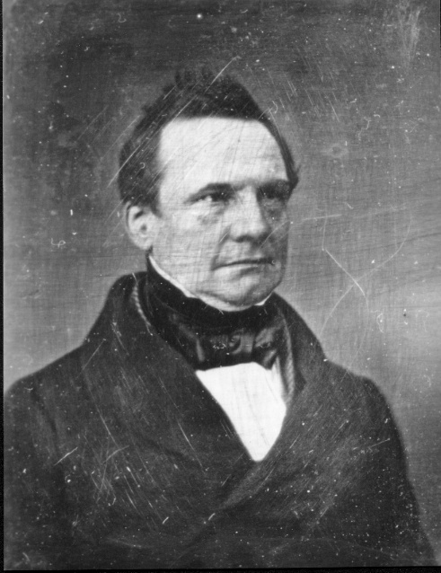
Charles Babbage 1791-1871 Lucasian Professor of Mathematics, Cambridge University, 1827-1839

Slide 23
Charles Babbage
Difference Engine 1823
Analytic Engine 1833
The forerunner of modern digital computer!
Application
Mathematical Tables – Astronomy
Nautical Tables – Navy
Background
Any continuous function can be approximated by a polynomial --- Weierstrass
Technology
mechanical - gears, Jacquard’s loom, simple calculators

Slide 24
Difference Engine A machine to compute mathematical tables
Weierstrass:
Any continuous function can be approximated by a polynomial
Any polynomial can be computed from difference tables
An example
f(n) = n² + n + 41
d1(n) = f(n) - f(n-1) = 2n
d2(n) = d1(n) - d1(n-1) = 2
f(n) = f(n-1) + d1(n) = f(n-1) + (d1(n-1) + 2)
all you need is an adder!
n
0
1
2
3
4
d2(n)
2
2
2
d1(n)
2
4
6
8
f(n)
41
43
47
53
61

Slide 25
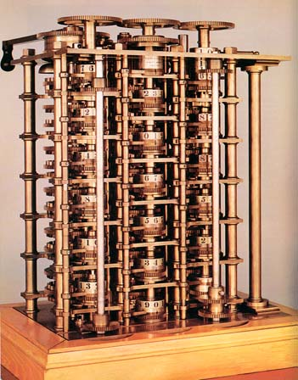
Difference Engine
1823
Babbage’s paper is published
1834
The paper is read by Scheutz & his son in Sweden
1842
Babbage gives up the idea of building it; he is onto Analytic Engine!
1855
Scheutz displays his machine at the Paris World Fare
Can compute any 6th degree polynomial
Speed: 33 to 44 32-digit numbers per minute!
Now the machine is at the Smithsonian

Slide 26
Analytic Engine
1833: Babbage’s paper was published
conceived during a hiatus in the development of the difference engine
Inspiration: Jacquard Looms
looms were controlled by punched cards
The set of cards with fixed punched holes dictated the pattern of weave ⇒ program
The same set of cards could be used with different colored threads ⇒ numbers
1871: Babbage dies
The machine remains unrealized.
It is not clear if the analytic engine could be built using the mechanical technology of the time

Slide 27
Analytic Engine The first conception of a general-purpose computer
The store in which all variables to be operated upon, as well as all those quantities which have arisen from the results of the operations are placed.
The mill into which the quantities about to be operated upon are always brought.
The program
Operation variable1 variable2 variable3
An operation in the mill required feeding two punched cards and producing a new punched card for the store.
An operation to alter the sequence was also provided!

Slide 28
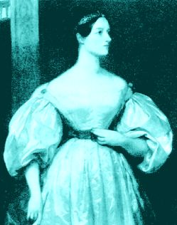
The first programmer Ada Byron aka “Lady Lovelace” 1815-52
Ada’s tutor was Babbage himself!

Slide 29
Babbage’s Influence
Babbage’s ideas had great influence later primarily because of
Luigi Menabrea, who published notes of Babbage’s lectures in Italy
Lady Lovelace, who translated Menabrea’s notes in English and thoroughly expanded them.
“... Analytic Engine weaves algebraic patterns....”
In the early twentieth century - the focus shifted to analog computers but
Harvard Mark I built in 1944 is very close in spirit to the Analytic Engine.

Slide 30
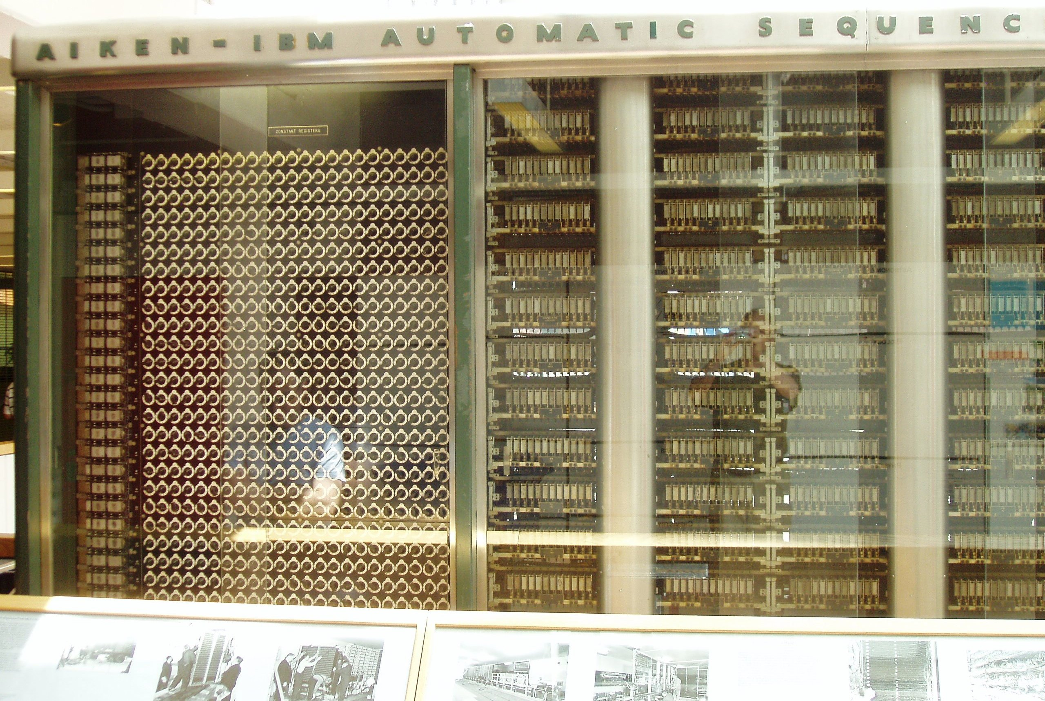
Harvard Mark I
Built in 1944 in IBM Endicott laboratories
Howard Aiken – Professor of Physics at Harvard
Essentially mechanical but had some electro-magnetically controlled relays and gears
Weighed 5 tons and had 750,000 components
A synchronizing clock that beat every 0.015 seconds (66Hz)
Performance:
0.3 seconds for addition
6 seconds for multiplication
1 minute for a sine calculation
Decimal arithmetic
No Conditional Branch!
Broke down once a week!

Slide 31
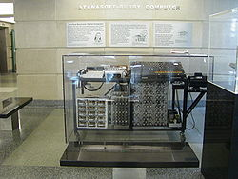
Linear Equation Solver John Atanasoff, Iowa State University
1930’s:
Atanasoff built the Linear Equation Solver.
It had 300 tubes!
Special-purpose binary digital calculator
Dynamic RAM (stored values on refreshed capacitors)
Application:
Linear and Integral differential equations
Background:
Vannevar Bush’s Differential Analyzer
--- an analog computer
Technology:
Tubes and Electromechanical relays
Atanasoff decided that the correct mode of computation was using electronic binary digits.

Slide 32
Electronic Numerical Integrator and Computer (ENIAC)
Inspired by Atanasoff and Berry, Eckert and Mauchly designed and built ENIAC (1943-45) at the University of Pennsylvania
The first, completely electronic, operational, general-purpose analytical calculator!
30 tons, 72 square meters, 200KW
Performance
Read in 120 cards per minute
Addition took 200 μs, Division 6 ms
1000 times faster than Mark I
Not very reliable!
WW-2 Effort
Application: Ballistic calculations
angle = f (location, tail wind, cross wind,
air density, temperature, weight of shell,
propellant charge, ... )
Notes:
Designers were obliged to install a ventilation shaft and a cooling system in the room. Machine had 18,000 vacuum tubes.
The slogan was: The ENIAC is able to calculate the trajectory of a large-caliber naval shell in less time than the shell takes to reach its target!
To change a program, it was necessary to change the instructions, the connector panels, and the positions of the switches all at the same time.
The inventors of ENIAC themselves admitted that, after taking into account human error, the machine only got the correct result 20 times out of 100!

Slide 33
Electronic Discrete Variable Automatic Computer (EDVAC)
ENIAC’s programming system was external
Sequences of instructions were executed independently of the results of the calculation
Human intervention required to take instructions “out of order”
Eckert, Mauchly, John von Neumann and others designed EDVAC (1944) to solve this problem
Solution was the stored program computer
⇒ “program can be manipulated as data”
First Draft of a report on EDVAC was published in 1945, but just had von Neumann’s signature!
In 1973 the court of Minneapolis attributed the honor of inventing the computer to John Atanasoff
Notes:
Von Neumann (1903-1957) was born in Budapest. Great quantities of work in set theory to quantum physics. Celebrated for his theory of games and its application to economics.
Report was the formal specification of EDVAC. Before that the documentation on ENIAC or EDVAC was non-existent. Von Neumann devised a mathematical logical notation which expressed fundamental ideas of the fetch-execute-decode loop.
Five major components: Arithmetic unit, control unit, the memory, input devices and output devices.

Slide 34
Stored Program Computer
Program = A sequence of instructions
How to control instruction sequencing?
manual control calculators
automatic control
external (paper tape) Harvard Mark I , 1944
Zuse’s Z1, WW2
internal
plug board ENIAC 1946
read-only memory ENIAC 1948
read-write memory EDVAC 1947 (concept )
The same storage can be used to store program and data
EDSAC 1950 Maurice Wilkes

Slide 35
Technology Issues
ENIAC ⇒ EDVAC
18,000 tubes 4,000 tubes
20 10-digit numbers 2000 word storage
mercury delay lines
ENIAC had many asynchronous parallel units
but only one was active at a time
BINAC : Two processors that checked each other
for reliability.
Didn’t work well because processors never
agreed

Slide 36
Dominant Problem: Reliability
Mean time between failures (MTBF)
MIT’s Whirlwind with an MTBF of 20 min. was perhaps the most reliable machine !
Reasons for unreliability:
1. Vacuum Tubes
2. Storage medium
acoustic delay lines
mercury delay lines
Williams tubes
Selections
Reliability solved by invention of Core memory by J. Forrester 1954 at MIT for Whirlwind project

Slide 37
Commercial Activity: 1948-52
IBM’s SSEC (follow on from Harvard Mark I)
Selective Sequence Electronic Calculator
150 word store.
Instructions, constraints, and tables of data were read from paper tapes.
66 Tape reading stations!
Tapes could be glued together to form a loop!
Data could be output in one phase of computation and read in the next phase of computation.

Slide 38
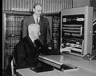
And then there was IBM 701
IBM 701 -- 30 machines were sold in 1953-54
used CRTs as main memory, 72 tubes of 32x32b each
IBM 650 -- a cheaper, drum based machine,
more than 120 were sold in 1954
and there were orders for 750 more!
Users stopped building their own machines.
Why was IBM late getting into computer technology?
IBM was making too much money!
Even without computers, IBM revenues were doubling every 4 to 5 years in 40’s and 50’s.

Slide 39
Computers in mid 50’s
Hardware was expensive
Stores were small (1000 words)
⇒ No resident system software!
Memory access time was 10 to 50 times slower than the processor cycle
⇒ Instruction execution time was totally dominated by the memory reference time.
The ability to design complex control circuits to execute an instruction was the central design concern as opposed to the speed of decoding or an ALU operation
Programmer’s view of the machine was inseparable from the actual hardware implementation

Slide 40
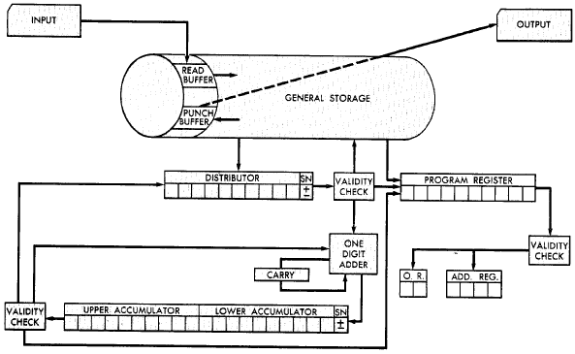
The IBM 650 (1953-4)
Magnetic Drum (1,000 or 2,000
10-digit decimal words)
Active instruction (including next program counter)
Digit-serial ALU
20-digit accumulator
[From 650 Manual, © IBM]

Slide 41
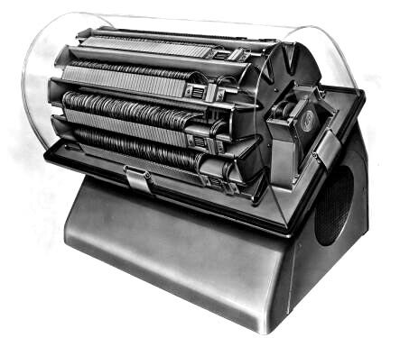
Programmer’s view of the IBM 650
A drum machine with 44 instructions
Instruction: 60 1234 1009
“Load the contents of location 1234 into the distribution; put it also into the upper accumulator; set lower accumulator to zero; and then go to location 1009 for the next instruction.”
Good programmers optimized the placement of instructions on the drum to reduce latency!

Slide 42
The Earliest Instruction Sets
Single Accumulator - A carry-over from the calculators.
LOAD x AC ← M[x]
STORE x M[x] ← (AC)
ADD x AC ← (AC) + M[x]
SUB x
MUL x Involved a quotient register
DIV x
SHIFT LEFT AC ← 2 × (AC) SHIFT RIGHT
JUMP x PC ← x
JGE x if (AC) ≥ 0 then PC ← x
LOAD ADR x AC ← Extract address field(M[x])
STORE ADR x
Typically less than 2 dozen instructions!

Slide 43
Programming: Single Accumulator Machine
C_{i} ← A_{i} + B_{i}, 1 ≤ i ≤ n
A
B
C
N
ONE
code
LOOP LOAD N
JGE DONE
ADD ONE
STORE N
F1 LOAD A
F2 ADD B
F3 STORE C
JUMP LOOP
DONE HLT
-n
1
How to modify the addresses A, B and C ?

Slide 44
Self-Modifying Code
C_{i} ← A_{i} + B_{i}, 1 ≤ i ≤ n
LOOP LOAD N
JGE DONE
ADD ONE
STORE N
F1 LOAD A
F2 ADD B
F3 STORE C
JUMP LOOP
DONE HLT
Each iteration involves
total book-
keeping
instruction
fetches
operand
fetches
stores
LOAD ADR F1
ADD ONE
STORE ADR F1
LOAD ADR F2
ADD ONE
STORE ADR F2
LOAD ADR F3
ADD ONE
STORE ADR F3
JUMP LOOP
DONE HLT
14
8
4
17
10
5
modify the
program
for the next
iteration

Slide 45
Index Registers Tom Kilburn, Manchester University, mid 50’s
One or more specialized registers to simplify
address calculation
Modify existing instructions
LOAD x, IX AC ← M[x + (IX)]
ADD x, IX AC ← (AC) + M[x + (IX)]
...
Add new instructions to manipulate index registers
JZi x, IX if (IX)=0 then PC ← x
else IX ← (IX) + 1
LOADi x, IX IX ← M[x] (truncated to fit IX)
...
Index registers have accumulator-like characteristics

Slide 46
Using Index Registers
C_{i} ← A_{i} + B_{i}, 1 ≤ i ≤ n
LOADi -n, IX
LOOP JZi DONE, IX
LOAD LASTA, IX
ADD LASTB, IX
STORE LASTC, IX
JUMP LOOP
DONE HALT
A
LASTA
Program does not modify itself
Efficiency has improved dramatically (ops / iter)
with index regs without index regs
instruction fetch 17 (14)
operand fetch 10 (8)
store 5 (4)
Costs: Instructions are 1 to 2 bits longer
Index registers with ALU-like circuitry
Complex control
5(2)
2
1

Slide 47
Operations on Index Registers
To increment index register by k
AC ← (IX) new instruction
AC ← (AC) + k
IX ← (AC) new instruction
also the AC must be saved and restored.
It may be better to increment IX directly
INCi k, IX IX ← (IX) + k
More instructions to manipulate index register
STOREi x, IX M[x] ← (IX) (extended to fit a word)
...
IX begins to look like an accumulator
⇒ several index registers
several accumulators
⇒ General Purpose Registers

Slide 48
Evolution of Addressing Modes
1. Single accumulator, absolute address
LOAD x
2. Single accumulator, index registers
LOAD x, IX
3. Indirection
LOAD (x)
4. Multiple accumulators, index registers, indirection
LOAD R, IX, x
or LOAD R, IX, (x) the meaning?
R ← M[M[x] + (IX)]
or R ← M[M[x + (IX)]]
5. Indirect through registers
LOAD R_{I}, (R_{J})
6. The works
LOAD R_{I}, R_{J}, (R_{K}) R_{J} = index, R_{K} = base addr

Slide 49
Variety of Instruction Formats
One address formats: Accumulator machines
Accumulator is always other source and destination operand
Two address formats: the destination is same as one of the operand sources
(Reg × Reg) to Reg R_{I} ← (R_{I}) + (R_{J})
(Reg × Mem) to Reg R_{I} ← (R_{I}) + M[x]
x can be specified directly or via a register
effective address calculation for x could include indexing, indirection, ...
Three address formats: One destination and up to two operand sources per instruction
(Reg x Reg) to Reg R_{I} ← (R_{J}) + (R_{K})
(Reg x Mem) to Reg R_{I} ← (R_{J}) + M[x]

Slide 50
Zero Address Formats
Operands on a stack
add M[sp-1] ← M[sp] + M[sp-1]
load M[sp] ← M[M[sp]]
Stack can be in registers or in memory (usually top of stack cached in registers)
Register
A
SP
B
C

Slide 51
Burrough’s B5000 Stack Architecture: An ALGOL Machine, Robert Barton, 1960
Machine implementation can be completely hidden if the programmer is provided only a high-level language interface.
Stack machine organization because stacks are convenient for:
expression evaluation;
subroutine calls, recursion, nested interrupts;
accessing variables in block-structured languages.
B6700, a later model, had many more innovative features
tagged data
virtual memory
multiple processors and memories

Slide 52
Evaluation of Expressions
(a + b * c) / (a + d * c - e)
/
+
-
a
*
+
e
b
c
a
*
d
c
c
*
b * c
b
Reverse Polish
a b c * + a d c * + e - /
a
Evaluation Stack
push a
push b
push c
multiply

Slide 53
Evaluation of Expressions
(a + b * c) / (a + d * c - e)
/
+
-
a
*
+
e
b
c
a
*
d
c
b * c
Reverse Polish
a b c * + a d c * + e - /
+
a + b * c
a
Evaluation Stack
add

Slide 54
Hardware organization of the stack
Stack is part of the processor state
  ⇒ stack must be bounded and small
≈ number of Registers,
not the size of main memory
Conceptually stack is unbounded
⇒   a part of the stack is included in the
processor state; the rest is kept in the
main memory

Slide 55
Stack Operations and Implicit Memory References
Suppose the top 2 elements of the stack are kept in registers and the rest is kept in the memory.
Each push operation⇒ 1 memory reference
pop operation ⇒ 1 memory reference
No Good!
Better performance by keeping the top N elements in registers, and memory references are made only when register stack overflows or underflows.
Issue - when to Load/Unload registers ?

Slide 56
Stack Size and Memory References
a b c * + a d c * + e - /
program stack (size = 2) memory refs
push a R0 a
push b R0 R1 b
push c R0 R1 R2 c, ss(a)
* R0 R1 sf(a)
+ R0
push a R0 R1 a
push d R0 R1 R2 d, ss(a+b*c)
push c R0 R1 R2 R3 c, ss(a)
* R0 R1 R2 sf(a)
+ R0 R1 sf(a+b*c)
push e R0 R1 R2 e,ss(a+b*c)
- R0 R1 sf(a+b*c)
/ R0
4 stores, 4 fetches (implicit)

Slide 57
Stack Size and Expression Evaluation
a b c * + a d c * + e - /
program stack (size = 4)
push a R0
push b R0 R1
push c R0 R1 R2
* R0 R1
+ R0
push a R0 R1
push d R0 R1 R2
push c R0 R1 R2 R3
* R0 R1 R2
+ R0 R1
push e R0 R1 R2
- R0 R1
/ R0
a and c are
“loaded” twice
      ⇒
not the best
use of registers!

Slide 58
Register Usage in a GPR Machine
(a + b * c) / (a + d * c - e)
More control over register usage since registers can be named explicitly
Load Ri m
Load Ri (Rj)
Load Ri (Rj) (Rk)
⇒
- eliminates unnecessary
Loads and Stores
- fewer Registers
but instructions may be longer!
Load R0 a
Load R1 c
Load R2 b
Mul R2 R1
Reuse
R2
Add R2 R0
Load R3 d
Mul R3 R1
Add R3 R0
Reuse
R3
Reuse
R0
Load R0 e
Sub R3 R0
Div R2 R3

Slide 59
Stack Machines: Essential features
In addition to push, pop, + etc., the instruction set must provide the capability to
refer to any element in the data area
jump to any instruction in the code area
move any element in the stack frame to the top
machinery to
carry out
+, -, etc.
⇔
stack
SP
DP
a
b
c
push a
push b
push c
*
+
push e
/
PC
.
.
.
data
code

Slide 60
Stack versus GPR Organization Amdahl, Blaauw and Brooks, 1964
1. The performance advantage of push down stack organization is derived from the presence of fast registers and not the way they are used.
2.“Surfacing” of data in stack which are “profitable” is approximately 50% because of constants and common subexpressions.
3. Advantage of instruction density because of implicit addresses is equaled if short addresses to specify registers are allowed.
4. Management of finite depth stack causes complexity.
5. Recursive subroutine advantage can be realized only with the help of an independent stack for addressing.
6. Fitting variable-length fields into fixed-width word is awkward.

Slide 61
Stack Machines (Mostly) Died by 1980
1. Stack programs are not smaller if short (Register) addresses are permitted.
2. Modern compilers can manage fast register space better than the stack discipline.
GPR’s and caches are better than stack and displays
Early language-directed architectures often did not
take into account the role of compilers!
B5000, B6700, HP 3000, ICL 2900, Symbolics 3600
Some would claim that an echo of this mistake is visible in the SPARC architecture register windows - more later…

Slide 62
Stacks post-1980
Inmos Transputers (1985-2000)
Designed to support many parallel processes in Occam language
Fixed-height stack design simplified implementation
Stack trashed on context swap (fast context switches)
Inmos T800 was world’s fastest microprocessor in late 80’s
Forth machines
Direct support for Forth execution in small embedded real-time environments
Several manufacturers (Rockwell, Patriot Scientific)
Java Virtual Machine
Designed for software emulation, not direct hardware execution
Sun PicoJava implementation + others
Intel x87 floating-point unit
Severely broken stack model for FP arithmetic
Deprecated in Pentium-4, replaced with SSE2 FP registers

Slide 63
Software Developments
up to 1955 Libraries of numerical routines
- Floating point operations
- Transcendental functions
- Matrix manipulation, equation solvers, . . .
1955-60 High level Languages - Fortran 1956
Operating Systems -
- Assemblers, Loaders, Linkers, Compilers
- Accounting programs to keep track of
usage and charges
Machines required experienced operators
⇒ Most users could not be expected to understand
these programs, much less write them
⇒ Machines had to be sold with a lot of resident
software

Slide 64
Compatibility Problem at IBM
By early 60’s, IBM had 4 incompatible lines of computers!
701 → 7094
650 → 7074
702 → 7080
1401 →   7010
Each system had its own
Instruction set
I/O system and Secondary Storage:
magnetic tapes, drums and disks
assemblers, compilers, libraries,...
market niche
business, scientific, real time, ...
⇒ IBM 360

Slide 65
IBM 360 : Design Premises Amdahl, Blaauw and Brooks, 1964
The design must lend itself to growth and successor machines
General method for connecting I/O devices
Total performance - answers per month rather than bits per microsecond ⇒ programming aids
Machine must be capable of supervising itself without manual intervention
Built-in hardware fault checking and locating aids to reduce down time
Simple to assemble systems with redundant I/O devices, memories etc. for fault tolerance
Some problems required floating-point larger than 36 bits

Slide 66
IBM 360: A General-Purpose Register (GPR) Machine
Processor State
16 General-Purpose 32-bit Registers
may be used as index and base register
Register 0 has some special properties
4 Floating Point 64-bit Registers
A Program Status Word (PSW)
PC, Condition codes, Control flags
A 32-bit machine with 24-bit addresses
But no instruction contains a 24-bit address!
Data Formats
8-bit bytes, 16-bit half-words, 32-bit words, 64-bit double-words
The IBM 360 is why bytes are 8-bits long today!

Slide 67
IBM 360: Initial Implementations
Model 30 . . . Model 70
Storage 8K - 64 KB 256K - 512 KB
Datapath 8-bit 64-bit
Circuit Delay 30 nsec/level 5 nsec/level
Local Store Main Store Transistor Registers
Control Store Read only 1μsec Conventional circuits
IBM 360 instruction set architecture (ISA) completely hid the underlying technological differences between various models.
Milestone: The first true ISA designed as portable hardware-software interface!
With minor modifications it still survives today!

Slide 68
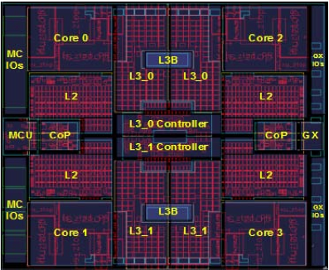
IBM 360: 47 years later… The zSeries z11 Microprocessor
5.2 GHz in IBM 45nm PD-SOI CMOS technology
1.4 billion transistors in 512 mm²
64-bit virtual addressing
original S/360 was 24-bit, and S/370 was 31-bit extension
Quad-core design
Three-issue out-of-order superscalar pipeline
Out-of-order memory accesses
Redundant datapaths
every instruction performed in two parallel datapaths and results compared
64KB L1 I-cache, 128KB L1 D-cache on-chip
1.5MB private L2 unified cache per core, on-chip
On-Chip 24MB eDRAM L3 cache
Scales to 96-core multiprocessor with 768MB of shared L4 eDRAM
[ IBM, HotChips, 2010]

Slide 69
And in conclusion …
Computer Architecture >> ISAs and RTL
CS152 is about interaction of hardware and software, and design of appropriate abstraction layers
Computer architecture is shaped by technology and applications
History provides lessons for the future
Computer Science at the crossroads from sequential to parallel computing
Salvation requires innovation in many fields, including computer architecture
Read Chapter 1 & Appendix A for next time!

Slide 70
Acknowledgements
These slides contain material developed and copyright by:
Arvind (MIT)
Krste Asanovic (MIT/UCB)
Joel Emer (Intel/MIT)
James Hoe (CMU)
John Kubiatowicz (UCB)
David Patterson (UCB)
MIT material derived from course 6.823
UCB material derived from course CS252

