Slide 1
CS 152 Computer Architecture and Engineering Lecture 14: Multithreading
Krste Asanovic
Electrical Engineering and Computer Sciences
University of California, Berkeley
http://www.eecs.berkeley.edu/~krste
http://inst.cs.berkeley.edu/~cs152

Slide 2
Last Time Lecture 13: VLIW
In a classic VLIW, compiler is responsible for avoiding all hazards -> simple hardware, complex compiler. Later VLIWs added more dynamic hardware interlocks
Use loop unrolling and software pipelining for loops, trace scheduling for more irregular code
Static scheduling difficult in presence of unpredictable branches and variable latency memory

Slide 3
Multithreading
Difficult to continue to extract instruction-level parallelism (ILP) from a single sequential thread of control
Many workloads can make use of thread-level parallelism (TLP)
TLP from multiprogramming (run independent sequential jobs)
TLP from multithreaded applications (run one job faster using parallel threads)
Multithreading uses TLP to improve utilization of a single processor

Slide 4
Pipeline Hazards
t0
t1
t2
t3
t4
t5
t6
t7
t8
t9
t10
t11
t12
t13
t14
LW r1, 0(r2)
LW r5, 12(r1)
ADDI r5, r5, #12
SW 12(r1), r5
F
D
X
M
W
F
D
D
D
D
X
M
W
F
F
F
F
D
D
D
D
X
M
W
F
F
F
F
D
D
D
D
Each instruction may depend on the next
What is usually done to cope with this?
interlocks (slow)
or bypassing (needs hardware, doesn’t help all hazards)

Slide 5
Multithreading
How can we guarantee no dependencies between instructions in a pipeline?
-- One way is to interleave execution of instructions from different program threads on same pipeline
Interleave 4 threads, T1-T4, on non-bypassed 5-stage pipe
t0
t1
t2
t3
t4
t5
t6
t7
t8
t9
T1: LW r1, 0(r2)
T2: ADD r7, r1, r4
T3: XORI r5, r4, #12
T4: SW 0(r7), r5
T1: LW r5, 12(r1)
F
D
X
M
W
Prior instruction in a thread always completes write-back before next instruction in same thread reads register file
F
D
X
M
W
F
D
X
M
W
F
D
X
M
W
F
D
X
M
W

Slide 6
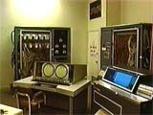
CDC 6600 Peripheral Processors (Cray, 1964)
First multithreaded hardware
10 “virtual” I/O processors
Fixed interleave on simple pipeline
Pipeline has 100ns cycle time
Each virtual processor executes one instruction every 1000ns
Accumulator-based instruction set to reduce processor state
Notes:
Was objective was to cope with long I/O latencies?

Slide 7
Simple Multithreaded Pipeline
X
PC
1
GPR1
PC
1
I$
IR
GPR1
PC
1
GPR1
PC
1
GPR1
D$
Y
+1
2
Thread select
2
Have to carry thread select down pipeline to ensure correct state bits read/written at each pipe stage
Appears to software (including OS) as multiple, albeit slower, CPUs

Slide 8
Multithreading Costs
Each thread requires its own user state
PC
GPRs
Also, needs its own system state
virtual memory page table base register
exception handling registers
Other overheads:
Additional cache/TLB conflicts from competing threads
(or add larger cache/TLB capacity)
More OS overhead to schedule more threads (where do all these threads come from?)

Slide 9
Thread Scheduling Policies
Fixed interleave (CDC 6600 PPUs, 1964)
Each of N threads executes one instruction every N cycles
If thread not ready to go in its slot, insert pipeline bubble
Software-controlled interleave (TI ASC PPUs, 1971)
OS allocates S pipeline slots amongst N threads
Hardware performs fixed interleave over S slots, executing whichever thread is in that slot
Hardware-controlled thread scheduling (HEP, 1982)
Hardware keeps track of which threads are ready to go
Picks next thread to execute based on hardware priority scheme
Notes:
Software-controlled interleave, S > N. Wheel with the threads in each slot. If thread is ready to go
It goes, else NOP, I.e., pipeline bubble.

Slide 10
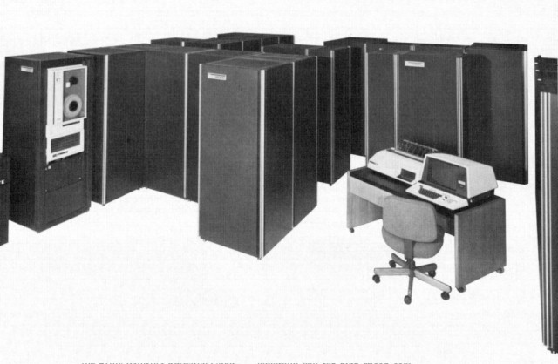
Denelcor HEP (Burton Smith, 1982)
First commercial machine to use hardware threading in main CPU
120 threads per processor
10 MHz clock rate
Up to 8 processors
precursor to Tera MTA (Multithreaded Architecture)
Notes:
Would be nice to add a slide on the implementation…

Slide 11
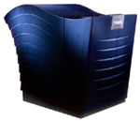
Tera MTA (1990-)
Up to 256 processors
Up to 128 active threads per processor
Processors and memory modules populate a sparse 3D torus interconnection fabric
Flat, shared main memory
No data cache
Sustains one main memory access per cycle per processor
GaAs logic in prototype, 1KW/processor @ 260MHz
Second version CMOS, MTA-2, 50W/processor
New version, XMT, fits into AMD Opteron socket, runs at 500MHz

Slide 12
MTA Pipeline
Issue Pool
Inst Fetch
Every cycle, one VLIW instruction from one active thread is launched into pipeline
Instruction pipeline is 21 cycles long
Memory operations incur ~150 cycles of latency
W
M
A
C
W
Write Pool
Memory Pool
W
Retry Pool
Assuming a single thread issues one instruction every 21 cycles, and clock rate is 260 MHz…
What is single-thread performance?
Effective single-thread issue rate is 260/21 = 12.4 MIPS
Interconnection Network
Memory pipeline
Notes:
Memory unit is busy, or sync operation failed retry.
Just goes around the memory pipeline.

Slide 13
Coarse-Grain Multithreading
Tera MTA designed for supercomputing applications with large data sets and low locality
No data cache
Many parallel threads needed to hide large memory latency
Other applications are more cache friendly
Few pipeline bubbles if cache mostly has hits
Just add a few threads to hide occasional cache miss latencies
Swap threads on cache misses
Notes:
Tera --- 256 mem-ops/cycle * 150 cycles/mem-op = 38K instructions-in-flight…
Tera not very successful, 2 machines sold.
Changed their name back to Cray!

Slide 14
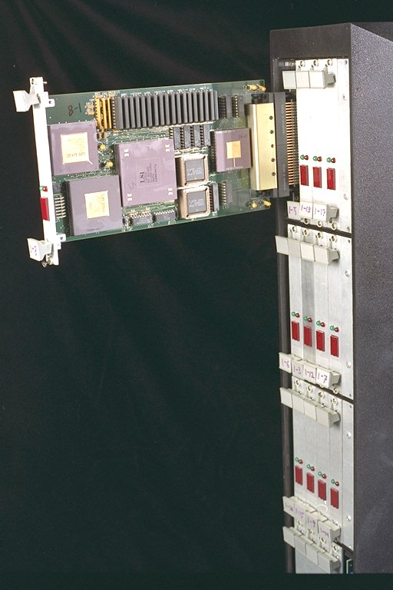
MIT Alewife (1990)
Modified SPARC chips
register windows hold different thread contexts
Up to four threads per node
Thread switch on local cache miss

Slide 15
IBM PowerPC RS64-IV (2000)
Commercial coarse-grain multithreading CPU
Based on PowerPC with quad-issue in-order five-stage pipeline
Each physical CPU supports two virtual CPUs
On L2 cache miss, pipeline is flushed and execution switches to second thread
short pipeline minimizes flush penalty (4 cycles), small compared to memory access latency
flush pipeline to simplify exception handling

Slide 16
Oracle/Sun Niagara processors
Target is datacenters running web servers and databases, with many concurrent requests
Provide multiple simple cores each with multiple hardware threads, reduced energy/operation though much lower single thread performance
Niagara-1 [2004], 8 cores, 4 threads/core
Niagara-2 [2007], 8 cores, 8 threads/core
Niagara-3 [2009], 16 cores, 8 threads/core

Slide 17
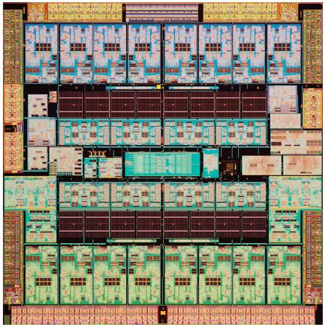
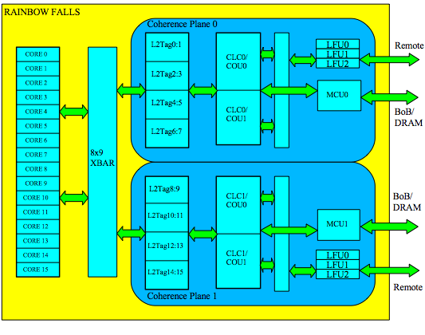
Oracle/Sun Niagara-3, “Rainbow Falls” 2009

Slide 18
CS152 Administrivia
Quiz 3, Monday March 28 (first class back after spring break)
All material on complex pipelining and branch prediction (L10-L12, plus review at start of L13), PS3, Lab 3
Pick up hard-copy draft of Hennessey & Patterson 5th edition chapter on Vector Processing & GPUs
Read before lectures L15 & L16
Not available electronically

Slide 19
EECS Undergraduate Town Hall
Today at 4pm in 306 Soda Hall
Give faculty feedback on undergraduate experience in EECS

Slide 20
Simultaneous Multithreading (SMT) for OoO Superscalars
Techniques presented so far have all been “vertical” multithreading where each pipeline stage works on one thread at a time
SMT uses fine-grain control already present inside an OoO superscalar to allow instructions from multiple threads to enter execution on same clock cycle. Gives better utilization of machine resources.

Slide 21
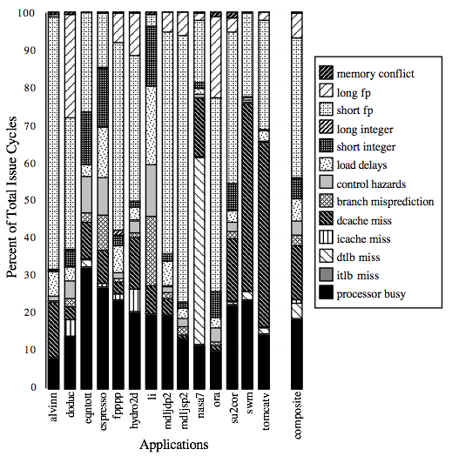
For most apps, most execution units lie idle in an OoO superscalar
For an 8-way superscalar.
From: Tullsen, Eggers, and Levy,
“Simultaneous Multithreading: Maximizing On-chip Parallelism”, ISCA 1995.

Slide 22
Superscalar Machine Efficiency
Issue width
Instruction issue
Completely idle cycle (vertical waste)
Time
Partially filled cycle, i.e., IPC < 4
(horizontal waste)
Notes:
Focus is switching to function unit efficiency (as a measure of throughput).

Slide 23
Vertical Multithreading
Issue width
Instruction issue
Second thread interleaved cycle-by-cycle
Time
Partially filled cycle, i.e., IPC < 4
(horizontal waste)
What is the effect of cycle-by-cycle interleaving?
removes vertical waste, but leaves some horizontal waste

Slide 24
Chip Multiprocessing (CMP)
Issue width
Time
What is the effect of splitting into multiple processors?
reduces horizontal waste,
leaves some vertical waste, and
puts upper limit on peak throughput of each thread.

Slide 25
Ideal Superscalar Multithreading [Tullsen, Eggers, Levy, UW, 1995]
Issue width
Time
Interleave multiple threads to multiple issue slots with no restrictions

Slide 26
O-o-O Simultaneous Multithreading [Tullsen, Eggers, Emer, Levy, Stamm, Lo, DEC/UW, 1996]
Add multiple contexts and fetch engines and allow instructions fetched from different threads to issue simultaneously
Utilize wide out-of-order superscalar processor issue queue to find instructions to issue from multiple threads
OOO instruction window already has most of the circuitry required to schedule from multiple threads
Any single thread can utilize whole machine

Slide 27
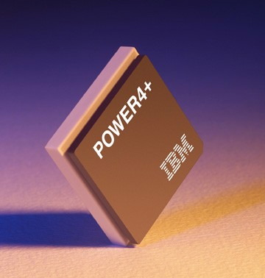
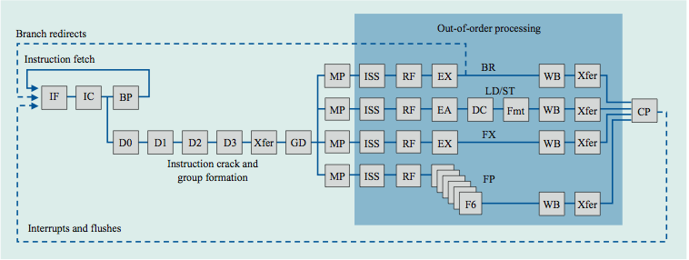
IBM Power 4
Single-threaded predecessor to Power 5. 8 execution units in
out-of-order engine, each may
issue an instruction each cycle.

Slide 28
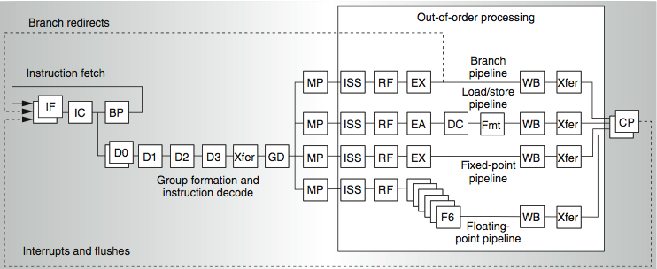
Power 4
2 commits (architected register sets)
Power 5
2 fetch (PC), 2 initial decodes

Slide 29
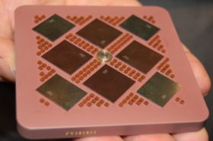
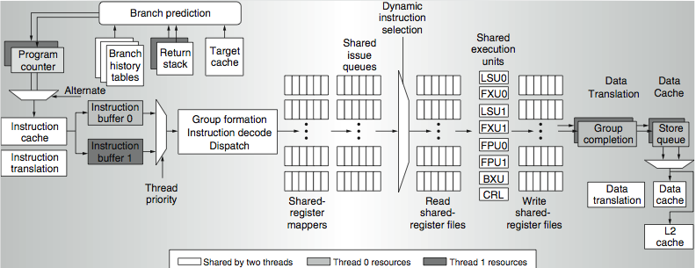
Power 5 data flow ...
Why only 2 threads? With 4, one of the shared resources (physical registers, cache, memory bandwidth) would be prone to bottleneck

Slide 30
Changes in Power 5 to support SMT
Increased associativity of L1 instruction cache and the instruction address translation buffers
Added per thread load and store queues
Increased size of the L2 (1.92 vs. 1.44 MB) and L3 caches
Added separate instruction prefetch and buffering per thread
Increased the number of virtual registers from 152 to 240
Increased the size of several issue queues
The Power5 core is about 24% larger than the Power4 core because of the addition of SMT support

Slide 31
Pentium-4 Hyperthreading (2002)
First commercial SMT design (2-way SMT)
Hyperthreading == SMT
Logical processors share nearly all resources of the physical processor
Caches, execution units, branch predictors
Die area overhead of hyperthreading ~ 5%
When one logical processor is stalled, the other can make progress
No logical processor can use all entries in queues when two threads are active
Processor running only one active software thread runs at approximately same speed with or without hyperthreading
Hyperthreading dropped on OoO P6 based followons to Pentium-4 (Pentium-M, Core Duo, Core 2 Duo), until revived with Nehalem generation machines in 2008.
Intel Atom (in-order x86 core) has two-way vertical multithreading
Notes:
Load-store buffer in L1 cache doesn’t behave like that, and hence 15% slowdown.

Slide 32
Initial Performance of SMT
Pentium 4 Extreme SMT yields 1.01 speedup for SPECint_rate benchmark and 1.07 for SPECfp_rate
Pentium 4 is dual threaded SMT
SPECRate requires that each SPEC benchmark be run against a vendor-selected number of copies of the same benchmark
Running on Pentium 4 each of 26 SPEC benchmarks paired with every other (26² runs) speed-ups from 0.90 to 1.58; average was 1.20
Power 5, 8-processor server 1.23 faster for SPECint_rate with SMT, 1.16 faster for SPECfp_rate
Power 5 running 2 copies of each app speedup between 0.89 and 1.41
Most gained some
Fl.Pt. apps had most cache conflicts and least gains

Slide 33
SMT adaptation to parallelism type
For regions with high thread level parallelism (TLP) entire machine width is shared by all threads
For regions with low thread level parallelism (TLP) entire machine width is available for instruction level parallelism (ILP)
Issue width
Issue width
Time
Time
Notes:
Amdahl’s law…

Slide 34
Icount Choosing Policy
Fetch from thread with the least instructions in flight.
Why does this enhance throughput?
Notes:
Fetch unit that can keep up with the simultaneous multithreaded execution engine
have the fewest instructions waiting to be executed
making the best progress through the machine
40% increase in IPC over RR
Don’t want to clog instruction window with thread with many stalls ➔ try to fetch from thread that has fewest insts in window

Slide 35
Summary: Multithreaded Categories
Simultaneous
Multithreading
Time (processor cycle)
Superscalar
Fine-Grained
Coarse-Grained
Multiprocessing
Thread 1
Thread 3
Thread 5
Thread 2
Thread 4
Idle slot

Slide 36
Acknowledgements
These slides contain material developed and copyright by:
Arvind (MIT)
Krste Asanovic (MIT/UCB)
Joel Emer (Intel/MIT)
James Hoe (CMU)
John Kubiatowicz (UCB)
David Patterson (UCB)
MIT material derived from course 6.823
UCB material derived from course CS252

