Slide 1
CS 152 Computer Architecture and Engineering Lecture 7 - Memory Hierarchy-II
Krste Asanovic
Electrical Engineering and Computer Sciences
University of California at Berkeley
http://www.eecs.berkeley.edu/~krste
http://inst.eecs.berkeley.edu/~cs152

Slide 2
Last time in Lecture 6
Dynamic RAM (DRAM) is main form of main memory storage in use today
Holds values on small capacitors, need refreshing (hence dynamic)
Slow multi-step access: precharge, read row, read column
Static RAM (SRAM) is faster but more expensive
Used to build on-chip memory for caches
Cache holds small set of values in fast memory (SRAM) close to processor
Need to develop search scheme to find values in cache, and replacement policy to make space for newly accessed locations
Caches exploit two forms of predictability in memory reference streams
Temporal locality, same location likely to be accessed again soon
Spatial locality, neighboring location likely to be accessed soon

Slide 3
CPU-Cache Interaction (5-stage pipeline)
0x4
Add
E
Decode,
Register
Fetch
M
A
we
Y
addr
nop
ALU
Y
IR
B
Primary
Data
Cache
rdata
PC
addr
inst
D
R
wdata
hit?
hit?
wdata
PCen
Primary
Instruction
Cache
MD1
MD2
Stall entire CPU on data cache miss
To Memory Control
Cache Refill Data from Lower Levels of Memory Hierarchy
Notes:
How are writes to istream handled?

Slide 4
Improving Cache Performance
Average memory access time =
Hit time + Miss rate x Miss penalty
To improve performance:
reduce the hit time
reduce the miss rate
reduce the miss penalty
What is the simplest design strategy?
Biggest cache that doesn’t increase hit time past 1-2 cycles (approx 8-32KB in modern technology)
[ design issues more complex with out-of-order superscalar processors ]
Notes:
Design the largest primary cache without slowing down the clock
Or adding pipeline stages.

Slide 5
Serial-versus-Parallel Cache and Memory access
α is HIT RATIO: Fraction of references in cache
1 - α is MISS RATIO: Remaining references
Addr
Addr
CACHE
Main
Memory
Processor
Data
Data
Average access time for serial search: t_{cache} + (1 - α) t_{mem}
Addr
CACHE
Main
Memory
Processor
Data
Data
Average access time for parallel search: α t_{cache} + (1 - α) t_{mem}
Savings are usually small, t_{mem} >> t_{cache}, hit ratio α high
High bandwidth required for memory path
Complexity of handling parallel paths can slow t_{cache}

Slide 6
Causes for Cache Misses
Compulsory: first-reference to a block a.k.a. cold start misses
- misses that would occur even with infinite cache
Capacity: cache is too small to hold all data needed by the program
- misses that would occur even under perfect
replacement policy
Conflict: misses that occur because of collisions
due to block-placement strategy
- misses that would not occur with full associativity

Slide 7
Effect of Cache Parameters on Performance
Larger cache size
reduces capacity and conflict misses
hit time will increase
Higher associativity
reduces conflict misses
may increase hit time
Larger block size
reduces compulsory and capacity (reload) misses
increases conflict misses and miss penalty
Notes:
Requested block first….
The following could be in the slide…
spatial locality reduces compulsory misses and capacity reload misses
fewer blocks may increase conflict miss rate
larger blocks may increase miss penalty

Slide 8
Write Policy Choices
Cache hit:
write through: write both cache & memory
Generally higher traffic but simpler pipeline & cache design
write back: write cache only, memory is written only when the entry is evicted
A dirty bit per block further reduces write-back traffic
Must handle 0, 1, or 2 accesses to memory for each load/store
Cache miss:
no write allocate: only write to main memory
write allocate (aka fetch on write): fetch into cache
Common combinations:
write through and no write allocate
write back with write allocate

Slide 9
Write Performance
Tag
Index
Block
Offset
b
t
k
V
Tag
Data
2^{k}
lines
t
=
WE
HIT
Data Word or Byte
Notes:
Completely serial (jse)

Slide 10
Reducing Write Hit Time
Problem: Writes take two cycles in memory stage, one cycle for tag check plus one cycle for data write if hit
Solutions:
Design data RAM that can perform read and write in one cycle, restore old value after tag miss
Fully-associative (CAM Tag) caches: Word line only enabled if hit
Pipelined writes: Hold write data for store in single buffer ahead of cache, write cache data during next store’s tag check
Notes:
Need to bypass from write buffer if read address matches write buffer tag!

Slide 11
Pipelining Cache Writes
Address and Store Data From CPU
Tag
Index
Store Data
Delayed Write Addr.
Delayed Write Data
Load/Store
=?
Tags
S
Data
L
=?
1
0
Load Data to CPU
Hit?
Data from a store hit written into data portion of cache during tag access of subsequent store

Slide 12
Write Buffer to Reduce Read Miss Penalty
Unified L2 Cache
Data Cache
CPU
RF
Write
buffer
Evicted dirty lines for writeback cache
OR
All writes in writethrough cache
Processor is not stalled on writes, and read misses can go ahead of write to main memory
Problem: Write buffer may hold updated value of location needed by a read miss
Simple scheme: on a read miss, wait for the write buffer to go empty
Faster scheme: Check write buffer addresses against read miss addresses, if no match, allow read miss to go ahead of writes, else, return value in write buffer
Notes:
Deisgners of the MIPS M/1000 estimated that waiting for a four-word buffer to empty
increased the read miss penalty by a factor of 1.5.

Slide 13
Block-level Optimizations
Tags are too large, i.e., too much overhead
Simple solution: Larger blocks, but miss penalty could be large.
Sub-block placement (aka sector cache)
A valid bit added to units smaller than full block, called sub-blocks
Only read a sub-block on a miss
If a tag matches, is the word in the cache?
100
300
204
1 1 1 1
1 0 0
0 1 0 1
Notes:
Main reason for subblock placement is to reduce tag overhead.
Sector cache (jse)

Slide 14
CS152 Administrivia

Slide 15
Multilevel Caches
Problem: A memory cannot be large and fast
Solution: Increasing sizes of cache at each level
DRAM
CPU
L2$
L1$
Local miss rate = misses in cache / accesses to cache
Global miss rate = misses in cache / CPU memory accesses
Misses per instruction = misses in cache / number of instructions
Notes:
MPI makes it easier to compute overall performance (jse)

Slide 16
Presence of L2 influences L1 design
Use smaller L1 if there is also L2
Trade increased L1 miss rate for reduced L1 hit time and reduced L1 miss penalty
Reduces average access energy
Use simpler write-through L1 with on-chip L2
Write-back L2 cache absorbs write traffic, doesn’t go off-chip
At most one L1 miss request per L1 access (no dirty victim write back) simplifies pipeline control
Simplifies coherence issues
Simplifies error recovery in L1 (can use just parity bits in L1 and reload from L2 when parity error detected on L1 read)

Slide 17
Inclusion Policy
Inclusive multilevel cache:
Inner cache holds copies of data in outer cache
External coherence snoop access need only check outer cache
Exclusive multilevel caches:
Inner cache may hold data not in outer cache
Swap lines between inner/outer caches on miss
Used in AMD Athlon with 64KB primary and 256KB secondary cache
Why choose one type or the other?
Notes:
New slide (jse)

Slide 18
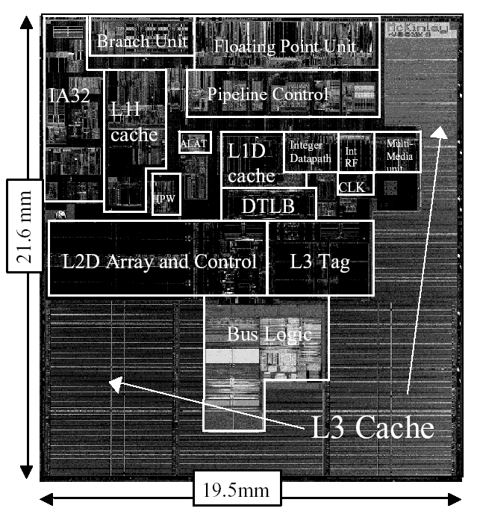
Itanium-2 On-Chip Caches (Intel/HP, 2002)
Level 1: 16KB, 4-way s.a., 64B line, quad-port (2 load+2 store), single cycle latency
Level 2: 256KB, 4-way s.a, 128B line, quad-port (4 load or 4 store), five cycle latency
Level 3: 3MB, 12-way s.a., 128B line, single 32B port, twelve cycle latency
Notes:
If two is good, then three must be better (jse)

Slide 19
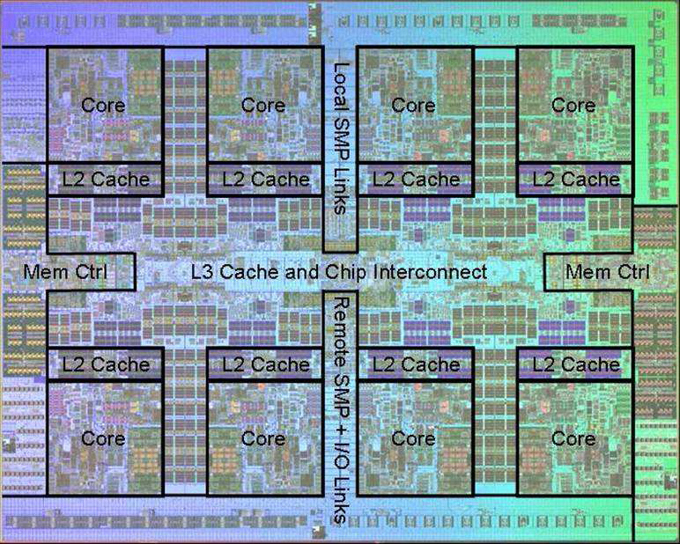
Power 7 On-Chip Caches [IBM 2009]
32KB L1 I$/core
32KB L1 D$/core
3-cycle latency
256KB Unified L2$/core
8-cycle latency
32MB Unified Shared L3$
Embedded DRAM
25-cycle latency to local slice

Slide 20
Prefetching
Speculate on future instruction and data accesses and fetch them into cache(s)
Instruction accesses easier to predict than data accesses
Varieties of prefetching
Hardware prefetching
Software prefetching
Mixed schemes
What types of misses does prefetching affect?
Notes:
Reduces compulsory misses, can increase conflict and
capacity misses.

Slide 21
Issues in Prefetching
Usefulness – should produce hits
Timeliness – not late and not too early
Cache and bandwidth pollution
L1 Instruction
Unified L2 Cache
CPU
L1 Data
RF
Prefetched data

Slide 22
Hardware Instruction Prefetching
Instruction prefetch in Alpha AXP 21064
Fetch two blocks on a miss; the requested block (i) and the next consecutive block (i+1)
Requested block placed in cache, and next block in instruction stream buffer
If miss in cache but hit in stream buffer, move stream buffer block into cache and prefetch next block (i+2)
Prefetched
instruction block
Req
block
Stream
Buffer
CPU
Unified L2 Cache
L1 Instruction
RF
Req
block
Notes:
Need to check the stream buffer if the requested block is in there.
Never more than one 32-byte block in the stream buffer.

Slide 23
Hardware Data Prefetching
Prefetch-on-miss:
Prefetch b + 1 upon miss on b
One Block Lookahead (OBL) scheme
Initiate prefetch for block b + 1 when block b is accessed
Why is this different from doubling block size?
Can extend to N-block lookahead
Strided prefetch
If observe sequence of accesses to block b, b+N, b+2N, then prefetch b+3N etc.
Example: IBM Power 5 [2003] supports eight independent streams of strided prefetch per processor, prefetching 12 lines ahead of current access
Notes:
HP PA 7200 uses OBL prefetching
Tag prefetching is twice as effective as prefetch-on-miss in
reducing miss rates.

Slide 24
Software Prefetching
for(i=0; i < N; i++) { prefetch( &a[i + 1] ); prefetch( &b[i + 1] ); SUM = SUM + a[i] * b[i]; }
Notes:
Cache should be non-blocking or lockup-free.
By that we mean that the processor can proceed while the prefetched
Data is being fetched; and the caches continue to supply instructions
And data while waiting for the prefetched data to return.

Slide 25
Software Prefetching Issues
Timing is the biggest issue, not predictability
If you prefetch very close to when the data is required, you might be too late
Prefetch too early, cause pollution
Estimate how long it will take for the data to come into L1, so we can set P appropriately
Why is this hard to do?
for(i=0; i < N; i++) { prefetch( &a[i + P] ); prefetch( &b[i + P] ); SUM = SUM + a[i] * b[i]; }
Must consider cost of prefetch instructions

Slide 26
Compiler Optimizations
Restructuring code affects the data block access sequence
Group data accesses together to improve spatial locality
Re-order data accesses to improve temporal locality
Prevent data from entering the cache
Useful for variables that will only be accessed once before being replaced
Needs mechanism for software to tell hardware not to cache data (“no-allocate” instruction hints or page table bits)
Kill data that will never be used again
Streaming data exploits spatial locality but not temporal locality
Replace into dead cache locations
Notes:
Miss-rate reduction without any hardware changes.
Hardware designer’s favorite solution.

Slide 27
Loop Interchange
for(j=0; j < N; j++) { for(i=0; i < M; i++) { x[i][j] = 2 * x[i][j]; } }
for(i=0; i < M; i++) { for(j=0; j < N; j++) { x[i][j] = 2 * x[i][j]; } }
What type of locality does this improve?

Slide 28
Loop Fusion
for(i=0; i < N; i++) a[i] = b[i] * c[i];
for(i=0; i < N; i++)
d[i] = a[i] * c[i];
for(i=0; i < N; i++) { a[i] = b[i] * c[i]; d[i] = a[i] * c[i];
}
What type of locality does this improve?

Slide 29
Matrix Multiply, Naïve Code
z
j
for(i=0; i < N; i++) for(j=0; j < N; j++) { r = 0; for(k=0; k < N; k++) r = r + y[i][k] * z[k][j]; x[i][j] = r; }
k
y
k
x
j
i
i
Not touched
Old access
New access

Slide 30
Matrix Multiply with Cache Tiling
for(jj=0; jj < N; jj=jj+B) for(kk=0; kk < N; kk=kk+B) for(i=0; i < N; i++) for(j=jj; j < min(jj+B,N); j++) { r = 0; for(k=kk; k < min(kk+B,N); k++) r = r + y[i][k] * z[k][j]; x[i][j] = x[i][j] + r; }
z
j
k
y
k
x
j
i
i
What type of locality does this improve?
Notes:
Y benefits from spatial locality
z benefits from temporal locality

Slide 31
Acknowledgements
These slides contain material developed and copyright by:
Arvind (MIT)
Krste Asanovic (MIT/UCB)
Joel Emer (Intel/MIT)
James Hoe (CMU)
John Kubiatowicz (UCB)
David Patterson (UCB)
MIT material derived from course 6.823
UCB material derived from course CS252

