Slide 1
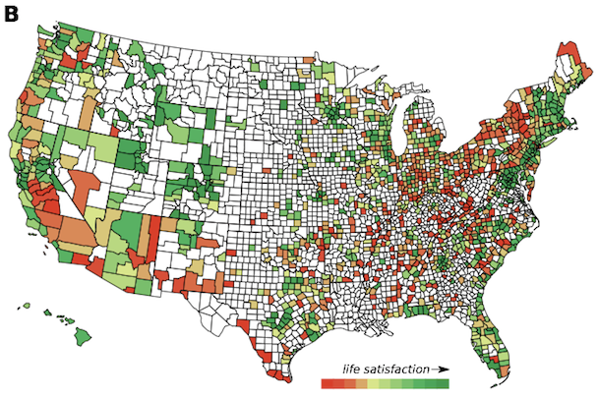
The Beauty and Joy of Computing Lecture #19 Higher Order Functions II
Instructor:
Sean Morris
Twitter Can Tell Whether Your Community Is Happy or Not
"training," "gym," "waves," "mountains," "camping", "ideas," "suggestions," "advice," "meetings," "conferences," "support," "donate"
www.theatlanticcities.com/neighborhoods/2013/07/how-twitter-can-predict-your-communitys-wellbeing/6270

Slide 2
Today
Review useful HOFs
map Reporter over List
Report a new list, every element E of List becoming Reporter(E)
keep items such that Predicate from List
Report a new list, keeping only elements E of List if Predicate(E)
combine with Reporter over List
Combine all the elements of List with Reporter(E)
This is also known as “reduce”
Acronym example
keep ➔ map ➔ combine
The script, run and launch
For each
Compose example

Slide 3
Pair this out …
Composing Higher-Order Functions, report this…
Notes:
Answer: D (includes everything in which the computer poses a question and you have to answer in a computer-readable form, which so far means multiple choice)

Slide 4
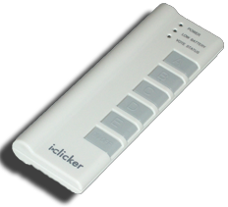
Peer Instruction
What would this report:
UCB, as before
UoCaB
UCaB
UoCB
Something else
Notes:
Answer: D (includes everything in which the computer poses a question and you have to answer in a computer-readable form, which so far means multiple choice)

Slide 5
Pair this out …
What does the Sprite do?
Say : “ “, “ “ , “ “
Say : “Tweet 1”, “Tweet 1”, “Tweet 1”
Say : “Tweet 3”, “Tweet 3”, “Tweet 3”
Say : “Tweet 1”, “Tweet 2”, “Tweet 3”
Notes:
Answer: D (includes everything in which the computer poses a question and you have to answer in a computer-readable form, which so far means multiple choice)

Slide 6
Go Deep …
What makes “for each” a High-Order Function?
Notes:
Answer: D (includes everything in which the computer poses a question and you have to answer in a computer-readable form, which so far means multiple choice)

Slide 7
Go Deeper …
Explain the difference between the Higher-Order function, “map”, and the Higher-Order function “for each”.
Notes:
Answer: D (includes everything in which the computer poses a question and you have to answer in a computer-readable form, which so far means multiple choice)

Slide 8
Higher-Order Functions so far…
Consumers of functions …
Notes:
Answer: D (includes everything in which the computer poses a question and you have to answer in a computer-readable form, which so far means multiple choice)

Slide 9
Cascade: Pair this out
What is reported?
2
16
60
80
Notes:
Answer: D (includes everything in which the computer poses a question and you have to answer in a computer-readable form, which so far means multiple choice)

Slide 10
Cascade: Check it out
Notes:
Answer: D (includes everything in which the computer poses a question and you have to answer in a computer-readable form, which so far means multiple choice)

Slide 11
Compose: Pair this out
What does the Sprite say?
Nothing
Build Your Own Blocks
Build
Your
Own
Blocks
Notes:
Answer: D (includes everything in which the computer poses a question and you have to answer in a computer-readable form, which so far means multiple choice)

Slide 12
Compose : Returning Functions
Returns a function ➔ f(g(x))
Notes:
Answer: D (includes everything in which the computer poses a question and you have to answer in a computer-readable form, which so far means multiple choice)

Slide 13
Compose : Another Example
Notes:
Answer: D (includes everything in which the computer poses a question and you have to answer in a computer-readable form, which so far means multiple choice)

Slide 14
Compose : Try this …
A screensaver? A circle starts with a radius of 1 cm and expands as a function of time – doubles its radius every second. Using “compose,” write the function that will calculate the circle’s area at any given time.
What are the two functions?
Notes:
Answer: D (includes everything in which the computer poses a question and you have to answer in a computer-readable form, which so far means multiple choice)

Slide 15
Write your own : Try this …
Notes:
Answer: D (includes everything in which the computer poses a question and you have to answer in a computer-readable form, which so far means multiple choice)

Slide 16
Functions as data
Lambda
Notes:
Answer: D (includes everything in which the computer poses a question and you have to answer in a computer-readable form, which so far means multiple choice)

