Slide 1
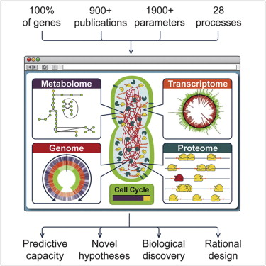
Complete Cell Simulation
CS10 : The Beauty and Joy of Computing Lecture #19 Higher Order Functions I
2012-07-23
UC Berkeley EECS Summer Instructor Ben Chun
This is the first time the entire lifecycle of an organism has been simulated at the molecular level.
(Image Credit: Cell)
http://www.nytimes.com/2012/07/21/science/in-a-first-an-entire-organism-is-simulated-by-software.html

Slide 2
Today
Functions as Data
Higher-Order Functions
Useful HOFs (build them all!)
Demo

Slide 3
map Reporter over List
Report a new list, every element E of List becoming Reporter(E)
Lists are immutable (you get a new list back)

Slide 4
keep items such that Predicate from List
Report a new list, keeping only elements E of List if Predicate(E)
This is also known as “filter”

Slide 5
combine with Reporter over List
Return the result of combining all the elements of List with Reporter(E)
This is also known as “reduce”

Slide 6
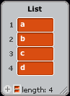
combine with Reporter over List
a
b
c
d

Slide 7
Click click click
I understand higher-order functions.
Strongly disagree
Disagree
Neutral
Agree
Strongly agree
Notes:
Answer: D (includes everything in which the computer poses a question and you have to answer in a computer-readable form, which so far means multiple choice)

Slide 8
Summary
Functions as data is one of the three big ideas in this course
It can give a beautiful abstraction of list iteration details
Now widely used in industry
Google’s map-reduce
JavaScript idioms
(Image Credit: Simply Scheme by Brian Harvey & Matt Wright)
(Credit: Geekologie)

