Slide 1
Dnschanger shut down
CS10 : The Beauty and Joy of Computing Lecture #13 Social Implications of Computing
2012-07-11
UC Berkeley EECS Summer Instructor Ben Chun
The FBI busted an Estonian company in November 2011 for infecting over 4M computers with software that redirected access to certain links. A nonprofit operated replacement servers, but finally pulled the plug Monday.
http://bit.ly/MTuoYN

Slide 2
Overview
This course is NOT just about programming!
Lecs + Reading: Big ideas
Labs: Programming
Disc: Distillation
CS195 Social Implications of Computing
Computers in Education
Most important use?
Judah Schwartz’ continuum
RSA Animate “Changing Education Paradigms”
UC Online Pilot

Slide 3
Peer Instruction
The most important use of computers in education so far...
Web search
Arithmetic drill programs
Word processing
iClicker-like technologies
Social networking
Notes:
Answer: D (includes everything in which the computer poses a question and you have to answer in a computer-readable form, which so far means multiple choice)

Slide 4
Answer
“Multiple choice tests have changed what counts as knowledge in schools. Open-ended questions were the norm 30 years ago. The kind of knowledge you can report on multiple-choice tests is unimportant in the big scheme of things, and what’s really important is not what you already know, but how you can take what you already know and apply it something you’ve never seen before. Multiple choice tests make that hard. Teaching follows tests! The folks who invented Standardized Testing didn’t foresee how it would affect what knowledge means! (unintended consequence)” – Brian Harvey

Slide 5
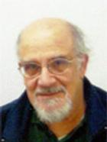
Computers in Education (open?)
Judah Schwartz
Tools
Word Processor
Browser
Microworlds
Interactive geometry
Physics simulation
Courseware
Arithmetic drill
Computer-assisted instruction
Programming language
Databases (e.g., atlas)
Computer-managed instruction
Myphysicslab demo ASSIST movie

Slide 6
RSA Animate : Changing Education Paradigms
www.youtube.com/watch?v=zDZFcDGpL4U

Slide 7
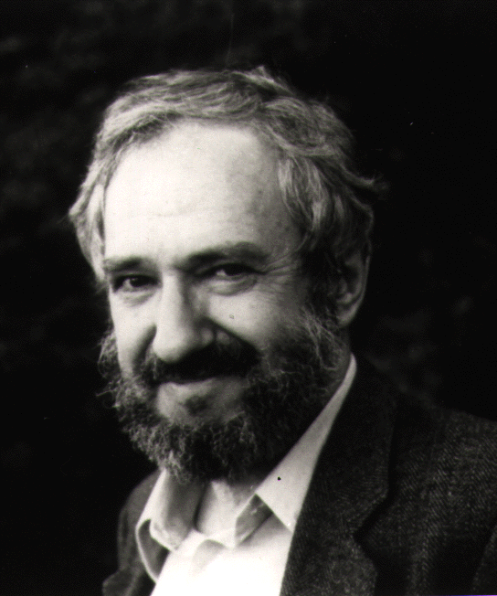
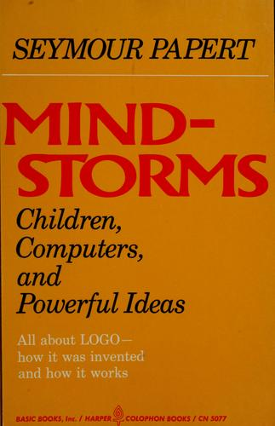
Seymour Papert - Mindstorms
School teaches that errors are bad; the last thing one wants to do is pore over them, dwell on them, or think about them. The child is glad to take advantage of the computer’s ability to erase it all without any trace for anyone to see.

Slide 8
Why should we teach CS?
The debugging philosophy suggests an opposite attitude. Errors benefit us because they lead us to study what happened, to understand what went wrong, and, through understanding, to fix it.
Experience with computer programming leads children more effectively than any other activity to “believe in” debugging.
Papert, Mindstorms

Slide 9
Taking CS10 Online
The most effective thing for your learning, if you were taking CS10 online (remotely)…
“Test yourself” mini-quizzes
Mini-programming challenges
Tree-structure interface to lectures
HD video archived lectures
“Instructor takes the class” videos of us doing labs, HW, exams
Notes:
Answer: D (includes everything in which the computer poses a question and you have to answer in a computer-readable form, which so far means multiple choice)

