Slide 1
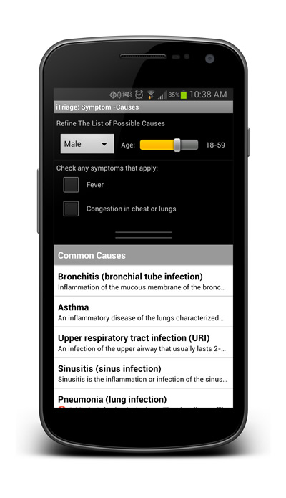
Mobile Health?
The Beauty and Joy of Computing
Lecture #5: Algorithms
Instructor: Sean Morris
Quest REVIEW in 6 days!
Quest (first exam) in in 7 days!
Mobile applications are effecting how we monitor and improve our own health as well as deliver healthcare in rural and developing countries.
http://mobihealthnews.com/23418/most-patients-want-their-doctors-to-prescribe-apps/
Notes:
MIT Can predict the future on twitter.

Slide 2
Consider this …
A team of community health workers in
Africa uses a mobile application to diagnose
and treat people in remote areas of the
country. The data is collected in a central
location for monitoring health across
regions.
You need to sort the data by last name.

Slide 3
Our Sorting Algorithm
Step 1) Find the “smallest”
Step 2) Place in sorted list
Step 3) Remove from unsorted list
Step 4) Repeat until all “n” items sorted

Slide 4
What is an algorithm?
An algorithm is any well-defined computational procedure that takes some value or set of values as input and produces some value or set of values as output.
The concept of algorithms, however, is far older than computers.

Slide 5
Early Algorithms
Dances, ceremonies, recipes, and building instructions are all conceptually similar to algorithms.
Babylonians defined some fundamental mathematical procedures ~3,600 years ago.
Photo credit: Daniel Niles
Notes:
Factorization and square roots
----- Meeting Notes (2/10/13 20:22) -----

Slide 6
Algorithms You've Seen
Multiplication algorithm (for humans)
2
187
X 53
187
X 53 1
187
X 53 1

Slide 7
Algorithms in CS10
Length of word
Join words (pig latin)
Greet a List of People (Next Lab)
Word Comparisons
(You will write one for HW1!)
Sort a List (Next lab!)
Notes:
MANY MANY Different ways to sort a list.

Slide 8
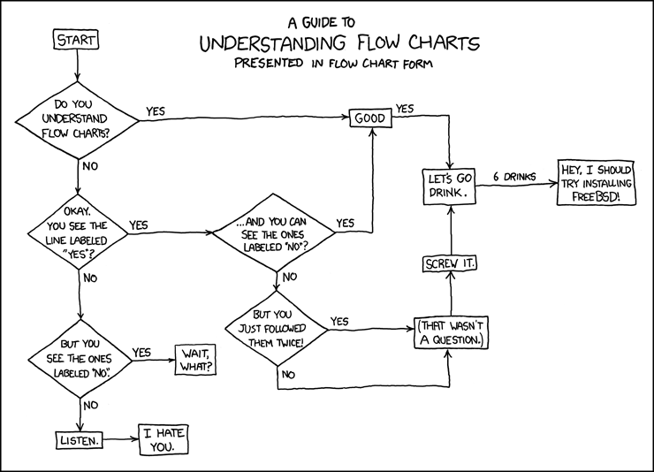
How much money is an Algorithm worth?
http://xkcd.com/518/
a) Nothing!
b) $1000 or less
c) $1 Million
d) $1 Billion
e) More than $1 Billion!

Slide 9
Commonly-Used Algorithms
Luhn algorithm Credit card number validation | Deflate Lossless data compression
PageRank Google’s way of measuring “reputation” of web pages | EdgeRank Facebook’s method for determining what is highest up on your news feed

Slide 10
Choosing a Technique
Most problems can be solved in more than one way, i.e., multiple algorithms exist to describe how to find the solution.
Not all of these algorithms are created equal. Very often we have to make some trade-offs when we select a particular one.
We'll talk more about these next time.
Notes:
QUESTION:
What are some trade-offs we see?

Slide 11
Ways to Attack Problems
Many ways to approach an algorithm!
Top-down
Starting from the top, divide the full problem up into smaller subproblems, working your way down.
You often write “stubs” for missing parts below to test your code before it’s done
Bottom-up
Starting from the bottom (smallest thing you need to do), work your way up, building your way up.
Your system always “works” as you build layers on top of working (smaller) pieces.
Notes:
TOP DOWN:
Stanford
Business
BOTTOM UP:
Berkeley
Startups

Slide 12
Top-down vs Bottom-up example
Top-Down : Stub it Out
Bottom-up

Slide 13
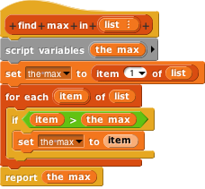
Algorithms vs. Functions & Procedures
Algorithms are conceptual definitions of how to accomplish a task and are language agnostic, usually written in pseudo-code.
Find max value in list
Set (a temporary variable) the max as the first element
Go through every element, compare to max, and if it’s bigger, replace the max
Return the max
A function or procedure is an implementation of an algorithm, in a particular language.
Find max value in list
Notes:
Function := pure def of a function (no state, no side effects)
Procedure := a block, like a function, but may have a state or side effects
===========
POINT OUT YOU CANT DRAG VARIABLES IN A SET BLOCK

Slide 14
Algorithm Correctness
TOTAL Correctness Always reports, and the answer is always correct.
PARTIAL Correctness Sometimes reports, and the answer is always correct when it reports.
We don't only want algorithms to be fast and efficient; we also want them to be correct!
We also have probabilistic algorithms that have a certain probability of returning the right answer.
Notes:
TOTAL Correctness:
Luhn Algorithm
Mathematical Calculations
Encryption and Decryption
PARTIAL:
Perfect Numbers (28 is one)
PROBABALISTIC:
Weather predictions
File Download times

Slide 15
Summary
The concept of an algorithm has been around forever, and is an integral topic in CS.
Algorithms are well-defined procedures that can take inputs and produce output (or have side-effects).
We're constantly dealing with trade-offs when selecting / building algorithms.
Correctness is particularly important and testing is the most practical strategy to ensure it.
Many write tests first!
Notes:
IF TIME GO BACK TO THE LAB EXAMPLE.

Slide 16
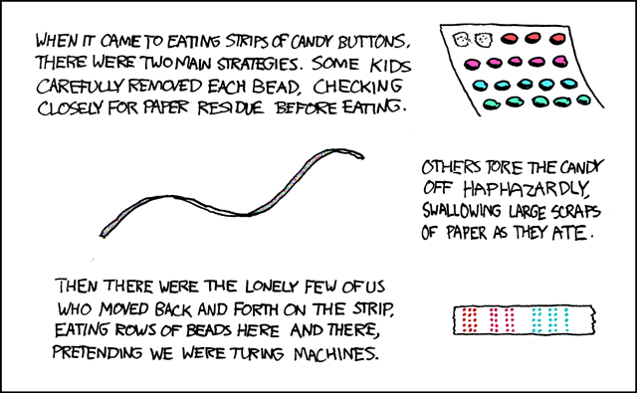
Turing Completeness
en.wikipedia.org/wiki/Turing_completeness ironphoenix.org/tril/tm/
A Turing Machine has an infinite tape of 1s and 0s and instructions that say whether to move the tape left, right, read, or write it
Can simulate any computer algorithm!
A Universal Turing Machine is one that can simulate a Turing machine on any input
A language is considered Turing Complete if it can simulate a Universal Turing Machine
A way to decide that one programming language or paradigm is just as powerful as another
Turing Machine by Tom Dunne
Xkcd comic “Candy Button Paper”

Slide 17
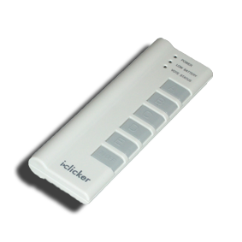
Are Scratch & BYOB Turing Complete?
a) Nope, not a chance!
b) Scratch Only
c) BYOB Only
d) Of course!

