Slide 1
The Beauty and Joy of Computing Lecture #3 : Functions
Instructor: Sean Morris
DatA You Can BELIEVE In?
The role of data mining in the last presidential election. A mind-blowing piece on how the Obama campaign used various sources of data to target voters at an intensity unheard of before. Privacy ramifications? #cs10news
http://www.nytimes.com/2013/06/23/magazine/the-obama-campaigns-digital-masterminds-cash-in.html?pagewanted=all

Slide 2
BJC in one slide
Big Ideas of Programming
Abstraction
Algorithms (2)
Recursion (2)
Functions-as-data, λ (2)
Programming Paradigms
Concurrency
Distributed Computing
Beauty and Joy
“CS Unplugged” activities
Lab work in pairs
Two projects in pairs
Of your own choice!!
One blog
Of students’ own choice!!
Big Ideas of Computing
HowStuffWorks
3D Graphics
Video Games
Computational Game Theory
Research Summaries
AI
HCI
Apps that Changed the World
Social Implications of Computing
Saving the World with Computing
How Twitter Works
Cloud Computing
Future of Computing

Slide 3
Today
Define Functions (⬅ Connected to Abstraction?)
Inputs and Output (Domain/Range)
Why Functions
Practical Example
The nuts and bolts of generalization
A method for solving large problems
See and work with BYOB

Slide 4
Generalization (in CS10) Review
You are going to learn to write functions, like in math class:
y = sin(x)
sin is the function
x is the input
It returns a single value, a number
x
sin
“Function machine” from Simply Scheme (Harvey)

Slide 5
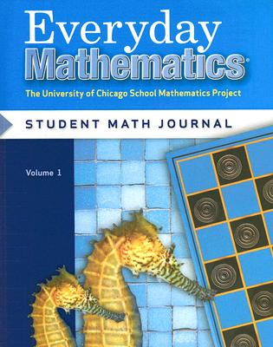
Sean’s kid’s 2nd grade HW!

Slide 6
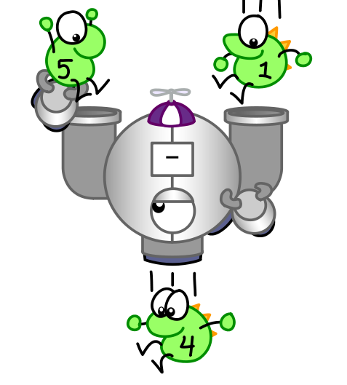
Function basics
Functions take in 0 or more inputs and return exactly 1 output
The same inputs MUST yield same outputs.
Output function of input only
Other rules of functions
No state (prior history)
No mutation (no variables get modified)
No side effects (nothing else happens)
CS Illustrated function metaphor

Slide 7
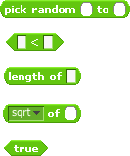
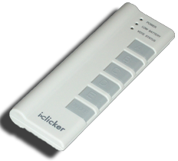
Which is NOT a function?

Slide 8
Pair Action…
Function named:
Calculate Potential Popularity of Movie
Input(s)
Output
What action might break one our rules for functions?

Slide 9
More Terminology (from Math)
Domain
The “class” of input a function accepts
Examples
Sqrt of
Positive numbers
Length of
Sentence, word, number
_ < _
Both: Sentence, word, number
_ and _
Booleans
Letter _ of _
Number from 1 to input length
Sentence, word, number
Range
All the possible return values of a function
Examples
Sqrt of
Non-negative numbers
Length of
Non-negative integer
_ < _
Boolean (true or false)
_ and _
Boolean (true or false)
Letter _ of _
Letter(Character)

Slide 10
Types of input (there are more)
Sentences
E.g., CS 10 is great
Word
Cal, 42, CS10
E.g., A, 3, #
Digit
E.g., 7
0-9 only
Character
Length = 1
Words separated by N spaces, N ≥ 0
Length ≥ 1, no spaces

Slide 11
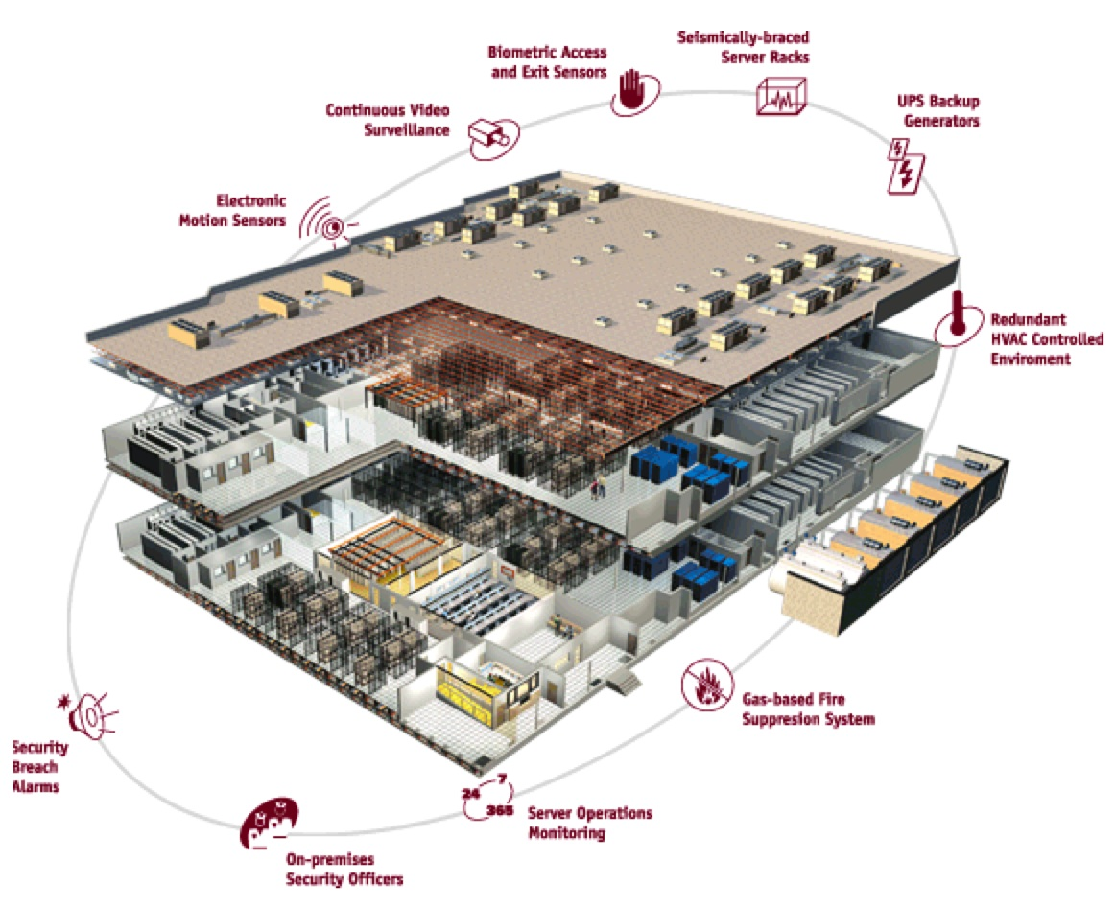
Why functions are great!
If a function only depends on the information it gets as input, then nothing else can affect the output.
It can run on any computer and get the same answer.
This makes it incredibly easy to parallelize functions.
Functional programming is a great model for writing software that runs on multiple systems at the same time.
Datacenter

Slide 12
Scratch → BYOB (Build Your Own Blocks)
Scratch
Invented @ MIT
Maintained by MIT
Huge community
Sharing via Website
No functions ☹
Scratch 2.0 in Flash
No iOS devices. ☹
scratch.mit.edu
BYOB (and SNAP! )
Based on Scratch code
Maintained by jens & Cal
Growing community
No sharing (yet) ☹
Functions! ☺ … “Blocks”
Snap! Is in HTML5
All devices ☺
snap.berkeley.edu/run

Slide 13
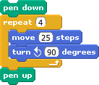
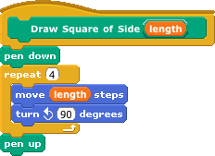
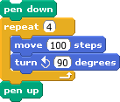
Why use functions? (1)
The power of generalization!

Slide 14
Why use functions? (2)
They can be composed together to make even more magnificent things.
They are literally the building blocks of almost everything that we create when we program.
We call the process of breaking big problems down into smaller tasks functional decomposition

Slide 15
Types of Blocks
Command
No outputs, meant for side-effects
Not a function…
Reporter (Function)
Any type of output
Predicate (Function)
Boolean output
(true or false)

Slide 16
Quick Preview: Recursion
Recursion is a technique for defining functions that use themselves to complete their own definition.
We will spend a lot of time on this.
M. C. Escher : Drawing Hands

Slide 17
Functions Summary
en.wikipedia.org/wiki/Functional_programming
Computation is the evaluation of functions
Plugging pipes together
Each pipe, or function, has exactly 1 output
Functions can be input!
Features
No state
E.g., variable assignments
No mutation
E.g., changing variable values
No side effects
Need BYOB/Snap!, and not Scratch 1.x
f(x)=(x+3)* x
x
x 3
x
+
f
*

